Slide 1
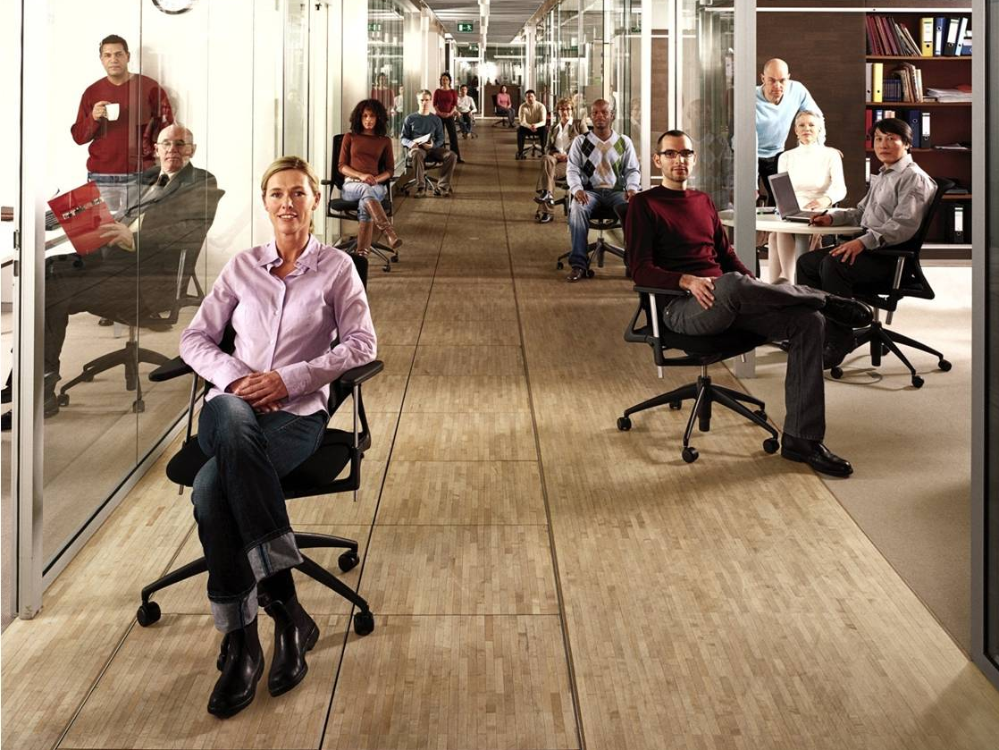


Partner Roadshow
Optimizing desktop infrastructure

Slide 2
Windows Vista
Microsoft Desktop Optimization Pack (MDOP)
Leren
Verkopen
Uitrollen
Kwalificeren
Olivier van Noort
Product Manager – Windows Client
Microsoft

Slide 3

Leren
Verkopen
Uitrollen
Kwalificeren
Waar staan we op dit moment?
Windows Vista adoptie loopt volgens verwachting. waar liggen de kansen voor u?
Geoptimaliseerde werkplek
Windows Vista Enterprise en MDOP maken onderdeel uit van een geoptimaliseerde werkplek die zowel voor de eindgebruikers als IT vele voordelen kent.
Nu nog better met
Service Pack 1
SP1 levert een verzameling van updates als mede een verbeterde stabiliteit, snelheid en beveiliging
Verbeterde compatibility
Met ondersteuning van onze software en hardware partners wordt het ecosysteem van Windows Vista verrijkt met een hoge mate van compatibiliteit
Experience Windows Vista Today!
Ontdek wat Windows Vista voor uw organisatie kan betekenen

Slide 4
Windows Vista
Waar staan we vandaag?
Leren
Verkopen
Uitrollen
Kwalificeren
100mln licenties verkocht! -> 1,5mln in Nederland
Iets meer dan de helft in de zakelijke markt
Negatieve perceptie
  -> We zijn een jaar verder, en ja het is beter geworden
  -> Windows Vista Service
  -> Windows Vista SP1

Slide 5
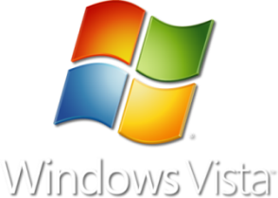






Wie gebruikt het al?
Erik Ubels
CIO
Deloitte Netherlands
“Our move to Windows Vista and the 2007 Microsoft Office system has been the easiest migration so far. With the correct planning, we were able to deploy across our entire organization in less than 4 weeks.”
Christ van Gestel
Business Unit Manager Defense Telematics Organization
“The use of Windows Vista will allow us to reduce IT costs by 10 percent annually.”
Jan-Willem ten Hove
IT Manager
Vanboeijen
“We’re confident that Windows Vista is a strong foundation for integrating new IT services. With Windows Vista, we’re ready for the future.”
Nederlandse organisaties bezig met de uitrol van Windows Vista
Notes:
© 2006 Microsoft Corporation. Microsoft Confidential. All rights reserved.
This presentation is for informational purposes only. Microsoft makes no warranties, express or implied, in this summary.

Slide 6

Leren
Verkopen
Uitrollen
Kwalificeren
Verbeterde compatibility
Met ondersteuning van onze software en hardware partners wordt het ecosysteem van Windows Vista verrijkt met een hoge mate van compatibiliteit
Geoptimaliseerde werkplek
Windows Vista Enterprise en MDOP maken onderdeel uit van een geoptimaliseerde werkplek die zowel voor de eindgebruikers als IT vele voordelen kent.
Nu nog better met
Service Pack 1
SP1 levert een verzameling van updates als mede een verbeterde stabiliteit, snelheid en beveiliging
Waar staan we op dit moment?
Windows Vista adoptie loopt volgens verwachting. waar liggen de kansen voor u?
Experience Windows Vista Today!
Ontdek wat Windows Vista voor uw organisatie kan betekenen

Slide 7
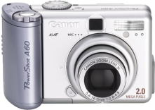
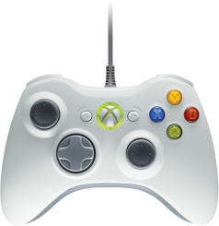
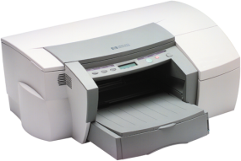
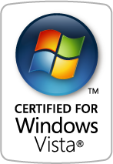

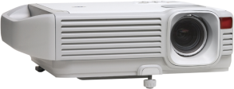
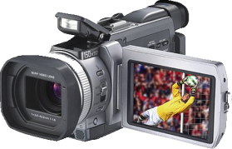
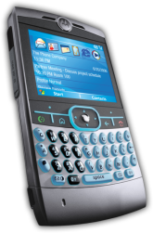
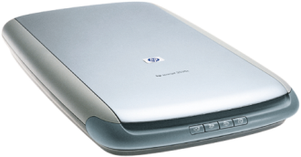
Significant Device Compatibility Progress
Leren
Verkopen
Uitrollen
Kwalificeren
Windows Vista supports the
vast majority of devices and components in the ecosystem
43,000 new devices and components supported on Windows Update since Windows Vista RTM
Thousands of Hardware ID’s Supported on Windows Vista
80
70
60
50
54
56
40
30
23
More than 17,000 logoed hardware and device submissions completed by over 600 hardware partners since launch
20
13
Updates to compatible drivers continue to improve performance. For example, updated drivers have improved battery life for many models of PCs
10
20
20
20
20
0
Nov 06
Jan 07
Oct 07
Dec 07
Inbox
Windows Update
The Most Supported OS Ever

Slide 8

















Application Compatibility Continues to Improve
Leren
Verkopen
Uitrollen
Kwalificeren
Over 160 Global Enterprise applications have been remediated since RTM
10-times more applications have either “Certified for” or “Works with” Windows Vista Logos than at launch
Document
Management
Design &
Engineering
Critical Enterprise-blocking Applications Remediated Since RTM
Present
Network
Administration
Supply Chain
Management
Dutch ISVs are also in the process of certifing their apps. Like Exact, Unit4Agresso, Davilex & Afas
98 of NPD Group top 100 applications work with Windows Vista
Nov 06
CRM
IT Security
ERP

Slide 9
Windows Vista is the Most Secure Microsoft OS Ever
Microsoft released Windows Vista as a redesigned operating system to enhance security
Fewer High Severity Vulnerabilities
than Leading Operating Systems

Slide 10

Nu nog better met
Service Pack 1
SP1 levert een verzameling van updates als mede een verbeterde stabiliteit, snelheid en beveiliging
Geoptimaliseerde werkplek
Windows Vista Enterprise en MDOP maken onderdeel uit van een geoptimaliseerde werkplek die zowel voor de eindgebruikers als IT vele voordelen kent.
Verbeterde compatibility
Met ondersteuning van onze software en hardware partners wordt het ecosysteem van Windows Vista verrijkt met een hoge mate van compatibiliteit
Waar staan we op dit moment?
Windows Vista adoptie loopt volgens verwachting. waar liggen de kansen voor u?
Experience Windows Vista Today!
Ontdek wat Windows Vista voor uw organisatie kan betekenen

Slide 11

With SP1, Windows Vista gets even Better
Windows Vista SP1 is an update to Windows Vista that addresses customer input on key performance areas
Reliability, performance, and
security improvements,
“We heard you”
Improvements
to the administration experience
Support
for emerging hardware and standards

Slide 12
Windows Vista SP1 Highlights
Notable Changes in SP1
Performance improvements in SP1
  Battery life
  Faster logon experience
  Copying and unzipping files
  Resume from hibernate and standby
  Performance of domain joined PCs when operating off of the domain
Security improvements in SP1
  New set of APIs for third-party security and malicious software providers
  Certificate revocation with the Online Certificate Services Protocol
  BitLocker now for all disk volumes instead of only the system volume
  Improved security running RemoteApp™ programs and desktops
Reduced Functionality Mode removed

Slide 13
Windows Vista SP1
Engels
  RTM - Feb 6 √
  WU&Download - Mid March
  Automatic WU + 1 month
  Retail FPP – End March
Nederlands
  RTM begin April
  Download + 1 week
  Automatic Update +1 month
  In Retail + 6 weeks

Slide 14

Geoptimaliseerde werkplek
Windows Vista Enterprise en MDOP maken onderdeel uit van een geoptimaliseerde werkplek die zowel voor de eindgebruikers als IT vele voordelen kent.
Nu nog better met
Service Pack 1
SP1 levert een verzameling van updates als mede een verbeterde stabiliteit, snelheid en beveiliging
Verbeterde compatibility
Met ondersteuning van onze software en hardware partners wordt het ecosysteem van Windows Vista verrijkt met een hoge mate van compatibiliteit
Waar staan we op dit moment?
Windows Vista adoptie loopt volgens verwachting. waar liggen de kansen voor u?
Experience Windows Vista Today!
Ontdek wat Windows Vista voor uw organisatie kan betekenen

Slide 15




Geoptimalizeerde werkplek
Wat is het en hoe verkoop je het?

Slide 16

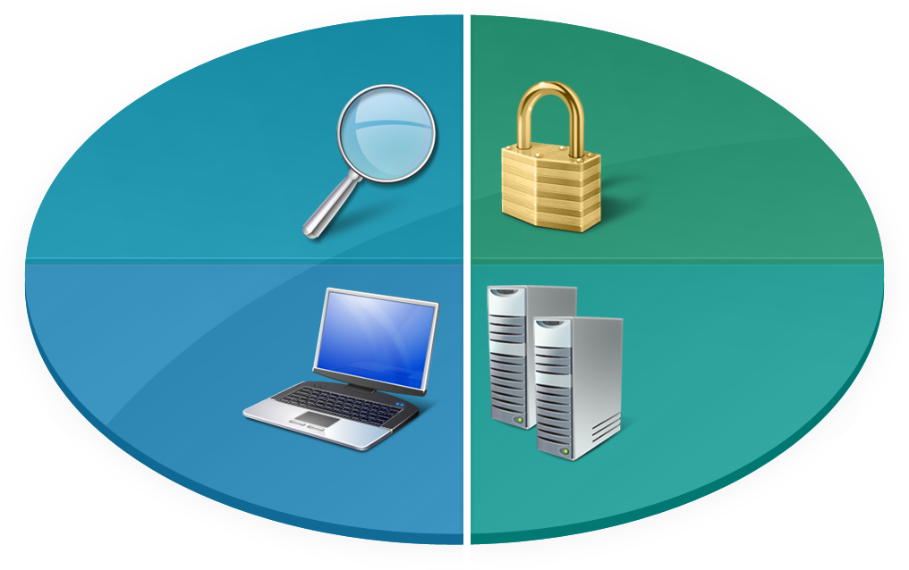

Partners’ Customers Face Challenges
“
“
I need to find
information easily
Security is very important to me
”
”
End Users
Easier
Find information and collaborate with colleagues
More Secure
Improve security and legislative compliance
IT Pros
Better Productivity
Reduce PC downtime and
empower your workforce
Lower Cost
Reduce complexity and give back time to the IT generalist
Business Managers
IT Pros
“
“
I need to improve employee productivity and PC reliability
”
I need to save time and reduce IT complexity
”
Notes:
16

Slide 17





Path to Optimized Desktop
Through Software Assurance and Open Value
The Optimized Desktop
(subscription access only
within Software Assurance)
The Enterprise-class Desktop
(available only with
Software Assurance)
The Business Desktop
SoftGrid Application
Virtualization
Asset Inventory Services
Diagnostic & Recovery Toolset
Advanced Group Policy Management
Desktop Error Monitoring
Includes all features of Windows Vista Business plus:
Enables businesses to:
Four Virtual Operating Systems
Windows® BitLocker™
Drive Encryption
Multi-lingual User Interface (MUI)
Subsystem for Unix-Based Apps (SUA)
Find and Use Information
Enable Mobile Workforce
Improve Security and Compliance
Optimize Desktop Infrastructure

Slide 18

Business vs. Enterprise
Windows Vista editions for businesses:
*
Windows Aero™ Interface
✓
✓
Integrated desktop search
✓
✓
Windows Mobility Center
✓
✓
User Account Control
✓
✓
Windows Bitlocker
Drive Encryption
✓
Multilingual User Interface
(MUI)
✓
Support advanced application compatibility via rights to four virtual operating systems
✓
Subsystem for UNIX-based apps
✓
Qualify for purchase of Microsoft Desktop Optimization Pack (MDOP)
✓
* Windows Vista Enterprise is available exclusively through Microsoft Software Assurance.
Notes:
18
18

Slide 19








Toegevoegdewaarde met volume licensing

Slide 20

Upgrading to a Microsoft
Select or Open Value License Agreement:
What’s in it for the customer? (Part 1 of 2)
Tracking and managing licenses can be challenging, especially if people are running different versions of software. With Microsoft Open Value, you can control the upgrade cycle with the latest software releases and can run any version of Windows software.
The ability to run any
software version
As your organization grows and you need to purchase new desktops, it's easy to integrate the licenses from the new desktop computers into your existing Open Value agreement through Software Assurance.
Flexibility for
business growth
Open Value grants you the rights to run any version of the software so that you can stay current and upgrade when you want. With New Version Rights and flexible version management, you can focus more on implementing critical IT projects instead of on building a business case for the next upgrade.
The ability to deploy
the software you
need now
Notes:
20
20

Slide 21
Upgrading to a Microsoft
Open Value License Agreement:
What’s in it for the customer? (Part 2 of 2)
If your organization needs longer-term visibility into IT budget planning, Open Value offers predictable annual payments to help make better decisions about which IT projects to implement each year.
Predictable planning
and budgeting
Open Value helps organizations that have a limited budget. With Open Value, you can amortize software costs over three years, similar to financing without the interest rates and associated fees. With reduced up-front costs and payments spread over time, you can afford to get the software you need now.
Spread payments
Notes:
21
21

Slide 22

Microsoft Desktop Optimization Pack
Waarom?
MDOP bied additionele technologieën waarmee het beheer en de toegang tot bedrijfsmatige data en applicaties eenvoudig te beheren valt.
Beveiliging
MDOP maakt “anywhere access” voor applicaties en gebruikersinstellingen mogelijk.
Mobility
MDOP verlaagt de ‘downtime’ en helpt de helpdesk effectiever te werken
Productivity
Notes:
22
22

Slide 23
Microsoft Desktop Optimization Pack
Wat zit er in?
Wat: Application virtualisatie & streaming
Overal en altijd en met de juiste licentie kunnen werken waarbij de applicatie centraal beheerd wordt.
Microsoft SoftGrid
Application Virtualization
Microsoft Asset
Inventory Services
Wat: Geavanceerde inventarisatie van software
Hosted service with efficient scanning for Microsoft and 3rd-party software resulting in intelligent reporting
Wat: GPO versie-beheer, change management, and delegatie
Versies, historie en ‘rollback’ van GPO veranderingen met offline bewerken, zoeken, granulair delegatie en change management.
Microsoft Advanced
Group Policy Management
Microsoft Diagnostic
and Recovery Toolset
Wat: Efficiente diagnose en herstel van PCs
Intuïtieve tools om onbruikbare PCs te herstellen, terug halen van bestanden en offline virus verwijder mogelijkheden.
System Center
Desktop Error Monitoring
Wat: Proactief beheer van application and OS fouten
Identificeer de impact en ‘root cause’ van toepassingsfouten op de werkplek.
Notes:
23
23

Slide 24


Leren

Slide 25
Application Virtualization in Context
Computing resources deployed in real-time based on immediate needs
Without Virtualization
With Virtualization
Applications installed to specific
hardware and OS
Virtual Applications
Any application on any computer on-demand via network
Interface bound to process
Virtual Presentation
Presentation layer separate from process
Operating System assigned to
specific hardware
Virtual Machine
OS can be assigned to any desktop or server
Storage assigned to specific locations
Virtual Storage
Storage and backup over the network
Network assigned to specific locations
Virtual Network
Localizing dispersed resources

Slide 26
Multiple types of virtualization
Virtual System
Real Virtual
UI
Virtual Apps
Apps
UI
Virtual Experience
OS
Apps
UI
Host PC
OS
Apps
Host PC
OS
Host PC

Slide 27

Virtual systems allow hardware independence
Virtual System
Real Virtual
UI
Host system has a base OS
Lightweight OS environments
reduce hardware dependence
Multiple OSes can run on one system
Apps
OS
Host PC
Cumbersome to manage over distributed networks
OS images may still need to be managed
Applications still need to be managed

Slide 28
Virtual experience allow hardware independence
Real Virtual
Remote application access,
centralized secure model
Data stays in the data center
User logs onto server-based apps
Virtual Experience
UI
Apps
Requires network connectivity
Some apps won’t run or scale poorly
Reduced user experience
Significant server infrastructure requirements
OS
Host PC

Slide 29
Virtual applications revolutionize deployment
Real Virtual
Virtual Apps
Application is run in an isolated environment from the OS
Allows for a single desktop image
Provisioning, changing apps is easy
UI
Apps
OS
May require repackaging of apps
OS needs to be managed, patched
Typically requires Windows
Host PC

Slide 30




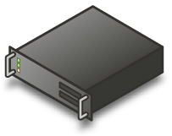


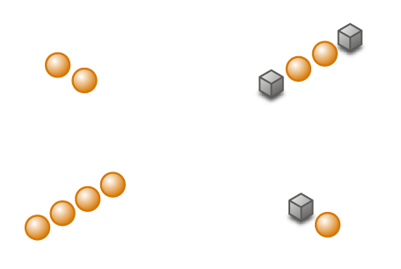



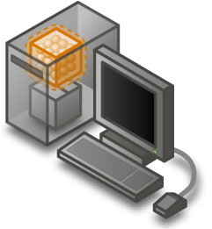


Microsoft Virtualization options
A complete set of virtualization products, from the data center to the desktop
All assets – both virtual and physical – managed from a single platform
Presentation Virtualization
Server Virtualization
Desktop Virtualization
Application Virtualization

Slide 31
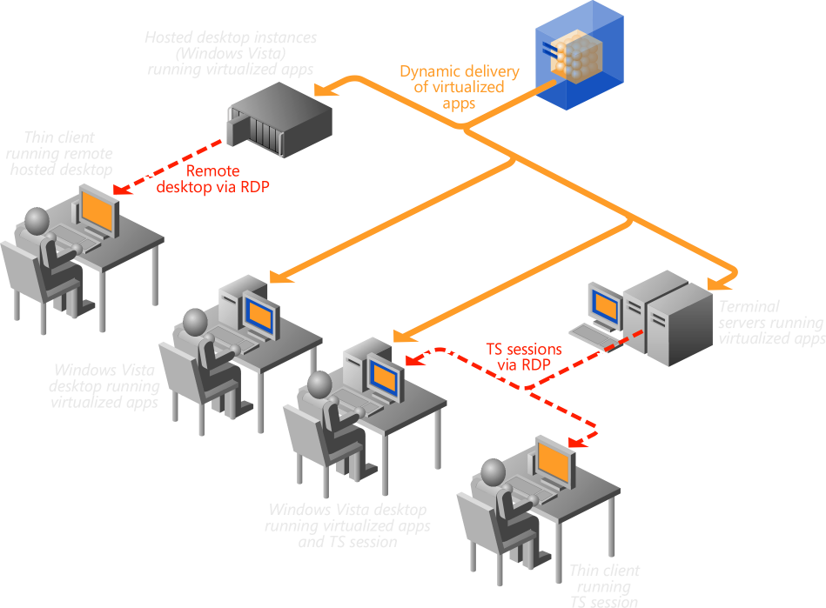
Microsoft Application Virtualization
Dynamically Delivering The Virtual Application Solution
Transform Windows applications into Virtualized Entities
Simplified management
  Applications delivered on-demand
  Application conflicts eliminated
  Applications follow users
  Application updates are automatic
Granular Application Control
  Not only control access to computing platform, but to virtualized applications as well
Multiple Desktop Deployments
  Use SoftGrid with Local, Diskless, and Centralized Desktops deployments on both PCs and Thin Clients

Slide 32
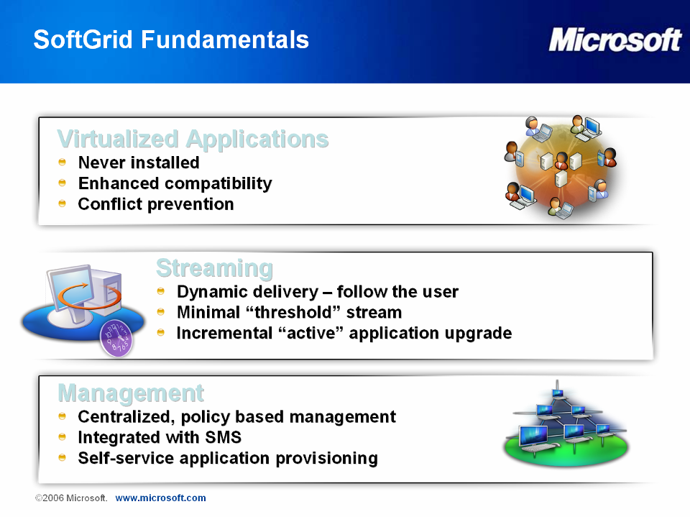
Software as a service:
Microsoft Application Virtualisation
Virtualized Applications
Never Installed
Enhanced compatibility
Conflict prevention
Streaming
Dynamic delivery – follow the user
Minimal `threshold` stream
Incremental `active` application upgrade
Management
Centralized, policy based management
Integrated with SMS
Easy application provisioning

Slide 33
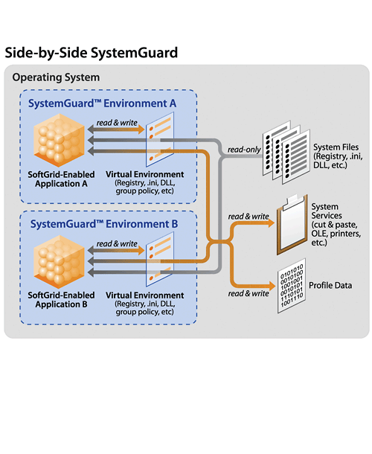
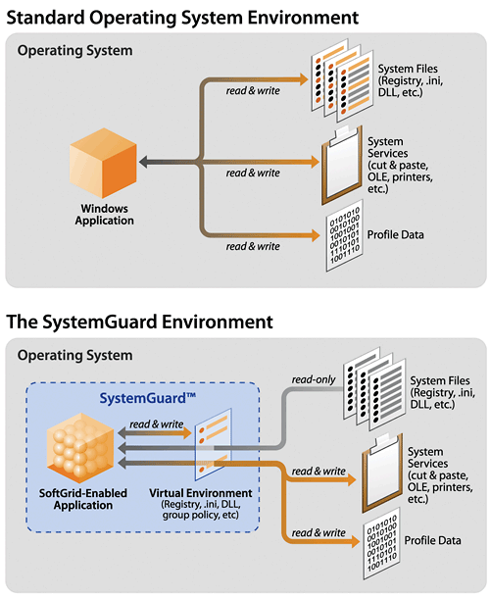
Application Virtualization Explained
Applications are virtualized per instance:
    Files (including System Files)
    Registry
    Fonts
    .ini
    COM objects
Applications do not get installed or alter the operating system
Yet tasks process locally on the host computer.
…and inter-application communication can still take place.

Slide 34
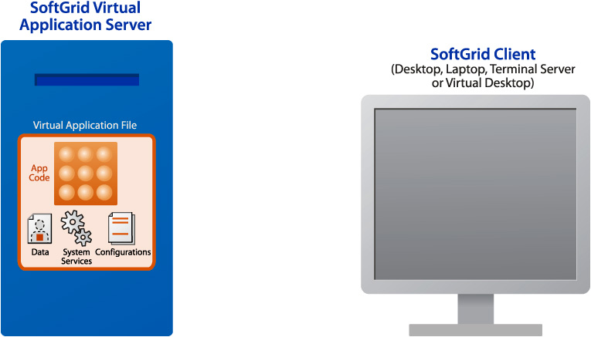
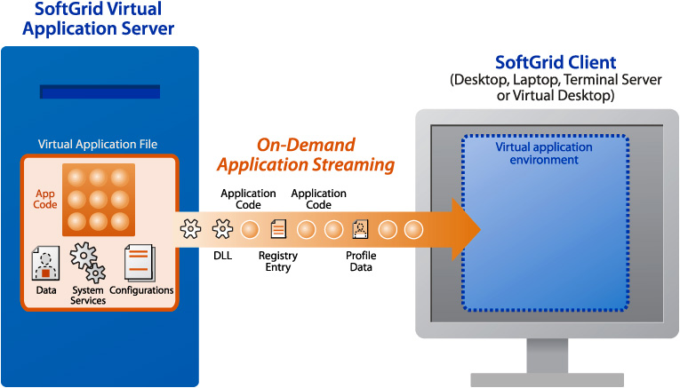
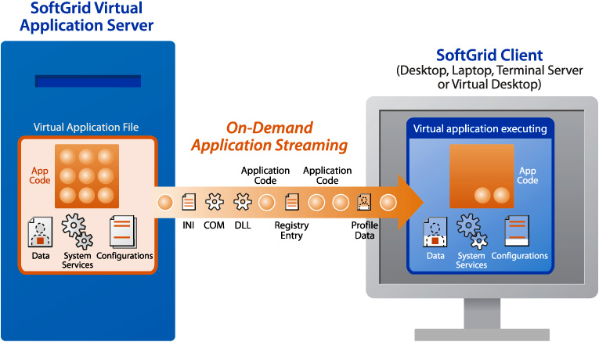

On-Demand Streaming of Virtual Apps
Permission Based
  User clicks on desktop shortcuts –
  authentication, authorization and
  licensing checked every time users
  launch a SoftGrid application
Centrally Served
  The first time the Server streams
  “just enough” code (5-40%) to client
  or TS machine. As more code is
  needed, it is dynamically delivered.
Locally Executed
  App executes on desktop, laptop and/or Terminal Server, not on SoftGrid Server
Cached for Performance
  App code is cached for repeat use – even without a network
Disconnected Use Support
  Entire set of applications are cached for limited time before expiring

Slide 35
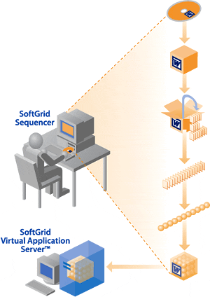
Virtualization Starts with the Sequencer
The Sequencer is a wizard-based tool that rapidly virtualizes applications without changing source code.
Sequencer models an application’s configurations and dependencies then segments application code into a file
Sequencer file is placed onto one or more SoftGrid servers for on-demand deployment to desktops, laptops or terminal servers.
With 4.2, can sequence Office in less than 15 mins.

Slide 36
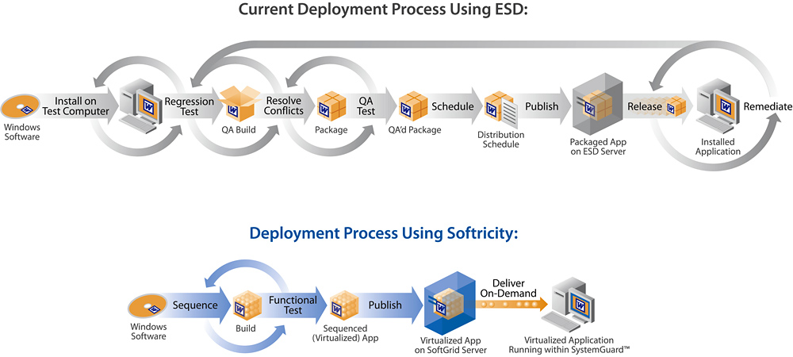
Accelerate Application Availability
With the SoftGrid application deployments and updates are dramatically accelerated. Once an application is virtualized, it can be deployed instantly to any and all global users on any client device from a central console.
Compress the steps associated with Application Packaging
Package on one platform, run on many
Eliminate installations and dramatically reduce compatibility testing
Updates are now one file change on a server
Terminations are one change to the management console

Slide 37
Kwalificeren
Geoptimalizeerde werkplek
Optimalisatie maar waarom?

Slide 38
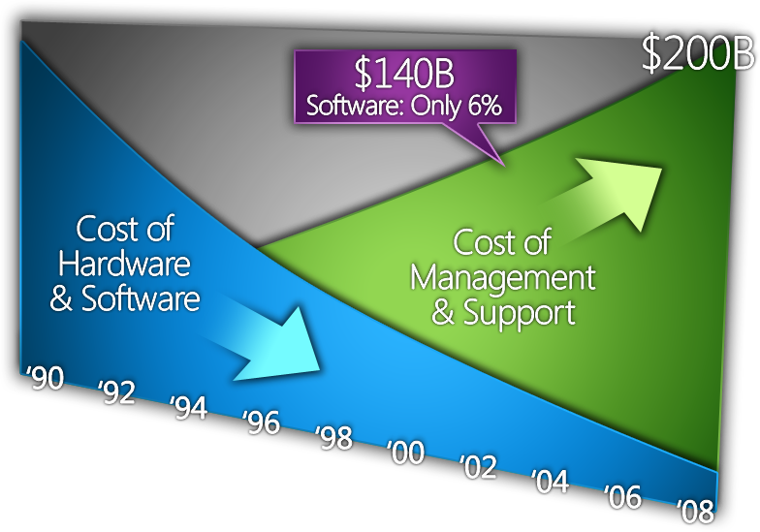

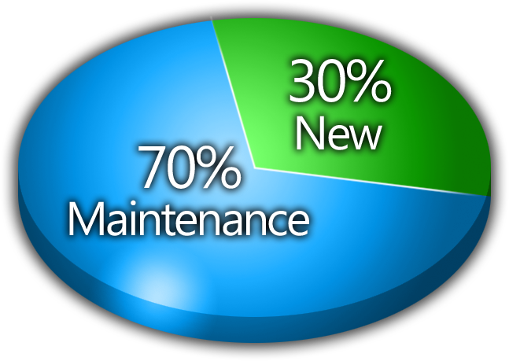
IT Complexity And Cost

Slide 39


Wat wil men bereiken?
Unprecedented
volumes of data
Increasing
compliance
requirements
End Users Want Freedom, Flexibility
IT Pros Want Control
Anywhere/
Anytime Access
Device Independence
Personal Data/Applications
Flexible Configurations
Controlled Network Access
Managed Devices
Data Security
Predictable Configurations
HW mix shifting
to laptops
Increased emphasis on manageability to lower cost,
increase agility

Slide 40
Desktop TCO breakdown
Desktop costs go beyond hardware and software
70% of desktop TCO is labor related
Desktop TCO
($4600-$5000/year)
50%
100%
(US$ /desktop/year)
20%
30%
HW/SW
IT costs
End-user
Total
Cost of hardware and software
Cost of IT labor and administration
Cost of self-support & downtime
Source: Leading Analyst Firm, December 2005
Note: Excludes server & network costs for centrally manages services

Slide 41











Windows Vista: Enabling IT Infrastructure Optimization
Windows Vista Advancements
Standard Images
User Account Control
Group Policy
Secure Networking
Windows Vista Firewall
Network Access Protection
Secure Wireless
Management Tool Integration
Unified Health Model
Backup Desktops

Slide 42
Optimizing Reduces Total TCO
Labor efficiencies with optimized desktop infrastructure
Total TCO
($4600-$5000/year)
A leading industry analyst found over 90% of the TCO reductions from best practices for desktop management result from increased labor efficiency for IT workers and
End-users
Total TCO
($3200-$3300/year)
End-user
(US$ /desktop/year)
IT
HW/SW
“Basic”
“Rationalized”
Source: Leading Analyst firm, December 2005
Note: Excludes server & network costs for centrally manages services

Slide 43
Activiteiten
Tijdelijk korting
Nu 15% korting op Windows Client + SA + MDOP licenties
  OpenValue en Select contracten
  Geldig t/m 30 juni 2008
Partner Roadshows
Geoptimaliseerde werkplek evenementen
  18 maart, Microsoft, Auditorium Schiphol Rijk
  21 maart, NH Capelle
  31 maart, Regardz Zwolle
Marketing
Slimme formules campagne – start april

Slide 44

© 2008 Microsoft Corporation. All rights reserved. Microsoft, Windows, Windows Vista and other product names are or may be registered trademarks and/or trademarks in the U.S. and/or other countries. The information herein is for informational purposes only and represents the current view of Microsoft Corporation as of the date of this presentation. Because Microsoft must respond to changing market conditions, it should not be interpreted to be a commitment on the part of Microsoft, and Microsoft cannot guarantee the accuracy of any information provided after the date of this presentation. MICROSOFT MAKES NO WARRANTIES, EXPRESS, IMPLIED OR STATUTORY, AS TO THE INFORMATION IN THIS PRESENTATION.

Slide 45
Quiz time !!

Slide 46
Waar staat MDOP voor en wat zit erin?
Microsoft Desktop Optimization Pack
Welke 5 componenten zitten erin?
Microsoft Application Virtualization (MAV) (SoftGrid)
Advanced Group Policy Management (AGPM)
Asset Inventory Services (AIS)
Desktop Error Monitoring (DEM)
Diagnostics and Recovery Toolset (DaRT)

Slide 47
Uit welke producten bestaat de ‘geoptimaliseerde werkplek’ ?
Windows Vista Enterprise
+ Software Assurance
+ SP1
+ Microsoft Desktop Optimization Pack
________________________________ +
Geoptimaliseerde werkplek

Slide 48
© 2008 Microsoft Corporation. All rights reserved. Microsoft, Windows, Windows Vista and other product names are or may be registered trademarks and/or trademarks in the U.S. and/or other countries. The information herein is for informational purposes only and represents the current view of Microsoft Corporation as of the date of this presentation. Because Microsoft must respond to changing market conditions, it should not be interpreted to be a commitment on the part of Microsoft, and Microsoft cannot guarantee the accuracy of any information provided after the date of this presentation. MICROSOFT MAKES NO WARRANTIES, EXPRESS, IMPLIED OR STATUTORY, AS TO THE INFORMATION IN THIS PRESENTATION.

Slide 49
Bronnen
Windows Partner Solutions
http://partner.microsoft.com/windowspartnersolutions
Windows Sales Training
https://partner.microsoft.com/40048510
partner tooling:
https://partner.microsoft.com/MAP

Slide 50
Fasering
Leren
Verkopen
Uitrollen
Kwalificeren
Selecteer de juist fase die slaat op de info op de slide; plaats deze rechts bovenin.
Leren
Verkopen
Uitrollen
Kwalificeren
Leren
Verkopen
Uitrollen
Kwalificeren
Leren
Verkopen
Uitrollen
Kwalificeren
Leren
Verkopen
Uitrollen
Kwalificeren

Slide 51
Uitrollen
Geoptimalizeerde werkplek
Hoe rol je dit uit?

Slide 52
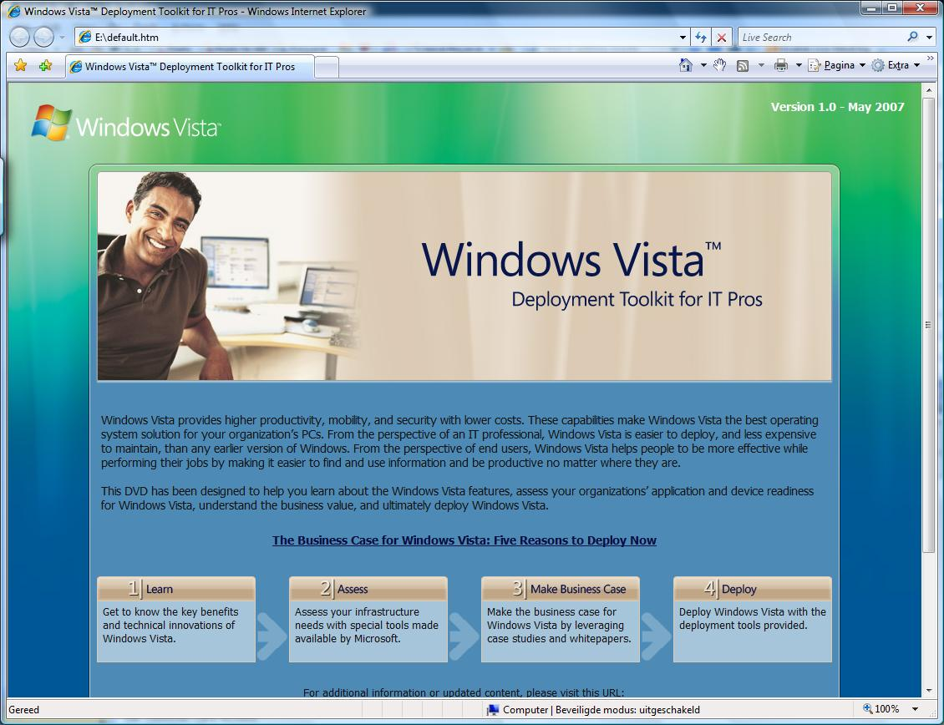
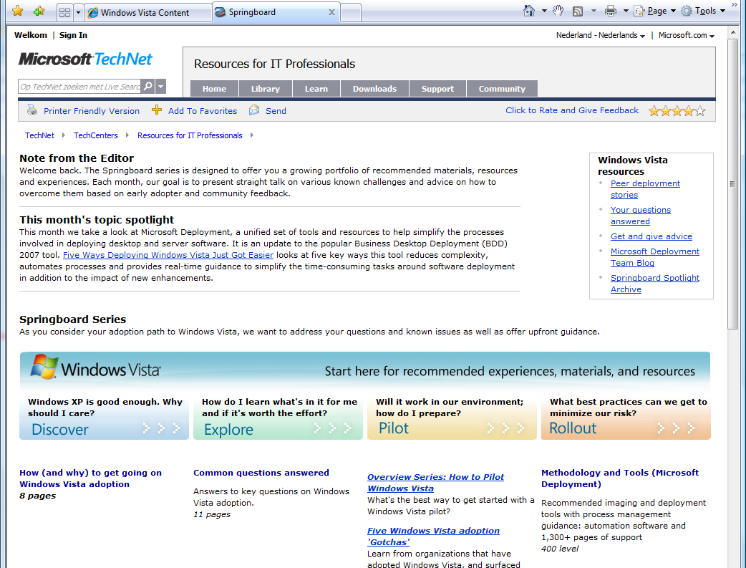
Windows Vista Deployment Kit for ITPro‘s
& Windows Vista Springboard
Information about with Windows Vista
Getting started with Windows Vista
http://www.microsoft.com/technet/springboard

Slide 53
Microsoft Assessment and Planning
Integrated Portal with Automated Tools and Guidance from desktops to servers
Agentless inventory of clients, servers, applications, devices and roles
Technology migration and readiness assessment and proposal generation
Multi-Technology coverage
  Hardware and Device Compatibility for Windows Vista, Windows Server 2008 and 2007 Microsoft Office System
  Server Virtualization candidates for consolidation with Hyper-V and Virtual Server 2005 R2
  Application Virtualization candidates with SoftGrid
MAP
Windows Server 2008
Other Products
Hyper-V
Virtual Server 2005 R2
Windows Vista
2007 Microsoft Office
SoftGrid
Terminal Services
System Center VMM

Slide 54

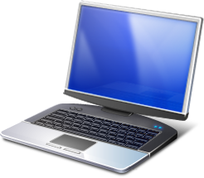



MAP – How it works?
Server Consolidation?
Virtualization?
Windows migration?
Customer Network
MAP
Assess customer’s environment and
recommend the right technologies
MAP Tool User
(IT Pro/Partner)
Report Generation
For Different Migration
Scenarios

Slide 55
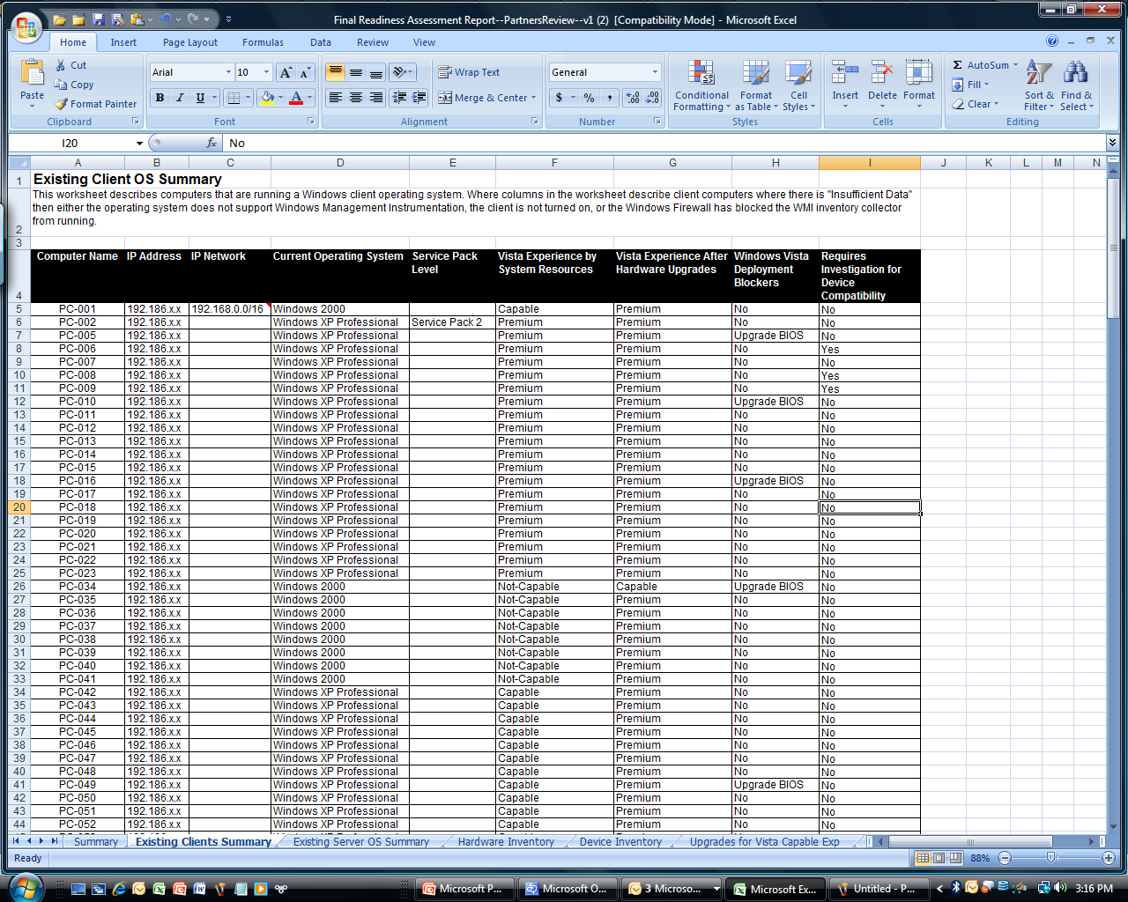
MAP – Detailed Assessments
PC-by-PC Level Detailed Reporting
Current OS Results
Hardware and Device Assessment Results
System Resources
Experience after Upgrades
Deployment Blockers
Device Compatibility

Slide 56
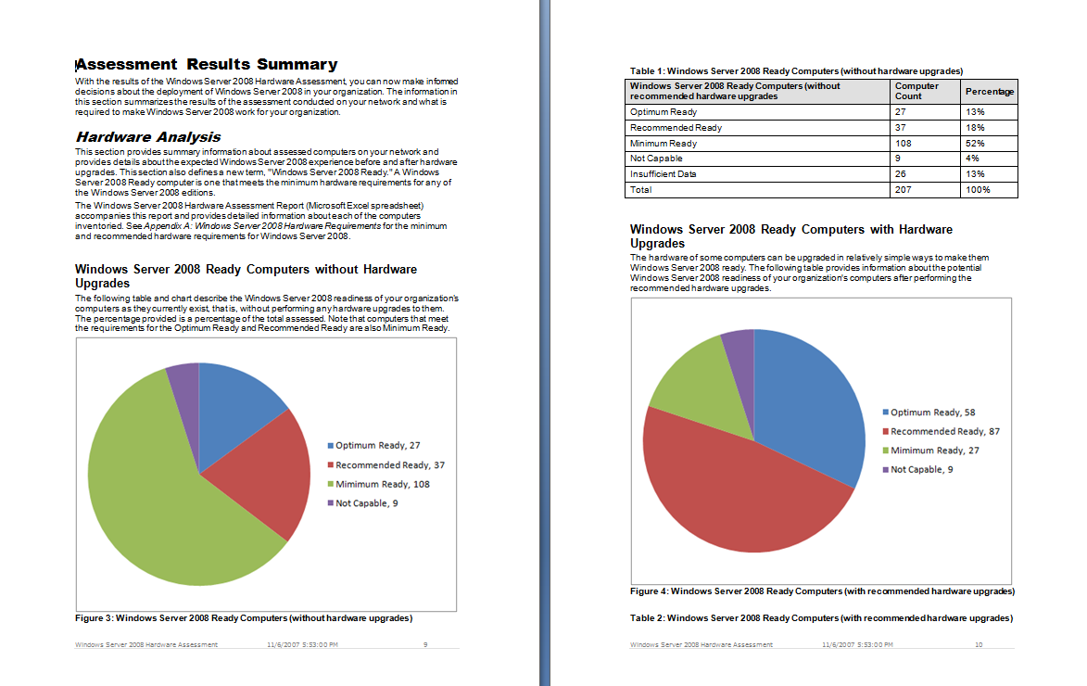
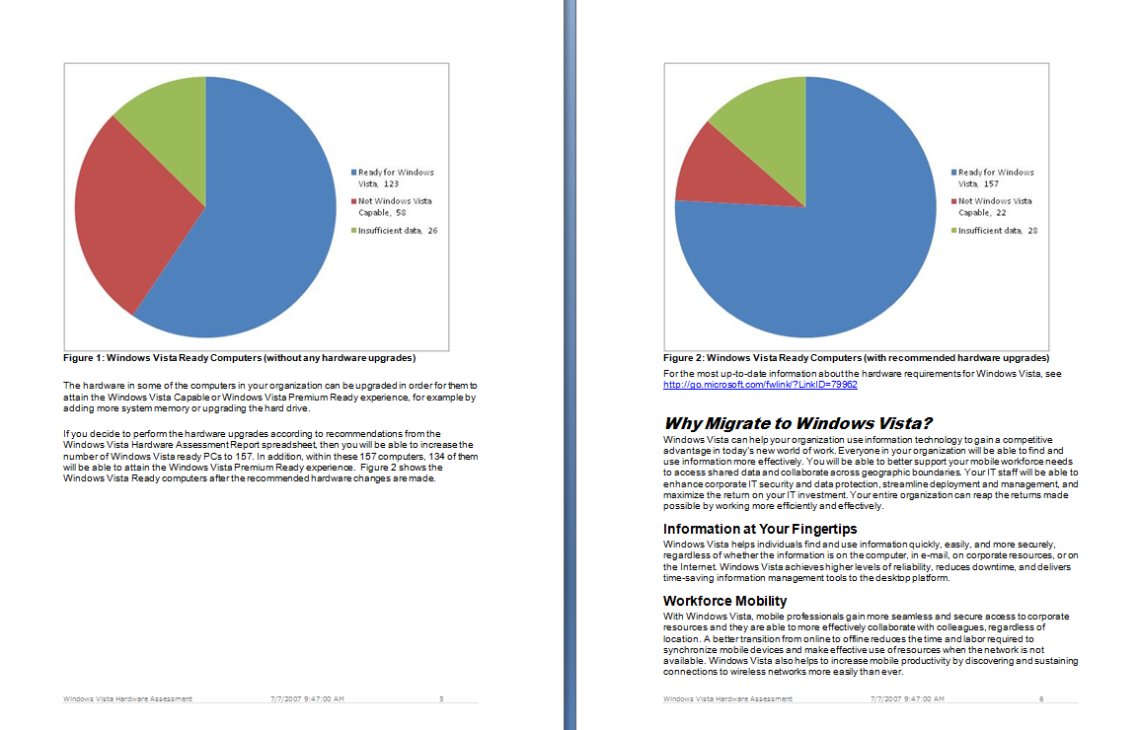
MAP - Proposals

Slide 57
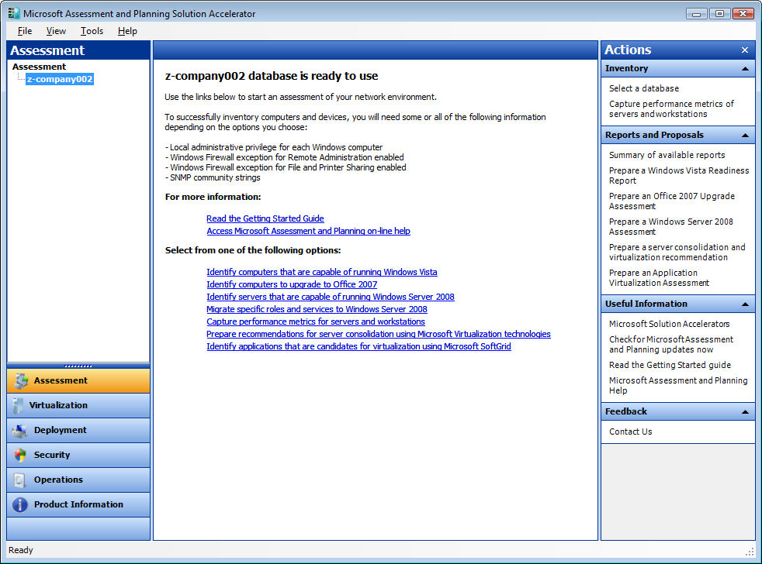
MAP - New User Interface
Database
Driven
Multiple Technologies

Slide 58
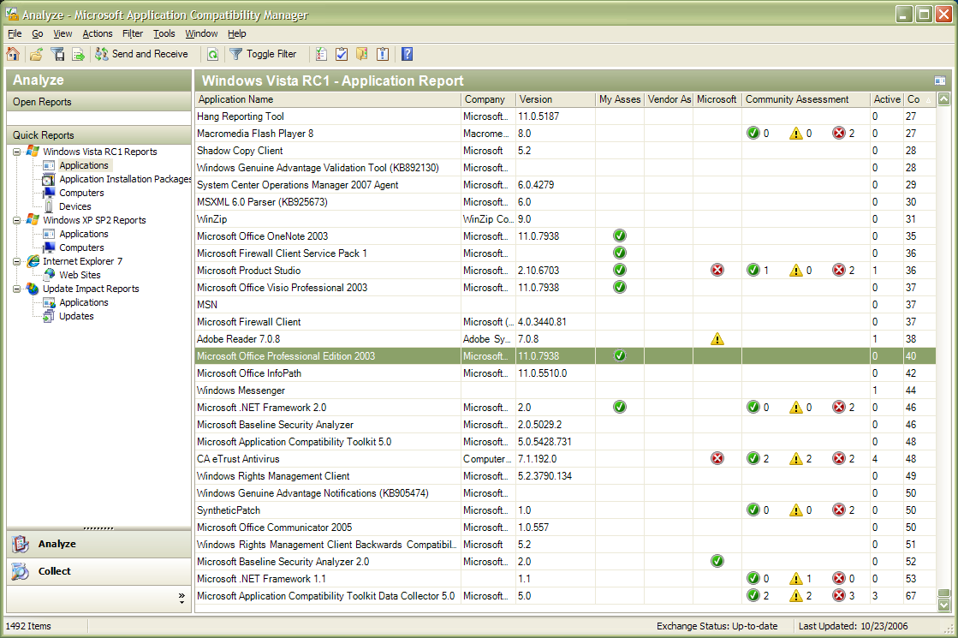
Application Compatibility Toolkit
  Single environment to help detect, diagnose, and mitigate compatibility issues found in Windows Vista
  Microsoft Compatibility Exchange to facilitate exchange of compatibility data between ISV/IHV, Microsoft, and customers
  Available Compatibility Evaluators include:
    Inventory collector,
    User Account Control,
    Windows Vista specific
      Deprecations
      GINA
      Session 0
      Internet Explorer

Slide 59
Windows Vista
Business Value Assessment Tool
Kwalificeren
Do your customers seek to improve their IT Business Value Performance?
How do you articulate the Business Value story for Windows?
Will your (internal) customers believe it?
Once they believe,
  how can the value story be leveraged into use?
  a more valuable IT partnership?

Slide 60
