Slide 1



Partner Roadshow
Optimizing desktop infrastructure

Slide 2
Windows Vista
Partner Tooling
Leren
Verkopen
Uitrollen
Kwalificeren
Leren
Verkopen
Uitrollen
Kwalificeren

Slide 3

Infrastructure Tooling
Leren
Verkopen
Uitrollen
Kwalificeren
Microsoft Assessment Planning
Application Compatibility Toolkit
Business Value Assessment
..

Slide 4
Microsoft Assessment and Planning
Leren
Verkopen
Uitrollen
Kwalificeren
Integrated Portal with Automated Tools and Guidance from desktops to servers
Agent-less inventory of clients, servers, applications, devices and roles
Technology migration and readiness assessment and proposal generation
Multi-Product Pre-Sales Assessment Tool (proposals included)
  Hardware and Device Compatibility for Windows Vista, Windows Server 2008 and 2007 Microsoft Office System
  Server Virtualization candidates for consolidation with Hyper-V and Virtual Server 2005 R2
  Infrastructure assessment for environment to leverage Microsoft Application Virtualization (formerly SoftGrid)
MAP
Windows Server 2008
Other Products
Hyper-V
Virtual Server 2005 R2
Windows Vista
2007 Microsoft Office
Microsoft
Application
Virtualiz-ation
Terminal Services
System Center VMM
www.microsoft.com/MAP

Slide 5





Hoe werkt MAP?
Leren
Verkopen
Uitrollen
Kwalificeren
Server Consolidation?
Virtualization?
Windows migration?
Customer Network
MAP
Assess your customer’s environment and
recommend the right technologies
MAP Tool User
(Microsoft Partner)
Report Generation
For Different Migration
Scenarios

Slide 6
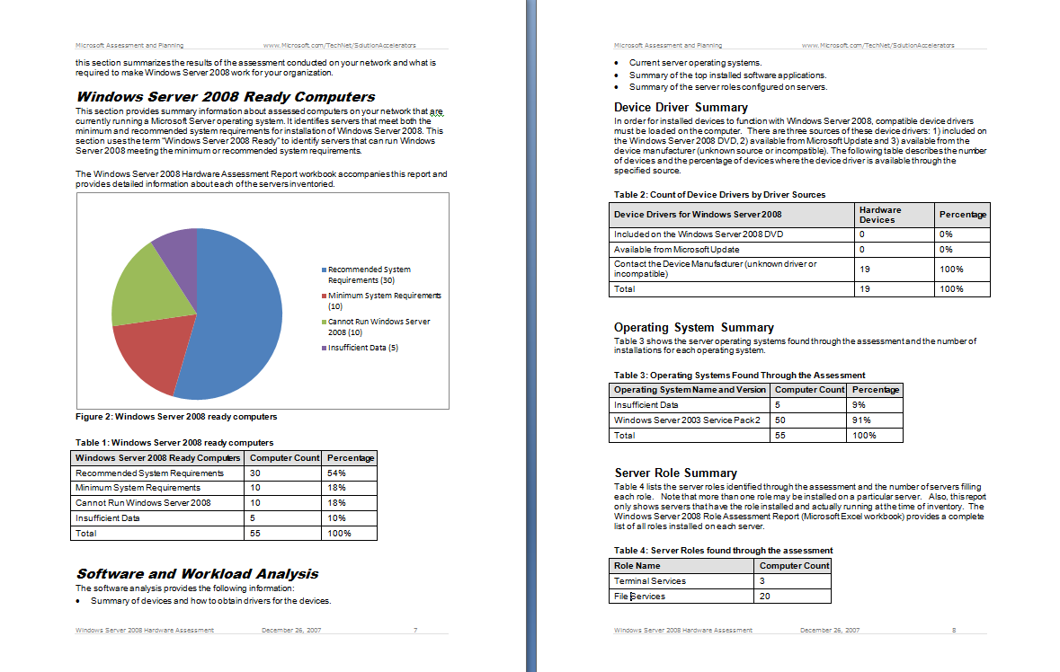
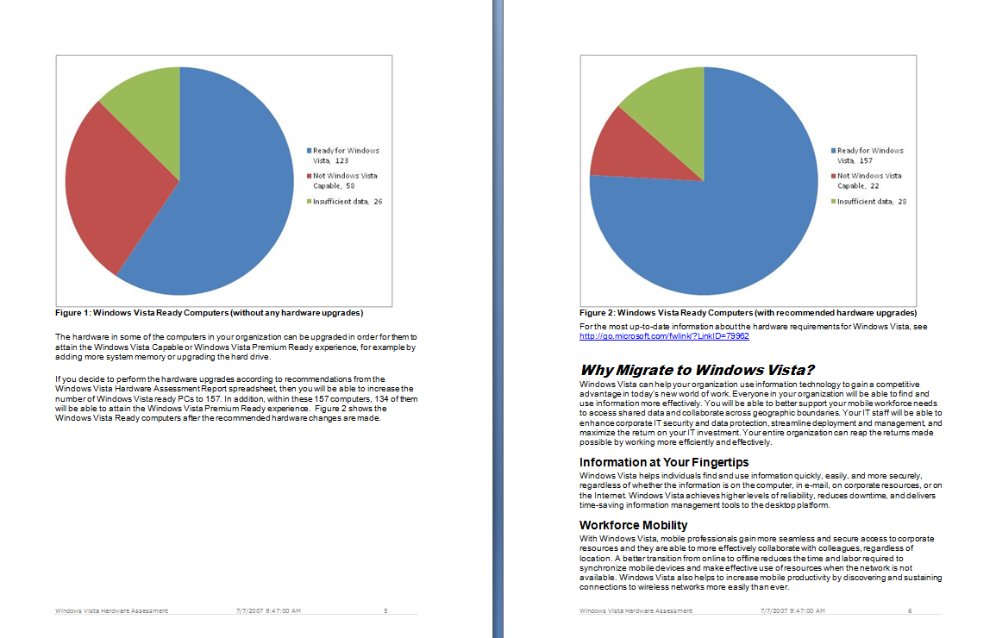
Voorbeeld MAP rapportage
Leren
Verkopen
Uitrollen
Kwalificeren

Slide 7
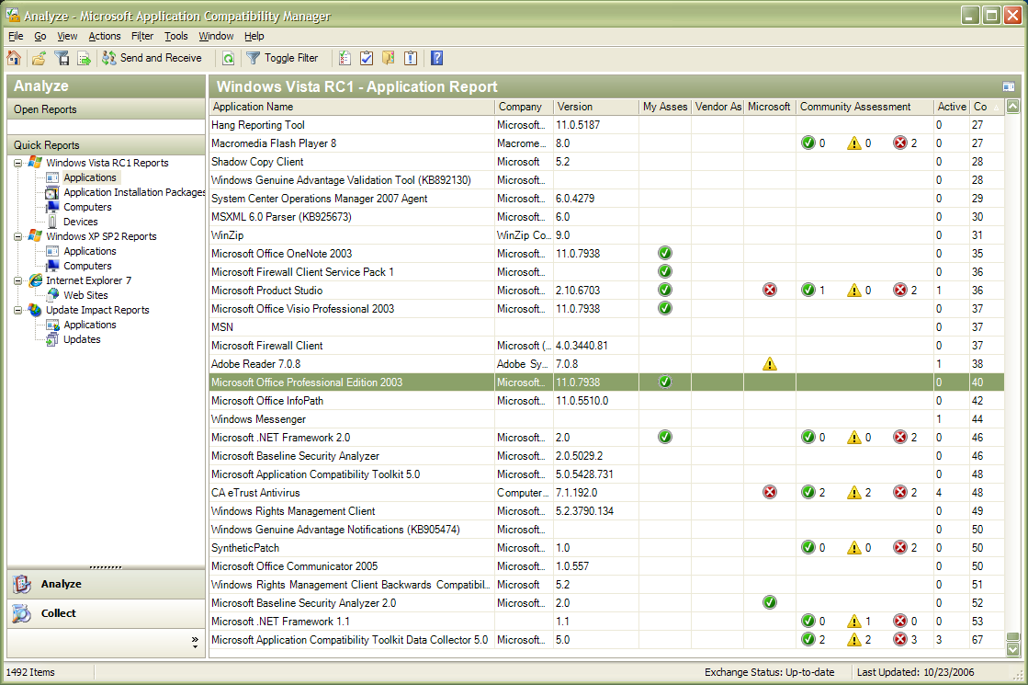
Application Compatibility Toolkit
  Single environment to help detect, diagnose, and mitigate compatibility issues found in Windows Vista
  Microsoft Compatibility Exchange to facilitate exchange of compatibility data between ISV/IHV, Microsoft, and customers
  Available Compatibility Evaluators include:
    Inventory collector,
    User Account Control,
    Windows Vista specific
      Deprecations
      GINA
      Session 0
      Internet Explorer

Slide 8
Windows Vista Business Value Discussion Tool
Leren
Verkopen
Uitrollen
Kwalificeren
Tool for Microsoft field sales and partners
  Estimate deployment cost and benefits
  (IT and business) of Windows Vista
  Provide customers with initial business case as discussion-starter for more investigation or specific deployment solutions
Open design based on Microsoft® Office Excel® spreadsheet software

Slide 9
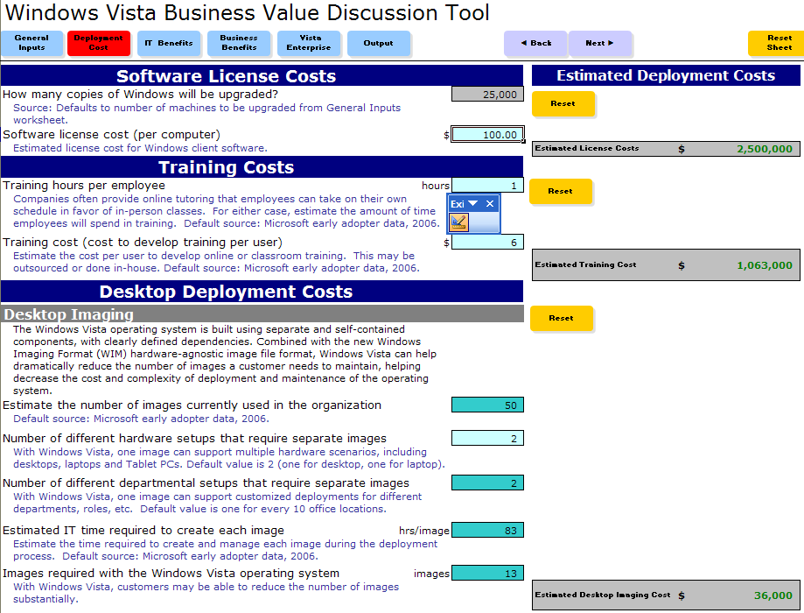
Deployment kosten
Leren
Verkopen
Uitrollen
Kwalificeren
Software license costs
Training costs
Desktop deployment costs
  Desktop imaging
  Application compatibility
  remediation
  Infrastructure remediation
  Planning and organization
  Deployment process

Slide 10
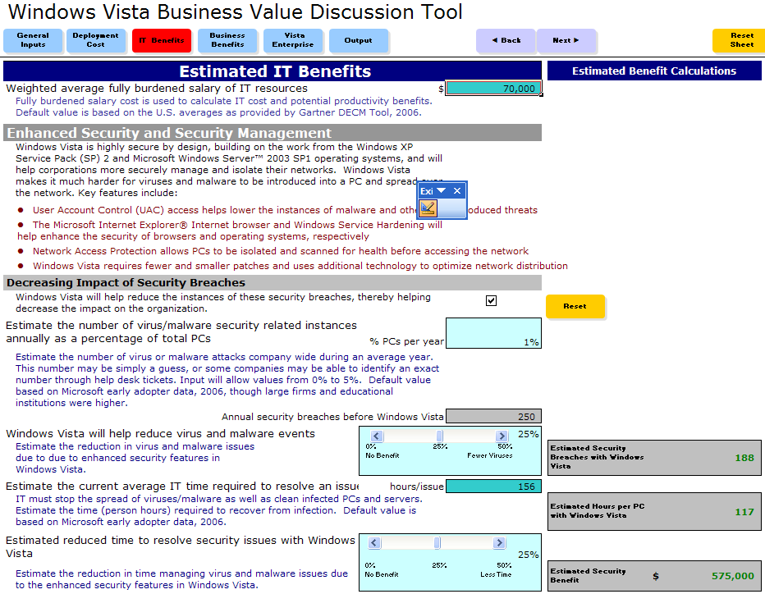
IT Benefits
Leren
Verkopen
Uitrollen
Kwalificeren
Enhanced security and
security management
  Decreasing impact of
  security breaches
  Security patch management
Automated desktop
management
Help-desk support
Reduced image management
Third-party software savings

Slide 11
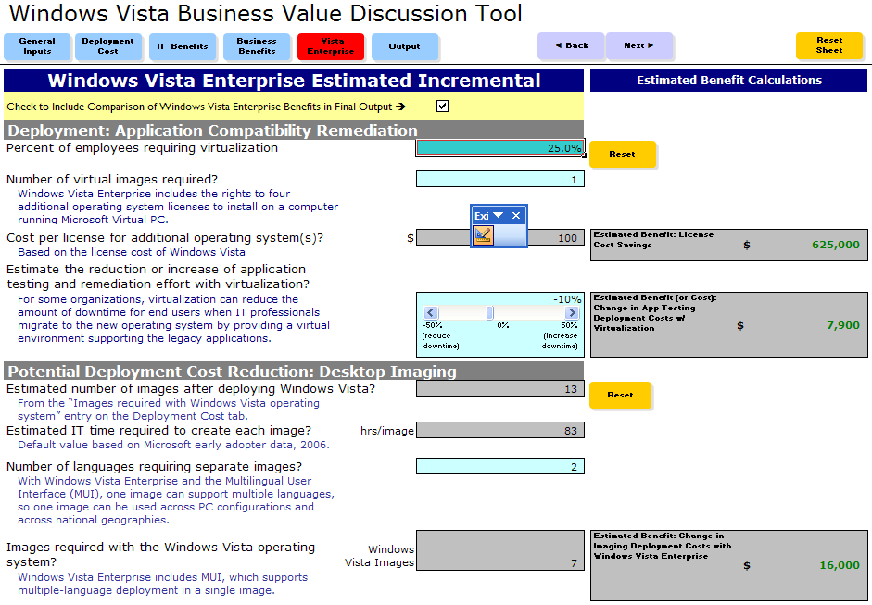
Business benefits
Leren
Verkopen
Uitrollen
Kwalificeren
Potential deployment
benefits
  Application compatibility
  remediation
  Desktop imaging
Potential IT benefits
  Image management
  Data protection (computer loss/theft, PC recycling)
Potential business benefits
  Subsystem for UNIX-based Applications (SUA)

Slide 12
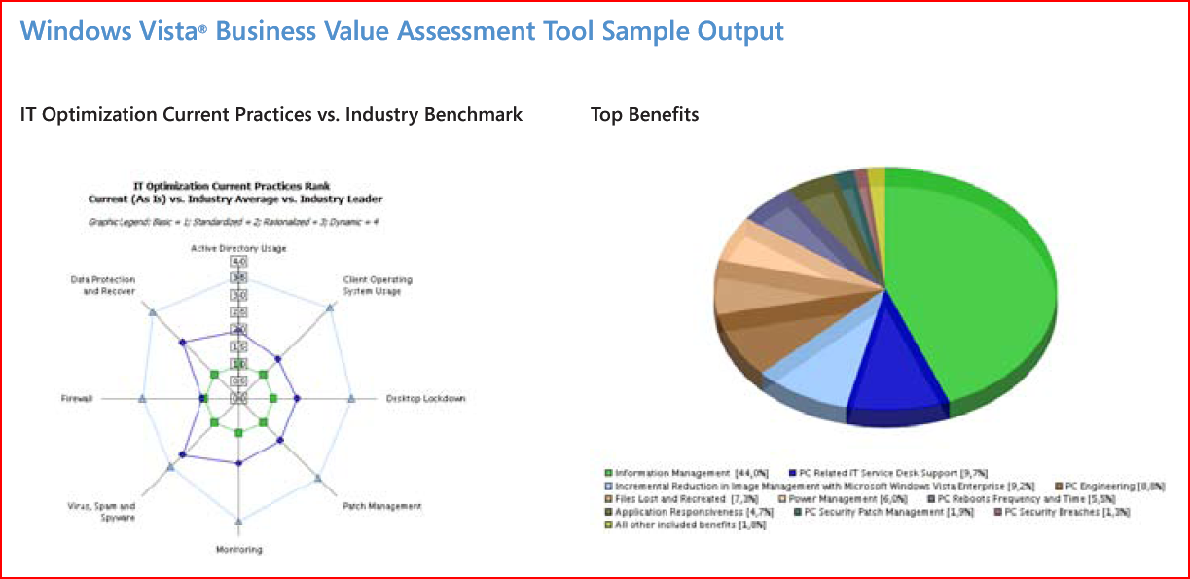

Slide 13

© 2008 Microsoft Corporation. All rights reserved. Microsoft, Windows, Windows Vista and other product names are or may be registered trademarks and/or trademarks in the U.S. and/or other countries. The information herein is for informational purposes only and represents the current view of Microsoft Corporation as of the date of this presentation. Because Microsoft must respond to changing market conditions, it should not be interpreted to be a commitment on the part of Microsoft, and Microsoft cannot guarantee the accuracy of any information provided after the date of this presentation. MICROSOFT MAKES NO WARRANTIES, EXPRESS, IMPLIED OR STATUTORY, AS TO THE INFORMATION IN THIS PRESENTATION.

