Slide 2
Tools and Techniques for Productive and Effective SharePoint Development
OFC303
Matt Smith (MCTS) Zac Smith (MCTS, MVP)
Developer MOSS Consultant
Intergen Trinkit

Slide 3
The Smith & Smith Show (Not related!)
Zac Smith
MOSS Consultant
Trinkit (Wellington)
MCTS (WSS, MOSS)
MVP
Member of CKS team
www.trinkit.co.nz/blog
Matt Smith
MOSS Developer
Intergen (Christchurch)
MCTS (WSS, MOSS)
Not an MVP
ChCh SharePoint U/G
blog.mattsmith.co.nz

Slide 4
Tools and Techniques for Productive and Effective SharePoint Development
OFC303

Slide 5
Agenda M & Z’s 8 step rehab for SharePoint developers
1. Optimize your development environment
2. Get a productive build cycle
3. Don’t be a tool, be a better developer through tools!
4. Only code when you have to
5. Use the right tool for the job
6. Get friendly with PowerShell
7. Make peace with SharePoint Designer
8. Get help faster, and stay up to date

Slide 6
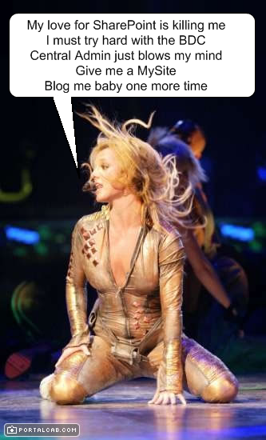
Assumptions
You have at least some SharePoint development experience
You dream about CAML, 12 Hive, Features and Solutions
“SharePoint” == SP == WSS or MOSS

Slide 7
Step #1 Optimize your development environment

Slide 8
1. Optimize your development environment Tweak your Hardware
Should I virtualize?
Minimal system specs:
3GB+ RAM
Multiple core
7200 RPM+ HD
Other options
Server 2008 Workstation
Vista and SharePoint?
Dual Boot

Slide 9
1. Optimize your development environment Tweak your Software
Tune your VM
Use a separate (fast) physical disk
Use SQL Express
DEFRAG lots – host and guest
Hardware acceleration on full
Turn off unnecessary services
Log throttling

Slide 10
1. Optimize your development environment Tweak your Environment
IntelliSense for CAML
Take some shortcuts
Desktop/toolbar shortcuts
Browser shortcuts
Explorer shortcuts
Visual Studio shortcuts
Shell extensions
Path variables

Slide 11
Taking Shortcuts
demo

Slide 12
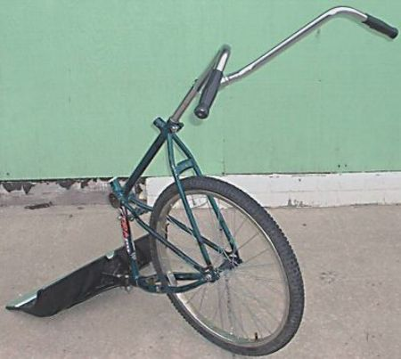
Step #2 Get a productive build cycle

Slide 13
2. Get a productive build cycle Deployment Frustrations
Biggest productivity killer is during deployment
Getting your code into SharePoint can be complex and slow
VSeWSS: The “costly 7 steps”

Slide 14
2. Get a productive build cycle Rapid, Iterative Deployment
Use custom Debug and Release build cycles
Release creates a WSP and performs the 7 steps
Debug does the bare minimum to deploy to SharePoint (e.g. xcopy, gac install + reset app pool)
Debug used 99% of the time for iterative build-test-fix cycle
How?
Write custom post-build events (cmd files)
Or, use a tool (http://www.codeplex.com/STSDEV)

Slide 15
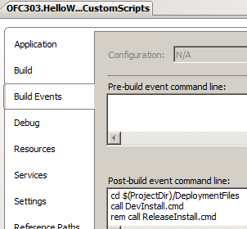
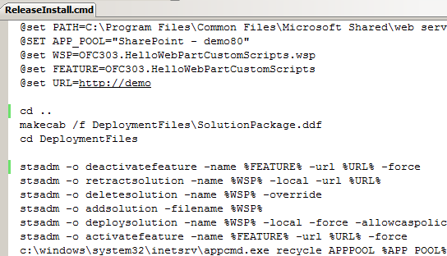
2. Get a productive build cycle Custom Post Build Events

Slide 16
2. Get a productive build cycle Why STSDEV?
 | VSeWSS | STSDEV | WSPBuilder | Andrew Connell’s Tool | Custom Build Scripts
Project template generation | P | P | O | O | O
Productive build cycle alternatives | O | P | O | O | P
Auto WSP generation | ½ | P | P | P | O
F5 Debug | P | O | O | O | O
Add Matt’s DebugApp trick for F5 debug and other coolness (without VSeWSS)!

Slide 17
Productive Build Cycle
demo

Slide 18
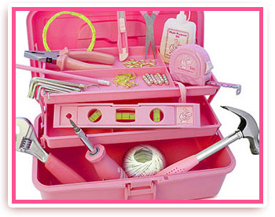
Step #3 Don’t be a tool, be a better developer through tools!

Slide 19
3. Don’t be a tool, be a better developer through tools! Build Your Toolkit
You owe it to yourself to spend a few hours building a Toolkit of time savers
Resources:
CodePlex search for “SharePoint” - goldmine
Tool indexes and portals (free and otherwise)
Warning:
Tools don’t make you smarter, they help you work smarter
Still good to understand what’s really going on

Slide 20
3. Don’t be a tool, be a better developer through tools! What’s in Our Toolkit (Partial)?
Build and Packaging Tools
STSDEV
AppPool Recycle Utility
Solution Installer
CAML/Search Tools
U2U Query Builder
YACQT
Search Service Tool
CAML.NET
LINQ to SharePoint
Visual Studio Optimisations
AC's CodeRush Tools
SPDevMod
Content/Config Replication
Content Deploy Wizard
CMP Package Explorer
Cross Site Configurator
SPS Tips Utility Pack
In-SharePoint Tools
SP Features
Smart Tools
SP Config Store
Enhanced CQWP
Testing Tools
Test Data Population
Imtech Test Content
Inspection Tools
SharePoint Manager
SharePoint Inspector
SP Explorer Client (IE)
Governance/Manageabilty
SP Governance Tools
Reporting Framework
MS Asset Inventory
MS Monitoring Kit
SP Admin Toolkit
STSADM Tools
AC’s STSADM
Imtech STSADM
Gary LP’s STSADM
STSADM Win
Planning/Design Tools
MS Capacity Planning
Visio Shapes
Logging Tools
SP Logging Spy
SPTraceView
General Tools
SharePoint Toolbox
SharePoint SUSHI
.NET Essentials
Fiddler
Reflector
Sysinternals

Slide 21
Don't be a Tool
demo

Slide 22
Step #4 Only code when you have to

Slide 23
4. Only code when you have to Avoiding Another Wheel
Chances are that “it’s been done before”
Familiarise yourself with:
CodePlex solutions: CKS, PKC, SLK, SCT etc…
Third Party products (free/not) that extend or integrate with SharePoint
Microsoft’s “Fantastic 40”
SharePoint SDK Samples
The full SharePoint feature set

Slide 24
Step #5 Use the right tool for the job

Slide 25
5. Use the right tool for the job VS vs SP Designer vs The Browser
Many ways to customise SharePoint
Use the most productive tool, then move into managed VS solutions as needed
e.g. build lists in the browser then extract list definitions
e.g. develop/iterate master pages and page layouts in SharePoint Designer first

Slide 26
5. Use the right tool for the job User Control Pattern for Web Parts
Generating a Web Part GUI in pure code behind is not a productive experience
this.Controls.Add(new Label(“Sigh!”));
Use the power of the graphical designer to build re-usable User Control components
Load these into web parts (ala SmartPart)
Page.LoadControl(“/Path/MyControl.ascx”);
Use the DebugApp to speed development

Slide 27
User Controls in Web Parts
demo

Slide 28
Step #6 Get friendly with PowerShell

Slide 29
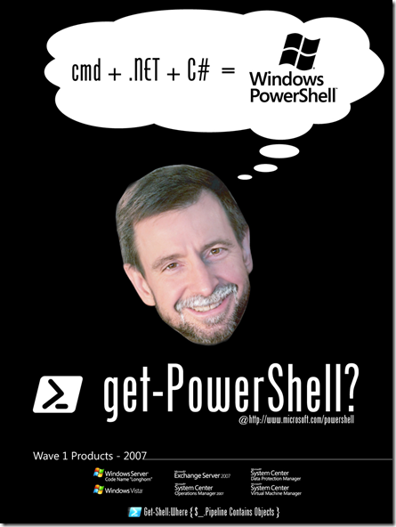
6. Get friendly with PowerShell What is PowerShell?
Command prompt where the values piped between commands are .NET objects
Light weight text scripts
Access and manipulate .NET objects easily without writing full “programs”
Extensible (cmdlets)

Slide 30
6. Get friendly with PowerShell Using PowerShell with SharePoint
Use SharePoint APIs + Web Services rapidly
Quick proof-of-concepts
Inspection and extraction (e.g. SchemaXML)
Write scripts for common tasks
e.g. replication across your SP farm
e.g. bulk document uploading
e.g. backup/restore scripts
Use as part of a repeatable build process

Slide 31
PowerShell + SharePoint
demo

Slide 32
Step #7 Make peace with SharePoint Designer… it’s for developers, too!
++

Slide 33
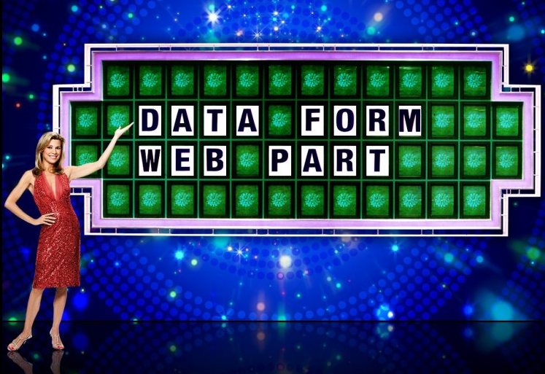
7. Make peace with SharePoint Designer Q: Anything A: Data View Web Part
“The most powerful Web Part in SharePoint”
Can avoid coding custom web parts in many (not all!) scenarios -> speed development
Some features:
Flexible data sources
Linked data sources
Flexible XSLT rendering
Connectable
Two-way data binding

Slide 34
Data View Web Part
demo

Slide 35
Step #8 Get help faster, and stay up to date

Slide 36
8. Get help faster, and stay up to date Build A Library of Resources
Essential Resources
Microsoft: MSDN WSS Portal, MSDN MOSS Portal, TechNet WSS Portal, TechNet MOSS Portal, MSDN WSS SDK, MSDN MOSS SDK, GearUp, Office Online, Developer Intro Portal
Community: SharePointPedia, SP Community Portal
Other Portals: wssdemo.com, WSS FAQ, SPS FAQ
Forums: SharePointU, MSDN, TechNet
Stay Up to Date
Aggregate Blogs: MVPs, MS Individuals, MS Teams

Slide 37
Resources
www.microsoft.com/teched
Tech·Talks Tech·Ed Bloggers
Live Simulcasts Virtual Labs
http://microsoft.com/technet
Evaluation licenses, pre-released products, and MORE!
http://microsoft.com/msdn
Developer’s Kit, Licenses, and MORE!

Slide 38
Please complete an
evaluation

Slide 39
Q & A
Zac Smith
www.trinkit.co.nz/blog
Matt Smith
blog.mattsmith.co.nz

Slide 40
© 2008 Microsoft Corporation. All rights reserved. Microsoft, Windows, Windows Vista and other product names are or may be registered trademarks and/or trademarks in the U.S. and/or other countries.
The information herein is for informational purposes only and represents the current view of Microsoft Corporation as of the date of this presentation. Because Microsoft must respond to changing market conditions, it should not be interpreted to be a commitment on the part of Microsoft, and Microsoft cannot guarantee the accuracy of any information provided after the date of this presentation. MICROSOFT MAKES NO WARRANTIES, EXPRESS, IMPLIED OR STATUTORY, AS TO THE INFORMATION IN THIS PRESENTATION.

Slide 41
Presentation Outline (hidden slide):
Speaker instructions: Complete this slide to assist your SME (subject matter expert) in evaluating your presentation flow, topic coverage, demo integration and alignment of content to your session description and level.
Title: Tools and techniques for productive + effective SP development
Technical Level: 300
Intended Audience: Developers (Visual Studio focus)
Objectives (what do you want the audience to take away from this session):
1. Awareness of development best practices and optimisations
2. Awareness of a variety of tools that can be leveraged in development
3. An understanding of “advanced” techniques for productive dev
Presentation Outline (including demos): ?

Slide 42
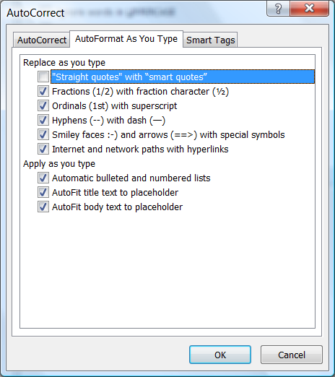
Slide for Showing Software Code
Use this layout to show software code
The font is Consolas, a monospace font
The slide doesn’t use bullets but levels can be indented using the “Increase List Level” icon on the Home menu
To use straight quotes " instead of smart quotes ”, do this:
Click on the Office Button in the upper left corner
At the bottom of the menu, choose PowerPoint Options
From the left pane, select Proofing
Click on the AutoCorrect Options button
Select the AutoFormat As You Type tab, and deselect “Straight quotes” with “smart quotes”. Then Click OK.

