Slide 1



Windows Presentation Foundation
and
Silverlight
Pandurang Nayak
Client Platform Evangelist
Microsoft Corporation India

Slide 2
Windows Presentation Foundation

Slide 3
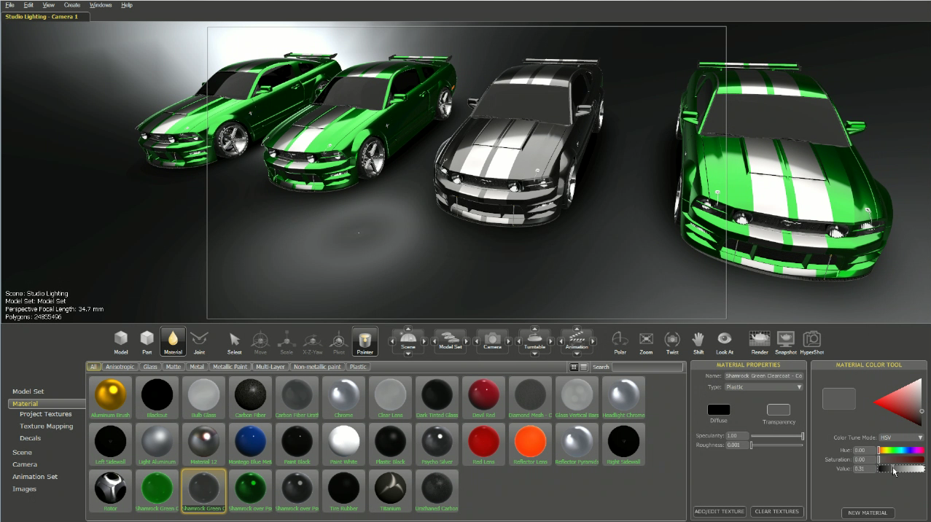
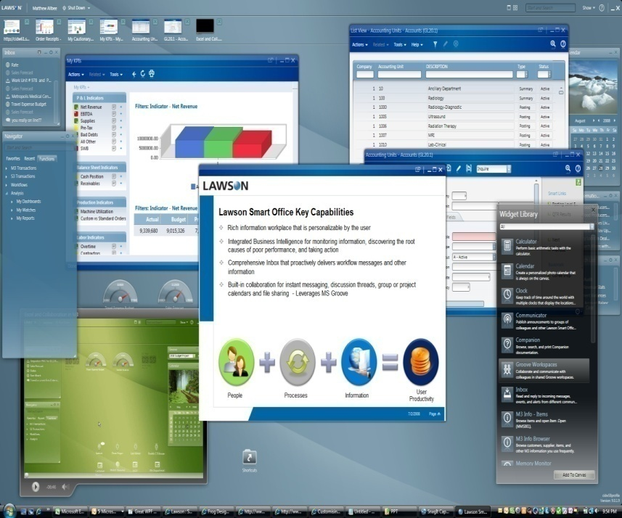
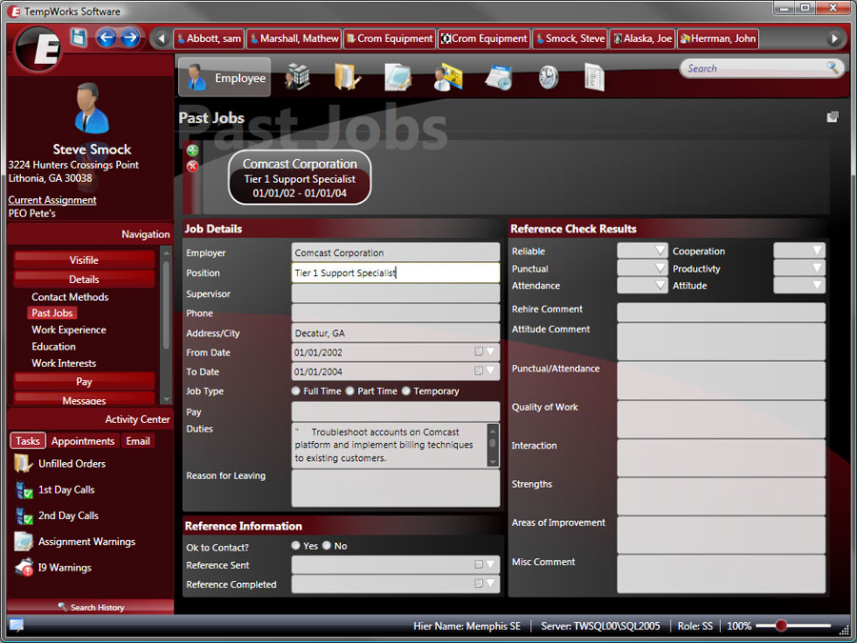
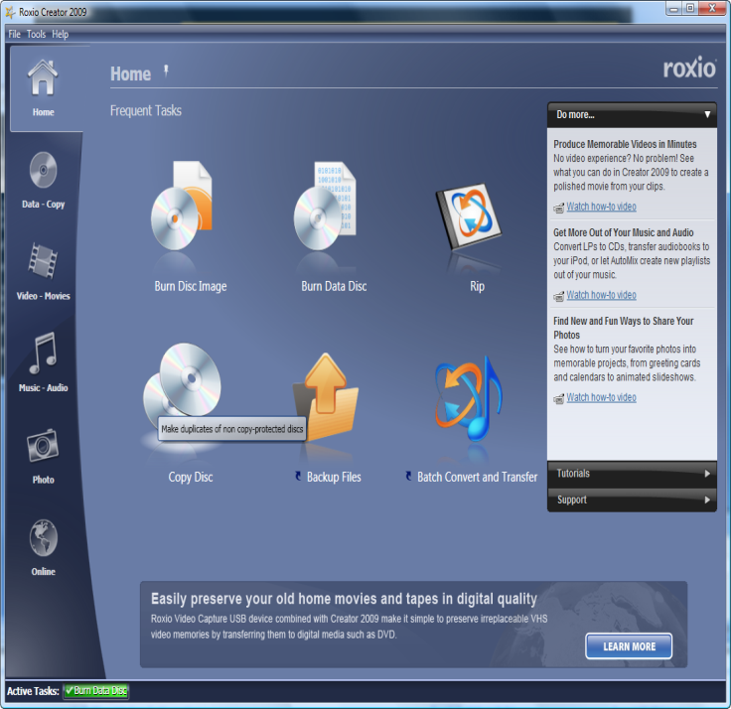
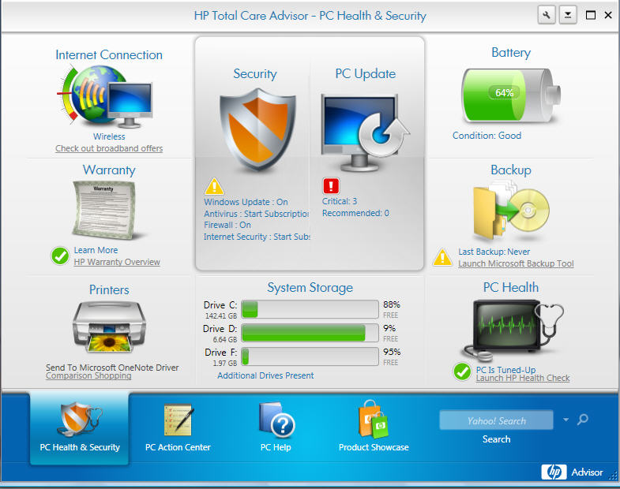
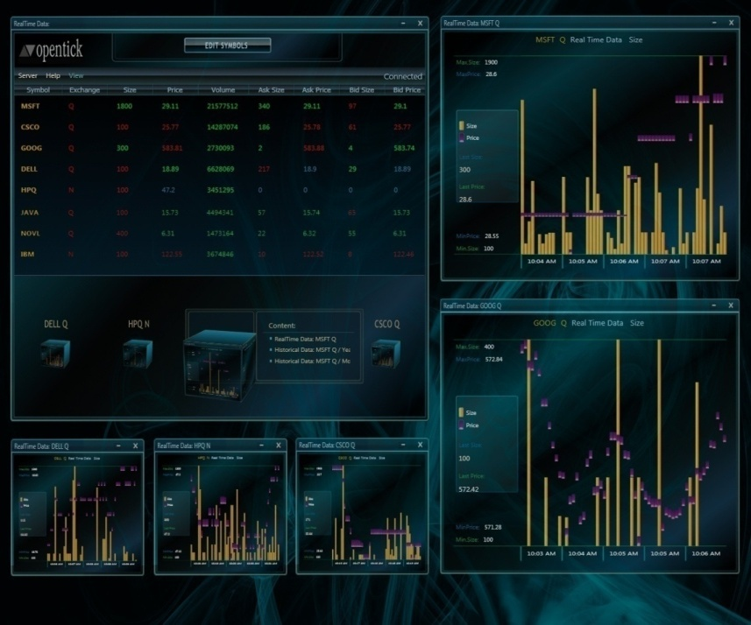
.NET Client Momentum

Slide 4
WPF in Action
demo

Slide 5
WPF 3.5 SP1
Application Startup and Working Set Performance Improvements
New .NET Framework Client Profile Setup Package
New .NET Framework Setup Bootstrapper for Client Applications
ClickOnce Client Application Deployment Improvements
Graphics Performance Improvements
Data Improvements
Extensible Shader Effects
WPF Interoperability with Direct3D
Visual Studio 2008 for WPF Improvements
Notes:
Application Startup and Working Set Performance Improvements, including significant performance improvements to the CLR to enable 10-40% faster application startup times.
New .NET Framework Client Profile Setup Package, a new setup installer that enables a smaller, faster, and simpler installation experience for .NET client applications on machines that do not already have the .NET Framework installed.
New .NET Framework Setup Bootstrapper for Client Applications, a new "bootstrapper" component that you can use with client applications to help automate making sure that the right version of the .NET Framework is installed.
ClickOnce Client Application Deployment Improvements.
Performance Improvements, specifically in the graphics and data scalability arenas.
Data Improvements
Extensible Shader Effects
WPF Interoperability with Direct3D
Visual Studio 2008 for WPF Improvements

Slide 6
WPF Platform Roadmap
WPF Toolkit
  WPF DataGrid and other controls
WPF Futures
  Client Profile Configuration Designer
WPF Ribbon Preview
All available today from www.codeplex.com/WPF

Slide 7
.NET Client Profile and
Configuration Designer
demo

Slide 8
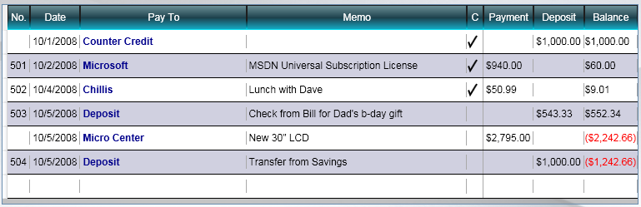

WPF DataGrid Control
Getting started with DataGrid
  Autogenerate columns in one line
  Resizing, Reordering, Sorting,
  Selection, Editing, Keyboard navigation
  Variety of Column Types
      DataGridCheckBoxColumn
      DataGridComboBoxColumn
      DataGridHyperlinkColumn
      DataGridTextColumn
      DataGridTemplateColumn

Slide 9
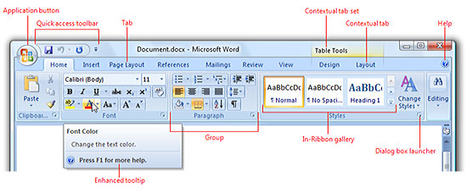
  WPF Ribbon Control
Getting started with Ribbon
  RibbonCommands are the heart of the Ribbon
  Use RibbonWindow for title bar integration
  Customize resizing without writing layout code

Slide 10
WPF Ribbon Control & DataGrid
demo

Slide 11
  Touch Experiences
Windows 7 Touch
  New and Differentiated Experiences
  Natural User Behavior
Windows 7 Device Support
  Sensor Platform
  Location, Position, Environment, etc.
WPF will help you build next-generation Win7 applications!

Slide 12
Windows 7 Development
video

Slide 13
Silverlight 2

Slide 14
Silverlight 2
Cross-browser, Cross-platform plug-in to deliver rich media and Internet application experiences
Silverlight 2
  .NET Programmability
  Data Visualization
  Communication and Networking Support
  Styles and Templates
  Deep Zoom
  Silverlight Control Pack
  Developer-Designer Collaboration
  Visual Studio 2008 SP1
  Expression Blend 2 SP1
  Visual Studio Web Developer 2008 SP1
  Eclipse Support (via eclipse4sl.org)

Slide 15
Silverlight in Action
demo

Slide 16
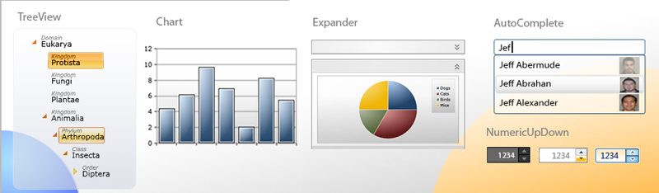
Silverlight Control Toolkit
Ready-to-use Controls
  Enables several common scenarios
Charting features
  Based on powerful Dundas charts
  Available today from www.codeplex.com/silverlight

Slide 17
Silverlight Toolkit
demo

Slide 18
Call to Action
Evaluate new user experiences
  Desktop
  Web
  Mobile
Innovate on interaction
  Sensors
  Touch
  Ink
Differentiate with competition
  Rich
  Futuristic
  Best-in-class

Slide 19

2006 Microsoft Corporation. All rights reserved. Microsoft, Windows, Windows Vista and other product names are or may be registered trademarks and/or trademarks in the U.S. and/or other countries. The information herein is for informational purposes only and represents the current view of Microsoft Corporation as of the date of this presentation. Because Microsoft must respond to changing market conditions, it should not be interpreted to be a commitment on the part of Microsoft, and Microsoft cannot guarantee the accuracy of any information provided after the date of this presentation. MICROSOFT MAKES NO WARRANTIES, EXPRESS, IMPLIED OR STATUTORY, AS TO THE INFORMATION IN THIS PRESENTATION.

