Slide 1
Virtualization 360º

Slide 2
Agenda
People Ready Business & Dynamic IT
Microsoft Optimization Model
Role of Virtualization
Virtualization Scenarios
Action Plan

Slide 3

Our Commitment
At Microsoft, we believe in the potential of software and technology innovation to help people and businesses around the world improve the environment.
Notes:
At Microsoft, we are committed to software and technology innovations that help people and organizations around the world improve the environment. Our goal is to reduce the impact of our operations and products, and to be a leader in environmental responsibility

Slide 4





Growing Issues And Opportunities
Energy Demands
Carbon Emissions
Negative Impact
Software Solutions
Notes:
Energy Demands
Will increase almost 40% by 2030
Primary fuel sources are still fossil fuels
Over 4 billion people don’t have reliable energy, but should
Carbon Emissions
Here are some ways to look at the carbon impact -- before the industrial revolution, atmospheric carbon was 280 parts per million. Today, we are at about 390 parts per millions, and on our current path, we will exceed the 450 – 500 ppm level in the next few decades. We will see an increase in both the world’s population to potentially 9 billion people over this century, as well as rise in per capita energy consumption as more societies start to consume energy at an increasing rate. -- In 1950 there were about 300 million heavy consumers of energy and goods on the planet. Today we are surpassing 1 billion and with the rise in resource needs in developing nations, we will surpass the 1.5 billion mark in the next decade, if not sooner. This is great for society as there are over 4 billion people today who do not have access to first world living standards. The implications for our planet, however, are concerning
Global Impact
Today, we are just beginning to see the impact that increased carbon levels will have on our planet. Temperatures have risen by .65 degrees celcius since the 1950’s and will rise between at least 1 and possibly 4.5 degrees or more in this century. Yet, even at .65 degrees, we are already seeing significant impacts to ice loss in the seas, increased frequency and magnitude of weather anomalies and stresses on our food supply chain.
So, against this backdrop, what is it that Microsoft, or any company, can do?
To put this in context, a 4.5 to 6 degree Celsius change in the other direction, with cooler temperatures, resulted in over 4 km of ice covering Europe during the ice age. The current projected range of temperature rise will put us in an area not seen in the history of human existence. What is driving this change? The evidence is largely in that anthropogenic, human induced, change is a significant factor.
Software Solutions
We view our role is to simultaneously increase the efficiency of computing while also empowering people and businesses to leverage the potential of software to help drive the invention and development of a new wave of highly efficient transportation methods, use technology as a substitute for travel or shipment of many goods that are still done with physical transportation today, and to help scientists and entrepreneurs use technology to invent new, clean energy sources.
So let’s look at how we can create a Sustainable IT infrastructure

Slide 5



Approach For Sustainable IT
Reduce
  Built in energy efficiency
  Resource optimization through consolidation
  Integrated power management solutions
Manage
  Proactively monitor computing health
  Actively analyze results
  Record and control progress
Rethink
  Increase productivity while reducing footprint
  Visualize environmental impacts
  Innovate for the future
Notes:
Microsoft can help IT organizations address their sustainability or Green IT needs by helping them Reduce Energy Demands, Manage Environmental Footprint and Rethink business practices.
Microsoft is helping to reduce the direct impact of computing on the environment through power management at the software and enterprise level. Making it easier for customers to manage their computing footprint, Microsoft helps by providing:
Built In Energy Efficiency
Resource Optimization Through Consolidation
Power Management Guidance and Education
Microsoft gives customers the power to proactively manage the lifecycle of their environmental footprint. Enterprise customers can make a difference by using Microsoft products to:
Monitor Computing Efficiency
Analyze Results
Record and Control Progress
Making our world sustainable will mean rethinking the way each industry works, and how we balancing needs with responsible choices and solutions. Microsoft enables organizations to implement new workplace solutions to reduce environmental impact and delivers technologies that can address our current and future global challenges. We see our role in helping rethink how to:
Increase Productivity While Reducing Footprint
Visualize Environmental Impacts
Innovate for the Future

Slide 6

Benefits Of “Sustainable IT”
  Businesses worldwide can save $800 billion in annual energy costs by 2020
  Companies can also reduce global greenhouse gas emissions by 15%
  American companies are interested in cost-cutting initiatives, and Europeans are more focused on improving brand image with corporate responsibility—but both factors benefit all types of businesses
Notes:
From “SMART 2020: Enabling the Low Carbon Economy in the Information Age,” by the Global e-Sustainability Initiative (GeSI) and the Climate Group, June 2008.
There are direct cost savings that IT organizations can have from moving to a sustainable IT infrastructure. Businesses WW can save up 800billion a year. In addition, the benefit to the environment is significant and can help companies reduce GHG emissions by 15%.

Slide 7
Virtualization Drives Efficiency
Environmental Impact
  Energy costs to go over 50 % of the total IT budget for a typical data center
  Daily power consumption of a typical datacenter = monthly power consumption of thousands of homes
  61 billion kilowatt hours going toward data centre energy consumption
  10-15 more power plants needed by 2011 to keep up with data centre power consumption
  x86 hardware consumes ~80% of the normal workload power even when idle
Virtualization Promise
  Virtualization can reduce energy usage by 90%
  Virtualizing 100 servers eliminates estimated 500K lb CO2 (annual emissions)
  95% or over 30M servers are still to be virtualized
Notes:
As we mentioned earlier, organizations can reduce their energy use dramatically by driving server consolidation. This can help increase utilization on servers and turn off un-used servers. As a result, IT can also see a reduction in cooling costs which now represent about 50% of energy demands in data centers but also reduce their CO2 emissions.

Slide 8
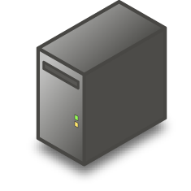
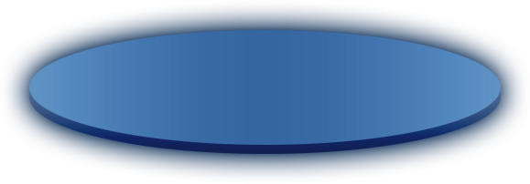
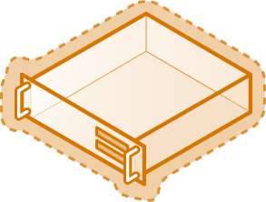
Server Consolidation
Typically, server workloads only consume a small fraction of total physical server capacity, wasting hardware, space and electricity
APP
APP
APP
OS
OS
OS
Through virtualization, these workloads can be consolidated onto fewer physical servers, saving resources and increasing flexibility
9%
Utilization
6%
Utilization
14%
Utilization
APP
APP
APP
OS
OS
OS
30%
Utilization
Notes:
Typically, server workloads only consume a small fraction of total physical server capacity, wasting hardware, space and electricity.
Through virtualization, these workloads can be consolidated onto fewer physical servers, saving resources and increasing flexibility

Slide 9
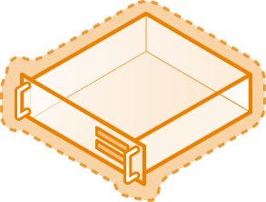

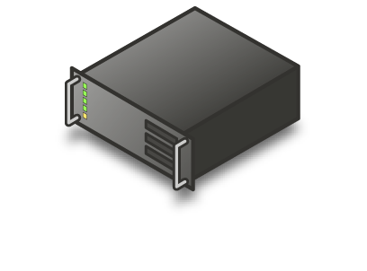









Controlling Costs
Server Consolidation
  Physical & Virtual
  Management
.NET
IIS
.NET
Exchange
SQL
Notes:
9
The “low-hanging fruit” in many datacenters is server consolidation. By consolidating servers, datacenters can see an immediate reduction in power use. Datacenters can keep some unused servers as spare capacity and decommission others to free up precious floor space and to reduce cooling requirements.
As datacenters move to mixed physical and virtual servers, it’s critical that they have comprehensive tools to manage both environments seamlessly.

Slide 10
Controlling Costs
Convert Physical Machines to Virtual Machines
Utilize P2V technologies to assist in the transition
Host Multiple Virtual Machines on Fewer Physical Machines
Physical machine can host Windows, Linux, and other OS virtual machines
Eliminate stand alone servers for legacy applications
Purchase fewer server licenses.
Reduce Power Consumption
Fewer servers to power
Reduced cooling
Notes:
The first step in server consolidation is converting appropriate physical servers to virtual servers. Servers with single workloads and low utilization are the most logical initial candidates for consolidation. Microsoft’s Hyper-V is a high-performance hypervisor that can host Windows, Linux, UNIX, and other operating systems. Server consolidation can be especially valuable for legacy workloads that are tied to discontinued hardware. Microsoft’s Windows Server 2008 licenses are designed with virtualization in mind, and depending on the SKU, a single Windows Server 2008 physical license also includes licenses for multiple Windows server virtual machines.
There is a near one-to-one relationship between servers consolidated, and power saved. For example, consolidating ten physical servers results in a power savings of 80 to 90 percent. As the number of needed stand-alone and blade servers drops, cooling requirements drop as well.

Slide 11
Windows Server 2008: Energy Efficiency
100%
90%
80%
70%
60%
50%
40%
Designed with Energy Efficiency in Mind
Updated Support for ACPI PPM including:
  Processor performance states (P-states)
  Processor idle sleep states
  Enabled by default
  Configure through Group Policy
Power savings of up to 10 percent over Windows Server 2003
Watts (% of maximum)
0% 10% 20% 30% 40% 50% 60% 70% 80% 90% 100%
Workload (% of maximum throughput)
Windows Server 2003 Windows Server 2003
Notes:
The U.S. Department of Energy has said that the datacenter is the fastest-growing energy consumer in the United States today, with 61 billion kilowatt hours going toward datacenter power consumption and a projected ten to fifteen additional power plants needed by 2011 to keep up.
According to Gartner Research, energy costs could soon account for more than 50 percent of the total information technology budget for a typical datacenter (Gartner Press Release, “Gartner Urges IT and Business Leaders to Wake Up to IT's Energy Crisis,” September 28, 2006).
While power consumption is often viewed as a hardware issue, Microsoft has made significant engineering investments to ensure that Windows Server 2008 uses energy efficiently. As a result, Windows Server 2008 out of the box uses approximately 10 percent less energy than Windows Server 2003 running an identical workload.
BUILD:
This is largely because Windows Server 2008 includes updated support for Advanced Configuration and Power Interface (ACPI) processor power management (PPM) features, including support for processor performance states (P-states) and processor idle sleep states on multiprocessor systems. These features simplify power management in Windows Server 2008 and can be managed easily across servers and clients using Group Policies.

Slide 12
Savings Through Virtualization
Projected Savings
50,000
45,000
40,00035,000
30,000
25,000
20,000
15,000
10,000
5,000
0
Server setup | Average Watts | kWh/year | Cost | KG of CO2
Standalone IIS x10 | 5,001 | 43,839 | $4,007 | 34,084
One Hyper-V server with 10 IIS7 virtual machines | 512 | 4,490 | $410 | 3,491
Savings | 4,489 | 39,349 | $3,597 | 30,593
kWh/Year
Microsoft Actual Dev/Test Savings
 | Number of Servers | Hard Drive Space | Rack Space | Power
Physical | 477 systems ~$5k each | 19 terabytes | 30 racks | 525 amps
Virtual | 20 systems ~$20k each | 8 terabytes | 2 racks | 8 amps
Savings | ~ $2,000,000 | 11 terabytes | 28 racks | 517 amps
1 Server
4 Servers
10 Servers
Virtual Servers Physical Servers
Notes:
While a 10 percent power savings is significant, virtualization provides an opportunity for a vastly greater impact. One of the primary goals of almost all forms of virtualization is making the most efficient use of available system resources. Microsoft’s Hyper-V dramatically improves capacity utilization because it allows for the consolidation of underutilized servers. This translates to less space required, less cooling necessary, and fewer kilowatt hours of power – all of which saves money and reduces the environmental footprint.
Microsoft’s measurements with Hyper-V show a near one-to-one energy savings for each server consolidated. In other words, the power consumption of the host OS does not substantially increase as guests are added.
BUILD:
To put these savings into perspective, consider these actual measurements, which show the power consumption of 10 IIS Web servers compared to that of 10 IIS Virtual Servers running on Hyper-V.
Within our own IT department servicing more than 100,000 employees and contractors, we have seen tremendous savings in both test/development and production virtualization implementations. As shown in the bottom table, the savings go beyond just power. Virtual machines allocate disk space as needed, resulting in lower overall storage requirements. The conversion from a physical to a virtual system also greatly lowers costs by reducing cabling needs and the number of servers and racks required, among other costs.

Slide 13
Approach For Sustainable IT
Reduce
  Built in energy efficiency
  Resource optimization through consolidation
  Integrated power management solutions
Manage
  Proactively monitor computing health
  Actively analyze results
  Record and control progress
Rethink
  Increase productivity while reducing footprint
  Visualize environmental impacts
  Innovate for the future
Notes:
As we’ve mentioned at the beginning, Microsoft can help IT organizations address their sustainability or Green IT needs by helping them Reduce Energy Demands, Manage Environmental Footprint and Rethink business practices.
Server Consolidation using Virtualization is a great way to get started on your sustainability efforts. There are a number of additional things that you can do to drive your efforts even further….

Slide 14
Green IT - 10 Things You Can Do
Enable Windows power management: >30% energy reduction
Replace older hardware/CRT with Energystar pcs
Deploy Windows Server 2008: 10% savings on same workload
Virtualization: avg CPU utilization < 15%
Look at energy bills: <20% of IT professionals are accountable for, or even know, energy consumption
Do a thermal scan of data centers
Telework, remote meetings through unified communications
Plan, analyze, monitor your environmental sustainability efforts using BI
Empower your employees
Start today

Slide 15
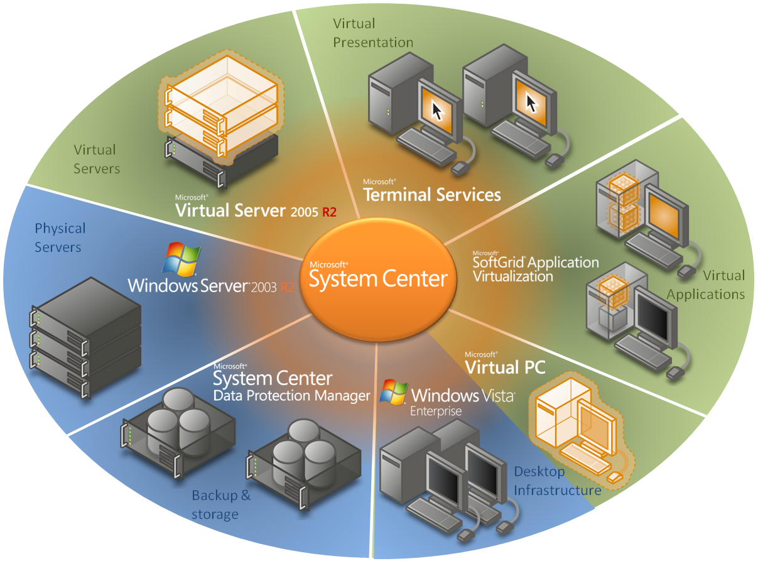
Managing Dynamic IT
Microsoft delivers end-to-end virtualization solutions…
…System Center provides the tools for integrated infrastructure management
"Virtualization without good management is more dangerous than not using virtualization in the first place“
- Thomas Bittman, Gartner
Notes:
Microsoft Virtual Server
Provides the virtual operating system that facilitates consolidated infrastructure, application, and branch office server workloads with rapid deployment and provisioning
Runs most major x86 operating systems in the virtual machine guest environment
Virtual machines utilize the Windows host operating system’s qualified device drivers, ensuring robust and stable device support and broad device compatibility
Virtual Machine Manager in Microsoft System Center
Manage Host configuration, Virtual Machine creation, library management, Intelligent VM placement, monitoring, rapid recovery , self provisioning and automation
Seamlessly manage virtual server environment with existing familiar physical server management tools
Provides complete scripted control of portable, connected virtual machines and enables easy automation of deployment, ongoing change and configuration
SoftGrid Application Virtualization (part of the Microsoft Desktop Optimization Pack)
Virtualize applications and deliver them as an on-demand, streaming service to desktop users
Simplify desktop images by decoupling application layer from image
Reduce number of server silos required to support Terminal Services
Centralize application permissions and control
Enables centralized patching & updating of applications
Virtual PC
Host legacy LOB applications
Host applications not compatible with desktop OS
Microsoft Terminal Services in Windows Server 2003 R2
Virtualize the presentation of entire desktops or specific applications
Provides an architecture for consolidation of applications and data in the data center, while providing broad access to local and remote users
Operations Manager in System Center
Comprehensive monitoring and reporting of host OS and guest Virtual machines, including discovery, state view, diagram view, alerts, tasks and performance
Identify good candidates for conversion to virtual machines based on specified memory and CPU requirements
Configuration Manager in System Center
Scalable migration and provisioning management
Manage patch and upgrades in physical, host and guest OS
Data Protection Manager in System Center
Captures data changes as they occur in real-time and synchronizes every 15 minutes to ensure Windows data and user productivity are protected
Enables IT administrators and end-users to easily recover data in minutes from easily accessible disk

Slide 16
Microsoft Core IO Approach
Infrastructure Optimization with Virtualization

Slide 17



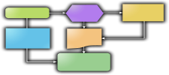


Role Based Productivity
Last Mile Of Productivity
Business Process Automation
Personal Productivity
Finance
Operations
Sales and Marketing
Notes:
What is the Last Mile of Productivity? Understanding that, irrespective of business units, there are significant productivity gains which can be enjoyed by deploying role-based productivity tools which address specific common functions across the board.

Slide 18



IT Challenges Remain
Business Productivity Infrastructure Optimization
Application Platform Optimization
Enabling
IT Resources
  Technology Change
  Competition
  Security Threats
  IT Service Management
  Interoperability
  End-User Productivity
  Cost Reduction
  Device Proliferation & Management
20%
New
%
New
%
Maintenance
80%
Maintenance
Unleashing Role-Based
Productivity
Provisioning
Core Infrastructure Optimization
Notes:
18
Meeting the Challenges of IT (Challenges identified by independent Industry Analysts)
Technology Change
Competition
Security Threats
IT Service Management
Interoperability
End-User Productivity
Cost Reduction
Device Proliferation & Management
Core IO provides the provisioning bedrock on which to enable role-based productivity gains from BPIO and APO
The objective is to reduce the 80% maintenance component of the average IT budget down to a more manageable 50-60% through the effective implementation of Optimization strategies.

Slide 19








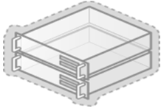
Dynamic IT
Enabling IT pros and development teams across the IT lifecycle
Manage Complexity,
Achieve Agility
Advance the Business
with IT Solutions
Protect Information,
Control Access
Amplify the Impact
of Your People
Process-Led,
Model-Driven
Service-
Enabled
Unified &
Virtualized
User-
Focused
Secure & Interoperable Platform
Core Innovation Areas

Slide 20
What Is Virtualization?
Virtualization is the isolation of one computing resource from the others
Traditional software
stack
Applications installed to specific hardware and OS
Component isolation with
virtualization
Virtual Applications
Any application on any computer, on demand
Interface bound to process
Virtual Presentation
Presentation layer separate from process
Operating system assigned
to specific hardware
Virtual Machine
OS can be assigned to any desktop or server
Storage assigned to specific
locations
Virtual Storage
Storage and backup over the network
Network assigned to specific
locations
Virtual Network
Localizing dispersed resources
Virtualization results in more efficient resource utilization, and supports greater flexibility and simplified change management
Notes:
Create animation to separate computing resources

Slide 21
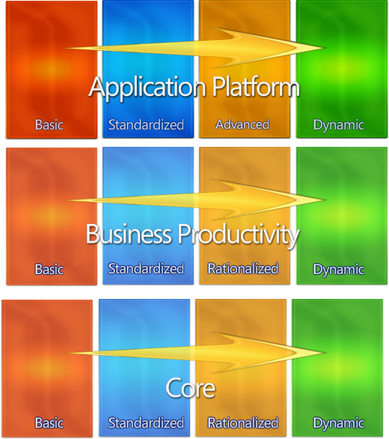
A Blueprint To Overcome The Challenges
Microsoft Optimization Model
A Model-Based Approach
  Capability sequencing framework to help you build an optimized infrastructure (not Microsoft-specific)
  Grounded in industry analyst and academic work, consortium work coming
  Provides guidance and best practices for step-by-step implementation
  Drives cost reduction, security and efficiency gains as well as enabling agility
Notes:
Key points
Implies a technology-agnostic approach
Capability sequencing framework to help you build an optimized infrastructure (not Microsoft-specific)
Grounded in industry analyst and academic work, consortium work coming
2. Not just a model but specific directional guidance
Provides guidance and best practices for step-by-step implementation
Provides tangible returns to the customer
Drives cost reduction, security and efficiency gains as well as enabling agility

Slide 22
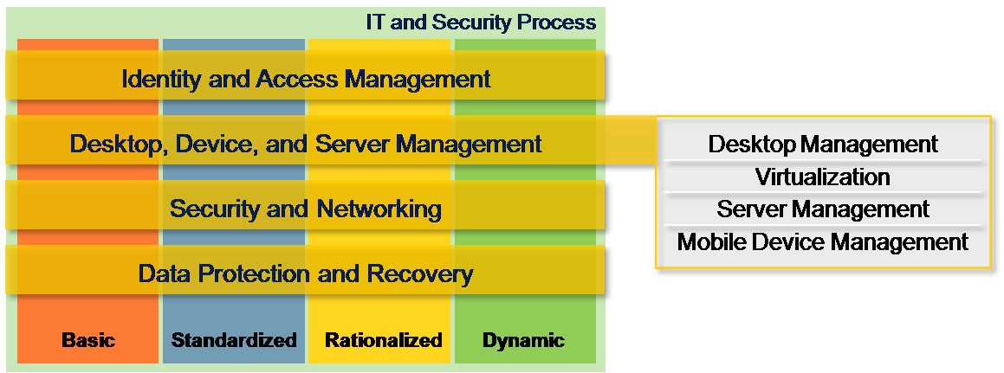
Core Infrastructure Optimization Model

Slide 23

Core Infrastructure Optimization Model
Progression toward dynamic IT will reduce costs, improve service levels, and drive agility
Basic
Standardized
Rationalized
Dynamic
Managed and
consolidated IT
infrastructure
with extensive
automation; knowledge captured
and reused
Fully automated
management,
dynamic resource
usage, business-
linked SLAs; knowledge capture and use
automated
Uncoordinated,
manual infrastructure
Managed IT
infrastructure
with limited
automation and knowledge capture
Cost Center
Efficient Cost Center
Business Enabler
Strategic Asset
Reduce Costs
  Test and development
  Server consolidation
  Application compatibility
Increase Service Levels
  Business Continuity
  Integrated management
Drive Agility
  Dynamic Infrastructure
  Dynamic provisioning
  Self-managing systems
. . . and virtualization solutions enable this progression . . .
Notes:
Adopting virtualization across the enterprise should naturally follow a maturation curve. While each scenario provides concrete and compelling benefits, it is best if an organization adopts these approaches in a more or less defined order. Different circumstances will dictate some modification to this sequence, but the stages of the Infrastructure Optimization Model can provide a rough guide on how to employ virtualization in your organization.

Slide 24




Virtualization Benefits
Basic
Standardized
Rationalized
Dynamic
Reduce Total Cost of Ownership
Increase Availability
Enable Agility
  Power
  Asset utilization
  Application testing
  Backup
  Recovery
  High Availability
  Dynamic provisioning
  Migration
  Self-managing dynamic systems

Slide 25
Key Scenarios

Slide 26



Virtualization Scenarios
Server Consolidation
  Convert physical machines to virtual machines so you can consolidate the number of physical servers and reduce power consumption
  Server Virtualization and Provisioning
Business Continuity
  Reduces maintenance and disaster impact by providing more options, the ability to shift workloads between servers and data protection regardless of OS
  Business Continuity/Disaster Recovery
  High Availability
Improve Security
and Availability
Control Costs
Increase Agility
Centralized, policy-based management
Notes:
Let’s look at some of these challenges and solutions in action. We’ll walk through four real-world scenarios in which Microsoft’s virtualization helped datacenters move toward dynamic IT. In specific, you’ll see how virtualization solutions help control costs, increase availability, and make the business more agile.
The first two scenarios are related to business continuity. The first scenario examines infrastructure costs and shows how server consolidation and provisioning reduced them. The second scenario examines management and complexity and shows how centralized, policy-based management brought the datacenter under control.
The next third and fourth scenarios relate to business continuity. In the third scenario, we’ll look at business continuity and show how technologies were used to implement a disaster recovery solution. Finally, we’ll look at a scenario in which a reactive datacenter was consumed with maintaining existing operations, and we’ll discover how the center was able to get ahead of issues and to free resources for strategic initiatives.
---------------
Virtualization is another solution area within Core IO. Two of the solutions for Virtualization are server consolidation and business continuity. In terms of server consolidation, by consolidating multiple workloads onto a single hardware platform via server (or hardware) virtualization, you can maintain “one application/one server” while reducing physical server sprawl. This allows you to fully support your business with less hardware, resulting in lower equipment costs, less electrical consumption for server power and cooling, and requiring less physical space for the server farm.
Virtualization can also simplify and accelerate provisioning. Adding workload resources can be decoupled from hardware acquisition. If a particular business process requires more capability (say, a web commerce engine), adding this capability becomes streamlined and immediate. In an advanced virtualized environment, workload requirements can be self-provisioning, resulting in dynamic resource allocation.
In terms of business continuity, Virtualization can make maintaining bullet-proof continuity and disaster recovery strategies for all these assets simple. By compartmentalizing workloads, you prevent one application from affecting the performance of another, or causing a system crash. Even less stable legacy applications can be operated in a secure, isolated environment.
A holistic virtualization strategy also allows you to maintain an instant fail-over plan that provides business continuity throughout disruptive events. By enabling you to convert OS and application instances into data files, it can help automate and streamline backup, replication, and movement providing more robust business continuity and speeding recovery in the case of an outage or natural disaster.

Slide 27
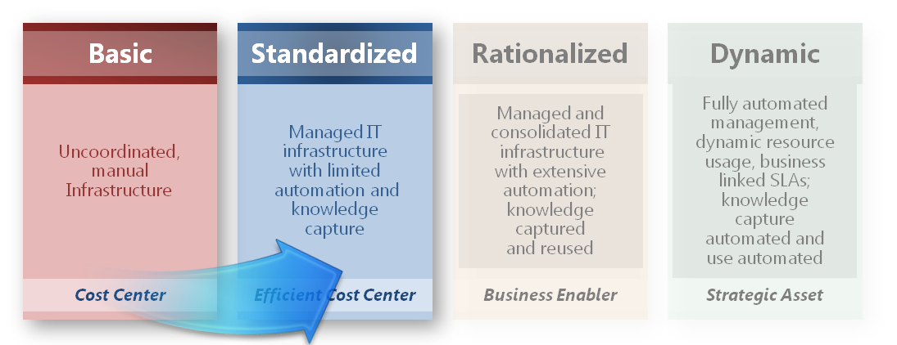









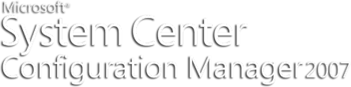
Virtualization
Server consolidation
Challenge
  Real Estate Costs
  Management overhead
  Lower server Utilization
  Power and Cooling Costs
  Impact on Environment
Solution
  Consolidated and Green Datacenter with Management
SQL
.NET
.NET
IIS
.NET
File & Print
Oracle
Hyper-V
VMM
Hyper-V
Hyper-V
Virtual Machine Manager
Virtual Machine Manager

Slide 28
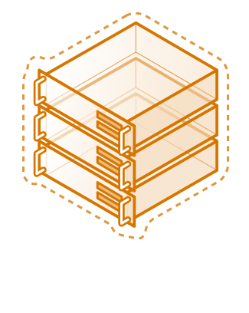
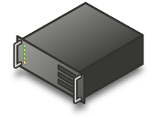
Virtualization
Server consolidation
Challenge
  Interoperability
  Virtualization Cost
  Management Complexity
Solution
  Consolidated and Green
  Datacenter with Management
  Coexistence with VMware
SQL
.NET
.NET
IIS
.NET
File & Print
Oracle
VM Ware
Hyper-V
VMM
Hyper-V
Hyper-V
Virtual Machine Manager
Virtual Machine Manager

Slide 29
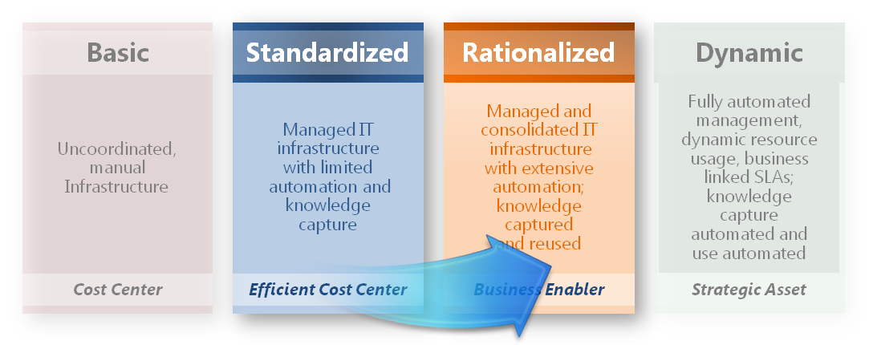
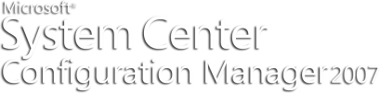

Virtualization
Business continuity
Challenge
  Impact of application/server outage
  Meeting Business SLAs
  Mission Critical Systems
Solution
  High Availability
  Cost effective and robust Business continuity
  Instant-On Failover Plan
X
Hyper-V
Virtual Machine Manager
Server B
Server A
Server C

Slide 30
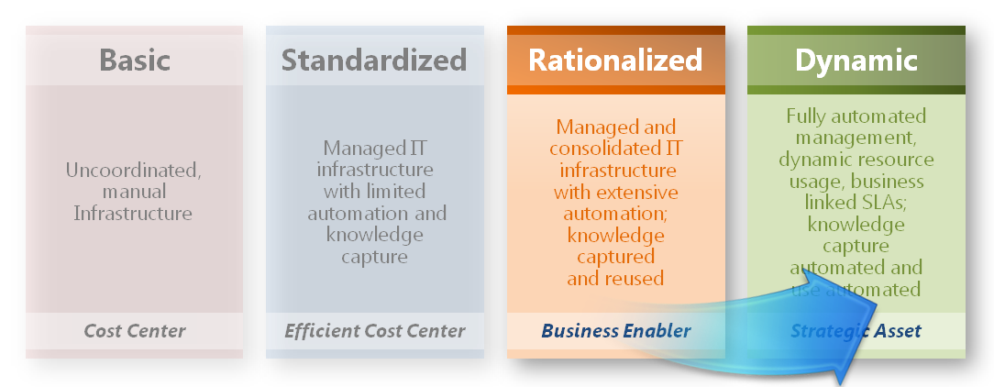





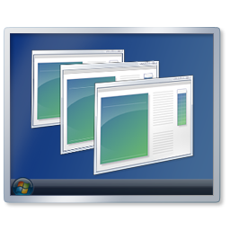

Microsoft Virtualization
Dynamic infrastrucutre
  Challenge
  Scale to peak demand
  Underutilized systems
  Solution
  Adaptive and
  Resilient Datacenter
Web Farm
Hyper-V
Virtual Machine Manager

Slide 31
How To Get Started
Identify Virtualization targets
Build business case

Slide 32


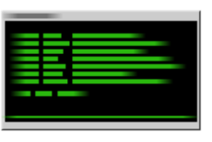

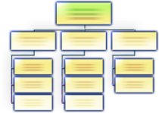

What Are Solution Accelerators?
  Offer automation tools and guidance
  Accelerate adoption of Microsoft technologies
  Cross-product approach
Scripts
and Code
Guidance
Models
Tools

Slide 33
Server+Virtualization Solution Accelerators
For every part of IT life-cycle
Assess Plan
Microsoft Assessment
and Planning (tool + guidance)
Infrastructure Planning
and Design Series (guidance)
Offline Virtual Machine Servicing Tool
(tool + guidance)
Operate
Secure
Microsoft Deployment
(tool + guidance)
Deploy
Windows Server 2008 Security Guide (guidance)

Slide 34
Microsoft Assessment and Planning
  Expanded version of WVHA
  Integrated portal with tools and guidance
  Agentless inventory of clients, servers, applications, devices and roles
  Technology migration and readiness assessments including desktop and server migration with virtualization
  Powerful pre-sales assessment tool for multiple products (proposals included)
Windows Server 2008
Other Products
Hyper-V Virtual Server 2005 R2
System Center VMM
MAP 3.1
Windows Vista
Terminal Services
2007 Microsoft Office
Microsoft Application Virtualization

Slide 35
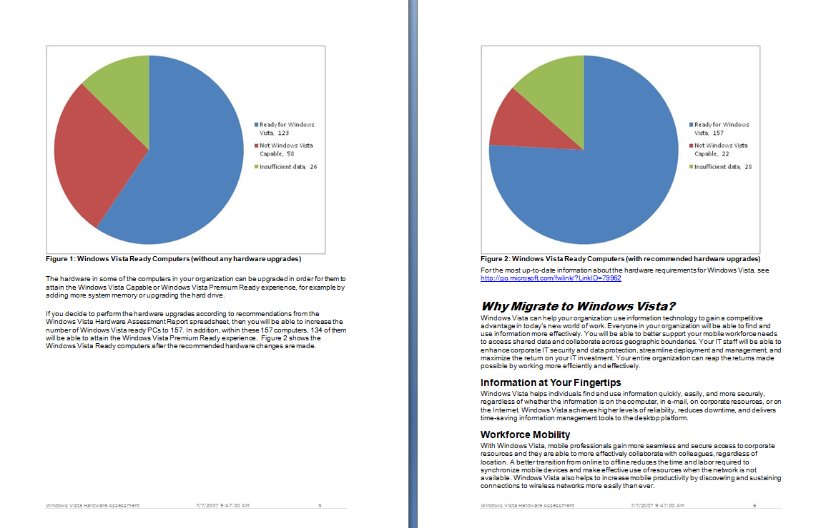
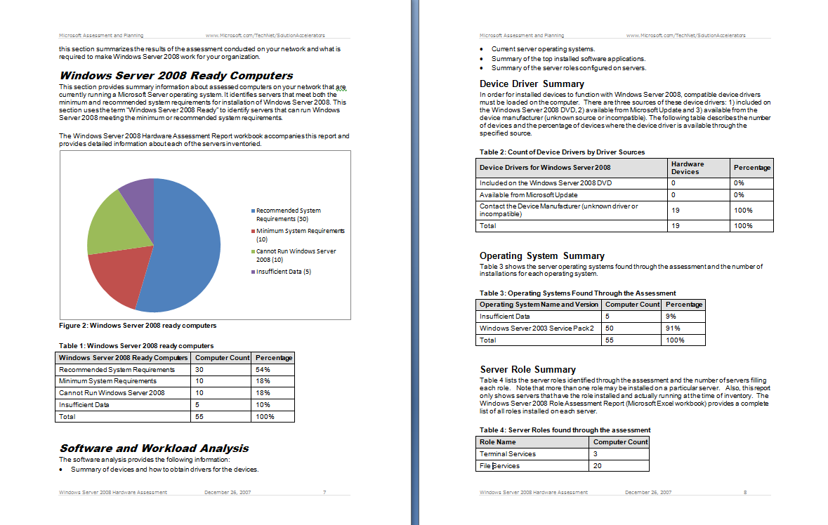
MAP – Proposals

Slide 36
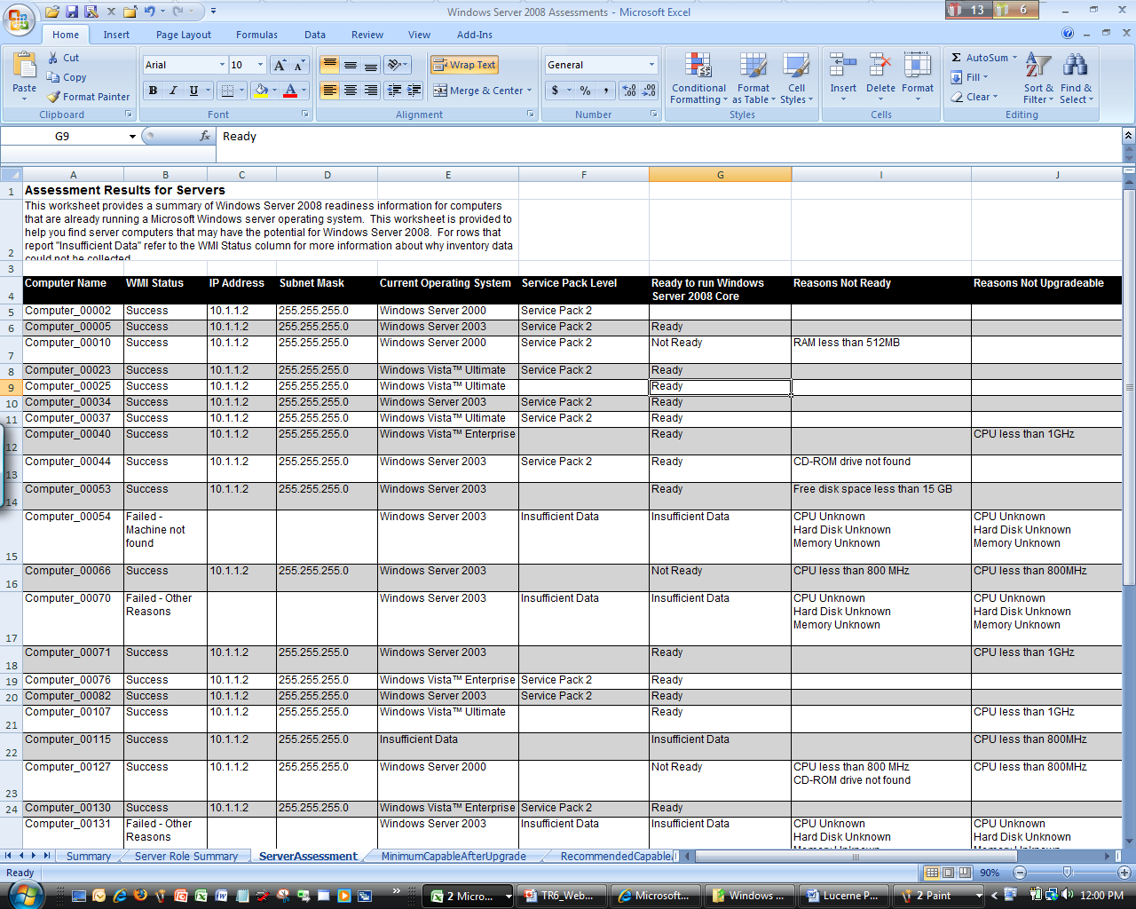
MAP – Detailed Assessments
PC-by-PC Level Detailed Reporting
Current OS Results
Hardware and Device Assessment Results
System resources
Experience after upgrades
Deployment blockers
Device compatibility

Slide 37
Virtualization Demo

Slide 38
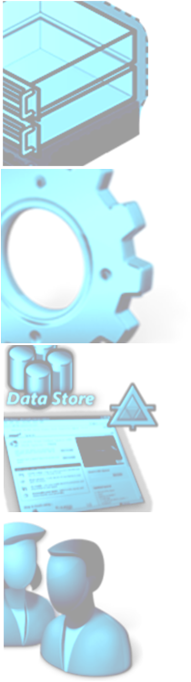
Dynamic IT And Infrastructure Optimization
Dynamic IT is
the destination
Basic
Standardized
Rationalized
Dynamic
Unified & Virtualized
Managed and
consolidated IT
infrastructure
with extensive
automation; knowledge captured
and reused
Fully automated
management,
dynamic resource
usage, business-
linked SLAs; knowledge capture and use
automated
Uncoordinated,
manual
infrastructure
Managed IT
infrastructure
with limited
automation and knowledge capture
Process-Led,
Model-Driven
Cost Center
Efficient Cost Center
Business Enabler
Strategic Asset
Service-Enabled
User-
Focused

Slide 39
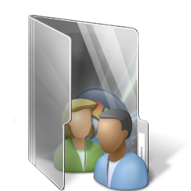
Action Plan
Assessment
Business case
Prove the capability
Notes:
To move forward with using virtualization to enable a dynamic datacenter, it’s important to ready your team. Your team should seek to understand virtualization solutions, and team members should see for themselves how Microsoft offers the lowest cost and the most integrated, interoperable management tools. Once you determine how a majority of virtualization solutions compare with your business needs, we’re confident that you’ll find Microsoft to be the best fit.
Your first tactical step should be performing a MAP analysis to determine the level of impact that virtualization could have on your organization. Next, use the ROI Tool to discern the cost of a virtualized implementation and when that implementation would pay for itself.

Slide 40
Virtualization Resources
Microsoft Virtualization
  http://www.microsoft.com/virtualization
System Center Virtual Machine Manager
  http://www.microsoft.com/scvmm
Hyper-V
  http://www.microsoft.com/windowsserver2008
Notes:
40
To get started with your investigation, we recommend these resources.

Slide 41

© 2008 Microsoft Corporation. All rights reserved. Microsoft, Windows, Windows Vista and other product names are or may be registered trademarks and/or trademarks in the U.S. and/or other countries.
The information herein is for informational purposes only and represents the current view of Microsoft Corporation as of the date of this presentation. Because Microsoft must respond to changing market conditions, it should not be interpreted to be a commitment on the part of Microsoft, and Microsoft cannot guarantee the accuracy of any information provided after the date of this presentation.
MICROSOFT MAKES NO WARRANTIES, EXPRESS, IMPLIED OR STATUTORY, AS TO THE INFORMATION IN THIS PRESENTATION.

