Slide 1
SQL Server 2008 Unplugged
Microsoft’s Data Platform
Vinod Kumar
Technology Evangelist – DB and BI
www.ExtremeExperts.com
http://blogs.sqlxml.org/vinodkumar

Slide 2
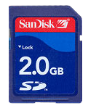
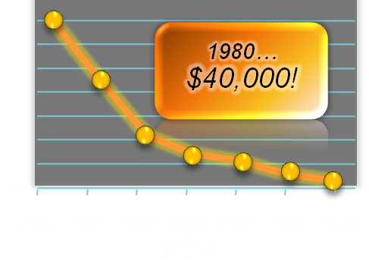
The Data Explosion
Game Changers
Data Types
Form Factors
Hard Drive Prices
IT & Regulatory Compliance
Storage Innovation

Slide 3
Trusted
Productive
Intelligent
Protect your information
Ensure business continuity
Predictable response
Manage by policies
Simplify Application Development
Store any information
Integrate data
Deliver relevant information
Drive actionable insights
Trusted. Productive. Intelligent

Slide 4
Protect your information
Secure business-critical data
Secure Access
Strong Authentication
Granular Authorization
Transparent Data Encryption
External Key Management
Protect system
Secure deployment
Secure by default
Simplify compliance
Enhanced Data Auditing
Enterprise Wide Security Policies

Slide 5
Predictable Response
Scale for any size business
Optimize Performance
Efficient Data Storage
Prescriptive Guidance
Analyze Performance
Data Collection
Performance Insights
Predict Performance
Plan Freezing
Resource Governor

Slide 6
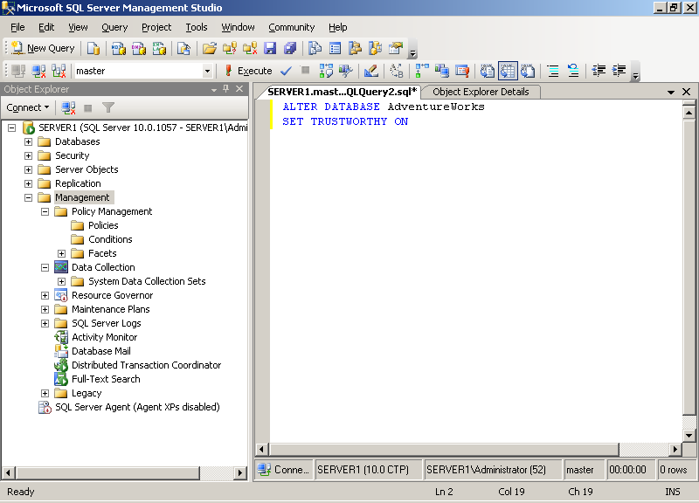
Reduce Management Cost
Spend less time on operations
Flexible Administration
Visual Management
Automate Operations
Manage centrally
Enterprise Policies
Monitor Compliance
Monitor Health
Management Reports
Performance Tuning Tools

Slide 7
Store your information
Information Lifecycle Management
Unstructured Information
File Storage
Search text
Extensible Types
Geospatial information
Spatial Standards
Visualize Location
Structured information
Model complex hierarchies
Sparsely populated data

Slide 8
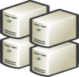
Integrate & Manage data
Next Generation Data Warehousing
Build Faster
Connect to data
Cleanse data
Integrate data
Manage Efficiently
Efficient Data Storage
Manage mixed workloads
Streamline Aggregates
Scalable Performance
DW Query Optimizations
Enhanced Partitioning

Slide 9
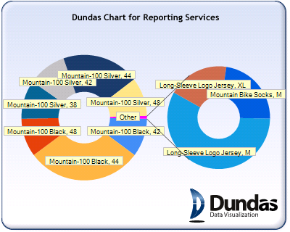
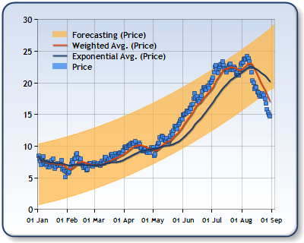
Deliver Relevant Reports
Enterprise Reporting Platform
Author reports
Enhanced Designers
Flexible Layout
Manage reports
Enterprise Platform
Server-based Deployment
Deliver reports
Rich Visualizations
Render in Office
Share reports

Slide 10
Demo, Demo …
Vinod Kumar

Slide 11
Summary
Realm of databases are changing
Data Explosion, Increasing functionality and shrinking maintenance window is a challenge
SQL Server 2008 is an ocean
Know how to swim through various features
When to use one over other
Keep exploring
Businesses drives usage of features

Slide 12
Thank You

Slide 13
Resources
Virtual Labs:
http://www.microsoft.com/sqlserver/2008/en/us/virtual-labs.aspx
http://msdn.microsoft.com/en-us/virtuallabs/default.aspx
SQL 2005 Labs: http://technet.microsoft.com/en-us/bb499681.aspx (30 labs)
e-Book of SQL 2008: http://www.microsoft.com/sql/experience/LearnSQL.aspx?h=t&loc=en
Certifications and Learning: http://www.microsoft.com/learning/
Express Edition: http://www.microsoft.com/sqlserver/2008/en/us/express.aspx
SQL Server 2008 Web Edition: http://www.microsoft.com/sqlserver/2008/en/us/web.aspx

