Slide 1



Keynote:
Microsoft Software + Services
Pandurang Nayak Harish Ranganathan
Client Platform Evangelist Web Platform Evangelist
Microsoft Corporation India Microsoft Corporation India

Slide 2
Software + Services Platform
Notes:
This is a turning point for Microsoft as for the first time we're able to talk end-to-end about what we've been working on for the past couple of years. It's the transformation of our software, it's the transformation of our strategy and our offerings across the board to fundamentally embrace services.
Today, we're in the early days of a transformation towards services across the industry, a change that's being catalyzed by a confluence of factors, by cheap computing and cheap storage, by the increasing ubiquity of high bandwidth connectivity to the Internet, by an explosion in PC innovation from the high-end desktop to the low-end netbook, by an explosion in device innovation, Media Players, Smart Phones, net-connected devices of all shapes and sizes.
The notion of utility computing was pioneered in the '60s. Virtualization was also pioneered in that same era by IBM and its VM370 took virtualization very, very broadly into the enterprise datacenter. Today, that same virtualization technology is making a strong comeback, driven by our trend toward consolidation of our PC-based servers. With racks of machines now hosting any number of Virtual Servers, computing is looking more and more like an economical shared utility, serving our enterprise users, apps and solutions.

Slide 3





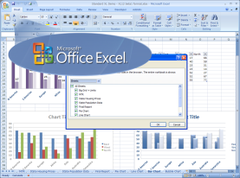
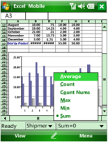

Platform Evolution
Hosted software platform
Shared infrastructure
Virtualized and dynamic
Increasingly higher level services
Pay as you go pricing model
Client
Server
Mobile
Cloud

Slide 4
Why a Cloud Platform?
Changing the Economics of Software
Reduce capital & operations costs
Simplify application deployment & management
Application & infrastructure flexibility
Simplify scaling to internet scale
Cost effectively handle peak loads
Focus on new functionality & not infrastructure

Slide 5







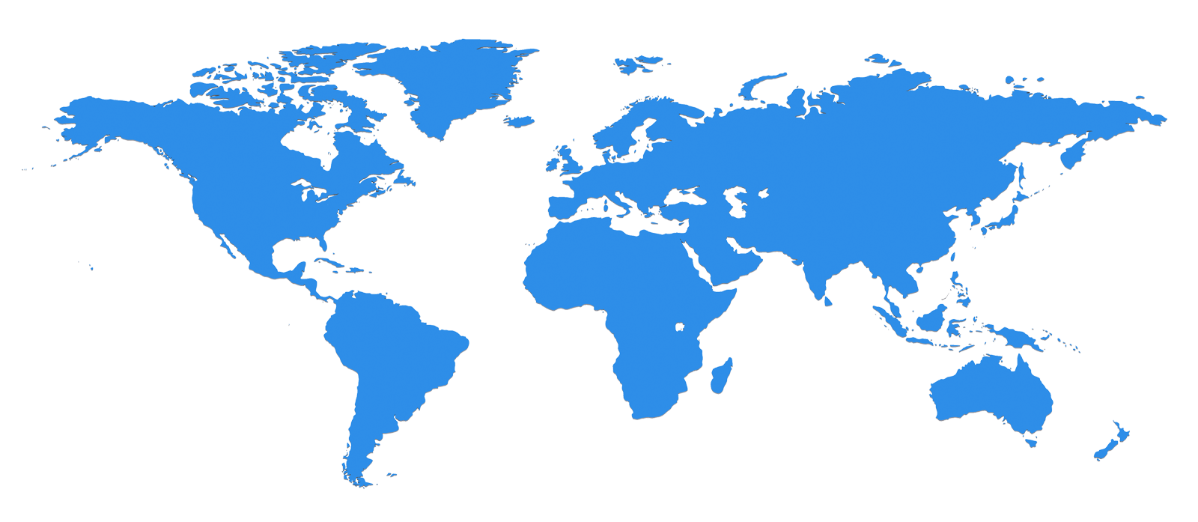












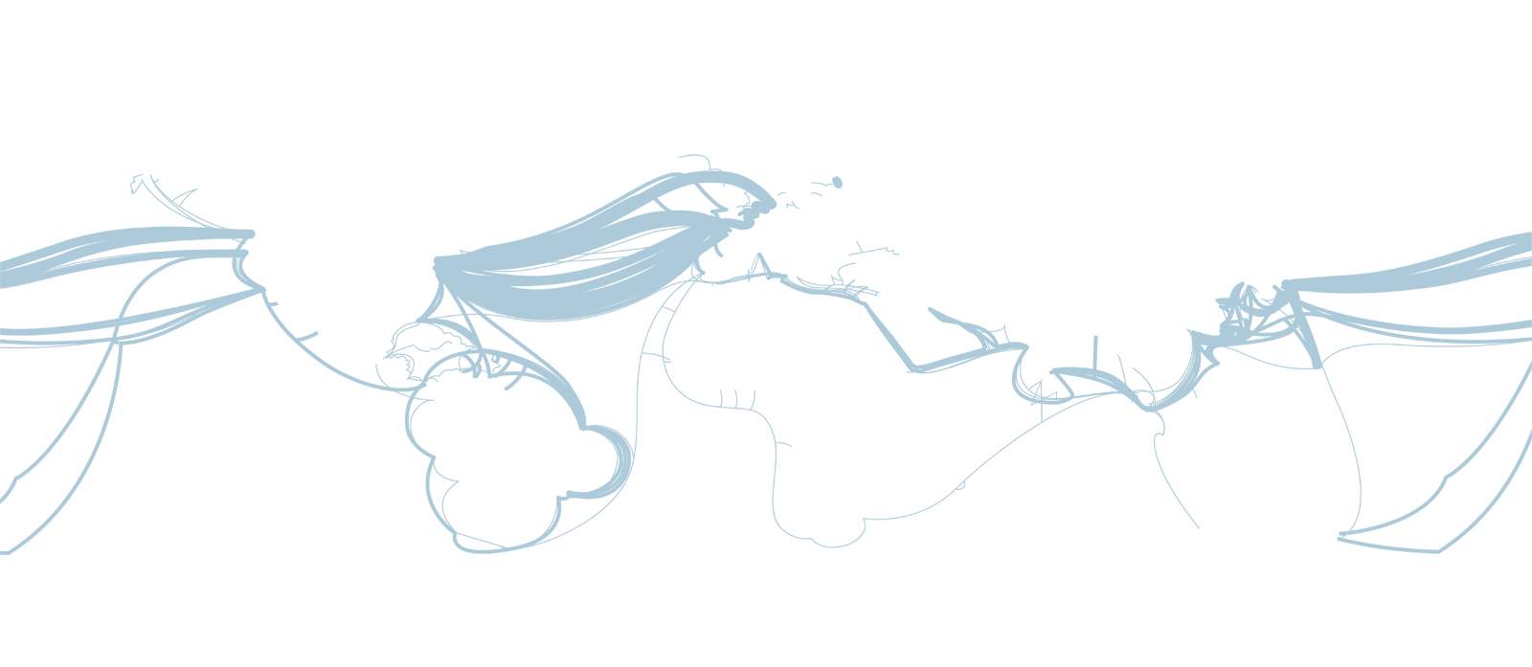
Notes:
But today, even in the best of our virtualized enterprise datacenters, most of our enterprise computing architectures have been designed for the purpose of serving and delivering inwardly facing solutions. That is, most of our systems and networks have been specifically built to target solutions for our employees, in some cases for our partners, hundreds or thousands or perhaps tens of thousands of concurrent users; desktops, datacenters, and the networks between them all scoped out, audited, controllable and controlled by an IT organization skilled in managing the enterprise as the scope of deployment.
Companies are coming to realize that regardless of their industry, the Web has become a key demand generation mechanism, the first place customers look, every organization's front door. Now more than ever, the richness, reach and effectiveness of all aspects of a company's Web presence has become critical to the overall health of the business. And company's IT systems now have to deal with far more outside users, their customers, than the users that they serve within their own four walls.
All in all over the years we've accumulated lots and lots of high scale services' expertise, but all that knowledge, technology and skill, tremendous and expensive as that asset is, wasn't packaged in a form that could be leveraged by outside developers or in a form that could benefit our enterprise customers. It certainly wasn't packaged in a form that might be helpful to you.

Slide 6
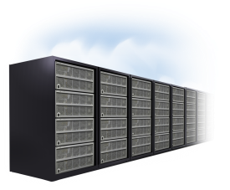
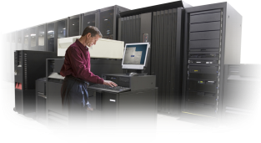


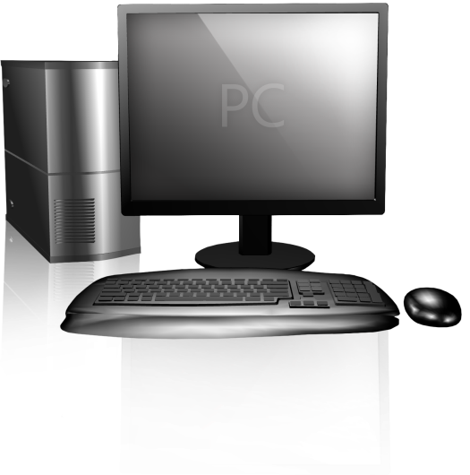

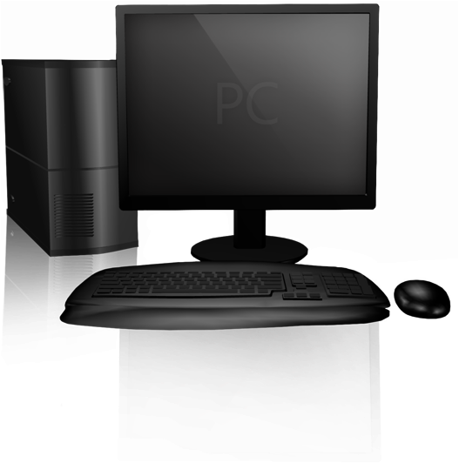


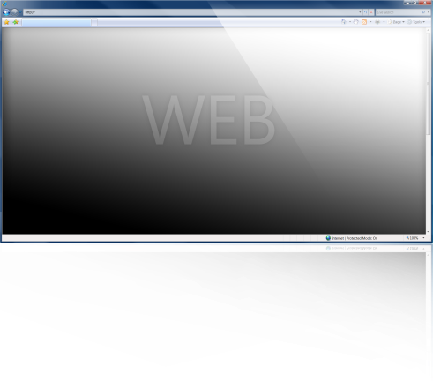
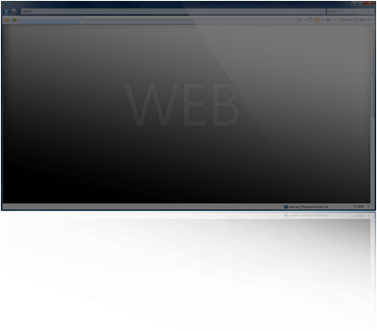
Notes:
The first tier, of course, is our experience tier, the PC on your desk or the phone in your pocket. The scale of this first tier of computing is one, and it's all about you.
The second tier is the enterprise tier, the back-end systems hosting our business infrastructure and our business solutions, and the scale of this tier is roughly the size of the enterprise, and to serve this tier is really the design center of today's server architectures and systems management architectures and most major enterprise datacenters.
The third tier is this Web tier, externally facing systems serving your customers, your prospects, potentially everyone in the world. The scale of this third tier is the size of the Web, and this tier requires computation, storage, networking, and a broad set of high level services designed explicitly for scale with what appears to be infinite capacity, available on-demand, anywhere across the globe.
High-scale internet services infrastructure are a new tier in computing architecture

Slide 7










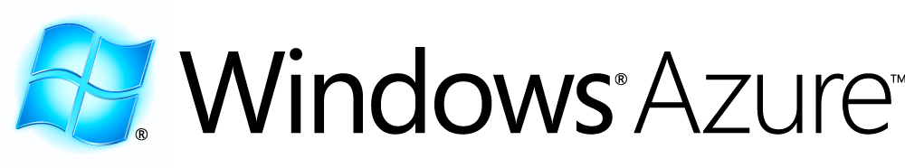
Azure™ Services Platform
Notes:
Windows Azure is a new Windows offering at the Web tier of computing. This represents a significant extension to our family of Windows computing platforms from Windows Vista and Windows Mobile at the experience tier, Windows Server at the enterprise tier, and now Windows Azure being our Web tier offering, what you might think of as Windows in the cloud.
Windows Azure is our lowest level foundation for building and deploying a high scale service, providing core capabilities such as virtualized computation, scalable storage in the form of blogs, tables and streams, and perhaps most importantly an automated service management system, a fabric controller that handles provisioning, geo-distribution, and the entire lifecycle of a cloud-based service.
You can think of Windows Azure as a new service-based operating environment specifically targeted for this new cloud design point, striking the best possible balance between two seemingly opposing goals. We're betting on Azure ourselves, and as the system scales out, we'll be bringing more and more of our own key apps and key services onto Windows Azure because it will be our highest scale, highest availability, most economical, and most environmentally sensitive way of hosting services in the cloud.
Microsoft also provides higher-level developer services including Live Services, Microsoft .NET Services and Microsoft SQL Services. These services, when taken together with Windows Azure itself, constitute a much larger Azure Services Platform. The higher level developer services, which you can mix and match ala carte, provide functions that as Windows developers you'll find quite valuable and familiar and useful. As you are well aware, Dynamics CRM and SharePoint are two of our most capable and most extensible platforms for business content, collaboration, and rapid solutions. And later this morning, you'll hear about how these two platforms also fill a very important role in the overall Azure Services Platform.

Slide 8


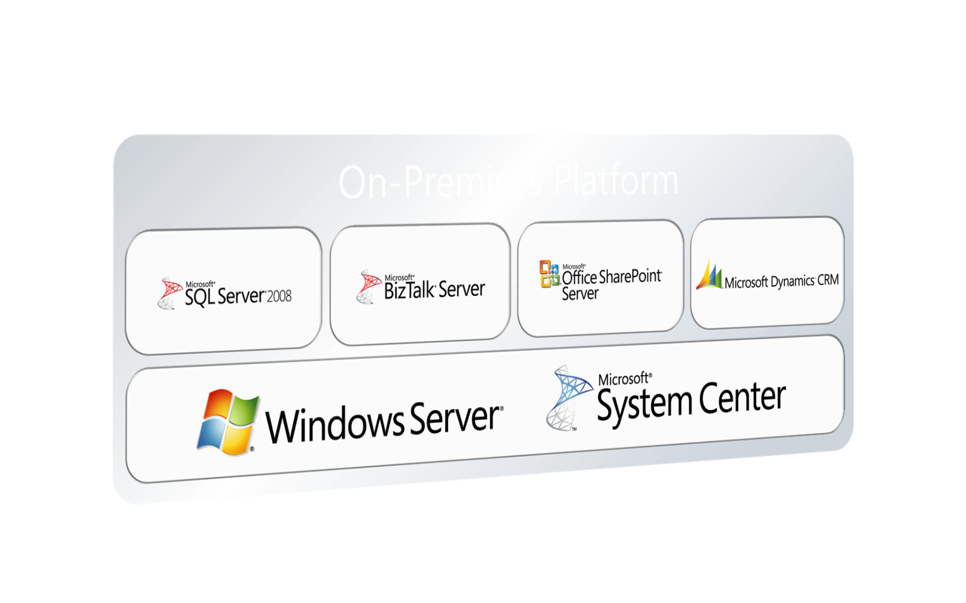
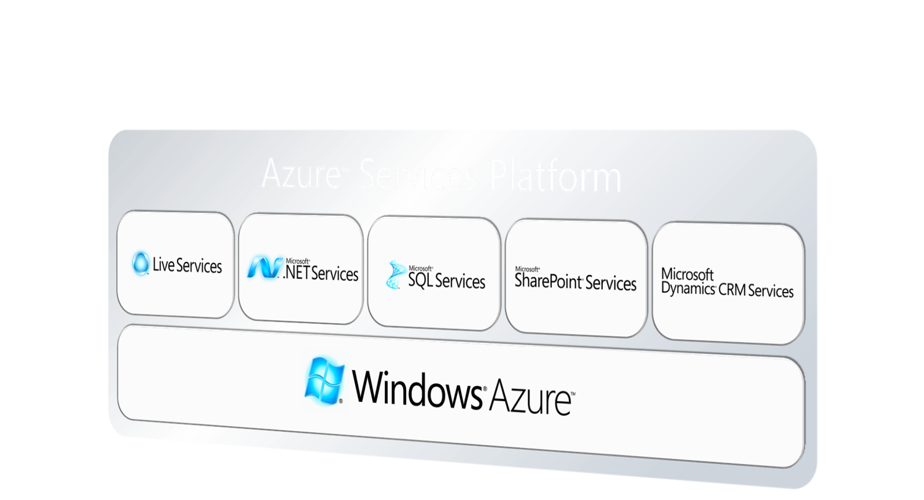

On-Premises
Cloud Services
Visual Studio & .NET
“Oslo” - Modeling
Partners
Notes:
Where we see this going is a world where customers certainly continue to have on-premises systems. They begin to figure out ways to take advantage of the services platform and build services that exist inside the cloud. One of our goals is to create symmetry across these two things so that the knowledge, the skills that you've built, and even in many cases the code you've built can be transferred up into the cloud environment.
The Azure Services Platform is a new generation of platform, but the skill sets that you've learned today are highly leverageable. Over time, we see the development in the things we're learning from Windows Azure in the services platform moving back on-premises. We want to do this in a way that is very partner friendly. We're focused on working, as we always have, with partners in the industry. So what we will be doing over time is taking the developments that we have with Windows Azure and the services platform and incorporating those capabilities into Windows Server, into SQL Server, into System Center that can be run by companies both on-premises and by hosters within their environment, providing their own platform environment.
The Azure Services Platform builds on your knowledge and it builds on the applications that you have today. But it also opens up all sorts of new possibilities, and it's a possibility for us to take advantage of new things. One of the things that we're introducing is our next-generation modeling platform.
We've been talking about modeling for some time, for quite some time. We have a project we code-named Oslo, and this week, we’ve released developer kits associated with this modeling platform that enables a consistency between the IT process and the developer process. This is something we've been talking about in the form of Dynamic IT for a long time. Oslo is going to have some very important ramifications on the way code is written in the long term. It actually incorporates a new language called M that allow models to be defined as well a domain-specific languages to be defined.

Slide 9
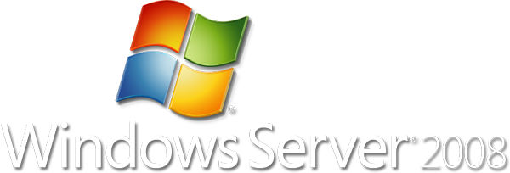
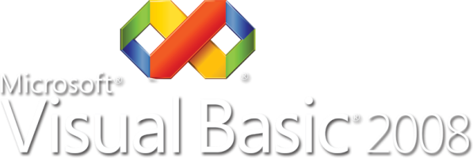
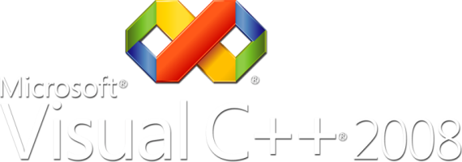
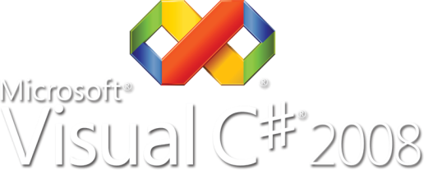
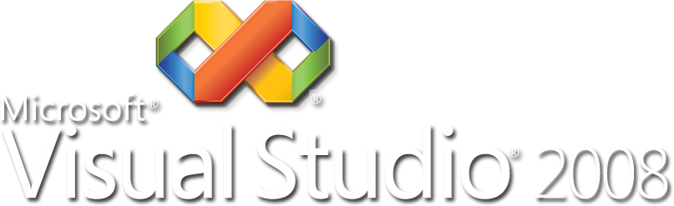

Windows Azure Skill Transfer
Notes:
Windows Azure leverages Microsoft's current tools to ensure your skills transfer to the cloud. You get Visual Studio, ASP.NET, and all the .NET programming languages. Windows Azure works both with managed and native code. Deep Visual Studio integration makes development a familiar and a fantastic experience.

Slide 10
Windows Azure
demo

Slide 11
The Front End Experience

Slide 12
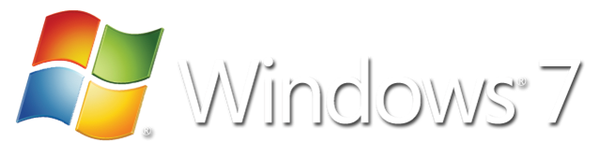



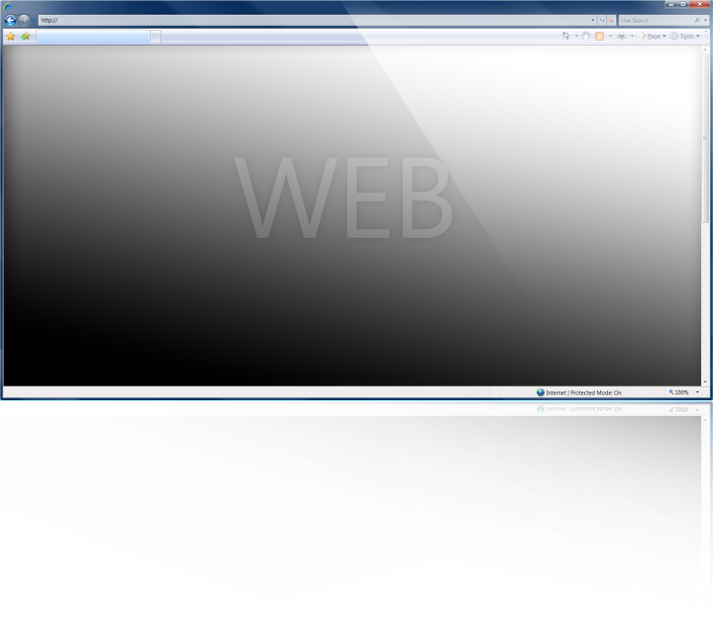
Notes:
With Windows 7, we want everybody to think along three lines. Windows 7 brings you a personalized experience where you're in control of your PC. Windows 7 helps you connect whether it's devices or storage or all the information so you can find and organize the information across your PC, and lastly, Windows 7 brings together all the functionality of devices.

Slide 13
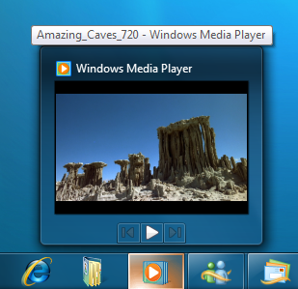
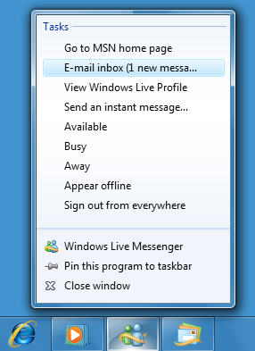
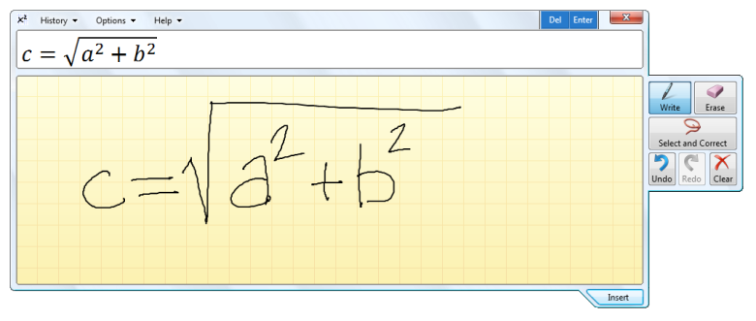
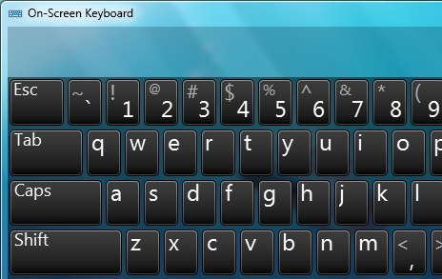
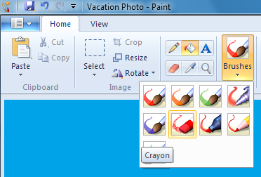
Develop For Windows 7
Develop & Test with Vista
Ribbon User Interface
Jump Lists
Libraries
Multi-touch, Ink, Speech
DirectX® family
Notes:
For developers, there are a lot of things in Windows 7 for you.
The first is the ribbon user interface. And so that's an opportunity for you to modernize your client user interface, to use a data-driven UI paradigm, and to make it simple to bring that interface to all of your customers. So we've used interface, we've used in WordPad and in Paint, you'll see it show up in Movie Maker, in Windows Live, and we're going to start to move that across a broad set of applications.
Two other features that are really important are jump lists and libraries. Jump lists are the little menus down at the start menu on the task bar that show up when you right click on the start menu, and libraries are the way to bring together search and storage locations and multiple computers. The idea of both of these is to integrate deeply with the Windows desktop experience. These are opportunities for you and your software to really work seamlessly through and across and with Windows. It's an opportunity for you to differentiate your software, and an opportunity for you to participate in the personalization, the choice, and the control that Windows 7 promises end users. So you'll see this in Messenger and in mail -- Windows Live Messenger, Windows Live Mail, and all the applications across Microsoft will soon contribute to really bringing forward jump lists and libraries. Also libraries update the common dialogue and that makes it easy for you to access the libraries and use them when you use the common dialogue.
Multi-touch is a fantastic example of a way that unique hardware can also manifest amazing experiences for customers. Whether you're designing software that might be used in a directory that would be in front of a building or in a mall or a really, really small screen that might serve as the basis for a moderate home automation system.
Finally, the Direct X family of APIs. Direct X really brings the amazing power of graphics hardware today and puts an incredibly powerful API around it that allows you to really tap the incredible potential of graphics on a modern PC. We're all familiar with Direct X for games, and that's certainly the heritage. With Windows 7, we've extended Direct X to 2D, to animation, and also to very, very high-performance and extremely fine-looking text.

Slide 14
Windows 7
demo

Slide 15



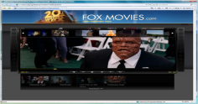
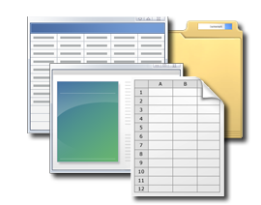
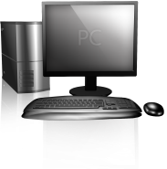
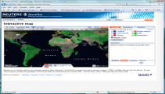


Live Services
User-centric services that provide programmatic access to a user’s data and Windows Live
Users
Devices
Applications
Data Sync
Identity
Directory
Storage
Comms & Presence
Search & Geospatial
Live Framework
Programming Model
Live Operating Environment

Slide 16



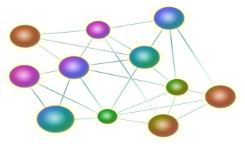




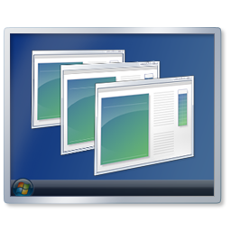

What Can You Do?
Access user data
Access information
on user devices
Share user’s data
Access user’s
social graph
Access
user’s profile
Sync user’s data
Provide news
on actions
Manage
applications
Provide access control to user’s data

Slide 17
Live Mesh
demo

Slide 18

2006 Microsoft Corporation. All rights reserved. Microsoft, Windows, Windows Vista and other product names are or may be registered trademarks and/or trademarks in the U.S. and/or other countries. The information herein is for informational purposes only and represents the current view of Microsoft Corporation as of the date of this presentation. Because Microsoft must respond to changing market conditions, it should not be interpreted to be a commitment on the part of Microsoft, and Microsoft cannot guarantee the accuracy of any information provided after the date of this presentation. MICROSOFT MAKES NO WARRANTIES, EXPRESS, IMPLIED OR STATUTORY, AS TO THE INFORMATION IN THIS PRESENTATION.
Notes:
As we move forward into the services era, we’ll continue to deepen our investments in extending our platform to the cloud to enable a world of applications that span from local software to services on the Web, as well as client experiences that transcend any single device. The breadth of technology that Microsoft offers developers is unparalleled in the industry, an industry which is increasingly embracing the shift toward software + services. This shift enables developers to take advantage of combining client and server-based scenarios in which software runs locally with service-based scenarios that fully exploit the reach and scale of the Web.

