Slide 1
Architecting MOSS based Internet Facing Websites
Prashanth Govindaiah
Senior Technical Architect
Infosys Technologies Limited
Presented by:
Sachin Prakash Sancheti
Technical Architect
Infosys Technologies Limited
Hosted by:
Nahas Mohammed
Technology Advisor
Microsoft Corporation

Slide 2
Our Speakers
Prashanth Govindaiah, is a Senior Technical Architect with Microsoft Technology Center (MTC) in Infosys and has an experience of over 10.5 years in the software industry. He has been working on .NET for the past 6 years and has been providing consulting to Microsoft technology based projects especially focusing on .NET platform.
He has also have authored a book on VSTS and co-authored a book on SharePoint (101 reasons to move to SharePoint Technologies) links to both of which are available on http://www.Infosys.com site
Sachin Prakash Sancheti, is a Technical Architect, with Microsoft Technology Centre (MTC) in Infosys , Pune and has 9 years of experience in the software industry. His Areas of Expertise include MOSS based Portals and Solutions, Office Business Applications, Messaging and Outlook based Solutions.
He is involved in consulting to large Microsoft Technology based projects especially focused on MOSS and OBA.

Slide 3
About Infosys Microsoft technology center We possess tools, assets, architecture and access to Microsoft that we bring to our clients to develop solutions on the Microsoft Platform
Infosys Microsoft Technology Center (MTC) – our dedicated Center Of Excellence for Microsoft technologies
Microsoft Product Competency Center to build competency on latest Microsoft products & build thought leadership
Solution development using Microsoft technologies
Consulting on the latest bleeding edge technologies
Key focus of MTC
Awareness & Understanding
Experience
IP & Solution creation
Institutionalization
Over 140 professionals dedicated to research on Microsoft Technologies.
Technology watch on Microsoft related products.
Working extensively with customers on Microsoft platform.
Proof Of Concept with customers on Microsoft products.
Creating horizontal solutions on Microsoft platform - Collaboration, Business Intelligence, Mainframe Migration.
Creation of point solutions
Development of Frameworks, Reusable components and best practices for development and deployment on Microsoft technologies.
Outputs of MTC
Product Competency Centre (PCC)
Solutions
MTC Consulting
Software Factory + Speed
.NET 3.0/VSTS
UI / UX Tech
MOSS
SQL Server
Cloud Computing
Collaboration
Active Desk
Legacy Modernization
Technology Direction
Presales & Proposal support
Engagement Consultancy
Critical Project Support

Slide 4
Agenda
Enterprise Content Management - Overview
Web Content Management Drill Down
Architecture of Publishing Site
Requirement Buckets
Foundation of Architecture
Architecture and Design Decisions
Case Study
Development
Deployment
Search Engine Optimization Tips
Tips & Best Practices

Slide 5
Enterprise Content Management
Enterprise Content Management (ECM)
ECM refers to the creation, management, personalization, and distribution of an enterprise content, including documents, recorded discussions, e-mail, Web pages, rich media, or multimedia in support of business process.
ECM enables organizations to effectively create, manage and distribute content to stakeholders (Customers, Employee ) across and outside the enterprise irrespective of location and language.
Content Management Includes
Document Management
Records Management
Forms Solutions
Digital Asset Management
Web Content Management (WCM)

Slide 6
What Drives the Need for ECM?
Reusing information is difficult
Inability to protect sensitive information
Efficiency in collaborative authoring
Risk of non-compliance with regulations
Risk from improperly retaining content
Retaining records for business continuity
Content
Chaos
Regulatory Climate
ECM
Process Efficiencies
Multiple Publishing Channels
Automation of high volume processes
Integration of content and processes
Webmasters are a content bottleneck
Multiple site types increase mgmt. costs
Brand assets are improperly used

Slide 7
Web Content Management Drill Down
Web Content Management: The ABC
Authoring
Web-based authoring experience
Word / InfoPath authoring experience
Branding
Enforcing consistent Look & Feel
Controlled Publishing
Enforcing rules & policies
Controlling the entire publishing process through workflow
Content Deployment
Content Life Cycle
Authoring
Approval
Publishing
Archival

Slide 8
WCM Drill Down
Terminologies
Publishing Site
Site Template, Publishing Feature (Collection of features)
Includes master pages, page layouts, site definition and other cool things
Site Content Type
Logical grouping for a set of informational fields, workflow, template, information policy etc. that serve a common and specific purpose
Page Layout
Template for content pages
Field Control
Added to page layouts to manage content

Slide 9
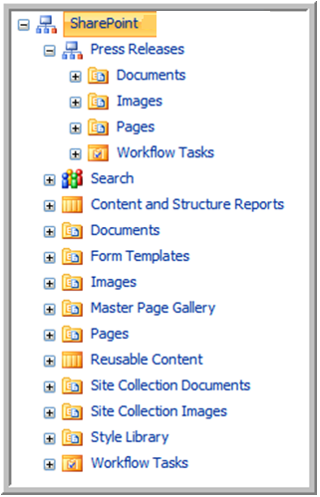
Architecture of a Publishing Site
mycompany
(pages library)
Site Collection
Mydivision
(pages library)
Services
(pages library)
About Us (pages library)
Sites
Pages library
Each site can have unique permissions
Each site has content galleries
Documents, Images & Pages
Root site has special galleries
Master Page Gallery
Reports
Reusable Content
Site Collection Documents & Images
Sites can support multilingual publishing

Slide 10
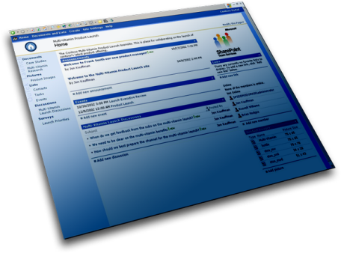
Multilingual Site Publishing
“I need this available in French and Spanish also”
English
…/eng-us/proposals/
After English Workflow Approval
French
…/fr/proposals/
Copied to French site in an unpublished state
Translation Workflow
Spanish
…/sp/proposals/
Copied to Spanish site in an unpublished state
Translation Workflow

Slide 11
WCM - Other Aspect
E-Commerce Sites
No direct integration with MOSS
Pages deployment
/_Layouts/ Folder
Detached Pages in Pages Library
Custom Development
Custom database
Custom web parts

Slide 12
Requirement Buckets
Content Management
Search
Portal
Workflow for authoring and publishing
Multi lingual Sites
E-Commerce Sites

Slide 13
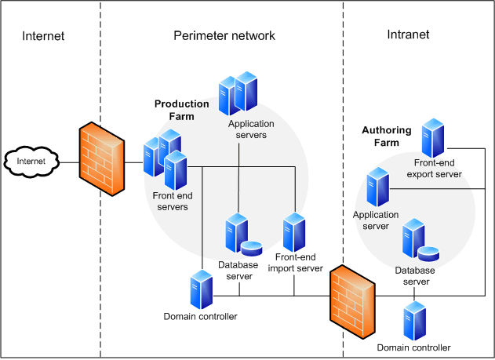
Foundation of Architecture
Plan Environment
Deployment Topology
Authoring and Publishing Topology
Integration Points

Slide 14
Foundation of Architecture
Plan Taxonomy
Information Architecture & Taxonomy
How are contents arranged ?
How do contents roll up?
How repurposing happens?
Plan Security
Security Groups
How are users going to access the Site?
What are the Roles & Rights for content management

Slide 15
Foundation of Architecture
Plan Search
Search Requirements
What should be searchable?
Scopes
Managed Properties
Best Bets
Authoritative Pages
Define Meta data
How contents are related?
Search - Meta data helps to “roll call” contents

Slide 16
Architecture and Design Decisions
Select Site Template
Site Templates - Site Collection and Sub Sites
Best fit is Publishing Portal Templates
Custom Templates may also be opted for
Plan authentication
Authentication Mechanism
Windows
Forms
Anonymous users
Plan Site Structure
Site Structure
Site Navigation

Slide 17
Architecture and Design Decisions
Plan Content Structure
Content Types
Content types (Page, Document and List)
Use Content Type Hierarchy
Workflow or Information Policy to be applied to Content Type
Templates
Site Columns
Plan Content Workflows
Workflows
Out of the Box / Custom
Prefer attaching it to the content types

Slide 18
Architecture and Design Decisions
Page Structure Explained
Master Page
Content Placeholders
Header, Navigation, Footer, other common elements
Content Page/Page Layout
Field Controls/Content Type Fields
Edit Panel
Web Part Zone
Web Part Zone
Web Part
Web Part
Web Part

Slide 19
Architecture and Design Decisions
Plan Content Creation and Presentation
Pages & Page Layouts
Content Page
Landing Page
Roll up Page
Custom/Detached Pages
Web Parts
Out of the Box and Customization
Custom Web Part

Slide 20
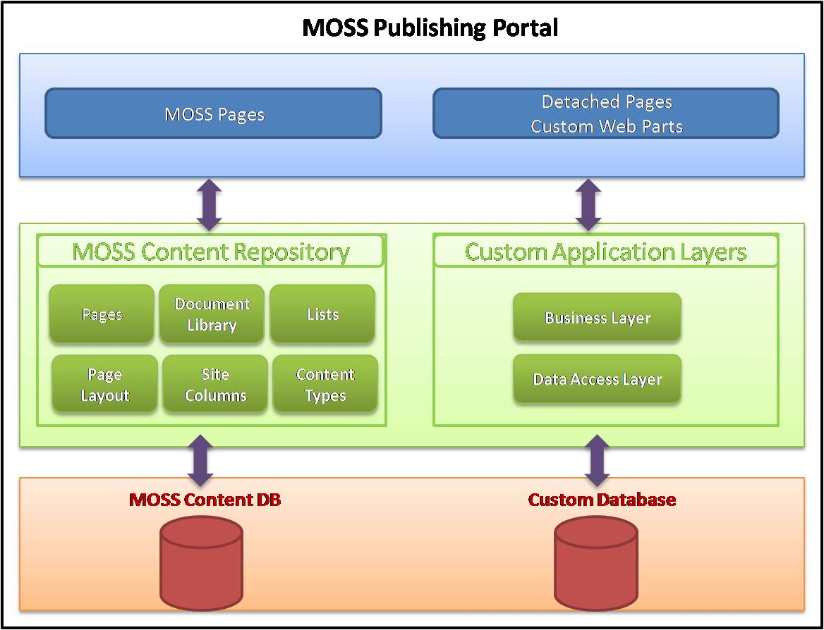
Architecture and Design Decisions
Plan External Data Integration

Slide 21
Building Architecture
Plan External Integration
Plan Workflows
Plan Content Creation
Plan Content Presentation
Plan Content Structure
Plan Page Blocks
Select Site Template
Plan Site Structure
Plan Authentication
Plan Environment
Plan Taxonomy
Plan Security
Plan Search

Slide 22
Case Study
Problem Statement
The Company, udanairways.com, is a large and one of the fastest growing airline company servicing multiple geographies and continents. The company treats customers as their own guests and wants to excel in all aspects from big things like flights to small things like what movies they watch. Content on the Site and online Ticket booking is one of key elements of their success as they derive close to 25% of their revenue through online booking. There is a constant content refresh that happens in the site across the 12 languages it supports and they needed a robust WCM Solution which can integrate well with the ticketing/transaction system as well.
Challenges faced:
Information base and churn is overwhelming to manage Highly dynamic project teams – composition, skill base, work locations
Disclaimer : This company name and problem statement is a work of fiction. Any resemblance to any company with the same name is unintentional and purely coincidental. ☺

Slide 23
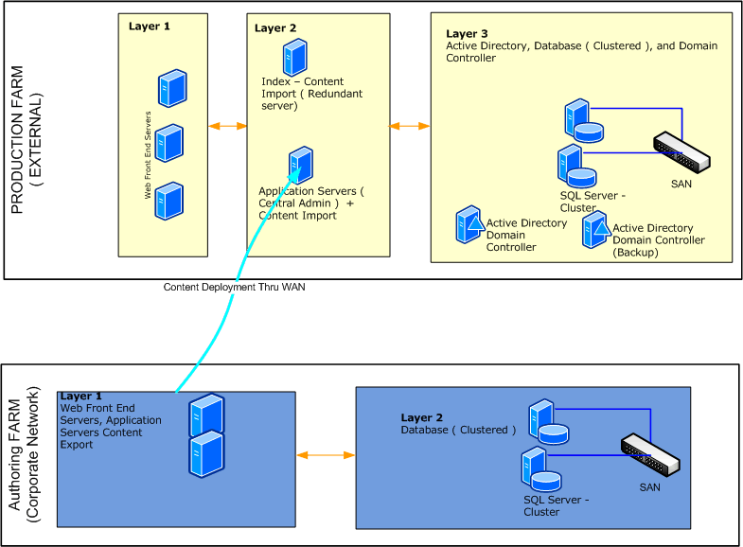
Case Study
Deployment Architecture

Slide 24
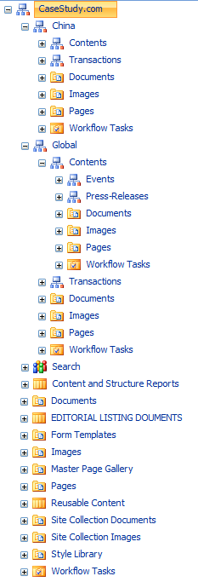
Case Study
Udanairways.com
Site Structure
www.UdanAirways.com
Global
Contents
Press-Releases
Events
Transactions
China
Contents
Transactions
France
Contents
Transactions
…….
Master Pages
Master pages Home Site and sub sites
Custom bread crumb Control

Slide 25
Case Study
Site Content Types
Content Title | Inherited From
CASESTUDY_ROOT_PAGE_CONTENT | Page
CASESTUDY_PRESS_RELEASE_PAGE_CONTENT | CASESTUDY_ROOT_PAGE_CONTENT
CASESTUDY_EVENT_PAGE_CONTENT | CASESTUDY_ROOT_PAGE_CONTENT
CASESTUDY_DOCUMENT | Document
CASESTUDY_LIST_ITEM | Item
CASESTUDY_EDITORIAL_ITEM | Item

Slide 26
Case Study
Page Layouts
Main Home
Sub Site Home
Single Column HTML
Single Column HTML Zone
Press Release Page Layout
Event Page Layout

Slide 27
Case Study
Lists
Editorially Controlled Contents
Configurations
Reusable Contents
Contact Addresses
About information
Custom Field Controls
Header Meta Tags
Description, Author and Keywords
Reference Link Control
Customize HTML Editor

Slide 28
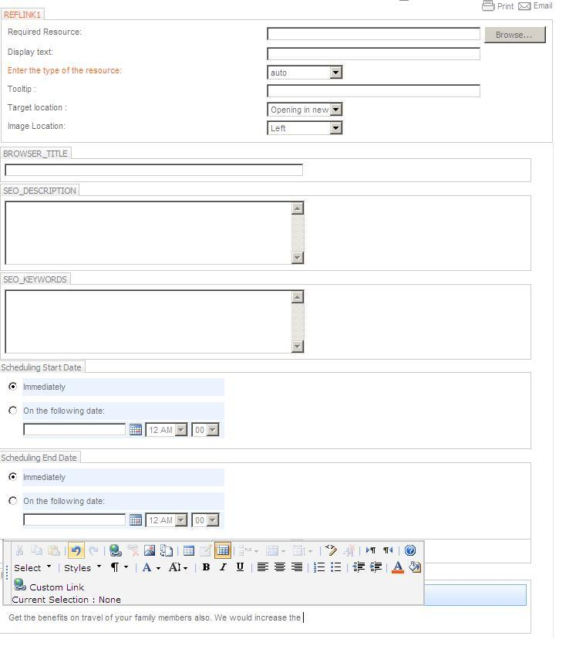
Case Study
Sample Page Layout
Within Edit Panel

Slide 29
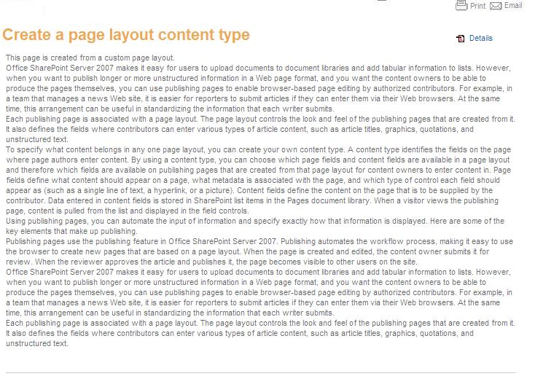
Case Study
Sample Page from Page Layout

Slide 30
Case Study
Web Parts
Content Query Web Part : This is being used as a Swiss knife
Custom Web Parts
Contextual Contents : This web part is present on almost every page. It shows information as per the current URL and is controlled from a list
Custom Database Transactions : Mostly dealing with custom database, feedback , service requests etc.

Slide 31
Development
Assembly based Components
Web Parts
Event Handlers
Workflows
Custom .NET components
Non Assembly Components (Artifacts)
Master Pages
Page Layouts
CSS Styles
Features & Solution Package (WSP)
Logically group Solution Packages

Slide 32
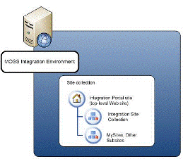
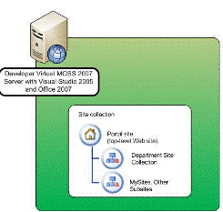
Development
Development and Integration Environment Synchronization
Integration Server
Features/WSP Deployment. Batch files
Content Deployment Jobs
Development Servers

Slide 33
Deployment
Setup environment strictly follow msdn guidelines of least privileged account
Farm Configurations
Diagnostic Logging, SSP, Search , Other Services if any
Web Application Deployment
Utility, Custom Features, Export/Import
Extend Web Application
Crawling
Anonymous Access
Alternate Access Mapping
Lock down feature
This system library was created by the Publishing feature to store pages that are created in this site

Slide 34
Deployment
Code Deployment
Features
Solution Package Deployment
Content Deployment - Authoring to Publishing
Content Deployment Path
Export/Import
WAN - Custom Utility using Content Migration (PRIME) API
PRIME APIs are Content Deployment APIs (SPImport, SPExport objects)

Slide 35
Search Engine Optimization Tips
What is SEO
Search engine optimization is the process of optimizing sites and pages for search engines to result in better relevance and ranking for the site
SEO Considerations
SiteMap.xml : Needs to be generated and submitted to the search engines. Custom utility or feature to generate it
Refer http://www.sitemaps.org/
Welcome Page is 302 Redirect: Temporary redirects can affect the page’s ranking adversely. you could develop a custom http module to trap a temporary redirect (302) and make it permanent redirect (301)

Slide 36
Search Engine Optimization Tips
SEO Considerations
Search Settings : Set up a content source to an Internet-facing site (accessed by using http://www.yoursite.com), you should add a rule to crawl the SharePoint site as a normal HTTP site
Robots.txt : Robots.txt is a text file which needs to be placed in web application folder at root level. Should be accessible by http://yoursite.com/robots.txt. Web site owners use the /robots.txt file to give instructions about their site to web robots; this is called The Robots Exclusion Protocol. Generation of Sitemap.xml should abide to the robots.txt file. For more information about robots.txt check here http://www.robotstxt.org/robotstxt.html
Header Meta Tags : Pages should have Author, Description, Keywords and other meta tags. Custom Field control is used to address this

Slide 37
Tips & Best Practices
Prefer Customization over Custom Development
Prefer “Configuration List” over Config settings
Use Features and Solutions for deployment
Prefer to create a separate database instead of using the Content Database for custom storage
Lazy Load Core.CS for anonymous users
http://support.microsoft.com/kb/933823
Enable Feature ViewFormPagesLockdown
Sometimes need to deactivate and reactivate anonymous access on the portal

Slide 38
Tips & Best Practices
Field Control or Web Part
Versioning is available for the site column field
It is easily programmable
Avoid Content Editor Web Part (CEWP) in Publishing environment
Avoid creating SPWeb or SPSite objects in custom code individually. Instead propose “List Access Component”
Application Pool Settings
Recycle the application pool once every day
Shutdown the application pool if idle for more than 10 minutes
Ensure the number of Application Pools are not more than 8 as each Application Pool uses a minimum memory of ~150MB
Configure Diagnostic logging as that comes handy during debugging of configuration/authentication issues

Slide 39
Summary
Need of Content Management
MOSS Web Content Management
Foundation of Architecture
Plan Environment
Plan Taxonomy
Plan Security
Plan Search
Architecture and Design Decisions
Site Templates, Site Structure & Navigation
Content – Structure, Creation, Presentation
Workflows
External Data Integration

Slide 40
References
www.msdn.com
http://blogs.msdn.com/sharepoint/
http://andrewconnell.com/blog/articles/Speaking.aspx

Slide 41
Thank You
Take part in our contest and you stand to win an HTC Diamond phone. Go to http://www.microsoftasap.com for more details.

