Slide 1
How Microsoft IT Designed And Deployed The Edge Transport Servers To Protect The Messaging Environment
Omesh Desai
Systems Engineer
Microsoft Corporation

Slide 2
Session Objectives
  Understand messaging infrastructure security challenges
  Understand Microsoft IT’s approach and design to deploy Exchange
  2007 Edge Transport servers
How Edge Transport servers can improve messaging security
How to successfully migrate from Exchange Server 2003-based Internet mail infrastructure to Exchange 2007 Edge Transport server

Slide 3
Agenda
E-mail messaging hygiene and security
  Overview
  Challenges
  How can it be better?
Introducing Microsoft Exchange Server 2007
Edge Transport server
Microsoft IT Edge server design
Deployment experience

Slide 4
Internet Mail At Microsoft
Microsoft Overview
Primary domain: @microsoft.com
Mail volumes
  ~17 -22 million inbound Internet e-mail submission
  attempts per day on average
  96% or more is filtered as non-legitimate (spam, viruses)
  ~500,000-700,000 outbound Internet messages per day
Distributed architecture
  4 Internet e-mail gateway points
    Inbound and Outbound: Redmond and Silicon Valley
    Outbound only: Dublin and Singapore

Slide 5
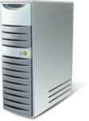


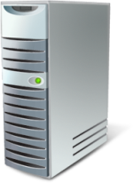

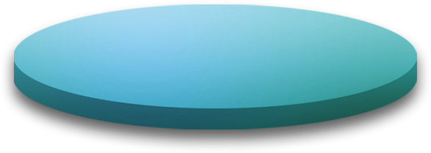



E-mail Messaging Hygiene
Layered defense: Legacy
Exchange Server 2003 (SP2) servers
6 primary Exchange Server 2003 gateway
servers performing Messaging Hygiene
Exchange Servers are Corporate
Domain-joined machines
Exchange Hosted Filtering
Exchange SMTP Gateways
Exchange SMTP Routing Hubs
Mailbox
Servers
Clients
Connection Filtering
Sender Filtering
Recipient Filtering
Sender ID Filtering
Anti-Spam (IMF)
Attachment Filtering
Antivirus
Attachment Blocking
Antivirus & Anti-Spam
Internet

Slide 6
Challenges
Dependencies
  Reliance of Exchange Server 2003 servers
  on the Active Directory
  Dual-homed nature of gateway servers
Risks
  Internal corporate network resources exposure
  Denial-of-service (DoS) attacks

Slide 7
E-mail Messaging Hygiene And Security Design Improvements
Review and redesign the Internet e-mail
gateway infrastructure in Microsoft IT
to address the key security risks
Design secure Internet e-mail infrastructure
based on Exchange Server 2007 technologies
Move internal network resources further
from the direct risk of Internet attacks

Slide 8
Technical Goals
Reduce the attack surface
Improved spam and virus filtering
Platform for secure e-mail deployment
Protection at the network layer
Ease of administration and management

Slide 9
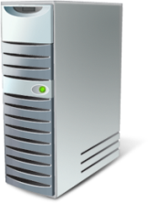

Definitions
Perimeter Network
In common computer security parlance, a Perimeter
Network can be defined as a buffer network which sits between an organization’s internal, or private network,
and the public Internet
Dual Homed Server
Dual Home/Dual Homing is a machine that creates
direct visibility to a protected network by bridging
two separate networks
Internet
Perimeter
Network
Internal
Network

Slide 10
Exchange Server 2007 Edge Server
Platform for Anti-Spam and Antivirus
Platform for secure e-mail
Not required to be part of the Active Directory
Key new messaging hygiene features
  Protocol Analysis and Sender Reputation
  Respect Outlook Safe Senders at Edge

Slide 11
Protocol Analysis
Components
Protocol Analysis Agent
  Analyzes and gathers information about sender
  (IP address) at the SMTP protocol layer
Sender Reputation Level (SRL)
  Data collected by the protocol analysis agent is
  aggregated and a reputation level is computed
  SRL Threshold
IP Reputation Service (IRS)
  A service that provides IP addresses with
  associated Sender Reputation Levels
  Supplements locally generated sender reputation
  Edge server will utilize this data to generate list of
  IP addresses to block

Slide 12
Protocol Analysis: Explained
External
SMTP Servers
Blocked IPs
Edge Server
1
SmartScreen
(Content Filter)
Content Filter
Updates
Updates
Signatures
Content
Phishing
Microsoft
Update
Publishing
Content Filter
DAT
6
2
Microsoft
Update
Client
Protocol Analysis
IRS Reputation
DAT
Verbs
Content
Reputation
Open Proxy
IRS Updates
3
SRL Logic
Sender Reputation
Database
5
TCS Training
Systems
Database
4
Protocol
Analysis
Background
Agent
Local SRL Table
IP
SRL
Heuristics
207.46.181.2
7
IRS Fed Table
IP
SRL
207.46.181.2
7

Slide 13
Exchange 2007
Concepts
Accepted Domains
  Simple Mail Transfer Protocol (SMTP) namespace for which
  a Microsoft Exchange organization sends or receives e-mail
  Types: Authoritative, Internal Relay, External Relay
Edge Subscription
  Used to populate Active Directory Application Mode (ADAM) on Edge server with Active Directory (AD) data
  One time task of subscribing Edge to an Active Directory site
  Edgesync service on Exchange 2007 Hub Transport server performs periodic one-way synchronization

Slide 14
Microsoft IT: Edge Server Design Approach
Identify the risks and define the requirements
Identify possible attack layers
  Exchange application layer
  Windows layer
  Network layer
Understand operational dependencies
Create a conceptual design
Security design review
Create a functional design

Slide 15






Conceptual Design
Active Directory Forest in Perimeter Network –
Non-corporate AD
joined OR trusted
Port 25 (SMTP)
Port 53 (DNS)
Port 80 (AV Signature Updates)
SMS
DC / GC
MOM
Port 25 (SMTP)
Port 3389 (Terminal Services)
Port 50636 (EdgeSync)
DC / GC
Exchange 2007
Mailbox servers
Location 1 Location 2
Internet
Exchange 2007
Edge Servers
Exchange 2007
HUB servers
MOM
Corp Forest
Perimeter Forest
Port 25 (SMTP)
Connection Filtering
Sender Filtering
Recipient Filtering
Recipient Lookup
Anti-Spam
Antivirus
Port 25 (SMTP)
Notes:
7/31/2008 9:15 AM
15
© 2006 Microsoft Corporation. All rights reserved. Microsoft, Windows, Windows Vista and other product names are or may be registered trademarks and/or trademarks in the U.S. and/or other countries.
The information herein is for informational purposes only and represents the current view of Microsoft Corporation as of the date of this presentation. Because Microsoft must respond to changing market conditions, it should not be interpreted to be a commitment on the part of Microsoft, and Microsoft cannot guarantee the accuracy of any information provided after the date of this presentation.
MICROSOFT MAKES NO WARRANTIES, EXPRESS, IMPLIED OR STATUTORY, AS TO THE INFORMATION IN THIS PRESENTATION.

Slide 16
Microsoft IT Messaging Hygiene Architectural Principles
Anti-spam MUST be done before anti-virus
Anti-spam SHOULD be done for inbound mail only
Anti-spam filtering SHOULD remove vs. quarantine
Anti-virus MUST scan both inbound
and outbound mail
Anti-virus MUST be e-mail direction aware
Anti-virus MUST follow “block on fail” rule
Anti-virus and Anti-spam systems MUST
integrate with Exchange

Slide 17
Functional Design
Messaging topology design
Authentication and authorization
Windows Server security
Exchange Server security
Server management

Slide 18
Messaging Topology Design
Edge Server location: Perimeter Network
Mail routing between internal network and perimeter network
  Router Access Control List
  Connection restrictions
Establishing EdgeSync Process between Exchange Server 2007 Hub Transport
servers and Edge Transport servers

Slide 19
Messaging Topology Design
Inbound and outbound Internet e-mail
  6 Exchange Server 2007 Edge Transport machines
    Same number of servers as legacy Exchange Server
    2003-based design
  Servers located in 2 datacenters for site resiliency
Outbound-only Internet e-mail
  4 regional Exchange Server 2007 Edge
  Transport machines

Slide 20
Windows Server Security
Reduced attack surface
  Lightweight server build
  Not required to be Active Directory joined
Lock down file system and shares
Restricted local administrative permissions
Security Configuration Wizard (SCW)
Only required Windows services are enabled
  WWW, SMTP, NNTP IIS services are not required
Server patch management
  Using Microsoft Systems Management Server (SMS)

Slide 21
Exchange Server Security
Encrypted connections
  Support for encryption for external communications
  Enabled by default for internal communication
Anti-Spam
  Layered defense
  Reject messages at protocol level
Antivirus
  Microsoft Forefront Security for Exchange Server
  File filtering
Configuration monitoring using DCM
(Desired Configuration Monitoring)

Slide 22
Anti-Spam Configuration
Global IP Allow & Deny List
  Static list
  Dynamic IP Block generated by Sender Reputation Agent
Connection filtering → 2 block list provider entries
Sender filtering → static list
Recipient filtering
  Static list
  Directory lookup → recipient data pushed using EdgeSync
Sender ID filtering
  Current action = StampStatus
Content Filter agent
  SCL Reject threshold >= 7
  SCL Junk e-mail threshold = 5-6

Slide 23
Safelist Aggregation
Reducing the instances of false-positives
in anti-spam filtering
Exchange 2007 anti-spam functionality
Shared across Microsoft office Outlook
and Exchange
Enabled using Exchange Management Shell Update-safelist cmdlet
Hashed and stored in Active Directory
Exchange EdgeSync replicates the
safelist data to the Edge Server ADAM

Slide 24
Safelist Aggregation – Implementation
Currently deployed in Corp
4 scheduled jobs
  North America
  Europe
  Asia
  Sao Paulo
get-mailboxserver -id na-exmsg* | % { get-mailbox –resultsize unlimited -server $_ } | where {($_.RecipientType -eq "UserMailbox") | foreach { $i++; update-safelist $_; if ($i % 2000 -eq 0) { (date).ToString() + ": processed $i entries" } }

Slide 25
Antivirus Configuration
Installed on Edge Transport and Hub
Transport servers
Forefront Security for Exchange Server
  Number of scan engines = 5
  Bias = Max certainty
  Action = Delete: Remove infection
  Notifications = Internal only
File filtering
  Inbound only
  Action = Delete: Remove contents

Slide 26
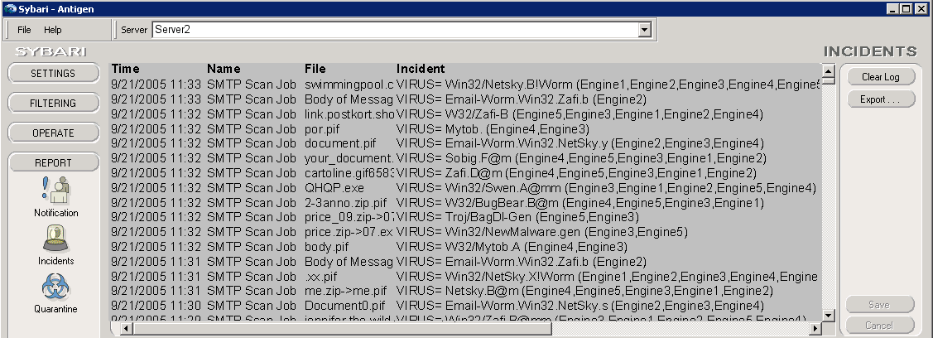
Using Multiple Antivirus Scanning Engines
All engines are engaged for each message
(Maximum Certainty)
Not all engines demonstrated the same efficiency
for different virus types

Slide 27
Microsoft IT Deployment Approach
Design the Perimeter network
Network readiness
  Router ACLs/Lockdown
  TCP/UDP Ports
Server lockdown as per Extranet requirements
  TCP/IP Filtering
  Disable NetBIOS over TCP/IP
Microsoft IT standard configuration
Management infrastructure
  MOM and SMS
Deploy at par with Exchange 2003 hygiene features first and then enable new features

Slide 28
Mail Routing: Implementation
Introduce Hub Transport Server role in Corp
Establish mail routing between the Exchange 2007 and Exchange 2003 routing groups
Install and configure Edge servers
in the Extranet
  9 servers (6 Exchange 2003 + 3
  Exchange 2007 Edge)
  Subscribe Edge to Redmond AD site
  Configure all spam filtering agents
  No antivirus installed at this stage

Slide 29
Mail Routing: Implemenation
Continued
Internet mail (inbound & outbound) scanned
by Exchange 2003 Hub servers
  Required additional steps to route mail from Exchange 2007 Hub servers → Internet
Install and configure antivirus on Edge servers
Re-configure mail routing to send and receive Internet mail directly through Edge servers
Remove Exchange 2003 Internet
gateway servers

Slide 30










Mail Routing: Intermediate Stage
@microsoft.com
*, Cost = 75
*, Cost = Implicit
*, Cost = 5
--, Cost = 1
RGC
Cost = 1
*, Cost = 10
*, Cost = 25
@microsoft.com

Slide 31
Internet Mail Routing:
Final stage

Slide 32
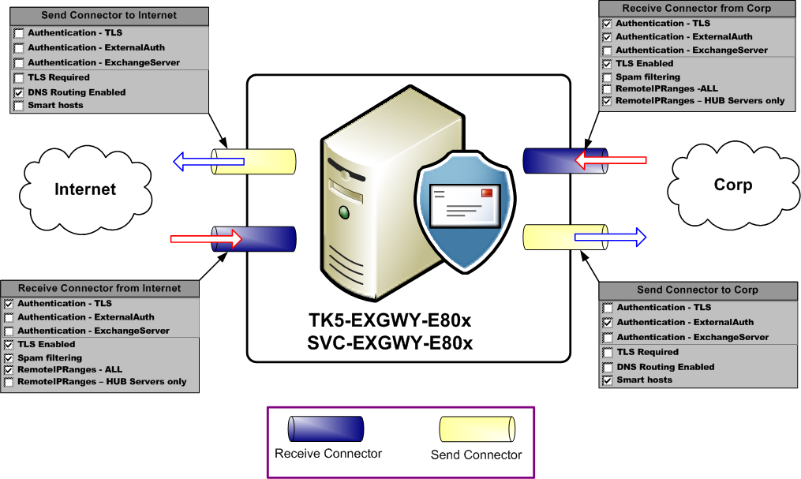
Edge Server Connector Configuration
Intermediate stage

Slide 33
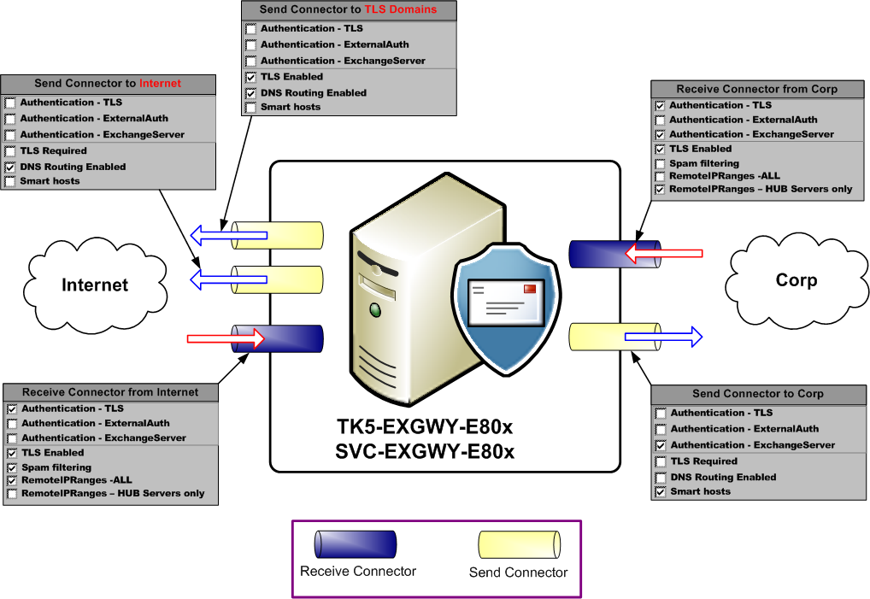
Edge Server Connector Configuration Final Stage

Slide 34
Redundant Routes
Inbound same as always
  Equal cost MX records
E-mail Domain | DNS Record | DATA
microsoft.com | MX 10 | maila.microsoft.com
microsoft.com | MX 10 | mailb.microsoft.com
microsoft.com | MX 10 | mailc.microsoft.com
Record | IP Address
maila.microsoft.com | IP1
maila.microsoft.com | IP2
mailb.microsoft.com | IP3
mailb.microsoft.com | IP4
mailc.microsoft.com | IP5
mailc.microsoft.com | IP6

Slide 35
Regional Edge Server Configuration
Outbound-only Internet mail
  Europe
  Asia
Edge servers subscribed to regional AD site
  Accepted domains required to route NDRs back to Corp
Send connector to Internet are scoped to
local AD site
New-sendconnector DUB_Edgeserver_To_Internet -DNSRoutingEnabled:$true -port:25 -ProtocolLoggingLevel:Verbose -AddressSpaces: 'Local:SMTP:*;25' -SmartHostAuthMechanism:None –MaxMessageSize:100MB -SourceTransportServers: DUB-EXGWY-E801, DUB-EXGWY-E802 -fqdn smtp-dub.microsoft.com –Usage:Internet

Slide 36
Anti-Spam Process order
Understanding Anti-Spam and
Antivirus Mail Flow
  http://technet.microsoft.com/
  en-us/library/aa997242.aspx

Slide 37
Conclusion
True perimeter network with
no loss of e-mail functionality
Protected internal messaging infrastructure
Foundation for secure e-mail
Increased spam filtering defenses
Common administration and monitoring model

Slide 38
How Microsoft Does IT
Best practices from Microsoft IT Showcase
White papers, case studies, webcasts and more: http://www.microsoft.com/itshowcase
  Enterprise Messaging with
  Microsoft Exchange Server 2007:
  http://www.microsoft.com/technet/itshowcase/
  content/exchange2007.mspx

Slide 39
Related Content
Microsoft IT shares its best practices and experiences: http://www.microsoft.com/itshowcase
  Microsoft Exchange Server 2007 Edge Transport and Messaging Protection
  http://technet.microsoft.com/en-us/library/bb735142.aspx
  Enterprise Messaging with Microsoft Exchange Server 2007
  http://technet.microsoft.com/en-us/library/bb735153.aspx
  Messaging Hygiene at Microsoft: How Microsoft IT Defends Against Spam, Viruses, and E-Mail Attacks
  http://technet.microsoft.com/en-us/library/bb735195.aspx

Slide 40
Track Resources
Technical Communities, Webcasts, Blogs, Chats & User Groups
http://www.microsoft.com/communities/default.mspx
Microsoft Learning and Certification
http://www.microsoft.com/learning/default.mspx
Microsoft Developer Network (MSDN) & TechNet
http://microsoft.com/msdn
http://microsoft.com/technet
Trial Software and Virtual Labs
http://www.microsoft.com/technet/downloads/trials/default.mspx

Slide 41
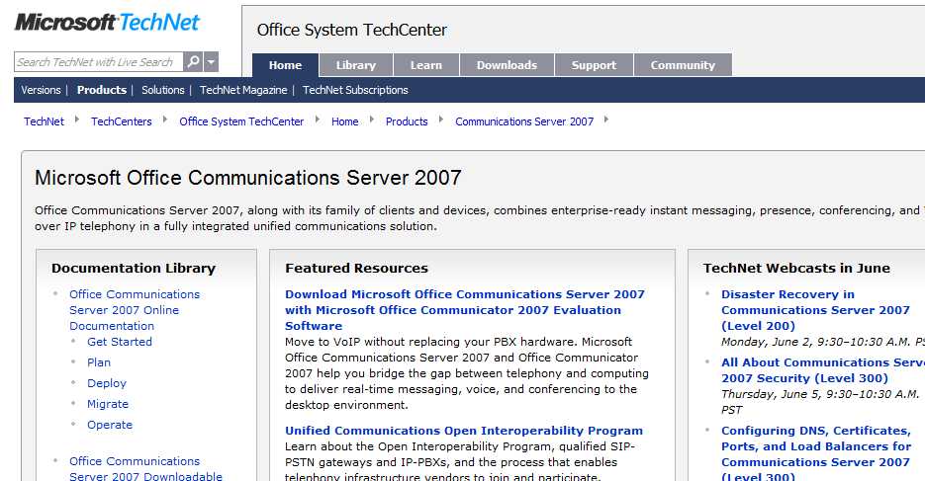
Want To Be An Expert?
Get in depth and up to date technical resources from TechNet
  Leverage the variety
  of Webcasts and
  Virtual Labs available
  Be part of the OCS
  Product Dialogue
  Join the OCS Community
http://technet.microsoft.com/office/ocs/

Slide 42

© 2008 Microsoft Corporation. All rights reserved. Microsoft, Windows, Windows Vista and other product names are or may be registered trademarks and/or trademarks in the U.S. and/or other countries.
The information herein is for informational purposes only and represents the current view of Microsoft Corporation as of the date of this presentation. Because Microsoft must respond to changing market conditions, it should not be interpreted to be a commitment on the part of Microsoft, and Microsoft cannot guarantee the accuracy of any information provided after the date of this presentation. MICROSOFT MAKES NO WARRANTIES, EXPRESS, IMPLIED OR STATUTORY, AS TO THE INFORMATION IN THIS PRESENTATION.

