Slide 1
OCS Video Conferencing
Jingyu Qiu
Sr. Program Manager
Microsoft Corporation

Slide 2
Agenda
Our Vision
OCS 2007 Feature Set
OCS 2007 Video Deep Dive
Interop with Tandberg and Polycom
OCS Video Roadmap
Q&A

Slide 3
Our Vision
Make video conferencing useful,
usable and affordable to the mass
Help people save travel, work more efficiently
Help company save money
and improve productivity
Make the world a better place to live

Slide 4
Video Conferencing Reality
Since 60’
  Not meeting expectation
  Low quality, not useful
  Hard to use
  Low usage
  No ROI model
Good Sign in 2007
  Is the time for video conferencing coming?

Slide 5
Our Multi-Release Approach
Every release, we focus on improving
Area of Focus | OCS 2007 | OCS 2008 …
High Quality Audio/Video
Ease of Use
Reliability
Network Resilience
Affordability
Face to Face Experience

Slide 6
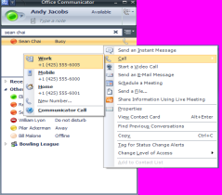
OCS 2007 Video Capabilities
Point to Point Video “calls”
Escalate to Video
Multi-point Video conferences
Escalate to conference

Slide 7
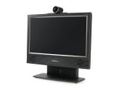












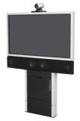
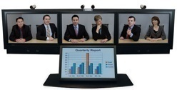

OCS 2007 Video Components
UC endpoints
QOE Monitoring Archiving
CDR
Remote
Users
DMZ
Data
Audio/Video
Inbound
Routing
SIP
Outbound
Routing
Voice Mail
Routing
Access
Server(s)
Front-End Server(s)
Conference
Server(s)
Backend
SQL server
Active Directory
Federated
Businesses
3rd Party
Video
Gateway
ISDN
3rd Party Video Conference Endpoints

Slide 8
OCS 2007 Demo
P2P Video
  From Outlook, OC, Audio Elevation
Multiparty Video
  From OC, P2P Elevation, Audio Elevation
Live Meeting Video
Video Setup
Firewall Traversal

Slide 9
OCS 2007 Video Deep Dive
Codec
Quality
Ease of Use
Reliability
Network Resilience
Affordability
Area of Focus
High Quality Audio/Video
Ease of Use
Reliability
Network Resilience
Affordability
Face to Face Experience

Slide 10
Video Codec
VC1 Codec
  Used in WMV 9, next generation DVD formats,
  SMPTE-421M standard since April 2006
  High Quality, High Compression, Low CPU
RTVideo – VC1 Extension
RTVideo Challenges
  Real Time
  Bandwidth
  Packet Loss

Slide 11
Video Encoding Pattern
IBBP Video Frame Pattern
  Intra Frame and Inter Frame
  Inter Frame Dependency
GOP Structure
  10 Second GOP, 15 FPS
System Design Around Encoding Pattern
  Channel Protection
  Active Video Switching
  Rate Matching

Slide 12
Bitstream Structure
I: Intra Frame
P: Prediction Frame
B: Bidirectional Frame
SP: Super P Frame, VC1 Extension
I
I
SP
SP
P
P
P
P
B
B
B
B
B
B
B
1 2 3 4 5 6 7 8 9 10 11 12 13 14 15
I
P
B
SP
B
P
B
SP
B
P
B
I
B
P
B

Slide 13
Artifact
A packet loss in I Frame
Causes whole I Frame Loss
I
Causes Artifact till next I frame
I
SP
SP
P
P
P
P
B
B
B
B
B
B
B
1 2 3 4 5 6 7 8 9 10 11 12 13 14 15

Slide 14
Artifact
A packet loss in SP Frame
Causes artifact till next I frame
I
I
SP
SP
P
P
P
P
B
B
B
B
B
B
B
1 2 3 4 5 6 7 8 9 10 11 12 13 14 15

Slide 15
Artifact
A packet loss in P Frame
Causes artifact till next I/SP frame
I
I
SP
SP
P
P
P
P
B
B
B
B
B
B
B
1 2 3 4 5 6 7 8 9 10 11 12 13 14 15

Slide 16
Artifact
A packet loss in B Frame
Causes no artifact
I
I
SP
SP
P
P
P
P
B
B
B
B
B
B
B
1 2 3 4 5 6 7 8 9 10 11 12 13 14 15

Slide 17
Encoder/Decoder Flow
Sender
AVMCU
Receiver
Camera
Render
Encoder
Decoder
Crossbar
Crossbar
Crossbar
I
Media
RTP
Network
Device
Src
Sink
Network
Device
Preview
BW Estimate
BW Estimate
Signaling
Control
RTCP
Quality
Controller
Quality
Controller
Quality
Controller
Packet Loss Report
Error
Recovery
Rate
Matching

Slide 18
Feature Set
Codec: RTVideo, H.263 (fall back)
1:1, Multi-party Video
NAT/Firewall Traversal (no need for VPN)
SRTP
Video Archiving
Resolution | BW (kbps) | CPU
CIF@15 | 100-350 | 1.5G
VGA@15 | 400-800 | Dual Core
Pano@15 | 100-350 | Dual Core

Slide 19
Quality In OCS 2007
Advanced VC1 Codec
CIF, VGA
Low BW Usage
Wideband Audio
Network Resilience
Quality of Experience
Quality Monitoring

Slide 20
Usability In OCS 2007
One Click to Start Video
Never Set BW
Never Set Firewall
Never Set Codec
Never Set Security
No Special Hardware
UC Webcam

Slide 21
Reliability In OCS 2007
Reliable firewall traversal
Network resilience
Simple reliable hardware setup

Slide 22
Network Resilience In OCS 2007
Channel Protection
Error Concealment
Error Recovery
Dynamic BW Allocation

Slide 23
Channel Protection
Goal: Improve perceived
video quality in a lossy network
System Design
  Forward Error Correction
  Error Concealment
  Error Recovery
Result
  Packet Loss Impact become un-noticable

Slide 24
Forward Error Correction
Goal: Reduce Frame Loss Probability
Design
  Packet Level Protection using Redundant Data
  Protect Key Frames Only
  10% extra protection bits
Result @ 1% loss network
  I frame loss rate: 10% -> 0.1%
  Artifact: 30% -> 6%

Slide 25
Error Concealment
Goal: Hide Artifact
  Human eyes more sensitive to
  artifact than to short frozen video
Design
  Share frame dependency
  info between sender/receiver
  Hide frames with impaired dependency
Result
  Zero Artifact

Slide 26
Error Recovery
Goal: Reduce Frozen Video Interval
  Worst: GOP(10 Sec)
Design
  Receiver Sends Packet Loss Report
  Sender Resends I/SP frame
Result
  Frozen interval < RTT time (200ms, 3 frames)

Slide 27
Dynamic BW Allocation
Cannot Predict Available BW At Beginning
Dynamic BW Allocation
  BW Estimation Every 5 Seconds
  BW Allocation to Audio Video Channels
  Reset Encoder Bitrate
    QP, Frame Rate, Resolution
Optimal QoE Given Available BW

Slide 28
Affordability In OCS 2007
Commodity Hardware,
WinTel, Webcam, Headset
Scalable AVMCU Server
  How to Handle Heterogeneous End Point
Easy Admin, lower TCO

Slide 29
Video Conferencing
Large Multiparty Video Conf
  Up to 250 participants
  Live Meeting Can do Even More
Switched Video (one video window)
  Active speaker switching
  Manual switching
Rate Matching
Video Archiving
  Client/Server side archiving

Slide 30
Rate Matching
Scale Down Video Stream on low speed link in AVMCU
Remove frames without causing artifact
I
I
SP
SP
P
P
P
P
B
B
B
B
B
B
B
1 2 3 4 5 6 7 8 9 10 11 12 13 14 15

Slide 31

Multi-Party Video
See A’s video
Firewall
256K
SP . . SP . . I
B
Dominant Speaker: A
Error Recovery
Upper Link
See Previous DS
100M
SP B P B SP B P B I
AVMCU
See A’s video
100M
SP B P B SP B P B I
A
Dominant Speaker Switching
Manual Switching
Rate Matching
Error Recovery
High Performant AVMCU
C

Slide 32
OCS 2007 Video Recap
Area of Focus | OCS 2007 | OCS 2008
High Quality Audio/Video
Ease of Use
Reliability
Network Resilience
Affordability
Face to Face Experience

Slide 33
Interop With Tandberg
SIP Client using H.263 or RTVC1
Video Gateway

Slide 34
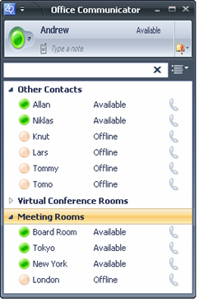


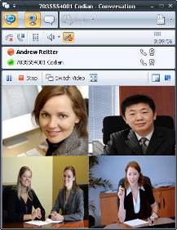
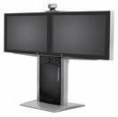
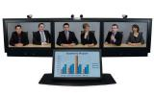
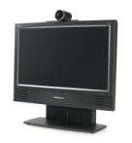
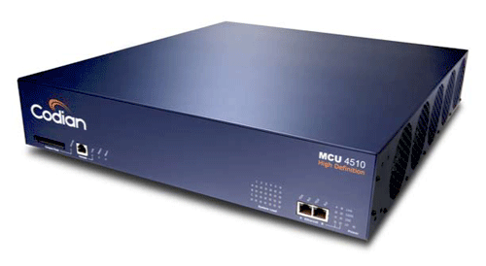

TANDBERG – OCS Interoperability
Released solution
Simple to deploy
  TANDBERG endpoints register directly to OCS
  TANDBERG MCU registers conferences directly with OCS
User Experience
  Calling a TANDBERG Endpoint is the same as calling a MOC client
  Click a contact to joing a multi-protocol conference
  Multiple User Scenarios Supported
    Persoanl Telepresence
    Conference Rooms
    Telepresence Stutios
SIP
MOC
Exec Desktop
Board Room
Telepresence Studio
MCU

Slide 35



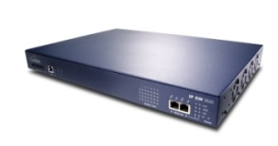

TANDBERG – OCS Interoperability – Roadmap
Media Gateway
Enhanced Media Support
  RTV to H.264 Transcoding – enables HD interoperability
    TANDBERG HD Webcamera and MOC
User Experience
  Same consistenet user experience
Content Server
Video
Communication
Server
HD MCU
H.323 and SIP
SIP
Media Gateway
Exec Desktop

Slide 36
Interop With Polycom
SIP Client H.263
Native End Point (RTVC1)

Slide 37
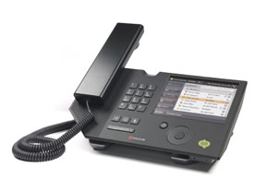

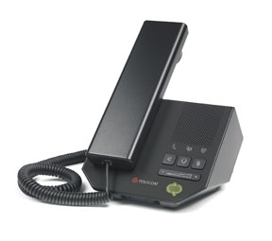




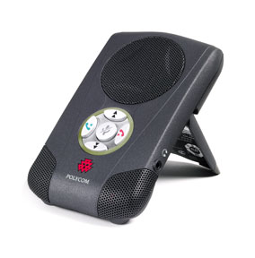
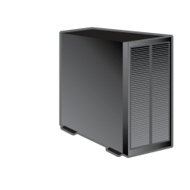
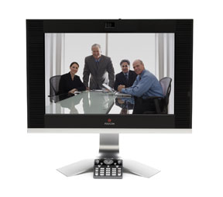

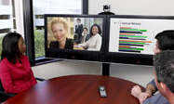


Polycom Video Components In An
Office Communications Server 2007 Topology
RMX 2000™ Conferencing
Server
Office
Communications Server 2007
H.323
CX700
CX200
H.323
Gateway
PSTN
PSTN
Gateway
CX100
Voice Gateway
Traditional PBX
Exchange
Server 2007
Active
Directory
HDX 4000™
Traditional Phones
HDX 8000™

Slide 38


Three Phase Video Integration into
Office Communications Server 2007
Seamless interoperability
  Point to point calling between
  HDX and Office Communicator
  Companion HDX – forked calls to OC client and HDX
  Meet-me conferencing with RMX
Phase 1
Q2/3, 08
Phase 2
Q2, 09
Full integration and manageability
  VC2 compliance
  Support for large-scale video management
  Federation and security
Phase 3
2H, 09
Native Interoperability
  Support for Microsoft’s RTVideo and RTAudio codec’s
  Aligned with Microsoft’s
  Wave 14 release of OCS 2007
38

Slide 39
OCS Video Roadmap
Area of Focus | OCS 2007 | Next OCS
High Quality Audio/Video
Ease of Use
Reliability
Network Resilience
Affordability
Face to Face Experience

Slide 40
OCS Video Future
VGA/HD 720P
  1:1 and Multi-party
  Mixed Video (CIF/VGA/HD)
  Capability Negotiation
Partner/EcoSystem Play
  $300 HD Webcam From Tandberg
  Tandberg/Polycom Signs RTVideo Porting Kit
  Interop With VTC System

Slide 41
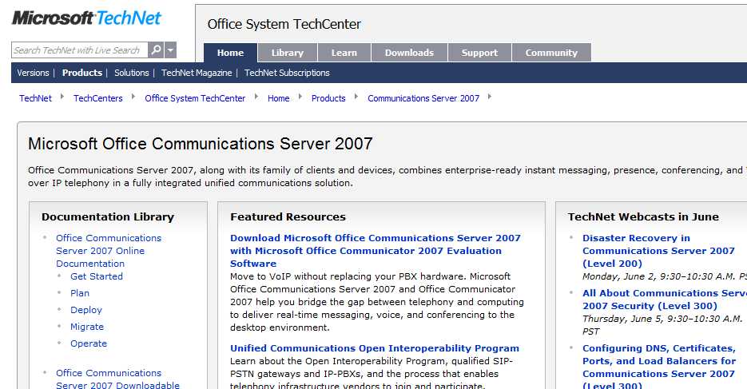
Want To Be An Expert?
Get in depth and up to date technical resources from TechNet
  Leverage the variety
  of Webcasts and
  Virtual Labs available
  Be part of the OCS
  Product Dialogue
  Join the OCS Community
http://technet.microsoft.com/office/ocs/

Slide 42

© 2008 Microsoft Corporation. All rights reserved. Microsoft, Windows, Windows Vista and other product names are or may be registered trademarks and/or trademarks in the U.S. and/or other countries.
The information herein is for informational purposes only and represents the current view of Microsoft Corporation as of the date of this presentation. Because Microsoft must respond to changing market conditions, it should not be interpreted to be a commitment on the part of Microsoft, and Microsoft cannot guarantee the accuracy of any information provided after the date of this presentation. MICROSOFT MAKES NO WARRANTIES, EXPRESS, IMPLIED OR STATUTORY, AS TO THE INFORMATION IN THIS PRESENTATION.

Slide 43
Appendix

Slide 44
Telepresence Myth
Immersive Experience
  Life size image
  Better Eye Gaze
  Spatial Audio
High Quality Audio/Video
Ease of Use
Reliability
Feels like Private Jet

Slide 45
Telepresence Demystified
Immersive Experience
  Camera Angle, Display Size, Spatial Audio, Position Camera on top, Geometry
High Quality Audio/Video
  HD Audio Video, Low Latency, jitter, lip sync
Ease of Use
  Hide technology from UI
Reliability:
  Dedicated Network, Dedicated Support
Feels like Private Jet – Costs Like one too

Slide 46
Do You Need Telepresence?
Yes, your CEO asked for it
  Private Jet in VTC
For the rest of us
  HD Camera on top of screen
  Full screen video on a larger screen
  Quad Core Machine
  Good lighting
  Good Microphone
  Good speaker
  $3000 price tag

