Slide 2
NZ Post Fast & Affordable BI
John McDermott & Amir Shevat
Architects
NZ Post / Datacom
Session Code: VOC202

Slide 3
Hidden Speaker Notes
Some speakers at Microsoft like to use this slide for hidden “notes slides”.
Delete it if you don’t want to use it.
NEXT: <next slide title>

Slide 4
The BI - EDW Myth
BI costs millions and takes years - right?
WRONG!
BI can be agile and cost effective

Slide 5
Who are we?
John McDermott
  NZ Post Retail Technology Architect
Amir Shevat
  Datacom Architect

Slide 6
Why are we here?
We have recently successfully delivered a Business Intelligence solution for NZ Post Retail
Out of the box Microsoft stack
The project was agile!
The project was a success!
Application Platform Solution Award

Slide 7
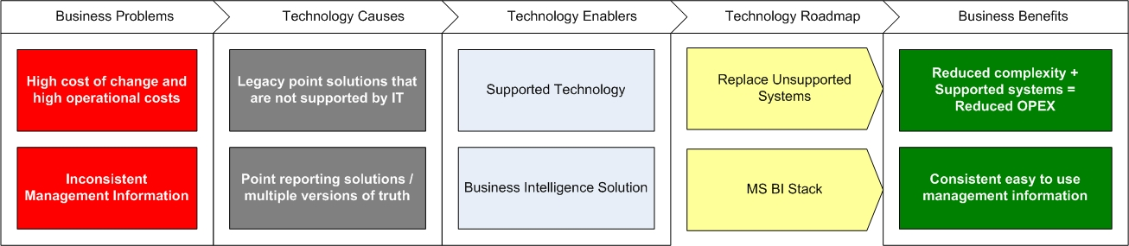
The problem we wanted to solve
High cost / low margin business
Inconsistent Management Information
Unsupported point solutions

Slide 8
Business Problems
High Cost of Change & High Operational Costs
Inconsistent Management Information

Slide 9
Technology Causes
Legacy Point Solutions – Not Supported
Point Reporting Solution = Multiple versions of the truth

Slide 10
Technology Enablers
Supported Technology
Business Intelligence Solution

Slide 11
Technology Roadmap
Replace Unsupported Systems
Microsoft BI Stack

Slide 12
Business Benefits
Reduced Complexity + Supported Systems = Reduced OPEX
Consistent easy to use Management Information

Slide 13
High Level Architecture
SharePoint
Performance Point 2007
SQL Server Integration Services
SQL Server Reporting Services
SQL Server 2008
Windows Server 2008

Slide 14
Key technology drivers
Heterogeneous Systems
Build vs. Buy
Microsoft Stack
Browser-based
Business self-service / easy to use

Slide 15
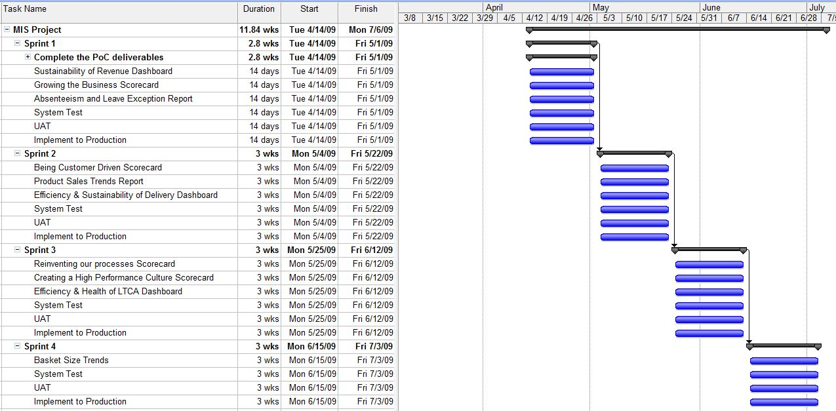
Agile!

Slide 16
What does Agile mean (for us)?
Business + IT
Prototypes
Short iterations
Small teams (3.5 FTE)
Learn mistakes early = cheaply
Embrace change

Slide 17
Partnership
NZ Post Retail
Datacom
Microsoft

Slide 18
Retail Management Information System
demo

Slide 19
A Slightly Deeper Dive

Slide 20
Step 1 - ETL to Kitchen
Extract data from various data sources
  Oracle
  Flat Files
  SQL Server
Load all the data into a Kitchen DB
Kitchen DB – is a throwaway temporary data storage
Business keys
(Dimensions)
Kitchen DB
Data
(Facts)

Slide 21
Step 2 - Kitchen to Staging
Normalise the data structure
Add integer BI keys to the business keys
Add the new data to the current consolidated data
Staging DB – is a normalised consolidation of all the previous and current data
Business keys
(Dimensions)
Kitchen DB
Staging DB
(dimensions and Facts)
Data
(Facts)

Slide 22
Step 3 – Staging to Presentation
Strip the business keys
Process the OLAP cubes
Service the UI
Presentation DB – holds only what is needed for the BI – the single source of truth for all UIs
Business keys
(Dimensions)
Kitchen DB
Staging DB
(dimensions and Facts)
Presentation DB
Data
(Facts)

Slide 23
Step 4 – Adding User interface
Static reports with reporting services
PerformancePoint for analytic charts
Excel for deep dives
Different User Interfaces to enable different business/roles BI features
Business keys
(Dimensions)
PPS
Kitchen DB
Staging DB
(dimensions and Facts)
Presentation DB
SSRS
Data
(Facts)
Excel

Slide 24
Step 5 – Consolidate User Interfaces
Use a SharePoint portal to combine the analytic charts with the static reports.
Use the well known portal to expose the new business intelligence features.
SP
Business keys
(Dimensions)
PPS
Kitchen DB
Staging DB
(dimensions and Facts)
Presentation DB
SSRS
Data
(Facts)
Excel

Slide 25
Technical Benefits
Easy to implement
Multiple user interfaces
Getting a lot ‘out of the box’

Slide 26
What Worked?
Agile
Microsoft 2008 BI stack

Slide 27
Challenges
PPS 2007 is going away ☹
Analytic charts are not there yet ☹

Slide 28
Conclusion
We would do this again
The technical stack works
Agile works for BI
BI can be affordable for low margin business

Slide 29
question & answer

Slide 30




Resources
www.microsoft.com/teched
  Sessions On-Demand & Community
www.microsoft.com/learning
Microsoft Certification & Training Resources
http://microsoft.com/technet
  Resources for IT Professionals
http://microsoft.com/msdn
  Resources for Developers

Slide 32

© 2009 Microsoft Corporation. All rights reserved. Microsoft, Windows, Windows Vista and other product names are or may be registered trademarks and/or trademarks in the U.S. and/or other countries.
The information herein is for informational purposes only and represents the current view of Microsoft Corporation as of the date of this presentation. Because Microsoft must respond to changing market conditions, it should not be interpreted to be a commitment on the part of Microsoft, and Microsoft cannot guarantee the accuracy of any information provided after the date of this presentation. MICROSOFT MAKES NO WARRANTIES, EXPRESS, IMPLIED OR STATUTORY, AS TO THE INFORMATION IN THIS PRESENTATION.

