Slide 2
A lap around "Oslo"
Rahul Garg
National Technology Specialist
Microsoft Australia
SOA303

Slide 3
Agenda
Introduction to modeling
What are some of the big challenges in IT?
“Oslo” – what is it?
Basic concepts & architecture of “Oslo”
Demos of some simple scenarios in “Oslo”
Summary

Slide 4

Agenda
Introduction to modeling
What are some of the big challenges in IT?
“Oslo” – what is it?
Basic concepts & architecture of “Oslo”
Demos of some simple scenarios in “Oslo”
Summary

Slide 5
Who can relate to this?

Slide 6
And this?
+ +
-
-

Slide 7
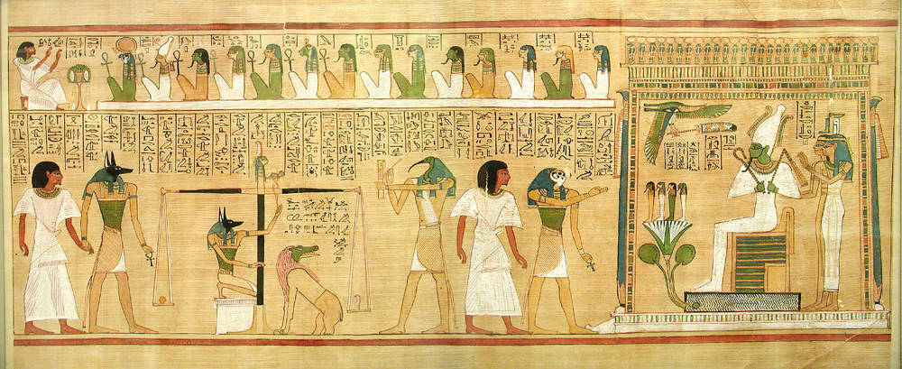
Models are everywhere ..

Slide 8


Models are everywhere ..
Represent a complex entity or process
Help us to simplify complexity
Allow us to capture information & share them
Can have different representations (textual/visual/etc.)

Slide 9
Agenda
Introduction to modeling
What are some of the big challenges in IT?
“Oslo” – what is it & where are we today?
Basic concepts & architecture of “Oslo”
Demos of some simple scenarios in “Oslo”
Summary

Slide 10

IT today..
Business Process
Customer
SLA?
Workflow
Service
Data Center
Activity
Computer
Application

Slide 11
Can we do better?
The big challenge:
  Help people in diverse roles work with diverse information across different domains
  Make IT simpler, more effective, and less expensive
The “Oslo” approach:
  Inspire efficient collaboration between people in diverse roles across different domains
  Make modeling mainstream providing simplified development & better visibility

Slide 12
Agenda
Introduction to modeling
What are some of the big challenges in IT?
“Oslo” – what is it?
Basic concepts & architecture of “Oslo”
Demos of some simple scenarios in “Oslo”
Summary

Slide 13
What is "Oslo"?
"Oslo" is our new platform for Model-driven applications
  It is not the code name for a single new product
  It is not the new name for existing product(s)
The "Oslo" technologies that we’ll talk about today
  The “M” Language
  The “Quadrant”
  The “Repository”

Slide 14
Where is “Oslo” today?
No formal release dates have yet been announced
The objective of today’s discussion
  Describe some of the main problems “Oslo” addresses
  Give you a big-picture view of the technology
Don’t be surprised if there are changes before
the first “Oslo” release

Slide 15
Agenda
Introduction to modeling
What are some of the big challenges in IT?
“Oslo” – what is it?
Basic concepts & architecture of “Oslo”
Demos of some simple scenarios in “Oslo”
Summary

Slide 16



What is "Oslo"?
“M”
The language for authoring models & DSLs (Domain-Specific Languages)
“Quadrant”
The tool for interacting with models
Repository
The database for storing & sharing models

Slide 17

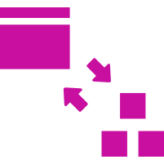

Why "Oslo"?
TRANSPARENCY
Better understanding of your application
FLEXIBLITY
Faster changes to your application
PRODUCTIVITY
“More essence, less ceremony”

Slide 18








"Oslo" Architecture
“QUADRANT”
INTELLIPAD
[Your Visual DSL]
[Your Textual DSL]
EDITOR
FRAMEWORK
LANGUAGE
FRAMEWORK
RUNTIMES
[Your Runtime]
REPOSITORY
SQL SERVER
“Dublin”
REPOSITORY
SQL SERVER
ASP.NET
REPOSITORY
SQL SERVER
[Your Models]
WCF/WF
[Your Models]
Base Models
[Your Models]
SQL
Base Models
“M” Runtime
.Net Models
Other ISV Runtimes
“M” Runtime
Repository Models

Slide 19
Creating models using "M"
demo

Slide 20
What we just did..
“QUADRANT”
INTELLIPAD
[Model]
[Model]
EDITOR
FRAMEWORK
LANGUAGE
FRAMEWORK
REPOSITORY
SQL SERVER
REPOSITORY
SQL SERVER
[Your Models]
[Models]
Base Models
.Net Models
“M” Runtime
Repository Models

Slide 21
The "Oslo" Repository
A common store for diverse information
Provides one place to find information
about the IT environment
Examples of what the repository allows:
  People in different roles can see and modify a
  common set of information:
    About applications, business processes, or anything else
  Relationships between information can be made apparent
  Problems can be tracked from end to end

Slide 22
The Repository
A closer look
Schemas
Instances
Defined using the language “M”

Slide 23
The “Quadrant”
A tool for working with that information
Provides a useful tool to create, read,
update, and delete the repository's information
Examples of what “Quadrant” allows:
  People in different roles can see the information they care about in the way they want to see it
    They can have better conversations with one other
  Relationships between information can be examined visually
    People can make connections across the environment

Slide 24
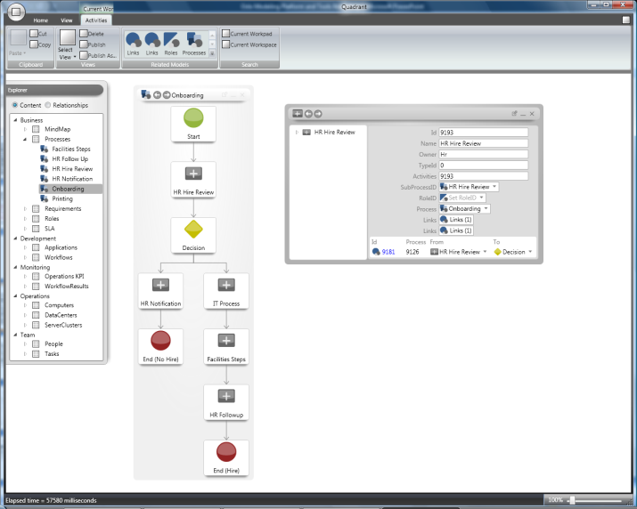
The Repository & “Quadrant”
An illustration
“Quadrant”
Repository
Information about applications, computers, business processes, etc.

Slide 25
Defining Schemas
The "M" language
"Oslo" introduces a new language “M” for authoring schemas & DSLs
  All schemas in the
  repository are defined using this language
  The language generates SQL
    The repository can be accessed
    using standard SQL and common database tools
Many (most?) people won't need to
use this language explicitly
  They'll rely on schemas defined by others

Slide 26
Using DSLs with "M"
demo

Slide 27
What we just did..
“QUADRANT”
INTELLIPAD
[Model]
[Model]
EDITOR
FRAMEWORK
LANGUAGE FRAMEWORK
MGrammar
REPOSITORY
SQL SERVER
REPOSITORY
SQL SERVER
[Your Models]
[Models]
Base Models
.Net Models
“M” Runtime
Repository Models

Slide 28
Agenda
Introduction to modeling
What are some of the big challenges in IT?
“Oslo” – what is it?
Basic concepts & architecture of “Oslo”
Demos of some simple scenarios in “Oslo”
Summary

Slide 29
Summary
Today’s talk was an overview of the "Oslo" platform
Specifically we looked at:
  The new language “M” for authoring the models
  The new editor “Quadrant” for interacting with the models
  The “Repository” for storing the models
These changes will affect us all...
  Business analysts, architects, developers, and IT pros

Slide 30
Resources
OSLO: http://msdn.microsoft.com/en-us/oslo/default.aspx
Download MAY CTP, Videos, Tutorials, Learning Materials & Oslo Samples
My Email: rgarg@microsoft.com
My Blogs: http://blogs.msdn.com/rgarg/

Slide 31




Resources
www.microsoft.com/teched
  Sessions On-Demand & Community
www.microsoft.com/learning
Microsoft Certification & Training Resources
http://microsoft.com/technet
  Resources for IT Professionals
http://microsoft.com/msdn
  Resources for Developers

Slide 33

© 2009 Microsoft Corporation. All rights reserved. Microsoft, Windows, Windows Vista and other product names are or may be registered trademarks and/or trademarks in the U.S. and/or other countries.
The information herein is for informational purposes only and represents the current view of Microsoft Corporation as of the date of this presentation. Because Microsoft must respond to changing market conditions, it should not be interpreted to be a commitment on the part of Microsoft, and Microsoft cannot guarantee the accuracy of any information provided after the date of this presentation. MICROSOFT MAKES NO WARRANTIES, EXPRESS, IMPLIED OR STATUTORY, AS TO THE INFORMATION IN THIS PRESENTATION.

