Slide 1

iSCSI Fabric and the Enterprise
Paul Rambo, Senior Program Manager – Windows Server Division
Adeel Siddiqui, Development Lead – Networking Ecosystem
Claus Joergensen, Senior Program Manager – Storage Solutions Division
Suzanne Morgan, Senior Program Manager – Core OS Division
Jim Teague, Senior Program Manager – Storage Solutions Division
Microsoft Corporation
Gaurav Chawla, Technology Strategist, Storage Architecture, CTO Office, DELL
Giri Basava, Consultant Software Engineer, CLARiiON Engineering, EMC
Dinesh Kumar, Sr. Network Engineer, Intel

Slide 2
Agenda
This is a Series of Two One-Hour Sessions
Fabric Topology Overview
iSCSI Target Discussion
  iSCSI Storage Array
  Windows Unified Data Storage Server 2003
Windows iSCSI Architecture
iSCSI Support in NDIS
iSCSI NIC Support
  Client Option ROM Configuration
  iBFT
  DHCP Setup
  Client Installation to iSCSI LUN
iSCSI HBA Support
  Client Configuration
  Demo Client Installation
OS Imaging Support and Management
  WDS & System Center

Slide 3

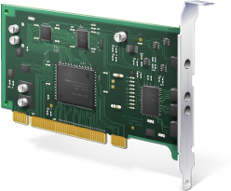



Fabric Topology Overview
An Overview of the Fabric Topology for this Chalk Talk
iSCSI HBA
iSCSI Appliance
GbE Fabric
iSCSI NIC
WUDSS

Slide 4
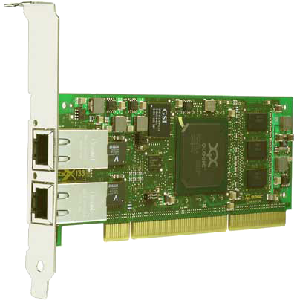
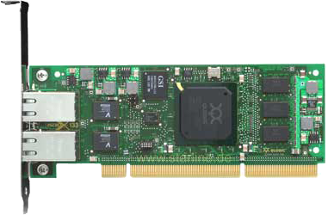

iSCSI HBA
QLogic QLA405x Family
Industry’s First Dual Port LP iSCSI Offload HBA
Target Application
  1U servers in Data Center with IP SAN
Key Features
  64/133MHz PCI-X
  Single & Dual 1Gbps Copper RJ45 ports
  Single Optical SFF-LC
  Low profile
  Hardware State based TCP & iSCSI offload engine
  BIOS, FCode for boot
  GUI & CLI Management Utility

Slide 5
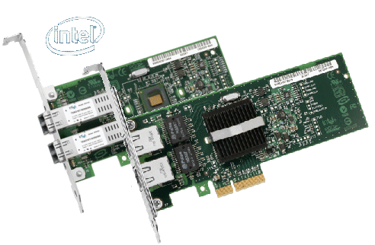
iSCSI NIC
Intel PRO/1000 PT Dual port Server Adapter
  Advanced cable diagnostics
  Supports category-5 unshielded twisted pair (UTP), 4-pair cabling
  Supports Windows Receive-Side Scaling for load balancing on multiple CPUs
  Intel I/O Acceleration Technology
  Large send offloads (IPv4, IPv6)
  Intel® PROSet Utility for Microsoft Device Manager
Key Features
  Intel® 82571EB Gigabit Controller for PCI-E
  Compatible with x1, x4, x8, and x16 full-height and low-profile PCI Express slots

Slide 6
iSCSI NIC
Intel iSCSI Boot
iSCSI Boot is standard feature for all Intel 1/10 GbE PCI-E server adapters and on-board controllers
Intel iSCSI Boot Firmware
  Integrated in NIC NVRAM or in system BIOS
  iSCSI disk access for BIOS initialization and OS loader
  Failover in pre-boot environment
  Supports CHAP for iSCSI Boot traffic
  Configurations via local console setup, DHCP or SM CLP interface
  Tools for firmware upgrade and configuration
Windows OS enablement
  Native Host OS Networking as well as iSCSI stacks
  “Shared port”: LAN, SAN and OS traffic share I/O port
  Windows Server Longhorn DVD install for Diskless systems. Crash dump support for iSCSI Boot
  Windows 2003 Diskless install using Intel F6 driver

Slide 7



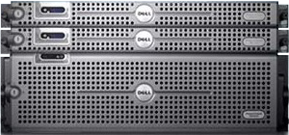
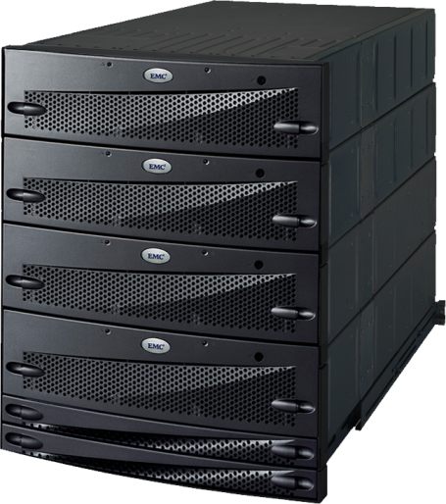
iSCSI Target Discussion
NX1950
CX3-xx

Slide 8
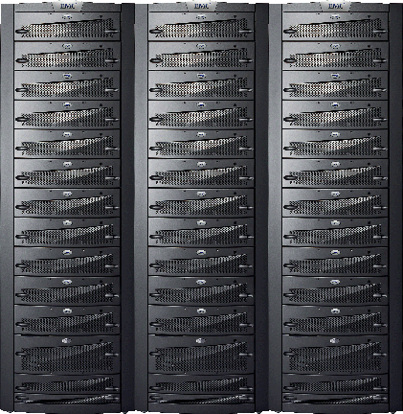
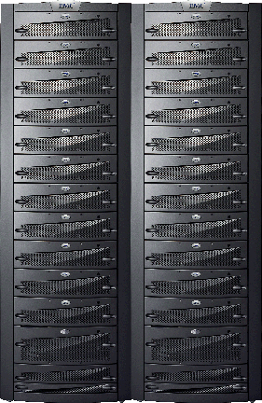
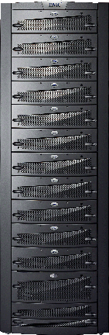

CLARiiON UltraScale Series
High performance FC/iSCSI Storage System.
Two hot swappable storage processors for high availability.
Up to 8 iSCSI (GbE) and 8 FC ports for host connectivity.
Up to 239TB of storage capacity.
Replication and data protection: MirrorView, SanCopy, Clones and Snapshots.
Support for Longhorn features: iSCSIBoot, Failover Clusters, MPIO, Volume Shadow Copy Service, Virtual Disk Service.
CX3-80
SCALABILITY
New
CX3-40
CX3-20
CX3-10
SERVICE LEVEL

Slide 9

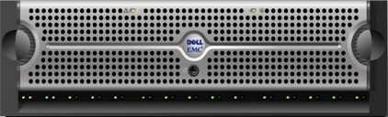
Dell NX1950 iSCSI & NAS
Integrated
Configuration
Features
  Unified file and block (WUDSS)
  Integrated with Dell MD SAS array
  Expansion JBODs for MD3000
  2-node HA cluster support
  Wizard assisted management
Futures
  Storage on Dell/EMC FC SAN
  Cluster with up to 8 NX1950 nodes
NX1950
NX1950
MD3000
MD1000
MD1000
Gateway Configuration
NX1950
NX1950
FibreChannel Switch
Dell/EMC
FibreChannel
Arrays

Slide 10
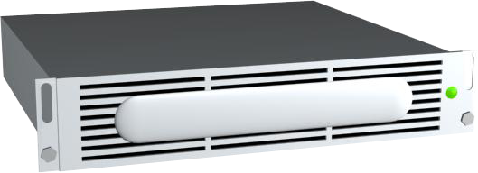
Windows Unified Data Storage Server 2003
Fixed function device
Built on Windows technology
Unified File and Block
Pre-configured and available from major OEM’s
From 160Gb to Terabytes++
Redundant configurations
Headless
Easy to Deploy
Windows ISV ECO-system
Price competitive

Slide 11




iSCSI Software Target
SMB and NFS – traditionally for file sharing
Microsoft’s iSCSI Software Target enables
block storage
Consolidate file
sharing and
application server
data storage in a
Windows Storage Server
Create a storage tier
to serve both client
and application tiers
FibreChannel SANs
are not required for
block-level data
VHD Files, 32/64 bit
support, VSS/VDS,
MPIO, iSNS, CHAP,
IPSec
Public LAN (for file access)
Network
Shares
Exchange
WUDSS
SQL
iSCSI
LUNs
Private LAN (for block access)

Slide 12
Windows iSCSI Architecture
Enables boot from LUN located on iSCSI SAN
Can be implemented in either NIC Option ROM, Server ROM or PXE
No changes needed to
NIC drivers in Windows
Pre-Boot
Windows
iSCSI Software Initiator
Int13
iBF
Table
Windows Boot
Loader
UNDI
TCP/IP
NIC
NDIS
Microsoft iSCSI
NDIS Miniport
Microsoft Windows
NIC
Vendor

Slide 13
iSCSI Fabric and the Enterprise
INTERMISSION

Slide 14
iSCSI NIC Support
iSCSI Boot Support in NDIS 6.0
Intel PRO/1000 PT
Client Option ROM Configuration
DHCP Setup
  Reservation by MAC Address
  iSCSI-Boot DHCP Option
  Display iBFT
Client Installation to iSCSI LUN

Slide 15
iSCSI HBA Support
QLogic QLA405x Series
Client Configuration
  Option ROM
  Device Driver
Client Installation to iSCSI LUN

Slide 16
OS Imaging Support
OS Imaging Process
OS Imaging Tools
  Sysprep
  ImageX

Slide 17
Management Deployment
Managed Scenarios
Management Tools
  Windows Deployment Services
  System Center
    Configuration Manager 2007

Slide 18
Additional Resources
    Hec7stor @ microsoft.com
Questions:
Web Resources:
    Microsoft iSCSI Portal: http://www.microsoft.com/WindowsServer2003/technologies/storage/iscsi/default.mspx
    Windows Automated Installation Kit: http://www.microsoft.com/downloads/details.aspx?familyid=c7d4bc6d-15f3-4284-9123-679830d629f2&displaylang=en
    IETF RFC 3720 (iSCSI spec): http://www.ietf.org/rfc/rfc3720.txt
    IETF RFC 4173 (iSCSI boot): http://www.ietf.org/rfc/rfc4173.txt
KB Articles
    DHCP and iSCSI Boot: http://support.microsoft.com/kb/928496
    Exchange: http://support.microsoft.com/kb/839686
    SQL: http://support.microsoft.com/kb/833770/en-us
Case Studies:
    School District of Philadelphia http://www.microsoft.com/casestudies/casestudy.aspx?casestudyid=200039
    SDC Udvikling A/S http://www.microsoft.com/casestudies/casestudy.aspx?casestudyid=53678
    Royal Appliance http://www.microsoft.com/casestudies/casestudy.aspx?casestudyid=53717

Slide 19

© 2007 Microsoft Corporation. All rights reserved. Microsoft, Windows, Windows Vista and other product names are or may be registered trademarks and/or trademarks in the U.S. and/or other countries.
The information herein is for informational purposes only and represents the current view of Microsoft Corporation as of the date of this presentation. Because Microsoft must respond to changing market conditions, it should not be interpreted to be a commitment on the part of Microsoft, and Microsoft cannot guarantee the accuracy of any information provided after the date of this presentation.
MICROSOFT MAKES NO WARRANTIES, EXPRESS, IMPLIED OR STATUTORY, AS TO THE INFORMATION IN THIS PRESENTATION.

Slide 20
Debugging Setup
Grab the setup logs
Setup with debug options
  Boot to DVD
  SHIFT+F10 (open a command prompt)
  setup.exe -debug:1 -baudrate:115200
F-8
  Select ‘Start Setup Under Debugger’

Slide 21
Debugging Setup
First boot of the OS
  Serial:
    bcdedit -debug on
    bcdedit -dbgsettings serial debugport:1 baudrate:115200
  1394:
    bcdedit -debug on
    bcdedit -dbgsettings 1394 channel:1
  USB:
    bcdedit -debug on
    bcdedit -dbgsettings usb targetname:<anystring> (may have to experiment to find the first enumerated port on the first enumerated root hub)

