Slide 1
UPnP Forum and DPWS
Standardization Status
Toby Nixon
Senior Standards Program Manager
Windows Device and Storage Technologies Group
toby.nixon@microsoft.com

Slide 2
Microsoft Plans
Microsoft supports UPnP and DLNA for home entertainment scenarios
Microsoft supports DPWS for other scenarios, particularly enterprise and verticals
Windows Rally Technologies enhance the user experience for both UPnP and DPWS
  PnP-X, WCN, LLTD

Slide 3


UPnP Forum Progress
Forum continues to quietly do its work
Now over 850 members
Over 330 UIC certified devices
Over 2000 DLNA certified devices
Steering Committee election starts this month
  Nine seats open for election including three vacancies

Slide 4
ISO/IEC Standardization of UPnP
72 UPnP specifications recently approved as International Standards
  UPnP Device Architecture 1.0
  DCPs: Basic Device, AVv1, AVv2, Digital Security Camera, HVAC, Lighting, Internet Gateway, Printer, Scanner, QOSv1, QOSv2, RemoteUI, Device Security
  Publication process continues – expected soon
Applied for extension of PAS submitter status

Slide 5
UPnP Device Architecture
UDA v1.0.2 and v1.1 in final approval process
  60 day member review ends July 5
  UDA v1.0.2 – editorial update to UDA v1.0
    Remove reference to RFC 3927
  UDA v1.1 – significant update
Technical Committee collecting requirements for UDA v1.2
  You’re invited to submit ideas!

Slide 6
UDA v1.1 Overview (1 of 2)
RFC 3927 (IETF AutoIP) support mandatory
SSDP Improvements
  BOOTID, CONFIGID, SEARCHPORT
  Message spreading, recovery from lost messages
  ssdp:update
Full range of XML Schema data types
SOAP 1.1 and WS-I Basic Profile support

Slide 7
UDA v1.1 Overview (2 of 2)
Multicast eventing
IPv6 incorporated into spec
  Many multi-homed device clarifications
HTTP 1.0/1.1 clarifications
XML Schemas defined for device and service description documents and all messages

Slide 8
UPnP DCP Activities (1 of 3)
AV v3 60-day member review completed
AV v4 requirements definition underway
  enhancements to content directory, playback setup, playback control, scheduled recording, AV infrastructure
IGD v2 requirements definition underway
  Security, wireless WAN (WCDMA, GPRS, WiMax), Bluetooth PAN, maintenance
QOS v3 nearing completion

Slide 9
UPnP DCP Activities (2 of 3)
Home Automation
  Shutter/Blind/Motor Control about to enter 60-day review period
  looking for reference implementations for Power System and Home Security System DCPs
Remote Access DCP near completion
  needs reference implementers, plugfest
Work stalled on Storage, Device Directory
  Need participants for work to move forward

Slide 10
UPnP DCP Activities (3 of 3)
Execution Platform (aka Device Management)
  Technical requirements defined; drafting is starting
  Seven major areas
    software and firmware provisioning (install, update, uninstall)
    software control (start/stop)
    management (get, set, create, delete)
    performance monitoring
    diagnostics (self-test, ping, tracert, nslookup)
    log management
    security

Slide 11
Microsoft Plans, redux
Microsoft supports UPnP and DLNA for home entertainment scenarios
Microsoft has not announced UPnP v1.1 plans
  Let us know of your interest – customer driven
Microsoft supports DPWS for other scenarios, particularly enterprise and verticals

Slide 12
UPnP and DPWS
 | UPnP | DPWS
Addressing | DHCP, AutoIP | DHCP, AutoIP
Discovery | SSDP | WS-Discovery
Description | UDA Schema | WSDL
Control | SOAP 0.9, 1.1 | SOAP 1.2
Eventing | GENA | WS-Eventing
Presentation | HTTP, HTML | HTTP, HTML

Slide 13
Why Web Services on devices?
Unified protocol platform
  Single stack for local and internet interactions
  Integrated development tools and developer skills
  Leverage investments in general WS protocols such as for performance and security
  Smaller security surface area
Rich device metadata and data types
Scales across the enterprise and the Internet
Integration with enterprise directory services
Integration with enterprise and web security

Slide 14
DPWS Standardization Progress
All specs (including DPWS) publicly available under Microsoft Open Specification Promise
Most core specs already standardized
Devices Profile, WS-Discovery, and SOAP-over-UDP to be submitted to OASIS this summer
  Watch for announcements and join efforts
WS-Transfer, WS-MetadataExchange, WS-Eventing standardization plan in progress

Slide 15
Devices Profile Subset of WS-* Framework
Workshop
Member Sub
Submitted
Standard
Infrastructure
and Profiles
Metadata
WS-Federation
WS-Management
Devices
Profile
WS-Discovery
Assurances
WS-Secure
Conversation
UDDI
WS-Trust
WS-Atomic
Transaction
WS-Metadata Exchange
WS-Security
WS-Reliable
Messaging
WS-Coordination
WS-Policy
Messaging
WS-Transfer
WS-Enumeration
WS-Eventing
WSDL
SOAP
WS-Addressing
MTOM
XML Schema
Foundation
XML Infoset
SOAP / UDP
XML 1.0
XML
Namespaces
MIME
SOAP / HTTP

Slide 16
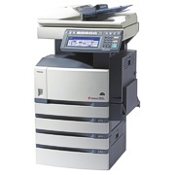
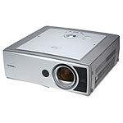
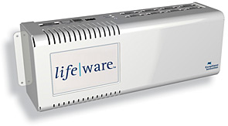

Device Classes - Now
Supported in Vista
  Printers
  Scanners
  MFPs
  Projectors
Third Party Products
  Home Automation
  Building Control
  RFID

Slide 17
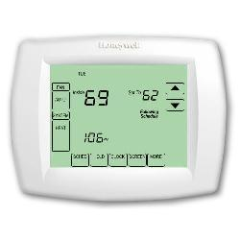

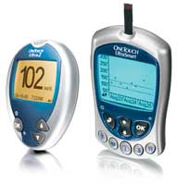
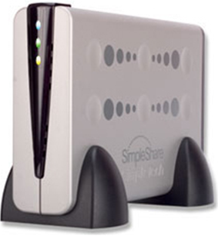

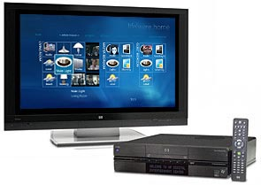
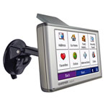

Future Device Classes
Point of Service
Energy Management
Network Infrastructure
Healthcare
Hospitality
Factory Automation
Mobile devices
Automotive
Many more…

Slide 18
Summary
Microsoft supports UPnP and DLNA for home entertainment scenarios
Microsoft supports DPWS for other scenarios, particularly enterprise and verticals
Windows Rally Technologies enhance the user experience for both UPnP and DPWS
  PnP-X, WCN, LLTD

Slide 19

© 2006 Microsoft Corporation. All rights reserved. Microsoft, Windows, Windows Vista and other product names are or may be registered trademarks and/or trademarks in the U.S. and/or other countries.
The information herein is for informational purposes only and represents the current view of Microsoft Corporation as of the date of this presentation. Because Microsoft must respond to changing market conditions, it should not be interpreted to be a commitment on the part of Microsoft, and Microsoft cannot guarantee the accuracy of any information provided after the date of this presentation.
MICROSOFT MAKES NO WARRANTIES, EXPRESS, IMPLIED OR STATUTORY, AS TO THE INFORMATION IN THIS PRESENTATION.

