Slide 1
Static Driver Verifier How to Analyze KMDF Drivers
Ella Bounimova
Research Software
Development Engineer
Microsoft Corporation
Jakob Lichtenberg
Software Development Engineer
Microsoft Corporation

Slide 2
Overview
Background
Static Analysis Tools in the WDK
Static Driver Verifier (SDV)
Kernel Mode Driver Framework (KMDF)
New Features at WinHEC 2007
Static Driver Verifier for KMDF
Precondition Rules
Role Types in KMDF
Questions, Feedback, and Discussion

Slide 3
Static Analysis Tools In The WDK
PREfast for Drivers (PFD)
Lightweight / fast
Easy to use early in development
Limited to function scope
Works on anything, C and C++
Static Driver Verifier (SDV)
Extremely deep analysis
More useful in the later stages of development
Requires complete driver
Works over the whole driver
Limited to some kinds of drivers, and to C
Limited to WDM and (new) KMDF Driver Models

Slide 4
Static Driver Verifier For WDM
SDV
WDM
Rules
WDM Driver
ü
Verification Engine
X
WDM
OS Model

Slide 5
Static Driver Verifier For KMDF
SDV
KMDF
Rules
KMDF Driver
ü
Verification Engine
X
KMDF
OS Model

Slide 6
Kernel Mode Driver Framework
Simpler Model
Simplified PNP and Power Management
Cancel safe I/O queues with multiple presentation patterns, integrated with PNP/Power
Callbacks with specific tasks, less complex code
Consistent interfaces, naming, and patterns
Features
Fully integrated USB support
Simplified WMI
Built in tracing and verification
Support from Windows 2000 through Windows Vista
Allows the flexibility of escaping to WDM
Easier to verify using PFD and SDV

Slide 7
Static Driver Verifier For KMDF
Joint project of KMDF, MSR, and SDV teams
52 rules
Specialized KMDF OS Model
Found 20 real bugs in 20 extensively tested KMDF drivers. Many drivers were SDV-clean, others had more than one bug
Additional KMDF rules under development

Slide 8
SDV KMDF Versus SDV WDM
Faster due to smaller driver size
Some rules are only applicable when a precondition rule gives a specified result
Callbacks must be declared with role types
Checks of non-trivial coding patterns in KMDF (For example, Request cancellation pattern)

Slide 9
KMDF Rule InputBufferAPI In EvtIoRead callback, WdfRequestRetrieveXXXInputXXX cannot be called
state {
enum {INIT, READ} s = INIT;
}
fun_WDF_IO_QUEUE_IO_READ.entry {
s = READ;
}
fun_WDF_IO_QUEUE_IO_READ.exit {
s = INIT;
}
[sdv_WdfRequestRetrieveInputBuffer
,sdv_WdfRequestRetrieveUnsafeUserInputBuffer
,sdv_WdfRequestRetrieveInputWdmMdl
,sdv_WdfRequestRetrieveInputMemory ].entry {
if (s == READ) {
abort "$fname cannot be called for Request Buffer retrieval in
EvtIoRead callback.";
}
}

Slide 10
SDV For KMDF Demo
Use SDV to detect bug in driver!
Fix bug
Re-run, discover new bug!
Fix bug
Re-run, tool shows that driver is SDV-clean!

Slide 11
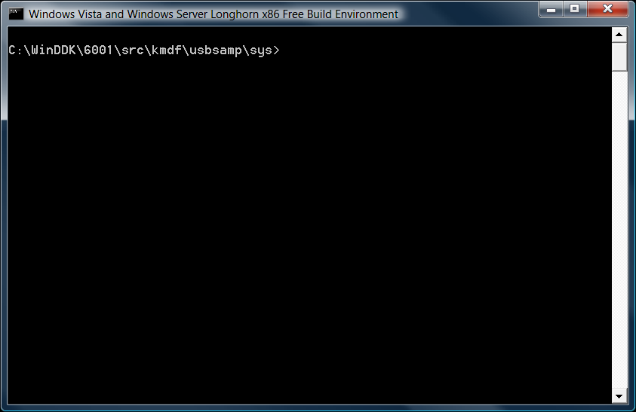
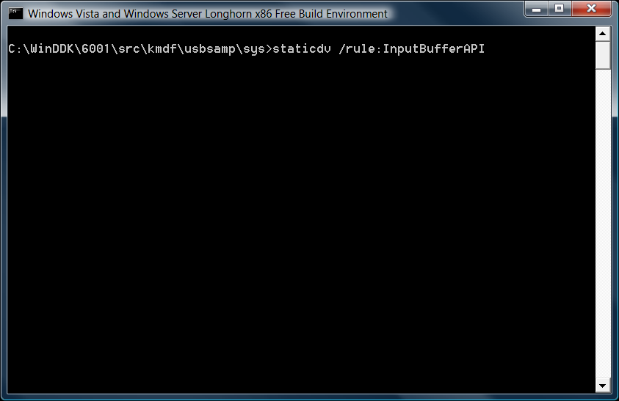
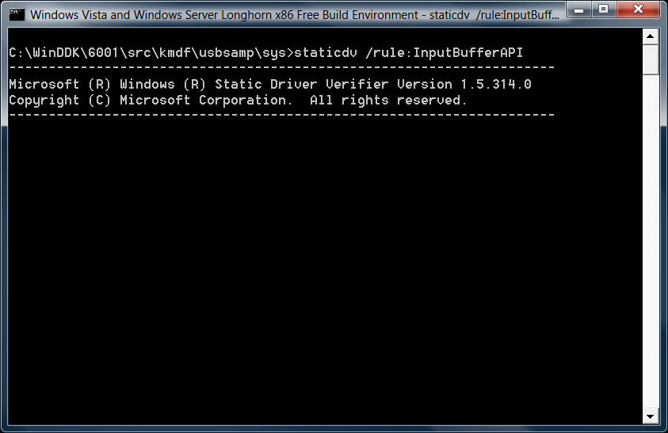
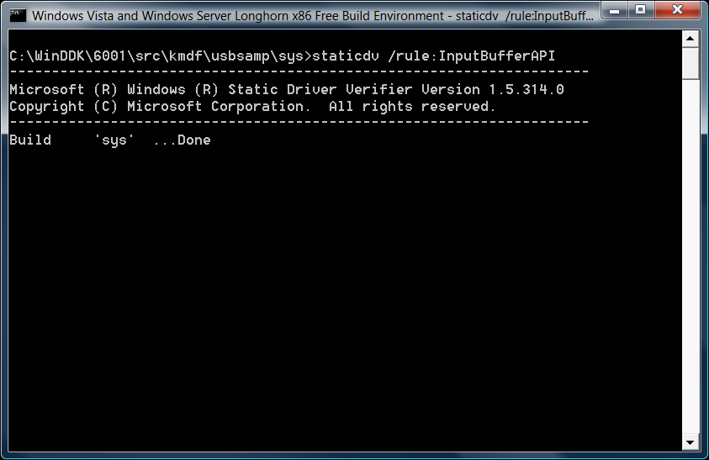
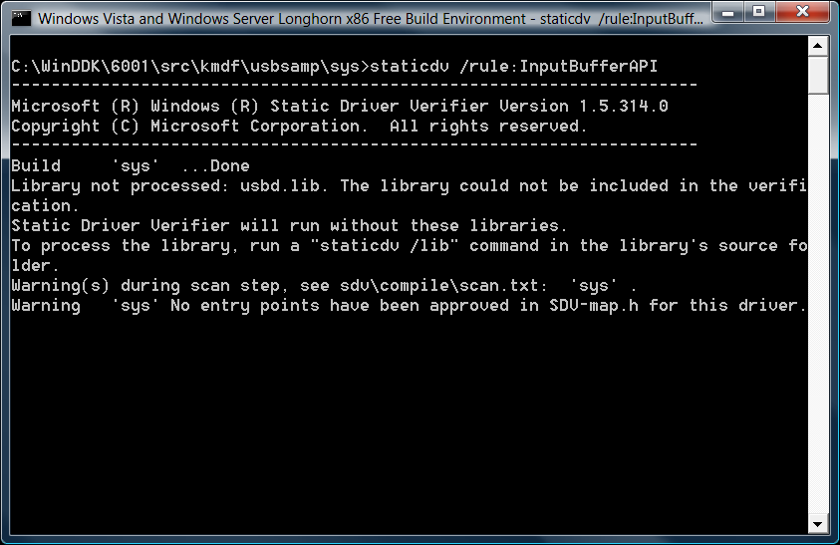
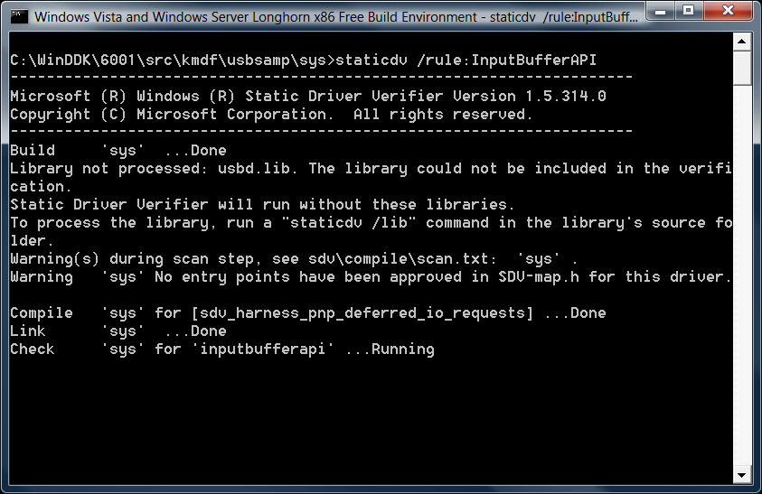
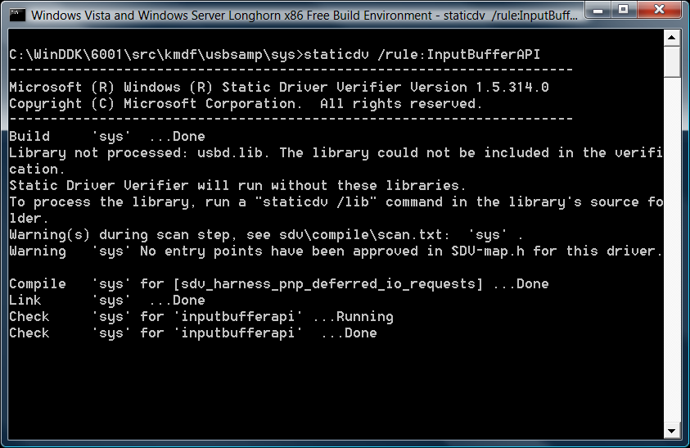
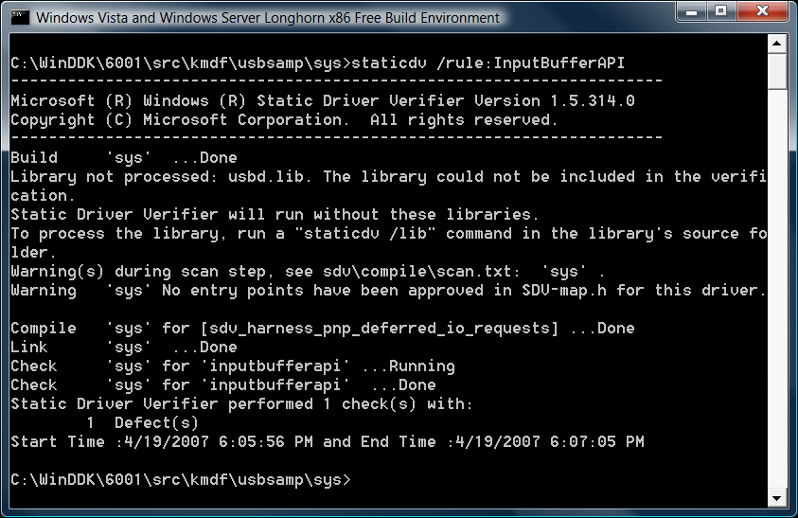
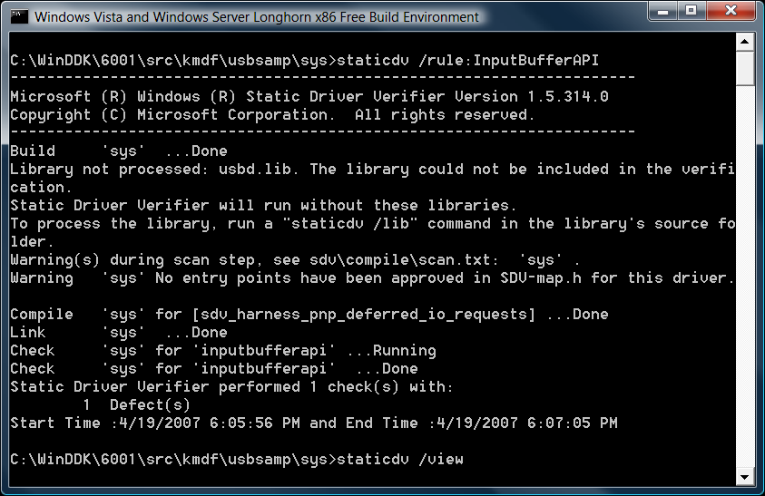

Slide 12
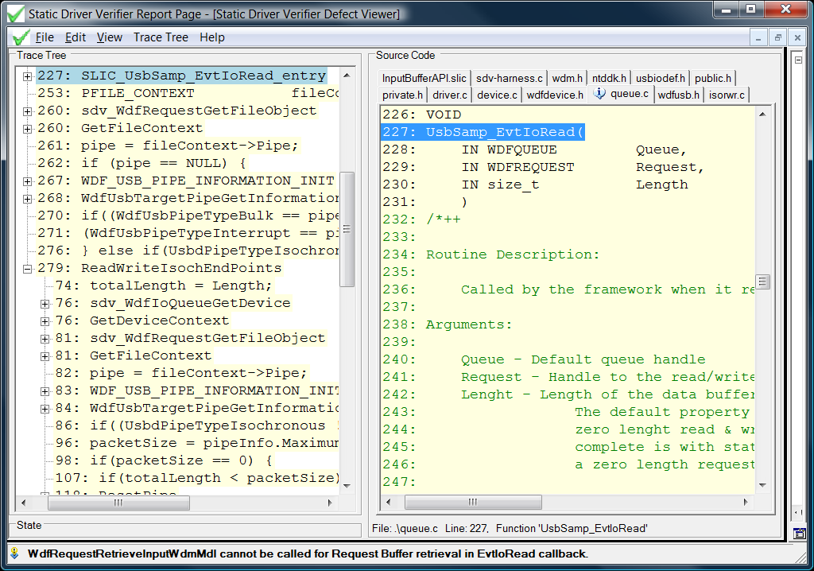

Slide 13
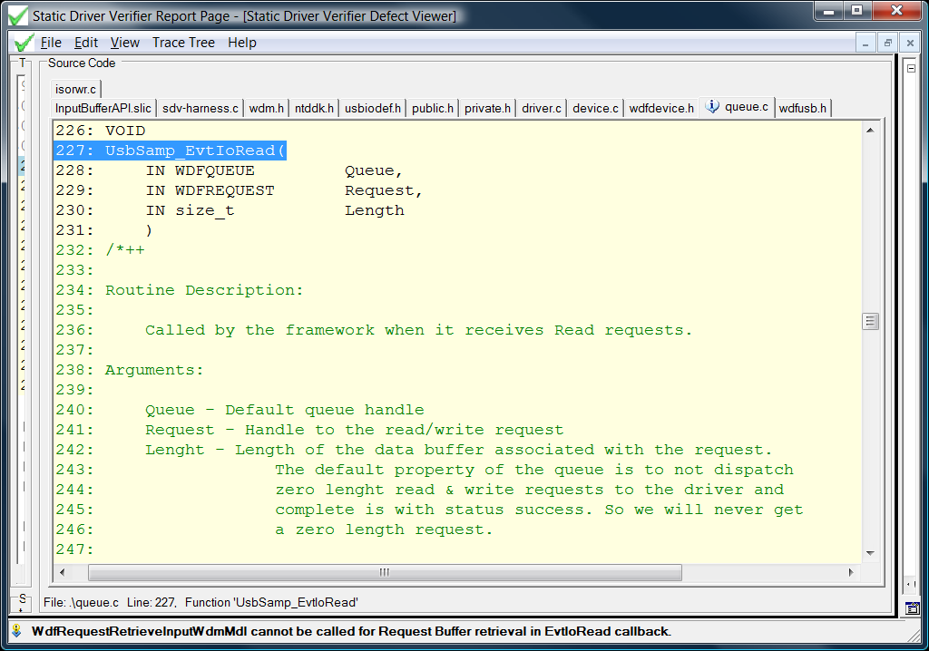

Slide 14
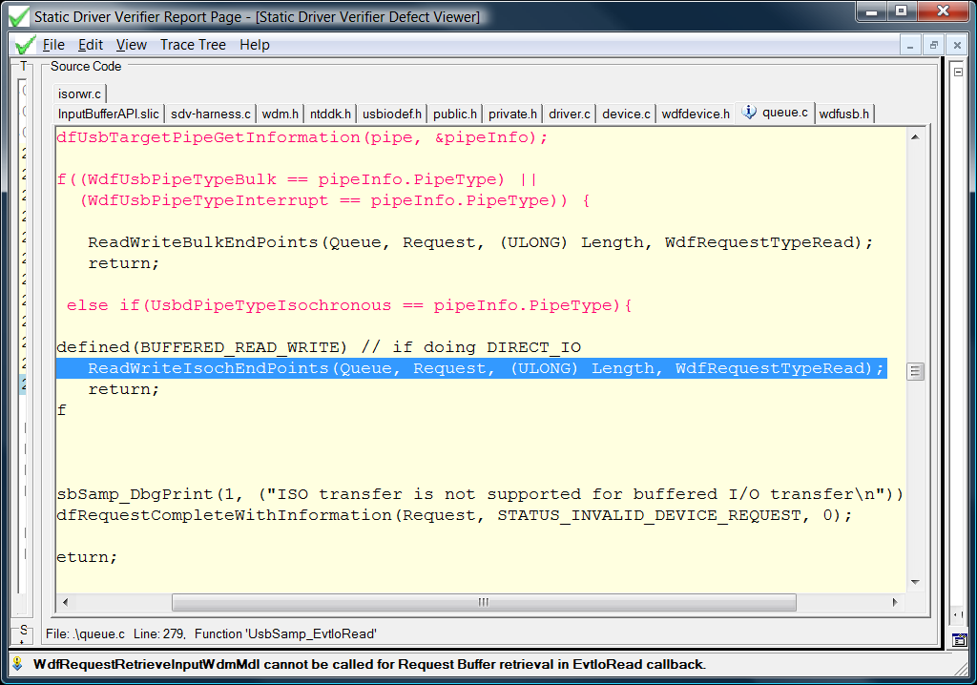

Slide 15
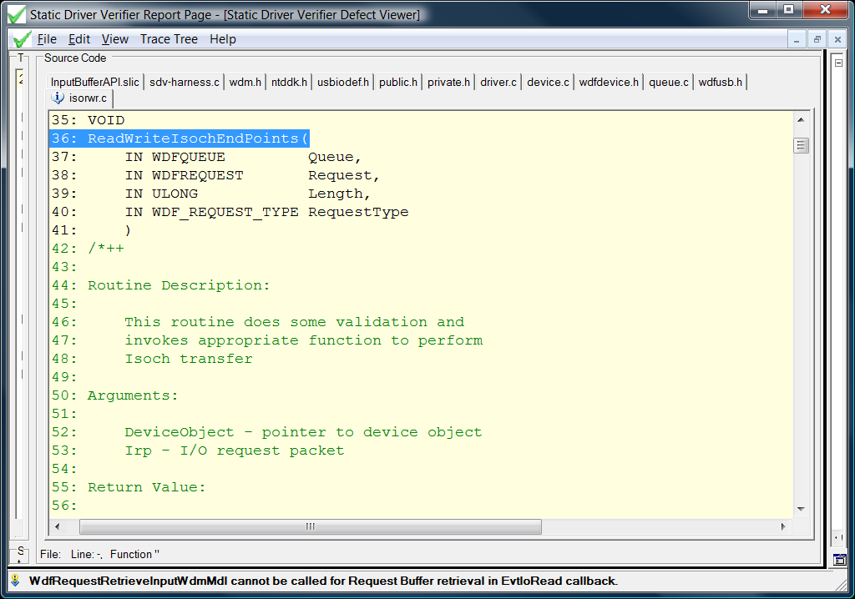

Slide 16
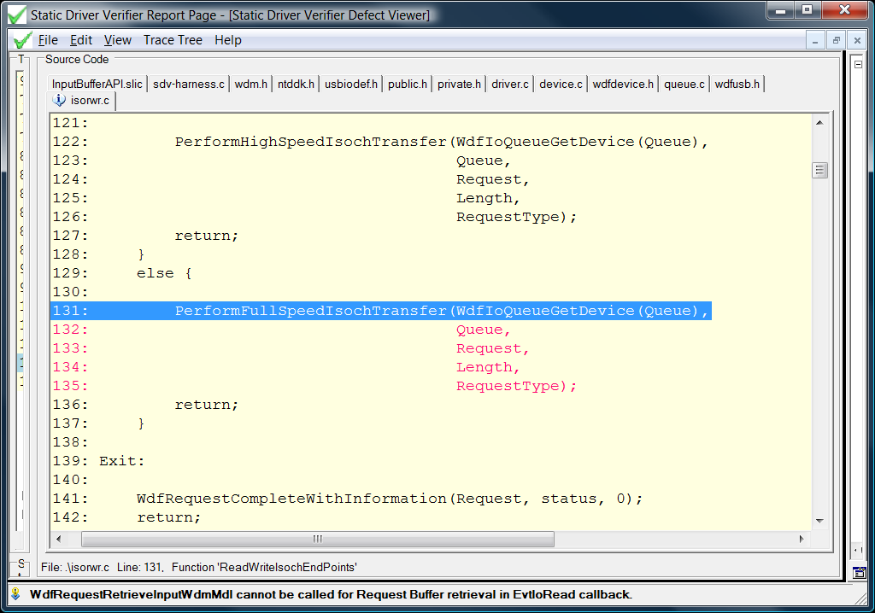

Slide 17
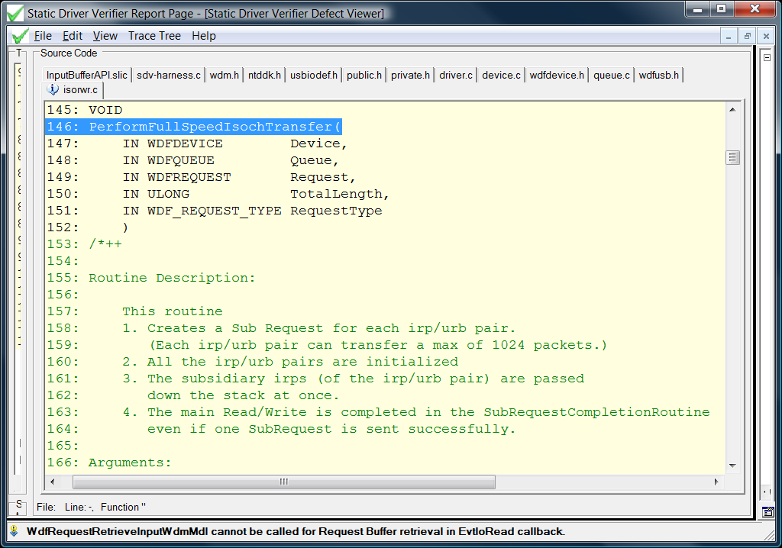

Slide 18
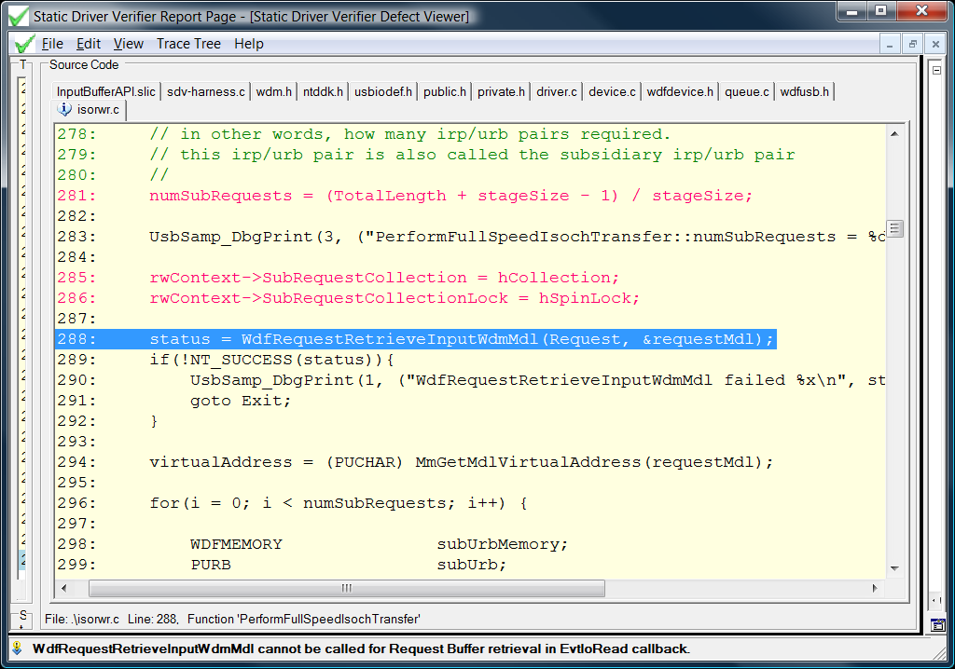

Slide 19
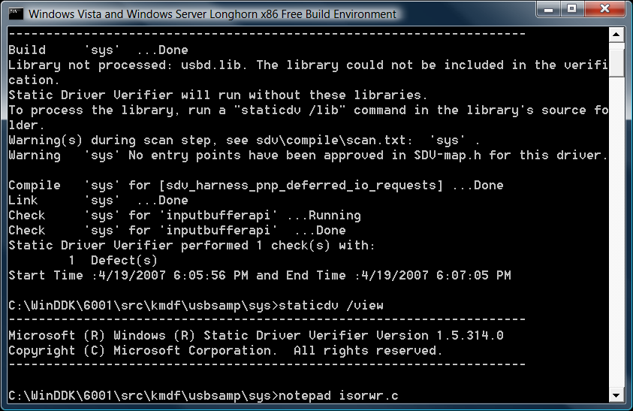

Slide 20
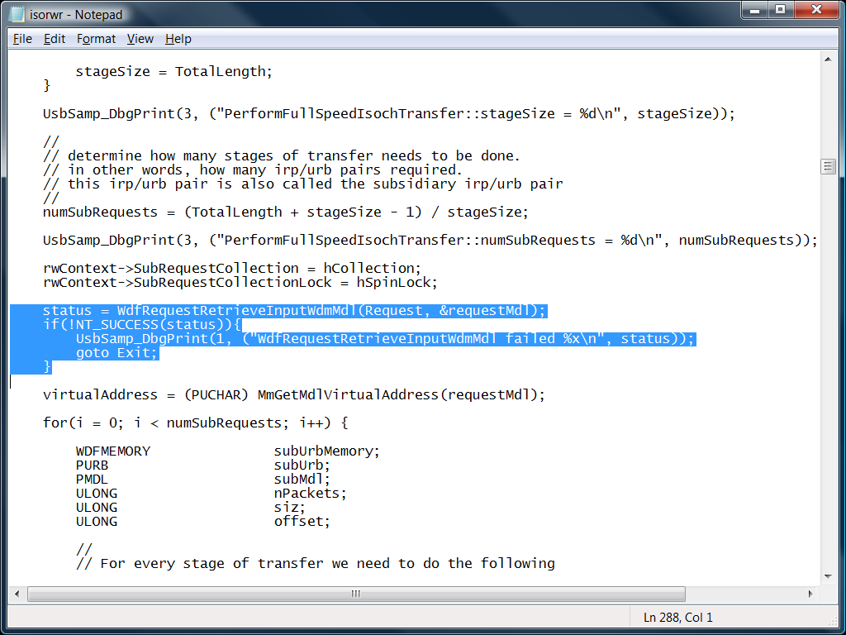

Slide 21
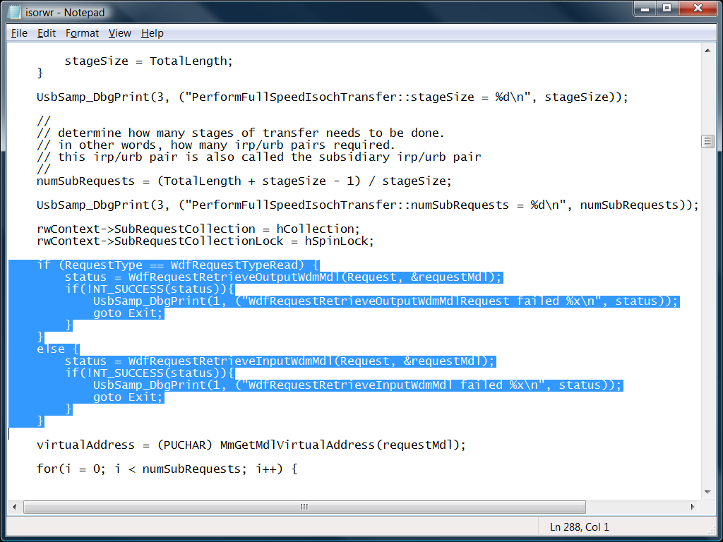

Slide 22
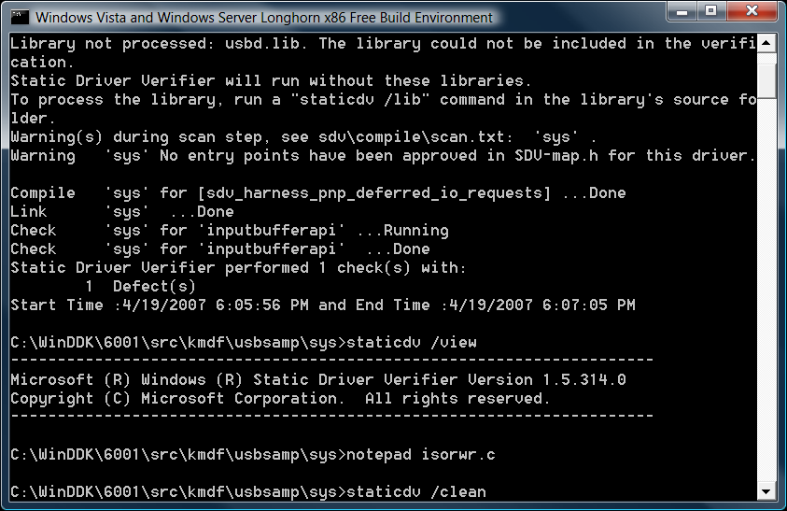
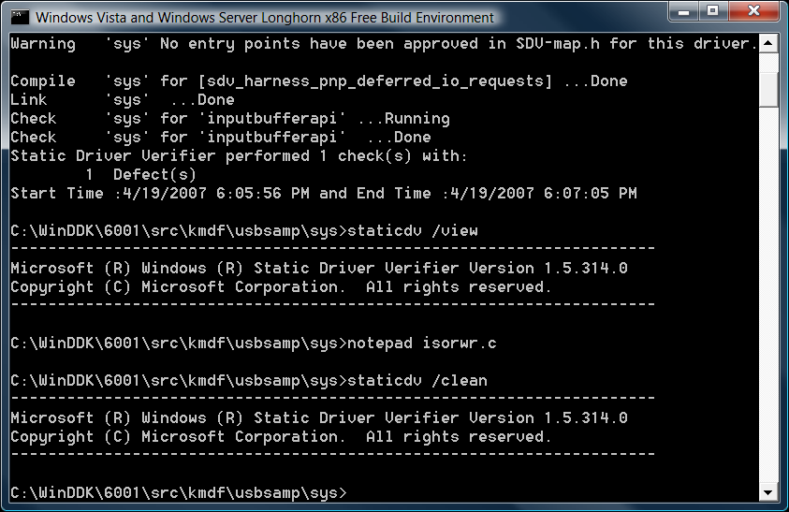
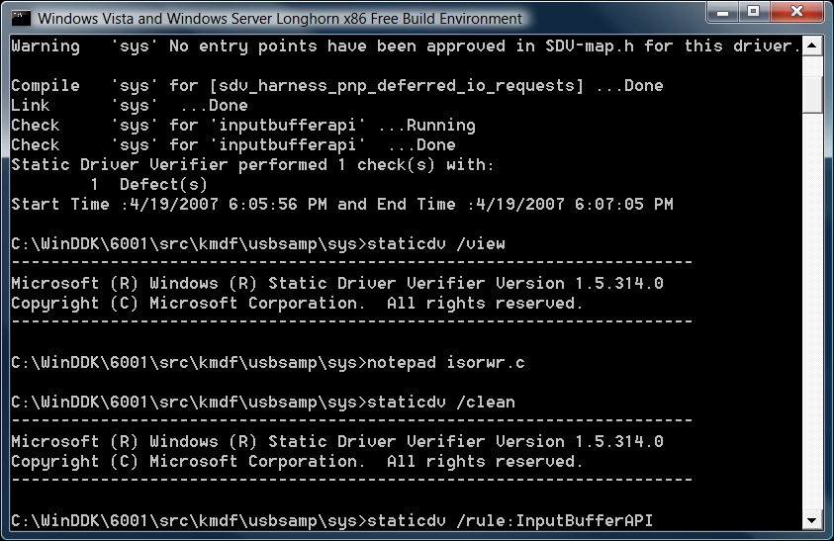
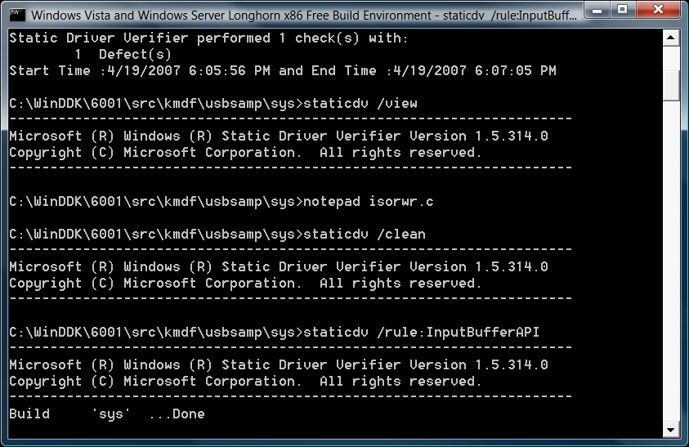
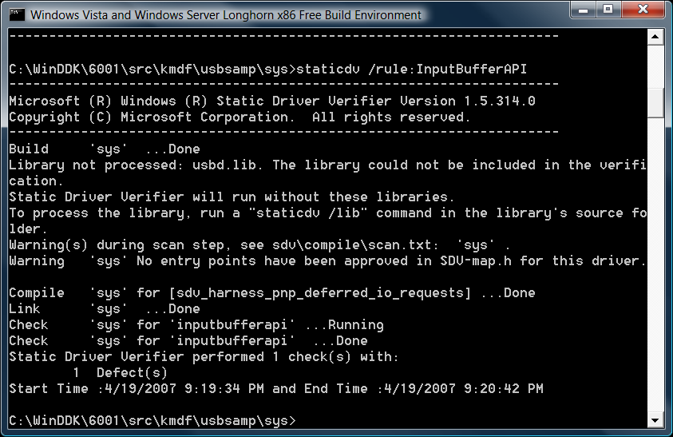
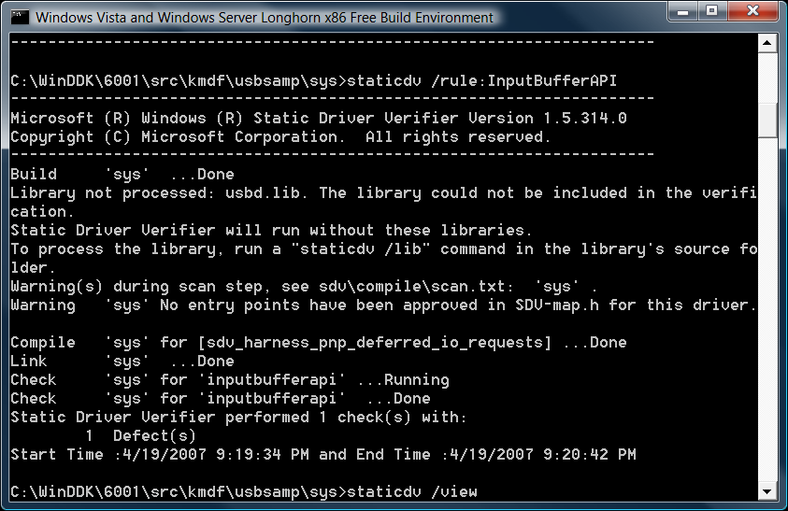

Slide 23
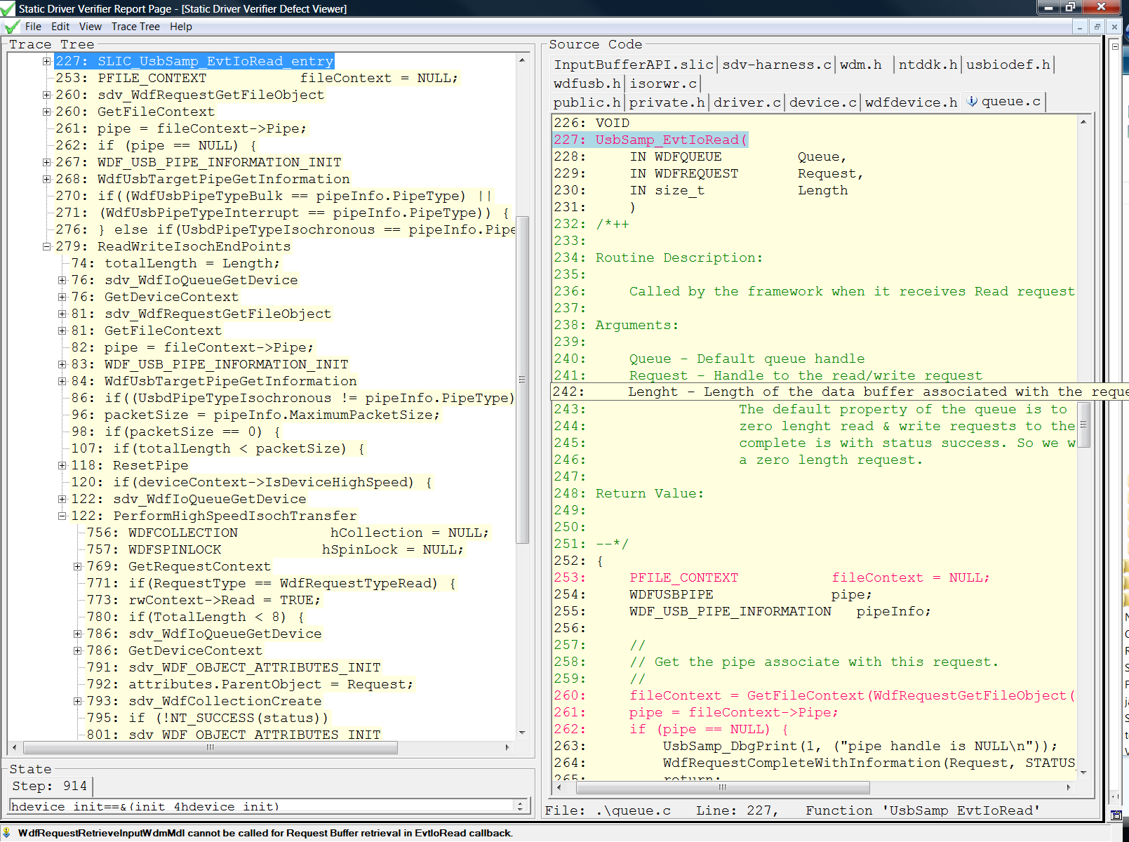
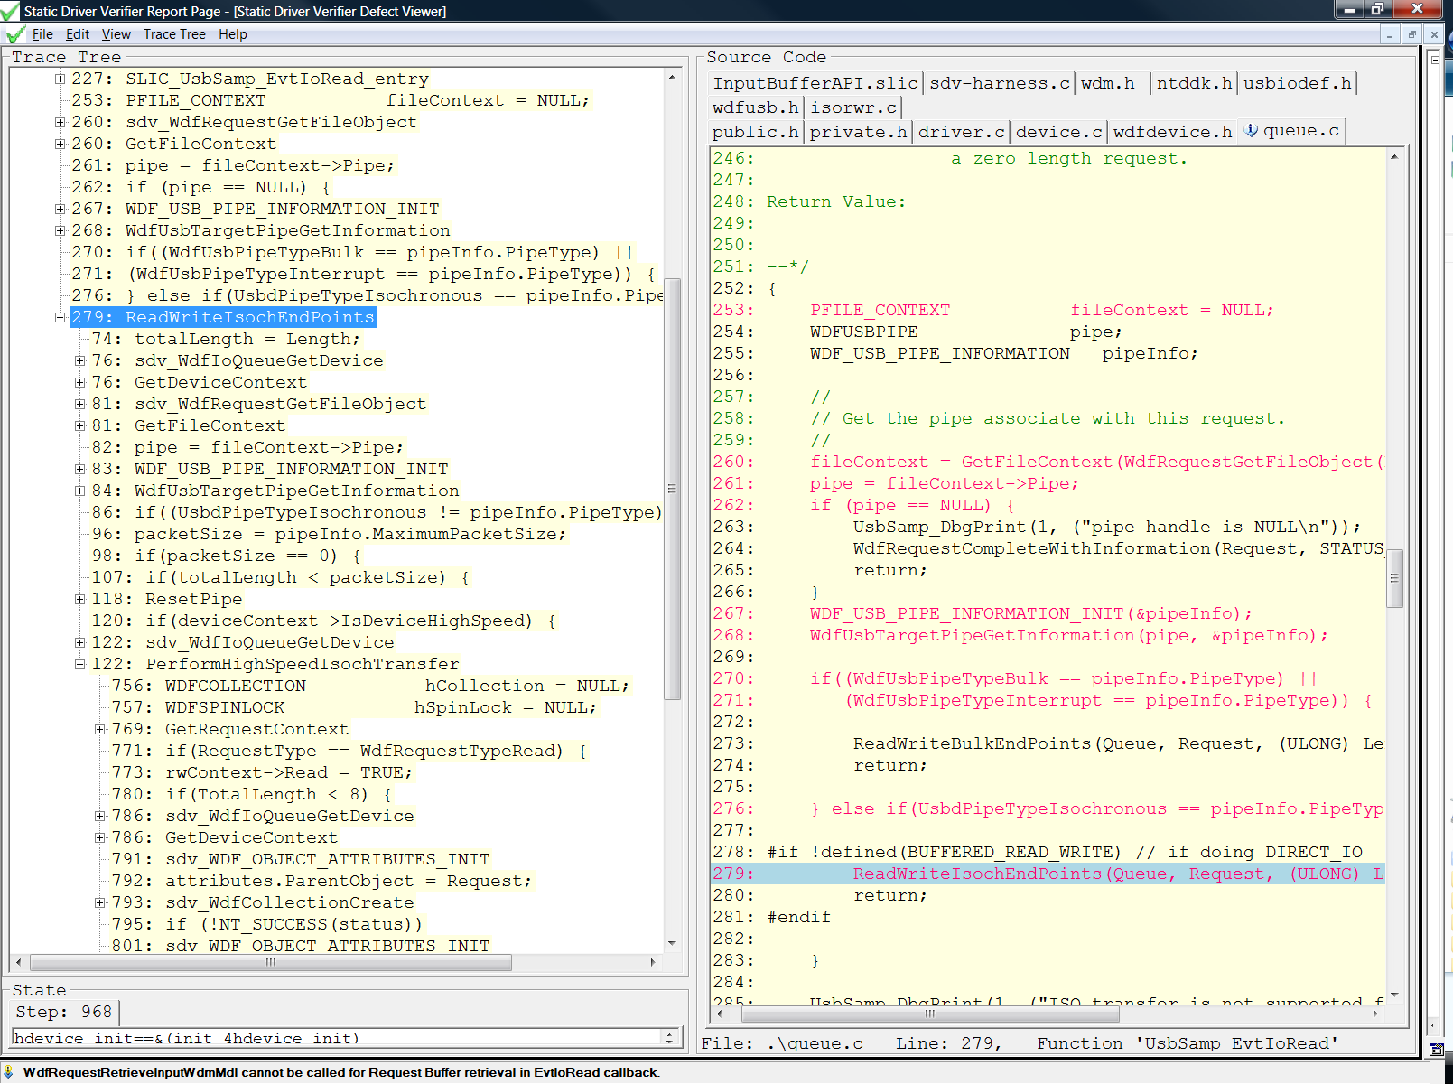
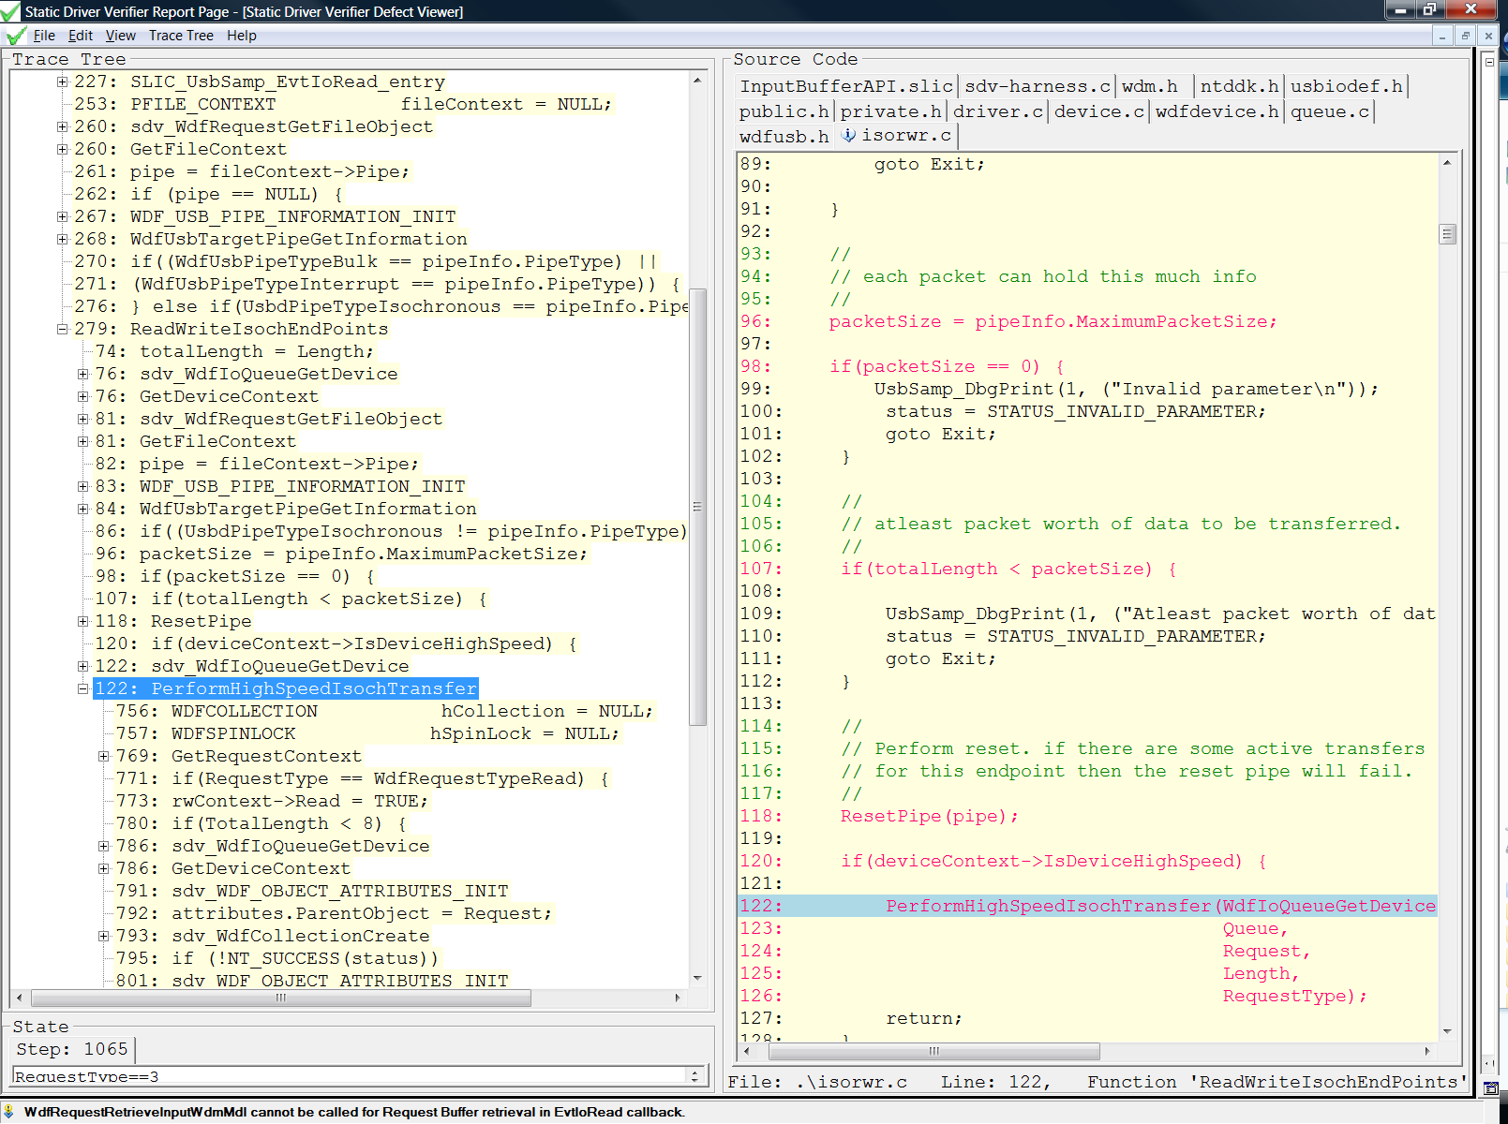

Slide 24
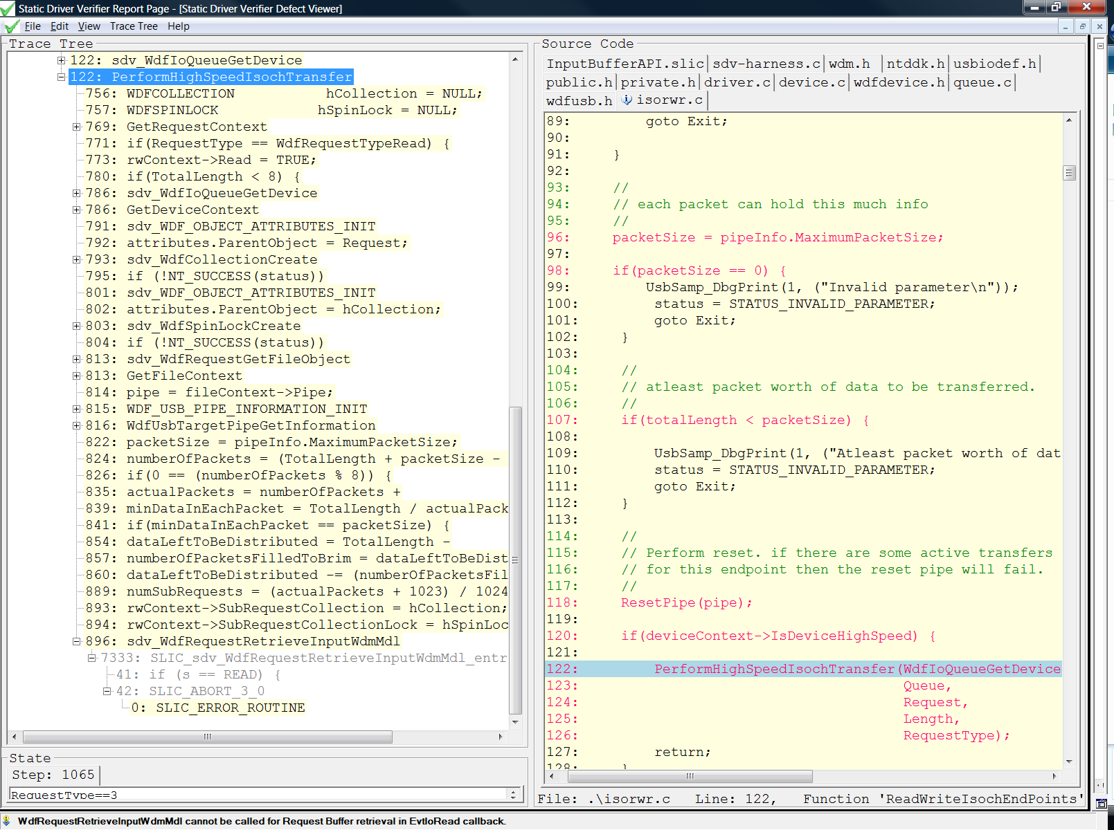
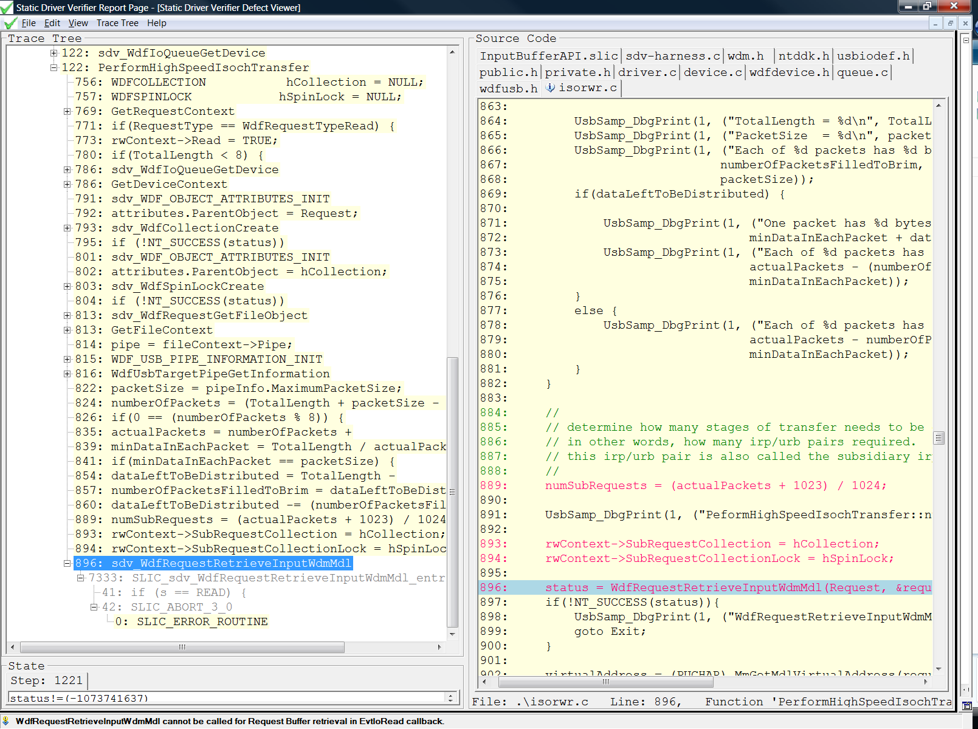
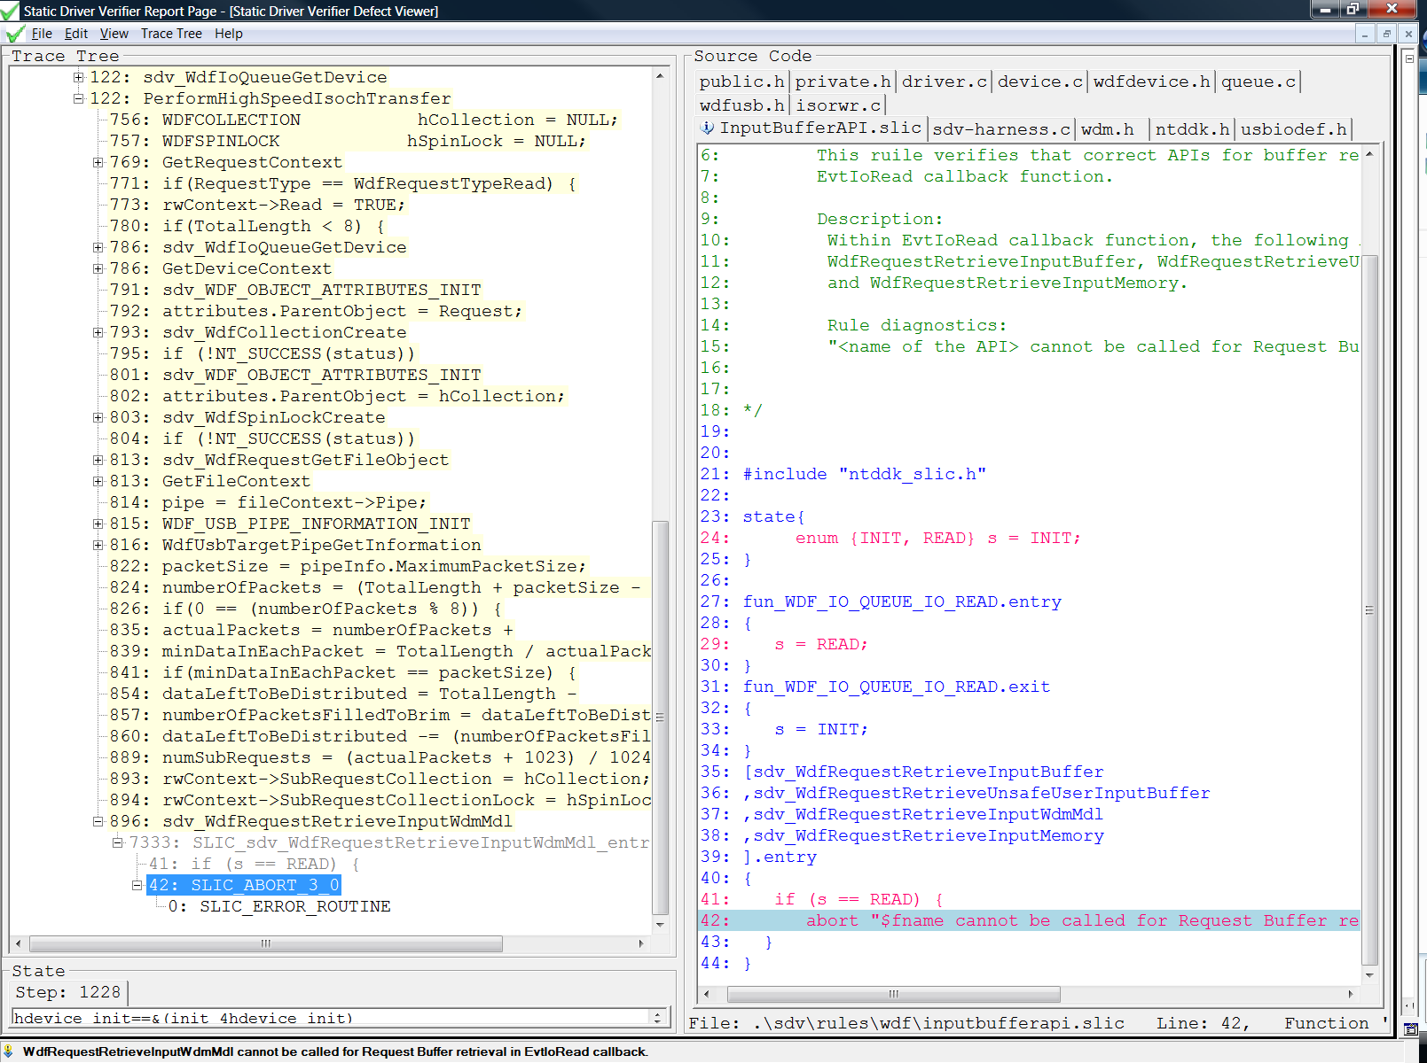

Slide 25
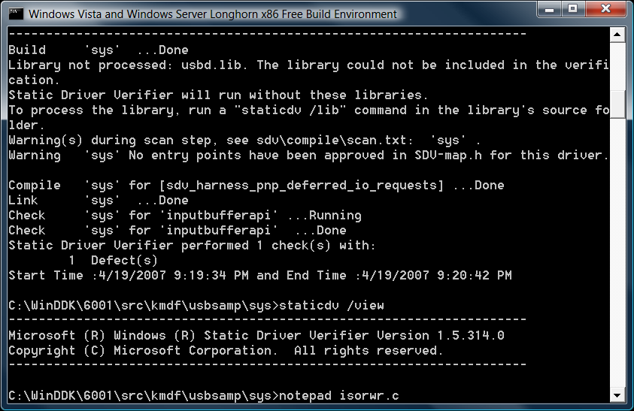
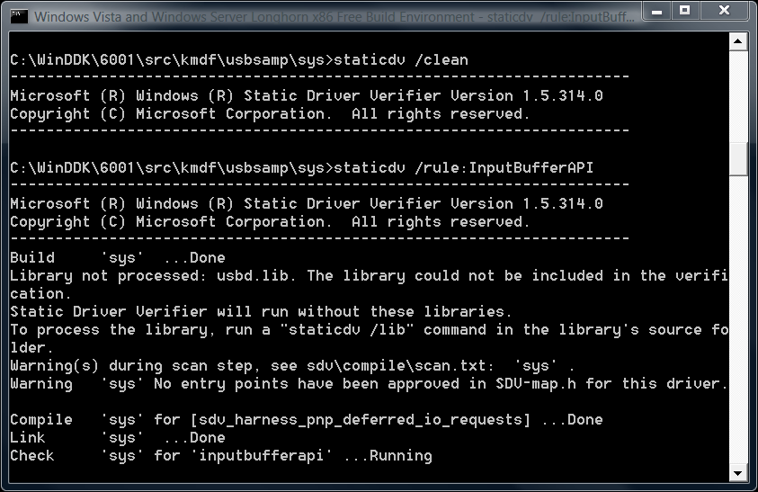
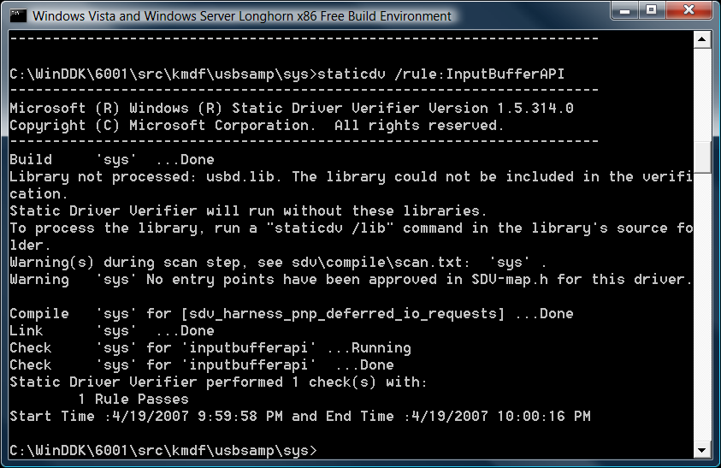

Slide 26
KMDF Rules
Rule Category | Types of DDIs
DDI order (4) | Dependent DDIs
Device Init (4) | WDFDEVICE_INIT-related
Control Dev cleanup(2) | WdfDeviceCreate/ WdfObjectDelete
Request Completion (5) | WDFREQUEST-related
Request Cancellation(6) | WDFREQUEST-related
Req Buf/Memory/Mdl(26) | Req Buf/Memory/Mdl access
Power Policy Owner (5) | Power Policy-related DDIs

Slide 27
Precondition Rules
rule P with (“pass” | “fail” | “N/A”) ⇒ R
Apply rule R only if the application of rule P produces a certain result, which might be either “pass”, “fail” or “N/A”
Precondition rule P reveals a type of the driver. Rule R is applicable only to drivers of type P
Example of a precondition: rule FDODriver

Slide 28
Preconditions For Power Policy Owner Rules
Power Policy Owner Rules | Precondition: FDODriver
NonFDONotPowerPolicyOwnerAPI | Fail
FDOPowerPolicyOwnerAPI | Pass

Slide 29
Role Types In KMDF
Inform SDV about the distinct roles defined for callback functions in KMDF
Must be added to your driver’s source code (header files)
Example
EVT_WDF_DEVICE_FILE_CREATE MyFileCreate;

Slide 30
Role Types Clarify Function Purpose
MyKMDFdriver.h:
VOID
MyEntryPoint1 (
IN WDFQUEUE Queue,
IN WDFREQUEST Request,
IN size_t Length
);
VOID
MyEntryPoint2 (
IN WDFQUEUE Queue,
IN WDFREQUEST Request,
IN size_t Length
);
KMDF Headers:
typedef
VOID
(EVT_WDF_IO_QUEUE_IO_READ) (
IN WDFQUEUE Queue,
IN WDFREQUEST Request,
IN size_t Length
);
typedef
VOID
(EVT_WDF_IO_QUEUE_IO_WRITE) (
IN WDFQUEUE Queue,
IN WDFREQUEST Request,
IN size_t Length
);

Slide 31
Role Types Clarify Function Purpose
MyKMDFdriver.h:
EVT_WDF_IO_QUEUE_IO_READ MyEntryPoint1;
EVT_WDF_IO_QUEUE_IO_WRITE MyEntryPoint2;
KMDF Headers:
typedef
VOID
(EVT_WDF_IO_QUEUE_IO_READ) (
IN WDFQUEUE Queue,
IN WDFREQUEST Request,
IN size_t Length
);
typedef
VOID
(EVT_WDF_IO_QUEUE_IO_WRITE) (
IN WDFQUEUE Queue,
IN WDFREQUEST Request,
IN size_t Length
);

Slide 32
Questions, Feedback, And Discussion
SDV
What are your major issues with using SDV?
Do you have any rule ideas for SDV?
What driver models are important for you and how important is
SDV with C++ support?
SDV with NDIS support?
SDV with UMDF support?
What version of the WDK will you use?
KMDF Adoption
Is SDV for KMDF a useful add-on?
Have you developed any KMDF drivers?
Will you be adopting KMDF and for what kind of drivers?
For older drivers: Will you rewrite portions of the driver to perhaps use PNP and Power Management features from KMDF?

Slide 33
© 2007 Microsoft Corporation. All rights reserved. Microsoft, Windows, Windows Vista and other product names are or may be registered trademarks and/or trademarks in the U.S. and/or other countries.
The information herein is for informational purposes only and represents the current view of Microsoft Corporation as of the date of this presentation. Because Microsoft must respond to changing market conditions, it should not be interpreted to be a commitment on the part of Microsoft, and Microsoft cannot guarantee the accuracy of any information provided after the date of this presentation. MICROSOFT MAKES NO WARRANTIES, EXPRESS, IMPLIED OR STATUTORY, AS TO THE INFORMATION IN THIS PRESENTATION.

