Slide 1






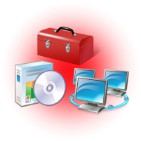
Desktop Virtualization
Microsoft delivers a broad range of desktop virtualization offerings to address your unique business and IT challenges
Data &
User Settings
Folder Redirection
Roaming Profiles
Data
Applications
Applications
Application Virtualization
RemoteApp™
Operating
System
Hardware
Operating
System
Virtual Desktop Infrastructure (VDI)
Session Virtualization
Image Management
Enterprise Desktop Virtualization
Notes:
With Desktop Virtualization, we have broken the bonds between the OS, Application, and Data and User Settings. With Virtualization solutions in each of these areas, we provide our customers the ability to provide the best solution for the customer depending on the individual need.
For Data and User Settings: Folder redirection and roaming profiles having the user’s personal profile and data available dynamically on any authorized PC. Providing companies with the ability to back up personal profiles and data to the data center.
Solutions:
Application Virtualization: Providing end users with the ability to have their business applications available on any authorized PC. Decoupling applications from the operating system (OS) and helping to eliminate application-to-application incompatibility, because applications are no longer installed on the local client machine. In addition, application streaming expedites the application delivery process so that IT no longer needs to install applications locally on every machine.
Remote App : programs that are accessed remotely through Terminal Services and appear as if they are running on the end user's local computer. Users can run RemoteApp programs side by side with their local programs. A user can minimize, maximize, and resize the program window, and can easily start multiple programs at the same time. If a user is running more than one RemoteApp program on the same terminal server, the RemoteApp programs will share the same Terminal Services session.
VDI: technology enabling users to access their personalized Windows desktops that are hosted on servers. (performance subject to network connection)
Session Virtualization: Microsoft has been active in Session Virtualization for over a decade. Session virtualization makes it possible for companies to run an application or an entire desktop in one location, but have it be controlled in another. It allows companies to install and manage session-based desktops and applications, or virtual-machine based desktops on centralized servers in the data center; screen images are delivered to the users, and the users' client machines, in turn, send keystrokes and mouse movements back to the server. When using Session Virtualization, administrators can present users with an entire desktop environment, or with their individual applications and data which they require to complete their task. From a user perspective, these applications are integrated seamlessly—looking, feeling, and behaving like local applications.
Enterprise Desktop Virtualization providing companies with the ability to deploy and manage virtual Windows desktops to help enterprises upgrade to the latest version of Windows, without having to worry about application compatibility. Provides companies the ability to run two operating systems on one device, adding virtual image delivery, policy-based provisioning, and centralized management.

Slide 2




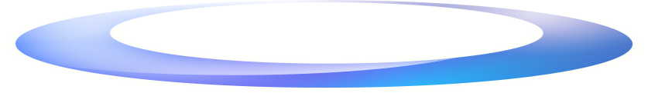
Choices for Desktop Virtualization
Supporting Your Hybrid Environment
App-V/User State Virtualization
for All Desktops
VDI and Remote Desktop Services (RDS) for Every Company
Not Every Desktop
Data &
User Settings
Data &
User Settings
Business Agility and Continuity
Anywhere Access for Users
Comprehensive Set of Solutions
Applications
Applications
Windows Executes Locally
Windows® in
Data Center
Comprehensive Management Tools
Notes:
So we talked about the essential capabilities companies need to deliver on.
Business Agility and Continuity and Anywhere Access for Users.
Microsoft has a comprehensive set of solutions that go across the datacenter and the desktop. We enable companies to run a hybrid environment
VDI is for every company and not for every desktop as it is best suited to certain scenarios (it assumes workers are connected)
For example: Managing unmanaged desktops; For Remote offices with excellent connectivity; Providing greater flexibility for users with existing centralized desktops;
Providing A high level of security as everything is centralized in the datacenter
User State Virtualization and Application Virtualization provide the flexibility for every customer scenario.
There are three reasons for this:
Virtualizing these layers provide immediate TCO benefits. The TCO benefits are well proven today.
These technologies are applicable for users across all your Windows desktops – existing desktops as well as future deployments. This allows companies to realize the TCO benefits on the large population of existing users and increase the impact on bottom line costs.
Last, these technologies lay the foundation for future desktop virtualization deployments. It does not matter what companies plan to deploy in the future (rich-client or thin-client), and for which set of users. Virtualizing applications and user state will be required in almost all cases
Regardless of a company’s virtualization environment, having management capabilities across both the physical and virtual environments is key. Microsoft has a comprehensive unified management infrastructure allowing for a single console to provide integrated management
What do we mean by the management capability that Microsoft offers?
• the ability to deliver to users targeted virtual applications, along with physical applications, in addition to software updates and other configuration management services; Integrated incident awareness, response, problem tracking, help desk support, remediation, recovery, and reporting across physical and virtual PCs/Apps
• Centralized, policy-based management – including deployment, patching, and updating through application termination

Slide 3
IDC Discusses Client Virtualization: Overview, Benefits and Market Trends
Al Gillen
Program Vice President
System Software
IDC
732-842-4276
agillen@idc.com

Slide 4
Agenda
  Industry Highlights
  Market Landscape
  Competitive Assessment
  Future View of the Market
  Essential Guidance

Slide 5
Virtualization Industry Highlights
Client Software
  Client virtualization widely over-generalized as VDI
  Four distinct forms of client virtualization tracked by IDC
    Application Virtualization, Virtual User Session, Centralized Virtual Desktop (CVD, a.k.a. VDI), Distributed Virtual Desktop (DVD)
  Value prop of client virtualization is NOT immediate CapEx reduction, rather measureable OpEx reduction from better management and IT efficiency
  Client virtualization expected to ramp steeply thanks to changing user habits and shifting device form factors
  Server hypervisors are increasingly commoditized, management and user experience are the vendor differentiators
  Microsoft enters market with full product portfolio, intent to be a serious player
  Next-generation users likely to push the envelope on client virtualization services that traditional IT must support
Notes:
Talk about the key term, lead to next slide
Client hypervisor still coming

Slide 6
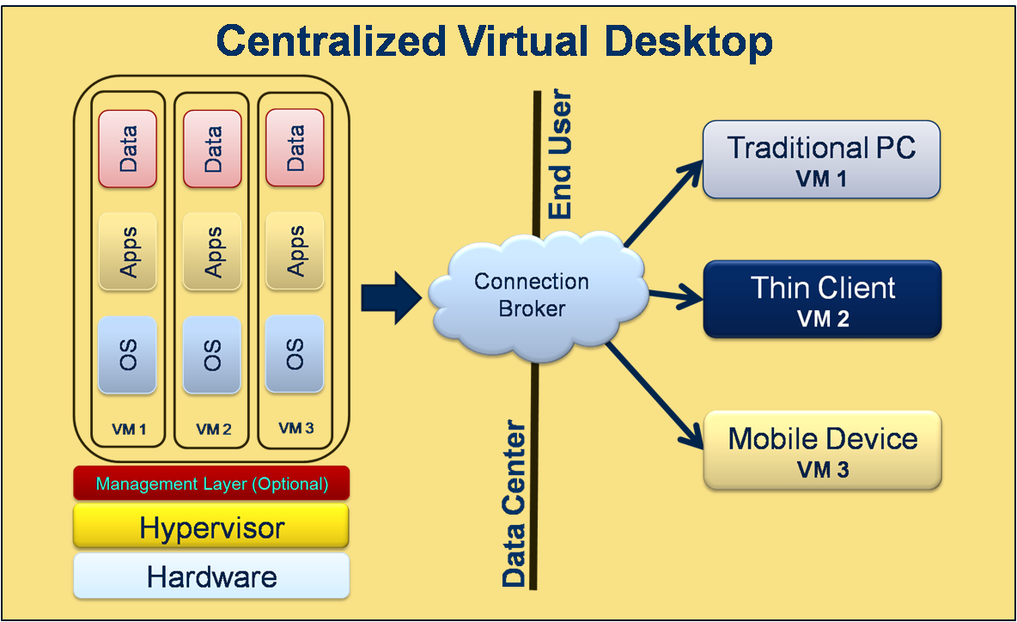
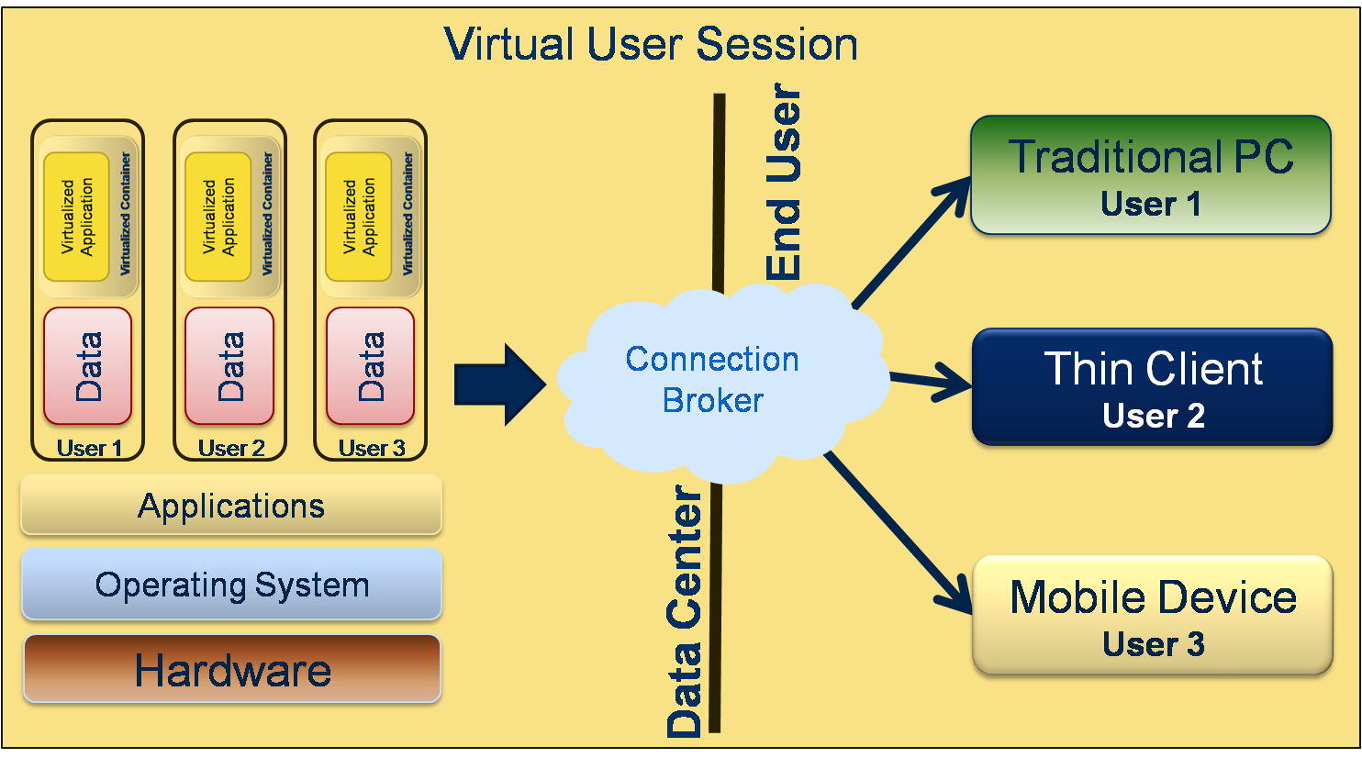
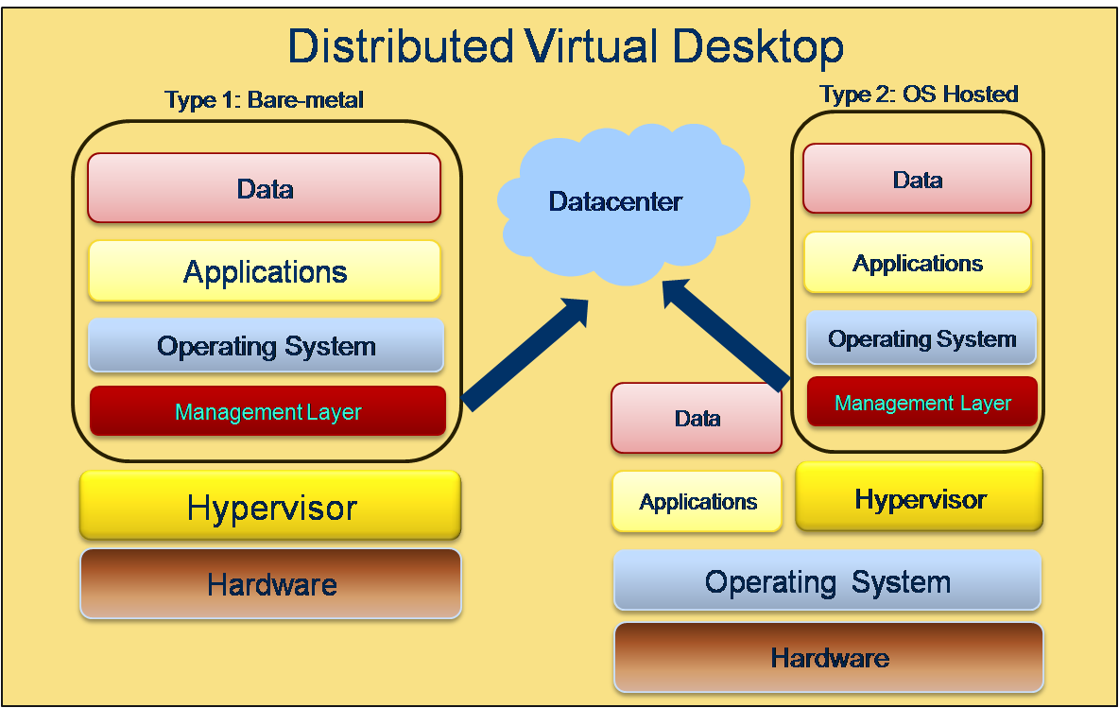
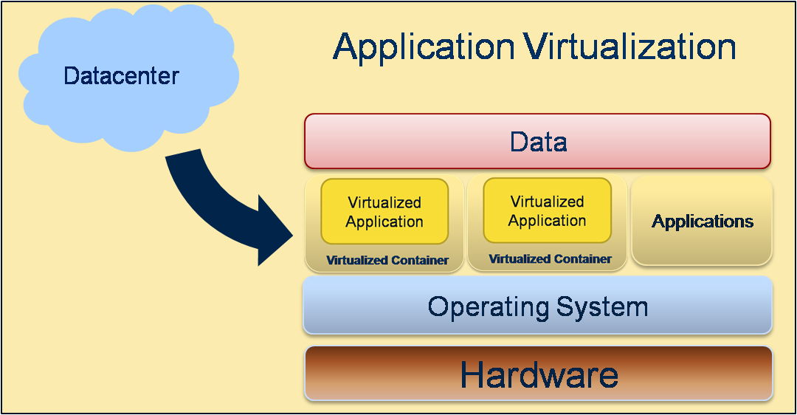
Industry Highlights
Client Virtualization Solutions

Slide 7
Agenda
  Industry Highlights
  Market Landscape
  Competitive Assessment
  Future View of the Market
  Essential Guidance

Slide 8
Drivers for Adoption
Windows® 7 migration
Cost savings/green IT
Business continuity planning/disaster recovery (DR)
PC lifecycle management
Desktop management/helpdesk efficiency
User experience
Cloud integration
Organization-specific drivers

Slide 9
Market Overview
Where We’re Going
Virtualization 1.x
Virtualization 2.0
Virtualization 3.0
The fully virtualized datacenter spans internal and external cloud adaptive, intelligent infrastructure service oriented (IT as a service)
The journey to Virtualization 3.0…
2013+
Virtualization 1.x: Near term
Virtualization 2.0: Emerging
Virtualization 3.0: Future
Integrated cloud management
Holistic monitoring/diagnosis
Cross-hypervisor management
External cloud federation
Platform as a Service
Virtualization-aware applications
Utility billing/chargeback
Automation and Orchestration
Self-service portals
Storage virtualization
Client hypervisor
Integrated physical/virtual management
Policy-based management
Network/IO virtualization
Application Virtualization
2009
Tier-1 Applications
Unplanned downtime
VDI
Resource optimization
Business continuity
…Operational Savings

Slide 10
Market Overview
Client Virtualization Use Cases Expanding
Use cases expanding for client virtualization in and out of the datacenter, and in the cloud, with new use cases still being found
Mature
Emerging
Terminal Services
Server-side virtual machine (VM)
Type-2 client hypervisor
Desktop consolidation
  Client virtualization management
  User experience
  Application management
  Type-1 client hypervisor
Business continuity
  High availability
  Fault tolerance
  Disaster recovery
Resource optimization
  Mobile computing
Notes:
Create more specific use cases, focus on client.
Re-visit maturity and emerging.
Re-create the slide.

Slide 11
Buyer Insights – Client Virtualization
Application Virtualization
Benefits
Eliminates/reduces application conflicts
Legacy application support
Simplify/improve provisioning and management
Enable “follow me” applications
Reduce storage requirement
Good starting point to client virtualization
Challenges
Complexity
Application compatibility
Application interoperability

Slide 12
Buyer Insights – Client Virtualization
Virtual User Session
Benefits
Proven technology
Lower cost
Enable thin computing
High ratio of users per server
Highly managed environment
Challenges
Address only connected users
Limited customization/personalization
Performance depended on network and protocol

Slide 13
Buyer Insights – Client Virtualization
Centralized Virtual Desktops
Benefits
Centralize, simplify management
Enable thin-client computing
Simplify device support and management
Lower service desk costs
Provide business continuity
Challenges
Cost
Complexity
Address only connected users
Performance depended on network and storage

Slide 14
Buyer Insights – Client Virtualization
Distributed Virtual Desktop
Benefits
Ubiquitous computing
CVD type management and enforcement
Reduce initial investment
Enable BYOC
Challenges
Unproven technology
Physical device management
Lower performance for type-2 hypervisors
Requires full PC

Slide 15
Market Landscape
Client Virtualization Software
Solution Providers
Full-Solution Providers
 | User Session | CVD | DVD | Application Virtualization | Management
VMware |  | View | View Offline (Type 2)* | ThinApp | View Manager
Citrix | XenApp | XenDesktop | XenClient* (Type 1) | XenApp | XenDesktop
Microsoft | Remote Desktop Services | VDI Suite | MED-V/XP Mode (Type 2) | APP-V | System Center
* Not yet available

Slide 16
Agenda
  Industry Highlights
  Market Landscape
  Competitive Assessment
  Future View of the Market
  Essential Guidance

Slide 17
Client Virtualization Will Have a Breakout Year in 2010 Thanks to Microsoft
  Expect more production deployments of centralized virtualized desktops in 2010
  Application incompatibilities with Windows® XP and Windows 7 ensure that Windows XP Mode and Microsoft® Enterprise Desktop Virtualization (MED-V) are used to virtualize a guest copy of Windows XP aboard
  Windows® 7 Professional installations
  Microsoft will grab market share by focusing on Windows® compatibility issues
  Competitors focus on accessing desktop from any device in any place
  Bare-metal client hypervisors finally debut in 2010, face adoption hurdles
Source: IDC

Slide 18
Client Virtualization Software Vendor Shares
Worldwide Application Virtualization and Virtual User Session Software 2009 Vendor Shares by Revenue
Vendor | Share
Citrix* | 69.9%
Microsoft | 28.6%
VMware | 0.6%
Symantec | 0.6%
Sun/ Oracle | 0.5%
Quest | 0.2%
Others | 9.2%
* Citrix share represent Presentation Server and Application Virtualization
Source: Software Market Forecaster Database, 2009
Notes:
Talk about Xenapp market-share, be more clear.

Slide 19
Drivers and Inhibitors
Client Virtualization Software
  Drivers
    Full-solution providers are producing maturing products/solutions
    Vendors now offer end-to-end solutions as well as well consulting services to build solutions according to customer needs
    Vendors offers scalable solutions to minimize initial CapEx
    General agreement that VDI is not the only solution
    System integrators offer managed turnkey solutions
    Smaller vendors offer solutions to fill gaps left by bigger vendors
  Inhibitors
    Conflicted messaging from different vendors and integrators
    Full-solution provider product portfolios complex and confusing
    Few vendors offers both physical and virtual desktop management solutions
    There is no catch-all solution for one single vendor
    Initial deployment costs for CVD is still high
    Client virtualization deployment is still complex

Slide 20
Agenda
  Industry Highlights
  Market Landscape
  Competitive Assessment
  Future View of the Market
  Essential Guidance

Slide 21
Market Outlook
Client Virtualization
2009:
- Client Virtualization begin to get noticed
- CVD is the dominate solution
- A lot of pilots, no real deployments
- Not much in terms of management
2010:
- Real deployments emerge
- Client hypervisors release
- Management getting better
- CVD still dominate market
- Use cases more widely available
2011:
- Additional industry verticals to adapt client virtualization
- Solutions finally maturing
- Vendors integrate CVD with DVD
- DaaS solutions maturing
2012:
- Industry to consolidate
- Client Virtualization becoming a service
- Deployment cost decrease dramatically
- SMB begin to adapt (through SI and DaaS)
Client Virtualization 1.0
Client Virtualization 2.0

Slide 22
Agenda
  Industry Highlights
  Market Landscape
  Competitive Assessment
  Future View of the Market
  Essential Guidance

Slide 23
Essential Guidance
Client Virtualization Software
Client Virtualization 1.0 was easy
  Server virtualization mindset, focus on CapEx reduction
  Little to no management
  High Deployment cost, low efficiency, low utilization
  Client Virtualization 2.0 will be hard
  Must understand client virtualization value lies with OpEx reduction and improving resource utilization through management
  Integrate client virtualization into the overall desktop management strategy
  Conduct proof of concept (POC) and pilot to gauge product and user fit
  Recognize that organizations will need to manage the hybrid, both physical and virtual
Notes:
Determine where existing infrastrcuture can continue to deliver ROI now and include virtualization in the future

Slide 24
Essential Guidance
Process for Adaption
Determine where existing infrastructure can continue to deliver return on investment (ROI) now, and include virtualization in the future
Create solid business cases client virtualization can address
Gain buy-in or sponsorship from senior management
Recognize both the technical limitations and the business value of available virtualization technologies
Evaluate vendors with pilot programs
Create proof of concept and define target user groups
Begin deploying virtual desktop solutions to the selected user groups
Stage deployment to maintain proper capacity management
Scale deployment depend on the success of initial deployment
Notes:
Determine where existing infrastructure can continue to deliver ROI now and include virtualization in the future

Slide 25
Questions and Answers
Submit text questions using the “Ask” button.
Don’t forget to fill out the survey.
For upcoming and previously live webcasts: www.microsoft.com/webcast
Got webcast content ideas? Contact us at: http://go.microsoft.com/fwlink/?LinkId=41781

Slide 26

Questions
Al Gillen, Program VP
agillen@idc.com
732-842-4276
For more information on the Enterprise Virtualization CIS and published research, please visit: www.idc.com and search using this service name.

