Slide 1
Application and Multi-Server Management
<name> <title, group>

Slide 2
Information Platform Vision
Pervasive Insight
Empowered IT
Dynamic Development
MISSION CRITICAL PLATFORM
Desktop & Mobile
Server & Datacenter
Cloud
Notes:
Before we get started, let’s take a quick look at Microsoft’s Information Platform Vision, an evolution from the Data Platform Vision seen with previous releases.
Now more than ever, organizations have the need to use information management to compete and grow in a difficult market by reducing costs and identifying the highest value opportunities for their organization.
As we engage with customers, you explain the pressures you have to deliver more real-time information through rich applications while also reducing costs in this new economy.
We understand that at the center of delivering on these business needs there are people - IT Professionals, who support the expanding information needs of the business through IT services, Developers who build solutions in time to capture business opportunities in an increasingly competitive market and Business Users, who quickly mine volumes of data for business insights to help increase customer satisfaction and drive business results. Microsoft, along with our worldwide partners, is committed to deliver an Information Platform which enables your people and provides you with a complete set of technologies and tools to help you realize more value from your information at the lowest total cost of ownership. As we invest in the Information Platform we think about what we need to deliver to customers in each of these 4 areas:
Mission-Critical Platform
Mission-Critical Platform for all your application requirements, delivered with the industry’s best TCO From the server to the datacenter, Microsoft is dedicated to ensuring your applications and systems are reliable, highly available, secure and deliver superior, predictable performance is top priority for IT and for Microsoft. Interoperability across the Windows Server platform, System Center, and SQL Azure help ensure greater resource utilization to reduce administration overhead, greater mission critical support and greater agility to dynamically scale to support changing and growing business needs.
Dynamic Development
Integrated tools to help Developers more quickly build rich, intuitive and connected applications
Developers are continually asked to deliver richer applications and services while lowering the time-to-solution to adapt to business needs and opportunities. With interoperability across Visual Studio, the .NET Framework, and SQL Server developers have a highly productive platform to deliver data through their applications and to collaborate more efficiently with IT on deployment needs and requirements. This also gives developers the power to build applications for deployment across devices, desktops, the datacenter, and the cloud.
Pervasive Insight
A complete Business Intelligence platform that enables users across the organization to derive greater insights through familiar tools
Business Intelligence continues to be the #1 priority for CIOs. Even as budgets are cut IT is asked to do more to deliver information to the business. Getting the right information to the right person at the right time is critical for success now more than ever. This requires providing access through familiar tools to end users while also providing IT the ability to manage and secure access to the information. Microsoft helps companies consolidate information, deliver access and empower users at all levels of the business: strategic, tactical and operational decision makers.
Closing
Looking across the Information Platform, we think about delivering capabilities that can better support our customers’ information needs. Looking across the Information Platform, the ability to dynamically respond to customer needs could be built by working with your development organization to develop a new application or extending an existing application, partnering with IT to support the application through greater utilization of existing assets, and delivering information to business users through familiar tools, enabling customers to much more quickly identify and capture business opportunities.
The Information Platform delivers the rich capabilities of SQL Server and SQL Azure to enable IT, developers and end users to deliver on your most critical business needs and maximize the value of your information throughout the organization at a low cost of ownership.

Slide 3
SQL Server 2008 – Strong Release
SQL Server IS mission critical
20+ points increase in all DB Tracker perception metrics
Better value – less expensive up front, easier to manage
TRUSTED PLATFORM
Highest DBA productivity
Industry-leading developer tools
Extend apps to the cloud with SQL Azure
PRODUCTIVITY
Strong, winning strategy
Build BI into the stack, through familiar tools for users
Gartner MQ leader for BI platforms
BUSINESS INTELLIGENCE
Notes:
SQL Server 2008 R2 builds on the foundation of SQL Server 2008.
SQL Server 2008 delivered a trusted, productive and intelligent platform.
The enhancements and new capabilities engineered into SQL Server 2008 help enable your applications to run better and reduce the amount of time you need to spend managing them.
Customers running existing applications on SQL Server 2000 or 2005, will find a set of exciting new capabilities to improve your applications and reduce support needs within a familiar management interface on the 2008 platform. SQL Server 2008 R2 builds on the 2008 platform with investments for even more efficiencies and insights.

Slide 4
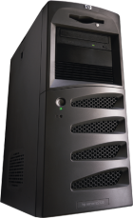
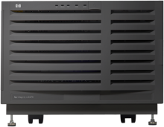
TRUSTED, SCALABLE PLATFORM
IT & DEVELOPER EFFICIENCY
MANAGED SELF-SERVICE BI
Enterprise-level security, scalability
High-scale, complex event processing
Data consistency across heterogeneous systems
Multi-server management
Accelerated development & deployment
Virtualization & Live Migration
Self-service analytics
Self-service reporting
Streamlined collaboration & management
COMPREHENSIVE PLATFORM FOR IT VALUE
MPP support for 10s-100s TB DW
Highly scalable appliances
Seamless BI Integration
Scalable relational database platform
Consistent, familiar model & tools Self-managed, highly available cloud service
Notes:
Built on the trusted, productive and intelligent platform of SQL Server 2008, R2 continues the momentum by offering more investments across the key areas.
Trusted, Scalable Platform, New investments within the area of trusted and scalable are: StreamInsight for Complex Event Processing, Master Data Services for data consistency across heterogeneous systems, SQL Server support for up to 256 Logical Processors – providing greater flexibility in hardware choice, and enhanced data compression including Unicode compression for greater storage efficiency.
IT & Developer Efficiency, New investments within the area of efficiency are: Application and Multi-Server Management for resource optimization and deployment efficiencies plus R2 support for Windows Server 2008 R2 Hyper-V Virtualization and Live Migration.
Managed Self Service BI – New investments in our intelligent promise bring customers managed self-service BI. Self-service analytics is delivered with PowerPivot – which is about enabling users to get the data they need without IT having to do a 6-month project to create a new application. PowerPivot gives users the power and flexibility to take internal data, integrate it with other information – and within Excel do all the slicing and dicing you need to get to the view of information you really need for decision making. This is all done “in memory” through really high compression in RAM – which is very powerful. None of the other major BI vendors can do this. User can easily share their application with others by publishing it to SharePoint.
SQL Server 2008 R2 delivers choice through a comprehensive platform: On the high end, Microsoft introduces Parallel Data Warehouse for massive parallel processing support for 10s to 100s of Terabytes. While interoperability across on premise and off premise comes to life with SQL Server 2008 R2 and SQL Azure. SQL Azure offers customers choice in a 100% outsourced relational database platform.
CLICK: Today we’ll talk about Application and Multi-Server Management

Slide 5
Challenges: People vs. Hardware
Trends
Database apps increasing at a higher rate than DBAs
Overburdened DBAs
Hardware computing capacity exploding
Underutilized hardware
Underutilized Hardware
Hardware computing capacity
Number of database apps
Overburdened Administrators
Number of DBA’s
1990
2000
2010
Notes:
Before we dive into the improvements around Application and Multi-Server Management, let’s talk quickly about the challenges IT departments face, specifically DBAs.
First, the number of database applications are increasing at a faster rate than DBA resources. Meanwhile, hardware computing capacities are exploding, leaving a large majority of servers tremendously under-utilized. However, each hardware resource still requires the same level of maintenance to ensure compliance, SLAs and performance.
This is not optimal for customers.

Slide 6
Challenges: Real world problems
Customer Survey Results:
Hundreds of small database apps
>99% use a single database file
Average size is < 2 Gb
NUMBER OF APPS
Number of Apps
CRM
ERP
APP SOPHISTICATION
Findings confirm challenges
Focus on tier 2-3 apps
App Sophistication
Notes:
What we see driving these challenges across the server environment is the increase in small applications, or sometimes called departmental apps.
To validate this, we’ve done some customer surveying and the results support these trends: organizations have hundreds to thousands of small database apps, >99% of them only utilize a single database file and the average size is < 2GB suggesting the majority of these hardware resources could be consolidated and better managed.
In the diagram to the left you can see a visual representation of this growing trend. From left to right, the application sophistication increases and from bottom to top the number of applications increase.
In the bottom right, you see very large but very few line-of-business applications, these typically have dedicated resources managing them. In the opposite corner, the top left, we see 100-1,000s of small apps, sometimes called departmental apps or tier 2-3 apps. It’s these smaller apps that are growing in numbers at a faster rate than the DBAs can effectively manage. This is where our focus is for SQL Server 2008 R2.

Slide 7
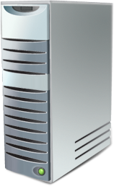
Introducing a Better Way
TODAY
TOMORROW
Control server sprawl with 1 to many management – setup is fast and easy
Manage capacity through policies – save time, optimize resources
DAC
Single unit of deployment – increase deployment and upgrade efficiency
Notes:
So let’s talk about a better way to optimize and manage our growing resources.
With application and multi-server management, organizations will proactively manage database environments more efficiently at scale through centralized visibility into resource utilization and help streamline consolidation and upgrade initiatives across the application lifecycle—all with tools that make it fast and easy.
Control:
Today DBAs manage a growing number of SQL Server instances individually.
With SQL Server 2008 R2, we enable an increase in the ratio of DBAs to databases for management at scale. New tools allow DBAs to set up a multi-server environment in minutes and enroll their sprawling instances into a new SQL Server Control Point.
Optimize Resources: Today with disparate instances and no central management DBAs have hundreds to thousands of underutilized instances running small departmental apps, all requiring equal maintenance for compliance and versioning control.
With SQL Server 2008 R2, the new Control Point removes the need to manually assess the capacity of each instance through central capacity policies. At-a-glance viewpoints provide insight into resources and data-tier application utilization helping you maximize your existing resources and choose consolidation candidates at a huge time savings.
Single Unit of Deployment: Today, preparing for upgrades and deployments means a lot of time spent locating the many disparate objects associated with a single deployed application (tables, runtimes, stored procedures) or preparing the many objects related to a database application deployment, without knowing if there are specific deployment requirements. Moving existing data-tier applications and deploying new ones is a very time consuming process littered with trial and error.
With R2, we introduce a new concept to the market, a single unit of deployment. A new single unit of deployment will significantly increase the efficiencies around data-tier application deployments and upgrades resulting in dramatically streamlined consolidation and management efforts.

Slide 8
Application and Multi-Server Management
TARGET AUDIENCE
DATABASE ADMINISTRATOR
IT PROFESSIONAL
TARGET SCENARIO
End-to-End Service Management
Data Platform Resource Optimization
Datacenter and cross-platform
Real-time monitoring of distributed applications
SQL Server RDBMS focused
Central evaluation of utilization policies
TARGET DOMAIN
APPs
SQL Server
OS
Hardware
SQL Server
Application and Multi- Server Management
Real-time, Breadth/Composable
Planning + trend Analysis, Depth/Domain specific
Notes:
So before we go any further, you might be thinking: hey, this sounds a lot like System Center. Don’t worry. We get this question a lot. So let’s take a quick moment to look at System Center and the capabilities offered with Application and Multi-Server Management.
<click>
First: System Center is targeted at the IT generalist, where SQL Server tools are targeted directly at the DBA.
<click>
Second: System Center is focused on end-to-end service management across a company’s environment, providing real-time monitoring across the enterprise. Application and Multi-Server Management is strictly focused on the database and helping DBAs better utilize their resources and make decisions about their database environment.
And last: you can see that System Center services span applications, the database, the OS, and hardware where Application and Multi-Server Management is focused on in-depth SQL Server planning and trend analysis.
OK: let’s dive back into Application and Multi-Server Management.

Slide 9
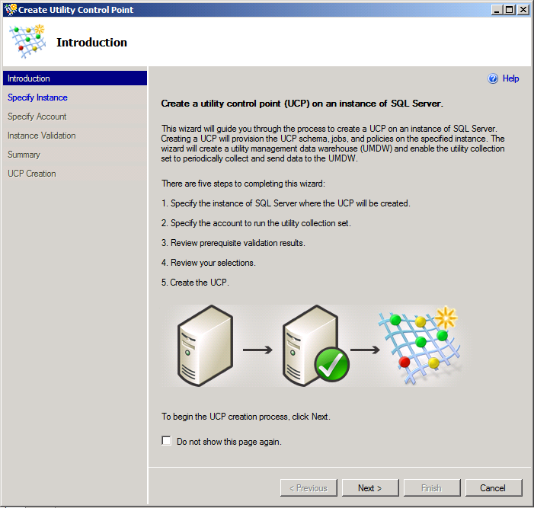
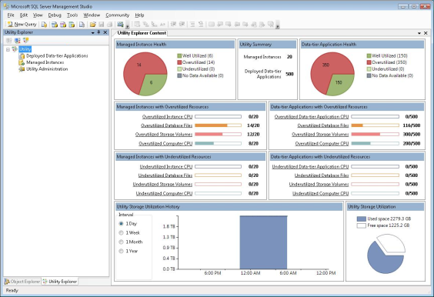
Key Benefits
CONTROL • OPTIMIZATION • EFFICIENCIES
Gain Visibility and Control
New wizards in SSMS – fast and easy setup
Create a Control Point
Enroll instances
Insights refreshed every 15 minutes
MANAGEMENT STUDIO
Database
Administrator
MANAGED SERVER GROUP
Notes:
As I mentioned before, Application and Multi-Server Management enables DBA teams to gain more visibility and control over their environment through new extensions in SQL Server Management Studio.
Today, DBAs use Object Explorer to manage their databases one by one. In R2, DBAs can think of the new Utility Explorer as a way to manage many databases at once. Within the new Utility Explorer, <click> New wizards allow DBAs to quickly designate a SQL Server instance as a SQL Server Control Point and then enroll instances into centralized multi-server management.
<click>
Within about 15 minutes from setup DBAs will have insights into database utilization, enabling them to make decisions about consolidation candidates or proactively address applications and instances that are over utilized.
Contrast this to other major database vendors on the market who may require many installation DVDs or even professional services, SQL Server 2008 R2 makes it fast and easy to set up and multi-server management environment.

Slide 10
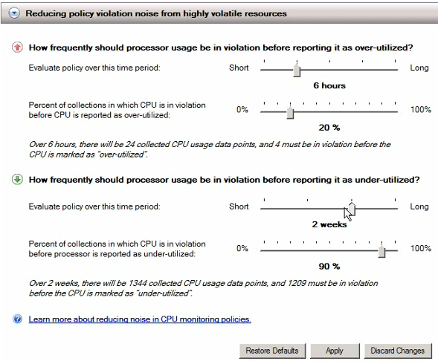
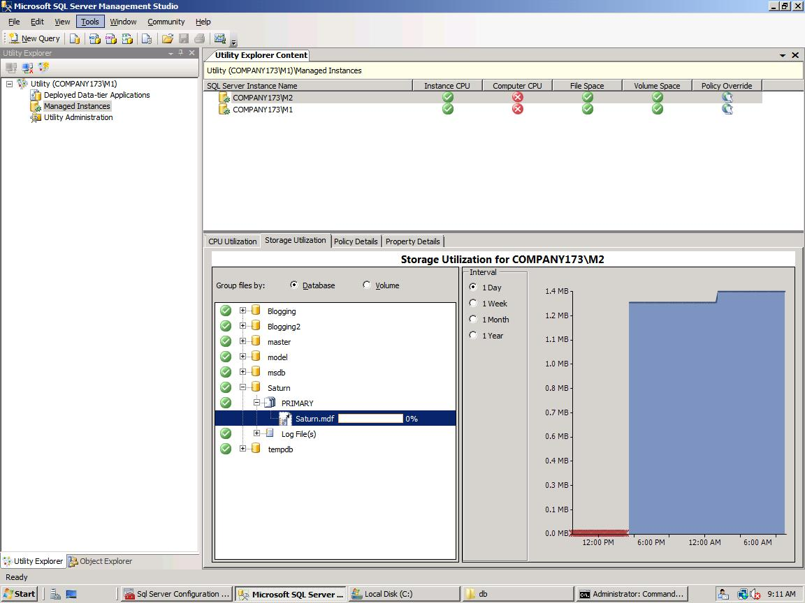
Key Benefits
CONTROL • OPTIMIZATION • EFFICIENCIES
Improve Resource Optimization
At-a-glance views for insights
ID consolidation opportunities
Quickly drill-down to detailed views
Simple UI for policy adjustments
Notes:
Once instances are enrolled and database applications are registered, At-a-glance dashboard viewpoints provide insights into application and database utilization and capacity policy violations to help identify consolidation opportunities, maximize investments and ultimately maintain healthy systems. <click for another view>
<click to animate> Extensions from Policy-Based Management delivered in SQL Server 2008, default utilization policies are set immediately upon Control Point setup. <click> However, DBAs can use simple UI tools to adjust these default policies to define their desired utilization thresholds across database instances or applications within the SQL Server Control Point.

Slide 11
Key Benefits
CONTROL • OPTIMIZATION • EFFICIENCIES
Improve Efficiencies
Single Unit of Deployment
Integration with Visual Studio
Data-Tier Developer
Streamlined deployments & upgrades; on or off premises
Database Administrator
Control Point
Management Studio
Managed Server Group
Notes:
<Click 1x for animation>
Let’s now talk about the efficiencies delivered in R2.
R2 introduces a new concept to the market: A single unit of deployment called a Data-tier Application. The Data-tier Application packages database schema (database, tables, stored procedures, etc) with deployment requirements and can be extracted from existing applications or created in Microsoft Visual Studio®. This single unit removes a lot of the legacy trial and error associated with deploying and upgrading the data-tier portion of an application. This ultimately accelerates deployments and upgrades.
<click>
Furthermore, this new concept is integrated with Visual Studio through a new project template that creates a Data-tier Application output file (DACPAC). Policy-Based Management is also extended here, allowing developers to define deployment requirements or intent within their database projects—for example, a developer can define that the application requires spatial data support and at least 20 gigs of free space to allow for growth.
<Click 3 times for animation>
This integration enables a single unit of deployment for DBAs to deploy database applications to available servers that meet deployment criteria. This helps significantly streamline deployments, moves and upgrades by reducing the amount of trial and error associated with typical database application deployments.
<click>
What’s more, customers can deploy Data-Tier Applications either on premise or directly to SQL Azure from SQL Server 2008 R2 or Visual Studio 2010 based on their needs and capacity.

Slide 13
Application & Multi-Server Management
Demo 1: Create and Manage
a Multi-Instance Control Point
Demo 2: Extract , Upgrade and Deploy a
Data-Tier Application
Notes:
Recommended demos:
SQL Server 2008 R2 Hyper-V Sales Demo and Script – AMM section
SQL Server 2008 R2 Click-Through Demo and Script

Slide 14
Key Take Aways
Wizards enable DBAs to quickly set up — no service engagement required
Utilization data refreshed every 15 minutes — less troubleshooting, more planning
Streamlined deployment and upgrades — objects packaged in a single unit of deployment
Wizards enable DBAs to quickly set up — no service engagement or complex setup required
Utilization data refreshed every 15 minutes — less troubleshooting, more planning
Streamlined deployment and upgrades — objects packaged in a single unit of deployment. Deploy on and off premises.
Notes:
We just learned a lot of new concepts and saw a quick demo of some of the new capabilities. Now let’s just take a moment to recap some of the key takeaways from Application and Multi-Server Management.
First: Unlike other major database vendors, New wizards in SQL Server Management Studio walk DBAs through setting up a multi-server management environment which can literally take minutes and doesn’t require third party service engagements or complex installation.
Second: Once servers and applications are enrolled, utilization data is set to update every 15 minutes. This means DBAs can almost immediately gain insight into utilization data and begin working on consolidation plans or preventative measure to stop potential problems.
And finally, Introducing a single unit of management removes the laborious task of manually locating and identifying disparate pieces of the data-tier application, in the future, DBAs will identify an application candidate to move, the system will reason over the utility for available instances that meet the criteria, and voila a move is quickly made.

Slide 15
Resources
Evaluate SQL Server 2008 R2 Today
Try Application and Multi-Server Management!
Download the November CTP
http://www.microsoft.com/sqlserver/2008/en/us/R2Downloads.aspx
Learn More!
Visit the web page for access to resources http://www.microsoft.com/sqlserver/2008/en/us/R2-multi-server.aspx
Get Technical!
Visit MSDN for detailed articles
http://msdn.microsoft.com/en-us/library/ee210579(SQL.105).aspx
Watch the Webcast!
http://msevents.microsoft.com/CUI/WebCastEventDetails.aspx?culture=en-US&EventID=1032415782&CountryCode=US
Notes:
Please visit the following sites and links for more information on Application and Multi-Server Management.

Slide 16
© 2010 Microsoft Corporation. All rights reserved. Microsoft, Windows, Windows Vista and other product names are or may be registered trademarks and/or trademarks in the U.S. and/or other countries. The information herein is for informational purposes only and represents the current view of Microsoft Corporation as of the date of this presentation. Because Microsoft must respond to changing market conditions, it should not be interpreted to be a commitment on the part of Microsoft, and Microsoft cannot guarantee the accuracy of any information provided after the date of this presentation. MICROSOFT MAKES NO WARRANTIES, EXPRESS, IMPLIED OR STATUTORY, AS TO THE INFORMATION IN THIS PRESENTATION.

