Slide 1
OCS 2007 進階系列 - 安全機制探討
馮立偉
台灣微軟特約講師

Slide 2
需先有初步認知
MTLS
TLS
Edge Servers
SIP, RTP, PSOM
NTLM, Kerberos
Certificates
Level 300

Slide 3
議程
說明 OCS 2007 各階段通訊如如何運作
說明 OCS 2007 各項安全元件如何運作
說明 Edge servers 如何提升與外部使用者溝通時之安全性

Slide 4
Trustworthy Computing Overview
Trustworthy by design
以 Security Development Lifecycle 為前提下進行開發
Trustworthy by default
通訊 – 訊號跟媒介 – 預設全部加密 (除了 mediation server 與 basic media gateway 之間)
Trustworthy by deployment
在規劃及部署手冊中提供安全性最佳實務

Slide 5
Trustworthy Computing OCS 2007 Communications 面臨的風險
Compromised-key attack
Network denial of service attack
Eavesdropping
Identity spoofing
IP address spoofing
Man-in-the-middle attack
RTP replay attack
SPIM
Viruses and worms

Slide 6
OCS 2007 安全性基礎架構
Microsoft ® Active Directory ® Domain Service
Public Key Infrastructure (PKI)
Transport Layer Security (TLS), Mutual-TLS (MTLS), Secure Real-time Transport Protocol (SRTP)
Industry-standard authentication protocols

Slide 7
OCS 2007 安全性基礎架構 Active Directory Objects
Trusted Server List | Active Directory Container
Standard Edition servers and pool Front End Servers | RTC Service/Global Settings
Conferencing Servers | RTC Service/Trusted MCUs
Web Components Servers | RTC Service/ TrustedWebComponentsServers
Mediation Servers and Communicator Web Access Servers (also 3rd-party SIP servers) | RTC Service/Trusted Services
Proxy Servers | RTC Service/Trusted Proxies

Slide 8
OCS 2007 安全性基礎架構 PKI, TLS, MTLS, SRTP
Certificates are used for server authentication
Valid certificate
Issued by a trusted CA
FQDN of server or load balancer VIP
Server authentication EKU
SIP, HTTP, PSOM protected by TLS or MTLS encryption
Media protected by SRTP encryption
Mediation server to gateway not encrypted

Slide 9
OCS 2007 安全性基礎架構 Trusted Connections

Slide 10
OCS 2007 安全性基礎架構 驗證
所有使用者都要驗證 – 包含匿名使用者
內部使用者使用 Kerberos
遠端使用者使用 NTLM 跟 Director 進行驗證
Access Edge 不會執行驗證但是會確認 SIP URIs 及 headers
匿名使用者使用摘要驗證及提供一個有效的會議鑰匙
邦聯使用者由各自的企業進行驗證

Slide 11
OCS 2007 安全性基礎架構 強化核心架構
伺服器更新隨時保持最新
檢查安全性權限及委派管理權限
管控實體存取權限
停用不必要服務
保護資料伺服器

Slide 12
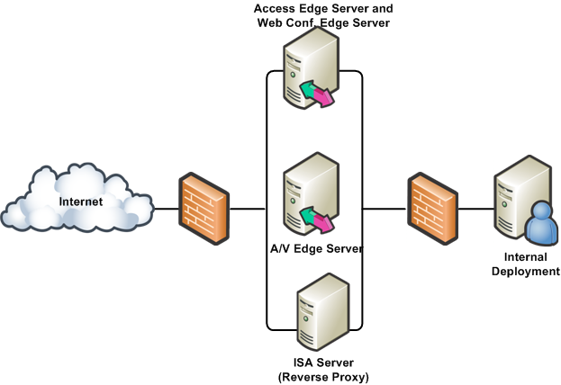
Edge Server 安全性 網際網路邊界
Edge servers 及 reverse proxy 控制存取經由企業防火牆的流量

Slide 13
Edge Server 安全性 目錄服務
單一連接點 : SIP 流量進出企業
依據 SIP domain 強制 routing rules
確認傳入訊息的表頭
驗證遠端邦聯伺服器及驗證邦聯流量
傳弟流量到 Director 進行驗證
Access Edge 不要是網域成員

Slide 14
Edge Server 安全性 Ports
是一個讓媒體進出企業的受信任的連接點
External ports
TCP/443, UDP/3478
For address allocation using A/V Edge server authentication credentials provided via SIP
UDP/50,000-59,999, TCP/50,000-59,999
Single process using these ports – no increased attack surface
Not listening on unused ports
Allocation performed randomly within range

Slide 15
Edge Server 安全性 Web Conferencing
驗證
邦聯使用者由各自企業內部進行驗證
匿名使用者經由會議鎖匙及會議邀請中的進行驗證
資料部分的授權 token 及解密的鎖匙由 SIP 通道中提供

Slide 16
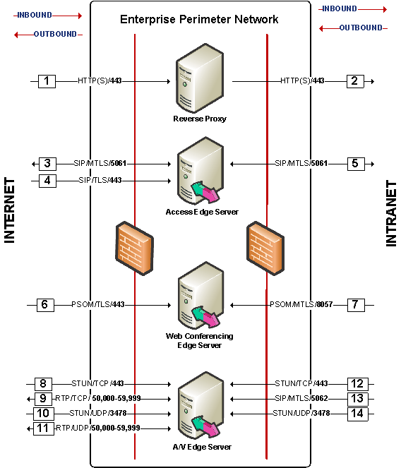
Edge Server 安全性 防火牆及 port
只有 Access Edge 及 RP 起始內部連線
A/V Edge server addresses 必須是publicly routable (不能用 NAT)
細部說明在 OCS 2007 Edge Server 部署手冊中

Slide 17
Edge Server 安全性 Reverse Proxy
Reverse proxy 是用於 :
通訊錄下載
群組展開
會議內容下載
針對 Microsoft® Internet Security and Acceleration (ISA) Server 2006 提供詳細設定步驟

Slide 18
Edge Server 安全性 部署最佳實務
Deploy Edge servers 放置於專屬子網段以及控制 路由
實體隔離內外網路
部署 Edge servers 於工作群組
移除不必要的服務

Slide 19
Mediation Server 安全性
於 Mediation server 及 gateway 之間的通訊沒有加密
部署於實體安全環境

Slide 20
Web Components Server 安全性
Reverse Proxy 設定
請參閱 Edge Server 部署手冊
驗證
通訊錄下載
通訊全組展開
會議資料安全性
針對簡報下載提供內容加密及授權

Slide 21
憑證

Slide 22
甚麼是 TLS 及 MTLS?
Transport Layer Security (TLS)
Client 與 Server 間加密
Mutual Transport Layer Security (MTLS)
Server 與 Server 間加密
TLS 需要憑證

Slide 23
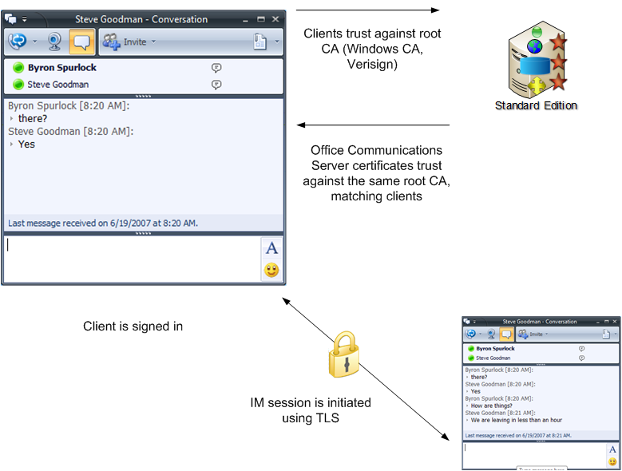
OCS 如何使用 TLS 及憑證 ?

Slide 24
OCS 如何使用 MTLS 及 憑證
Pool1
Director
MTLS
MTLS
AD

Slide 25
內部連接
Office Communicator
Trusts the CA of the certificate used by the Director
Pool1
Director
MTLS
MTLS
Active Directory

Slide 26
遠端連接
Remote user
Trusts the CA of the certificate used by the AP
Firewall
port 443 or 5061
DMZ*
Pool1
TLS
Director
MTLS
MTLS
Active Directory
Access
Edge
* Perimeter network (also known as DMZ, demilitarized zone, and screened subnet)

Slide 27
直接邦聯
Enterprise A
MTLS
Enterprise B
MTLS
MTLS
Communications Server 2007
Communications
Server 2007
Access Edge
Communications
Server 2007
Access Edge
Communications Server 2007
Communications Server clients
Communications Server clients

Slide 28
Public Instant Messaging Connectivity With MSN, AOL, Yahoo
Enterprise A
MTLS
MTLS
Communications Server 2007
Communications
Server 2007
Access Edge
Live Communications Server 2005
Access Proxy
Live Communications Server client
Live Communications Server client
Live Communications Server client
SIP Proxy
Federation uses Public SIP Namespace
A Host Record
_sip._federationtls._tcp SRV Record
Live Communications Server 2005
Access Proxy

Slide 29
Certificate Subject Name (1)
Certificate Friendly Name
Match DNS A Host record name
Certificate Subject Alternative Name (SAN)
Type = Server Authentication EKU
Template similar to Secure Sockets Layer (SSL)/Web Certificate
Need certificate chain
Trust against a CA

Slide 30
Certificate Subject Name (2)
Most confusing part with certificates
Certificate Friendly Name must match:
Fully qualified domain name “FQDN” of the Communications Server Standard Edition server
FQDN of the Communications Server Enterprise Edition Pool
A Host record in DNS

Slide 31
demonstration
Understanding Digital Certificate Properties

Slide 32
進階憑證配置技巧
Collocated Edge Server Certificates
Remote user access
Federation
Public Internet Connectivity
A\V conferencing
Web conferencing

Slide 33
甚麼是 Collocated Edge Server?
提供與外界的通訊
Access Edge
A\V Edge
Web Edge
不需要 Active Directory
不提供使用這驗證
只允許TLS 加密流量

Slide 34
所需之 DNS 配置 (Collocated Edge Server)
External
_sip._Federationtls for federation and PIC
_sip._tls.company.com for tls external (remote) access
An external DNS A record that resolves to the external name of the Web Conferencing Edge Server
An external DNS A record that resolves to the external name of the A/V Edge Server
This IP address must be a publicly routable IP address
Internal
An internal DNS A record that resolves the internal FQDN of the Edge Server to internal IP address of the Edge Server

Slide 35
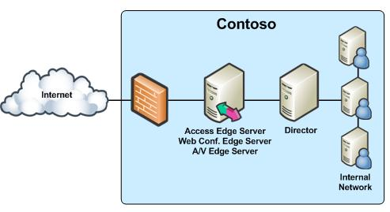
設定內部 Edge of Collocated Edge
設定 IP addresses
指派憑證
單一, 共用憑證且目標名稱要跟 Edge Server 的 FQDN 一樣

Slide 36
設置外部 Edge of Collocated Edge (1)
Configuring IP addresses
Assigning certificates
Access Edge - A certificate configured on the external interface with subject name that matches the external FQDN of the Edge Server

Slide 37
設置外部 Edge of Collocated Edge (2)
指派憑證
Web Conf Edge – 配置在外部介面上的憑證要和 Web Conferencing Edge Server外部 FQDN 一致
AV Edge – 不需要

Slide 38
Director
驗證及授權遠端使用者
把使用者導到所歸屬之伺服器
不放置任何使用者帳號
配置於 server pool 前端
提升 OCS home server 安全性
Edge Server 的下一個連接點

Slide 39
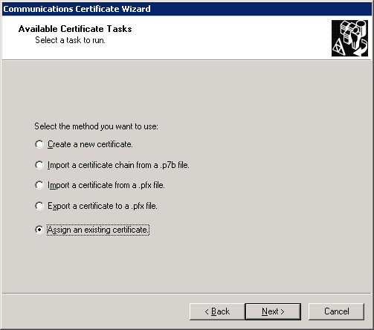
安裝及部署憑證
Certificate Wizard simplifies creating and assigning certificates to most Communications Server 2007 roles
Support for external and internal servers
The CA is selectable
Certificates are created by default with exportable private keys (PKCS #12)
Import/export operations are available

Slide 40
憑證授權中心
該使用哪種憑證授權?
公開
私有
公開 CA
不需要改變 Client 端配置: clients 端已信任 root CA
建議針對 : 遠端存取, 邦聯, 及 PIC
私有 CA
較能管控
沒有額外費用

Slide 41
Q&A

Slide 42
Resources
OCS Security Guide
http://www.microsoft.com/downloads/details.aspx?FamilyID=2d1ea693-25e0-43d9-8c5c-0822ef83955a&DisplayLang=en
OCS Edge Server Deployment Guide
http://technet.microsoft.com/en-us/library/bb880163.aspx
OCS Planning Guide
http://technet.microsoft.com/en-us/library/bb880158.aspx
Security Development Lifecycle
http://go.microsoft.com/fwlink/?linkid=68761

Slide 43
© 2007 Microsoft Corporation. All rights reserved. Microsoft, Windows, Windows Vista and other product names are or may be registered trademarks and/or trademarks in the U.S. and/or other countries.
The information herein is for informational purposes only and represents the current view of Microsoft Corporation as of the date of this presentation. Because Microsoft must respond to changing market conditions, it should not be interpreted to be a commitment on the part of Microsoft, and Microsoft cannot guarantee the accuracy of any information provided after the date of this presentation.
This document may contain information related to pre-release software, which may be substantially modified before its first commercial release. Accordingly, the information may not accurately describe or reflect the software product when first commercially released MICROSOFT MAKES NO WARRANTIES, EXPRESS, IMPLIED OR STATUTORY, AS TO THE INFORMATION IN THIS PRESENTATION.

