Slide 3

{Business Intelligence total }

Slide 4







Los retos
Cambian las necesidades de las empresas
Los datos están confinados dentro de las aplicaciones de negocio
Las herramientas de BI especializadas requieren un esfuerzo de aprendizaje
Notes:
Use this slide to introduce the key challenges that organizations face today and to set the pitch of the presentation to the audience. It is not important to dwell on each point, but be sure to emphasize them to highlight the key challenges raised throughout the presentation (namely, the three messaging pillars that you will shortly introduce: unlocking data, delivering relevant information, and driving actionable insights).

Slide 5
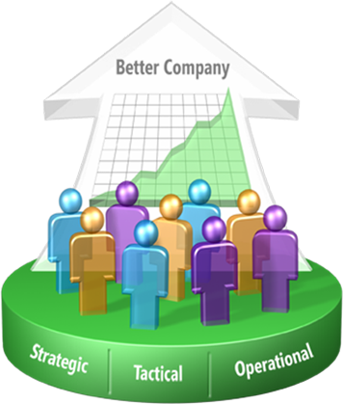
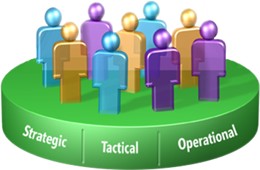
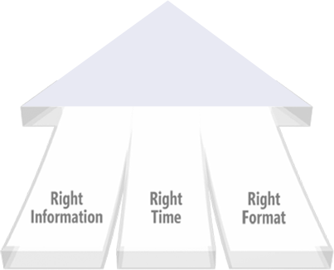
Microsoft Business Intelligence
Visión y estrategia
Mejorar el potencial de las organizaciones poniendo en manos de {todos} los empleados la información necesaria para una mejor toma de decisiones
Oferta de BI integrada y completa gestión del rendimiento
Amplia difusión del conocimiento interno por medio de Microsoft Office
Alcance corporativo y comodidad
Notes:
This slide might be familiar to many. It is an important slide that clearly states Microsoft’s vision and strategy. The message hasn’t changed over the past decade, and it is important to emphasize that the same commitment to business intelligence exists today. SQL Server 2008 is the latest manifestation of delivering the vision.
Read the vision aloud, and be sure to discuss how business intelligence is relevant to the different decisions made in the organization. To support sound strategic (big), tactical, and operational (small) decisions, delivery of the right information, at the right time, and in the right format is increasingly important.
Don’t talk about specific product offerings at this stage because they will be introduced in the following slide. Do use the three bullet points to discuss how Microsoft provides the only true end-to-end BI offering from data platform to information platform, including performance management. Today, as evidenced by strong adoption by large organizations, these platforms are enterprise-grade in that they are trustworthy, high performing, and reliable. From a cost perspective, competitive offerings are generally more expensive. This last point is particularly relevant for small and medium-sized organizations that consider BI a luxury afforded only by larger organizations.

Slide 6




Oferta completa de BI
DISTRIBUCIÓN
COLABORACIÓN
GESTIÓN DE CONTENIDOS
BUSQUEDA
SharePoint Server
Informes
Paneles
Archivos
Excel
Vistas de
análisis
Indicadores
Planes
Herramientas de usuario final y Aps. de Gestión del Rendimiento
Excel
PerformancePoint Server
PLATAFORMA DE BI
SQL Server
Reporting Services
SQL Server
Analysis Services
SGBD SQL Server
SQL Server Integration Services
Notes:
This presentation is principally about showcasing SQL Server 2008 offerings. Use this slide to introduce the data (BI) platform and how it has been designed to integrate with other Microsoft offerings.
Use this slide to introduce the three BI services and the relational engine, which in this presentation is usually referred to in the role of a data warehouse. In general, do not spend too much time talking about the relational engine improvements because they will be addressed in other presentations.
Briefly describe each of the three BI services:
Integration Services—typically used to perform ETL operations to populate data warehouses—can integrate, cleanse, and transform data from a large variety of data sources.
Analysis Services, consisting of OLAP and data mining components, provides superior aggregated analysis over large volumes of data and the ability to perform predictive analytics.
Reporting Services—which can source data from relational, multidimensional, and data mining data sources—can be used to present and distribute information.
These BI services have been designed to work together but work just as well independently.
Spend less time introducing the Office offerings. The important message to deliver is that the information-worker platform rests solidly on top of the SQL Server data platform to deliver relevant information to information workers (to support strategic, tactical, and operational decisions). In particular, define the role of Excel and PerformancePoint Server to help prepare for the upcoming demonstrations.

Slide 7







Business Intelligence
Liberar los datos
Ofrecer información
relevante
Datos para la toma de decisiones
Conexión a los datos
Integración de datos
Gestión de los datos
Diseño de forma intuitiva
Escala corporativa
Presentación desde Office
Análisis predictivo
Experiencia personalizada
Integración con otras aplicaciones
Plataforma de Datos Inteligente
Notes:
7
This slide is the key messaging slide. Each of the three pillars will be used to introduce the new business intelligence features in SQL Server 2008.
Use this slide to introduce each of the three pillars, then invoke the animation to de-emphasize the second and third pillars and focus on the first pillar, “Unlock Your Data.” Read each of the three bullet points for the first pillar, and then move directly to the next slide.

Slide 8










Liberar los datos
Conexión a los datos
  Amplia conectividad
  Proveedores nativos para Oracle, Teradata, SAP BW, y MySAP
Datos no estructurados
Aplicaciones antiguas: archivos binarios
Integración de los datos
  Mejoras en el pipeline de SSIS
  Revisión permanente de SSIS
  Perfilado de datos
BD aplicación
Gestión de los datos
  Compresión de datos
  Optimización en query de DW
  CDC (Change Data Capture)
Notes:
In this slide, you elaborate on the three points in the “Unlock Your Data” pillar. Keep the discussion high-level because these points are covered in more detail in later slides.
Connect to data: Data exists in different types of data stores, and users need to get to that data efficiently. Improved providers deliver better access to this data.
Integrate data: Describe how today, like no other time in history, organizations are storing increasingly large volumes of data. In the context of data warehousing, organizations need to integrate data from various source systems. The new and enhanced features delivered with Integration Services 2008 allow organizations to better consolidate their data.
Manage your data: Growing volumes of data, and the need to manage those volumes, has led to innovative new features in the SQL Server 2008 database engine.

Slide 9


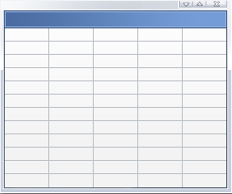

Conexión a los datos
CDC (Change Data Capture)
Mejora la escalabilidad de DW
  Registra cambios en la información, para un procesamiento más eficiente de las dimensiones
  Permite la carga continua de datos modificados
Los cambios se capturan e introducen en tablas de cambio
  Captura basada en log, con mínimo impacto sobre el origen de datos
  Los datos modificados se exponen en formato relacional empleando tablas de cambio
  Los metadatos modificados se guardan como parte de los cambios
  Enumeración de los cambios con T-SQL
Tabla de cambios
OLTP
Data Warehouse
Notes:
Discuss how Change Data Capture (CDC) has been designed to capture insert, update, and delete activity applied to SQL Server tables and to make the details of the changes available in an easily consumed relational format. The change tables used by CDC contain columns that mirror the column structure of a tracked source table, along with the metadata needed to understand the changes that have occurred.
This feature can help address the two challenges of efficiently integrating and managing growing volumes of data and of capturing operational changes in data.
This feature will be demonstrated.
References:
Using Change Data Capture: http://msdn2.microsoft.com/en-us/library/bb522489(SQL.100).aspx

Slide 10
Integración de datos
Integración escalable
Mayor escalabilidad
  Agrupamiento de threads
  Transformaciones con caché permanente
    Datos en cache de búsqueda
    Reutilización de cache dentro del flujo de datos
    Carga de datos en cache de búsqueda por programa
    P.Ej: cache de todas las filas de destino perdidas
Extensible
  Scripting de tareas con C#
  ADO.NET para tareas y para componentes de origen y destino.
Notes:
Use this slide to describe the new features related to data integration in more detail.
Scalability: Do not discuss this point in any more detail than already discussed in the previous slide.
Extensibility: Describe how Business Intelligence Development Studio (BIDS) now integrates seamlessly with the Microsoft Visual Studio 2005 Tools for Applications (VSTA) environment. VSTA is the development environment in which a developer writes scripts for the Script task and the Script component. VSTA supports both Visual Basic 2005 and Visual C# programming languages.
Explain how Integration Services 2008 includes two ADO.NET components: an ADO.NET source component that consumes data from a .NET Framework provider and makes the data available to the data flow, and an ADO.NET destination component that loads data into a variety of ADO.NET-compliant databases that use a database table or view.
References:
What’s New (Database Engine): http://msdn2.microsoft.com/en-us/library/bb510411(SQL.100).aspx

Slide 11
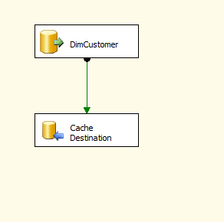
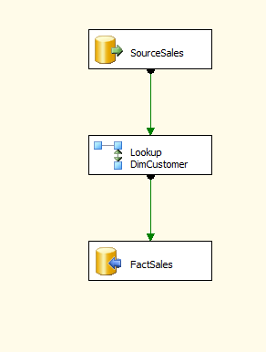
Integración de datos
Integración escalable – Uso del caché
Primer Paso
  Llenado del caché con datos de cualquier orígen y guardado en disco
Siguientes Pasos
  “Hidratación” del caché desde disco
customer .csv
Fact Sales
“Hidratación” del caché desde disco o memoria
Guardamos caché en disco o en memoria
Caché “compartible” y permanente

Slide 12
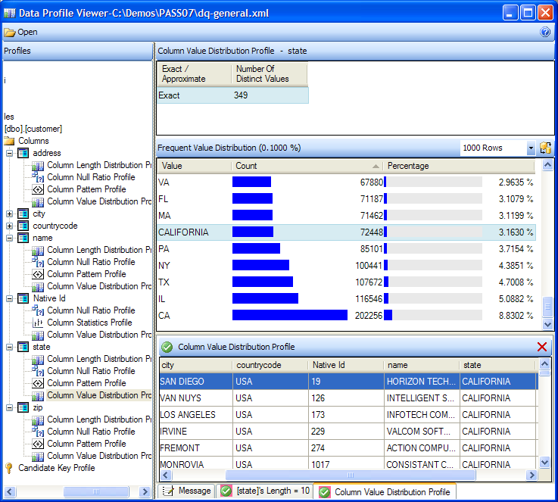
Integración de datos
Perfilado de datos
Perfilado integrado
  Tarea de flujo de datos
  Perfila cualquier tabla
  Salida a archivo
Visor externo
  Perfil por columna
    Outliers
    Claves candidatas
    Distribución de valor
    Patrones
Notes:
The new Data Profiling task has been designed to compute various profiles that let database designers, administrators, and integration specialists become familiar with their data and identify problems and quality issues in the data. You can configure the task to process many requests, with each request configured to analyze a particular profile for a table or view, which can be based on a single column or all columns.
There are eight different profiles; five analyze individual columns, and three analyze multiple columns or relationships between columns. The profile results are stored in an XML file and can be viewed by using a Windows application called Data Profile Viewer.
You will demonstrate this feature shortly.
References:
Data Profiling Task: http://msdn2.microsoft.com/en-us/library/bb895263(SQL.100).aspx
The following five profiles analyze individual columns.
Column Length Distribution Profile
Reports all the distinct lengths of string values in the selected column and the percentage of rows in the table that each length represents.
This profile helps you identify problems in your data, such as values that are not valid. For example, you profile a column of United States state codes that should be two characters and discover values longer than two characters.
Column Null Ratio Profile
Reports the percentage of null values in the selected column.
This profile helps you identify problems in your data, such as an unexpectedly high ratio of null values in a column. For example, you profile a Zip Code/Postal Code column and discover an unacceptably high percentage of missing codes.
Column Pattern Profile
Reports a set of regular expressions that cover the specified percentage of values in a string column.
This profile helps you identify problems in your data, such as string that are not valid. This profile can also suggest regular expressions that can be used in the future to validate new values. For example, a pattern profile of a United States Zip Code column might produce the regular expressions: \d{5}-\d{4}, \d{5}, and \d{9}. If you see other regular expressions, your data likely contains values that are not valid or in an incorrect format.
Column Statistics Profile
Reports statistics, such as minimum, maximum, average, and standard deviation for numeric columns, and minimum and maximum for datetime columns.
This profile helps you identify problems in your data, such as dates that are not valid. For example, you profile a column of historical dates and discover a maximum date that is in the future.
Column Value Distribution Profile
Reports all the distinct values in the selected column and the percentage of rows in the table that each value represents. Can also report values that represent more than a specified percentage of rows in the table.
This profile helps you identify problems in your data, such as an incorrect number of distinct values in a column. For example, you profile a column that is supposed to contain states in the United States and discover more than 50 distinct values.
The following three profiles analyze multiple columns or relationships between columns and tables.
Candidate Key Profile
Reports whether a column or set of columns is a key, or an approximate key, for the selected table.
This profile also helps you identify problems in your data, such as duplicate values in a potential key column.
Functional Dependency Profile
Reports the extent to which the values in one column (the dependent column) depend on the values in another column or set of columns (the determinant column).
This profile also helps you identify problems in your data, such as values that are not valid. For example, you profile the dependency between a column that contains United States Zip Codes and a column that contains states in the United States. The same Zip Code should always have the same state, but the profile discovers violations of this dependency.
Value Inclusion Profile
Computes the overlap in the values between two columns or sets of columns. This profile can determine whether a column or set of columns is appropriate to serve as a foreign key between the selected tables.
This profile also helps you identify problems in your data, such as values that are not valid. For example, you profile the ProductID column of a Sales table and discover that the column contains values that are not found in the ProductID column of the Products table.

Slide 13
{ Liberar los datos}
demo
Notes:
Refer to the demonstration notes.

Slide 14
Business Intelligence
Liberar los datos
Ofrecer información
relevante
Datos para la toma de decisiones
Conexión a los datos
Integración de datos
Gestión de los datos
Diseño de forma intuitiva
Escala corporativa
Presentación desde Office
Análisis predictivo
Experiencia personalizada
Integración con otras aplicaciones
Plataforma de Datos Inteligente
Notes:
14
Use this slide to re-introduce each of the three pillars that cover the new business intelligence features in SQL Server 2008, then invoke the animation to de-emphasize the first and third pillars. Emphasize that we have arrived at the second pillar, “Deliver Relevant Information.”
Read each of the three bullet points for the emphasized pillar, and then move directly to the next slide.

Slide 15




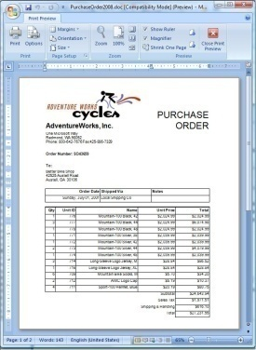
Ofrecer información relevante
Diseño intuitivo
  Diseño de análisis prescriptivo
  Diseño flexible de informes
Escala corporativa
  Gestión de memoria
  Neutral con respecto a IIS
  Solo lectura, escalabilidad horizontal
  Writeback para MOLAP
Presentación desde Office
  Elaboración de informes desde Word
  Integración con SharePoint
  Complementos “add-ins” de Data mining
Notes:
In this slide, you will elaborate on the three points in the “Deliver Relevant Information” pillar. Keep this discussion high-level because these points are covered in more detail in later slides.
Design intuitively: SQL Server 2005 delivered great enhancement for developers by introducing comprehensive visual design tools and wizards hosted in Visual Studio (BIDS). Further enhancements have been added in this release to provide tools that guide better design.
Scale for the enterprise: As the number of users, requests, and data volumes grows, you must still meet the demands for increased performance. In SQL Server 2008, the Reporting Services engine has been redesigned to scale and perform better. Analysis Services’ writeback support has also been redesigned to improve performance.
Deliver through Office: Extending the reach of business intelligence to the information worker has been achieved by deeper integration of reporting with SharePoint, the new Word report-rendering format, and an enhanced data mining add-in.

Slide 16
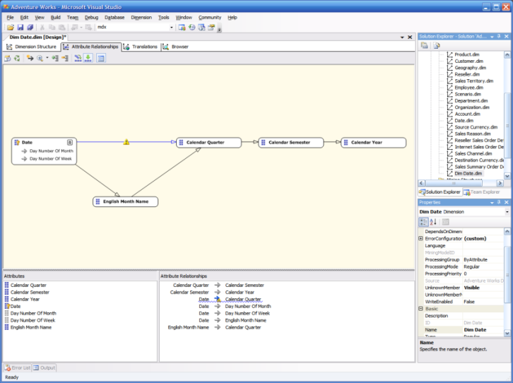
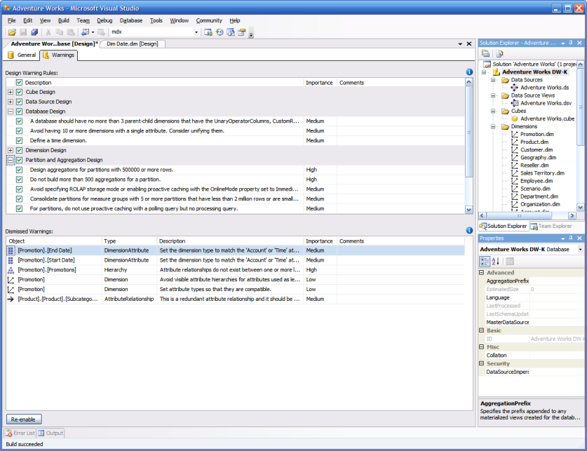
Diseño de forma intuitiva
Diseñadores de Analysis Services
Diseñador de Relación/Atributo
  Visor y editor de relaciones
  Validaciones integradas
Diseñador de agregaciones
  Vistas de diseño para agregados
Alertas para un diseño basado en buenas prácticas
  Verificaciones de diseño en tiempo real
  Gestión de alertas a nivel de instancia o globales
Notes:
In this slide, expand on the points introduced in the previous slide about meeting the challenges to delivering relevant information. Each of these features will be demonstrated.
New Dimension Wizard: The wizard auto-detects parent-child hierarchies, provides safer default error configuration, and supports specification of member properties.
Attribute Relationship Designer: This designer appears as a tab within the Dimensions Designer and uses visualization to make modifying attributes and hierarchies easier.
Dedicated Aggregation Designer: The Aggregation Designer makes it easier to browse and modify aggregation designs. Aggregation designs are now shown grouped by measure group. A new view for manual aggregation design is available for advanced users.
Best practice design alerts: Warning messages alert developers when they depart from design best practices, make logical errors in database design, or depart from aggregation design best practices.
References:
What's New (Analysis Services - Multidimensional Database): http://msdn2.microsoft.com/en-us/library/bb522628(SQL.100).aspx
Stacia Misner’s blog: http://www.sqlskills.com/blogs/stacia/2007/10/28/SQLServer2008BestPracticeDesignAlerts.aspx
Over 40 best practices integrated into real-time designer checks
Think of it auto BPA while you develop
Subtle:
- Blue squiggly lines and build time warnings
- No pop-ups to get in your way

Slide 17
{ Diseñar de forma intuitiva}
demo
Notes:
Refer to the demonstration notes.

Slide 18
Análisis escalable
Cálculo de sub-espacios
Optimiza la experiencia del usuario mediante el procesamiento exclusivamente de expresiones no-defecto
Mejora la capacidad analítica con procesos de cálculo y agregación más complejos
Mejor rendimiento con cubos con datos “dispersos”
Measures.ContributionToParent
 | Bebida | Comida | No consumible
Canadá
México
USA
=
(null)
(null)
(null)
(null)
(null)
(null)
9.22%
71.95%
18.83%
Measures.Sales
(Measures.Sales, Product.CurrentMember.Parent)’
 | Bebida | Comida | No consumible
Canadá | (null) | (null) | (null)
México | (null) | (null) | (null)
USA | $24,597.00 | $191,940.00 | $50,236.00
/
 | Todos los productos
Canada | (null)
México | (null)
USA | $ 266,773.00
Notes:
Use the animation in this slide to demonstrate how the cell navigation (i.e., the Parent function) is resolved just once instead of for every cell. Therefore, the expressions can be evaluated by dividing a constant value only for whatever values the storage engine returns for Sales. Tremendous performance gains can be achieved on “sparse” populated cubes.

Slide 19
Análisis escalable
Cálculo de sub-espacios
 | Bebida | Comida | No consumible
Canadá | (null) | (null) | (null)
México | (null) | (null) | (null)
USA | 9.22% | 71.95% | 18.83%
3) …y el resto es null
2) Realizamos el cálculo únicamente para los valores “non-null”.
3 operaciones en lugar de 9…
País | Producto | Medida | Valor
USA | Bebida | Contribution to Parent | 9.22%
USA | Comida | Contribution to Parent | 71.95%
USA | No consumible | Contribution to Parent | 18.83%
País | Producto | Medida | Valor
USA | Bebida | Ventas | $24,597.00
USA | Comida | Ventas | $191,940.00
USA | No consumible | Ventas | $50,236.00
País | Producto | Medida | Valor
USA | Todos | Ventas | $266,773.00
1. Recuperación de los valores “non-null” del orígen

Slide 20

Análisis escalable
Writeback para MOLAP
Recupera el writeback ejecutado desde MOLAP
Entrada de datos
Particiones del cubo
Copia al origen de datos
Tabla de Writeback
Cache de Writeback
Partición Writeback
Envía el writeback al almacén MOLAP
Almacén
MOLAP
Notes:
Use the animation in this slide, and the following scenario, to explain how MOLAP writeback works.
Click 1: The user updates a single value from 10 to 14.
Click 2: Analysis Services stores the delta of 4 in the writeback partition of the cube that now leverages a MOLAP store, and stores the delta in the cache also.
Click 3: When the writeback is committed, Analysis Services sends a copy, for backup purposes, to the writeback table in the original source system.
Click 4: When the application is ready to retrieve the committed writeback transactions, the result is retrieved directly from the MOLAP store. Huge performance gains are achieved because no additional trip back to the source system is required.
Essentially, this new feature extends the superior performance of the MOLAP storage mode to writeback scenarios and eliminates the need for ROLAP storage.

Slide 21
Análisis escalable
Monitorización de recursos
Mejor análisis de recursos
  Aprovecha la información de recursos del servidor expuesta
  Identifica quién ejecuta qué consultas y durante cuánto tiempo
  Optimiza la carga de trabajo y el uso de recursos
Analysis Services
Informes generados con Reporting Services
Cubo de recursos por defecto
Aplicaciones analíticas avanzadas de cliente
Tablas de recursos (DMV)
Ad hoc analysis
SELECT * FROM Session_Resources
Notes:
In this slide, briefly describe how Analysis Services 2008 includes advanced features for manageability, including Dynamic Management Views. These views enable the administrator to query for information about connections, sessions, and server performance.
Reference:
Advanced Manageability for Analysis Services 2008 webcast: http://msevents.microsoft.com/CUI/EventDetail.aspx?EventID=1032352698&Culture=en-US
Ask/Need
“I need to know what and who is running large queries on my server”
“I want to find and kill runaway query”
Monitoring server health – Infrastructure to allow for collecting server health statistics
Today's Problem
AS 2005 stats are not rich enough provides basic information such as:
User session/connection info
Connection Time
Last executed command (text)
AS 2008 Solution
New server infrastructure for resources monitoring collection and reporting

Slide 22
Informes escalables
Servicio alojado de SQL Server
  Distribución neutral con respecto a IIS
  Arquitectura de servicio único
Gestión de memoria
  Restitución por página
  Definiciones administrativas de destino máximo y mínimo
Notes:
In this slide, emphasize each of the points within the context of improved scalability. The improved memory management will result in performance improvements, particularly for large reports and those that involve resource-intensive rendering, such as Excel.
This topic is a major theme in Reporting Services 2008. A significant effort has been made to ensure that the report engine scales well for large reports.
In Reporting Services 2005 and 2000, report processing is instance-based, meaning that the report processing engine processes the entire report as a snapshot, including text box values, styles, and so on. As a result, these reports are memory-bound. In general, the memory consumed by this process is proportional to the size of the report. The bigger the report, the more memory it takes. Therefore, large reports do not scale well.
In contrast, the Reporting Services 2008 processing engine processes reports on-demand. It pre-computes and saves only certain invariants, such as grouping, sorting, filtering, and aggregates. However, text box values are calculated on-demand every time the containing page is rendered. As a result of the on-demand processing model, the in-memory presentation of the report is much smaller.
References:
Teo Lachev’s blog: http://prologika.com/CS/blogs/blog/archive/2007/08/29/under-the-hood.aspx
Enterprise Scale Reporting webcast: https://connect.microsoft.com/SQLServer/content/content.aspx?ContentID=6082

Slide 23
Informes escalables
Comparativa con 1,270 informes con SQL Server 2005 y 2008
 | Tiempo(s) | Memoria SQL (MB) | Memoria RS (MB)
SQL Server 2005
TFP (time to first page) | 262 | 130 | 240
TLP (time to last page) | 610 | 207 | 312
SQL Server 2008
TFP | 218 | 56 | 95
TLP | 430 | 44 | 95
Mejora (TLP) | 30% | 79% | 70%

Slide 24
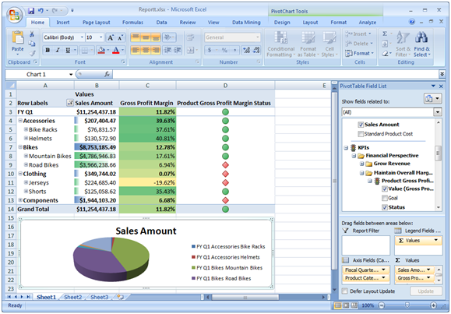
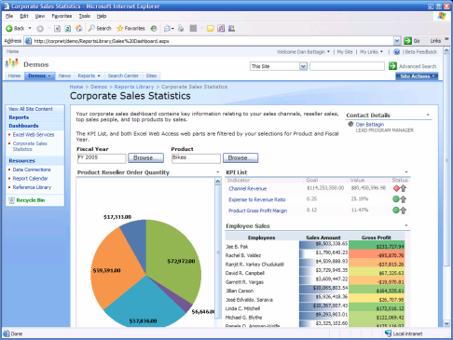


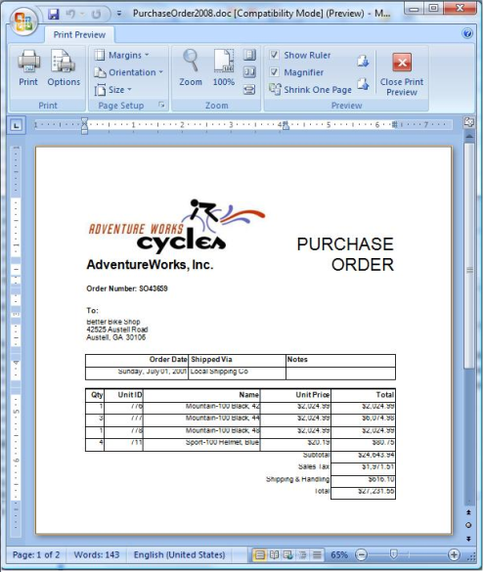
Presentación desde Office
Análisis de datos con Excel
Publicación de datos y análisis con SharePoint
SQL Server
Colaborar y compartir informes, análisis e indicadores
Presentación de informes desde Microsoft Office
Notes:
Use this slide to emphasize how SQL Server-managed data can be delivered to the information worker through Office.
Analyze data in Excel: Excel PivotTables provide a simple and effective way to analyze and navigate across data stored in a cube.
Publish reports and analysis to SharePoint: The integration of Reporting Services and SharePoint enables publishing, viewing, and management of reports. In SQL Server 2008, data-driven subscriptions can now be configured in integrated mode. Also, analysis performed in Excel can be published to SharePoint and then made available through document libraries or embedded in dashboards.
Render reports in Microsoft Office: Reporting Services reports can be rendered in Excel or Word format. This allows the delivery of reports in the format that makes the most sense for the end users.
Collaborate and share reports, analysis, and scorecards: PerformancePoint monitoring can effectively convey performance-monitoring information in the form of analytic and standard reports and scorecards.

Slide 25
{ Análisis escalable}
demo
Notes:
Refer to the demonstration notes.

Slide 26
Business Intelligence
Liberar los datos
Ofrecer información
relevante
Datos para la toma de decisiones
Conexión a los datos
Integración de datos
Gestión de los datos
Diseño de forma intuitiva
Escala corporativa
Presentación desde Office
Análisis predictivo
Experiencia personalizada
Integración con otras aplicaciones
Plataforma de Datos Inteligente
Notes:
26
Use this slide to re-introduce each of the three pillars that cover the new business intelligence features in SQL Server 2008, then invoke the animation to de-emphasize the first and second pillars. Emphasize that we have arrived at the third pillar, “Drive Actionable Insights.”
Read each of the three bullet points for the emphasized pillar, and then move directly to the next slide.

Slide 27
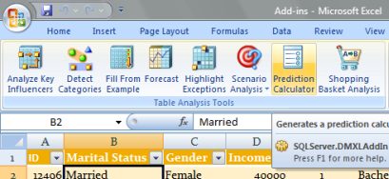

Datos para la toma de decisiones
Análisis predictivo
  Algoritmo de series temporales
  Complementos de Data mining
Experiencia personalizada
  Autoría del usuario final
  Visualizaciones ricas y avanzadas
  Presentación flexible de la información
Integración en otras aplicaciones
  Controles de Report Viewer
  Acceso como servicio Web
Notes:
In this slide, you will elaborate on the three points in the “Drive Actionable Insights” pillar. Keep this discussion high-level because these points are covered in more detail in later slides.
Predict outcomes: Improvements to the data mining offerings include the enhanced Time Series algorithm and new features in the data mining add-ins.
Personalize the experience: In response to user and customer feedback, a more powerful Report Designer hosted outside of Visual Studio will allow the authoring of rich reports. The new gauges, charts, and rich text support provide rich and professional visualizations. The support for multiple data sources and data regions and the new Tablix control provide flexible report layout.
Embed insights: The Report Viewer control easily allows the embedding of server- or local-based reports into your Windows and Web applications. Full programmatic access via Web service APIs provide access to report management and rendering.

Slide 28
Análisis predictivo
Data Mining con SQL Server 2008
Mejoras en el motor y algoritmos
  Predicciones a largo plazo con Series Temporales (ARIMA)
Estructuras de minería de datos mejoradas
  División de particiones de entrenamiento y test
  Consultas contra datos de la estructura
  Filtrado de datos durante la creación de los modelos
  Validación cruzada
Complementos de Data Mining para Office 2007
  Análisis “Market Basket”
  Cálculo predictivo
Notes:
In this slide, briefly discuss each of the following points:
Engine and algorithm improvements: To improve the accuracy and stability of some predictions in time series models, a new algorithm has been added to the Microsoft Time Series algorithm. Based on the well-known ARIMA algorithm, the new algorithm provides better long-term predictions than the ARTxp algorithm that Analysis Services has been using. (ARTxp is an auto-regressive tree algorithm that is optimized for either a single time slice or short-term predictions.)
Enhanced mining structures: When creating a mining structure, you can now divide the data in the mining structure into permanent training and testing sets. The definition of the partition is stored with the structure, and you can reuse the test set with any mining models that are based on that structure.
You can now query data cached in a mining structure, much like you could query case detail from a model.
You can now attach filters to a mining model and use the filter during both training and testing. Applying a filter to the model lets you control the data that is used to train the model and lets you more easily assess the performance of the model on subsets of the data.
Cross-validation is an established method of assessing the accuracy of data mining models. In cross-validation, you iteratively partition the mining structure data into subsets, build models on the subsets, and then measure the accuracy of the model for each partition. By reviewing the returned statistics, you can determine how reliable the mining model is and more easily compare models that are based on the same structure.
Reference:
What's New (Analysis Services - Data Mining): http://msdn2.microsoft.com/en-us/library/bb510513(SQL.100).aspx

Slide 29
{ Análisis predictivo }
demo
Notes:
Refer to the demonstration notes.

Slide 30
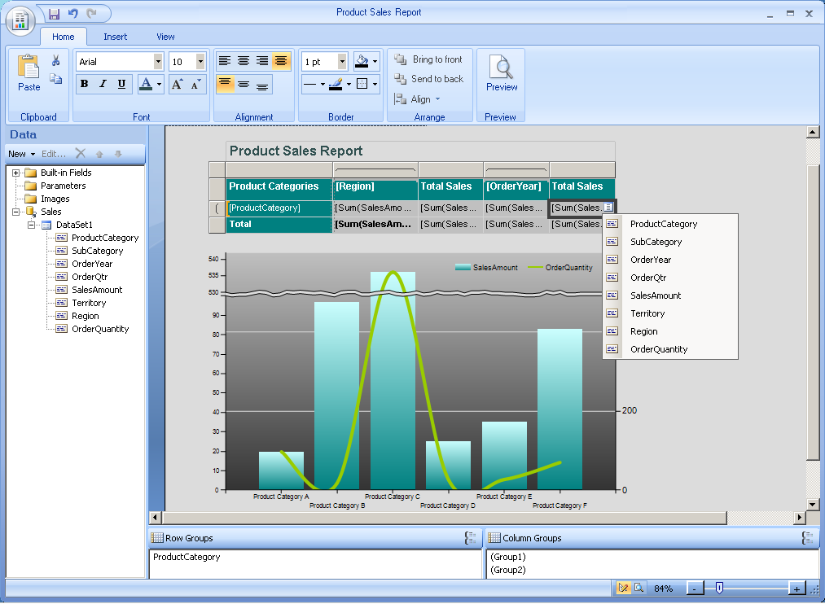
Experiencia personalizada
Mejoras en el Report Builder
Entorno de creación intuitivo para los usuarios finales
  Soporte para capa de semántica y acceso directo a SQL
  Capacidad de personalizar los informes independientemente del sitio donde fueron diseñados inicialmente
  Modificación cómoda y sencilla de campos de datos y tipos de gráficos
  Soporte para:
    Datos relacionales y multidimensionales
    Múltiples orígenes de datos
    Múltiples regiones
  Nuevos controles de visualización
Notes:
The new Report Builder provides an enhanced authoring environment and has been designed in response to user feedback asking for more powerful functionality, such as that available in Report Designer. It can work with direct database data sources as well as Report Builder models. It also lets the author customize the report regardless of where the report was originally designed; this way, a report developed by an IT professional can be maintained or extended by a user. This overcomes the limitations in SQL Server 2005, where reports designed in Report Designer could not be opened in Report Builder.
While not a new feature in SQL Server 2008, emphasize that there is support for relational and multidimensional data sources, and for multiple data sources and data regions.
Use the slide’s last point, new visualization controls, to lead into the next slide. Some of these features will be demonstrated.

Slide 31
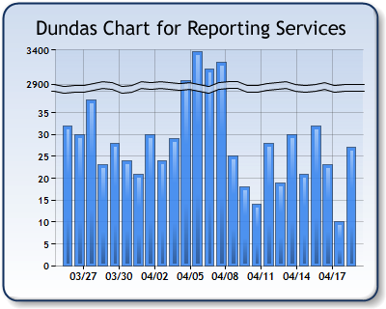
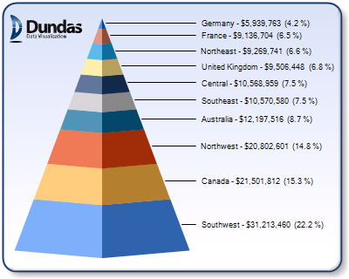
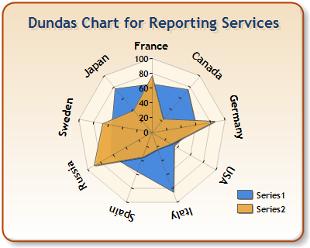
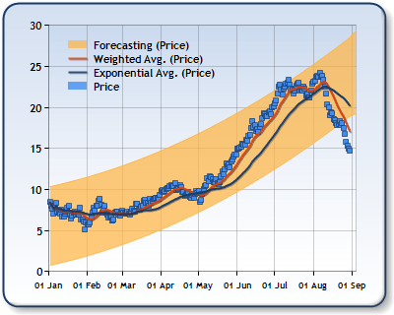
Producción de informes impactantes
Potentes visualizaciones
  Gráficos y diagramas
  Relojes
Soporte avanzado de texto
  Mezcla de estilos y vínculos dentro de un mismo cuadro de texto
Report Designer
  Panel de datos
  Cuadros de diálogo mejorados
  Líneas conectables
  Paneles de agrupamiento
Notes:
In this slide, discuss each of the following points:
Powerful visualizations: Describe how Microsoft acquired (June 2007) the Dundas Chart and Gauge components, and that they are now a standard feature of Reporting Services 2008.
Key features of the chart types include annotations, custom palettes, multiple axes (demonstrated), axis break, large data volumes, error bars, merged charts, anti-aliasing, alpha blending, and custom drawing events.
Additional chart types include Stepped line, Spline area, Pie callout, Polar, Radar, Gantt, Range line/column, Funnel, Pyramid, Histogram, and Box.
Supported gauge types include circular gauges, linear gauges, numeric indicators, and state indicators.
Rich text support: Text boxes now support mixing styles and hyperlinks, allowing report authors to further customize the look and functionality of their reports.
Design Surface: The new Report Designer, hosted in BIDS, provides an improved authoring experience supporting the four points listed.
Note that Report Designer in BIDS is still included with the October CTP release of SQL Server 2008, used in the demonstrations. You can access this tool through BIDS just as in earlier releases. However, you cannot use it to access the new features in SQL Server 2008.
References:
Dundas press release: http://dundas.com/Company/Media/PressSQL2008.aspx
Rich Report Design with SQL Server 2008 Reporting Services webcast: http://msevents.microsoft.com/CUI/WebCastEventDetails.aspx?culture=en-US&EventID=1032354776&CountryCode=US

Slide 32
Presentación flexible de los datos
Nueva estructura de región de datos: Tablix
  Lo mejor de las tablas junto con lo mejor de las matrices:
Tabla + Matriz
Customer
Retail
Odin
Bikes, Inc.
Wholesale
ABC Corp.
Thor, Ltd.
Grand Total
Growth
19%
322%
19%
322%
56%
Retail | Odin
 | Bikes, Inc.
Wholesale | ABC Corp.
 | Thor, Ltd.
Grand Total
2001 | 2002 | Total
1,115 | 1,331 | 2,446
152 | 642 | 794
11,156 | 13,312 | 24,468
1,523 | 6,421 | 7,944
13,946 | 21,706 | 35,653
1,267 | 1,973 | 3,230 | 56%
12,679 | 19,733 | 32,412 | 57%
Notes:
In this slide, first explain that the Tablix data region combines the flexibility of the Table and the crosstab reporting features of the Matrix, then click to invoke the animation.
Explain that the Tablix overcomes many of the limitations of the Matrix and adds functionality. The Table data region provides data presentation based on fixed columns and groupings on the rows. The Matrix data region allows for grouping on both the rows and columns. The Matrix provides superior and flexible presentation of data by supporting the combination of dynamic and static data. For example, it is now possible to have stepped columns with crosstab reports (where group values from different groups appear in the same column) as well as to have side-by-side sections, whereby different groups appear across the columns.
In this animation, point out the way that two groups of data can be combined into one region.
The following demonstration will provide an example of the flexibility of this new data region.

Slide 33
    { Informes flexibles}
demo
Notes:
Refer to the demonstration notes.

Slide 34
Resumen
SQL Server 2008 es una plataforma de BI completa y escalable que permite:
  Liberar sus silos de datos
  Distribuir información relevante a los usuarios a través de Microsoft Office
  Disponer de vistas generales de su organización mediante potentes informes y métodos analíticos avanzados y completos
Forma parte de la oferta de BI de Microsoft
  Completa e integrada
  Difusión general por medio de Microsoft Office
  Cómoda y para todo el ámbito corporativo
Notes:
Use this slide to recapitulate the messages and vision statements introduced at the beginning of the presentation.

Slide 35
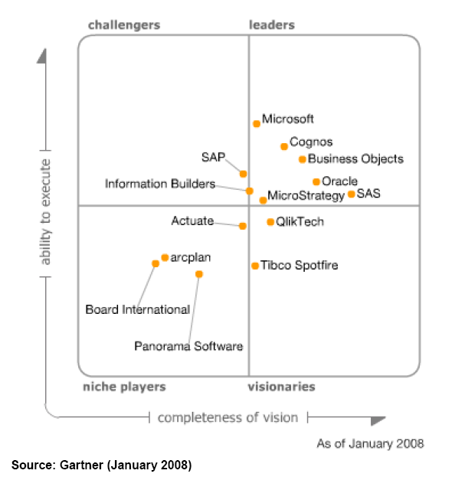
Gartner Magic Quadrant Q1 2008
“According to customers we contacted, of the mega-vendors, Microsoft's BI software quality is best, with over half of customers reporting no problems with software. This reflects Microsoft's focus on BI, the strength of its product line management team and the fact that much of its BI technology has been internally developed rather than acquired.”

Slide 36
Recursos
Más información sobre Business Intelligence
http://www.microsoft.com/sql/2008/solutions/bi.mspx
Más información sobre SQL Server 2008
http://www.microsoft.com/sql/2008/default.mspx
Descubra SQL Server 2008: Webcasts, laboratorios virtuales y Whitepapers
http://www.microsoft.com/sql/2008/learning/default.mspx
Formación en SQL Server 2008
http://www.microsoft.com/learning/sql/2008/default.mspx
Descarga de la última CTP de SQL Server
http://www.microsoft.com/sql/2008/prodinfo/download.mspx
Comunidad técnica SQL PASS
http://www.sqlpass.org

Slide 37

Content Prepared By
Industry-Leading Technical Experts, Authors, Speakers
Solid Quality™ Mentors are more than 100 of the world’s top technical experts who specialize in assuring client success using integrated Microsoft technologies.
http://www.SolidQ.com
Articles: http://www.solidq.com/na/TechArticles.aspx
Blogs: http://www.solidq.com/na/OurBlogs.aspx
42 Microsoft MVPs
7 Regional Directors
Microsoft’s 2007 Southeast District
Success Story of the Year
Mentors located in
over 20 countries
PRACTICE AREAS
Relational Database Management
Business Intelligence
Development Methodologies
SharePoint Collaboration
SERVICES
Advanced Public Training
Customized Private Training
Solution Delivery and Tuning
Enhanced Mentoring Services

Slide 38

Este es un documento preliminar y puede cambiar notablemente antes de la aparición de la versión comercial del producto descrito en él. La información contenida en este documento representa la visión actual de Microsoft Corporation acerca de los temas analizados en la fecha de publicación. Debido a que Microsoft debe responder a condiciones de mercado cambiantes, no debe interpretarse como un compromiso por parte de Microsoft, y Microsoft no puede garantizar la exactitud de ninguna información aquí mostrada después de la fecha de su publicación. Este documento se publica con fines informativos exclusivamente. MICROSOFT NO OFRECE GARANTIAS, EXPRESAS, IMPLICITAS NI ESTATUTARIAS SOBRE LA INFORMACIÓN CONTENIDA EN ESTE DOCUMENTO.
© 2008 Microsoft Corporation. Todos los derechos reservados. Microsoft, BizTalk Server,.NET Framework, el logo Office, SQL, SharePoint, Visio, Visual Studio, Windows Server y Windows son marcas registradas o marcas comerciales de Microsoft Corporation en Estados Unidos y/o en otros países. Otros nombres de empresas y productos mencionados aquí pueden ser marcas registradas de sus respectivos propietarios

Slide 39
{ Business Intelligence total}
apéndice
Introducción a las Demostraciones

