Slide 1
Business Productivity Online Suite: Screenshots for Formotus Mobile Business Forms Formotus, Inc.

Slide 2
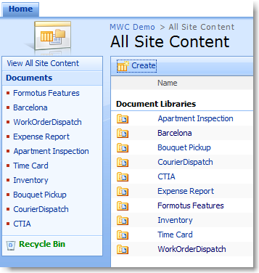
Formotus Mobile Business Forms
Store and manage
your InfoPath
forms with
SharePoint Online.
Formotus can upload
forms from SharePoint
for deployment to
mobile devices.

Slide 3
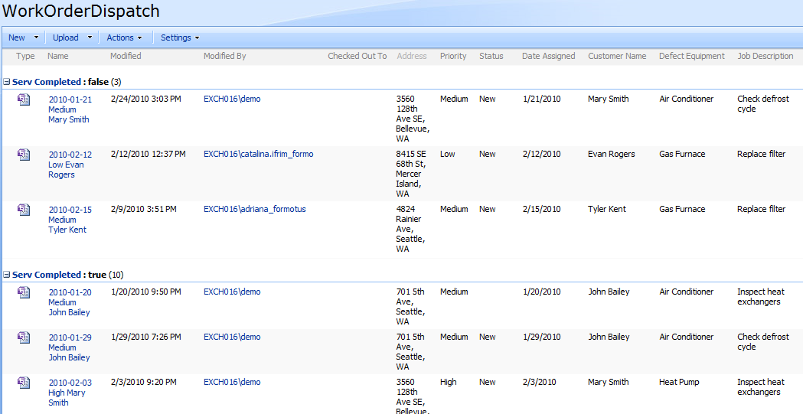
Formotus Mobile Business Forms
Use SharePoint Online as a mobile dispatch center, assigning tasks and locations to mobile workers.

Slide 4
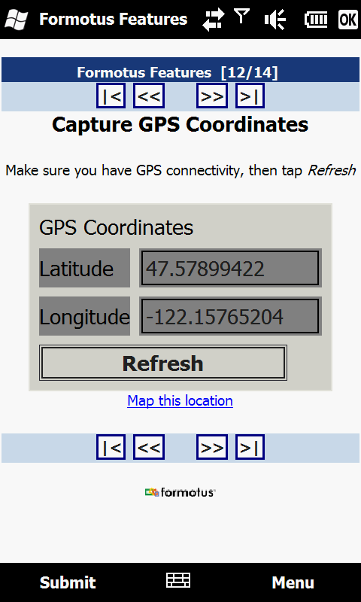
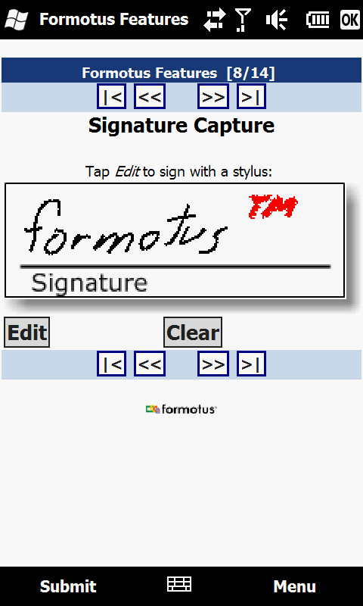
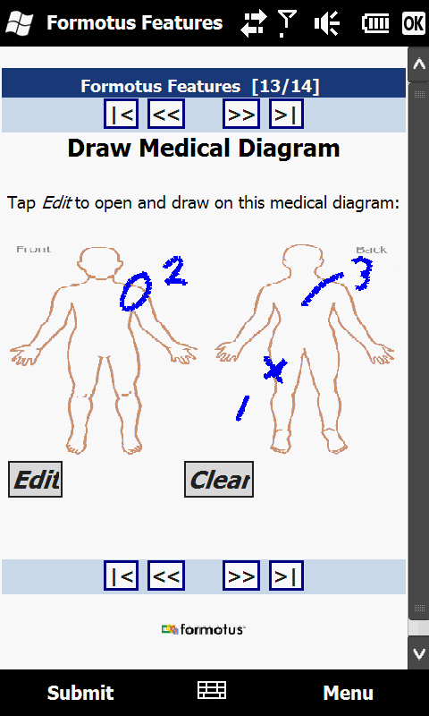
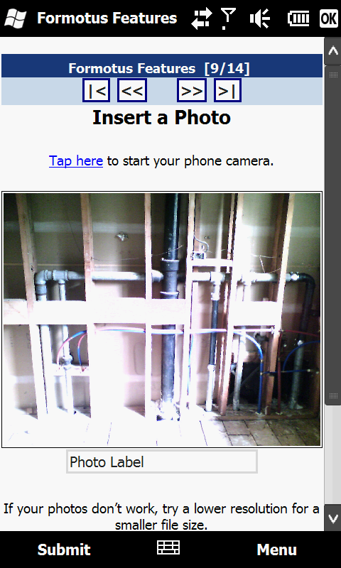
Formotus Mobile Business Forms
Mobile workers can
capture photos, signatures, GPS and timestamps in forms
that submit back to
SharePoint Online.

Slide 5
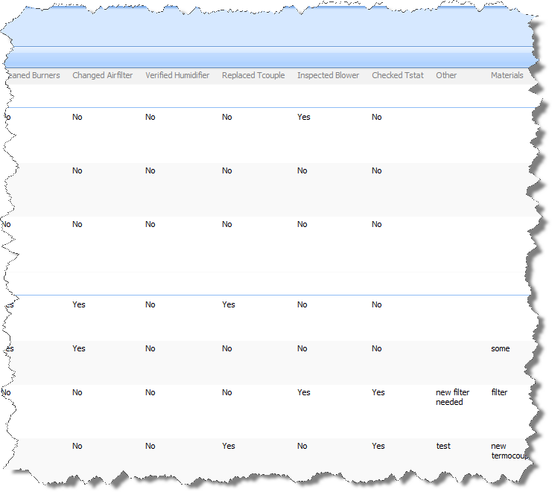
Formotus Mobile Business Forms
Data submitted
from phones is
viewable in
SharePoint
Online.

Slide 6
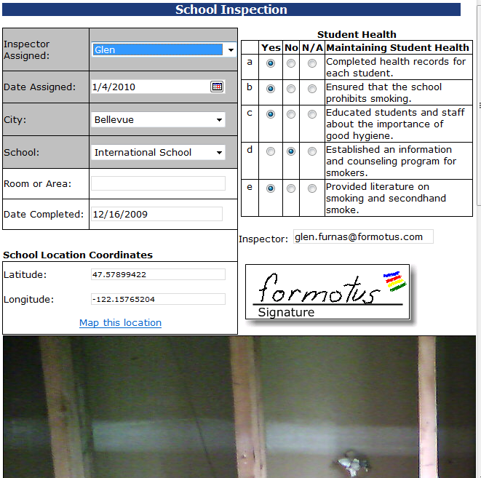
Formotus Mobile Business Forms
Mobile workers and
office workers can
collaborate on the
same form using
SharePoint Online.

Slide 7
Office Workers
Desktop Data
SharePoint
Online
Form Template
upload
Hosted Service
Business Data
Mobile App
Mobile Data
connect
deploy
Mobile User

Slide 8
Formotus Mobile Business Forms www.formotus.com
Formotus, Inc. 3633 136th Pl SE, Suite 202 Bellevue, WA 98006
Phone: 206-973-5060 Fax: 206-260-7235 info@formotus.com
www.formotus.com

