Slide 1

Présentation générale sql server 2008
Patrick Guimonet – Architecte Infrastructures
http://blogs.technet.com/patricg

Slide 3








SQL Server
SQL Server 2005, référence majeure des SGBD et du décisionnel
  Marché :
    Plus forte croissance sur le marché des SGBD : +28% (Gartner)
    +40% des ISV mondiaux supportent SQL Server
    Plus d’unités vendues que IBM & Oracle réunis (IDC)
    N°1 du décisionnel (Olap Report)
  Sécurité : Base plus sécurisée qu’Oracle et MySQL (ESG)
  Performance : leader sur plusieurs benchmarks OLTP & BI
  BI : plateforme complète intégrée et modulaire
  (ETL, Reporting, Analyse et Datamining en standard)
SQL Server 2008, renforce cette assise et poursuit l’innovation !

Slide 4


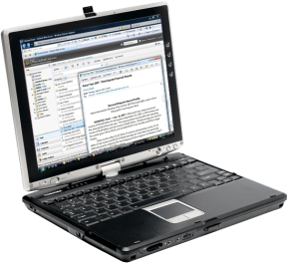


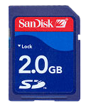






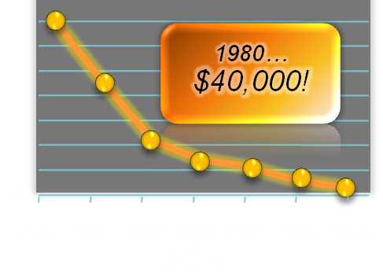
L’explosion des données
Facteurs de chan-gement
Types de données
Facteur Matériel
Hard Drive Prices
Conformité IT & règlementaire
Innovation du stockage

Slide 5










Vos données disponibles de partout et à tout instant
Fiabilité
Productivité
Intelligence
Protéger les données
Assurer la disponibilité
Avoir des temps de réponse prévisibles
Administration par règles
Développement d’application simplifié
Stocker tous les types de données
Intégrer toutes les données
Délivrer une information pertinente
Faciliter les prises de décision
Fiabilité. Productivité. Intelligence Métier
Notes:
3 Key benefits from SQL Server
Trusted – runs your business critical applications
Productive – simplifies management and development of apps – enabling your DBAs and developer to do more with less time
Intelligent – Reach all users with rekevant information

Slide 6
Vos données disponibles de partout et à tout instant
Fiabilité
Fiabilité
Productivité
Intelligence
Protéger les données
Assurer la disponibilité
Avoir des temps de réponse prévisibles
Administration par règles
Développement d’application simplifié
Stocker tous les types de données
Intégrer toutes les données
Délivrer une information pertinente
Faciliter les prises de décision
Fiabilité. Productivité. Intelligence Métier
Notes:
3 Key benefits from SQL Server
Trusted – runs your business critical applications
Productive – simplifies management and development of apps – enabling your DBAs and developer to do more with less time
Intelligent – Reach all users with rekevant information

Slide 7
Chiffrement d’une base de données
Fiabilité
Démos
Audit

Slide 8








Fiabilité
Protéger vos données
La sécurité pour vos données les plus critiques
Sécuriser les accès
  Authentification forte
  Autorisations granulaires
  Chiffrement transparent ou par API
  Gestion des clés externes
Protéger le système
  Gestion de la surface d’exposition
Vérifier la conformité
  Audit amélioré
  Politiques de sécurité à l’échelle de l’entreprise
2008
2008
Notes:
;lSQL Server protects your valuable informatio, by securing access to your data, protecting your system from external attacks and simplifying compliance for customers.
Secure Access
We significantly enhanced our capabilities here in SQL Server 2005 by providing strong authentication capabilities – either adding Kerebros authentication to ensure only the right folks have access to the system
From Authorization perspective – to ensure that the right user has access to only their data and to nothing else. We have provided granualar permissions so that we can narrow the scope of rights for users. This was provided with SQL Server 2005 we have reduced common customer pain points like granting admin rights to perform routing maintenance tasks.
Transparent Data Encryption
In SQL Server 2005, we enabled the encryption and decryption of data at rest by providing built-in functions for applications to call. With Katmai we extend this capability to enable encryption of an entire database, data and log, without the need for application changes. One key benefit of the SQL Server implementation is that it will provide a much richer ability to search encrypted data including both range and fuzzy searches whereas the Oracle solution is limited to equality searches. This is in addition to the bitlocker support that Windows Server introduces
External Key Management
Currently, in SQL Server 2005, encryption and key management is contained entirely within SQL Server. To some small applications and users this is acceptable. However, with the growing demand for regulatory compliance and the overall concern for data privacy more organizations are leveraging encryption as a way to provide a defense in depth solution.
Special hardware vendors including nCipher, RSA, SafeNet and Ingrian provide products that age, regenerate and manage the millions of encryption keys used by some enterprises. address the Enterprise Key Management problem.
SS 2008 will provide a mechanism for SQL Server encryption to work with third-party key management and HSM products.
Simplify Compliance
Increasing regulations like SOX, BASEL II and HIPAA require customers to identify what data was accesed. Especially in this area where customer information is commonly reported to be missing. SQL Server introduces new auditing infrastructure that enables orgs to answer common audit questions like what data was retrieved
With the launch of SQL Server 2008 and Windows Server 2008 – we believe the combination of these 2 products provide secure trusted platform – Windows Server – secures your infrastructure while SQL Server secures your data
As part of the trustworthy computing initiative , Microsoft and SQL Server has committed to customers to protect the confidentiality, integrity and availability of data at every phase of the Software life cycle. To enable this process, SQL Server has take the following steps of secure by design, secure by default and secure in deployment. This has been cooraborated with the analyst evidence from prior slides.
Encryption Details
External Key Management
Currently, in SQL Server 2005, encryption and key management is contained entirely within SQL Server. To some small applications and users this is acceptable. However, with the growing demand for regulatory compliance and the overall concern for data privacy more organizations are leveraging encryption as a way to provide a defense in depth solution.
Special hardware vendors including nCipher, RSA, SafeNet and Ingrian provide products that age, regenerate and manage the millions of encryption keys used by some enterprises. address the Enterprise Key Management problem. In addition, some of these vendors provide Hardware Security Modules (HSM) that allow users to store the keys in special hardware. This is a more secure solution since the keys do not reside where the data is. Regulatory parties like the payment card industry (PCI) encourage this separation.
Katmai will provide a mechanism for SQL Server encryption to work with third-party key management and HSM products.
Auditing
SQL Trace provides security auditing today (e.g. someone logged in, some permissions have changed) but it does not provide data auditing
e.g. User X updated the salary column to value exceeding 200k, or Who saw my credit card data?
Katmai will enable users to create and manage auditing via DDL.
E.g. AUDIT UPDATE(Salary) ON Employee TO MyAuditFolder WHERE Salary>200000,
E.g. AUDIT LOGON TO MyAuditFolder
With the folder containing a logical list of audit records

Slide 9
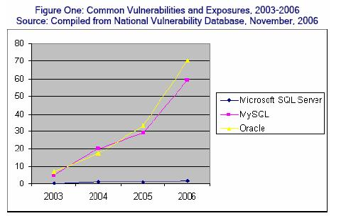
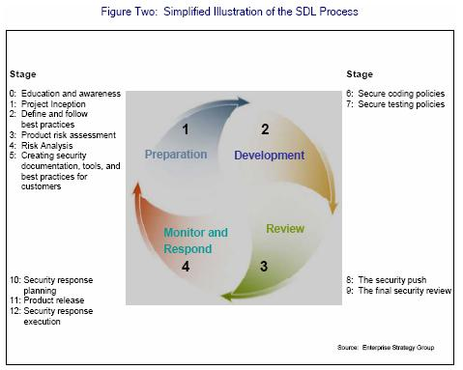
La sécurité au cœur de la conception du produit…
Fiabilité
http://www.microsoft.com/France/sql/sql2005/securite.mspx

Slide 10








Fiabilité
Assurer la disponibilité
Une plateforme sûre pour vos données
Assurer une haute disponibilité
  Améliorations du mode « BD en miroir »
  Cluster de basculement
  Services de réplication
  Ajout à chaud de processeurs et de mémoire
Minimiser les arrêts
  Opérations en ligne
  Redémarrage rapide
Accès concurrents
  « Database Snapshots »
  Mode d’isolation « snapshot »
2008
Notes:
SQL Server provides a trusted platform that enables you to run your mission critical applications. SQL Server 2005 provided extensive capabilities that included Database Mirroring, Comprehensive Failover clustering, while minimizing downtime of servers with online maintenance for common dB operations like backup, index etc. We also enabled organizations to provide applications that can reach more users with higher levels of concurrent access.
For SQL Server 2008 – We have continued to invest in the ability for organizations to provide highly reliable platforms with less management. We have enhanced the capability of Database Mirroring with easier configuration and much better performance with log stream compression.
We also take advantage of the advances in Windows Server 2008 by introducing Pluggable CPU. This allows organizations to reduce planned downtime of hardware upgrades by adding additional system resources to your applications. We also enable organizations to provide higher levels of reliability by providing 16 node failover clustering.

Slide 11







Fiabilité
Avoir des temps de réponses prévisibles Pour tous les besoins
Optimiser les performances
  Compression de données
  Recommandations
Analyser les performances
  Collecte des données
  Analyse de la performance
Prédire les performances
  Gèle des plans d’exécution des requêtes
  Gestionnaire de ressources
  “Resource Governor”
2008
2008
2008
Notes:
SQL Server 2005 provides scalable platform that has numerous customers running applications with thousands of users and multi terabyte data warehouses.
SQL Server enables customers to optimize their performance of their data bases as their data volumes and users continue to grow. SQL Server introduces Data Compression functionality that significantly reduces the cost of storing growing data volumes with more effective data storage. This also significantly increases the performance for read only workloads like DW.
With SQL Server 2005 SP2 we introduced the best practice analyzer that enables you to incorporate nest practices into query tuning and query optimization activities of the DBA. I will come back to this more from the management side.
As the amount of data grows and users grow it becomes harder for administrators to identify bottlenecks. SQL Server simplifies Performance analysis with the introduction of Performance Studio. Perf Studio can collect performance data from DMV, OS perfmons and other perofmrnac eindicators into a performance data warehouse. With SQL Server 2005 – we can get a snapshot of system performance at apoint in time - With Perf Studio – we can enhance that by the ability to do benchmarks, and analyze historical performance from the perf warehouse.
Another trend driving organizations is to consolidate the data from different applications. For Example, customers may have a database server for each app. For example – HR, Timesheet and Expenses may be 3 different apps with 3 servers. As we consolidate the databases onto single server – we need to ensure the performance of each app continue to perform as expected. With SQL Server 2008 – we introduce a new feature Resource Governor that defines limits on resources consumed by each application – whether they are CPU or memory. We can also define priorities on the applications. For example – End of the month – ensure that the Expense app has the highest priority- need to fill those expense reports.
One of the pain points we faced with SS 2005 was that when customers upgraded, query performance degraded due to different query plans being used. With Plan Freezing – we can take a snapshot of the ss2005 db performance and promote that to new SS 2008 DB – easing the upgrade path of customers. IT can also be used when customers move from staging to production environments.

Slide 12

Vos données disponibles de partout et à tout instant
Productivité
Fiabilité
Productivité
Intelligence
Protéger les données
Assurer la disponibilité
Avoir des temps de réponse prévisibles
Administration par règles
Développement d’application simplifié
Stocker tous les types de données
Intégrer toutes les données
Délivrer une information pertinente
Faciliter les prises de décision
Fiabilité. Productivité. Intelligence Métier
Notes:
3 Key benefits from SQL Server
Trusted – runs your business critical applications
Productive – simplifies management and development of apps – enabling your DBAs and developer to do more with less time
Intelligent – Reach all users with rekevant information

Slide 13
Administration par règles
Productivité
Démos
FILESTREAM
Données Spatiales

Slide 14

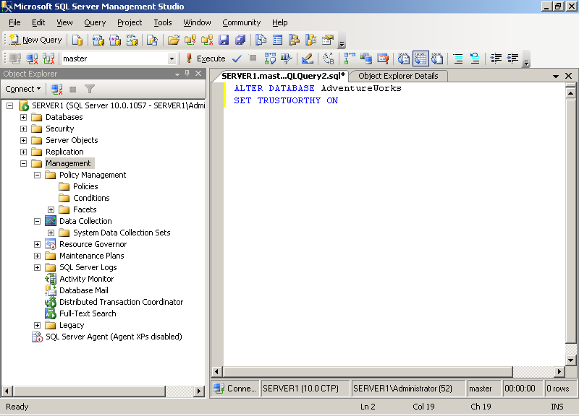




Productivité
Réduire les coûts d’administration
Passer moins de temps
Administration flexible
  Outils visuels
  Automatisations
Gestion centralisée
  Règles d’entreprise
  Suivi de la conformité
Suivi de l’état de l’installation
  Rapports d’administration
  Outils d’optimisation de la performance
2008
2008
2008
Notes:
SQL Server 2008 continues the tradition of making it easier to deploy, manage, monitor and tune enterprise data and analytical applications. By reducing the time it takes to administer the infrastructure, to troubleshoot and optimize the platform, it frees the DBA to focus on higher value tasks like adding new applications to serve your business.
SQL Server 2005 provided flexible administrative options – whether it is an easy to use visual administration tool in SSMS or extensive apis for DBA to program their own scripts using SMO. With SS 2008 – we have enhanced SSMS with easier to use interfaces and wizards while exposing our APIS directly to Powershell – the new scripting languages introduced as part of Windows Server 2008. this enables Administrators to more easily automate common tasks from the OS to the DB.
Everytime a company adds a new application or a new module for their ERP – they need to get a DBA to manage their data. To enable administrators to more easily manage their growing number of databases, SQL Server 2008 introduces new policy based management framework that enables DBAs to manage their infrastructure with a common set of policies whether it is for operations like backup and restore or common security policies enabling better compliance. DBA can create a common configuration policy for all Financial Applications and publish them. All Financial DBs can now subscribe to these policies and will adhere to new auditing settings, security setting or data archival settings. We can also monitor the compliance of the systems to these policies. For more info – lets go to the demo.
From system health perspective – the introduction of Performance Studio and performance tuning tools like Query Analyzer provides a rich set of capabilities for Admins to monitor and tune the platform.

Slide 15

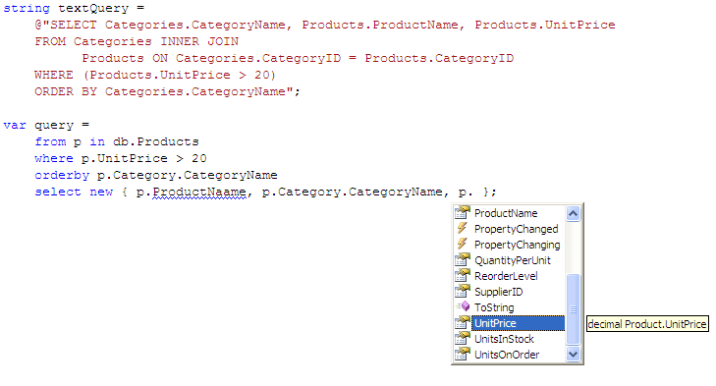
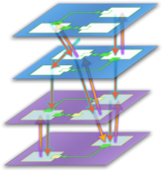




Productivité
Développements simplifés
Réduire le temps de développement
Développements accélérés
  Entités métier
  Dév. objets avec LinQ
  Adaptateurs manipulant les entités
Accéder à vos données n’importe où
  Gestion d’un cache local
  Détection des conflits
  Synchronisation automatique
2005
2008
2008
2008
Notes:
Microsoft and SQL Server have always focussed on providing a platform that enables developers to build applications that are secure, reliable and can be brought to market in less time. We are proud of our community and parnter ecosystem with over 3000 ISVs building applications for SQL Server .
With SQL server 2008 and .NET Framework – we are making advances in enabling developers to reduce the complexity of accessing data. This is normally the most common activity in applications and there is a lot of repeatable code that increases the cost of support and development. With the ADO.NET Entity Framework and sQL Server we enable developers to define business entities like Customer and Products instead of individual tables, rows and columns. Developers can also access these entities with the introduction of LINQ. LINQ was introduced to reduce the need for developers to create SQL Statements embedded in strings everywhere and then having to bind objects as values come back from the database.
We have always supported connectivity to our dataplaform whether it is managed code like ADO.NET or unmanaged code via ODBC. We also support applications that are built using Java /J2EE and emerging web technologies like PHP.
We have also signficantly enhanced the capabilities of developers to define complex busines logic in the database with enhancements to T/SQL. This included Table Value Parameters and intellisense capabilities within SSMS.
For Example – UPS driver comes to Microsoft to deliver packages. He has a mobile device that is plugged into his truck and downloads information via Satellite from corporate. He/She takes the mobile device with him ashe walks to each building and delivers the packages. Takes down the status and signatures as needed. This data is stored locally on the device. He comes back to this truck – plugs his device back in- suncrhonize with corporate – and the latest information sis now available on the web.
As mobile devices become more powerful and prevalent – uses want to use apps on their device similar to their e-mail capabilities. SQL Server Compact Editiona nd Microsoft Syncrhonization Platform enables developers toprovide similar apps that can work offline and then syncrhonize as needed with corporate. Compact provides the secure local data store while .NET Framework provides the apis tosynch the data.

Slide 16









Productivité
Stocker toutes les
informations
Données structurées
  Nouveaux types date
  Type .Net étendus
  Nouveau Type HierachyID
Données semi-structurées
  Améliorations XML
  Recherche texte intégrale intégrée !
Données multimédias
  Données géographiques et géométriques
  Espace de fichiers géré par la base
2008
2008
2008
Notes:
Lets take the example of a patient with an MRI Scan – Each MRI scan generates 100s of images. As organizations struggle this mange this content – they are also faced with increasing regulations. Wouldn’t it be useful to use the rich set of services that database provides on top of these documents. Whether it is rich set of security services from authorization to authenticaiton to Backup and Restore functionality. To enable this SQL Server 2008 introduces a new data type – FileStream – that enables you to store document son the field system but manage it from the DB – whether it is saving it as part of a transaction or applying the same security rules.
Orgs are also struggling to find insights not only from their relational info but also from their text – SQL Server 2008 provides a highly efficient full text search capability that enables uses to search through large text items
Location informaiton is becoming more important – Whether it is the government putting together property maps or retailers trying to do customer – store affinity analysis – SQL Server 2008 introduces new data types that support the latest spatial standards and provides the ability to easily create applications that incorporate location information

Slide 17


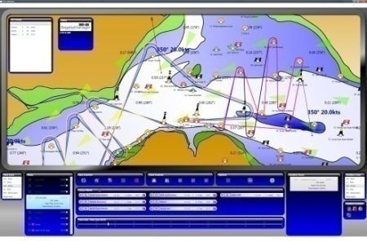
Architecture d’une application S+S
Données spatiales -
SQL Server 2008
Service
Web
Appli-cation .Net
Virtual Earth dans le navigateur
Service Live Search Maps

Slide 18
Vos données disponibles de partout et à tout instant
Intelligence
Fiabilité
Productivité
Intelligence
Protéger les données
Assurer la disponibilité
Avoir des temps de réponse prévisibles
Administration par règles
Développement d’application simplifié
Stocker tous les types de données
Intégrer toutes les données
Délivrer une information pertinente
Faciliter les prises de décision
Fiabilité. Productivité. Intelligence Métier
Notes:
3 Key benefits from SQL Server
Trusted – runs your business critical applications
Productive – simplifies management and development of apps – enabling your DBAs and developer to do more with less time
Intelligent – Reach all users with rekevant information

Slide 19







SQL Server 2008
Plateforme BI complète, modulaire, interopérable
Intelligence
Intégration des données
Analyse OLAP & DataMining
Reporting
Stockage Datamart & DWH
SQL Server Base de données
SQL Server Integration Services
SQL Server Analysis Services
SQL Server Reporting Services
Notes:
SQL Server fournit une plateforme complète de bout en bout pour la business intelligence.
Stockage – La base de données SQL Server fournit de hautes performances, fiabilité ey montée en charge pour les datawarehouse d’entreprise. (SQL Server 2005 est classé leader dans la matrice gartner des solutions de DataWarehouse).
Integration de données – SQL Server Integration Services fournit les services attendus pour un ETL d’entreprise et va même au delà car intègre des fonctions de DQM (Gestion de la qualité des données).
Analyse – SQL Server Analysis Services fournit un moteur OLAP et Datamining permettant aux utilisateurs d’extraire directement de l’information utile à partir des données brutes de l’enteprise => ils comprennent mieux leur business, plus rapidemment (le moteur OLAP est #1 du marché selon OLAP Report)
Reporting – SQL Server Reporting Services fournit l’ensemble des services attendus d’une soltuion de reporting d’entreprise (de la création du rapport, le stockage dans un référentiel centralisé à la diffusion multi canaux et multi format en mode push (via email ou sur un share) ou pull (sur un site web par exemple)).

Slide 20
Intelligence Métier
Démos
Créateur de rapports
Compression des données

Slide 21



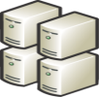

Intelligence
Intégrer les données
Nouveaux entrepôts de données
Construire plus vite
  Connexion aux sources de données
  Nettoyage des données
  Intégration
Gestion efficace
  Gestion efficace du stockage (compression)
  Gestion des charges mixtes (OLTP + DSS)
  Agrégats optimisés
Performance linéaire
  Optimisations des requêtes décisionnelles
  Partitionnement amélioré
2008
2008
Notes:
SQL Server provides a comprehensive and scalable data warehouse platform that enables organizations to build large scale enterprise data warehouses that can consolidate data from disparate systems within your organizations and manage them more effectively
SQL Server has enjoyed significant growth In DW –In the latest DW Tools report from IDC SQL Server has 2x the growth of Oracle, IBM And Teradata.
With SS 2008, To enable organizations to build data warehouses faster – we have significantly enhanced the ability to connect to different sources with ADO.NET improvements and with introduction of Change Data Capture that enables you to capture operational changes without imapct source systems.
We are also providing new data profiling capabilities allowing developers to identify the dirty or incorrect information prior to loading them into the data warehouse. We have significantly enhanced the performance of SSIS to enable you to integrate more data in less time. With these improvements we can enable new scenarios like Real Time BI
SQL Server has significantly enhanced the scalability and performance of data warehouses on SS 2008. With the introduction of data compression – we can store data the 10’s of terabytes of data more efficiently and at lower cost. This also provides performance gains especially in large I/O worklaods like DW queries. DW have several different workloads pulling data – whether it is your reporting or analysis or even applications that require the latest cleansed data. All these different solutions need to be able co-exist and retrieve data efficietnly. The introduction of Resource Governor enables these scenarios. Most DW store detailed data at the detail level ( for example store sales data at a daily level) but really analyze and report data at an aggregate level either at a week, month or quarter. SQL Server enables the management and creation of aggregates with Indexed Views
We are also provide signficant enhancements in increasing the performance of queries on extremely large table with Star Join Query optimizations or enhanced partitioning

Slide 22





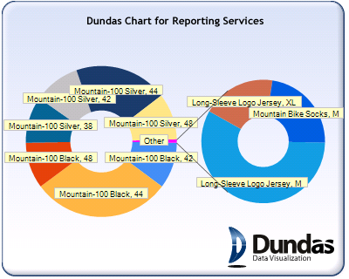
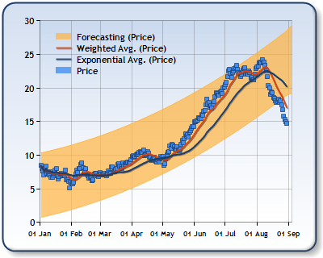
Intelligence
Délivrer l’information pertinente à toute l’enterprise
Serveur de rapports linéaire
  A l’intérieur de l’entreprise
  Comme à l’extérieur
  Outils de développement améliorés
Visualiser l’information
  Nouveaux graphiques
  Visualisations plus flexibles
Faciliter l’accès aux rapports
  Intégration avec les clients Office/Sharepoint
  Nouveau créateur de rapport pour les utilisateurs
2008
2008
2008
Notes:
SQL Server Reporting Services was introduced in 2004 to great reviews with significant enhancments for SQL Server 2005 with end user reporting tools. For SQL Server 2008 the focus has been on provide a scalable platform that can meet all your enterprise reporting needs and empowering end users with better visualizations and delivering information where they need it
From Scalability and Performance, we have significantly enhanced our reporting engine to render complex reports to more users. To enable developers to build more complex reports we have enhanced the design experience with easier tables, zooming capabilities, and embedded reports. We have also enhancing our security and authentication policies to enable organizations to share reports globally to their partners and external customers.
We enable organization to build powerful reports that enable users to visualize the information either via rich charts to flexible layouts enable you to present the information the way u want it. We have always believed in presenting the information through Microsoft Office. With SS 2008, we build on the strides of SQL Server 2005 SP2, where we allow users to share reports with deep integration of MOSS, and extend that to enable uses to render reports directly in Word and Excel.

Slide 23







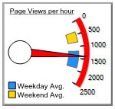

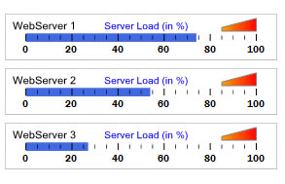
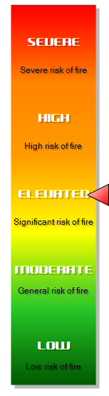

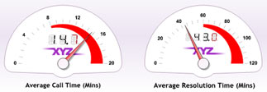
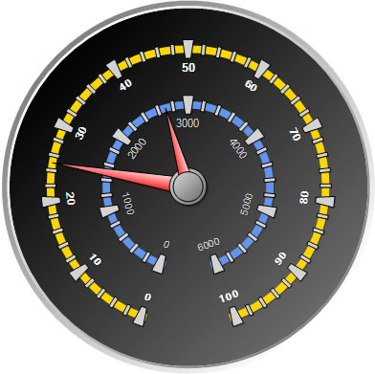
Plus de contrôles graphiques
2008

Slide 24



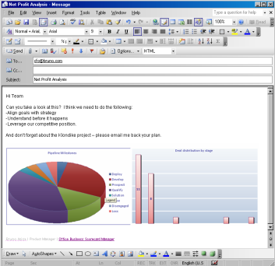
Intelligence
Faciliter les prises de décisions Analyses prédictives
Moteur d’analyse puissant
  Plateforme évolutive
  UDM - Unified Dimension Model
Accessible par l’utilisateur final
  Intégration avec Excel
  Ecosystème partenaires riche
Analyses prédictives
  Modèles d’analyse de données
  Accessibles via Microsoft Office
2008
2008
Notes:
SQL Server has provide analytical services since SQL Server 7.0. Over the past many years, SQL Server Analysis Services has made impressive strides in the analysis market – being the market leader for the past 2 years with over 30% market share.
We build onthis impressive momentum with the release of SQL Server 2008. One of the key tenets for the release across the entire BI platform was scalability and performance. We made significant investment in Analysis that provides complex and comprehensive Analysis while delivering better response to more users. We have also enhanced the design experience for analysis services. We believe the best way to have highly performant cubes is to build them with proper design principles. To enable that we have provided prescriptive guidance throughout the design experience with best practice alerts and intuitive user design.
We also build on the power of the UDM to provide semantic layer for your business users. We have always integrated closely with Microsoft Office and with the integration of MOSS and PPS we provide the foundation for your performance management needs. We have a rich ecosystem of partners providing a variety of client tools providing you with the right interface for your need.

Slide 25




SQL Server 2008
BI nouvelle génération
Facilité de développement et d’administration
  « Best Practices » MCS ou clients remontées sous forme d’assistants
  Nouvelles interfaces de design des cubes
  Traçabilité plus fine…
Toujours plus de Performance & de gestion de gros Volumes
  Amélioration de tous les modules ETL, OLAP, Mining, DataWarehousing
  Compression des backups
  Change Data Capture …
Niveau de service attendu
  Ressource Governor…
Reporting
  Indépendance de IIS
  Nouvelles représentations graphiques
  Nouveau designer de rapport ad-hoc pour plus d’autonomie des utilisateurs…

Slide 26
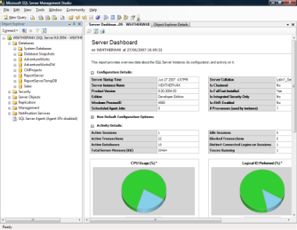


Pourquoi passer à SQL Server
2008
Réduction des coûts
Applications de politiques globales pour votre infrastructure
Simplification du développement d’applications par l’utilisation des entités
Stockage centralisé des données
Décisionnel de nouvelle génération
Temps de réponses prédictibles même avec des charges mixtes
Performances optimisées et linéaires jusqu’à 100 To
Données accessibles de tout terminal, avec synchronisation
Modules ETL, OLAP, Datamining, Reporting enrichis
Gestion du cycle de vie des données
Stocke et restitue n’importe quel type de données
Apporter une intelligence géographiques à vos applications
Sécurisation des données
Protection de vos informations avec cryptage transparent et audit avancé
Plateforme fiable avec cluster et bases de données miroir
Accessibles à l’échelle de l’entreprise

Slide 27
Et ensuite ?
S’informer sur SQL Server 2008
  http://www.microsoft.com/france/sql/sql2008/default.mspx
Site TechNet
  http://technet.microsoft.com/fr-fr/sqlserver/default.aspx
Blog francophone
  http://blogs.technet.com/patricg
Télécharger la version d’évaluation
  http://technet.microsoft.com/fr-fr/evalcenter/bb851664.aspx

Slide 28


La référence technique
pour les IT Pros :
technet.microsoft.com
L’engagement Microsoft
pour les développeurs :
msdn.microsoft.com
Abonnement TechNet Plus :
Versions d’éval + 2 incidents support
Visual Studio 2008 +
Abonnement MSDN Premium
S’informer - Un portail d’informations, des événements, une newsletter bimensuelle personnalisée
Se former - Des webcasts, des articles techniques, des téléchargements, des forums pour échanger avec vos pairs
Bénéficier de services - Des cursus de formations et de certifications, des offres de support technique

Slide 29




Certifications : Programme de nouvelle génération
Série Master – Ce programme valide les compétences technologiques de très haut niveau des individus sur les plateformes Microsoft
Master
Série Architecture– le programme Microsoft Certified Architect permet aux entreprises d’identifier facilement les architectes en informatique très expérimentés, ayant suivi un processus de validation particulièrement rigoureux.
Série Métier – Ce programme valide un ensemble complet de compétences à jour, permettant au professionel de réussir dans son métier et d’être très performant.
Une certification recherchée par les entreprises
4 séries et 5 titres adaptés et ciblés à chaque métier.
Un label pour votre expertise
Les certifications Microsoft permettent la validation de votre expertise : une certification constitue la preuve pour vos clients ou votre société de vos compétences sur les produits et technologies Microsoft.
Un gage de qualité pour l'entreprise
Série Technologie – Ces certifications vous permettent d’approfondir vos connaissances sur des technologies Microsoft spécifiques et d’obtenir toutes les compétences nécessaires pour les exploiter à fond.
Notes:
Microsoft a créé une nouvelle génération de certifications pour mieux répondre aux attentes des clients. Avant d’apporter ces changements, nous nous sommes adressés à nos clients pour mieux comprendre ce qu’ils recherchaient. En règle générale, ils nous ont laissé entendre que le programme devait être :
- mieux ciblé et plus souple.
- rigoureux et crédible.
- simple et approprié.
Nous vous proposons donc un programme de certification : 4 séries (technologie, métier, master, architecture) et 5 titres adaptés (technique, It pro, développeurs…) et ciblés à chaque métier.
Les examens de nouvelle génération comprend uniquement les cursus des produits de version à partir de 2005 (SQL Server 2005, Exchange Server 2007, Windows Server 2008…) http://www.microsoft.com/france/formation/nouvelle_certification/default.mspx
L’ancien programme avec les anciens cursus de certification est toujours d’actualité (MCSE,MCSA Windows Server 2003..)
Les examens seront mis à jour au fur et à mesure !
Plus d’infos : http://www.microsoft.com/france/formation/cert/default.mspx

Slide 30
Certification : validez vos compétences
Offre de certification Seconde chance :
  Bénéficiez d’un second passage gratuit pour tout 1er passage non réussi www.microsoft.com/france/formation
Guides de préparations aux examens :
  http://www.microsoft.com/france/formation/examens
Echangez et discutez sur les certifications sur le Forum :
  http://forums.microsoft.com/france/default.aspx
Contactez nous pour d’autres questions :
  formcert@microsoft.com
Notes:
Pour valider un cursus de certification, il faut obtenir un examen pour valider une certification technique.
Offre de certification Seconde chance :
Microsoft vous propose de bénéficier d’un second passage gratuitement si vous ne réussissez pas votre premier passage.
Pour plus d’informations, visitez le site formation et certification www.microsoft.com/france/formation
Le guide de préparation à l’examen vous indique quels sont les pré-requis pour passer cet examen.
Site formation & Certification est un site qui vous donne toutes les informations concernant les formations et examens disponibles, la liste des centres de formation (CPLS), centre de test Prometric de votre région et les offres de certifications disponibles….
Pour choisir ceux qui vous correspondent le mieux, vous avez la possibilité de sélectionner : une formation ou un examen sur un produit ou une technologie spécifique, le cursus correspondant à votre métier, le centre de formation le plus proche de chez vous.
Forums certifications : Il existe depuis peu deux forums dédiés à la certification technique Microsoft. Vous pouvez échanger et discuter autour des certifications développeurs (MCTS et MCPD) et des mises à niveau (pour les MCAD et MCSD).
Vous pouvez également échanger et discuter autour des certifications IT (MCTS et MCITP) et des mises à niveau (pour les MCDST, MCDBA, MCSA et MCSE)
Si vous avez des questions sur la certification individuelle, l’équipe formation et certification se tient à votre écoute, contactez nous par courriel.

Slide 31
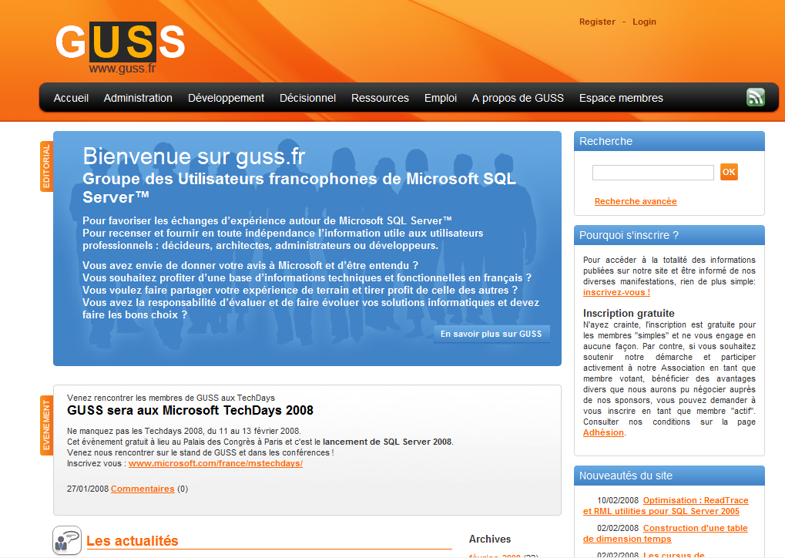
Groupe des Utilisateurs SQL Server
http://www.guss.fr

Slide 32

Votre potentiel, notre passion TM
© 2007 Microsoft Corporation. All rights reserved. Microsoft, Windows, Windows Vista and other product names are or may be registered trademarks and/or trademarks in the U.S. and/or other countries.
The information herein is for informational purposes only and represents the current view of Microsoft Corporation as of the date of this presentation. Because Microsoft must respond to changing market conditions, it should not be interpreted to be a commitment on the part of Microsoft, and Microsoft cannot guarantee the accuracy of any information provided after the date of this presentation.
MICROSOFT MAKES NO WARRANTIES, EXPRESS, IMPLIED OR STATUTORY, AS TO THE INFORMATION IN THIS PRESENTATION.

Slide 33


Plateforme de don- nées de l’entreprise
SQL Server 2005
SQL Server
2008
SS Management Studio
Opérations en ligne
Partitionnement
Sauvegardes en //
  Environnement d’Administration Déclaratif
  T-SQL Intellisense dans SSMS
  Sauvegardes compressées
Administration
Rapports personnalisées (SP2)
Améliorations SQL Profiler
Assistant Paramétrage (DTA)
DMVs
  Nouvelles DMVs
  Évènements étendus
  Performance Studio
Supervision
Miroir de BD (SP1)
Améliorations Cluster
Réplication Maître à maître
Partitionnement
Cliché de BD
  Optimisations Miroir de BD
  Détection et échange de pages endommagées
  Basculement transparent
Haute dispo
Schéma
Cryptage des données
SAC
  Cryptage transparent des données, des sauvegardes
  Gestion des clés externe
  Audit
Sécurité
Ajout de mémoire à chaud
Sauvegardes multiples
“Plan Guides”
Ajout de processeurs à chaud
Compression des données, des sauvegardes
Améliorations Plan Guide
Performances

Slide 34
Chiffrement d'une base de données
USE master;
GO
CREATE MASTER KEY ENCRYPTION BY PASSWORD = '<UseStrongPasswordHere>';
go
CREATE CERTIFICATE MyServerCert WITH SUBJECT = 'My DEK Certificate'
Go
USE AdventureWorks
GO
CREATE DATABASE ENCRYPTION KEY
WITH ALGORITHM = AES_128
ENCRYPTION BY SERVER CERTIFICATE MyServerCert
GO
ALTER DATABASE AdventureWorks
SET ENCRYPTION ON
GO

Slide 35
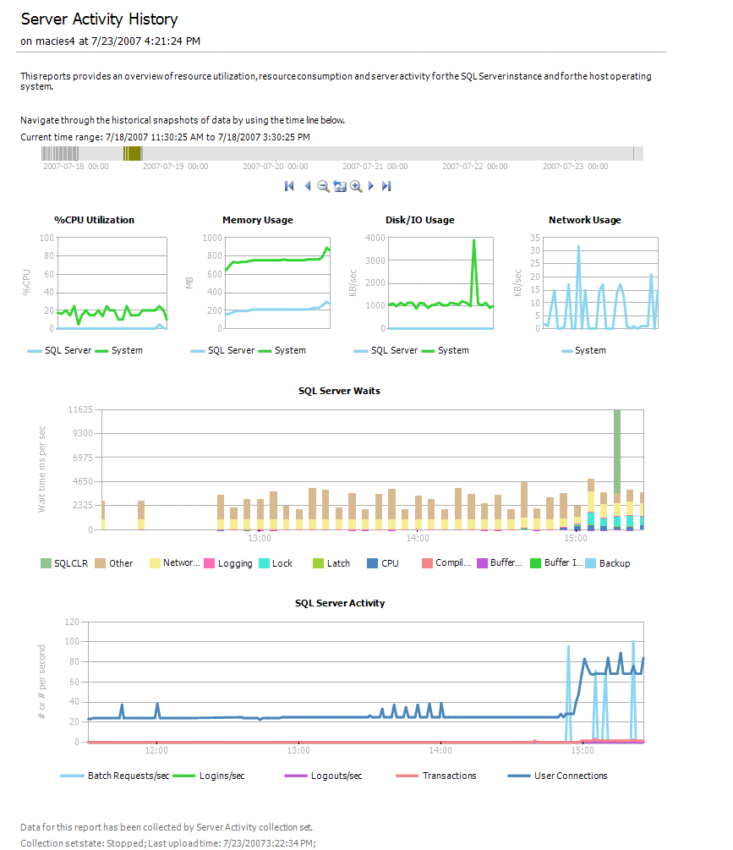
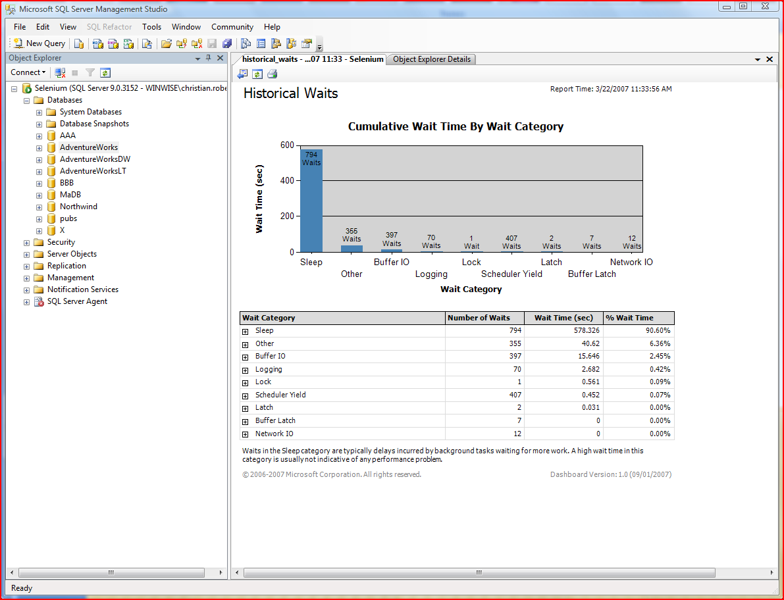
Performance Studio
2008
  Collecte des données
  Suivi de messages d’erreurs et de la performance
2008
Ensemble de collecte des données
Tableau de bord
Gestion par objectifs
Management
Data Warehouse
  Recherche des problèmes et Optimisation
  Historique et comparaison par rapport à des états précédents
2005 SP2
Notes:
Inspiré de SQL H2 (Health and History)

Slide 36



Gestionnaire de ressources
Resource Governor
2008
SQL Server
SQL Server
Backup
Backup
Executive
Reports
OLTP Activity
OLTP
Activity
Admin Tasks
Executive Reports
Admin Tasks
Ad-hoc
Reports
Ad-hoc Reports
High
Workloads
Admin Workload
OLTP Workload
Report Workload
Memory, CPU, Threads, …
Min Memory 10%
Max Memory 20%
Max CPU 20%
Max CPU 90%
Resources
Admin Pool
Application Pool

Slide 37







Au-delà du relationnel
SQL Server 2005
SQL Server
2008
Types définis par
l’utilisateur (UDT) via .Net
UDT de plus de 8ko
HierarchyID
Types .Net
XML
Type de données XML
Fonctions de manipulations
  Optimisations XML
Indexation de la Recherche en Texte Intégral (RTI)
  FILESTREAM
  API Gestion BLOB externes
  Intégration RTI
Documents &
Multimédia
  Types Geometry et Geography
  Fonctions de manipulations
Spatial

Slide 38

FILESTREAMS
2008
Stockage des attributs dans un VARBINARY(MAX)
Données non structurés stockées directement dans le système de fichier (nécessite NTFS)
Modèle de programmation double
  T-SQL (comme les SQL BLOB)
  Win32 Streaming APIs avec sémantique transactionnelle T-SQL
Consistence des données
Administration intégrée
  Sauvegrade/restauration
  Administration
La limite est la taille du système de fichiers
Sécurité SQL
Stockage
BD + fichiers
Application
BLOB
DB

Slide 39



2 Types de données
Type de données : geography
Type de données : geometry
Modèle de données planaire (“Terre plate”)
Définit les points, lignes et surfaces avec longitude et latitude
Définit les points, lignes et surfaces avec des coordonnées x et y
Utilisé pour les surfaces régionales et les plans
Tient compte de la courbure de la Terre et fournit des distances réelles
Modèle de données géodésique (« Terre ronde »)
Notes:
What exactly is Spatial data: Spatial data is used to represent points, lines, areas, and 3-dimensional structures on a surface. Most commonly, these elements relate to actual physical locations on Earth in which case they can be described a geospatial data. Most of us are familiar with this concept through the use of globes and maps, which generally show multiple geographic features and their relative locations.
SQL Server 2008 supports two spatial data types: GEOGRAPHY and GEOMETRY.
The GEOGRAPHY type
Geodetic (“Round Earth”) geospatial model : the geodetic or round earth model provides the most accurate way to represent geographic features
Define points, lines, and areas with longitude and latitude: these points can include a specific location like a restaurant, lines can be roads and power lines, and a polygon areas can include a lake or neighbourhood.
Account for planetary curvature and obtain accurate “great circle” distances
The GEOMETRY type
Planar (“Flat Earth”) geospatial model : To work with geospatial data on a flat, two dimensional surface, a projection is created to flatten the geographical objects on the spheroid.
Define points, lines, and areas with coordinates on an arbitrary plane
Use for localized areas or non-projected surfaces such as interior spaces This kind of data is commonly found in regional mapping systems, such as the state plane system defined by the United States government, or for maps and interior floorplans where the curvature of the Earth does not need to be taken into account.
Geometry side note: The geometry data type provides properties and methods that are compliant with the OGC Simple Features Specification for SQL, enabling you to perform operations on geometric data that produce industry-standard behavior.
General Side note: There are a number of different geodetic models in use throughout the world, including the Airy 1830 ellipsoid used in the United Kingdom’s Ordnance Survey geographic system, and the WGS84 ellipsoid used by most of the world’s GPS solutions.

Slide 40
Support du Type : Geometry
POINT
MULTIPOINT
LINESTRING
MULTI
LINESTRING
Exemple : Une Adresse
Exemple : Toutes les adresses de Microsoft en France
Exemple : Une Rue
Exemple : Le réseau des rues d’un arrondissement
POLYGON
POLYGON
(avec jusqu’à 65 000 trous)
MULTIPOLYGON
GEOMETRYCOLLECTION
Exemple : Immeuble
Exemple : Une region avec un lac
Exemple : un ensemble d’îles (archipel)
Exemple : Comment nous localiser ?

Slide 41

Décisionnel pour tous
SQL Server 2005
SQL Server
2008
  Optimisations Tables partitionnées
  Optimisation Jointure en étoile
  Colonnes avec données clairsemées
  INSERT sur DML
  Gestionnaire de ressources
  Compression des données
Tables partitionnées
Opérations en ligne
Entrepôt de données
Nouvel ETL : SSIS
  Optimisations SSIS
  Change Data Capture (CDC)
  Ordre MERGE
  Journalisation minimale
ETL
Nouveau modèle de données : UDM
Proactive caching
Nouveaux algorithmes de Datamining
Réécriture possible (Write back)
Indicateur clé de performances
  Optimisations performances SSAS
  Sauvegardes SSAS optimisées
Cubes OLAP
Nouvelles interactions utilisateurs
Requêteur accessible
à tous : Report Builder
Création de rapports dans Word
Nouveaux contrôles : Tablix, Dundas
Nouveau moteur de rapports
Rapports

