Slide 1
IE 8 pour les développeurs Web
Pierre Lagarde
Relation Technique Développeur

Slide 3
Agenda
La compatibilité
Les outils pour le développeur
Les nouvelles fonctionnalités pour le développeur Web
Les outils pour le tester
Notes:
Reach Beyond the Page

Slide 4
Internet Explorer 8 Developer Features
Compatibilité et Interopérabilité
Spend more time innovating and less time special-casing
Most standards-compliant (full CSS2.1 support) version of Internet Explorer
Interoperability with other browsers means “write once, run anywhere”
Compatibility modes for viewing/debugging content written for Internet Explorer 7 and Internet Explorer 5.5
Outils pour le développeur
Develop, test and debug without leaving the browser
Built-in developer toolbar enables debugging and performance tuning HTML, CSS, Javascript without leaving the page
Code profiler for identifying performance issues quickly and easily
Change Internet Explorer layout version on the fly to thoroughly test display scenarios
Nouvelles fonctionnalités
Build the richest experiences on the Web
AJAX support enhancements enable rich, dynamic experiences
Web Slices
Best cross-document/domain messaging implementation with XDR/XDM
Improved display and scripting performance makes this the fastest Internet Explorer ever
Tout dans IE8 – Pas d’add-in nécessaire
Notes:
Title: Developer Value Proposition
Talking Points: Interoperability and Compatibility: Spend more time innovating and less time special-casing
Most standards-compliant version of Internet Explorer (full CSS2.1 support)
Interoperability with other browsers means “write once, run anywhere”
Compatibility modes for viewing/debugging content written for Internet Explorer 7 and Internet Explorer 5.5
[CLICK] Built-in Developer Tools: Develop, test and debug without leaving the browser
Built-in developer toolbar enables debugging and performance tuning HTML, CSS, Javascript exactly as the browser renders it
Code profiler for quickly and easily identifying performance issues
Multiple rendering modes mean you can change the Internet Explorer layout version on the fly to thoroughly test display scenarios
[CLICK] Rich, Innovative Experiences: Build the richest experiences on the Web
AJAX support enhancements enable rich, dynamic experiences
Web Slices – take parts of the Web with you
XDR/XDM is best in class cross-document/domain messaging implementation
Improved display and scripting performance makes Internet Explorer 8 faster than before.
Transition: Finally let’s discuss the partner value proposition.

Slide 5
Les standards du Web
CSS 2.1 compliance
DOM Improvements
HTML Improvements
Acid2 Test compliance
CSS 2.1
HTML
ACID 2
Notes:
Title: Standards Compliance
Talking Points:
Standards Compliance: When different browsers interpret web page code (markup, style sheets, and script) in different ways, a website can look great in one browser and broken in another. Developers want their sites to work well for all browsers. To make the online user experience consistent for all browsers, developers need to make choices between coding what is unique for each browser – meaning extra work – or limiting themselves to develop code that behaves consistently across browsers – meaning a limited user experience. The more differences there is between browsers, developers are either faced with more custom coding or they must deal with bigger restrictions on design and user experience.
Web standards have emerged to address this problem. If all browsers interpret pages in a standard way and if developers write their code according to these standards, then developers aren’t forced to make choices between efficiency, productivity, and building great experiences. They can build great experiences that work as expected regardless of the user’s browser.
Internet Explorer 8 Beta 2 has enhanced support for Cascading Style Sheets (CSS) 2.1. In compliance with WC3 web standards, Internet Explorer 8 Beta 2 is designed so web pages can be written once and displayed correctly across multiple browsers. One of the most important web standards is CSS 2.1, which describe the style of a web page including fonts, colors, and (most importantly) layout. Microsoft is committed to delivering a new layout engine in Internet Explorer 8 that is fully compliant with the CSS 2.1 standard when officially released. This means that websites written to the CSS 2.1 standard will have consistent layout in Internet Explorer 8 and in other standards-compliant browsers. This is what it means to have browser interoperability. Web developers will write code once, and it will work consistently in all browsers. Internet Explorer 8 users will experience rich and high-fidelity web sites that are not compromised by the browser.
In addition, Internet Explorer 8 supports improvements to the Document Object Model (DOM). DOM is a platform and language-neutral interface that permits script to access and update the content, structure, and style of a document. The W3C DOM includes a model for how a standard set of objects representing HTML and XML documents are combined, and an interface for accessing and manipulating them. DOM improvements have been made in Internet Explorer 8 to help resolve cross-browser inconsistencies.
Data Uniform Resource Identifiers (URIs) offer Web developers the opportunity to embed external resources (such as CSS files or images) directly into a URL on a Web page. The primary use case for data URIs is the encapsulation of a binary file inside of a URL. The data URI implementation in Internet Explorer 8 attempts to balance security with functionality.
With improved namespace support in Internet Explorer 8, web developers have the ability to apply “behaviors” to page elements through special HTML markup known as HTCs (HTML Components).
To assist developers in taking full advantage of the elements offered by HTML 4, Internet Explorer 8 provides upgraded support for several presentational elements. Through improved support for these and other HTML elements, Web developers can deliver more expressive and accessible HTML markup.
Standards compliance in Internet Explorer 8 is evidenced by passing the Acid2 test, a web-based test code set that uses a wide array of HTML and CSS commands to expose layout behavior in browsers. While passing this test is an important indicator of compliance, there are some places where the standards are ambiguous or confusing. So as a demonstration of our commitment to and support of web standards, the Internet Explorer 8 team has handed off more than 1,000 certification test cases to the W3C for use by any web developers or other browser manufacturers. We’re sharing our interpretation of the standards specifications with the web community to invite discussion and advance the goals of a standardized set of certification tests and a fully standardized web.

Slide 6
Interopérabilité
<meta http-equiv="X-UA-Compatible" content="IE=8" >
Standard Mode
(default)
Higher Interoperability
Web Standards
Existing Internet Explorer 7 Mode
<meta http-equiv="X-UA-Compatible" content="IE=7" >
Notes:
Title: Interoperability
Talking Points:
Internet Explorer 8 improves rendering behavior for content authored to various web standards using the default Internet Explorer 8 standards mode. In order to maintain backwards compatibility, sites can easily opt to use Internet Explorer 7-like handling of content by inserting a special meta element into the web page, which will trigger the "IE7 standards mode“.
While the behavior of the browser is unchanged from Internet Explorer 7 in "IE7 Standards Mode", the new standards based rendering and layout engine in Internet Explorer 8 (the default Internet Explorer 8 rendering mode) supports Data: URIs, the abbr tag, CSS generated content, the display: table CSS properties, in addition to fixing CSS and HTML parsing bugs.
By default Internet Explorer 8 Beta 2 uses the new Standard Mode layout engine to display pages adhering to standards including HTML, CSS 2.1, DOM L2. In addition, Internet Explorer 8 renders the Acid2 test correctly – by default. This results in Internet Explorer 8 supporting and displaying more web pages correctly. This also results in a greater developer experience – increased interoperability for web pages viewed on all browsers, resulting in a “write once, run anywhere” scenario.
Additionally, sites written specifically for Internet Explorer 7, can elect to use the Internet Explorer 7 emulation mode to show pages without making any layout changes and still enjoy a smooth browsing experience.
By including both the Internet Explorer 7 and Internet Explorer 8 layout engines, Internet Explorer 8 provides a highly compatible browser while not breaking sites specifically written to take advantage of Internet Explorer 7 layout engine. In addition to making the web developers life much easier in dealing with a new browser release, this alleviates user frustration and leads to a better overall browsing experience.
Code Snippets
In past versions of Internet Explorer, developers and designers have found inconsistencies between Internet Explorer and defined standards with respect to the way the browser handles HTML, CSS, scripting, etc. In some cases, these inconsistencies arise because Internet Explorer supports standards prior to their finalization. If those standards change when they are ratified, the implementation Internet Explorer uses can be different from the standards. The Internet Explorer team has traditionally decided to support the legacy Internet Explorer model, so that sites developed to it would continue to behave as expected in newer versions of Internet Explorer. Moving forward, the decision to support legacy behaviors versus strict standards will be put in the hands of Web developers because they can select the rendering mode – all the way down to a page-by-page basis.
Windows Internet Explorer 8 Beta 2 ships with multiple rendering modes which the developer can select by using the X-UA-Compatible header.
This value may be set server-wide as an HTTP response header or at the document level by adding it directly after to the head tag, such as:
<meta http-equiv="X-UA-Compatible" content="IE=8" >
By default, Windows Internet Explorer 8 Beta 2 uses the Internet Explorer 8 Standards mode. Developers who want to continue to have their sites render in Internet Explorer 7’s Standards mode should add this immediately after HEAD tag :
<meta http-equiv="X-UA-Compatible" content=“IE=EmulateIE7">
Note that the setting in the document always overrides the HTTP header.
Interoperability with other browsers
None of the improvements or new features in Internet Explorer 8 will matter if websites look bad or work poorly. Since Internet Explorer 8 adheres to web standards by default, there is greater interoperability with all browsers as well as full compatibility with the existing Internet Explorer 7 web sites by including the Internet Explorer 7 layout engine in addition to the new engine. This means that developers can focus on innovation rather than creating special cases to achieve browser compatibility.
One browser for developers
Additionally, by including both layout engines as well as default standard compliance, developers only need Internet Explorer 8 to create, update, test, and deploy new and existing websites. This leads to higher productivity and more efficient development cycles. This also reduces corporate resource requirements because additional physical or virtual machines become less necessary.

Slide 7
Modes de compatibilité
Compatibility Mode Value | Render Behavior
IE=5 | “Quirks” mode
IE=7 | ”Standards” mode
IE=8 | Internet Explorer 8 Standards mode
Notes:
Title: Compatibility Modes
Talking Points:
Compatibility: With Internet Explorer 8, developers can easily change and view web pages using the different layout engines included. Developers can switch between rendering a page in Internet Explorer 5.5, Internet Explorer 7 or Internet Explorer 8. This leads to web pages that have higher compatibility across all Internet Explorer browsers without requiring all the browser types to be installed on a physical machine.
Compatibility View: In order to maintain backwards compatibility in the User Interface, developers an users can choose to view pages in Compatibility View, by pressing the button next to the Address Bar and Internet Explorer reports the Internet Explorer 7 user agent string and reloads the page using the Internet Explorer 7 layout modes. This is particularly useful if the site has been written specifically to take advantage of Internet Explorer 7 features.

Slide 8
Tag Meta
<html>
<head>
<!-- Moteur Internet Explorer 7 -->
<meta http-equiv="X-UA-Compatible"= content="IE=7" />
<title>Ma Page Web</title>
</head>
<body>
<p>Coucou.</p>
</body>
</html>

Slide 9
Web.Config
<configuration>
<system.webServer>
<httpProtocol>
<customHeaders>
<clear />
<add name="X-UA-Compatible" value="IE=7">
</customHeaders>
</httpProtocol>
</system.webServer>
</configuration>

Slide 10
Demo

Slide 11
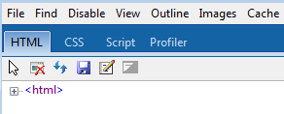
Intégration d'outils pour le développeur
Developer Toolbar
Facilite le développement et le débogage
Autorise le test, l’édition et le débogage en direct:
CSS et HTML
Performance du Script
Vision du DOM
Notes:
Title: Integrated Developer Tools
Talking Points: Although many developers found it to be highly useful for testing, debugging, profiling, or rapidly prototyping a Web page, The Developer Toolbar ran as an extension, so its performance was limited and it resulted in a larger memory footprint. In Internet Explorer 8, the Developer Toolbar is replaced with an integrated set of developer tools which can be accessed by pressing F12 or clicking the Developer Tools icon in the Command Bar. Because the Developer Tools are an integral component of the browser, performance is improved and no memory is used when the tools are not running. The integrated Developer Tools make it faster and easier for Developers to develop and troubleshoot rich content sites.
[CLICK] Developers can use the Developer Tools to edit and debug CSS and HTML, test and debug script, profile script performance, view or change the document object model (DOM), examine applied rules, and trace the origin of style values—all within a rich, visual environment that exposes the browser’s internal representation of a Web page as it runs, instead of just its source code. In this way, developers can rapidly iterate within Internet Explorer 8—for example, changing an attribute or a style rule and immediately viewing the results—and then save the HTML tree and CSS files to disk as text files for integration back into the original application. The Developer Tools also makes it easy to toggle between the different layout engines included Internet Explorer 8, enabling developers to quickly and easily identify changes that must be made for sites to work well with older versions of Internet Explorer.
[CLICK] By eliminating the need to use multiple applications to tweak source code in one program, save it, publish it and then refresh the browser to view the results, the Developer Tools enables Web developers to rapidly prototype and test a new page, debug a problem, or just learn more about Web development and understand behavior. While these capabilities won’t be used by most mainstream users of Internet Explorer 8, they will benefit everyone by making it easier to create, test, and fine-tune the Web sites that we all use.
Transition: Internet Explorer 8 includes features that enhance the ability to build rich applications, incorporate Web 2.0 features, and provide advanced code debugging and profiling.

Slide 12
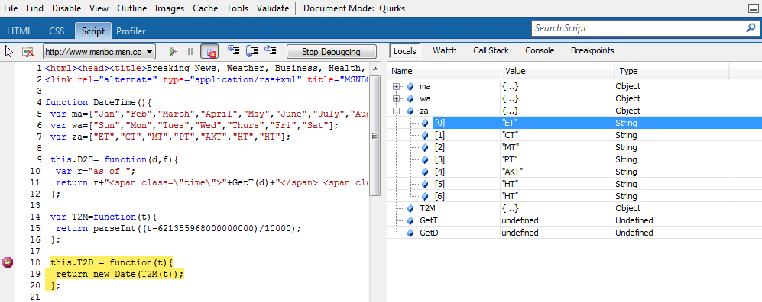
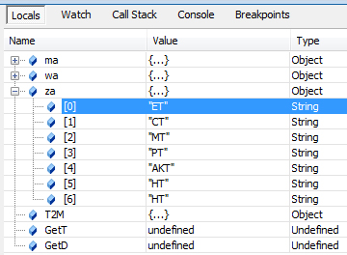
Débogage
Break Point
Debugging Toolbar
JavaScript Debugging Window
JavaScript Debugging Tools
Notes:
Title: Improved Debugging
Talking Points:
To debug JavaScript, developers simply click the script tab in the Developer Tools window and press ‘Start Debugging’.
[CLICK] Even if script debugging is disabled, Internet Explorer 8 will indicate that it will refresh the page and enable debugging for only the current Internet Explorer instance so developers will not see script error dialogs as they browse the web. However, if developers want to avoid the page refresh and dialog, script debugging is enabled for Internet Explorer in the ‘Advanced’ tab of the Internet Options Control Panel. JavaScript debugging in the Developer Tools window has all the same debugging tools as traditional debuggers providing dialogs for Local variables, Watch variables, a Callstack reference, an Immediate window for scripting commands…
[CLICK] …and a Breakpoint window for listing all breakpoints throughout the script.
[CLICK] As JavaScript code becomes more complex, these tools become more valuable and save web development time as well as company resources when deploying new web solutions.

Slide 13
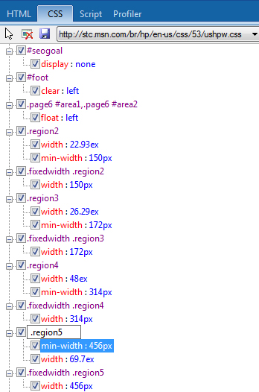
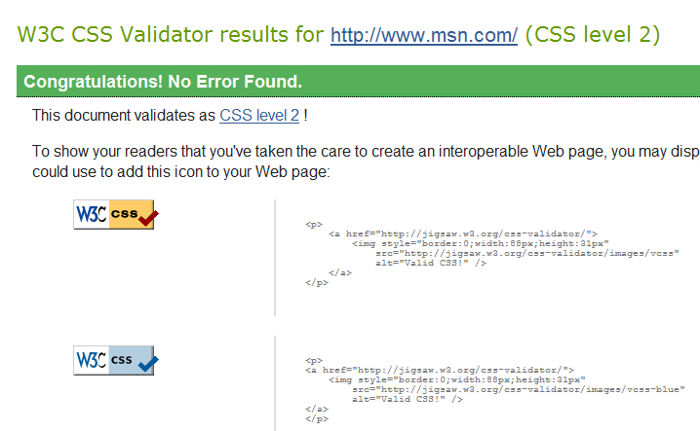
Tracing
Notes:
Title: Robust Tracing
Talking Points:
Robust Tracing: In addition to simplifying the debugging process, the new Developer Tools feature in Internet Explorer 8 offers a new perspective on websites. Instead of just a source view, the tool provides visibility into the Internet Explorer internal representation of the site. For example, the DOM tree in the tool is built from the tree Internet Explorer builds internally to display the page, not from the web page’s source. So if a script changes the tree, Internet Explorer 8 shows the updated tree. Developers can also view style information for an element to better understand what rules apply or what rules specify a given style property, as shown below.
The Internet Explorer 8 Developer Tools also provide the ability to experiment and rapidly iterate by letting developers edit a site within directly within the Internet Explorer instance. For example, once a style rule or property is found, clicking a checkbox enables or disables it, and clicking attributes in the DOM tree edit the style in-place. This provides a easier access to styles and helps expedite the debugging process.
[CLICK] Internet Explorer 8 also provides a CSS validator to test the CSS against W3C standards and returns any inconsistencies that may be found. This helps developers increase overall interoperability and consistency between browsers when creating websites.

Slide 14
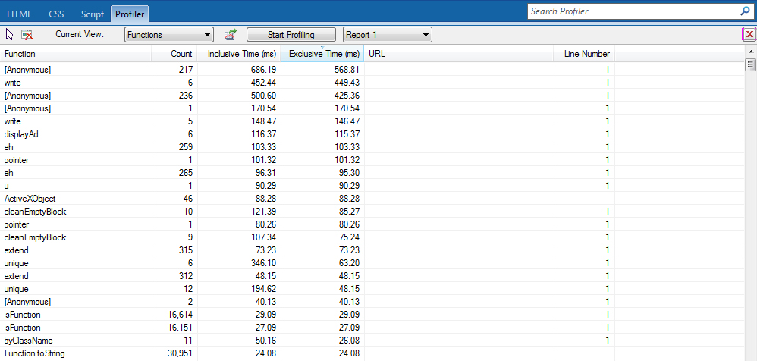
Profiling
Notes:
Title: Code Profiling
Talking Points:
Code Profiling: Internet Explorer 8 also includes a code profiler for identifying performance issues quickly and easily. The profiler allows developers to analyze functions within the page and determine where bottlenecks occur and then resolve them increasing the responsiveness of the page. Again, this is all done without having to leave the page making developers more productive and efficient.

Slide 15
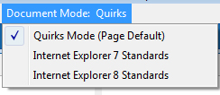
Changement du mode de rendu
<meta http-equiv="X-UA-Compatible" content="IE=7" >
Notes:
Title: Control Layout Mode
Talking Points:
Change Layout Mode: The Developer Tools also provide easy access to all available rendering modes so you can test different modes quickly. You can switch between Quirks (Internet Explorer 5) layout engine, to the Strict (Internet Explorer 7) layout engine and finally, developers can use the default Standards (Internet Explorer 8) layout engine. Changing compatibility modes results in the page refreshing and then displaying the page based on the layout engine chosen. The developer no longer needs all three versions running on different physical or virtual machines to test compatibility between the browser versions saving time and resources.

Slide 16
Demo

Slide 17
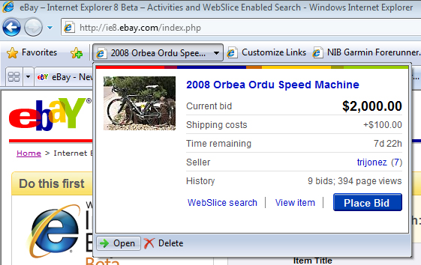
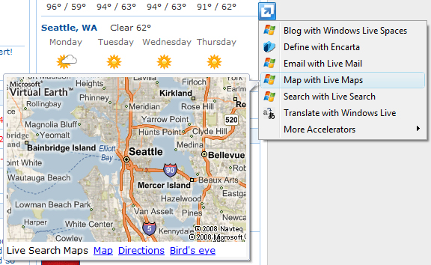
Les nouvelles fonctionnalités
WebSlices
Accelerateurs
Notes:
Title: Richest Experiences on the Web
Talking Points:
With Web Slices, Accelerators and Mashups, users can seamlessly integrate access to their favorite online services and information that they care about the most. These features make the browsing experience smoother and more convenient for users as they look for information.
Web Slices: One feature included in Internet Explorer 8 is Web Slices. Web Slices enable rich, real-time integration of the online services and content all without navigating away from the current page. For developers, they can better personalize the browser experience for users returning what is important, meaningful and relevant to them. Additionally, developers can also expand their ability to create on-going connections to end-users by regularly updating the Web Slice content. Web Slices now support active content with the release of Internet Explorer 8 Beta 2. This enables you to include script or ActiveX controls (for example, embedding Silverlight content) into your Web Slice.
[CLICK]
Accelerators: Another great feature in Internet Explorer 8 is Accelerators. Accelerators deliver ‘out-of-the-box’ access to the online services from within the page. For end-users, they get integrated access to the power of their favorite online services directly from content on the page. No add-ons or ‘assembly’ required. The page owner doesn’t need to make any changes to their content for users to take advantage of this feature. This provides a significant advantage to developers marketing their services to end-users while providing better convenience and browsing experience for the end-user.
[CLICK]
Mashups: A mashup composes a web application by combining programs and data services from multiple originators, and delivers it for presentation on a single web page. Usually, these programs and services interact with each other.
The same origin policy (SOP) governs access control in today’s browsers. It prevents documents or scripts loaded from one origin from getting or setting properties of documents from a different origin - it provides total isolation. While this is useful to protect one origin from another, it shackles mashups. A common technique mashup authors have used to break free of this restriction is by the clever use of the script tag. The SOP is not applicable to the src attribute on the <script> tag; a document may contain <script> elements from different origins (or domains). Such third party scripts are treated as originating from the document’s origin and can access all of the document’s resources - they have total trust.
Faced with this all-or-nothing security model, the mashup developer can use the <iframe> structure to confine components such that they cannot interfere with each other, but the SOP isolates them so completely they are also unable to interact with one another, or, use the <script> tag and ECMAScript to enable cross domain data exchange and compose rich client-side mashups.

Slide 18
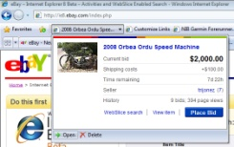
Developing Web Slices
Le Web Slice
<div class=”hslice” id=”1”>
<p class=”entry-title”>Las Vegas 79°</p>
<div class=”entry-content”>
<!-- HTML body content to render. -->
...
</div>
</div>
Discover
WebSlice
Contenu Web
Notes:
Title: Developing Web Slices
Talking Points:
Enable Content
Users commonly visit many Web sites several times a day to check for updates. The introduction of RSS feeds can make this experience easier for users, although this requires a nontrivial amount of work on behalf of the developer.
Web Slices is a new feature for Web developers can implement to enable users to subscribe to content directly within a Web page. Web Slices behave just like feeds in that users can subscribe to them and receive update notifications when the content changes. Sites are polled at user-defined intervals, similar to the way RSS feeds are polled. Site operators may also define a minimum wait time between polls to minimize requests.
A Web Slice is a section within a Web page that is treated like a subscribable item, just like a feed. To enable Web Slices on your Web site, annotate your Web page with class names for the title, description, and other subscribable properties. Web Slices uses a variation of the hAtom microformat.
Discover Web Slice
Users of Windows Internet Explorer 8 Beta 2 can discover Web Slices within a Web page and add them to the Favorites bar, a dedicated row below the Address Bar for easy access to links. Windows Internet Explorer 8 Beta 2 subscribes to the Web page, detects changes in the Web Slice, and notifies the user when updates occur.
View Web Slice
Users can preview these updates directly from the Favorites bar and click through to the Web site to get more information if they want to.
New for Beta 2
Developers who worked with Web Slices in Internet Explorer 8 Beta 1 may have experienced the limitations of static HTML content for the Web Slice window. Now in the Beta 2 release of Internet Explorer 8 you are able to add dynamic content and get a rich, interactive experience right inside the Web Slice. You can now use script and ActiveX controls in Web Slices, making it possible to do things like embed Silverlight video.

Slide 19
Demo

Slide 20
Cross Domain
 |  | Requête Ajax dans la zone :
 |  | Local | Intranet | Trusted (Intranet) | Trusted (Internet) | Internet | Restricted
Page dans la zone : | Local | Allow | Allow | Allow | Allow | Allow | Block
 | Intranet | Block | Allow | Allow | Allow | Allow | Block
 | Trusted (Intranet) | Block | Allow | Allow | Allow | Allow | Block
 | Trusted (Internet) | Block | Block | Block | Allow | Allow | Block
 | Internet | Block | Block | Block | Allow | Allow | Block
 | Restricted | Block | Block | Block | Block | Block | Block

Slide 21
Performance
Amélioration
Parsing et rendu HTML plus rapide
Exécution JavaScript plus rapide
Notes:
Title: Improved Performance
Talking Points:
HTML Performance: Internet Explorer 8 provides a significant improvement in rendering HTML and overall display performance.
Script Performance: In addition, script execution is particularly important given its prevalence on the web and so a major area of investment for Internet Explorer 8 was in the area of script engine improvements. Increasingly, the most interesting and popular websites are using script to bring content into the page dynamically. That means the browser has to do more than simply show static text and images, it has to read and execute program logic (script) on each page. The improved script engine in Internet Explorer 8 is designed to significantly increase site performance on these dynamic, heavily scripted sites.

Slide 22
Outil de test
IETester
ACT 50 (Application Compatibility Tool)
http://www.microsoft.com/downloads/details.aspx?FamilyID=24da89e9-b581-47b0-b45e-492dd6da2971&displaylang=en

Slide 23
WebBrowser
Demo

Slide 24
La référence technique
pour les IT Pros :
technet.microsoft.com
L’engagement Microsoft
pour les développeurs :
msdn.microsoft.com
Abonnement TechNet Plus :
Versions d’éval + 2 incidents support
Visual Studio 2008 +
Abonnement MSDN Premium
S’informer - Un portail d’informations, des événements, une newsletter bimensuelle personnalisée
Se former - Des webcasts, des articles techniques, des téléchargements, des forums pour échanger avec vos pairs
Bénéficier de services - Des cursus de formations et de certifications, des offres de support technique

Slide 25
Certifications : Programme de nouvelle génération
Série Master – Ce programme valide les compétences technologiques de très haut niveau des individus sur les plateformes Microsoft
Master
Série Architecture– le programme Microsoft Certified Architect permet aux entreprises d’identifier facilement les architectes en informatique très expérimentés, ayant suivi un processus de validation particulièrement rigoureux.
Série Métier – Ce programme valide un ensemble complet de compétences à jour, permettant au professionel de réussir dans son métier et d’être très performant.
Une certification recherchée par les entreprises
4 séries et 5 titres adaptés et ciblés à chaque métier.
Un label pour votre expertise Les certifications Microsoft permettent la validation de votre expertise : une certification constitue la preuve pour vos clients ou votre société de vos compétences sur les produits et technologies Microsoft.
Un gage de qualité pour l'entreprise
Série Technologie – Ces certifications vous permettent d’approfondir vos connaissances sur des technologies Microsoft spécifiques et d’obtenir toutes les compétences nécessaires pour les exploiter à fond.
Notes:
Microsoft a créé une nouvelle génération de certifications pour mieux répondre aux attentes des clients. Avant d’apporter ces changements, nous nous sommes adressés à nos clients pour mieux comprendre ce qu’ils recherchaient. En règle générale, ils nous ont laissé entendre que le programme devait être : - mieux ciblé et plus souple. - rigoureux et crédible. - simple et approprié.
Nous vous proposons donc un programme de certification : 4 séries (technologie, métier, master, architecture) et 5 titres adaptés (technique, It pro, développeurs…) et ciblés à chaque métier.
Les examens de nouvelle génération comprend uniquement les cursus des produits de version à partir de 2005 (SQL Server 2005, Exchange Server 2007, Windows Server 2008…) http://www.microsoft.com/france/formation/nouvelle_certification/default.mspx
L’ancien programme avec les anciens cursus de certification est toujours d’actualité (MCSE,MCSA Windows Server 2003..)
Les examens seront mis à jour au fur et à mesure !
Plus d’infos : http://www.microsoft.com/france/formation/cert/default.mspx

Slide 26
Certification : validez vos compétences
Offre de certification Seconde chance :
Bénéficiez d’un second passage gratuit pour tout 1er passage non réussi www.microsoft.com/france/formation
Guides de préparations aux examens :
http://www.microsoft.com/france/formation/examens
Echangez et discutez sur les certifications sur le Forum :
http://forums.microsoft.com/france/default.aspx
Contactez nous pour d’autres questions :
formcert@microsoft.com
Notes:
Pour valider un cursus de certification, il faut obtenir un examen pour valider une certification technique.
Offre de certification Seconde chance :
Microsoft vous propose de bénéficier d’un second passage gratuitement si vous ne réussissez pas votre premier passage.
Pour plus d’informations, visitez le site formation et certification www.microsoft.com/france/formation
Le guide de préparation à l’examen vous indique quels sont les pré-requis pour passer cet examen.
Site formation & Certification est un site qui vous donne toutes les informations concernant les formations et examens disponibles, la liste des centres de formation (CPLS), centre de test Prometric de votre région et les offres de certifications disponibles….
Pour choisir ceux qui vous correspondent le mieux, vous avez la possibilité de sélectionner : une formation ou un examen sur un produit ou une technologie spécifique, le cursus correspondant à votre métier, le centre de formation le plus proche de chez vous.
Forums certifications : Il existe depuis peu deux forums dédiés à la certification technique Microsoft. Vous pouvez échanger et discuter autour des certifications développeurs (MCTS et MCPD) et des mises à niveau (pour les MCAD et MCSD).
Vous pouvez également échanger et discuter autour des certifications IT (MCTS et MCITP) et des mises à niveau (pour les MCDST, MCDBA, MCSA et MCSE)
Si vous avez des questions sur la certification individuelle, l’équipe formation et certification se tient à votre écoute, contactez nous par courriel.

Slide 27
Votre potentiel. Notre passion. TM
© 2008 Microsoft Corporation. All rights reserved. Microsoft, Windows, Windows Vista and other product names are or may be registered trademarks and/or trademarks in the U.S. and/or other countries.
The information herein is for informational purposes only and represents the current view of Microsoft Corporation as of the date of this presentation. Because Microsoft must respond to changing market conditions, it should not be interpreted to be a commitment on the part of Microsoft, and Microsoft cannot guarantee the accuracy of any information provided after the date of this presentation. MICROSOFT MAKES NO WARRANTIES, EXPRESS, IMPLIED OR STATUTORY, AS TO THE INFORMATION IN THIS PRESENTATION.

Slide 28
Guide couleurs
Si besoin utiliser les palettes de couleur ci-dessous
Sample Fill
Sample Fill
Sample Fill
Sample Fill
Sample Fill
Sample Fill
Sample Fill
Sample Fill
Sample Fill
Sample Fill

Slide 29
Format Table
Title Table
Column 1 | Column 2 | Column 3 | Column 4 | Column 5

Slide 30
Bar Chart Example

Slide 31
Codes

Slide 32
Pie Chart Example

Slide 34
Notes
Les 3 slides suivants sont à présenter impérativement à la fin de votre session (même rapidement)
Les suivants sont cachés et seront disponibles pour les clients lors du téléchargement

Slide 35
Sécurisez et optimisez vos opérations avec un contrat de Support premier
Contrat de Support Premier
Bilans de santé
Transfert d’expertise
WorkshopPLUS
MS Insight
Ateliers
IT Operations
Le contrat de support premier est une offre complète et flexible vous permettant d’accéder à un ensemble de services préventifs visant à sécuriser, optimiser et assurer la disponibilité de vos plateformes.
Analyses en profondeur du système pour en cibler les failles et maximiser sa performance
Formations techniques réalisées par des Premier Field Engineers (PFE)
Formations techniques avancées et mondialement standardisées, délivrées par des ingénieurs certifiés
Ateliers interactifs permettant d’échanger avec des représentants de l’informatique interne de Microsoft sur leur expérience de l'utilisation des outils et méthodologies d'exploitation.
Plus orientés processus, ils s'adressent à des décideurs ainsi qu'à des responsables IT
Microsoft Operations Framework (MOF) fournit des méthodologies opérationnelles permettant aux entreprises d’optimiser la fiabilité, la supportabilité et la gestion des produits et technologies Microsoft
Ateliers techniques personnalisés

Slide 36
Certification : validez vos compétences
Microsoft Desktop Optimization Pack configuration
Examens disponibles :
70-403 TS: System Center Virtual Machine Manager, Configuration
70-643 TS: Windows Server 2008 Applications Infrastructure, Configuration
70-652 TS: Windows Server 2008 Virtualization, Configuration
70-656 TS: Microsoft Desktop Optimization Pack, Configuration
Examens disponibles :
70-351 TS: Configuration du serveur Microsoft Internet Security and Acceleration (ISA) Server 2006
Configuration du serveur Microsoft ISA Server 2006
Examens disponibles :
70-400 : TS : Configuration de Microsoft System Center Operations Manager 2007
70-401 : TS : Configuration de Microsoft System Center Configuration Manager 2007
70-403 TS: Configuration de System Center Virtual Machine Manager, (bientôt disponible)
Configuration de serveur Microsoft System Center
Examens disponibles :
Certification technologique (TS) : 70-236 : MCTS: configuration de MS Exchange Server 2007 (1 examen requis)
Certification métier (IT Pro): 70-236 +70-237 + 70-238 : MCITP: Enterprise Messaging Administrator (3 examens)
Configuration Microsoft exchange Server 2007
Notes:
Pour aller jusqu’au bout de votre parcours en tant professionnel de l’informatique, validez vos compétences sur les technologies Microsoft en vous certifiant.
Le guide de préparation à l’examen vous indique quels sont les pré-requis pour passer cet examen.
Offre de certification Seconde chance : Microsoft vous propose de bénéficier d’un second passage gratuitement si vous ne réussissez pas votre premier passage.
Pour plus d’informations, visitez le site formation et certification www.microsoft.com/france/formation
Site formation & Certification est un site qui vous donne toutes les informations concernant les formations et examens disponibles, la liste des centres de formation (CPLS), centre de test Prometric de votre région et les offres de certifications disponibles….
Pour choisir ceux qui vous correspondent le mieux, vous avez la possibilité de sélectionner : une formation ou un examen sur un produit ou une technologie spécifique, le cursus correspondant à votre métier, le centre de formation le plus proche de chez vous.
Forums certifications : Il existe deux forums dédiés à la certification technique Microsoft. Vous pouvez échanger et discuter autour des certifications développeurs (MCTS et MCPD) et des mises à niveau (pour les MCAD et MCSD).
Vous pouvez également échanger et discuter autour des certifications IT (MCTS et MCITP) et des mises à niveau (pour les MCDST, MCDBA, MCSA et MCSE)
Si vous avez des questions sur la certification individuelle, l’équipe formation et certification se tient à votre écoute, contactez nous par courriel.

Slide 37
Certification : validez vos compétences
Microsoft Configuration Office Communications Server 2007
Examens disponibles :
70-638 : TS : Configuration de Microsoft Office Communications Server 2007
Certification technologique (TS) : 70-236 : MCTS: configuration de MS Exchange Server 2007 (1 examen requis)
Certification métier (IT Pro) : MCITP: Enterprise Messaging Administrator (3 examens requis : 70-236 +70-237 + 70-238)
Examen Voice à venir : 88-924
Examens disponibles :
Certifications technologique (TS) : 70-640 : MCTS : Configuration d'une infrastructure Active Directory (1 examen requis)
70-642 : MCTS : Configuration d'une infrastructure réseau (1 examen requis)
70-643 : MCTS : Configuration d'une infrastructure d'applications (1 examen requis)
Certifications métier (IT) : MCIT Professionnel : Administrateur Entreprise (3 examens requis : 70-640 + 70-642 + 70-646)
MCIT Professionnel : Administrateur Serveur (5 examens requis : 70-624 ou 70-620 + 70-642 + 70-640 + 70-643 + 70-647)
MCSE/MCSA 2003 vers MCITP Windows Server 2008
MCSE vers MCTIP Administrateur Entreprise (3 examens requis : 70-649 + 70-620 ou 70-624 + 70-647)
MCSA vers MCTIP Windows Server 2008 – Administrateur Serveur (2 examens requis : 70-648 + 70-646)
Windows Server 2008 Active Directory Configuration
Examens disponibles :
Certification technologique (TS) : 70-557 : MCTS : Microsoft Forefront Client et Server Configuration
Microsoft Forefront Client et Server – Configuration
Notes:
Pour aller jusqu’au bout de votre parcours en tant professionnel de l’informatique, validez vos compétences sur les technologies Microsoft en vous certifiant.
Le guide de préparation à l’examen vous indique quels sont les pré-requis pour passer cet examen.
Offre de certification Seconde chance : Microsoft vous propose de bénéficier d’un second passage gratuitement si vous ne réussissez pas votre premier passage.
Pour plus d’informations, visitez le site formation et certification www.microsoft.com/france/formation
Site formation & Certification est un site qui vous donne toutes les informations concernant les formations et examens disponibles, la liste des centres de formation (CPLS), centre de test Prometric de votre région et les offres de certifications disponibles….
Pour choisir ceux qui vous correspondent le mieux, vous avez la possibilité de sélectionner : une formation ou un examen sur un produit ou une technologie spécifique, le cursus correspondant à votre métier, le centre de formation le plus proche de chez vous.
Forums certifications : Il existe deux forums dédiés à la certification technique Microsoft. Vous pouvez échanger et discuter autour des certifications développeurs (MCTS et MCPD) et des mises à niveau (pour les MCAD et MCSD).
Vous pouvez également échanger et discuter autour des certifications IT (MCTS et MCITP) et des mises à niveau (pour les MCDST, MCDBA, MCSA et MCSE)
Si vous avez des questions sur la certification individuelle, l’équipe formation et certification se tient à votre écoute, contactez nous par courriel.

Slide 38
Certification : validez vos compétences
Examens disponibles :
Certifications technologique (TS) : 70-654 : MCTS - Windows Essential Business Server 2008, Configuring (1 examen requis)
Windows Essential Business Server 2008, Configuring
Examens disponibles :
7 certifications technologique (TS) :
70-536 : MCTS: .NET Framework - Application Development Foundation
70-502 : MCTS: .NET Framework 3.5, Windows Presentation Foundation Applications
70-503 : MCTS: .NET Framework 3.5, Windows Communication Foundation Applications
70-504 : MCTS: .NET Framework 3.5, Windows Workflow Foundation Applications
70-505 : MCTS: .NET Framework 3.5, Windows Forms Applications
70-561 : MCTS: .NET Framework 3.5, ADO.NET Applications
70-562 : MCTS: .NET Framework 3.5, ASP.NET Applications
3 certifications métier (Pro) :
Développeur MCPD: Windows Developer 3.5 (3 examens requis : 70-536 (TS) + 70-563 (TS) + 70-505
Développeur MCPD: ASP.NET Developer 3.5 – (3 examens requis : 70-536 (TS) + 70-562 (TS) + 70-564
Développeur MCPD: Enterprise Application Developer 3.5
(3 examens requis : 70-536 (TS) + 70-565 + au choix 70-503 ou 70-561 ou 70-562 ou 70-505)
Visual Studio 2008
Notes:
Pour aller jusqu’au bout de votre parcours en tant professionnel de l’informatique, validez vos compétences sur les technologies Microsoft en vous certifiant.
Le guide de préparation à l’examen vous indique quels sont les pré-requis pour passer cet examen.
Offre de certification Seconde chance : Microsoft vous propose de bénéficier d’un second passage gratuitement si vous ne réussissez pas votre premier passage.
Pour plus d’informations, visitez le site formation et certification www.microsoft.com/france/formation
Site formation & Certification est un site qui vous donne toutes les informations concernant les formations et examens disponibles, la liste des centres de formation (CPLS), centre de test Prometric de votre région et les offres de certifications disponibles….
Pour choisir ceux qui vous correspondent le mieux, vous avez la possibilité de sélectionner : une formation ou un examen sur un produit ou une technologie spécifique, le cursus correspondant à votre métier, le centre de formation le plus proche de chez vous.
Forums certifications : Il existe deux forums dédiés à la certification technique Microsoft. Vous pouvez échanger et discuter autour des certifications développeurs (MCTS et MCPD) et des mises à niveau (pour les MCAD et MCSD).
Vous pouvez également échanger et discuter autour des certifications IT (MCTS et MCITP) et des mises à niveau (pour les MCDST, MCDBA, MCSA et MCSE)
Si vous avez des questions sur la certification individuelle, l’équipe formation et certification se tient à votre écoute, contactez nous par courriel.

