Slide 2
Unified Tracing and
Network Diagnostics Framework
Mike Bishop
Program Manager
Windows Core Networking

Slide 3
Agenda
Acronyms and Background
Unified Tracing Information
Unified Tracing Demonstration
Network Diagnostics Information
Troubleshooting Demonstrations
Additional Resources

Slide 4
List of Acronyms
NDF – Network Diagnostics Framework
UT – Unified Tracing
ETW – Event Tracing for Windows

Slide 5
NDF & UT with Packet Capturing
Key Goals
Help Windows PC Ecosystem reduce debugging and support costs
Help users help themselves
Assist users easily & efficiently

Slide 6
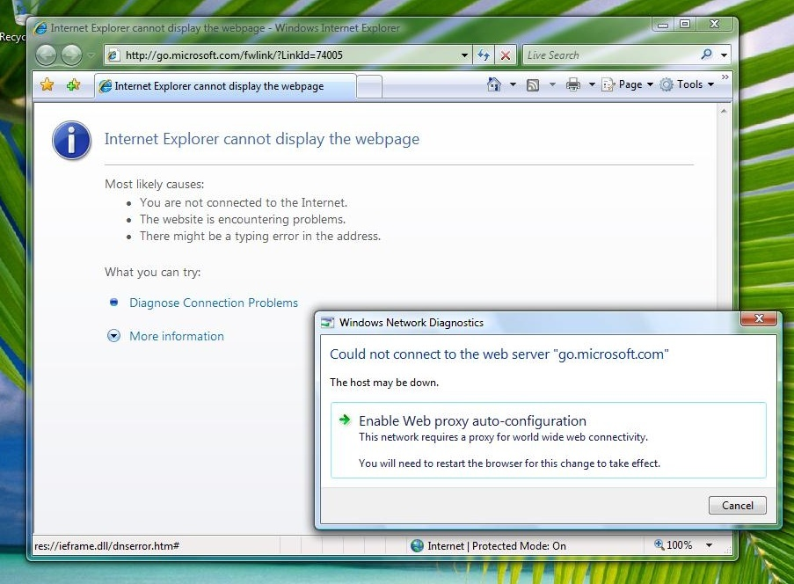
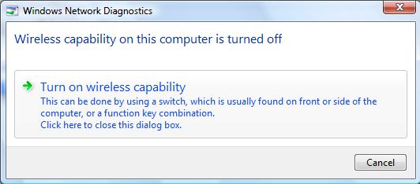
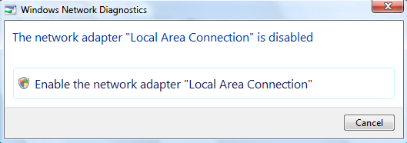
Remember how it was before?
Some good

Slide 7
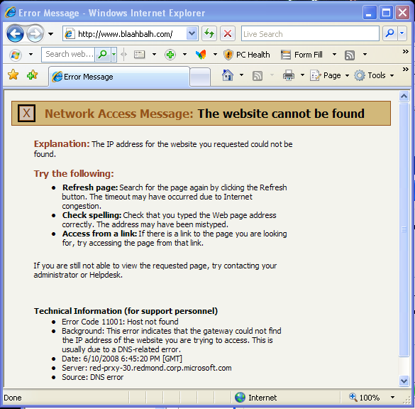
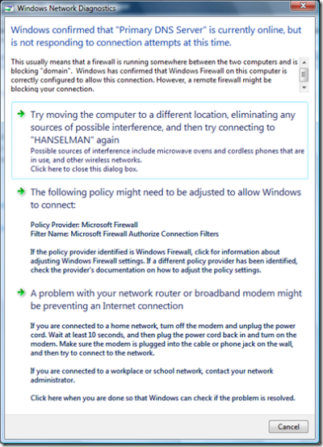
Remember how it was before?
Some not so good

Slide 8
Remember how it was before?
  Wireless
    netsh wlan set tra yes
    netsh wlan set tra no
  DHCP
    Netsh dhcpclient trace enable
    Netsh dhcpclient trace disable
  RAS
    netsh ras set tr * en
    Rasdiag.exe
    netsh ras set tr * dis
  Packet captures
    Download and install NetMon

Slide 9
Unified Network Tracing & Packet Capture

Slide 10
Reducing Cryptic Commands
A trace of all activity across the network stack can be activated per scenario
  netsh trace start scenario=http enables:
    WinInet
    WinSock
    TCP
    IP
    IPSec
    Wireless management
    NDIS
    Your driver’s error events
    And many more....

Slide 11
UT Architecture

Slide 12
Demo – Unified Tracing
  Capture event tracing and packet captures while connecting to an 802.1x wireless network

Slide 13
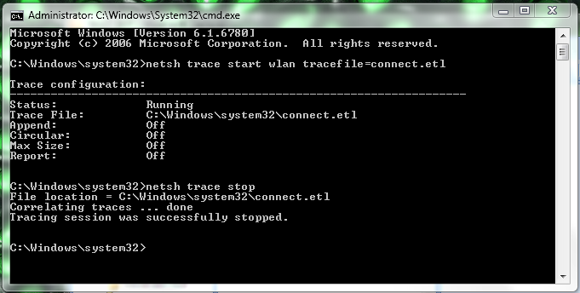
Start Tracing

Slide 14
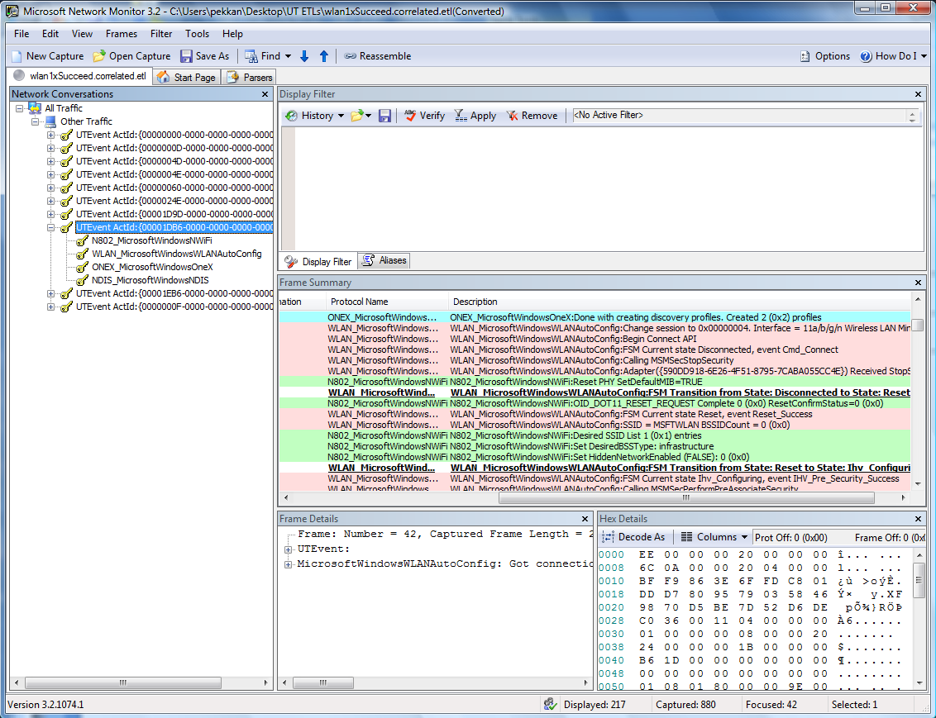
  Using Netmon 3.2 to troubleshoot networking problems

Slide 15
Choosing your events
Consider what events you want to emit
  Events should be useful to you in debugging the driver, as well as to a support engineer in troubleshooting driver-related issues
Select appropriate channels for each event
  Admin
  Operational
  Analytical
  Debug
These events can also be used for performance testing
  Consider logging events on state transitions or on start/stop of key activities, then compare timestamps

Slide 16
Integrating your driver with UT
NdisWriteErrorLogEntry API is automatically integrated to Unified Tracing
  If you already use this API, your drivers will automatically publish their errors into the UT infrastructure
WDK already contains documentation on using ETW in drivers
  Custom providers can be manually enabled on command line for debugging

Slide 17
Manifesting your events
All ETW events must be described in an XML manifest
Can include associations with levels and keywords
  Keywords and levels can be specified on UT command line
Manifest can optionally be used to create NetMon parser for your events

Slide 18
Unified Tracing Availability
Released version will contain many high-level scenarios
(HTTP, SMB, etc.)
  Most of these will be in Beta
  More may be added before release
In-box tools allow trace/capture generation and conversion to other formats (csv, evtx, txt)
Netmon 3.2 is the richest environment for viewing UT traces, but requires additional parsers to interpret the events
  Netmon 3.2 Beta currently on connect.microsoft.com
  UT Parsers available on CodePlex.com later this year

Slide 19
Getting UT files from users
Users should be directed to run Network Diagnostics when they encounter a problem
  NDF can identify (and often fix) most common networking problems
  UT traces of the problem are gathered when NDF is run
  Admin rights are not required to run NDF and gather these traces (though non-admins may have less system information stored in the log)
Past diagnostics incidents are stored on the machine and can be viewed or saved to a file after the fact
Support can direct users to start and stop tracing from the command line if you need:
  Keywords or verbosity other than default
  Additional providers

Slide 20
Network Diagnostics Framework

Slide 21
NDF Architecture

Slide 22
Areas checked by NDF
Connectivity to Remote Host
DHCP Service Status
File Sharing
Internet Protocol (IP) Configuration
IPv6 over IPv4 Connectivity
Name Resolution (DNS)
Name Resolution (PNRP)
Network Access Protection
Network Gateway Accessibility
Network Interface Configuration
Network Interfaces
Network Routing
Remote Assistance
Remote Host Availability
TCP Window Scaling Network Support
Web Connectivity
Windows Filtering Platform
Windows Firewall
Winsock Configuration
Wired Network Interface
Wireless Connectivity
Wireless Network Interface
Wireless Security
Wireless WAN Connectivity

Slide 23
Invoking NDF
NDF can be called from an application using standard Win32 calls
  Internet Explorer 7 & 8
  Windows Media Player
UI-less invocation is now possible if you want to build your own diagnostics experience
Multiple points within the Windows UI, including:
  Networking tray icon
  Wireless network selection
  Share access failure

Slide 24
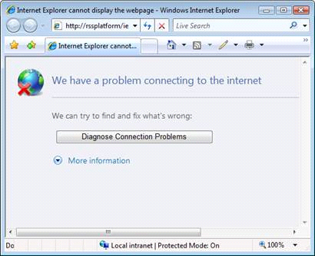
How does the user reach NDF?
Internet Explorer 8

Slide 25
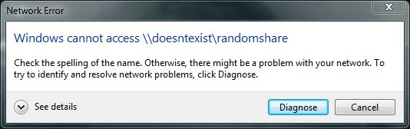
How does the user reach NDF?
Share access failure

Slide 26
Demo – Network Diagnostics
NDF identifies and repairs the immediate issue
Saved information and trace can be accessed by support later

Slide 27
Demo – Network Diagnostics

Slide 28
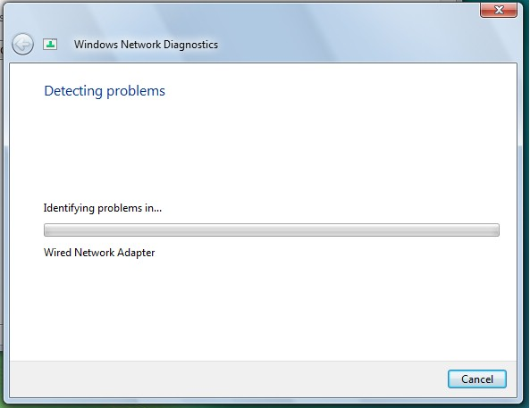
Demo – Network Diagnostics

Slide 29
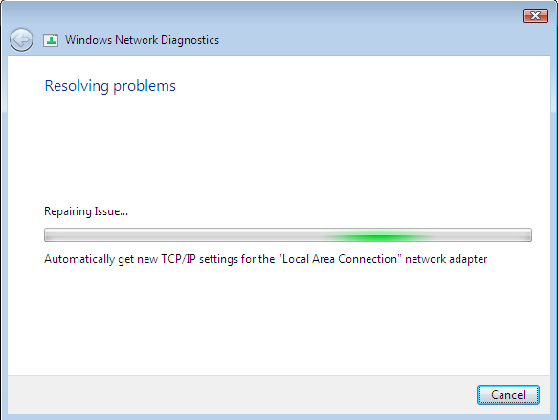
Demo – Network Diagnostics

Slide 30
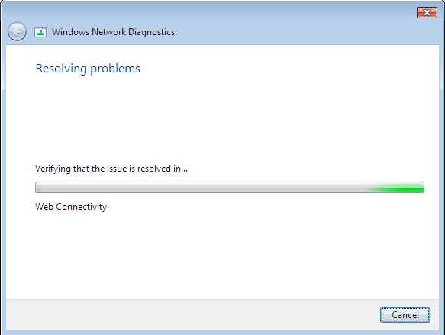
Demo – Network Diagnostics

Slide 31
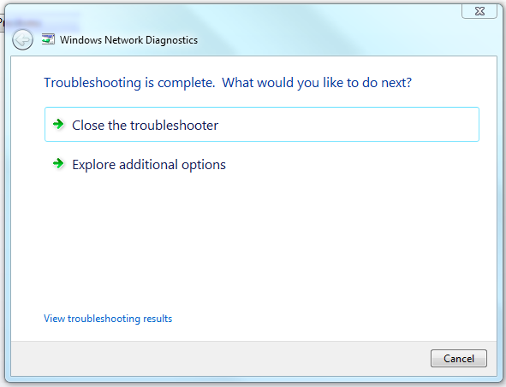
Demo – Network Diagnostics

Slide 32
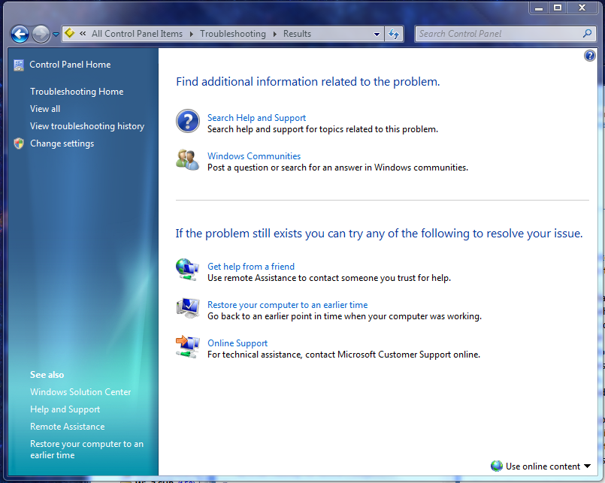
Demo – Network Diagnostics

Slide 33
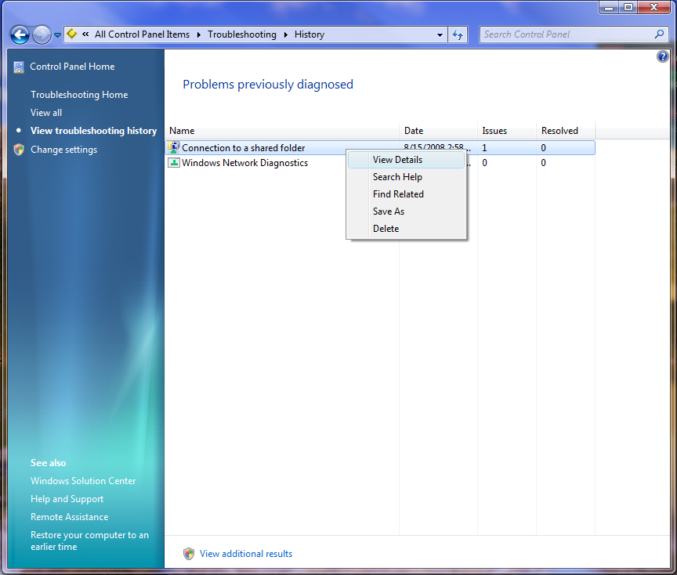
Demo – Network Diagnostics

Slide 34
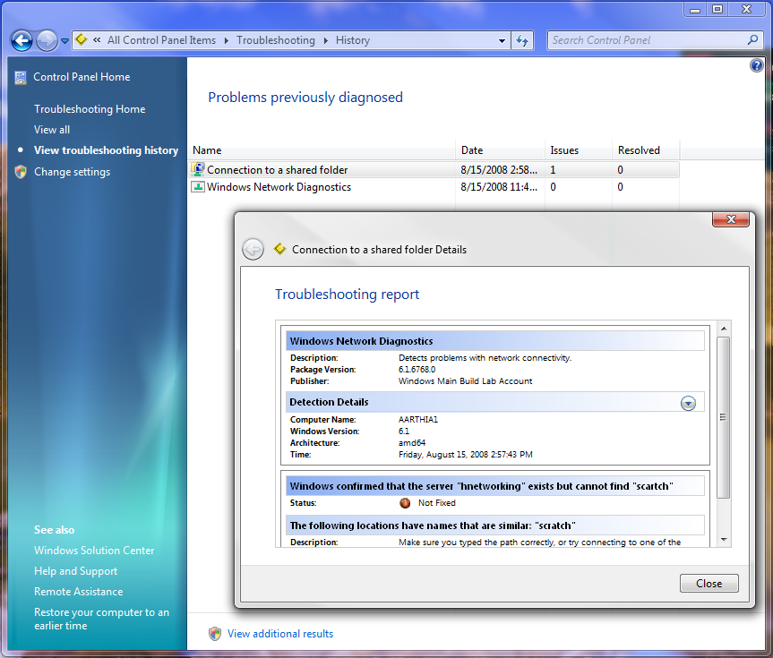
Demo – Network Diagnostics

Slide 35

Demo – Network Diagnostics

Slide 36
Additional Resources
White paper
  “Troubleshooting with Unified Tracing” planned for release with Beta
WDK Documentation on MSDN:
  Adding Event Tracing to Kernel-Mode Drivers
  http://go.microsoft.com/fwlink/?LinkID=80610
Please send your questions, comments or feedback to
ndftap@microsoft.com

