Slide 2
Creating Deployable Driver Packages
Eugene Lin
Principal Program Manager Lead
Device & Storage Technologies Group
elin@microsoft.com

Slide 3
Key Takeaways
Create device driver packages that can be deployed via any Windows-supported mechanism
Understand how Windows handles your driver packages in install, update, and uninstall scenarios
Express dependencies between multiple driver packages for
multifunction devices
Trigger application installation from your driver package in a deployment-friendly way

Slide 4
Creating Driver Packages

Slide 5
What Is a Driver Package?
[SourceDisksFiles]
MyFile1.sys= …
MyFile2.dll=…
[MyDDInstall]
CopyFiles=@MyFile1.sys
CopyFiles=@MyFile2.dll
A driver package is a self-describing collection of files defined by a declarative manifest.
The INF file is the manifest. It defines entire contents of the package via the SourceDisksFiles section and CopyFiles directives.
The INF file is the only source of information that Windows uses to identify which files are necessary to install the package.
If a file is not listed in the INF, Windows does not guarantee it will be present during device installation!
Driver Package
MyInf.inf
MyFile1.sys
MyFile2.dll
Live Search
site:msdn.microsoft.com "summary of INF sections"

Slide 6
Avoid Common Mistakes
Do not assume anything about any files not listed and copied by your INF
To make your package deployment-ready:
  DO NOT put resource files outside your package. Include them in your package or gracefully handle their absence.
  DO NOT depend on files copied by other packages. Include them in your package or gracefully handle their absence.
  DO NOT depend on files copied by apps. Include them in your package or gracefully handle their absence.
Driver Package
MyInf.inf
OemConfig.dat
MyFile1.sys
Depends on
OtherDriver.dll
MyFile2.dll
Depends on

Slide 7
Include All Files in Your Package
[SourceDisksFiles]
MyFile1.sys= …
MyFile2.dll=…
OemConfig.dat=…
OtherDriver.dll=…
[MyDDInstall]
CopyFiles=@MyFile1.sys
CopyFiles=@MyFile2.dll
CopyFiles=@OemConfig.dat
CopyFiles=@OtherDriver.dll
One solution is to include all dependencies within your package.
Yes, this means all the files are signed with the package.
Driver Package
MyInf.inf
OemConfig.dat
MyFile1.sys
Depends on
OtherDriver.dll
MyFile2.dll
Depends on

Slide 8
Overview of Driver Package Deployment
Windows copies driver package to Driver Store.
Time passes. The world changes.
Windows installs driver package on device.

Slide 9
Overview of Driver Package Deployment
Windows copies driver package to Driver Store.
Time passes. The world changes.
Windows installs driver package on device.
This is the hard part!

Slide 10
Overview of Driver Package Deployment
Windows treats your driver package as a time capsule and survival pod. Windows will preserve the contents of your driver package.
Windows copies driver package to Driver Store.
Time passes. The world changes.
Windows installs driver package on device.
Some examples of installation environment changes:
CD/DVD install → CD/DVD no longer in drive
OEM preinstall → OEM customized bits gone
Windows XP → Windows Vista
Windows Vista RTM → Windows Vista SP1
Windows Vista Home Basic→ Windows Vista Ultimate
Windows Home Server machine recovery
Windows Update deployment

Slide 11
Step 1: Driver package copied to Driver Store
Driver Package
MyInf.inf
Windows builds a list of files from the INF:
  MyFile1.sys
  MyFile2.dll
Windows copies those files (and the INF) into the Driver Store.
OemConfig.dat
MyFile1.sys
OtherDriver.dll
MyFile2.dll
Driver Store
Driver Package
Driver Package
Driver Package
Driver Package
MyInf.inf
MyFile1.sys
The Driver Store isolates driver packages
side-by-side in a private database.
MyFile2.dll

Slide 12
Step 2: The world changes
Remove media
Upgrade OS
Driver Package
MyInf.inf
Windows treats driver packages in the Driver Store as atomic entities.
Windows protects the Driver Store as one of its own components.
The Driver Store always contains all installable driver packages, including inbox drivers.
Transfer to new PC
OemConfig.dat
MyFile1.sys
Restore backup image
OtherDriver.dll
MyFile2.dll
Install service pack
Cesspool
Windows Resource Protection
Driver Store
Driver Package
Driver Package
Driver Package
Driver Package
MyInf.inf
MyFile1.sys
MyFile2.dll

Slide 13
Step 3: Driver installed on device
Windows performs file and registry operations as directed by the INF.
The driver package remains in the Driver Store for repair, reinstallation, verification, and migration operations.
Windows Resource Protection
Driver Store
Driver Package
Driver Package
Driver Package
Driver Package
MyInf.inf
MyFile1.sys
MyFile2.dll
Destinationdir\
MyFile1.sys
MyFile2.dll

Slide 14
Include All Files in Your Package
[SourceDisksFiles]
MyFile1.sys= …
MyFile2.dll=…
OemConfig.dat=…
OtherDriver.dll=…
[MyDDInstall]
CopyFiles=@MyFile1.sys
CopyFiles=@MyFile2.dll
CopyFiles=@OemConfig.dat
CopyFiles=@OtherDriver.dll
One solution is to include all dependencies within your package.
Yes, this means all the files are signed with the package.
Driver Package
MyInf.inf
OemConfig.dat
MyFile1.sys
Depends on
OtherDriver.dll
MyFile2.dll
Depends on

Slide 15
… Or Handle Their Absence
Treat the “missing file” case as a possible path.
Gracefully handle it
  Allow admins to override config, but provide a default if missing.
  Check for presence of plug-ins, etc. before attempting to load them.
Driver Package
MyInf.inf
OemConfig.dat
Optional
MyFile1.sys
Missing OK
OtherDriver.dll
Optional
MyFile2.dll
Missing OK

Slide 16
Creating Multiple Driver Packages for a Multifunction Device

Slide 17
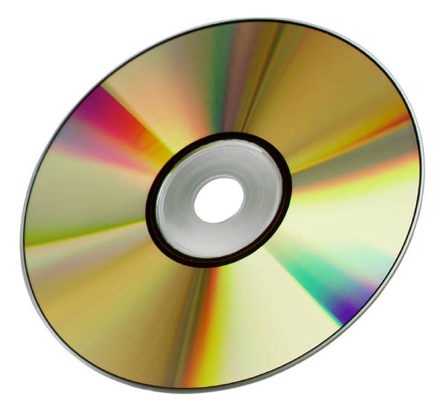

Multifunction Devices
Definition
  A device that enumerates as multiple devnodes
Problem
  Need to install multiple drivers from media without multiple prompts
  Need to install multiple drivers from Windows Update (WU) in a single submission
Solution
  CopyInf
Scanner Driver
Package
Printer Driver
Package

Slide 18
Multifunction Devices
CopyInf directive
  Links multiple INFs together, so when one gets copied into the Driver Store, the other gets copied also
  Parsed by Windows when a driver package is copied to the Driver Store
  If a driver package referenced in a CopyINF directive is already in the Driver Store, Windows will not attempt to re-copy the package
…
[DDInstall]
CopyINF=myinf1.inf[,myinf2.inf]...
…

Slide 19
Multifunction Devices: Parent device uses your driver
Parent.inf
CopyINF = child1.inf, child2.inf
Parent device
Child1.inf
Child2.inf
Child device #1
Child device #2

Slide 20
Multifunction Devices: Parent device uses inbox driver
Usb.inf
(inbox)
Since you don’t know
which child will enumerate first, put the matching CopyINF entries in each child driver package
Parent device
CopyINF = child2.inf
CopyINF = child1.inf
Child1.inf
Child2.inf
Child device #1
Child device #2

Slide 21
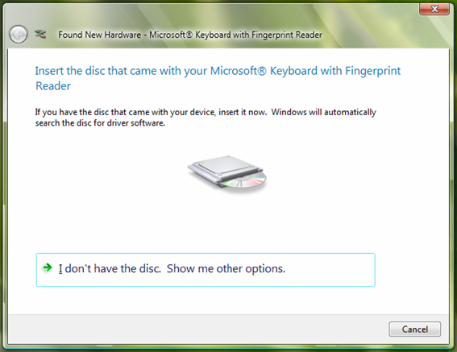
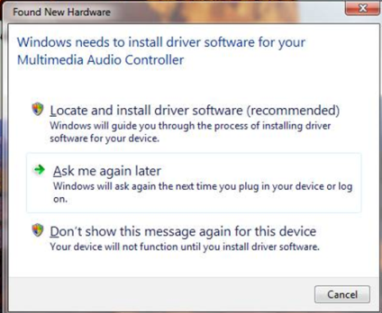
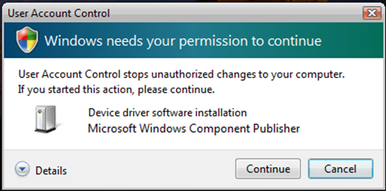
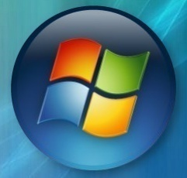


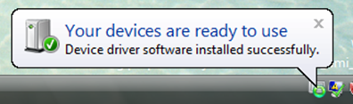
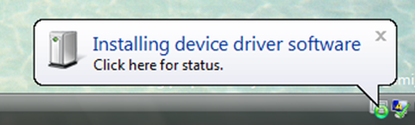
CopyInf Walkthrough
Usb.inf
(inbox)
Child1.inf
Child2.inf
CopyINF=Child2.inf
CopyINF=Child1.inf
Usbccgp.sys
File1
File4
Parent device
Parent device
Windows Update
DevicePath
File2
File5
File3
File6
Found New Hardware Wizard
Driver Store
File1
Usb.inf
(inbox)
Usb.inf
(inbox)
Usbccgp.sys
Child device #1
Usbccgp.sys
Child device #1
File1
Child1.inf
Child1.inf
Child2.inf
Child2.inf
File5
Child device #2
File5
Child device #2
CopyINF=Child2.inf
CopyINF=

Slide 22
Installing Device-Related Applications via Plug and Play

Slide 23
Installing Device-Related Applications
You have an application that is necessary to make your device work as advertised
  Examples
    Universal remote that is a HID device
    Portable music player that is a USB mass storage device
    Multifunction printer with print/scan/copy application
    Wireless picture frame with Windows configuration application
You want the application to be installed automatically when the device is connected, with minimal user interaction

Slide 24
Installing Device-Related Applications
Plug and Play has an extensibility mechanism that enables a driver package to execute arbitrary code
The mechanism for this extensibility is a device co-installer
Within the co-installer, the task is called a Finish-Install Action
Use a Finish-Install Action to obtain and install the app
Driver Package
MyInf.inf
Retrieve from preinstall location or web
MyFile1.sys
Coinstaller
MyFile2.dll
App installer

Slide 25
Use a Finish-Install Action to Install The App
Finish-Install Action defined:
  Custom code that is executed in an Administrator user’s context after a driver is installed and started
  Implemented in a co-installer within your driver package
  Compatible with Windows Vista and above
Live Search
site:msdn.microsoft.com "finish install actions"

Slide 26
Finish-Install Actions
How they work
  Windows installs the driver on a device
  Windows invokes your co-installer with DIF_NEWDEVICEWIZARD_FINISHINSTALL within the LocalSystem context
  Your co-installer tells Windows whether it needs to run a Finish-Install Action
  If your co-installer says yes, Windows does the following:
    Waits until the driver is installed and the device is started
    Waits until a user is logged in, if not already
    Prompts the user to run the Finish-Install action now or later
    Prompts the user for UAC elevation if necessary
    Invokes your co-installer with DIF_FINISHINSTALL_ACTION within an Administrator user’s context
    If your co-installer returns failure, Windows will repeat steps 4.2 thru 4.5 on every user login until it returns success

Slide 27
Implementing Finish-Install Actions
During DIF_NEWDEVICEWIZARD_FINISHINSTALL
  Determine whether you need to run your Finish-Install Action
    Check to see if your application is already installed
    Check for your private configuration overrides
      E.g. You provide a registry key to disable application install
      E.g. You provide a registry key to enable unattended install
  Set the DI_FLAGSEX_FINISHINSTALL_ACTION to have Windows run your Finish-Install Action

Slide 28
Implementing Finish-Install Actions (cont.)
During DIF_FINISHINSTALL_ACTION
  Determine again whether you need to run your Finish Install Action
    You need to do this again because time may have passed since the DIF_NEWDEVICEWIZARD_FINISHINSTALL call
  Obtain your application
    Look in your private staging area (e.g. OEM or IT Pro installs)
    Download from your web service
  Install your application
    Remember not to return until the installer is finished

Slide 29
Implementing Finish-Install Actions (cont.)
Does all the code have to live in my co-installer binary?
  No, but it makes authoring the INF easier.
How to include a pre-existing setup.exe in your driver package:
  Include the setup.exe and all its dependencies in your INF just like driver binaries
  Copy them from your ddinstall section
  Set the destination directory for these files to something private to your product, such as %ProgramFiles%\companyname\productname\installer
  In DIF_FINISHINSTALL_ACTION, execute setup.exe synchronously from the destination directory
  Be sure to wait for setup.exe to complete before returning from the DIF_FINISHINSTALL_ACTION handler

Slide 30

Device Applications
Windows system
%programfiles%\mycompany
myappsetup
myapp
Setup.exe
Setup.exe
Appfile1
App.cab
Appfile2
Appfile3
Appfile4
Appfile5
Driver Store
I have a Finish Install Action!
Foo.inf
%windir%\system32\drivers
Foo.inf
Coinst1.dll
Foo.sys
Coinst1.dll
Foo.sys
Setup.exe
Foo.dll
Setup.exe
Foo.dll
App.cab
Coinst1.dll
App.cab
Coinst1.dll
Bar.dll
OK! I’ll elevate and call you back
Bar.dll
Foo.dll
Foo.sys
Bar.dll

Slide 31
Key Takeaways
Create device driver packages that can be deployed via any Windows-supported mechanism
Understand how Windows handles your driver packages in install, update, and uninstall scenarios
Express dependencies between multiple driver packages for multifunction devices
Trigger application installation from your driver package in a deployment-friendly way

Slide 32
Related Sessions
Session | Day / Time
PCs and Devices in Windows 7: What You Need to Know | Mon. 5:15-6:15
Extending Device Installation by Using Co-installers | Mon. 4-5 and Wed. 1:30-2:30
Debugging Device Installation | Mon. 5:15-6:15 and Wed. 2:45-3:45
Diagnosing Common Driver Installation Errors | Mon. 11-12

Slide 34
Backup/Scratch

Slide 35
Installing Device-Related Applications
Some questions to ask yourself:
  Do I need to allow a user to uninstall the app but not the driver?
  Do I need to update the driver and/or app independently?
Install the app from your INF
Use a Finish Install Action to obtain and install the app
Yes to any of the above:
No to all of the above:
Driver Package
MyInf.inf
Retrieve from preinstall location or web
Driver Package
MyInf.inf
MyFile1.sys
Coinstaller
MyFile1.sys
Start menu entries
Uninstaller
MyFile2.dll
MyFile2.dll
App.exe
COM registration
Setup.exe

Slide 36
Install The App From Your INF
Use INF directives to:
  Copy files
    CopyFiles directive
  Create/write registry keys
    AddReg directive
  Create Start Menu items
    ProfileItems directive
  Register COM objects
    RegisterDll directive
  Create services
    AddService directive
Live Search
site:msdn.microsoft.com "INF CopyFiles Directive"
Live Search
site:msdn.microsoft.com "INF AddReg Directive"
Live Search
site:msdn.microsoft.com "INF ProfileItems Directive"
Live Search
site:msdn.microsoft.com "INF RegisterDlls Directive"
Live Search
site:msdn.microsoft.com "INF AddService Directive"

Slide 37
What About Uninstall?
Heads up: this is not pretty
Specify pnplockdown=0 in your [version] section
  This tells Windows to make your files writable by Administrators
  Without this, the files may be locked down so even your uninstaller can’t touch them
Your uninstaller must clean up everything performed by the INF
  Backward compatibility means we can’t reverse an INF operation
  We know this is ugly; alternate solution coming in Win7

Slide 38
Color Palette
Primary colors
INF
Driver Store
Co-Installer
Driver Binaries
CAT File
Driver
Package

Slide 39
What Is “Deployable?"
End-user
  On-demand install from Windows Update
  Browse to location
  Insert CD/DVD when prompted
  User-initiated Windows Update install
  Device Manager Update
  AutoUpdate push install
IT Pro
  WSUS
  Network share
OEM
  Unattend
  Package Manager

Slide 40
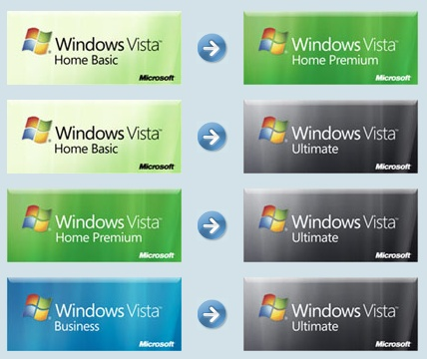
Scenario Example
Anytime Upgrade
  Driver package is saved
  Driver package is copied to new OS image pre-boot
  OS image boots
  Driver package is installed by PnP

Slide 41
Driver Packages
Foo.inf
How Windows will use the INF
Programmatic
  SetupCopyOemInf
  DiInstallDriver
  DIFx tools
User
  Found New Hardware Wizard
  Windows Update on-demand
  Windows Update manual
  AutoUpdate
Foo.sys
Foo.dll
Bar.dll
Configuration file
Localized UI
Application files
Driver Store

Slide 42
Driver Packages
Foo.inf
Windows uses the INF to build a list of files in the package
Foo.sys
Foo.dll
Bar.dll
Configuration file
Localized UI
Application files
Driver Store

Slide 43
Driver Packages
Foo.inf
Windows uses the INF to build a list of files in the package
Foo.sys
Foo.dll
Bar.dll
Configuration file
Localized UI
Application files
Driver Store

Slide 44
Driver Packages
Foo.inf
Windows uses the INF to build a list of files in the package
Windows copies those files into the Driver Store
Media goes away
Foo.inf
Foo.sys
Foo.sys
Foo.dll
Foo.dll
Bar.dll
Bar.dll
Configuration file
!!!
Localized UI
Application files
Foo.inf
Foo.sys
Foo.dll
Bar.dll
Driver Store

Slide 45

Driver Packages
Configuration file
Localized UI
Foo.inf
Application files
Foo.sys
Foo.dll
Bar.dll
Driver Store
Your device
Your device
Foo.inf
Foo.inf
Foo.sys
Foo.sys
Foo.dll
Foo.dll
Bar.dll
Bar.dll

Slide 46
Driver Packages
Foo.inf
Remember
List all your files in your INF
Don’t assume source media will be present during installation
Configuration file
Foo.sys
Localized UI
Foo.dll
Bar.dll
Application files
Correct
Foo.inf
Driver Store
Configuration file
Foo.sys
Localized UI
Foo.dll
Bar.dll
Application files
Incorrect

Slide 47
Multifunction Devices
Definition
  A device that enumerates as
  multiple devnodes
Problem
  Need to install multiple drivers without prompting users multiple times
Solution
  CopyInf
Driver package
Driver package
Driver package

Slide 48
Multifunction Devices
CopyInf directive
  Links multiple INFs together, so when one gets copied into the Driver Store, the other gets copied as well
  Parsed by Windows when a driver package is copied to the Driver Store
  If a driver package referenced in a CopyINF directive is already in the Driver Store, then Windows will not attempt to re-copy the package
…
[DDInstall]
CopyINF=filename1.inf[,filename2.inf]...
…

Slide 49
Multifunction Devices
CopyInf directive
  Example
  Myprinter.inf and myscanner.inf will be copied into the Driver Store when this driver package is copied into the Driver Store
…
[MyDDInstall]
CopyInf = myprinter.inf, myscanner.inf
…

Slide 50
Multifunction Devices
Parent device uses your driver
Parent.inf
CopyINF = child1.inf, child2.inf
Parent device
Child1.inf
Child2.inf
Child device #1
Child device #2

Slide 51
Multifunction Devices
Parent device uses inbox driver
Usb.inf
(inbox)
Since you don’t know
which child will enumerate first, put the matching CopyINF entries in each child driver package
Parent device
CopyINF = child2.inf
CopyINF = child1.inf
Child1.inf
Child2.inf
Child device #1
Child device #2

Slide 52
Multifunction Devices
Usb.inf
(inbox)
Child1.inf
Child2.inf
CopyINF=Child2.inf
CopyINF=Child1.inf
Usbccgp.sys
File1
File4
Parent device
Parent device
Windows Update
DevicePath
File2
File5
File3
File6
Found New Hardware Wizard
Driver Store
Driver Binaries
File1
Usb.inf
(inbox)
Usb.inf
(inbox)
Usbccgp.sys
Child device #1
Usbccgp.sys
Child device #1
File1
Child1.inf
Child1.inf
Child2.inf
Child2.inf
File5
Child device #2
File5
Child device #2
CopyINF=Child2.inf
CopyINF=

Slide 53
Device Applications
How do I install an application with my driver package?
Answer depends on target customer
  Home users: Maximize ease-of-use
  IT Pros/OEMs: Maximize flexibility

Slide 54
Device Applications
Windows Vista system
%programfiles%\mycompany
myappsetup
myapp
Setup.exe
Setup.exe
Appfile1
App.cab
Appfile2
Appfile3
Appfile4
Appfile5
Driver Store
I have a Finish Install Action!
Foo.inf
%windir%\system32\drivers
Foo.inf
Coinst1.dll
Foo.sys
Coinst1.dll
Foo.sys
Setup.exe
Foo.dll
Setup.exe
Foo.dll
App.cab
Coinst1.dll
App.cab
Coinst1.dll
Bar.dll
OK! I’ll elevate and call you back
Bar.dll
Foo.dll
Foo.sys
Bar.dll

Slide 55
Device Applications
Target: IT Pro/OEM
Separate your driver package and your application installer
Allow the customer to decide how best to deploy the combination

Slide 56
Call To Action
Make your driver packages deployable by including everything in the INF
For multifunction devices, use CopyInf to link multiple driver packages together
For home users, integrate your application setup into your driver package
For IT Pro and OEM users, keep your application setup separate from your
driver package

Slide 57
Additional Resources
Web Resources
  Specs
    CopyInf directive:
    http://msdn2.microsoft.com/en-us/library/ms794507.aspx
    Writing a co-installer:
    http://msdn2.microsoft.com/en-us/library/ms790151.aspx
  Whitepapers
    How to Install Windows Drivers with Software Applications:
    http://www.microsoft.com/whdc/driver/install/app_drv.mspx
Related Sessions
  DVR-T394 Extending Device Driver Installation with Co-Installers
  DVR-T395 Deploying Device Drivers for Windows Vista
  DVR-T396 Common Device Driver Installation Errors
  DVR-T502 Debugging Device Installation on Windows Vista

