Slide 2
Common Device Driver Installation Errors
Mitsuru Saito
Program Manager
Device Foundation Team
Microsoft Corporation

Slide 3
Goals for this Session
Understand Windows Error Reporting (WER) process for device driver installation failures
Understand the common device driver installation errors
Understand the root cause of the common driver installation errors

Slide 4
Agenda
Windows Error Reporting (WER) background
Common device driver installation errors
Call to action

Slide 5
Windows Error Reporting (WER)
Background

Slide 6
WER for driver installation errors
Collects the driver installation errors
User opt-in (Default: don’t send)
Windows Vista and later
Error types
  Driver Import Errors
  Driver Install Errors
  Driver Not Found
  Driver Problem Code

Slide 7
WER for driver installation errors
WER sends diagnostic information
  Error Code (e.g. 80070002)
  INF name
  Error section in the INF file
Additional Information
  INF file
  List of files in the driver package
  Setupapi.dev.log
  Mini dump (only for timeout error)

Slide 8
WER Walkthrough
Introduction when WER report is sent
Typical driver installation flow
  User plugs in a new device
  System searches for drivers for the device
  The driver is imported to driver store
  The driver is installed to driver folder
  The driver is loaded

Slide 9
WER Walkthrough
WER
Windows Vista System
Driver Store
Driver Folder

Slide 10

WER Walkthrough
User plugs in a new device
WER
Windows Vista System
Driver Store
Driver Folder

Slide 11
WER Walkthrough
System Searches for driver match
WER
Windows Vista System
Driver Store
Driver Folder

Slide 12
WER Walkthrough (Failed Case)
If NO driver matches…
WER
Windows Vista System
Driver Store
Driver Folder

Slide 13
WER Walkthrough (Failed Case)
The system sends Driver Not Found to WER
WER
Windows Vista System
Driver Store
Driver Folder
Driver Not Found
Error

Slide 14
WER Walkthrough
If the driver for the device is on the CD….
WER
Windows Vista System
Driver Store
Driver Folder

Slide 15
WER Walkthrough
Driver Store starts validation for the driver
WER
Windows Vista System
Driver Store
Driver Folder

Slide 16
WER Walkthrough (Failed Case)
If the driver validation fails…
WER
Windows Vista System
Driver Store
Driver Folder

Slide 17
WER Walkthrough (Failed Case)
Driver Store sends Driver Import Error to WER
WER
Windows Vista System
Driver Store
Driver Folder
Driver Import
Error

Slide 18
WER Walkthrough
If the driver validation passes, the driver is imported
WER
Windows Vista System
Driver Store
Driver Folder

Slide 19
WER Walkthrough
The system tries to install the driver package
WER
Windows Vista System
Driver Store
Driver Folder

Slide 20
WER Walkthrough (Failed Case)
If an error happens during this phase….
WER
Windows Vista System
Driver Store
Driver Folder

Slide 21
WER Walkthrough (Failed Case)
The system sends Driver Install Error to WER
WER
Windows Vista System
Driver Store
Driver Folder
Driver Install
Error

Slide 22
WER Walkthrough
If the driver is installed successfully…
WER
Windows Vista System
Driver Store
Driver Folder

Slide 23
WER Walkthrough
The system loads the driver
WER
Windows Vista System
Driver Store
Driver Folder

Slide 24
WER Walkthrough (Failed Case)
If the driver has a problem…
WER
Windows Vista System
Driver Store
Driver Folder

Slide 25
WER Walkthrough (Failed Case)
The system sends Driver Problem Code to WER
WER
Windows Vista System
Driver Store
Driver Folder
Driver Problem Code Error

Slide 26
Problem Reports and Solutions
WER Center on Vista
WER central point in Control Panel
All required information is collected
Good starting point to debug driver installation errors
Useful for developers and support people!

Slide 27
Problem Reports and Solutions (PRS) Walkthrough
Introduction of how to check the WER
Check the errors and start debugging
  Open Control Panel
  Open Problem Reports and Solutions
  Check each error report
  Check the driver package of each error

Slide 28
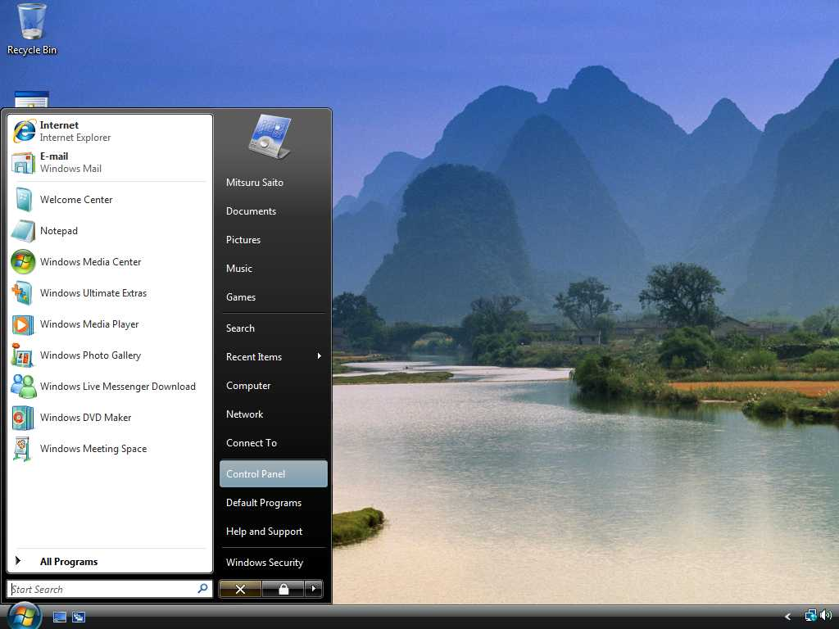

Slide 29
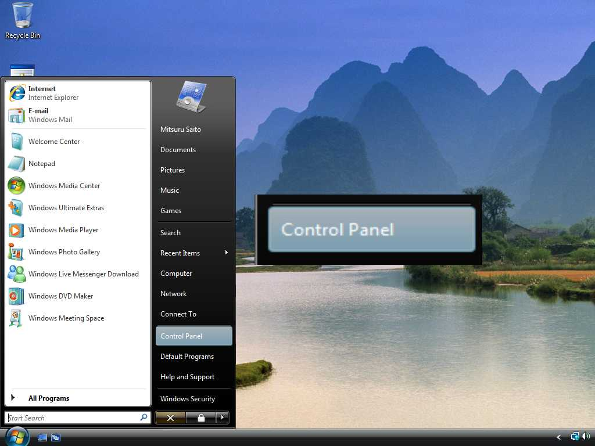

Slide 30
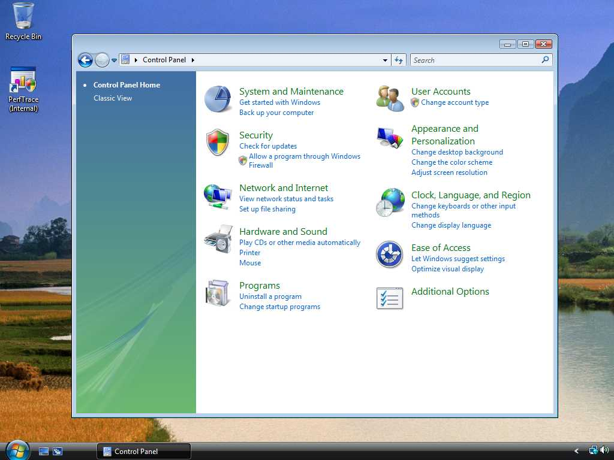

Slide 31
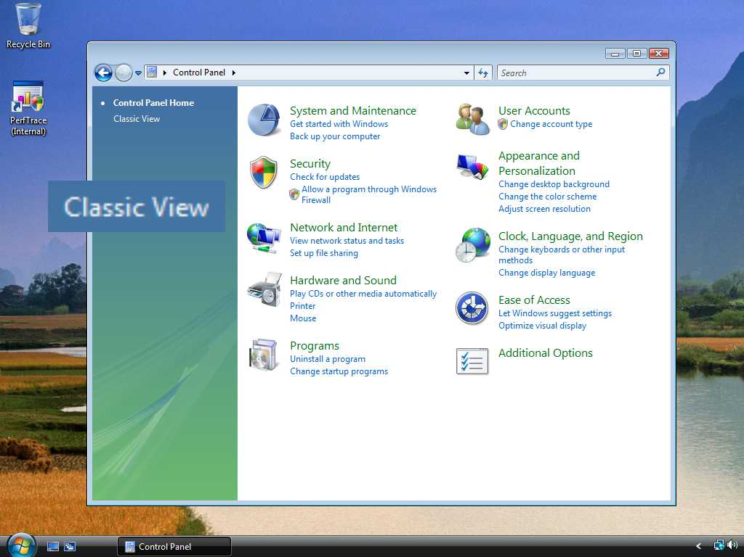

Slide 32
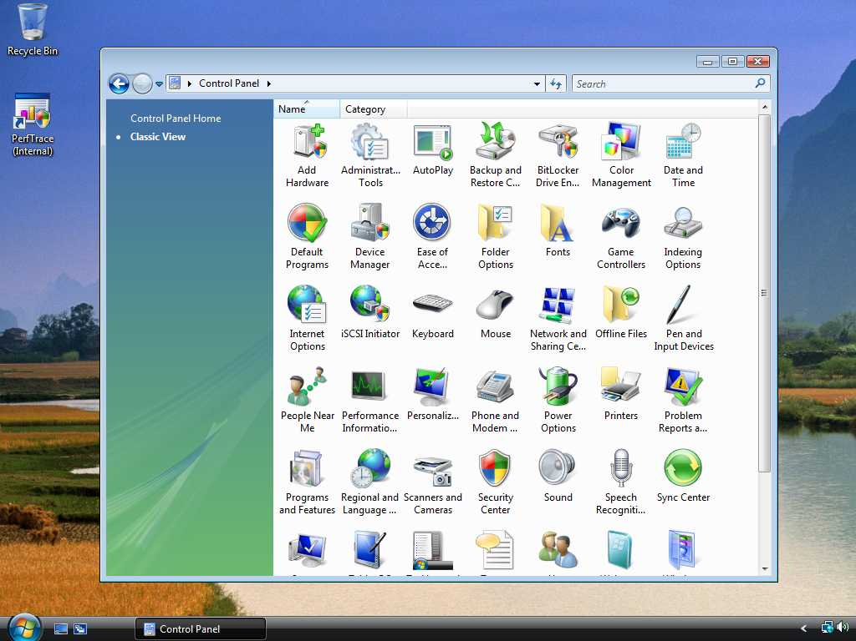

Slide 33
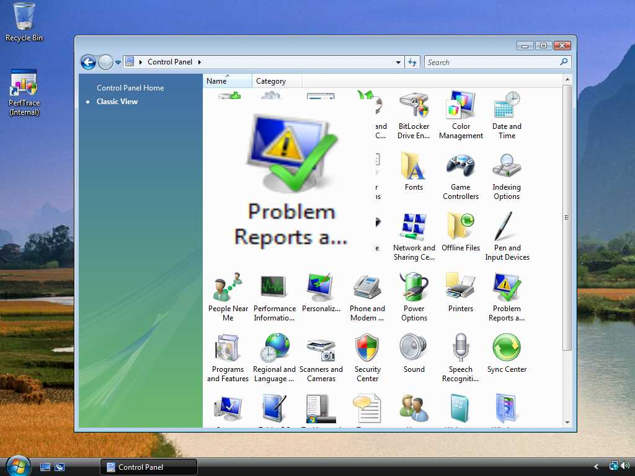

Slide 34
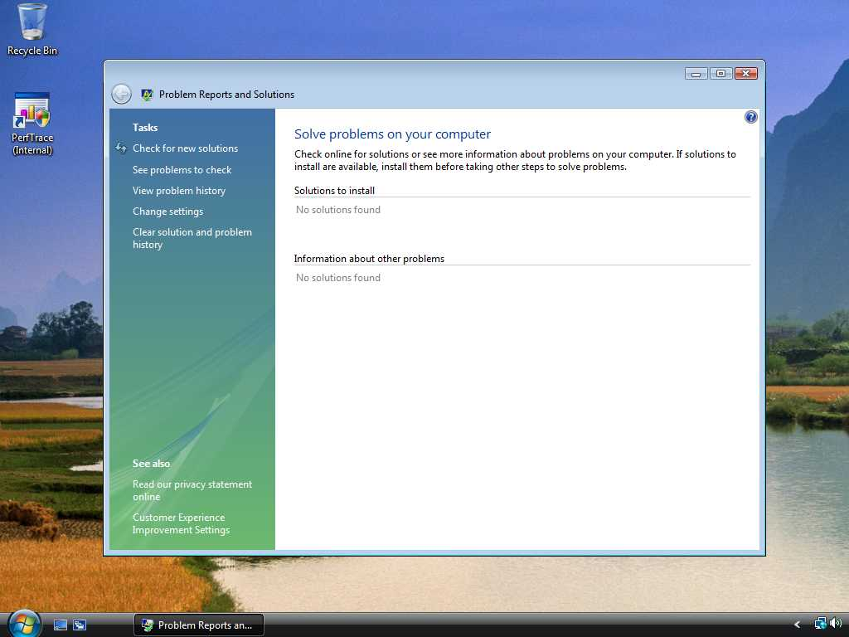

Slide 35
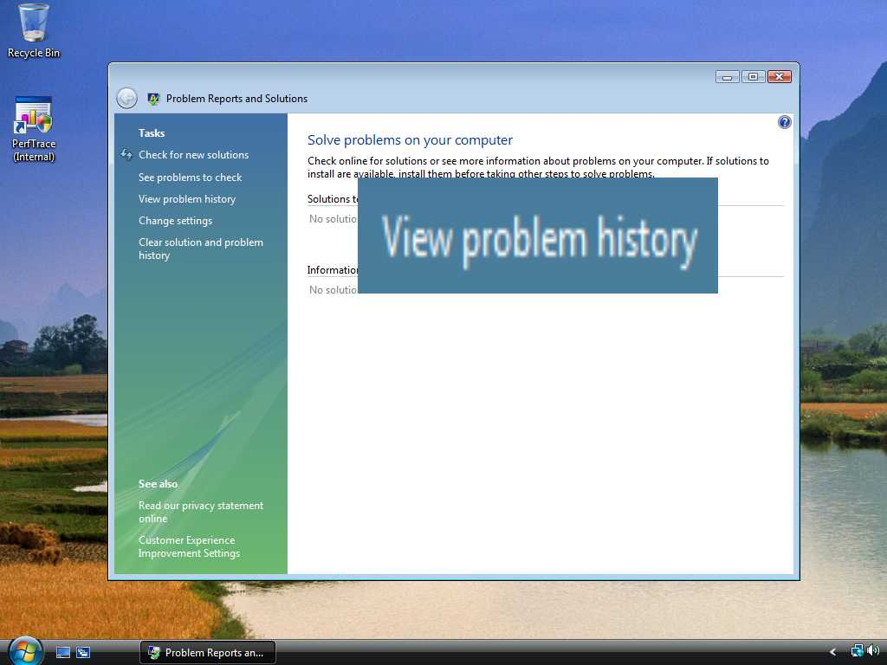

Slide 36
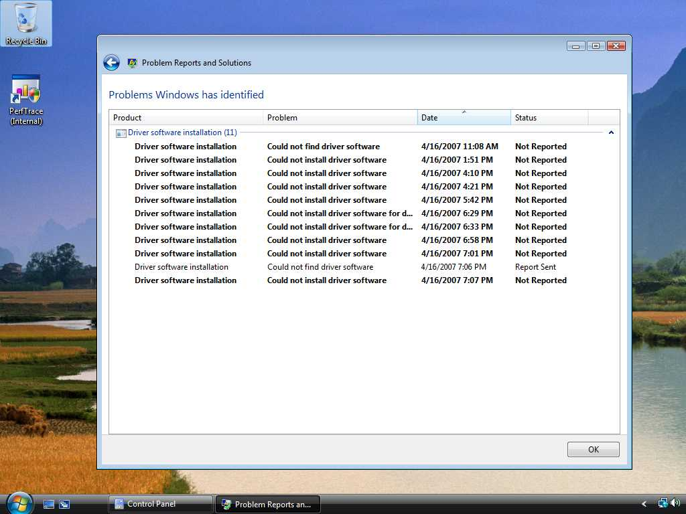

Slide 37
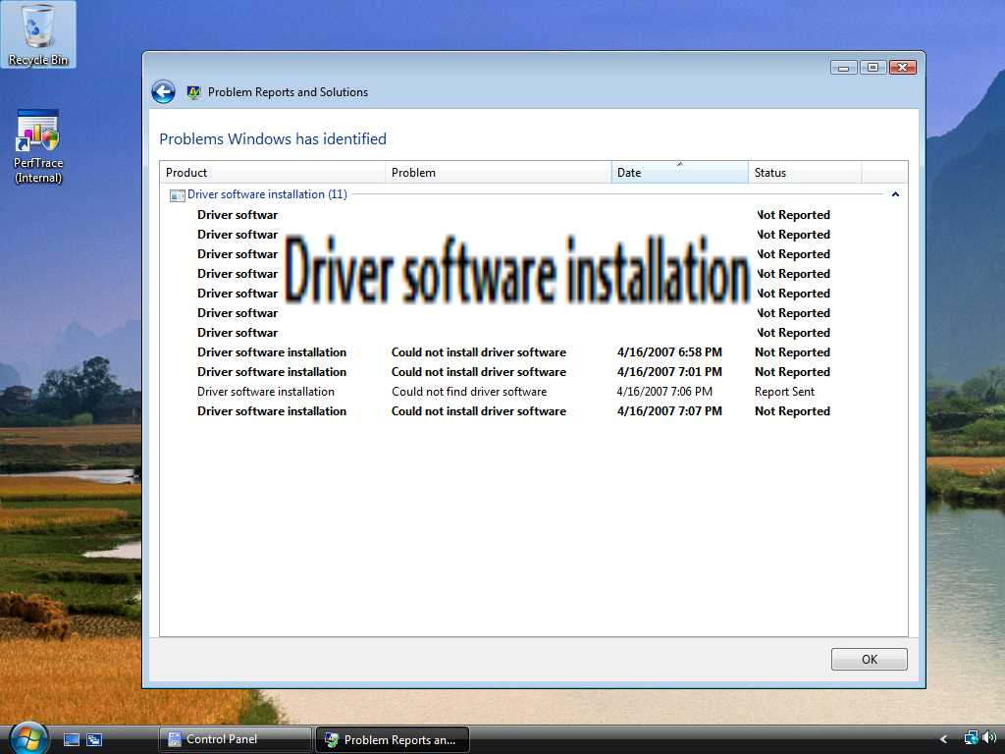

Slide 38
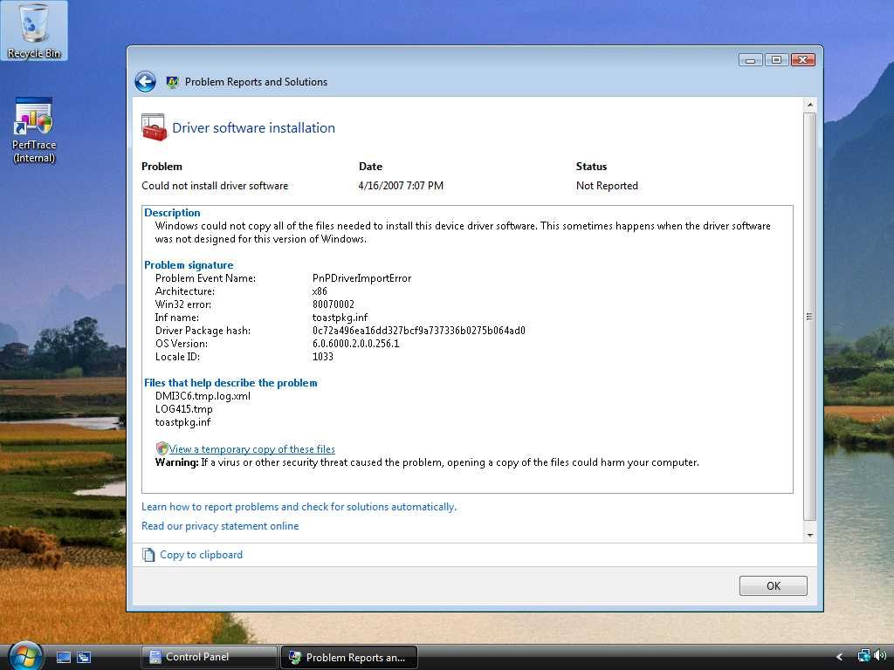

Slide 39
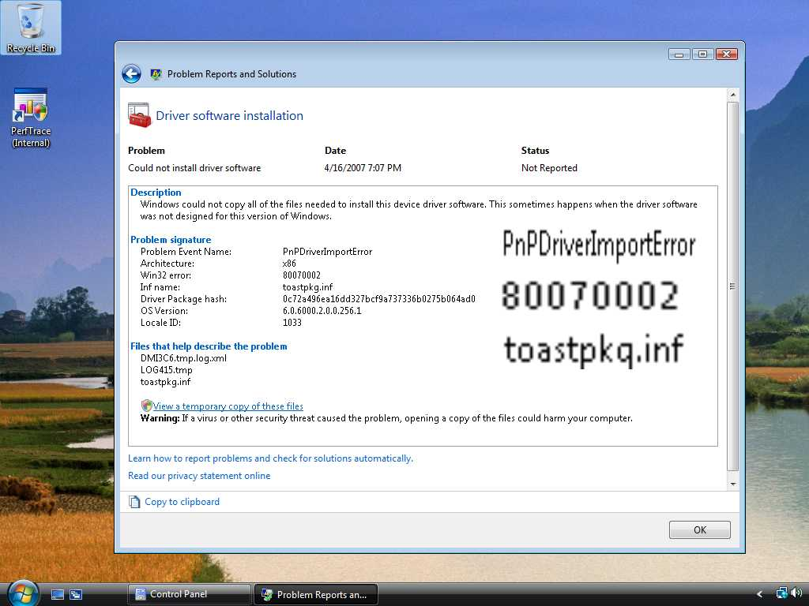

Slide 40
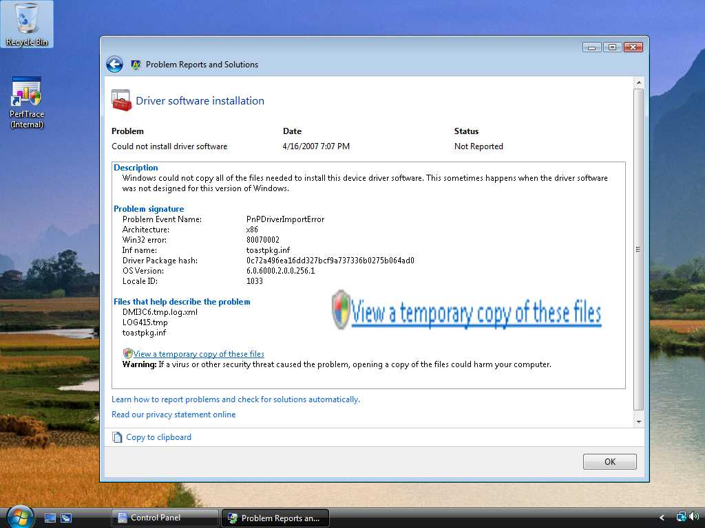

Slide 41
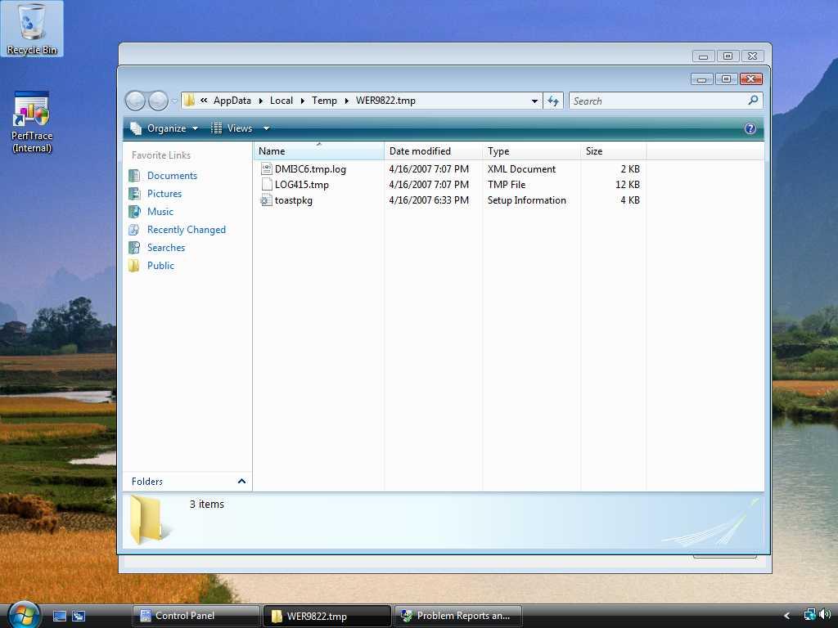

Slide 42
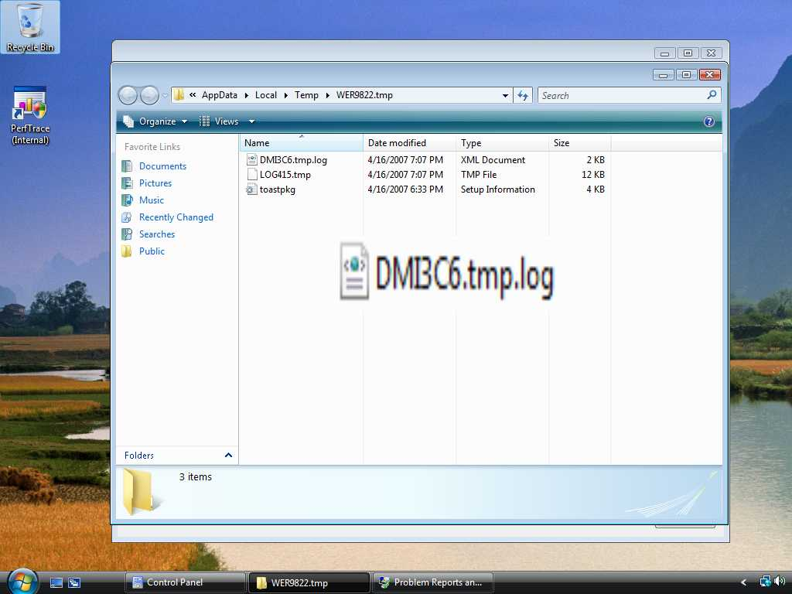

Slide 43
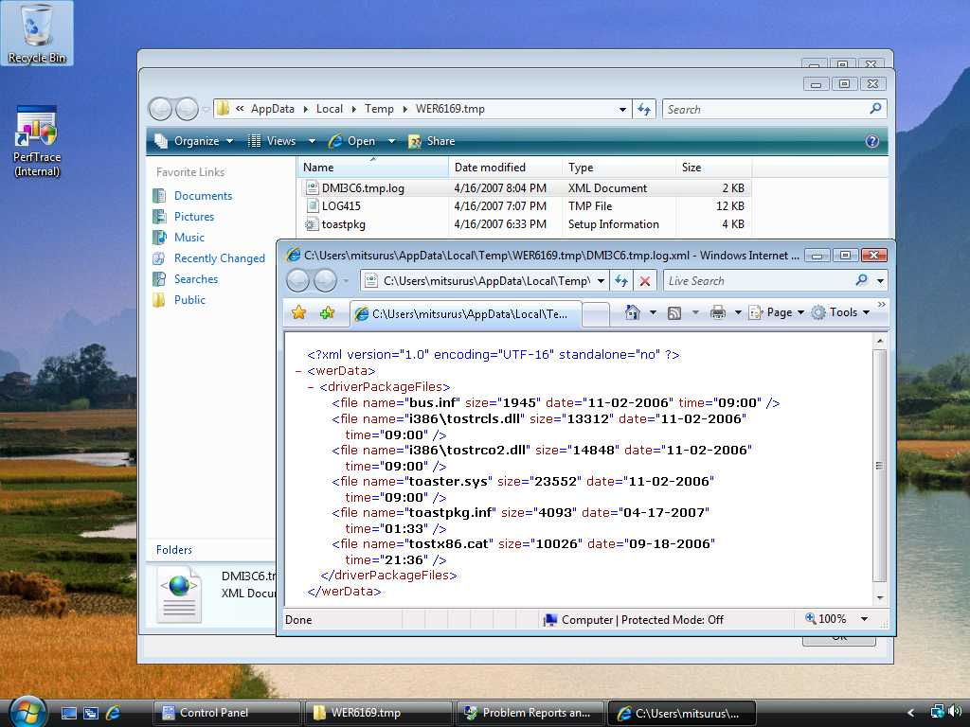

Slide 45
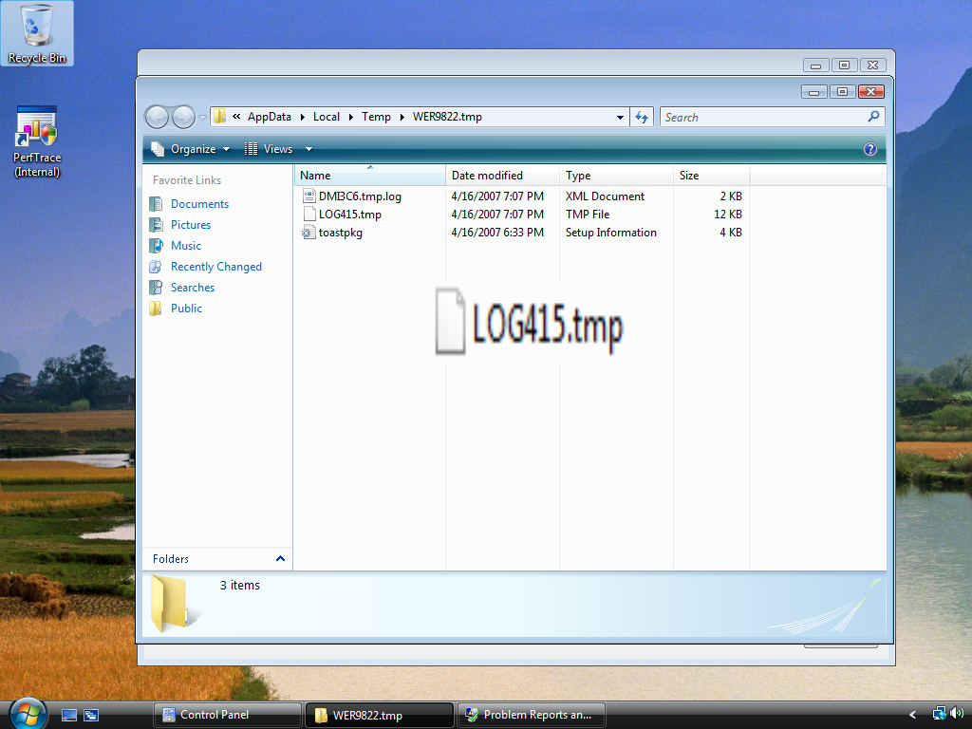

Slide 46
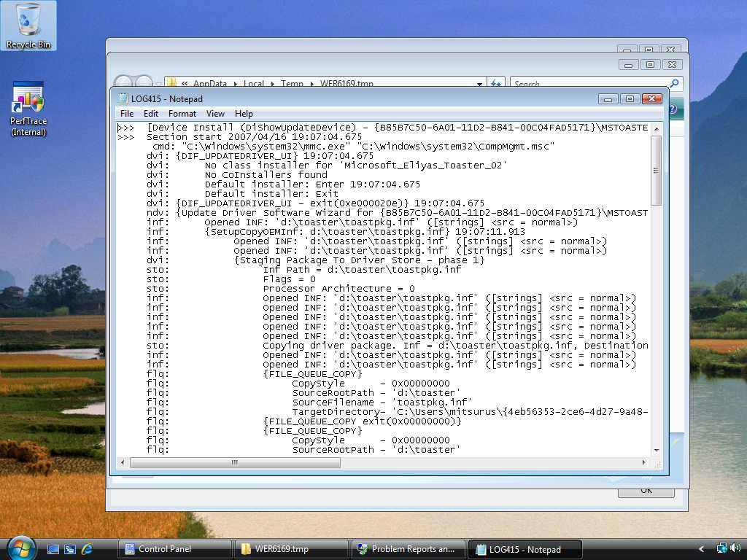

Slide 48


Slide 49
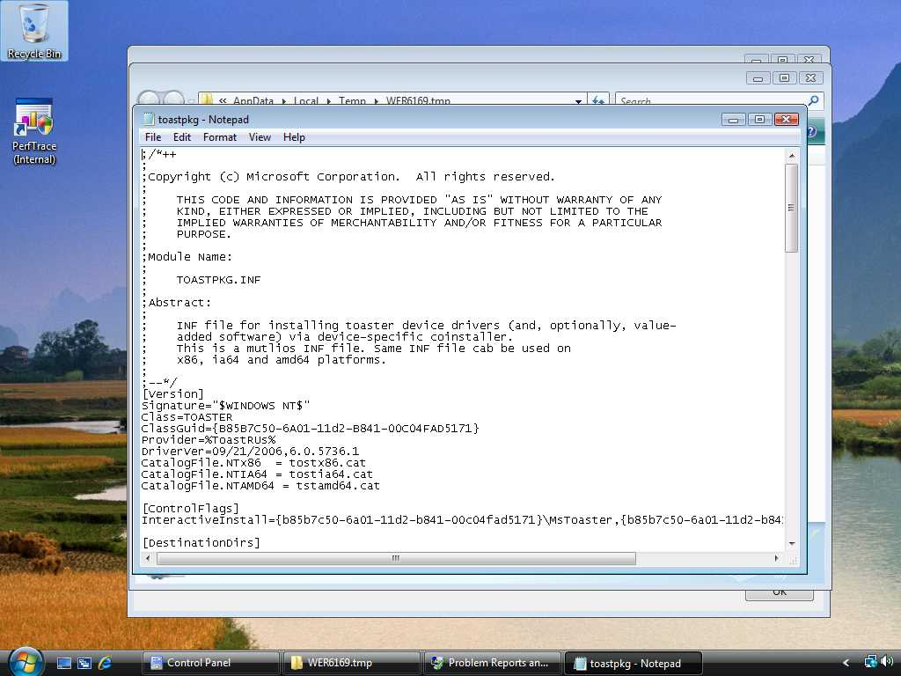

Slide 50
Common device driver installation errors
Collected through WER mechanism
September 2007 – August 2008
Vista RTM build

Slide 51
Driver Installation Errors
Time Out Error 34.5%
File Not Found 22.5%
No Associated Service 10.6%
Requires Interactive Window Station 8.7%
Bad Service Install Section 6.4%
Path Not Found 5.8%

Slide 52
#1 Time Out Error
34.5%

Slide 53
Time Out Error
Code: 000005B4
Name: ERROR_TIMEOUT
Issues
  Various root error causes
    Co-installer hangs
      Showing interactive UI
      Waiting for system restore point
    Busy system
    Waiting for the device restart
Solution
  It depends on the problem

Slide 54
#2: File Not Found
22.5%

Slide 55
File Not Found
Code: 00000002 or 80070002
Name: ERROR_FILE_NOT_FOUND
Issue
  The co-installer or the INF file references missing files.
Solution
  Ensure that all files that are referenced in the INF file or in the co-installer are present in the driver package.

Slide 56
File Not Found
Example 1
Some files are missing

Slide 57
File Not Found (Ex. 1)
There is a driver package
Driver Package

Slide 58
File Not Found (Ex.1)
The driver package has three files
Driver Package
FOO.INF
Foo.sys
Bar.sys

Slide 59
File Not Found (Ex.1)
The INF file has a “Copy File” section
Driver Package
[DDINSTALL.NT]
CopyFiles=WINXP_CPYFILE
[WINXP_CPYFILE]
Foo.sys
Bar.sys
Non-Exist.sys
Foo.sys
Bar.sys

Slide 60
File Not Found (Ex.1)
The copy file section refers to SYS files
Driver Package
[DDINSTALL.NT]
CopyFiles=WINXP_CPYFILE
[WINXP_CPYFILE]
Foo.sys
Bar.sys
Non-Exist.sys
Foo.sys
Bar.sys

Slide 61
File Not Found (Ex.1)
Issue: Cannot refer to Non-Exist.sys
Driver Package
[DDINSTALL.NT]
CopyFiles=WINXP_CPYFILE
[WINXP_CPYFILE]
Foo.sys
Bar.sys
Non-Exist.sys
Foo.sys
Bar.sys
Non-Exist.sys

Slide 62
File Not Found (Ex.1)
Typical Error Log
!!! flq: Error 2: The system cannot find the file specified.
flq: {SPFILENOTIFY_ENDQUEUE}
flq: {SPFILENOTIFY_ENDQUEUE - returned 0x00000000}
flq: {_commit_file_queue exit(0x00000002)}
!!! sto: Failed to copy the Driver Package to
C:\Users\Administrator\GUID Error = 80070002
!!! sto: Failed to copy driver package from source into temporary client location.
Error = 80070002,
SrcInf = X:\OEM Drivers\FooDriver\Foo.inf,
DestPath = C:\Users\Administrator\GUID

Slide 63
File Not Found (Ex.1)
Solution: All files should be in driver package
Driver Package
[DDINSTALL.NT]
CopyFiles=WINXP_CPYFILE
[WINXP_CPYFILE]
Foo.sys
Bar.sys
Exist.sys
Foo.sys
Bar.sys
Exist.sys

Slide 64
File Not Found
Example 2
SetupCopyOEMINF() in Co-Installer

Slide 65
File Not Found (Ex. 2)
There is a driver package
Driver Package

Slide 66
File Not Found (Ex.2)
The driver package has 4 files
Driver Package
FOO.INF
Foo.sys
Foo.dll
Bar.INF

Slide 67
File Not Found (Ex.2)
The INF file has a co-installer section
Driver Package
[DDInstall.CoInstallers]
CopyFiles = COINST_CPYFILES
[COINST_CPYFILES]
Foo.dll
Foo.sys
Foo.dll
Bar.INF

Slide 68
File Not Found (Ex.2)
The co-installer section registers Foo.dll
Driver Package
[DDInstall.CoInstallers]
CopyFiles = COINST_CPYFILES
[COINST_CPYFILES]
Foo.dll
Foo.sys
Foo.dll
Bar.INF

Slide 69
File Not Found (Ex.2)
The co-installer has SetupCopyOEMINF
Driver Package
[DDInstall.CoInstallers]
CopyFiles = COINST_CPYFILES
[COINST_CPYFILES]
Foo.dll
Foo.sys
DIF_INSTALLDEVICE:
SetupCopyOEMInf
(“Bar.inf”,,,);
Bar.INF

Slide 70
File Not Found (Ex.2)
Foo.dll tries to copy Bar.inf
Driver Package
[DDInstall.CoInstallers]
CopyFiles = COINST_CPYFILES
[COINST_CPYFILES]
Foo.dll
Foo.sys
DIF_INSTALLDEVICE:
SetupCopyOEMInf
(“Bar.inf”,,,);
Bar.INF

Slide 71
File Not Found (Ex.2)
Issue: SetupCopyOEMINF can't find the INF
Driver Package
[DDInstall.CoInstallers]
CopyFiles = COINST_CPYFILES
[COINST_CPYFILES]
Foo.dll
Foo.sys
DIF_INSTALLDEVICE:
SetupCopyOEMInf
(“Bar.inf”,,,);
Bar.INF

Slide 72
File Not Found (Ex.2)
Typical Error Log
dvi:CoInstaller 1: Enter (Post Processing)
inf:Opened PNF: ‘C:\Windows\INF\Foo.inf'
inf:{SetupCopyOEMInf: Z:\bar.inf}
inf:{SetupCopyOEMInf exit (0x00000002)}
!!! dvi: CoInstaller 1: failed(0x00000002)!
!!! Dvi:Error 2: The system cannot find the file specified.
dvi:{DIF_INSTALLDEVICE - exit(0x00000002)}
!!! ndv: Error(00000002) installing device!
ndv: Device install status=0x00000002

Slide 73
File Not Found (Ex.2)
Solution: Use CopyINF directive to copy the INF!
Driver Package
[DDInstall]
CopyINF = Bar.inf
Foo.sys
Foo.dll
Bar.INF

Slide 74
File Not Found
Example 3
References inbox driver directly

Slide 75
File Not Found (Ex.3)
There is a driver pkg and an inbox file
Driver Package
Driver Store
USBSER.sys

Slide 76
File Not Found (Ex.3)
The driver package has an INF file
Driver Package
Driver Store
FOO.INF
USBSER.sys

Slide 77
File Not Found (Ex.3)
The INF file has a "Copy File" section
Driver Package
Driver Store
[DDINSTALL.NT]
CopyFiles=VISTA_CPYFILE
[VISTA_CPYFILE]
usbser.sys
USBSER.sys

Slide 78
File Not Found (Ex.3)
The "Copy File" section refers to inbox file
Driver Package
Driver Store
[DDINSTALL.NT]
CopyFiles=VISTA_CPYFILE
[VISTA_CPYFILE]
usbser.sys
USBSER.sys

Slide 79
File Not Found (Ex.3)
Issue: Cannot find the sys file
Driver Package
Driver Store
[DDINSTALL.NT]
CopyFiles=VISTA_CPYFILE
[VISTA_CPYFILE]
usbser.sys
USBSER.sys

Slide 80
File Not Found (Ex.3)
Typical Error Log
flq:SourcePath - [C:\Windows\System32\DriverStore\FileRepository\foo.inf_3906eed6]
flq:SourceFile - [usbser.sys]
!!! Flq:SPFILENOTIFY_NEEDMEDIA: returned FILEOP_ABORT.
flq:{_COMMIT_FILE_QUEUE exit(0x00000002)}
ndv:Device install status=0x00000002
ndv:Performing device install final cleanup...
! Ndv:Queueing up error report since device installation failed...
ndv:{Core Device Install - exit(0x00000002)}

Slide 81
File Not Found (Ex.3)
Solution:Use Include/Needs directive!
Driver Package
Driver Store
FOO.INF
MDMCPQ.INF
USBSER.sys

Slide 82
File Not Found (Ex.3)
Solution: Use Include or Needs directive!
Driver Package
Driver Store
[DDINSTALL.NT]
Include=MDMCPQ.inf
Needs=
FakeModemCopyFileSection
MDMCPQ.INF
USBSER.sys

Slide 83
File Not Found (Ex.3)
Solution: Use Include or Needs directive!
Driver Package
Driver Store
[DDINSTALL.NT]
Include=MDMCPQ.inf
Needs=
FakeModemCopyFileSection
[FakeModemCopyFileSection]
usbser.sys,,,0x20
USBSER.sys

Slide 84
File Not Found (Ex.3)
Solution: Use Include or Needs directive!
Driver Package
Driver Store
[DDINSTALL.NT]
Include=MDMCPQ.inf
Needs=
FakeModemCopyFileSection
[FakeModemCopyFileSection]
usbser.sys,,,0x20
USBSER.sys

Slide 85
#3: No Associated Service
10.6%

Slide 86
No Associated Service
Code
  E0000219
Name
  SPAPI_E_NO_ASSOCIATED_SERVICE
Issue
  AddService directive was not processed.
Solution
  Ensure that all descriptions in the AddService directive in the Services section are correct.

Slide 87
No Associated Service Example
References non-existent section

Slide 88
No Associated Service
There is a driver pkg and an Inbox INF file
Driver Package
Driver Store
Bar.INF

Slide 89
No Associated Service
The driver package has an INF file
Driver Package
Driver Store
FOO.INF
Foo.inf
Bar.INF

Slide 90
No Associated Service
The INF file uses Include/Needs directive
Driver Package
Driver Store
[DDINSTALL.NT]
Include=Bar.inf
Needs=
Non_Exist_Sect
Bar.INF

Slide 91
No Associated Service
Needs directive refers to non-existent section
Driver Package
Driver Store
[DDINSTALL.NT]
Include=Bar.inf
Needs=
Non_Exist_Sect
[Exist_Sect]
Usbser.sys
[Non_Exist_Sect}

Slide 92
No Associated Service
Solution: Refer to existent section!
Driver Package
Driver Store
[DDINSTALL.NT]
Include=Bar.inf
Needs=
Non_Exist_Sect
[Exist_Sect]
Usbser.sys
[Non_Exist_Sect}
The referred section doesn’t exist

Slide 93
No Associated Service
Typical Error Log
!!! dvi: Error: No INF AddService directives contained the flag SPSVCINST_ASSOCSERVICE
!!! Dvi: Error while installing services.
!!! Dvi: Error 0xe0000219: The installation failed because a function driver was not specified for this device instance.
!!! Dvi: Cleaning up failed installation
dvi: {Install DEVICE exit (0xe0000219)}
!!! dvi: Cleaning up failed installation (e0000219)
!!! dvi: Error 0xe0000219: The installation failed because a function driver was not specified for this device instance.
dvi: {DIF_INSTALLDEVICE - exit(0xe0000219)}

Slide 94
No Associated Service
Solution: Refer to existent section!
Driver Package
Driver Store
[DDINSTALL.NT]
Include=Bar.inf
Needs=Exist_Sect
[Exist_Sect]
Usbser.sys

Slide 95
#4: Interactive Window Station
8.7%

Slide 96
Interactive Window Station
Error Code: 000005B3
Name: ERROR_REQUIRES_INTERACTIVE_WINDOWSTATION
Issue
  The driver installation requires an interactive window
This might be an intentional error

Slide 97


Interactive Window Station
Solution
  Solve the root cause of the problem that requires an interactive window.
  Ensure that the co‑installer uses a
  finish-install action or a
  finish-install page to show UI.

Slide 98
Interactive Window Station
Example
Some files are missing

Slide 99
Interactive Window Station
There is a driver package
Driver Package

Slide 100
Interactive Window Station
The driver package has an INF file
Driver Package
FOO.INF

Slide 101
Interactive Window Station
There is an InteractiveInstall directive
Driver Package
[ControlFlags]
InteractiveInstall = USB\VID_0000&PID_1111, USB\VID_0000&PID_2222

Slide 102
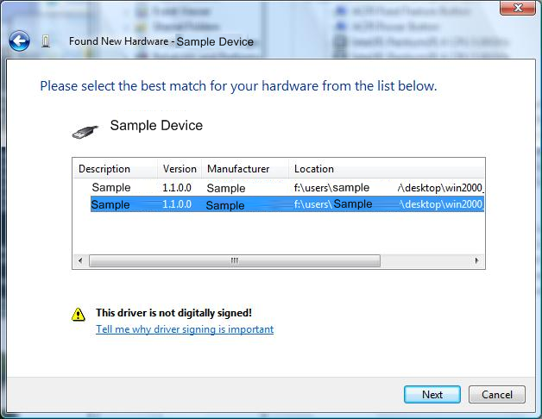
Interactive Window Station
InteractiveInstall directive tries to show UI
Driver Package
[ControlFlags]
InteractiveInstall = USB\VID_0000&PID_1111, USB\VID_0000&PID_2222

Slide 103
Interactive Window Station
Issue: This fails on Windows Vista
Driver Package
[ControlFlags]
InteractiveInstall = USB\VID_0000&PID_1111, USB\VID_0000&PID_2222

Slide 104
Interactive Window Station
Solution: Use Finish-Install Action
Driver Package
FOO.INF
Foo.dll

Slide 105
Interactive Window Station
Solution: Use Finish-Install Action
Driver Package
Foo.inf
Foo.dll
[DDInstall.CoInstallers]
CopyFiles = COINST_CPYFILES
[COINST_CPYFILES]
Foo.dll

Slide 106
Interactive Window Station
Solution: Use Finish-Install Action
Driver Package
[DDInstall.CoInstallers]
CopyFiles = COINST_CPYFILES
[COINST_CPYFILES]
Foo.dll
switch(InstallFunction) {
case DIF_NEWDEVICEWIZARD_FINISHINSTALL:
OpenUI()

Slide 107
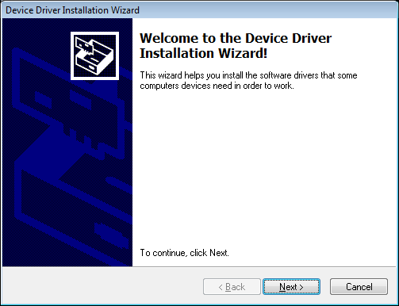
Interactive Window Station
Solution: Use Finish-Install Action
Driver Package
switch(InstallFunction) {
case DIF_NEWDEVICEWIZARD_FINISHINSTALL:
OpenUI()

Slide 108
#5: Bad Service Install Section
6.4%

Slide 109
Bad Service Install Section
Code: E0000217
Name: SPAPI_E_BAD_SERVICE_INSTALLSECT
Issue
  An AddService directive in a service installation section is invalid.
  The drivers in CopyFile section are not copied correctly.

Slide 110
Bad Service Install Section
Solution
  Ensure that all descriptions in the AddService directive in the Services section are correct
  Ensure that the binary file that is described in the AddService directive is present on the system

Slide 111
Bad Service Install Section Example
Some files are NOT copied correctly

Slide 112
Bad Service Install Section
There is a driver package
Driver Package

Slide 113
Bad Service Install Section
The driver package has two files
Driver Package
FOO.INF
Foo.sys

Slide 114
Bad Service Install Section
The INF file has CopyFile Sect and Service Sect
Driver Package
[DDINSTALL.NT]
CopyFiles=VISTA_CPYFILE
[VISTA_CPYFILE]
[DDINSTALL.NT.Services]
AddService=Foo,,,,,
Foo.sys

Slide 115
Bad Service Install Section
The copy file section refers to no files
No Files
Driver Package
[DDINSTALL.NT]
CopyFiles=VISTA_CPYFILE
[VISTA_CPYFILE]
[DDINSTALL.NT.Services]
AddService=Foo,,,,,
Foo.sys

Slide 116
Bad Service Install Section
Foo.sys is not copied correctly
Driver Package
[DDINSTALL.NT]
CopyFiles=VISTA_CPYFILE
[VISTA_CPYFILE]
[DDINSTALL.NT.Services]
AddService=Foo,,,,,
Foo.sys

Slide 117
Bad Service Install Section
Issue: The service section doesn't work
Driver Package
[DDINSTALL.NT]
CopyFiles=VISTA_CPYFILE
[VISTA_CPYFILE]
[DDINSTALL.NT.Services]
AddService=Foo,,,,,
Foo.sys

Slide 118
Bad Service Install Section
Typical Error Log
inf: {Install Inf Section [DDInstall.NT.Services]}
inf: AddService=WinXP,2,DriverService (Foo.inf line 47)
inf: ServiceBinary=C:\Windows\system32\drivers\Foo.sys
(Foo.inf line 53)
!!! Dvi:Add Service: Binary
'C:\Windows\system32\drivers\Foo.sys'
for service ‘Foo' is not present
!!! inf: {Install Inf Section [DDInstall.NT.Services]
exit(0xe0000217)}
!!! Dvi: Error while installing services.
!!! Dvi: Error 0xe0000217: A service installation section in this INF is invalid.
dvi: {Install DEVICE exit (0xe0000217)}
!!! dvi: Error 0xe0000217: A service installation section in this INF is invalid.

Slide 119
Bad Service Install Section
Solution: List files in the "Copy File" section
Driver Package
[DDINSTALL.NT]
CopyFiles=VISTA_CPYFILE
[VISTA_CPYFILE]
Foo.sys
[DDINSTALL.NT.Services]
AddService=Foo,,,,,
Foo.sys

Slide 120
Call To Action
Use ‘Problem Reports and Solutions’ to debug driver installation errors
Check your driver package if it is installed correctly on Windows Vista
Verify and fix your driver installation errors with today’s information

Slide 121
Additional Resources
  Driver Installation on the WHDC Web Site: http://go.microsoft.com/fwlink/?LinkID=79354
    Driver Package Compatibility for Windows Vista: http://www.microsoft.com/whdc/driver/install/drvpkgerrors.mspx
    Debugging Device Installation in Windows Vista: http://www.microsoft.com/whdc/driver/install/diagnose.mspx
    Device Finish-Install Actions in Windows Vista: http://www.microsoft.com/whdc/driver/install/Finish_Install.mspx
  How to use or to reference the Usbser.sys driver from universal serial bus (USB) modem .inf files:
  http://support.microsoft.com/kb/837637

Slide 122
Related Sessions
Session | Day / Time
Creating Deployable Driver Packages | Mon. 1:30-2:30
Extending Device Installation by Using Co-installers | Mon. 4-5 and Wed. 1:30-2:30
Debugging Device Installation | Mon. 5:15-6:15 and Wed. 2:45-3:45

Slide 123

© 2007 Microsoft Corporation. All rights reserved. Microsoft, Windows, Windows Vista and other product names are or may be registered trademarks and/or trademarks in the U.S. and/or other countries.
The information herein is for informational purposes only and represents the current view of Microsoft Corporation as of the date of this presentation. Because Microsoft must respond to changing market conditions, it should not be interpreted to be a commitment on the part of Microsoft, and Microsoft cannot guarantee the accuracy of any information provided after the date of this presentation.
MICROSOFT MAKES NO WARRANTIES, EXPRESS, IMPLIED OR STATUTORY, AS TO THE INFORMATION IN THIS PRESENTATION.

