Slide 2
Distributing Drivers on Windows Update
Tim Davis
Program Manager
Driver Publishing
Timdavis@microsoft.com

Slide 3
Agenda
What can be distributed
How to distribute software with a driver
How to use the driver distribution center

Slide 4
What can be distributed on Windows Update?
All drivers must pass logo testing prior to distribution
Drivers must include unique HardwareID
Some two-part HWIDs can now be published with computer system manufacturer name detection
Value-added software can be included with driver package

Slide 5
How to include value-added software with a driver package
Software must meet requirements in the Windows Update Hardware-Related Software Content Policy
http://www.microsoft.com/whdc/winlogo/drvsign/WinUp-policy.mspx
Use a co-installer to include a finish-install action that launches your application installation
Upload the entire Driver/Application package when making Logo submission
After submission passes, use the Driver Distribution Center (DDC) to post both on Windows Update (WU)

Slide 6
How to include value-added software with a driver package
See MSDN and the WHDC Web site for information on:
Writing a Co-installer http://msdn.microsoft.com/en-us/library/ms790151.aspx
How to Install Windows Drivers with Software Applications http://www.microsoft.com/whdc/driver/install/app_drv.mspx
Hardware first scenarios
Method: 1 A Co-installer that Launches an Application Installer

Slide 7
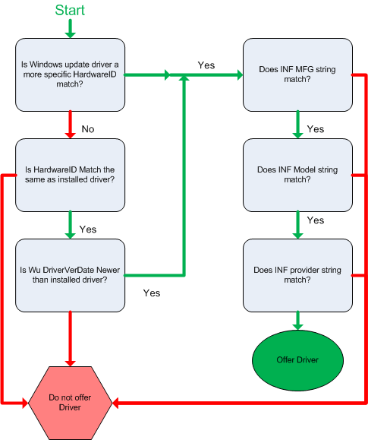
Windows Update logic for offering a driver
Does not apply to printers

Slide 8
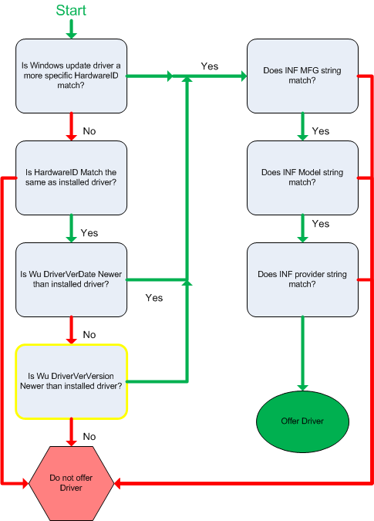
Windows Update Logic for offering a driver
Printer
(printer adds Driververversion check)

Slide 9
About the Driver Distribution Center
The Driver Distribution Center (DDC) allows you to change your driver distribution settings for Windows Update after a driver submission has been completed
Submission owners and Hardware ID (Plug and Play ID) owners can use the DDC to change driver distribution settings
The DDC has several sections:
Devices without drivers
Driver statistics
Add/ remove drivers
Submission Details page
Standard Distribution
Advanced distribution

Slide 10
Devices without Drivers Page
Lists devices that do not have a driver available on Windows Update but do have a driver available that has passed Windows Logo testing for Windows Vista.
All data on this page is for Windows Vista only
DNF (Driver not found) column shows numbers for the last 90 days
Submission ID link takes you to home page for that submission where you can distribute or download the driver
“Click to distribute now” link distributes the driver for Vista for the hardware ID listed
Driver version link downloads the driver package
Driver date is taken from the driververdate in the submitted INF

Slide 11
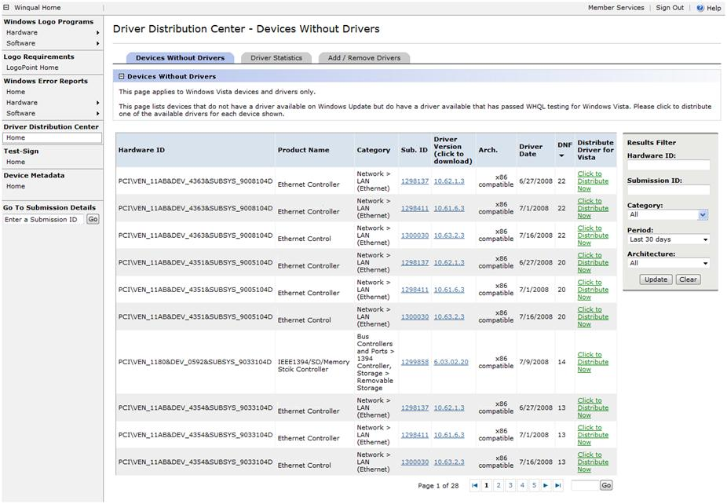
One click to distribute

Slide 12
Driver Statistics
Allows you to compare several drivers for a single device and choose the best driver to post on Windows Update.
Data on this page is based on hardware ID
You might see the same submission ID listed several times, once for each hardware ID.
Driver version link downloads the driver package
Results filter changes the search criteria for the page.
“+ “ sign expands the page to show all submissions that have been made for the hardware ID (device).

Slide 13
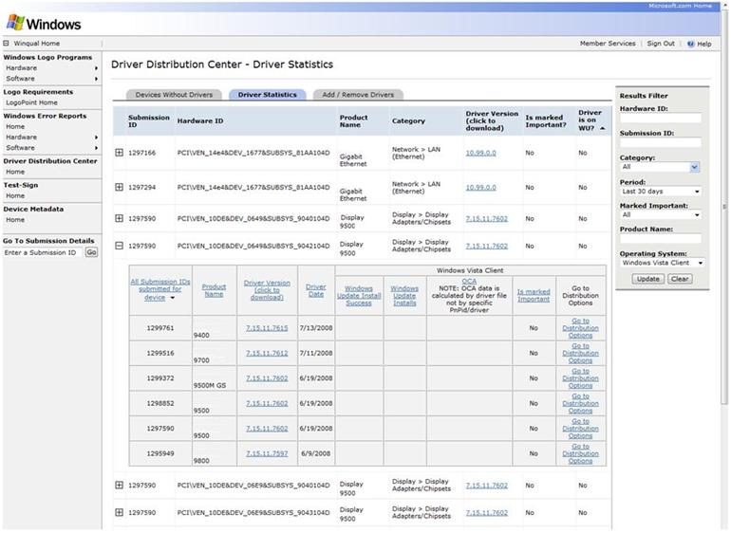
See all submissions for this device

Slide 14
Add/ Remove Drivers
Allows you to quickly change distribution settings for a submission.
Clicking the Submission ID takes you to the Submission home page
Clicking the “+” sign next to the submission ID takes you to a view that shows the distribution settings for all submissions that have been made for that hardware ID.
Only one of these views can be open at one time
Clicking the Driver version allows you to download the driver files for that submission

Slide 15
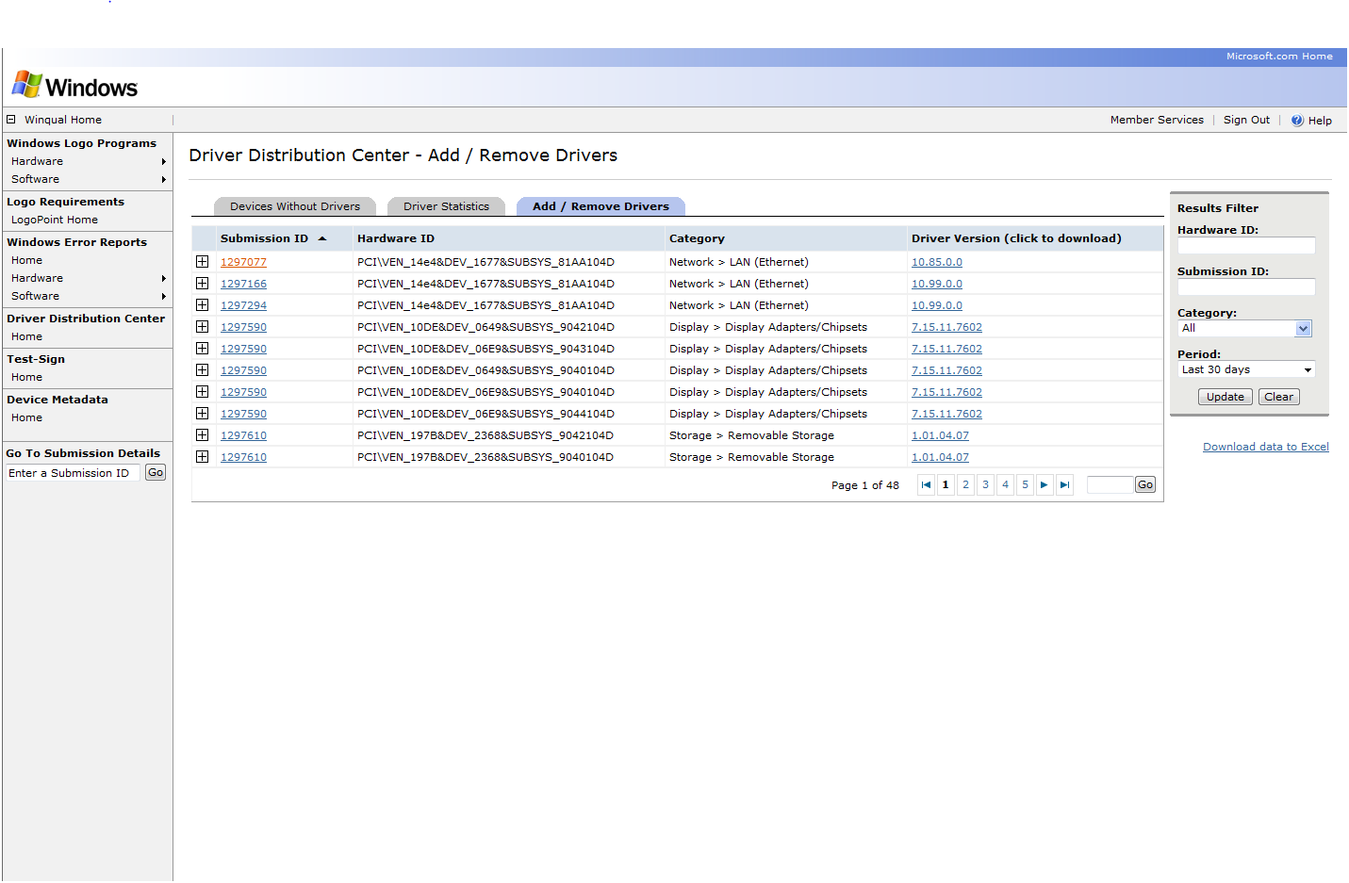
Go to home page for this submission
See distribution settings for all submissions made for this device
See all submissions for this device

Slide 16
Click checkbox to distribute
Download all data to excell
Click to see why the driver cannot be distributed

Slide 17
Submission Details Page
Allows you to view current distribution settings, set a driver publication date, and select additional actions
Driver publication date
Actions section
Standard Distribution
Select HardwareIDs from the submission to distribute on Windows Update
Advanced distribution
Select HardwareIDs from the submission to distribute on Windows Update
Add special detection to the driver posting such as Test targeting
Download driver
Download the driver file submitted

Slide 18
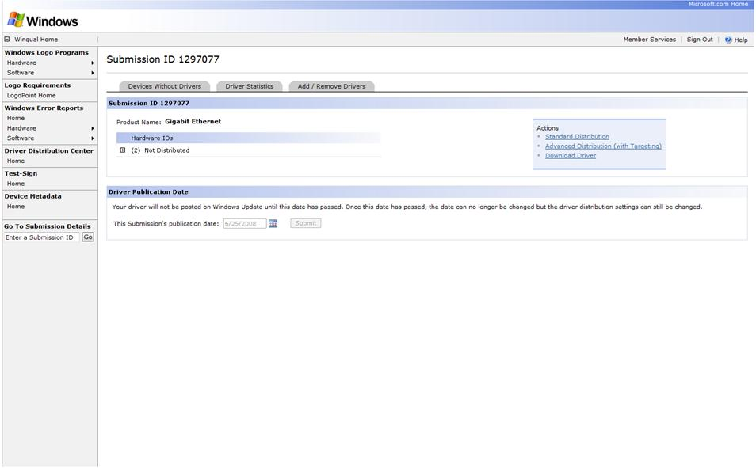
View current distribution settings
Go to action pages
Driver will not be distributed until this date has passed

Slide 19
Standard Distribution Page
Allows you to quickly change the distribution settings for all the hardware IDs in the submission
To distribute the driver for all hardware IDs in the submission, click the checkbox for “All”
If the HardwareID cannot be distributed:
“Not Distributable” appears. Click on the text to see why
If the HardwareID requires special targeting:
“Requires targeting” appears. Click the message to go to the Advanced Distribution page
If the HardwareID was distributed with special targeting:
“Targeted” link appears. Click the link to go to the Advanced Distribution page for that HardwareID

Slide 20
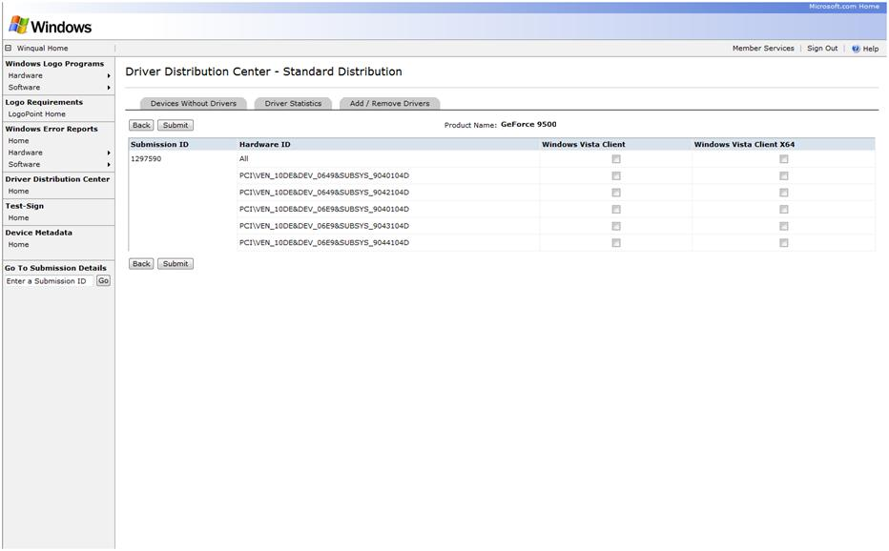
Click to select all HardwareIDs

Slide 21
Advanced Distribution Step 1
Wizard that lets you distribute a driver on Windows Update and add special driver targeting such as test registry key targeting
Select the hardware IDs you would like to manage
You can filter the list in several ways
Submission ID is required for all searches
Other fields are optional

Slide 22
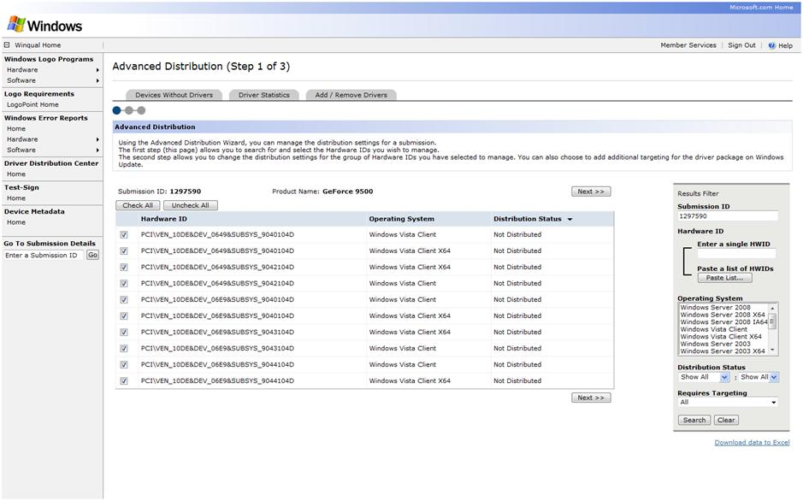
Paste in a list of IDs to manage from submission
Check box for IDs to manage

Slide 23
Advanced Distribution Step 2
Lets you view current distribution settings and add targeting
Distribution settings
Public groups
Private groups
Not Distributed
Test
Distributed
Original state

Slide 24
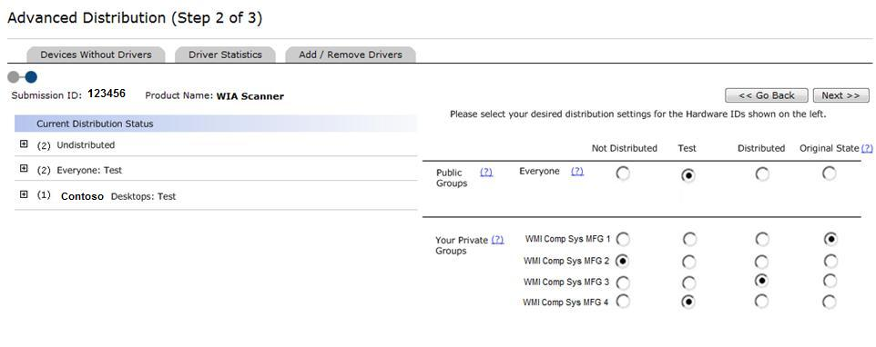
All companies can choose these
Only system MFG can choose company name targeting
What do all the settings mean?

Slide 25
Advanced Distribution Step 3
Lets you review the changes you made to the driver distribution settings before you submit them.
Click on any column to sort

Slide 26
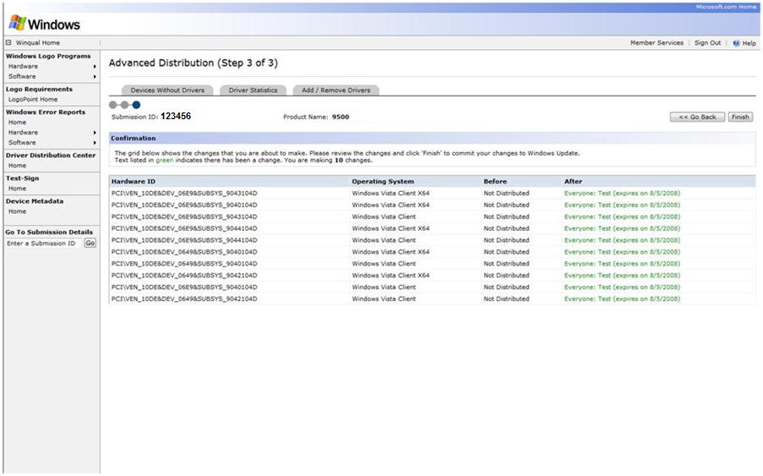
What changed

Slide 27
DDC Support
If you have problems with the DDC site, please send email to DDChelp@microsoft.com.
Please include the applicable information from the list below in your request
Company name
WHQL Submission ID
WHQL Device category (list all categories for a multifunction device)
Device name
Hardware ID(s)
Driver Version
Driver date
OS
Problem details and expected behavior
Steps to reproduce problem
Is driver on Windows Update?

Slide 28
Call To Action
Be sure the right people at your company know about these tools
Use crash data
Use DDC to manage driver distribution
Use Test Detection to test WU experience
Use Company Name Detection to distribute two-part drivers
Use Finish-Install Actions to install value-added software with a driver

Slide 29
Questions?

