Slide 1
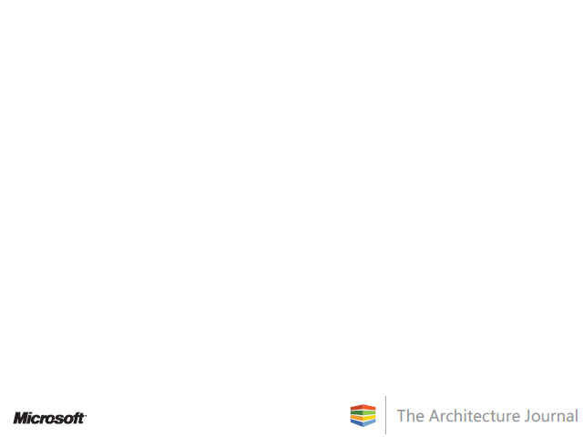

Design and Planning for a BI Project
Reeza Ali
Architect
Microsoft Corporation

Slide 2
Agenda
Logical and Physical Architecture Design
OLAP and Dimensional models
Security
Data Accessibility
Data Quality Analysis
Dashboards
How to conduct meetings with the business stakeholders
Review of meeting notes with the project sponsor
Report Design
ETL Design
Estimation

Slide 3
General Items
Don’t replace OLTP systems
Assumption
  You are familiar with the data warehousing concepts of star and snowflake schema

Slide 4
Logical and Physical Architecture Design
Problem: query and cube processing on the same server can stop the processing of the cube
Solution
  Define exclusive querying and processing windows
  Separate the querying and processing roles from the server

Slide 5
Logical and Physical Architecture Design
Synchronization Methods
  Attach & Detach
  Backup and Restore
  Synchronize Method
  Robocopy
Staging
  Acts as a development server
  Start project sooner
  Stage data scenarios

Slide 6
Logical and Physical Architecture Design
High Availability
  Storage space utilized
  Service Level Agreements (SLAs)
  Network Latency
  Disk Redundancy
  Cost
RAID configuration

Slide 7
OLAP and Dimensional Models
Attribute Design considerations
Dimension Design considerations
Cube Design considerations
Aggregations

Slide 8
Security
 | Admin Group | Finance Group | IT Mgmt Group | Accounts Payable Group
Reeza | X |  | X
George |  |  | X
Pradeep |  | X | X | X

Slide 9
Data Accessibility
When I connect to a data source using a tool, I should think about:
  Security Model
  Performance
  Ease of access to the data
  Supportability
  Is this the latest version of the tool?
  Ease of Management Functions

Slide 10
Data Quality Analysis
Comprised of
  Data Quality
    Database in 3NF?
    Use of Primary keys?
    New or legacy application?
    Adoption of the application?
  Data Cleansing and Standardization

Slide 11
Dashboards
Dashboards
  Problems conceptualizing
    Customers not accustomed to formal performance management
    Customers only familiar with OLTP reporting
  Customer accustomed to formal performance management – usually easier to get requirements from.
Scorecards
KPIs

Slide 12
Business Stakeholder Meetings
Worksheet
  10 questions
  Checklist of supporting documents
At the Meeting
  Worksheet discussion
After the Meeting
  Review meeting notes with project team

Slide 13
Report Design
Reporting Scenarios
Current Reports
Reporting Gaps and Current Requests

Slide 14
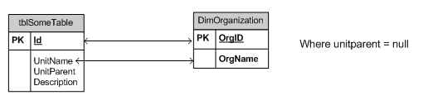
ETL Design

Slide 15
Estimation
Iterative Builds
ETL estimates
Prototyping
Iteration impacts to schedule and cost

Slide 16
References
http://sqlcat.com/technicalnotes/archive/2008/03/16/analysis-services-synchronization-best-practices.aspx
http://sqlcat.com/technicalnotes/archive/2008/02/11/analysis-services-should-you-use-many-to-many-dimensions.aspx
http://sqlcat.com/top10lists/archive/2007/09/13/analysis-services-query-performance-top-10-best-practices.aspx

Slide 17
References
http://technet.microsoft.com/en-us/library/cc966399.aspx
http://technet.microsoft.com/en-us/library/cc917670.aspx
http://technet.microsoft.com/en-us/library/cc966525.aspx
http://msdn.microsoft.com/en-us/library/ms190764.aspx

Slide 18
References
http://www.informit.com/guides/content.aspx?g=sqlserver&seqNum=162
http://www.informit.com/guides/content.aspx?g=sqlserver&seqNum=161

Slide 19

© 2009 Microsoft Corporation. All rights reserved. Microsoft, Windows, Windows Vista and other product names are or may be registered trademarks and/or trademarks in the U.S. and/or other countries.
The information herein is for informational purposes only and represents the current view of Microsoft Corporation as of the date of this presentation. Because Microsoft must respond to changing market conditions,
it should not be interpreted to be a commitment on the part of Microsoft, and Microsoft cannot guarantee the accuracy of any information provided after the date of this presentation.
MICROSOFT MAKES NO WARRANTIES, EXPRESS, IMPLIED OR STATUTORY, AS TO THE INFORMATION IN THIS PRESENTATION.

