Slide 1
Virtual Desktop Infrastructure (VDI) from Microsoft
Antonio Gámir
TSP – Windows Client
Microsoft Ibérica

Slide 2

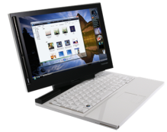

Dependencias Crean Complejidad
La Separación Crea Flexibilidad
Datos, configuración de ususuarios
Aplicaciones
OS
Hardware

Slide 3
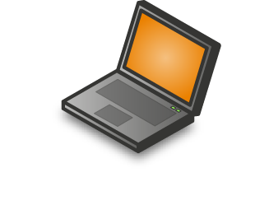

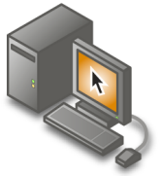

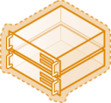

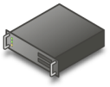


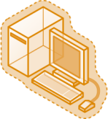
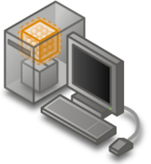



Productos Microsoft Virtualization
Profile
Virtualization
Document Redirection
Offline files
Server Virtualization
Presentation Virtualization
Management
Desktop Virtualization
Application Virtualization
Windows Vista Enterprise
Centralized Desktop (VECD)
3

Slide 4



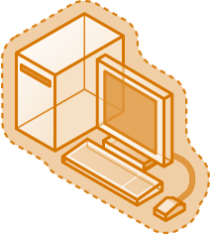


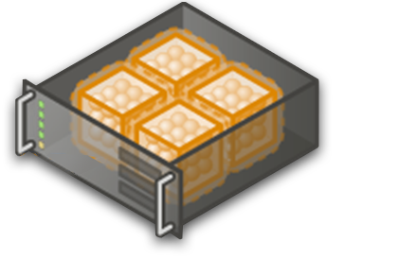
¿Qué es Virtual Desktop Infrastructure?
VDI es una tecnología emergente con la cual se define la estrategia de la centralización del desktop
Almacenaje y ejecución del desktop (SO, aplicaciones, datos) en máquinas virtuales en el datacenter
Presentación de la interfaz de usuario del desktop en remoto utilizando protocolos como RDP a usuarios en dispositivos como clientes ligeros o PCs
4
4

Slide 5

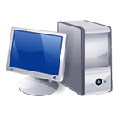
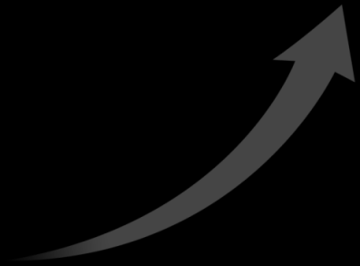



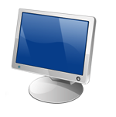
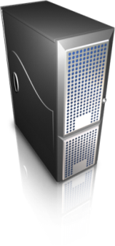

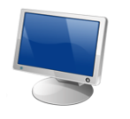
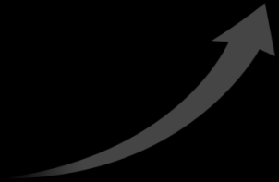







Modelos de Virtual Desktop Infrastructure
PCs sin Disco
Blade PCs
Desktop basado en servidor
Virtual Desktop en Server
SAN
SAN
Inicio en Remoteo
RDP
Inicio en Remoteo
Servers
Windows Server OS
RDP
Blade PC
RDP
RDP
RDP
RDP
Servers

Slide 6


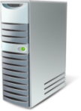

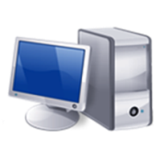
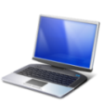
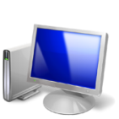



Arquitectura de VDI
Estática (“persistente”)
Desktops virtuales
Dinámico (“no persistente”)
Desktops virtuales
Profile Virtualization
(Folder Re-direction)
Application Virtualization
(SoftGrid)
Presentation Virtualization
(TS RemoteApp)

Slide 7





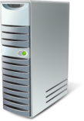








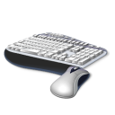







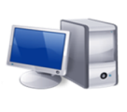
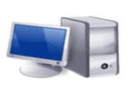


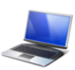





Microsoft Centralized Desktop Vision
Building on Terminal Services, Hyper-V and partners such as Citrix
Turn-key Centralized Desktop Solutions:
Enterprise Vision: Integrated Solution
VDI from Microsoft and Citrix
Terminal Services Remote Desktop
Virtual Image Management
Vista VMs on top of Hyper-V
Connection Broker
Server & Vista VMs
Connection
Management
Windows Server 2008 Hyper-V
Vista Enterprise Centralized Desktop
System Center Virtual Machine Manager
Session/connection broker (e.g. Citrix)
VM based isolation
Client OS
Integrated VMs & Sessions
Integrated connection & VM Management
Dynamic desktops and applications with TS RemoteApp and SoftGrid
Continued user experience enhancements with Calista
Continued value-add from Citrix
Proven & Mature
Best Price / Performance
Applications and desktops
Session based isolation
Server OS

Slide 8

© 2007 Microsoft Corporation. All rights reserved. Microsoft, Windows, Windows Vista and other product names are or may be registered trademarks and/or trademarks in the U.S. and/or other countries. The information herein is for informational purposes only and represents the current view of Microsoft Corporation as of the date of this presentation. Because Microsoft must respond to changing market conditions, it should not be interpreted to be a commitment on the part of Microsoft, and Microsoft cannot guarantee the accuracy of any information provided after the date of this presentation. MICROSOFT MAKES NO WARRANTIES, EXPRESS, IMPLIED OR STATUTORY, AS TO THE INFORMATION IN THIS PRESENTATION.

