Slide 1


What is new in Business Intelligence with SQL Server 2008

Slide 2













SQL Server 2008
Your Data Any Place, Any Time
Enterprise Data Platform
Services
Reporting
Integration
Analysis
Synch
Entity Data Model
Beyond Relational
FILE
Query
RDBMS
OLAP
Search
XML
Dynamic Development
Mobile and
Desktop
Cloud
Server
Pervasive Insight

Slide 3




Microsoft BI
An Integrated Offering
DELIVERY
COLLABORATION
CONTENT MANAGEMENT
SEARCH
SharePoint Server
Reports
Dashboards
Excel
Workbooks
Analytic
Views
Scorecards
Plans
END USER TOOLS & PERFORMANCE MANAGEMENT APPS
Excel
PerformancePoint Server
BI PLATFORM
SQL Server
Reporting Services
SQL Server
Analysis Services
SQL Server RDBMS
SQL Server Integration Services

Slide 4






SQL Server 2008
Business Intelligence Challenges Today
Business data is distributed across the enterprise
Relevant information on business performance does not span across the enterprise
Actionable insight isn’t easily accessible to everyone who needs it

Slide 5






SQL Server 2008
Intelligent Data Platform
Integrate Your Data
Consolidate and cleanse your data from virtually any source
Deliver Relevant Reports
Author extensive reports accommodating any reporting need
Drive actionable insights
Build enterprise-scale analytical solutions
Deliver intuitive reports to every user in the format and location they prefer
Manage and scale reporting workloads of any size
Extend with comprehensive and predictive capabilities
Simplified management of your data warehouse
Predictable response across growing volumes of data
Reach every user and drive actionable insight
Integration Services
Reporting Services
Analysis Services

Slide 6

SQL Server 2008
Design Pillars for SQL Server 2008 BI Technologies
Design
Process
Experience
Increased Developer Productivity
Improved Performance
Enriched End User Experience

Slide 7
Integrate Any Data
Data Warehousing and Integration Services 2008
Accelerate Data Warehousing
Data Warehouse
Build
Manage
Deliver
Connect to any source Integrate your data Develop visually
Predict response times Simplify Manageability Scale across mixed workloads
Deliver Relevant information Drive Actionable Insights Share insights

Slide 8
Integrate Your Data
Data Warehousing and Integration Services 2008
Build your Data Warehouse integrating any data, simplify manageability scaling across mixed workloads and deliver relevant, actionable insight
Scale and Manage large number of users and data
  Improved Query performance on large tables
  Queries Optimized for data warehousing scenarios
  Increase I/O performance with efficient and cost effective data storage
  Manage concurrent workloads of ad-hoc queries, reporting and analysis
Integrate growing volumes of data
  Optimize your ETL performance by identifying data in your largest tables
  Reduce the data load volumes by capturing operational changes in data
  Simplify your insert and update data processing
  Profile your information to identify dirty data

Slide 9
Integrate Your Data
Data Warehousing and Integration Services 2008
Scale and Manage large number of users and data
  Improved Query performance on large tables
  Queries Optimized for data warehousing scenarios
  Increase I/O performance with efficient and cost effective data storage
  Manage concurrent workloads of ad-hoc queries, reporting and analysis
Integrate growing volumes of data
  Optimize your ETL performance by identifying data in your largest tables
  Reduce the data load volumes by capturing operational changes in data
  Simplify your insert and update data processing
  Profile your information to identify dirty data
Enhanced Partitioning
DW Query Optimizations
Data Compression
Resource Governor
Persistent Lookups
Change Data Capture
MERGE SQL Statement
Data Profiling

Slide 10
Deliver Relevant Reports
Reporting Services 2008
Deliver Relevant Reports
Author
Manage & Scale
Experience
Author extensive reports accommodating any reporting need
Manage and scale reporting workloads of any size
Deliver intuitive reports to every user in the format and location they prefer

Slide 11
Deliver Relevant Reports
Reporting Services 2008
Deliver Relevant Reports
Author
Manage & Scale
Experience
New Report Designer
New Flexible Report Layout
Enhanced Data Visualization
Scalable Report Engine
IIS Agnostic Report Deployment
New Word Rendering
Improved Excel Rendering
New End User Design Experience

Slide 12
Extensive Report Authoring
Reporting Services 2008
Leverage rich visualizations and unique, flexible design capabilities to accommodate any reporting need
Introduction of new data region structure; Tablix
  The best of Table merged with the best of Matrix
Powerful visualizations
  Charts
  Gauges
New Report Designer
  Introduction of new Data Pane
  Improved dialogs
  Snap to lines
  Grouping panes
Deliver Relevant Reports
Author
Manage & Scales
Experience

Slide 13
Extensive Report Authoring
Reporting Services 2008
What is Tablix?
  The best of Table merged with the best of Matrix
  Allows for fixed and dynamic columns and rows
  Enables Arbitrary nesting on each axis
  Enables multiple parallel row/column members at each level
  Introduces optional omission of row/column headers
Deliver Relevant Reports
Author
Manage & Scale
Experience

Slide 14
Extensive Report Authoring
Reporting Services 2008
Tabl
e + Matr
ix
Customer
Retail
Odin
Bikes, Inc.
Wholesale
ABC Corp.
Thor, Ltd.
Grand Total
Growth
19%
322%
19%
322%
56%
Retail | Odin
 | Bikes, Inc.
Wholesale | ABC Corp.
 | Thor, Ltd.
Grand Total
2001 | 2002 | Total
1,115 | 1,331 | 2,446
152 | 642 | 794
11,156 | 13,312 | 24,468
1,523 | 6,421 | 7,944
13,946 | 21,706 | 35,653
Deliver Relevant Reports
Author
Manage & Scale
Experience
1,267 | 1,973 | 3,230 | 56%
12,679 | 19,733 | 32,412 | 57%

Slide 15
Flexible Report Layout
Reporting Services 2008
Tabl
e + Matr
ix
Customer
Retail
Odin
Bikes, Inc.
Wholesale
ABC Corp.
Thor, Ltd.
Grand Total
Growth
19%
322%
19%
322%
56%
Retail | Odin
 | Bikes, Inc.
Wholesale | ABC Corp.
 | Thor, Ltd.
Grand Total
2001 | 2002 | Total
1,115 | 1,331 | 2,446
152 | 642 | 794
11,156 | 13,312 | 24,468
1,523 | 6,421 | 7,944
13,946 | 21,706 | 35,653
1,267 | 1,973 | 3,230 | 56%
12,679 | 19,733 | 32,412 | 57%

Slide 16
Hierarchical rows with dynamic headers
(hierarchical row headers in matrix)
Reporting Services 2008
Extensive Report Authoring
Current
Desired
 |  | 2005 | 2006
Washington | Total | 80 | 100
 | Seattle | 50 | 60
 | Spokane | 30 | 40
Oregon | Total | 60 | 80
 | Portland | 40 | 50
 | Eugene | 20 | 30
 | 2005 | 2006
Washington | 80 | 100
Seattle | 50 | 60
Spokane | 30 | 40
Oregon | 60 | 80
Portland | 40 | 50
Eugene | 20 | 30
Deliver Relevant Reports
Author
Manage & Scalke
Experience

Slide 17
Parallel Dynamic Groups
Reporting Services 2008
Extensive Report Authoring
 |  | 2005 | 2006
WA | Seattle | 50 | 60
 | Spokane | 30 | 40
OR | Portland | 40 | 50
 | Eugene | 20 | 30
 |  | Table | Chair
WA | Seattle | 20 | 30
 | Spokane | 10 | 20
OR | Portland | 10 | 10
 | Eugene | 25 | 5
Current
 |  | Year |  | Product
 |  | 2005 | 2006 | Table | Chair
WA | Seattle | 50 | 60 | 20 | 30
 | Spokane | 30 | 40 | 10 | 20
OR | Portland | 40 | 50 | 10 | 10
 | Eugene | 20 | 30 | 25 | 5
Desired
Deliver Relevant Reports
Author
Process
Experience

Slide 18
Non-detail aggregates in subtotals
(does not make sense as a detail)
Reporting Services 2008
Extensive Report Authoring
Current
Desired
 |  |  | 2005 | 2006
NY | Joe | Count | 1 | 1
 |  | Sales | 50 | 60
 |  | Avg | 50 | 60
 | Sue | Count | 1 | 1
 |  | Sales | 80 | 100
 |  | Avg | 80 | 100
 | Total | Count | 2 | 2
 |  | Sales | 130 | 160
 |  | Avg | 65 | 80
 |  |  | 2005 | 2006
NY | Joe |  | 50 | 60
 | Sue |  | 80 | 100
 | Total | Count | 2 | 2
 |  | Sales | 130 | 160
 |  | Avg | 65 | 80
...
Deliver Relevant Reports
Author
Process
Experience
...

Slide 19
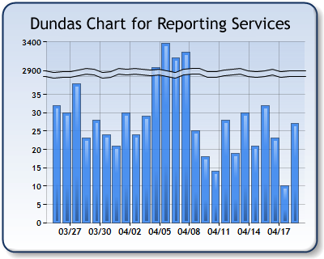
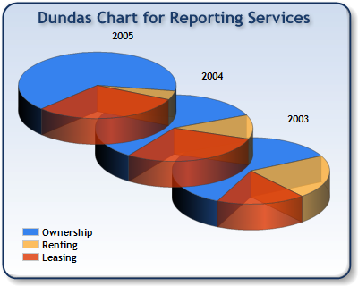
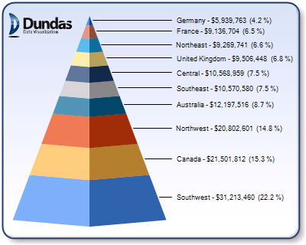
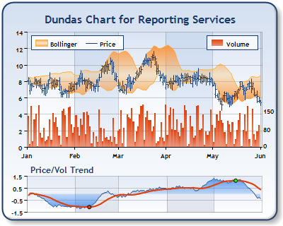
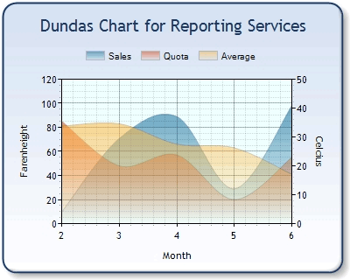
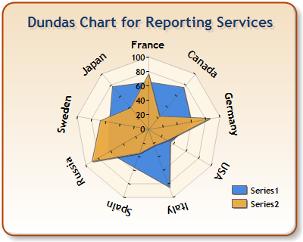
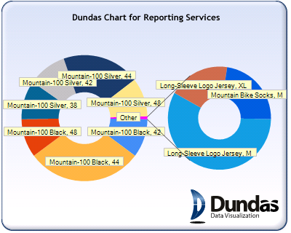
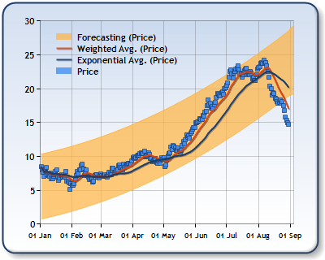
Enriched Visualizations - Chart
Reporting Services 2008
Extensive Report Authoring
Richer end user experience with new visualization engine
Chart Examples
Deliver Relevant Reports
Author
Process
Experience

Slide 20
Enriched Visualizations - Chart
Reporting Services 2008
Extensive Report Authoring
Key Features
  Annotations
  Custom Palettes
  Multiple Axes
  Axis Break
  Large data volumes
  Error Bars
  Merged charts
  Anti-aliasing
  Alpha Blending
  Custom Drawing Events
Additional Chart Types
  Stepped Line
  Spline Area
  Pie Callout
  Polar
  Radar
  Gantt
  Range Line/Column
  Funnel
  Pyramid
  Histogram
  Box
Deliver Relevant Reports
Author
Process
Experience

Slide 21


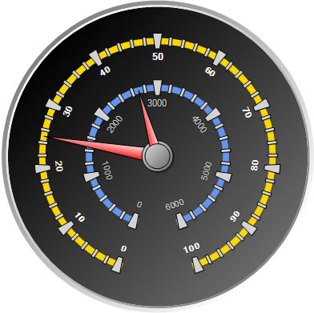
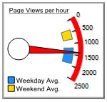
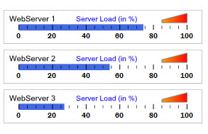
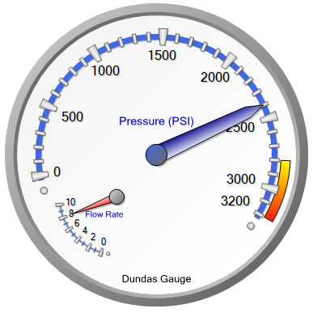
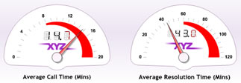

Enriched Visualizations - Gauge
Reporting Services 2008
Extensive Report Authoring
Deliver Relevant Reports
Author
Process
Experience

Slide 22
Enriched Visualizations - Gauge
Reporting Services 2008
Extensive Report Authoring
Display and monitor real-time data using a range of fully customizable gauge and dial types
Leverage as dashboard / scorecard components for visualizing KPI’s
Supported Gauge types
  Circular Gauges
  Linear Gauges
  Numeric Indicators
  State Indicators

Slide 23
Manage and Scale any Reporting Workload
Efficiently manage a trusted, centrally deployed, reporting environment designed for enterprise scale
Enjoy a Re-designed Report Engine
  Support reporting workload of any size
  Leverage a self-hosted Reporting Services Service
  Limit memory usage with non-memory bound reports
  Optimize report performance through on-demand processing and instance-based rendering.
Deliver Relevant Reports
Author
Manage & Scale
Experience

Slide 24
Deliver Intuitive Reports
Reporting Services 2008
Empower all users with interactive reports, dynamically delivered in the format and location they prefer
Enrich your End User Experience
  Deliver reports in format that make the most sense for the end users
  Render reports in fully editable Office formats
    Enrich user experience with new rendering in Microsoft Office Word for
    Benefit from improve rendering in Microsoft Office Excel
Deliver Relevant Reports
Author
Manage & Scale
Experience

Slide 25
Demo
Reporting Services 2008 in Action

Slide 26
Drive Actionable Insights
Analysis Services 2008
Designed to Perform
Design
Scale & Monitor
Run & Experience
Design enterprise-scale analytical solutions
Extend, Scale and Monitor
Reach every user and drive actionable insights

Slide 27
Drive Actionable Insights
Analysis Services 2008
Innovative Cube Designer
Enhanced Aggregation Design
Enhanced Dimension Design
Best Practice Design Alerts
“Designed to Perform”
Design
Run
Monitor
New Subspace Computations
Enhanced Back-Up Scalability
MOLAP Enabled Write-Back
New Resource Monitor
Execution Plan

Slide 28
Design Enterprise-Scale Solutions
Analysis Services 2008
Empower all users with interactive reports, dynamically delivered in the format and location they prefer
Optimized Design Experience
Reduce time/cost to create solutions
Modify design of key areas of the interface so that an optimal design is the natural outcome
Imbed best practices and performance tuning tricks into the object model and user interface
Best Practice Design Alerts
Leverage over 40 best practices integrated into real-time designer checks
Enjoy real time “squiggly alert lines” serving as build time warnings
  No pop-ups to get in your way
Dismiss alerts by instance or globally when desired
Drive Actionable Insights
Design
Scale & Monitor
Run & Experience

Slide 29
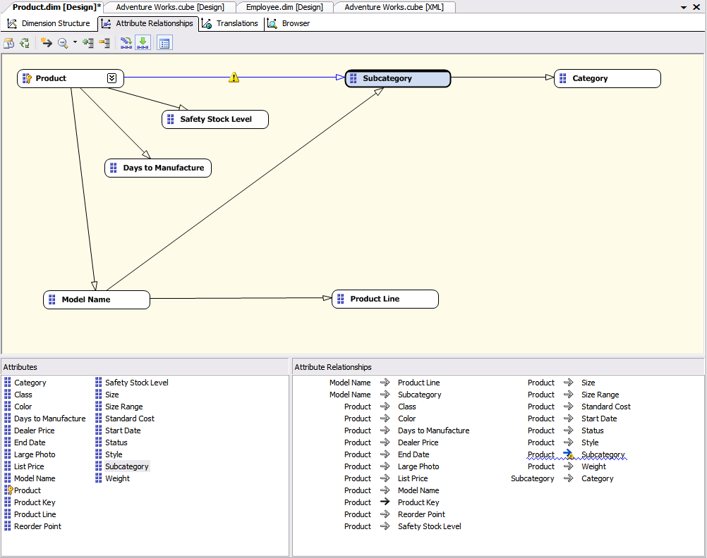
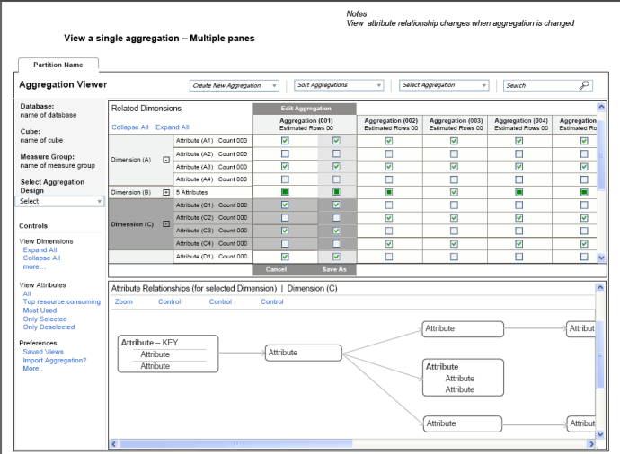
Analysis Services 2008
Design Enterprise-Scale Solutions
Design Tools
Dimension Design
Attribute Relationship Designer
  New designer for viewing and editing attribute relationships
  Multiple built-in validations for support of idea dimension design
Dimension Wizard
Dimension Editor
Aggregation Design
One Wizard
Improved Algorithm
Dedicated Designer
  Aggregation and aggregation design views
  Support for Manual edit/create/delete
  Built-in validations for optimal designs assistance
Drive Actionable Insights
Design
Scale & Monitor
Run & Experience

Slide 30
Analysis Services 2008
Extend and Monitor
Resource Monitor
Perform better resource analysis
  Leverage exposed server resource information
  Identify who run which queries, for how long
  Optimize workload and resource utilization
Analysis Services
Reports generated in Reporting Services
Default Resource cube
Rich analytical client applications
Resource tables (DMV)
Drive Actionable Insights
Design
Scale & Monitor
Run & Experience
Ad hoc analysis
Select * from Session_Resources

Slide 31
Analysis Services 2008
Run & Experience
Subspace Computation
Optimize user experience with computation of non-default expressions only
Enhance analytical capabilities with more complex computations and aggregations
Gain tremendous performance on “sparse” populated cubes
- vs
Drive Actionable Insights
Design
Scale & Monitor
Run & Experience
31

Slide 32
Optimized Write-Back Experience
Empower business users with MOLAP enabled write-back
  Extend the superior performance of the MOLAP storage mode to write-back scenarios
  Eliminate the need for ROLAP storage
  Enable an end-user optimized write-back experience
  Support improved what-if analysis

Slide 33

Analysis Services 2005 Write Back
Retrieve committed write back
Data Entry
Cube Partitions
Commit write back to data Store
Write-Back Table
Write Back Cache
Write-Back Partition
ROLAP Enabled Write Back

Slide 34
Analysis Services 2008 Write Back
Retrieve committed write back from MOLAP
Data Entry
Cube Partitions
Copy to data source
Write-Back Table
Write Back Cache
Write-Back Partition
Commit write back to the MOLAP store
MOLAP Store
MOLAP Enabled Write Back

Slide 35
SQL Server 2008 Data Mining
Analysis Services 2008
Engine and algorithm improvements
  Enable better prediction and insight
  Enhanced Time Series Support
  Enhanced Mining Structures
    Split data into training and testing partitions
    Querying against structure data
    Filter data when building models
    Build incompatible models in a structure
    Cross-validation
Data Mining Add-ins for Office 2007
  Deliver a compelling end-user experience
  Bring data mining to a new, and much larger audience
Drive Actionable Insights
Design
Scale & Monitor
Run & Experience

Slide 36
Demo
Analysis Services 2008 In Action

Slide 37
Summary
SQL Server 2008 Business Intelligence
Design
Process
Experience
Integrate Any Data
Deliver relevant Information
Drive Actionable Insights

Slide 38
Incredible Market Momentum
Microsoft is positioned in Leaders Quadrant for Magic Quadrant for Data Warehouse Database Management Systems, 2007
SQL Server is the fastest growing DBMS and BI vendor
SQL Server is the #1 OLAP Server on the market
SQL Server ships more units than Oracle and IBM combined
http://www.olapreport.com

Slide 39
Call To Action
Learn more about SQL Server 2008
  Visit the SQL Server 2008 web site for more details http://www.microsoft.com/sql/prodinfo/futureversion/default.mspx
  Get hands on experience through the latest CTP https://connect.microsoft.com/SQLServer/content/content.aspx?ContentID=5395
  Get up to speed on new Data Warehouse improvements http://msevents.microsoft.com/CUI/WebCastEventDetails.aspx?culture=en-US&EventID=1032344498&CountryCode=US
  Attend more of the upcoming SQL Server 2008 Webcasts http://www.microsoft.com/sql/prodinfo/futureversion/webcasts.mspx

Slide 40

© 2004 Microsoft Corporation. All rights reserved.
This presentation is for informational purposes only. Microsoft makes no warranties, express or implied, in this summary.

Slide 41
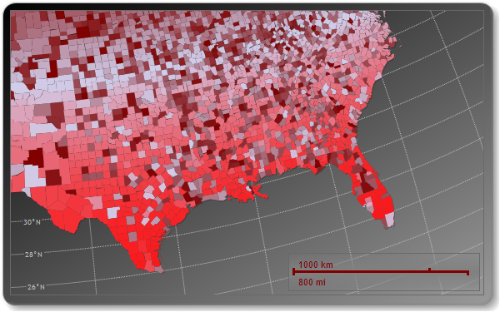
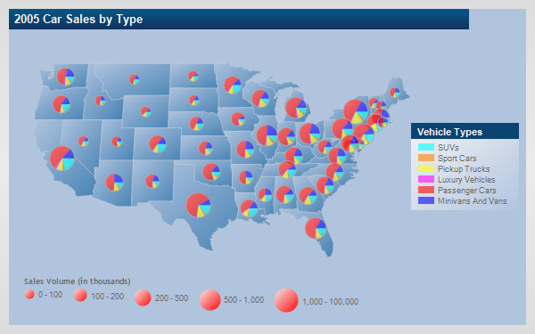
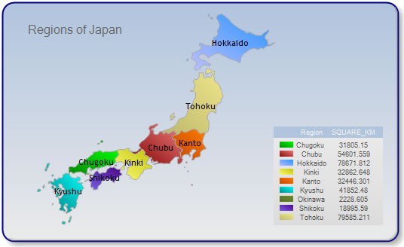
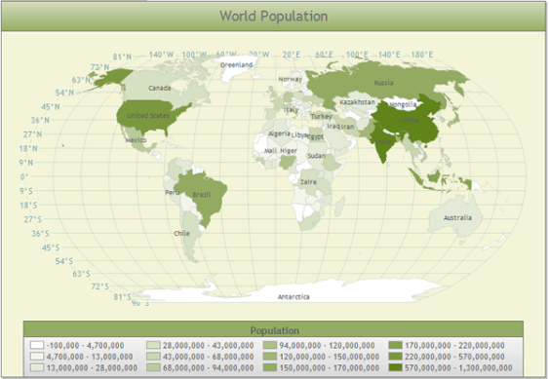
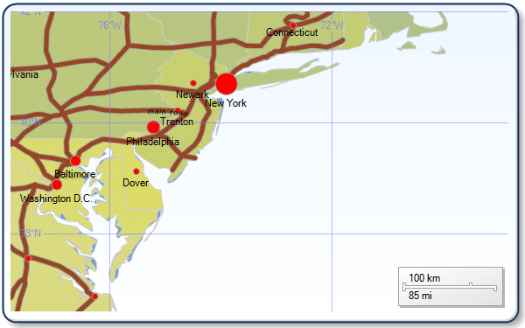
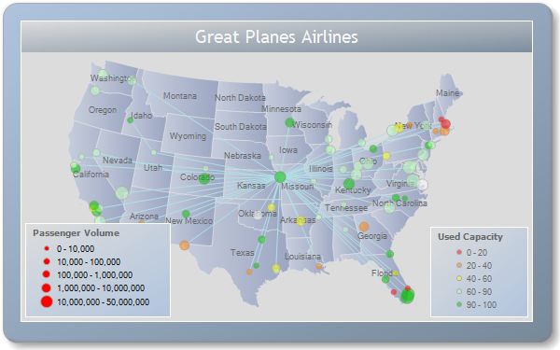
Enriched Visualization
Reporting Services 2008
Map Examples
“Designed to Perform”
Author
Process
Experience

Slide 42
Enriched Visualization
Reporting Services 2008
“Designed to Perform”
Author
Process
Experience

