Slide 1
Language Integrated Query (LINQ)

Slide 2
Data Access Programming Challenges
Multiple, disparate data stores
Developers must learn data store-specific query syntax
Data access code is mixed with application code
Difficult to debug and maintain
Code is often complex and verbose
Data model mismatch
Data schemas do not match application object models

Slide 3
Introduction to LINQ
Language Integrated Query (LINQ)
Extensions for .NET languages
Native syntax for query operations
Strong typing and object-orientation for data
Implementations for disparate data sources

Slide 4
Data Access Code Today
class DataAccess{
static void GetNewOrders(DateTime date, int qty) {
using (SqlConnection con = new SqlConnection(Settings.Default.NWDB)) {
con.Open();
SqlCommand cmd = con.CreateCommand();
cmd.CommandText = @"
SELECT o.OrderDate, o.OrderID, SUM(d.Quantity) as Total
FROM Orders AS o
LEFT JOIN [Order Details] AS d ON o.OrderID = d.OrderID
WHERE o.OrderDate >= @date
GROUP BY o.OrderID
HAVING Total >= 1000";
cmd.Parameters.AddWithValue("@date", date);
DbDataReader r = cmd.ExecuteReader();
while (r.Read()) {
Console.WriteLine("{0:d}:\t{1}:\t{2}", r["OrderDate"], r["OrderID"], r["Total"]);
}
}
}
}
Query syntax is source-specific and must be embedded into application code
Data values are contained in a data structures, which must be navigated

Slide 5
Data Access Code with LINQ
class DataAccess
{
static void GetNewOrders(DateTime date, int qty) {
using (NorthWindDB nw = new NorthWindDB ()) {
var orders = from o in nw.Orders
where o.OrderDate > date
select new { o.orderID,
o.OrderDate, Total = o.OrderLines.Sum(l => l.Quantity);
foreach (SalesOrder o in orders) {
Console.WriteLine("{0:d}\t{1}\t{2}",
o.OrderDate, o.OrderId, o.Total);
}
}
}
}
Query syntax is native application code
Data objects are first-class citizens

Slide 6
Benefits of LINQ
LINQ
Simpler data access code
Increased developer productivity
Flexible data access for the enterprise

Slide 7
Simplicity
No new syntaxes
Instead of having to learn and work in multiple languages (e.g., C#, T-SQL, XSLT) you now work in one language – yours!
var customers = from c in db.Customers
where c.City == "London"
select c;

Slide 8
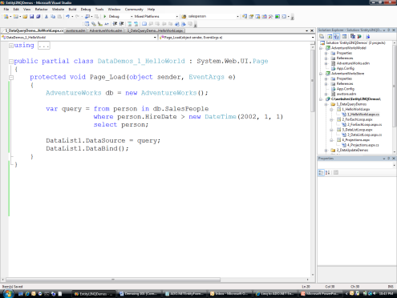
Productivity
Native CLR types
Intellisense
Compile-time error checking
Faster , more reliable application development

Slide 9
Flexibility
LINQ to SQL
LINQ to Entities
LINQ to DataSet
LINQ to XML
Strongly-typed LINQ access to SQL Server
Strongly-typed LINQ access to Microsoft ADO.NET Entity Framework
Strongly-typed LINQ access to DataSet functionality
Strongly-typed LINQ access to XML data
<xml>
…
</xml>

Slide 10
Using LINQ with Relational Data
LINQ to SQL
Rapid development against SQL Server®
Ideal for direct 1:1 mapping to database schema
Minimally intrusive object model
LINQ to Entities
Strongly-typed data access to relational data sources through Entity Framework
Flexible mapping to relational schema
Enterprise-level data modeling

Slide 11
Using LINQ with XML
LINQ to XML
XML API of choice in .NET Framework 3.5
Simpler and more efficient than System.Xml
var d = XDocument.Load(xmlPath)
var categories = from c in d.Descendants(
"category")
select new
{
Name = (string)c.Attribute("name"),
Value = (string)c.Attribute("id")
};
CategoryList.DataSource = categories;
CategoryList.DataBind();
<xml>
…
</xml>

Slide 12
Using LINQ with DataSets
LINQ to DataSet
Query DataSets with consistent LINQ syntax
Greater power and simpler code than existing Select, RowFilter and Find methods
var query = from r in customerDataTable.AsEnumerable()
where r.Field<string>("LastName") ==
"Smith"
select r.Field<string>(“FirstName”);

Slide 13
Summary
Use LINQ to
Simplify data access code
Enhance developer productivity
Create flexible data access solutions

Slide 14
This presentation is for informational purposes only. Microsoft makes no warranties, express or implied, in this summary.

