Slide 1
Solid-State Drives Next-generation storage
Frank Shu
Senior Program Manager
Storage Ecosystem Technologies
Microsoft Corporation

Slide 2
Key Takeaways
Understand Solid State Drive (SSD) technologies
Adopt best practices for SSD design in Windows platforms to enhance SSD performance and reliability
Let’s partner on this new hardware directions to make SSD the next-generation computer storage
Notes:
5/30/2007 8:50 AM
© 2006 Microsoft Corporation. All rights reserved. Microsoft, Windows, Windows Vista and other product names are or may be registered trademarks and/or trademarks in the U.S. and/or other countries.
The information herein is for informational purposes only and represents the current view of Microsoft Corporation as of the date of this presentation. Because Microsoft must respond to changing market conditions, it should not be interpreted to be a commitment on the part of Microsoft, and Microsoft cannot guarantee the accuracy of any information provided after the date of this presentation. MICROSOFT MAKES NO WARRANTIES, EXPRESS, IMPLIED OR STATUTORY, AS TO THE INFORMATION IN THIS PRESENTATION.
2

Slide 3
Agenda
SSD advantages
Issues for performance and reliability
Windows new features
Setting the platform for SSD to reach the next level
This session is not a debate between SSD and HDD
Join the panel discussion Thursday: WNS-P493: Solid State Disk
Notes:
5/30/2007 8:50 AM
© 2006 Microsoft Corporation. All rights reserved. Microsoft, Windows, Windows Vista and other product names are or may be registered trademarks and/or trademarks in the U.S. and/or other countries.
The information herein is for informational purposes only and represents the current view of Microsoft Corporation as of the date of this presentation. Because Microsoft must respond to changing market conditions, it should not be interpreted to be a commitment on the part of Microsoft, and Microsoft cannot guarantee the accuracy of any information provided after the date of this presentation. MICROSOFT MAKES NO WARRANTIES, EXPRESS, IMPLIED OR STATUTORY, AS TO THE INFORMATION IN THIS PRESENTATION.
3

Slide 4
SSD Primer
SSD: Solid State Drive, a primary storage device based on Flash memory
SLC NAND: Single Layer Cell NAND Flash
MLC NAND: Multi Layer Cell NAND Flash
SSD Page: Addressable unit in NAND flash memory
SSD Block: Erase unit in NAND flash memory

Slide 5
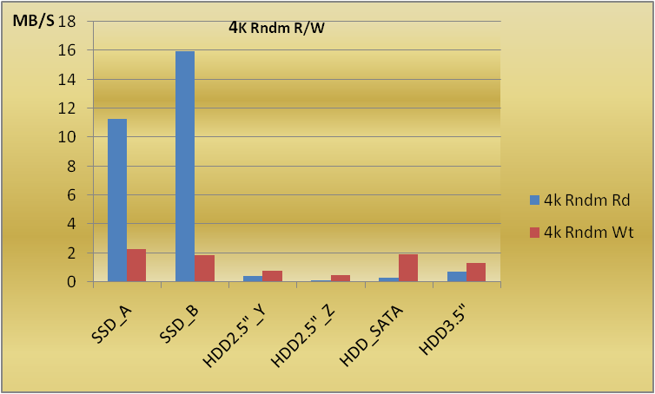
SSD Common Knowledge SSD features (1 of 3)
SSD random read performance is the best offered by NAND flash memory
Up to 20x faster on random read compare to HDD

Slide 6
SSD Common Knowledge SSD features (2 of 3)
SSD reliability is more robust because
Resistant to shock and vibration
Less concern about unrecoverable data
A bad memory cell is detected during erase
SSD Read-Merge-Write will not cause data corruption during power outage because the original data is preserved until the write is committed

Slide 7
SSD Common Knowledge SSD features (3 of 3)
SSD consumes less power
For example, sample drives in our labs
0.5W for a 32GB 2.5” SDD
1.2W for a 40GB 2.5” HDD
Less heat exhaustion also means less cooling requirement
SSD can reduce the footprint for storage need
SSD has no acoustic noise

Slide 8
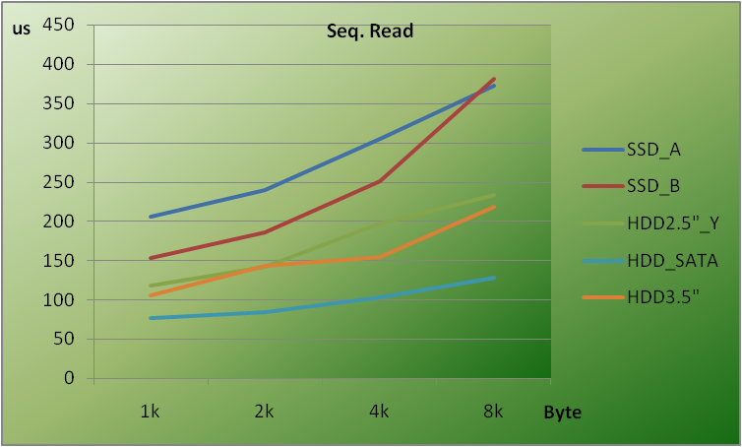
SSD Common Knowledge SSD issues (1 of 3)
Longer setup time for command execution
As: t(s) = Ks + t0 is a linear regression of total command execution time over transfer size(s) for sequential read
We have: t0 ≤ 130us for HDD; t0 ≥ 150us for SSD

Slide 9
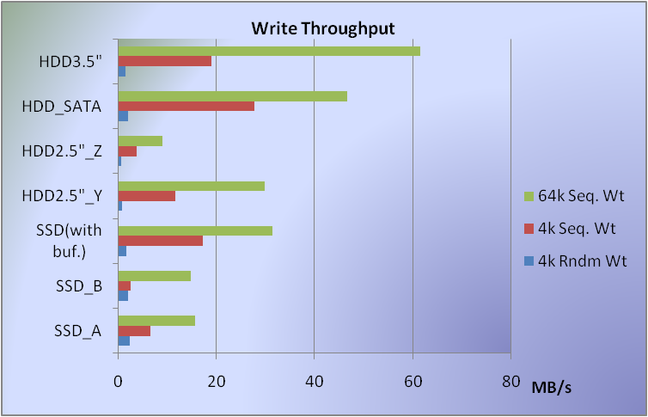
SSD Common Knowledge SSD issues (2 of 3)
SSD write performance is a concern
Erase before write
Merge operation is part of write
DRAM buffer can help, but introduces other issues

Slide 10
SSD Common Knowledge SSD issues (3 of 3)
Limited write cycles on NAND flash introduces a different reliability challenge to SSD
100K write cycles for SLC NAND flash
10K write cycles for MLC NAND flash
Cost of SSD is much higher than OEM and consumer expectation today
$250–$500 for 32GB SSD
$40–$70 for 32GB HDD

Slide 11
Windows: Best Platform For SSD Knowing what SSD needs (1 of 4 )
Identifying SSD in Windows
Identification in system must be standard
New proposal for SSD identification is in T13
Adding value to SSD by Windows can be a big win for IHVs and Windows users
Turning off “Defragger” on SSD can save write cycles and add performance to SSD

Slide 12
Windows: Best Platform For SSD Knowing how to use SSD better (2 of 4)
Reducing overhead of SSD write operation in Windows with “Remove-On-Delete”
New “trim” command proposal submitted to T13
Aligning file system partition with SSD layout
Aligning up to 4K in page size
Future directions: consider block size and more

Slide 13
Windows: Best Platform For SSD Performance/low cost: We take both (3 of 4)
“Composite SSD”: Further optimizing part of SSD’s total capacity can bring good performance and low cost
SLC NAND flash + magnetic media
SLC + MLC NAND flash
Other combinations
This is not the same as “Hybrid HDD”

Slide 14
Windows: Best Platform For SSD Performance/low cost: We take both (4 of 4)
Write-optimized storage schema puts most modified data in “Composite SSD” optimized area
Preparing for large-capacity SSD in server applications

Slide 15
SSD Directions

Slide 16
SSD Directions (1 of 3)
SSD needs its own defragmentation
Not much for random read performance as HDD does, but most important for SSD write
Different from what we have for HDD
Focused on optimization of write
SSD Page and SSD Block come to play, not sector or LBA

Slide 17
SSD Directions (2 of 3)
Advanced write-optimized schema
An adaptive algorithm in Windows can adjust the policy to user’s data usage pattern
Applications should be able put most modified data in more optimized area of composite SSD via Windows API

Slide 18
SSD Directions (3 of 3)
Minimizing random write can be a key for boosting SSD performance and reliability
SSD does not do random small write well
Small write causes more write cycle overhead
Affects SSD reliability

Slide 19
Call To Action
Windows, with its advanced technology, creates the best platform for SSD
Microsoft encourages IHVs and ISVs to take advantage of Windows APIs and guidelines for high-performance and more reliable SSD
Join SSD forum on MSDN or send us e-mail to have your questions answered

Slide 20
Additional Resources
Web Resources
New T13 proposals: http://www.t13.org/documents/UploadedDocuments//docs2007/e07153r0-Soild_State_Drive_Identify_Proposal.doc
http://www.t13.org/documents/UploadedDocuments//docs2007/e07154r0-Notification_for_Deleted_Data_Proposal_for_ATA-ACS2.doc
Storage topics on WHDC: http://www.microsoft.com/whdc/device/storage/stor-tech.mspx
Related Sessions, Chalk Talk, and Panel Discussion
WNS-P493: Solid State Disk panel discussion
WNS-C431: Next-Generation Personal and Portable Storage
WNS-C444: Logo Program for Storage Best Practices
For SSD discussion, send e-mail to:
SSDDiscussion @ microsoft.com

Slide 21
© 2007 Microsoft Corporation. All rights reserved. Microsoft, Windows, Windows Vista and other product names are or may be registered trademarks and/or trademarks in the U.S. and/or other countries.
The information herein is for informational purposes only and represents the current view of Microsoft Corporation as of the date of this presentation. Because Microsoft must respond to changing market conditions, it should not be interpreted to be a commitment on the part of Microsoft, and Microsoft cannot guarantee the accuracy of any information provided after the date of this presentation. MICROSOFT MAKES NO WARRANTIES, EXPRESS, IMPLIED OR STATUTORY, AS TO THE INFORMATION IN THIS PRESENTATION.

