Slide 1
Network Access Protection (NAP) Technologies
Sreenivas Addagatla - Development Lead
Lambert Green - Test Lead
Microsoft Corporation

Slide 2
Key Takeaways
Understand the NAP platform and related technologies
Learn about the extensibility of the NAP platform
Consider opportunities for building solutions over the NAP platform

Slide 3
Agenda
Problem space
NAP solution
Scenario walk-through
Platform architecture
APIs and protocols
Demo
Call to Action

Slide 4
Risks Of A Highly-Connected World
Many devices crossing enterprise boundaries on a regular basis
Compromised devices can result in lost productivity
How to define and enforce compliance requirements?
Internet
Perimeter
Customers
Intranet
Web Server
X
Infrastructure Servers
Business Partners
Extranet Server
Remote Access Gateway
Remote Employees

Slide 5
NAP Solution
Policy Validation
Are computers “healthy” – compliant with company’s security policies
Network Restriction
Restrict network access based on their compliance
Remediation
Provides necessary updates to become compliant
Once compliant, the network restrictions are removed
Ongoing Compliance
Changes in computers’ compliance to dynamically result in network restrictions

Slide 6
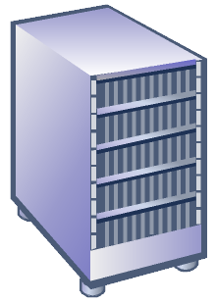
NAP Walk-Through
Corporate Network
Restricted Network
Remediation
servers
System health
servers
Here you go
Can I have updates?
Ongoing policy updates to NPS Policy Server
Should this client be restricted based
on its health?
May I have access?
Here’s my current
health status
Requesting access. Here’s my new health status
According to policy, the client is not up to date. Restrict client, request it to update
According to policy, the client is up to date
Grant access
802.1x
Switch
/ AP
Microsoft
network
policy server
You are given restricted access
until fix-up
Client
Client is granted access to full intranet

Slide 7
NAP Architecture
Remediation Servers
System Health Servers
Updates
Health Policy
NAP Client
Network Policy
Server
System Health Agents (SHA)
System Health Validators (SHV)
MS-SHA
SHA-1
SHA-2
MS-SHV
SHV-1
SHV-2
NAP Agent
Network
Access
Messages
Health
Data
NAP Server
Enforcement Clients (EC)
VPN
DHCP
EC-x
802.1x
IPSec
Network Access Devices
and Servers

Slide 8
System Health Agents
Provide Statements of Health
Monitor and notify health changes
Process server responses
Indicate remediation steps and/or auto-remediate
Report remediation status
Examples
Windows Updates, Firewall, Anti-virus, etc.
Remediation Servers
Updates
NAP Client
System Health Agents
MS-SHA
SHA-1
SHA-2
NAP Agent
Enforcement Clients
VPN
DHCP
EC-x
802.1x
IPSec

Slide 9
System Health Validators
Process Statements of Health
Evaluate compliance based on health policy
Provide health responses
Indicate health diagnosis and remediation steps to respective SHA
System Health Servers
Health Policy
Network Policy
Server
System Health Validators (SHV)
MS-SHV
SHV-1
SHV-2
NAP Server

Slide 10
Enforcement Clients
Maintain health enforced network connections
Provide transport for system statement of health (SoH) and SoH responses (SoHR)
Indicate network access status to other components
Remediation Servers
Updates
NAP Client
System Health Agents
MS-SHA
SHA-1
SHA-2
NAP Agent
Enforcement Clients
VPN
DHCP
EC-x
802.1x
IPSec

Slide 11
Microsoft NAP Agent
Maintains current health state of the NAP Client
Collect and manage SoH data from SHAs
Coordinates interaction between SHAs and ECs
Provide ECs with SoH data for transmission
Notify SHAs when network access state changes
Remediation Servers
Updates
NAP Client
System Health Agents
MS-SHA
SHA-1
SHA-2
NAP Agent
Enforcement Clients
VPN
DHCP
EC-x
802.1x
IPSec

Slide 12
Microsoft NAP Server Component
Coordinates interaction between SHVs and NPS
Distributes SoHs to corresponding SHVs
Collects SoHRs from SHVs and passes to NPS
System Health Servers
Health Policy
Network Policy
Server
System Health Validators (SHV)
MS-SHV
SHV-1
SHV-2
NAP Server

Slide 13
Network Access Device/Server
Provides network access to clients
E.g. VPN Server, 802.1x switch, DHCP Server, etc.
RADIUS interactions with a Network Policy Server
Network access enforcement
Provide the level of network access as defined by the Network Policy Server
Network
Policy Server
Client
Network Access Devices
and Servers

Slide 14
Microsoft Network Policy Server
Authentication, Authorization and Accounting Services for network access
Provides means for definition and evaluation of access control policies
Out-of-the-box support for many deployment scenarios
Dial-up, VPN, IPSec, 802.1x, TSG, DHCP, …
Comprehensive GUI with many wizards

Slide 15
NAP - RADIUS VSAs
RADIUS Client <-> NPS
MS-Quarantine-SoH
NPS -> RADIUS Client
MS-Quarantine-State
Full Access, Restricted, Probation until a certain time
MS-Quarantine-Grace-Time
Specified date and time for probation
MS-IPv4-Remediation-Servers, MS-IPv6-Remediation-Servers
Not-Quarantine-Capable

Slide 16
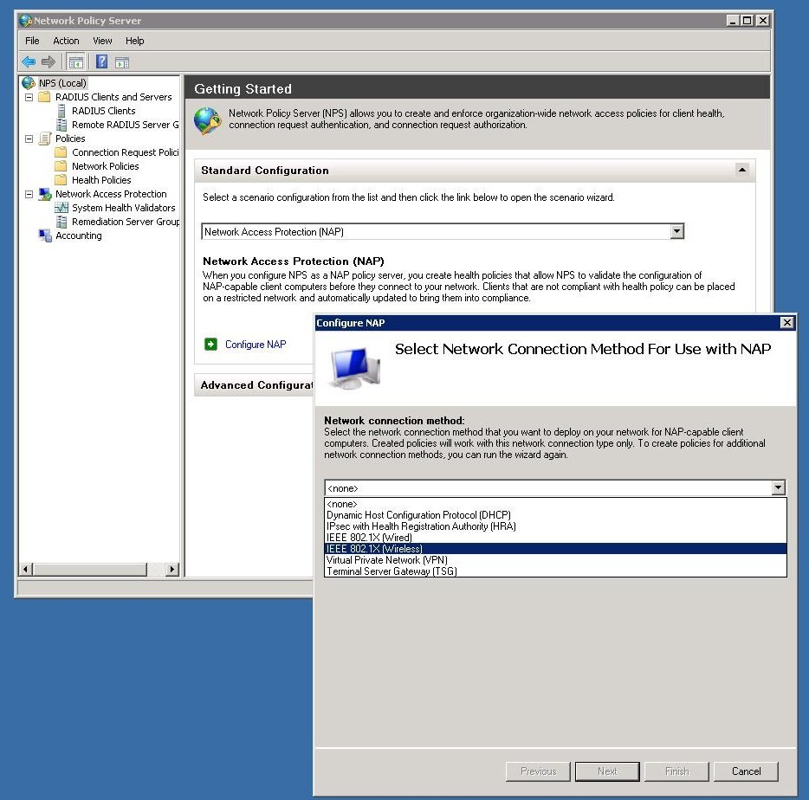
NPS Configuration Example

Slide 17
NAP 802.1x/EAP Enforcement
NAP Client
Network Policy
Server
System Health Agents
System Health Validators
MS-SHA
SHA-1
SHA-2
MS-SHV
SHV-1
SHV-2
NAP Agent
NAP Server
EAP EC
Network
Access
Messages
Health
Data
EAPHost
3rd party
EAP methods
EAPHost
PEAP
802.1x enabled switch/AP
PEAP
3rd party
EAP methods
802.1x
supplicant
3rd party EAP
supplicants

Slide 18
In-Band And Out-Of-Band Modes
In-band mode
NAP health data transmitted along with access request/response messages
Health validation as one of the authorization steps
E.g. 802.1x EAP enforcement
Out-of-band mode
Use of an earlier obtained health validation result for access control
E.g. IPSec enforcement

Slide 19
NAP IPsec Enforcement
NAP Client
Network Policy
Server
System Health Agents
System Health Validators
MS-SHA
SHA-1
SHA-2
MS-SHV
SHV-1
SHV-2
NAP Agent
NAP Server
Health
validation
IPsec EC
Health
Data
IPsec
Microsoft Health
Registration Authority
(HRA)
Certifcate
Requests/Responses
Microsoft
Certificate Authority
(CA)

Slide 20
Microsoft Health Registration Authority (HRA)
Collects health validation results from NPS
Obtains health certificates on behalf of clients
Provides clients with health certificate and health validation data (SoHRs)
NPS
Client
HRA
MS CA

Slide 21
Licensed Protocols
SoH / SoHR
RADIUS extensions
EAP TLVs
Health Certificate Enrollment Protocol (HCEP)

Slide 22
Windows Out-Of-The-Box NAP
Windows SHA/SHV
Windows Security Center integration
Provide state of WSC checks
e.g. automatic updates on/off, etc
Support for many access technologies
802.1x/EAP, IPsec, VPN, DHCP

Slide 23
NAP Extensions
Published APIs for customizing
SHA
SHV
EC
Cert-Relying Party (For out-of-band mode deployments)
MSDN Resources under “NAP Reference”

Slide 24
EAP Extensibility
EAPHost API
Supplicants (UI and transport)
EAP Methods (algorithms and mechanisms)
Peer side (client)
Authenticator (server)
Built-in components for EAP State machine, message validations, and method implementations

Slide 25
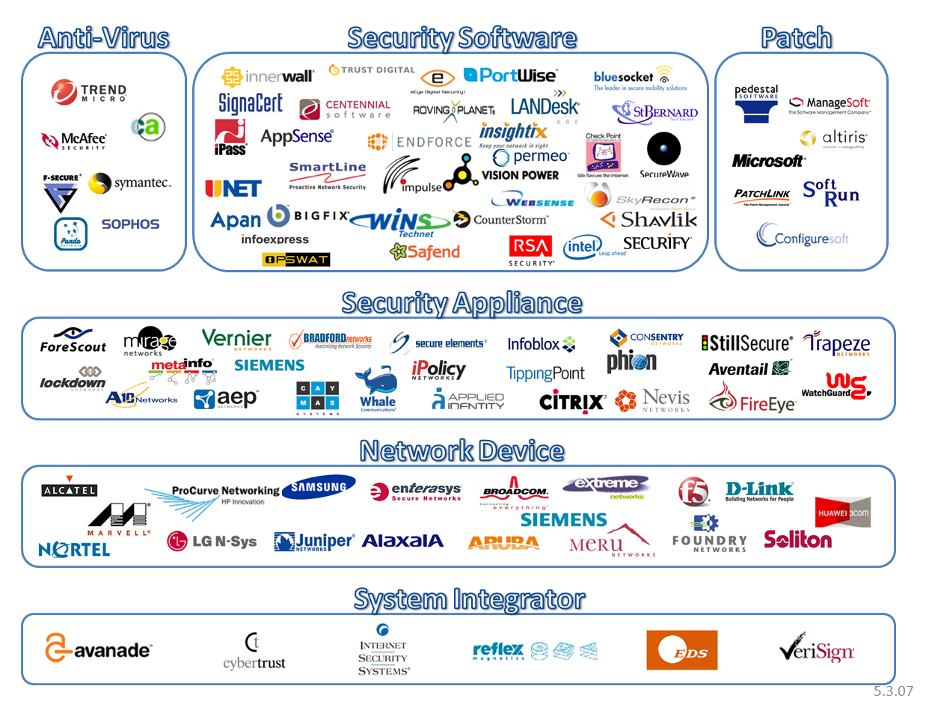
NAP Partners

Slide 26
NAP 802.1x Enforcement
demo
Lambert Green
Test Lead
Enterprise Networking Group

Slide 27
Call To Action
Leverage NAP into deployments
Value: Reduction of non-compliance related risks
Extend NAP to deliver value to the customer
On the client, switch and servers
Use EAPHost extensibility to build your supplicants, EAP Methods

Slide 28
Additional Resources
Web Resources
NAP Specs, whitepapers, step-by-step guides: http://www.microsoft.com/nap
NAP API: http://msdn2.microsoft.com/en-us/library/aa369705.aspx
NAP Blog: http://blogs.technet.com/nap
EAPHost API: http://msdn2.microsoft.com/en-us/library/aa363701.aspx
E-mail contacts
Asknap @ microsoft.com

Slide 29
© 2007 Microsoft Corporation. All rights reserved. Microsoft, Windows, Windows Vista and other product names are or may be registered trademarks and/or trademarks in the U.S. and/or other countries.
The information herein is for informational purposes only and represents the current view of Microsoft Corporation as of the date of this presentation. Because Microsoft must respond to changing market conditions, it should not be interpreted to be a commitment on the part of Microsoft, and Microsoft cannot guarantee the accuracy of any information provided after the date of this presentation. MICROSOFT MAKES NO WARRANTIES, EXPRESS, IMPLIED OR STATUTORY, AS TO THE INFORMATION IN THIS PRESENTATION.

