Slide 1
Compute Cluster Server And Networking
Sonia Pignorel
Program Manager
Windows Server HPC
Microsoft Corporation

Slide 2
Key Takeaways
Understand the business motivations for entering the HPC market
Understand the Windows Compute Cluster Server solution
Showcase your hardware’s advantages on the Windows Compute Cluster Server platform
Develop solutions to make it easier for customers to use your hardware
Notes:
6/5/2007 1:28 PM
© 2006 Microsoft Corporation. All rights reserved. Microsoft, Windows, Windows Vista and other product names are or may be registered trademarks and/or trademarks in the U.S. and/or other countries.
The information herein is for informational purposes only and represents the current view of Microsoft Corporation as of the date of this presentation. Because Microsoft must respond to changing market conditions, it should not be interpreted to be a commitment on the part of Microsoft, and Microsoft cannot guarantee the accuracy of any information provided after the date of this presentation.
MICROSOFT MAKES NO WARRANTIES, EXPRESS, IMPLIED OR STATUTORY, AS TO THE INFORMATION IN THIS PRESENTATION.
2

Slide 3
Agenda
Windows Compute Cluster Server V1
  Business motivations
  Customer case studies
  Product overview
Networking
  Top500
  Key challenges
  CCS V1 features
Networking roadmap
  Call to actions
Notes:
6/5/2007 1:28 PM
© 2006 Microsoft Corporation. All rights reserved. Microsoft, Windows, Windows Vista and other product names are or may be registered trademarks and/or trademarks in the U.S. and/or other countries.
The information herein is for informational purposes only and represents the current view of Microsoft Corporation as of the date of this presentation. Because Microsoft must respond to changing market conditions, it should not be interpreted to be a commitment on the part of Microsoft, and Microsoft cannot guarantee the accuracy of any information provided after the date of this presentation.
MICROSOFT MAKES NO WARRANTIES, EXPRESS, IMPLIED OR STATUTORY, AS TO THE INFORMATION IN THIS PRESENTATION.
3

Slide 4
Business Motivations
“High productivity computing”
Application complexity increases faster than clock speed so need for parallelization
Windows applications users need cluster-class computing
Make compute cluster ubiquitous and simple starting at the departmental level
Remove customer pain points for
  Implementing, managing and updating clusters
  Compatibility and integration with existing infrastructure
  Testing, troubleshooting and diagnostics
HPC market is growing. 50% cluster servers (source IDC 2006). Need for resources such as development tools, storage, interconnects, and graphics

Slide 5

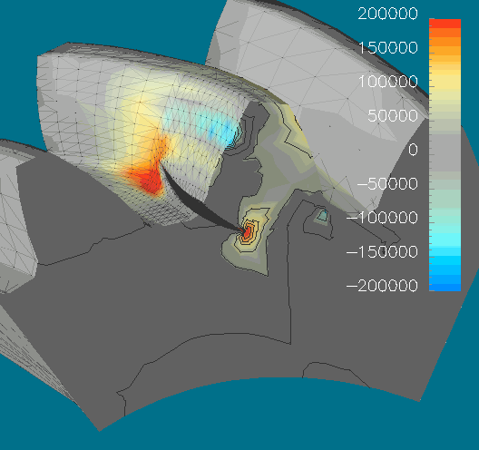
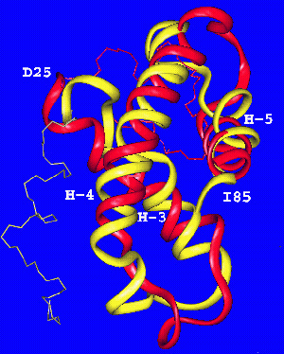
Clusters Used On Each Vertical
Finance
Oil and Gas
Digital Media
Engineering
Bioinformatics
Government/Research

Slide 6


































Partners

Slide 7
Agenda
Windows Compute Cluster Server V1
  Business motivations
  Customer case studies
  Product overview
Networking
  Top500
  Key challenges
  CCS V1 features
Networking roadmap
  Call to actions
Notes:
6/5/2007 1:28 PM
© 2006 Microsoft Corporation. All rights reserved. Microsoft, Windows, Windows Vista and other product names are or may be registered trademarks and/or trademarks in the U.S. and/or other countries.
The information herein is for informational purposes only and represents the current view of Microsoft Corporation as of the date of this presentation. Because Microsoft must respond to changing market conditions, it should not be interpreted to be a commitment on the part of Microsoft, and Microsoft cannot guarantee the accuracy of any information provided after the date of this presentation.
MICROSOFT MAKES NO WARRANTIES, EXPRESS, IMPLIED OR STATUTORY, AS TO THE INFORMATION IN THIS PRESENTATION.
7

Slide 8


Investment Banking
Windows Server 2003 simplifies development and operations of HPC cluster solutions
Challenge
  Investment banking driven by time-to-market requirements, which are driven by structured derivatives
  Computation speed translates into competitive advantage in the derivatives business
  Fast development and deployment of complex algorithms on different configurations
Results
  Enables flexible distribution of pricing and risk engine on client, server, and/or HPC cluster scale-out scenarios
  Developers can focus on .NET business logic without porting algorithms to specialized environments
  Eliminates separate customized operating systems
“By using Windows as a standard platform our business-IT can concentrate on the development of specific competitive advantages of their solutions.“
Andreas Kokott
Project Manager
Structured Derivatives Trading Platform
HVB Corporates & Markets

Slide 9

Oil And Gas
Microsoft HPC solution helps oil company increase the productivity of research staff
Challenge
  Wanted to simplify managing research center’s HPC clusters
  Sought to remove IT administrative burden from researchers
  Needed to reduce time for HPC jobs, increase research center’s output
Results
  Simplified IT management resulting in higher productivity
  More efficient use of IT resources
  Scalable foundation for future growth
“With Windows Compute Cluster Server, setup time has decreased from several hours—or even days for large clusters—to just a few minutes, regardless of cluster size.”
IT Manager, Petrobras CENPES Research Center
Notes:
9

Slide 10

Engineering
Aerospace firm speeds design, improves performance, lowers costs with clustered computing
Challenge
  Complex, lengthy design cycle with difficult collaboration and little knowledge reuse
  High costs due to expensive computing infrastructure
  Advanced IT skills required of engineers, slowing design
Results
  Reduced design cost through improved engineer productivity
  Reduced time to market
  Increased product performance
  Lower computing acquisition and maintenance costs
“Simplifying our fluid dynamics engineering platform will increase our ability to bring solutions to market and reduce risk and cost to both BAE Systems and its customers.”
Jamil Appa
Group Leader, Technology and Engineering Services
BAE Systems

Slide 11
Agenda
Windows Compute Cluster Server V1
  Business motivations
  Customer case studies
  Product overview
Networking
  Top500
  Key challenges
  CCS V1 features
Networking roadmap
  Call to actions
Notes:
6/5/2007 1:28 PM
© 2006 Microsoft Corporation. All rights reserved. Microsoft, Windows, Windows Vista and other product names are or may be registered trademarks and/or trademarks in the U.S. and/or other countries.
The information herein is for informational purposes only and represents the current view of Microsoft Corporation as of the date of this presentation. Because Microsoft must respond to changing market conditions, it should not be interpreted to be a commitment on the part of Microsoft, and Microsoft cannot guarantee the accuracy of any information provided after the date of this presentation.
MICROSOFT MAKES NO WARRANTIES, EXPRESS, IMPLIED OR STATUTORY, AS TO THE INFORMATION IN THIS PRESENTATION.
11

Slide 12



Microsoft Compute Cluster Server
Windows Compute Cluster Server 2003 brings together the power of commodity x64 (64-bit x86) computers, the ease of use and security of Active Directory service, and the Windows operating system
Version 1 released 08/2006

Slide 13
CCS Key Features
Easier node deployment and administration
  Task-based configuration for head and compute nodes
  UI and command line-based node management
  Monitoring with Performance Monitor (Perfmon), Microsoft Operations Manager (MOM), Server Performance Advisor (SPA), and 3rd-party tools
Extensible job scheduler
  Simple job management, similar to print queue management
  3rd-party extensibility at job submission and/or job assignment
  Submit jobs from command line, UI, or directly from applications
Integrated Development Environment
  OpenMP Support in Visual Studio, Standard Edition
  Parallel Debugger in Visual Studio, Professional Edition
  MPI Profiling tool

Slide 14




























How CCS Work
Head Node
Active Directory
Job Mgmt
Cluster Mgmt
Scheduling
Resource Mgmt
Jobs
Policy,
reports
User
Desktop App
Admin
Console
Input
Job Mgr UI
Admin
Tasks
Management
Cmd line
Cmd line
Domain\UserA
DB/FS
Data
High speed,
low latency
interconnect
Node Manager
Job Execution
User App
MPI
Notes:
14

Slide 15
Agenda
Windows Compute Cluster Server V1
  Business motivations
  Customer case studies
  Product overview
Networking
  Top500
  Key challenges
  Features
Networking roadmap
  Call to actions
Notes:
6/5/2007 1:28 PM
© 2006 Microsoft Corporation. All rights reserved. Microsoft, Windows, Windows Vista and other product names are or may be registered trademarks and/or trademarks in the U.S. and/or other countries.
The information herein is for informational purposes only and represents the current view of Microsoft Corporation as of the date of this presentation. Because Microsoft must respond to changing market conditions, it should not be interpreted to be a commitment on the part of Microsoft, and Microsoft cannot guarantee the accuracy of any information provided after the date of this presentation.
MICROSOFT MAKES NO WARRANTIES, EXPRESS, IMPLIED OR STATUTORY, AS TO THE INFORMATION IN THIS PRESENTATION.
15

Slide 16
Stretching CCS
Project
  Exercise driven by engineering team prior shipping CCS V1 (Spring 2006)
  Venue: National Center for Supercomputing Applications
Goals
  How big will Compute Cluster Server scale?
    Where are the bottlenecks in
        Networking
        Job scheduling
        Systems management
        Imaging
    Identify changes for future versions of CCS
    Document tips and tricks for big cluster deployment

Slide 17
Stretching CCS
Hardware
Servers
  896 Processors
    Dell PowerEdge 1855 blades
    Two single core Intel Irwindale 3.2 GHz EM64T CPUs
  Four GB memory
  73 GB SCSI local disk
Network
  Cisco IB HCA on each compute node
  Two Intel Pro1000 GigE ports on each compute node
  Cisco IB switches
  Force10 GbE switches

Slide 18
Stretching CCS
Software
Compute node
  CCE, CCP CTP4 (CCS released 08/06)
Head node
    Windows Server 2003 64-bit Enterprise Edition x64
    SQL Server 2005 Enterprise Edition x64
ADS/DHCP server
    Windows Server 2003 R2 Enterprise Edition x86 version
    ADS 1.1
DC/DNS server
    Windows Server 2003 R2 Enterprise Edition x64 version

Slide 19
Stretching CCS
Networking
InfiniBand
  Benchmarks traffic
  InfiniBand Cisco HCA
  OpenFabrics drivers
  Two layers of Cisco InfiniBand switches
Gigabit Ethernet
  Management + out of band traffic
  Intel Pro1000 GigE ports
  Two layers of GigE Force10 switches

Slide 20
Stretching CCS
Results
130/500 fastest computers in the world – 06/2006
  4.1 TFlops – 72% efficiency
Increased robustness of CCS
  Goals reached
    Identified bottlenecks at large scale
    Identify changes for future versions of CCS
      V1 SP1, V2, Hotfixes
    Document tips and tricks for big cluster deployment
      Large scale cluster best practices whitepaper
Strong partnerships
  NCSA, InfiniBand vendors
        Cisco, Mellanox, Voltaire, Qlogic
  Intel, Dell, Foundry Networks

Slide 22

Top500
More coming up

Slide 23
Agenda
Windows Compute Cluster Server V1
  Business motivations
  Customer case studies
  Product overview
Networking
  Top500
  Key challenges
  Features
Networking roadmap
  Call to actions
Notes:
6/5/2007 1:28 PM
© 2006 Microsoft Corporation. All rights reserved. Microsoft, Windows, Windows Vista and other product names are or may be registered trademarks and/or trademarks in the U.S. and/or other countries.
The information herein is for informational purposes only and represents the current view of Microsoft Corporation as of the date of this presentation. Because Microsoft must respond to changing market conditions, it should not be interpreted to be a commitment on the part of Microsoft, and Microsoft cannot guarantee the accuracy of any information provided after the date of this presentation.
MICROSOFT MAKES NO WARRANTIES, EXPRESS, IMPLIED OR STATUTORY, AS TO THE INFORMATION IN THIS PRESENTATION.
23

Slide 24
Key Networking Challenges
Each application has unique networking needs
  Networking technology often designed for micro-benchmarks less for applications
  Need to prototype your code to identify your application networking behavior and adjust your cluster
    Cluster resources usage and parallelism behavior
    Cluster architecture (e.g., single or dual proc), network hardware and parameters settings
Data movement over network takes server resources away from application computation
  Barriers for high speed still exist at network end-points
Managing network equipment is painful
  Network driver deployment and hardware parameter adjustments
  Troubleshooting for performance and stability issues

Slide 25
Agenda
Windows Compute Cluster Server V1
  Business motivations
  Customer case studies
  Product overview
Networking
  Top500
  Key challenges
  Features
Networking roadmap
  Call to actions
Notes:
6/5/2007 1:28 PM
© 2006 Microsoft Corporation. All rights reserved. Microsoft, Windows, Windows Vista and other product names are or may be registered trademarks and/or trademarks in the U.S. and/or other countries.
The information herein is for informational purposes only and represents the current view of Microsoft Corporation as of the date of this presentation. Because Microsoft must respond to changing market conditions, it should not be interpreted to be a commitment on the part of Microsoft, and Microsoft cannot guarantee the accuracy of any information provided after the date of this presentation.
MICROSOFT MAKES NO WARRANTIES, EXPRESS, IMPLIED OR STATUTORY, AS TO THE INFORMATION IN THIS PRESENTATION.
25

Slide 26
CCS Networking Architecture
Deploy
Data Storage
Mgmt
OOB
Computation
PXE
iSCSI
NFS
CiFS
.NET
IPMI
MSMPI
Socket
WinSock API
WinSock
WinSock Direct
IP
RDMA
TDI
WSD SPI
TCP/IP
WSD Provider
NDIS
Drivers
High-Speed HW
RDMA Capable High-Speed HW
User mode
Kernel mode

Slide 27

Networking Features Used By a Compute Cluster Server
MSMPI | CCP | Version of the Argonne National Labs Open Source MPI2 Microsoft Visual Studio® includes a parallel debugger End-to-end security over encrypted channels
Network Management | CCP | Auto configuration for five network topologies
Winsock API | CCE | Inter-process communications with socket
Winsock Direct | CCE | Takes advantage of RDMA hardware capabilities to implement socket protocol over RDMA Remove context transition from app to kernel Bypass TCP Zero memory copy Solve the header/data split to enable application level zero copy Bypass the intermediary receive data copy to the kernel
TCP Chimney Offload | CCE | Manages the hardware doing the TCP offload Offload TCP transport protocol processing Zero memory copy

Slide 28
Microsoft Message Passing Interface (MSMPI)
Version of Argonne National Labs Open Source MPI2 implementation
  Compatible with MPICH2 Reference Implementation
  Existing applications should be compatible with Microsoft MPI
Can use low-latency, high-bandwidth interconnects
MS MPI is integrated with job scheduler
  Helps improve user security

Slide 29




MSMPI Security Architecture
Job runs on compute cluster with user credentials
  Uses Active Directory for a single sign on to all nodes
  Provides proper access to data from all nodes
  Maintains security
Public Network
Job submitted by user tied to
Active Directory credentials
Client
Head node
Private Network
Compute node
Compute nodes access data
under credentials of Job owner
Data

Slide 30
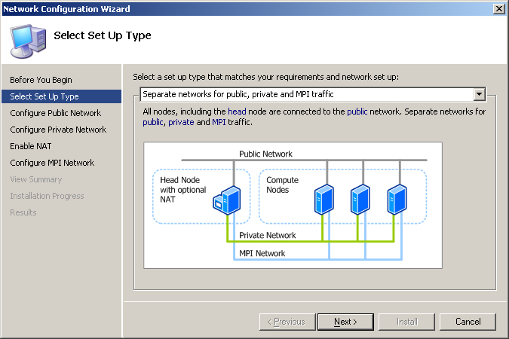

Slide 31
Network Types
Public network | Usually current business/organizational network Most users log onto this to perform work Carries management and deployment traffic, if no private or MPI network exists
Private network | Dedicated for intra-cluster communication Carries management and deployment traffic Carries MPI traffic, if no MPI network exists
MPI network | Dedicated network Preferable high bandwidth, low latency Carries parallel MPI app communication between cluster nodes

Slide 32
Winsock Direct and
TCP Chimney
CCS v1 | Usage | Interconnect
 |  | InfiniBand | GbE, 10GbE | iWARP GbE, 10GbE
Winsock Direct (Socket over RDMA) | Low-latency High bandwidth Bypass TCP | Yes | Yes | Yes
TCP Chimney | High bandwidth Use of TCP | N/A* | Yes | N/A**
* InfiniBand doesn’t use TCP for transport
** iWARP offload networking into hardware, no need for TCP Chimney

Slide 33



CCS Networking Roadmap
2008+
Future version based on
Windows Server codenamed “Longhorn”
Networking Mission: Scale
Beta in the Fall
MSMPI improvements
  Low-latency, better tracing, multi-thread
Network management
  Driver and hardware settings configuration, deployment and tuning from new UI
  ‘Toolbox’ of scripts and tips
2006
CCS v1 networking based on Windows Server 2003
MSMPI and Winsock API
Both using Winsock Direct to take advantage of RDMA hardware mechanisms
Notes:
33

Slide 34
Networking References
Whitepaper
  Performance Tuning White Paper released
  http://www.microsoft.com/downloads/details.aspx?FamilyID=40cd8152-f89d-4abf-ab1c-a467e180cce4&DisplayLang=en
Winsock Direct QFE from Windows 2003 Networking
  Only install the latest. QFEs are cumulative, latest QFE supersedes the others
  Latest as of 05/15/07: latest QFE is 924286
CCS v1 SP1 released
  Contains fixes of latest QFE 924286

Slide 35
Call To Action
Make 64-bit drivers for your hardware and complete WHQL certification for CCS v1
Make Windows Server Longhorn drivers for your hardware for CCS v2
Focus on easy to deploy, easy to manage networking hardware that integrates with CCS v2 network management
Benchmark your hardware with
real applications

Slide 36
Dynamic Hardware Partitioning
And Server Device Drivers
Server-qualified Drivers must meet Logo Requirements related to
  Hot Add CPU
  Resource Rebalance
  Hot Replace “Quiescence/Pseudo S4“
Reasons
  Dynamic Hardware Partition-capable (DHP) systems will become more common
  Customer may add arbitrary devices to those systems
  This is functionality all drivers should have in any case
Server-qualified Drivers must pass these Logo Tests
  DHP Tests
    Hot Add CPU
    Hot Add RAM
    Hot Replace CPU
    Hot Replace RAM
  Must test with Windows Server Longhorn “Datacenter”, not Windows Vista
  4 Core, 1GB system required
  Simulator provided, an actual partitionable system not required

Slide 37
Links
Compute Cluster Server Case studies
  http://www.microsoft.com/casestudies/
  Search with keyword HPC
Top500 list
  http://www.top500.org/lists/2006/06
Microsoft HPC web site (evaluation copies available)
  http://www.microsoft.com/hpc/
Microsoft Windows Compute Cluster Server 2003 community site
  http://www.windowshpc.net/
Windows Server x64 information
  http://www.microsoft.com/64bit/
  http://www.microsoft.com/x64/
Windows Server System information
  http://www.microsoft.com/wss/

Slide 38

© 2007 Microsoft Corporation. All rights reserved. Microsoft, Windows, Windows Vista and other product names are or may be registered trademarks and/or trademarks in the U.S. and/or other countries.
The information herein is for informational purposes only and represents the current view of Microsoft Corporation as of the date of this presentation. Because Microsoft must respond to changing market conditions, it should not be interpreted to be a commitment on the part of Microsoft, and Microsoft cannot guarantee the accuracy of any information provided after the date of this presentation.
MICROSOFT MAKES NO WARRANTIES, EXPRESS, IMPLIED OR STATUTORY, AS TO THE INFORMATION IN THIS PRESENTATION.

