Slide 1
Enterprise Networking Technologies
Sandeep Singhal, Ph.D
Director
Windows Core Networking
Microsoft Corporation

Slide 2
Agenda
Market Forces
Technical Challenges
Scalable Networking Goals
Scalable Networking Solutions
Scalable Networking Roadmap
Summary
Call to Action

Slide 3
Market Forces
Exponential growth of digital content
  Larger data payloads
  Mandated data retention policies
Security and privacy
  Increasing remote access needs for
  mobile workforce
  Site-to-site encryption for corporate extranets
  Increased load on Internet firewalls
  Mandated data exchange policies
  (e.g., HIPAA)

Slide 4
Market Forces
Fabric convergence
  Single networking fabric for web, file, database, and backup
Multiple CPU cores
  Better utilization of CPU resources
Virtualization
  More complex traffic loads on
  networking hardware

Slide 5
Technical Challenges
Physical network speeds outpacing CPU speeds
Receive processing limited to a single CPU core on multi-processor/multi-core systems
  Inbound connections not scaled across available processor cores
CPU overhead when moving data between network, system, and application buffers
  Data movement bottlenecks increase as network and protocol processing speeds increase

Slide 6
Scalable Networking Goals
Boost Windows Server 2008 scalability on 1Gb and 10Gb Ethernet
Increase application performance
Reduce protocol processing CPU utilization
Offer full range of price-performance solutions
Leverage existing Ethernet investments
Maintain application compatibility
Retain management tools and practices
Maintain security and reliability

Slide 7

Windows Server 2008 Scalable Networking Technologies

Slide 8
Windows Server 2008 Scalable Networking Scenarios
Environments
  Enterprises, data centers, high-performance clustering
Full-range of solutions for
  Web serving and file storage
  Security and Network Access Protection (NAP)
  Virtual private networks (VPN)
  Enterprise resource planning (ERP)
  High-performance computing (HPC)
  Databases
  Data backup and retention

Slide 9
Key Scenarios
Scenarios | Anticipated Benefits
 | Stateless |  |  |  |  | Stateful
 | NetDMA | LSOv2 | IPsec Task Offload v2 | RSS | WSD | TCP Chimney | IPsec Chimney
Storage |  | X |  | X |  | X
Backup | X | X |  | X |  | X
Web |  |  |  | X |  | X
Security |  |  | X |  |  |  | X
NAP |  |  | X |  |  |  | X
VPNs |  |  | X
ERP | X | X |  | X |  | X
Compute Clusters |  |  |  |  | X | X
Databases |  |  |  |  | X

Slide 10
TCP Chimney Offload
Overview
  TCP/IP protocol processing is intelligently offloaded to hardware after 3-way TCP handshake is established
Networking challenges solved
  Reduces CPU utilization and number of interrupts
  Reduces data movement bottleneck
    Zero copy solution for pre-posted buffers
Key scenarios
  Long-lived connections
    File and block storage, backup, media streaming, web

Slide 11
Chimney Architecture
Application
Application: Existing binaries
run over either software stack
or hardware
Logical Switch: Controls whether data transfer is through the host stack or the offload target stack
Chimney: Data only enters/exits from the top and bottom of
the chimney
Top Protocol: The top layer of the protocol stack which is offloaded
Intermediate Protocol: One or more protocols under the Top Protocol; chimneys are “stackable”
Stateful, cross-request offload
Logical Switch
Top Protocol
State
Updates
Data
Transfer
Intermediate
Protocol(s)
NDIS
NDIS Miniport
NIC hardware

Slide 12
TCP Chimney Offload
Realistic Web Server (IIS) Scenario
Windows Server 2008 x64, single CPU
Broadcom BCM 57710 10GbE single-chip C-NIC Ethernet controller supporting Microsoft TCP Chimney
Broadcom BCM 56800 10GbE switch
200 virtual clients (20 machines)
50% reduction in CPU utilization and
maximum network throughput!
 | Network Utilization | CPU Utilization | Notes
Non-Chimney | 75% | 90% | Network throughput fluctuating between 6Gb and 9Gb
Chimney | 98% | 45% | Network throughput stabilized with significantly lower CPU utilization

Slide 13
TCP Chimney Offload
Realistic Web Server (IIS) Scenario
Support >2x clients with TCP Chimney running realistic traffic patterns

Slide 14

Scalable TCP Chimney Enables Convergence Over Ethernet
Sockets Applications
TCP-based socket applications, iSCSI,
iSCSI boot, iWARP (RDMA)
Secure (network-based security), robust, and standards-compliant implementation
Ethernet functionality
  VLAN, WoL, power management
  Integrated
  Management
Windows Sockets
Storage
Applications
Windows Socket Switch
RDMA Provider
User
Mode
File System
Kernel
Mode
TCP/IP
Partition
Class Driver
iSCSI
Port Driver
NDIS
NDIS IM
Driver
.
iSCSI
Miniport
RDMA
Driver
NDIS
Miniport
C-NIC
HBA
NIC
RNIC

Slide 15
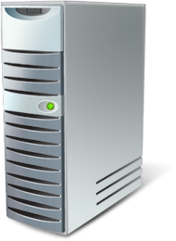
Broadcom’s C-NIC 10Gb/sec
NTTCP over 10Gb/sec TCP Chimney
C-NIC Perfmon
NTTTCPs
BCM57710
BCM57710
S2 (TX/RX)
Broadcom 10Gb Switch
BCM56800 StrataXGS III
S1 (TX/RX)
3.0GHz Intel 2 dual core
Xeon CPU
8 GB RAM
Windows Server 2003
SP2-SNP
BCM57710 NIC
3.0GHz Intel 2 dual core
Xeon CPU
8 GB RAM
Windows Server 2003
SP2-SNP
BCM57710 NIC

Slide 16
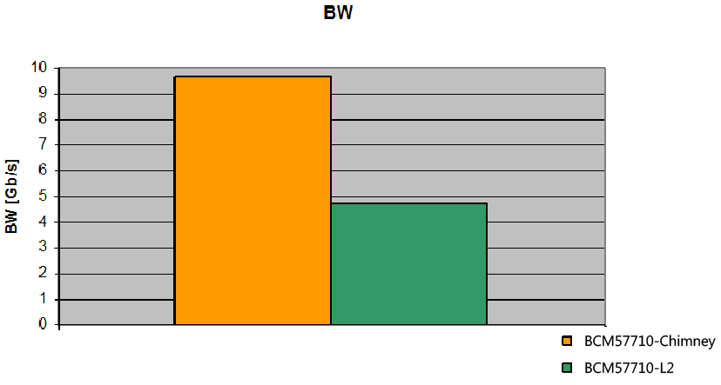
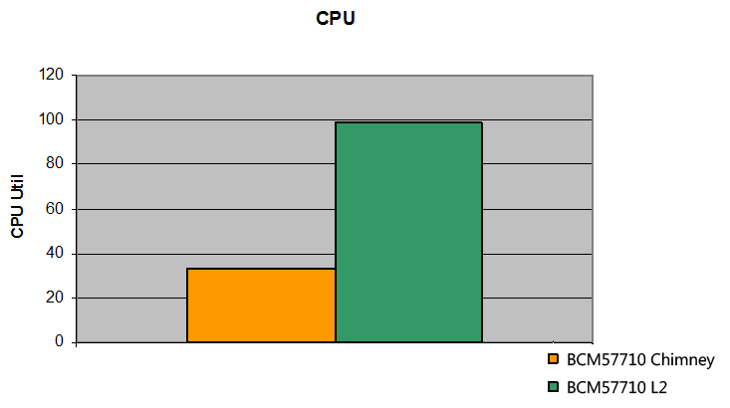

TCP Chimney Scales…
NTTTCP benchmark
Chimney
L2
Chimney
L2
BW improvement
TCP Chimney versus L2
CPU Utilization reduction
TCP Chimney versus L2
TCP Chimney provides 10Gb BW even for small I/O
TCP Chimney consumes significantly less CPU cycles
TCP Chimney demonstrates up to 6x better P/E

Slide 17
Large Send Offload
(LSO) v2
New in Windows Server 2008
Overview
  Stack supports sending buffer up to 256KB
  NIC segments TCP/IP packets larger than MTU during send operation
  Supports IPv4/IPv6
Networking challenges solved
  Reduces CPU utilization
Key scenarios
  Large I/O applications: Storage, backup, and ERP

Slide 18
NetDMA
Overview
  Operating system support for DMA engines that can do NIC to application memory copies of incoming packets
Networking challenges solved
  Reduces data movement bottleneck
    TCP/IP utilizes NetDMA to relieve the CPUs from copying received data into application buffers
Deployment scenarios
  Applications that use I/O larger than 256 bytes and
  pre-post buffers (e.g., backup)

Slide 19
IPsec Task Offload v2
New in Windows Server 2008
Overview
  NIC performs IPsec authentication and encryption
  IPsec Task Offload v2 supports
    Transport and tunnel mode
    IPv4/IPv6
    AH and ESP: AES-GCM, SHA-256, 3DES, SHA-1
Challenges solved
  Reduces CPU overhead for IPsec processing
Deployment scenarios
  Server and Domain Isolation, VPN

Slide 20
Winsock Direct (WSD) / Sockets Direct Protocol (SDP)
Overview
  WSD/SDP enable Remote Direct Memory Access (RDMA) fabrics
  Supports low latency/high throughput interconnects
  Binary compatibility for Winsock applications
  SDP interoperability standard maintained by Open Fabrics Alliance
Networking challenges solved
  Reduces CPU utilization and number of interrupts
  Reduces data movement bottleneck by eliminating buffer copies
  Provides kernel bypass capability
Deployment scenarios
  Small IOs with low latency requirements such as
  clustered computing and clustered databases

Slide 21
Receive-Side Scaling (RSS)
Overview
  Distributes incoming packet processing load across available CPU/cores
Networking challenges solved
  Without RSS, incoming packets processed by single CPU/core regardless of available processors
Key scenarios
  Large number of short-lived connections (e.g., web workloads, databases)

Slide 22
Receive-Side Scaling
Default NIC
Receive-Side Scaling NIC
NDIS
NDIS
NDIS
NDIS
NIC hashes incoming TCP segments to different processor cores
  Preserves in-order delivery for each TCP flow
Enables a variety of implementations
  Parallel interrupts, parallel DPCs,
  multiple hardware queues

Slide 23
Receive-Side Scaling Results
Server
  Windows Server 2008 x64, 4GB RAM
  Intel 10GigE RSS NIC with MSI-X
Clients: 8 x 1Proc running WebCat 6.1
Greater than 200% transactions/sec!
Less than 50% cycles/transaction!
 | RSS Off | RSS On
Transactions/sec | 142,000 | 302,000
Cycles/Transaction | 54,000 | 24,000
4 CPUs total % | 80% | 77%

Slide 24
Header-Data Split
New in Windows Server 2008
Overview
  Miniport intelligently separates header portion of packets and data payload into multiple memory descriptor lists
  Protocol stack processes headers; application interested in data (payload)
Challenges solved
  Increases TCP/IP processing performance due to
  cache locality
Deployment scenarios
  Server and Domain Isolation, VPN

Slide 25
Future
IPsec Chimney Offload
Planned directions
  IPsec crypto and auth processing is offloaded to hardware
  Plugs in under TCP Chimney
Networking challenges solved
  Reduces CPU utilization
    Crypto processing is CPU intensive
    Reduces interrupt count
  Reduces data movement bottleneck
    Zero copy solution for pre-posted buffers
Deployment scenarios
  All TCP Chimney scenarios that use IPsec
  Server and Domain Isolation

Slide 26
IPsec Offload Architecture
IPsec Task Offload
IPsec Chimney Offload
IKE
Setup
Application
Data
TCP
IP
IPsec
Conn.
State
Data
SA
SA
NDIS6
NIC

Slide 27

Hardware Offload Roadmap
Post Windows Server 2008
IPsec Chimney, …
Windows Server 2008
IPsec v2, Header-Data Split
Windows Vista
LSOv2
Scalable Networking Pack for Windows Server 2003
TCP Chimney Offload, RSS, NetDMA
Notes:
27

Slide 28
Summary
Windows Server 2008 and 10Gb TOE provide
high-performance and reduce CPU load
Windows Server 2008 and Receive-Side Scaling deliver significant throughput gains for intense workloads on multi-core CPUs
New offloads in Windows Server 2008
  LSOv2
  IPsec Task Offload v2
  Header-Data Split
Combine Windows Server 2008 network offload features for the most effective solution

Slide 29
Call To Action
OEM
  Consider usage scenarios when recommending NICs for your products
  Ensure all networking drivers (NDIS, LWF, WFP drivers) support offload features
IHV
  Implement offload features in your hardware
  Create NDIS6 drivers for all
  Windows Server 2008 NICs
  Engage with Microsoft on future
  offload technologies

Slide 30
Additional Resources
Web Resources:
  http://www.microsoft.com/windows/server/
  http://www.microsoft.com/snp

Slide 31

© 2007 Microsoft Corporation. All rights reserved. Microsoft, Windows, Windows Vista and other product names are or may be registered trademarks and/or trademarks in the U.S. and/or other countries.
The information herein is for informational purposes only and represents the current view of Microsoft Corporation as of the date of this presentation. Because Microsoft must respond to changing market conditions, it should not be interpreted to be a commitment on the part of Microsoft, and Microsoft cannot guarantee the accuracy of any information provided after the date of this presentation.
MICROSOFT MAKES NO WARRANTIES, EXPRESS, IMPLIED OR STATUTORY, AS TO THE INFORMATION IN THIS PRESENTATION.

