Slide 1
Application And Presentation Virtualization
Alex Balcanquall
Product Manager
Microsoft Corporation

Slide 2
Key Takeaways
Understand why Terminal Services (TS) is Presentation Virtualization
Discover new Windows Server “Longhorn”
TS features
Learn about Application Virtualization
Reinforce Presentation Virtualization and Application Virtualization are complimentary

Slide 3
Agenda
Microsoft Virtualization Platform
Presentation Virtualization
  What’s new in Terminal Services in Windows Server “Longhorn”
  Demo
Application Virtualization
  What is SoftGrid Application Virtualization
  Demo
Better together: Presentation and Application Virtualization

Slide 4
What Is Virtualization?
Microsoft’s
Virtualization Solution
Without Virtualization
With Virtualization
Interface bound to process
Virtual Presentation
Presentation layer separate from process
Infrastructure
Applications installed to
Specific hardware and OS
Virtual Applications
Any application on any computer on-demand
Management
Operating System assigned
to specific hardware
Virtual Machine
OS can be assigned to any desktop or server
Licensing
Storage assigned to specific
locations
Virtual Storage
Storage and backup over the network
Interoperability
Network assigned to specific
locations
Virtual Network
Localizing dispersed resources
Support

Slide 5
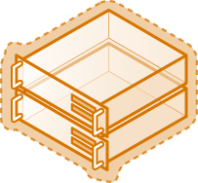

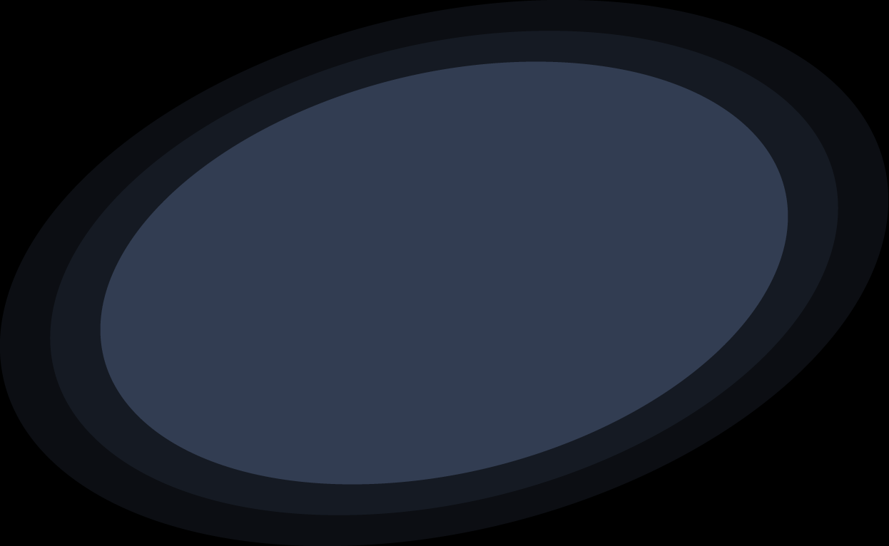
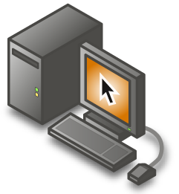
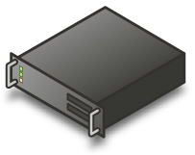

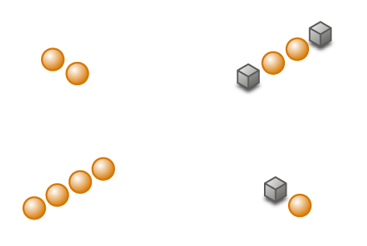



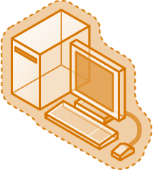
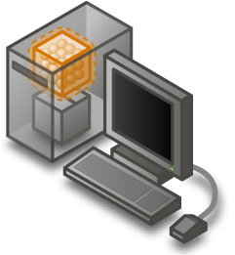


Microsoft Virtualization Products
A comprehensive set of virtualization products, from the data center to the desktop
Assets – both virtual and physical – are managed from a single platform
Server Virtualization
Presentation Virtualization
Management
Application Virtualization
Desktop Virtualization

Slide 6
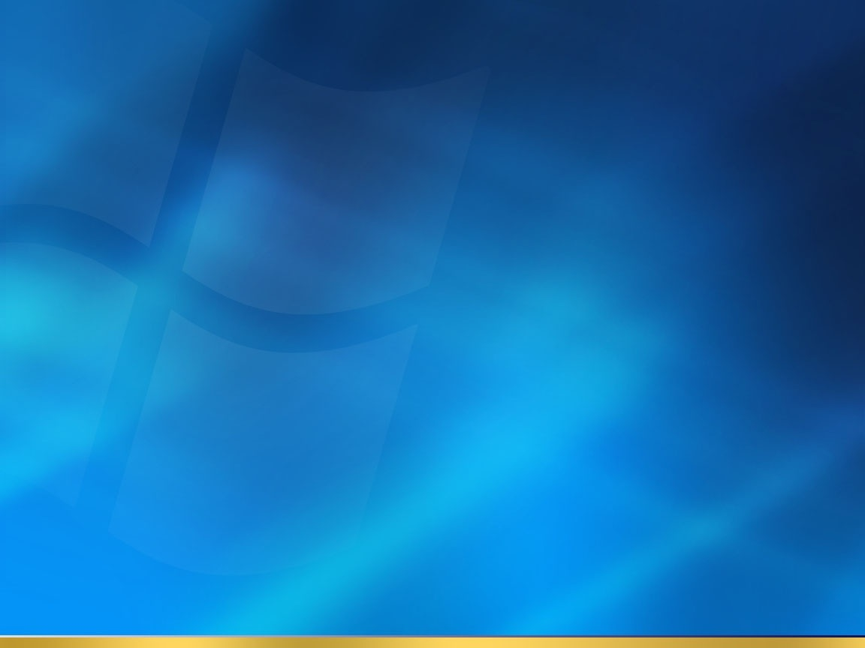

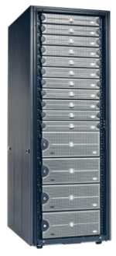
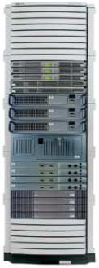
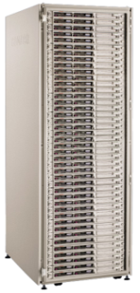
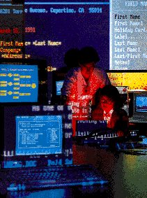

Presentation Virtualization:
Enabling Centralized Application Access
Remote Access
”I need to provide remote access to my users for certain applications”
Security and Control
“I don’t want data on my PCs or Laptops”
Branch Offices
“My branch IT costs are out of control I want to consolidate in the data center”
Single Desktop Image - Application Deployment
”I am moving to a single image, is there and easier way to deploy specific apps to specific users?”
Structured Task Worker
”These workers only access two or three applications day in and day out, how can make them more productive and keep costs down?”
Central Location
Mobile Worker
In Airport
Branch Office
Home Office

Slide 7
Presentation Virtualization
Isn’t this just Terminal Services?
Virtualization is decoupling of
system components
Terminal Services decouples application presentation from application execution

Slide 8

Terminal Services In Windows Server codename “Longhorn”
Two key areas of focus in the TS Windows Server codenamed “Longhorn platform
Improving the platform and enabling partner value add
Improve out of the box experience for lower complexity scenarios
Platform
Scenarios
Re-factored TS core
Expanded WMI interfaces
Improved event logging
PnP Device
Redirection Framework
TS Remote Programs
TS Gateway
TS Web Access
Single Sign-On

Slide 9
TS Remote Programs
Remote Programs
Run on terminal server
UI integrated locally
  Access to local devices
  via redirection
  System tray integration (e.g., Messenger, Outlook)
  Improved cut and paste
Side by side with
local applications
Benefits:
Reduces user confusion
Better integration with Windows client
Central management of Line of Business apps
Zero footprint delivery of applications

Slide 10
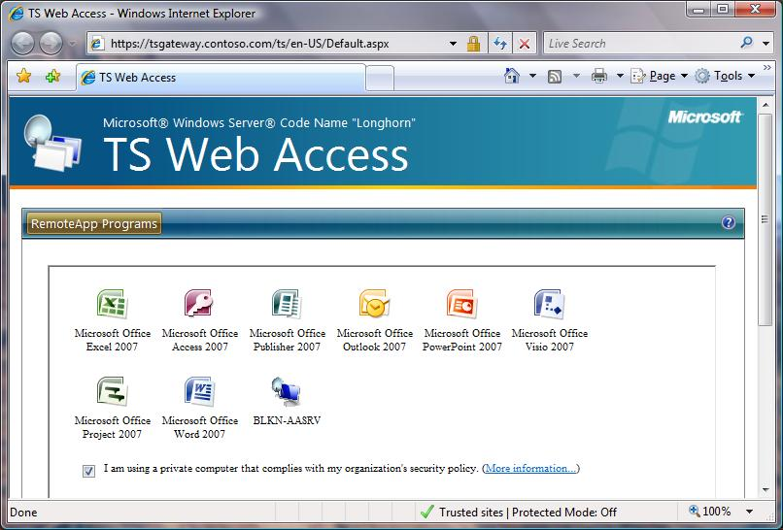
TS Web Access
Provide a simple solution and Infrastructure
Solution
  Provides simple web interface for launching applications
    TS Gateway Provides the HTTPS
    transport NOT Web Access
  Ideal for low complexity
  scenarios
Infrastructure Elements
  Web Part
  ActiveX Control
  Code Samples

Slide 11
TS Gateway
Allows access to
  Terminal Server Remote Desktops and Programs
  Client and Server Remote Desktop
Allows secure seamless connection without VPN
  Tunnels RDP over HTTPS
  Place TS behind multiple firewalls without opening multiple firewall ports other than 443
When should TS Gateway be used in place of VPN?
  When no local copy of data is required
  When a quicker connection time is required

Slide 12

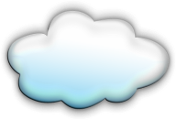

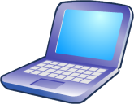
Terminal Services Gateway
Remote Access to internal applications resources
Internet
DMZ
Corp LAN
Passes RDP/SSL traffic to TS
Terminal
Server
Tunnels RDP over RPC/HTTPS
Internal Firewall
External Firewall
Strips off RPC/HTTPS
Home
Terminal
Server
Internet
HTTPS / 443
Hotel
Terminal Services Gateway Server
Other RDP
Hosts
Network
Policy
Server
Hot Spot
Business Partner/
Client Site
Active Directory
Notes:
12

Slide 13
What Else Is New In LH TS?
Experience
Security
Manageability
Platform
Resolution up to 4096x2048 and span multiple monitors
PnP Device Redirection Framework
32-bit Color and new RDP compression
Display Data Prioritization
NAP Integration
Single Sign-on for domain joined clients
Ability to block pre RDP6 client
Per session and direct attached device isolation
Display Data Prioritization
Spooler scalability improvements
Full IPv6 Support
Single Unified Win32 & Active X Client – serviced via Windows Update
Investments in Windows and TS to eliminate potential attack vectors
Faster Login and Logoff
Profile corruption scenarios addressed
Leverage UAP (LUA) for improved application compatibility

Slide 14
Benefits Of x64 Architecture
Can act like an x86 processor when an x64 system is booted into a 32-bit operating system and as such runs all 32-bit versions of Windows commercially available today
Runs 32-bit software without being recompiled
Runs 32-bit apps at high performance
  4 GB User VA for Large Memory Aware Processes
Eases Migration to 64-bit infrastructure
X64 ideal for current deployments that are kernel VA limited
x64 provides opportunities to increase user density with new
multi-core processors
Features Not Supported in x64
32-Bit Device Drivers
Printer Drivers
Software Kernel Driver Components
Subsystems
NTVDM / Command.com (DOS)
CMD processor still present
16-bit WOW
Legacy Transport Protocols
Apple Talk, Services for Macintosh
DLC LAN, NetBEUI
IrDA, OSPF
Hardware Specific Drivers
Dongles
POSIX

Slide 15
Why Is x64 So Important for TS?
X86 and x64 TS User Capacity Scaling
Up to 4x improvement with comparable hardware
Expected sweet spot for TS moves to 4 cores or more
If driver compatibility is an issue consolidate onto Windows Server 2003 x86
SP1 with 2 to 4 cores
x64 needs more resources for same workload set
Performance is entirely dependent on scenario
Whitepaper @ http://www.microsoft.com/ts
~ x6
~ x4
~ x2
2000 x86
4 cores
2003 x86
4 cores
2003 x64
4cores
2003 x64
8 cores
Windows Server 2000 32 Bit Baseline
Knowledge Worker
Based on Initial Internal Testing
x86 and x64 Performance Tip:
Registry Setting to Reduce Microsoft® Outlook® 2003 Periodic Polling
HKEY_CURRENT_USER\Software\Microsoft\Office\11.0\Outlook\RPC
[dword] ConnManagerPoll = 0x600

Slide 16

Presentation Virtualization In “Longhorn”
demo
Alex Balcanquall
Product Manager
Terminal Services

Slide 17


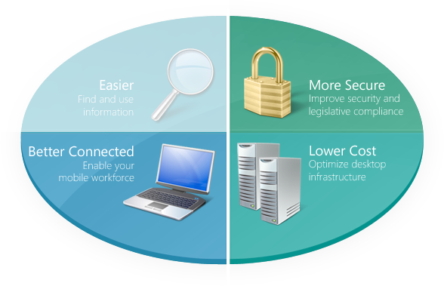
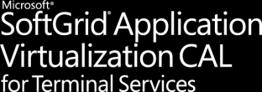
Microsoft SoftGrid Application Virtualization*
Turning Windows Applications into a
Centrally-Managed Dynamic Service
Life without traditional software installation
Runs on local desktop
Consolidate and standardize images
Build business continuity for applications
Applications can be taken offline
Applications to users
at log on
Centralized permissions
Sandboxed applications
Runs on Terminal Server*
Enable Server Consolidation
Mitigate Roaming Profile Issues
Transform TS into a dynamic system
Designed for low bandwidth
*SoftGrid Application Virtualization CAL for Terminal Services is available and sold separately from MDOP

Slide 18
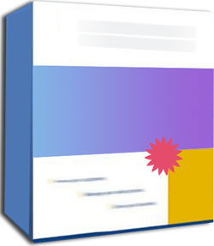
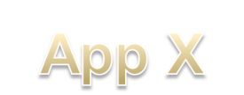

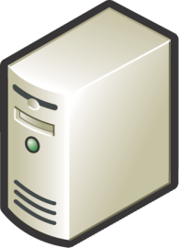
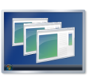
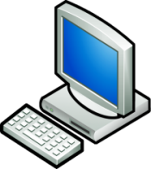

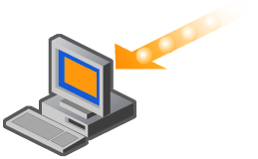


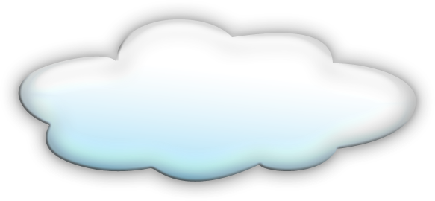


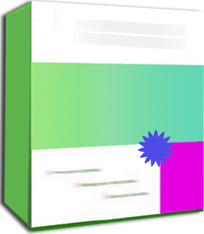

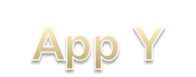
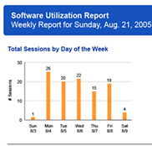
SoftGrid Overview
Application Virtualization
Standard Format (.SFT)
Streaming delivery
Connected and Disconnected support
Identity/policy-based centralized mgmt
Tracking and
Monitoring
Terminal Servers and Desktop PC’s

Slide 19

Reduce Application Management Costs
SoftGrid reduces and eliminates many common application management steps and optimizes computing resources, dramatically reducing labor and capital costs
Reduce management costs
by 80%
Deployments, updates
and termination
Reduce help desk call by
up to 30%
Improve user uptime by 4X
Consolidate terminal servers
up to 40%
Reduce license compliance risks
Microsoft SoftGrid has developed a Forrester TEI™ Compliant calculator to help you determine how SoftGrid can save application management costs
Case Study: Scotland’s Dundee City Council saved $290,000 (155,000 UK pounds) on IT support, replacement, server consolidation and license agreements

Slide 20
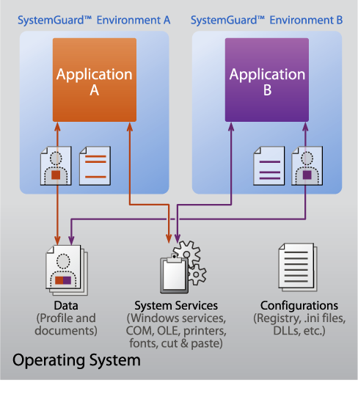
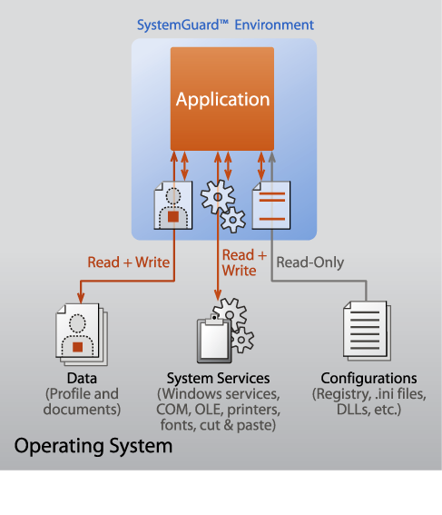
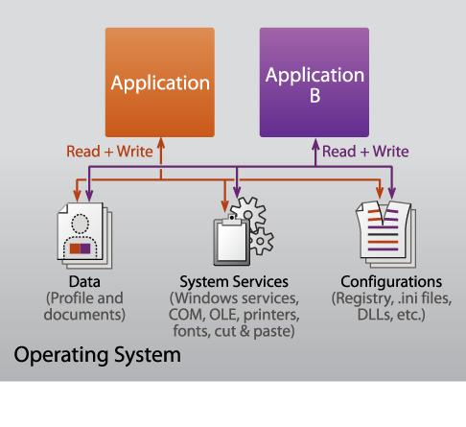
Improve Application Compatibility
Strong Isolation with Controlled OS Interaction
Applications are virtualized
per instance:
  Files (incl System Files)
  Registry, Fonts, .ini
  COM / DCOM objects
  Services, Name Space, Semaphores and Mutexes
Applications do not get installed or alter the operating system
Yet tasks process locally on the host computer (desktop or terminal server)
Case Study: The Medical Center at University of Illinois cut 100 hours of regression testing that was previously required to roll out new applications

Slide 21
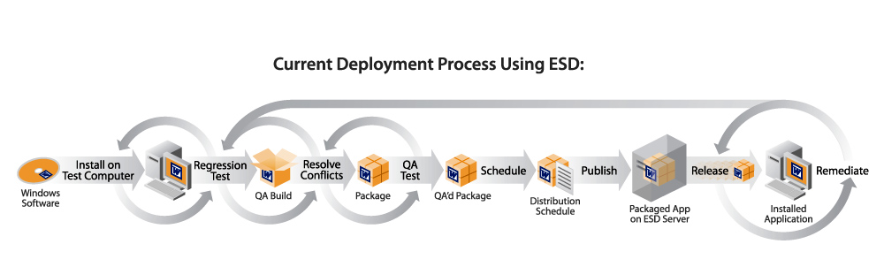
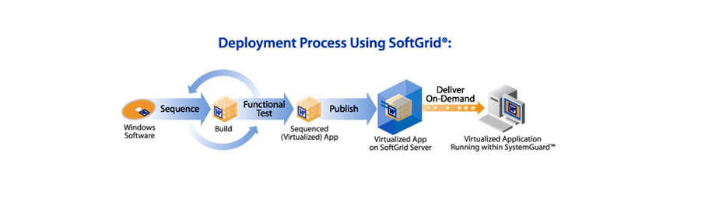
Reduce Time To Solution, Increase Agility, And Reduce Cost
Eliminate installations and dramatically reduce compatibility testing
Updates are now one file change on a server
De-installs are one change to the management console
Case Study: Sanofi-Aventis accelerated application deployments and updates from 2 weeks to 3 hours

Slide 22
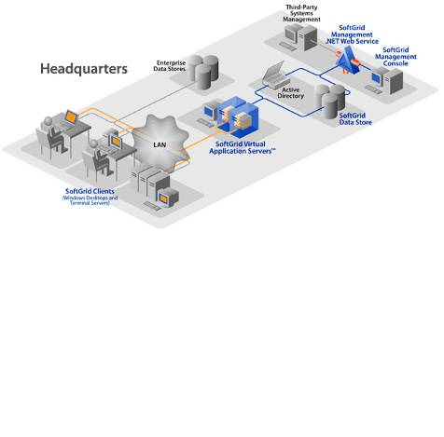
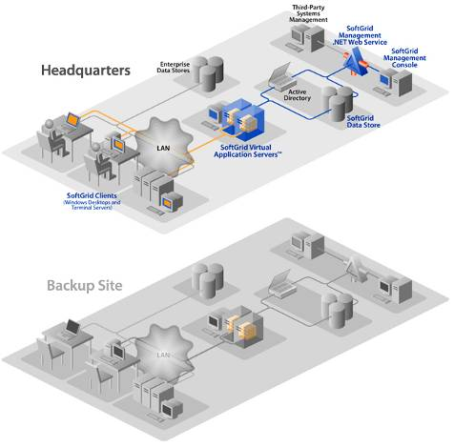
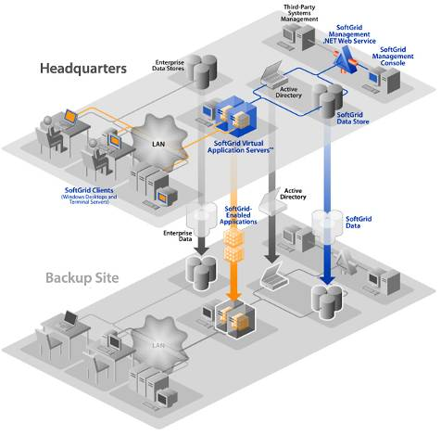
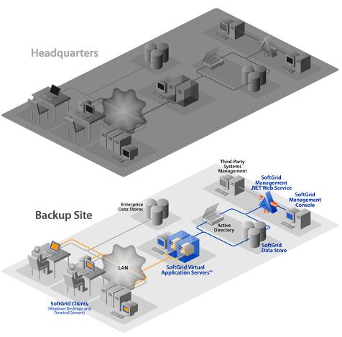
Build Business Continuity For Applications
Applications can be replicated like other data, reducing the costs of synchronizing applications and user down time
Applications are automatically replicated: Desktops and terminal server are updated without installation
User down time is reduced to minutes instead of hours/days
Case Study
A Major Investment Company enabled applications to be available to their users at their backup site in minutes.

Slide 23
Reduce Help Desk Calls
SoftGrid reduces Help Desk calls by over 30%
Resolve problems centrally
Reduce likelihood of problems in the first place
Problem resolution is application-centric, not system-wide
Case Study
Heartland Financial used to spend 2 hours on the phone with a single user. With SoftGrid it takes less than 10 minutes to solve a user’s problem
Source: 2003 Intel IT Avg. Quarterly
Spending on desktop PC support

Slide 24
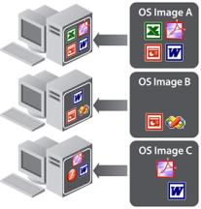
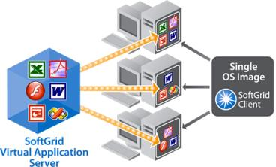

Consolidate, Standardize and Stabilize Desktop Images
Reduce the size and complexity of images
Move closer to the goal of a “single image” for the entire enterprise
Repurpose systems without constant re-imaging
Case Study: Fidelity National Financial reduced 13 virtual images into one with SoftGrid
Before SoftGrid
With SoftGrid

Slide 25
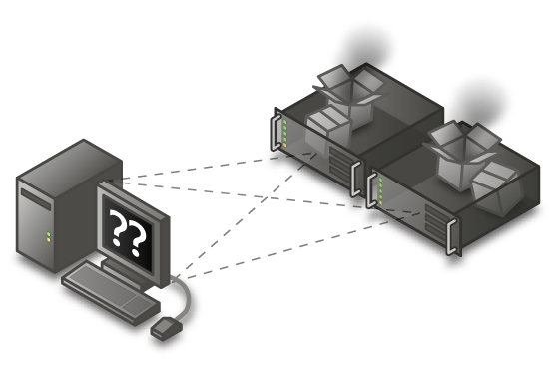
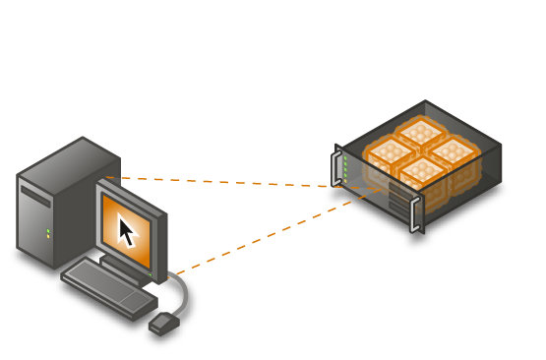
Consolidate Terminal Servers
Application compatibility issues
  Often require separate servers for separate applications
  Causes underutilized servers and spare capacity
SoftGrid for TS
  Enables applications to run
  side-by-side
  Reduce server silos
  Eliminate unused capacity
Case Study
Russell Investments reduced
their terminal servers by 40% with SoftGrid

Slide 26
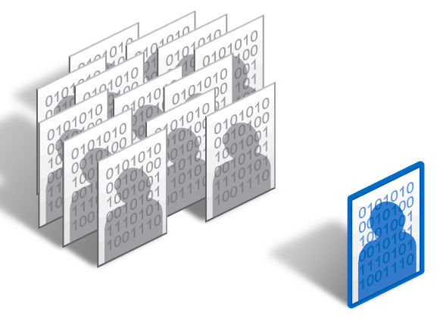
Mitigate TS User Profile Issues
SoftGrid “extracts”
application preferences
from Windows profiles
Allows preferences to persist on the network
Reduces or eliminates
profile corruption
Change from per profile to per application settings
Makes roaming profiles effective –
only operating system settings roam

Slide 27
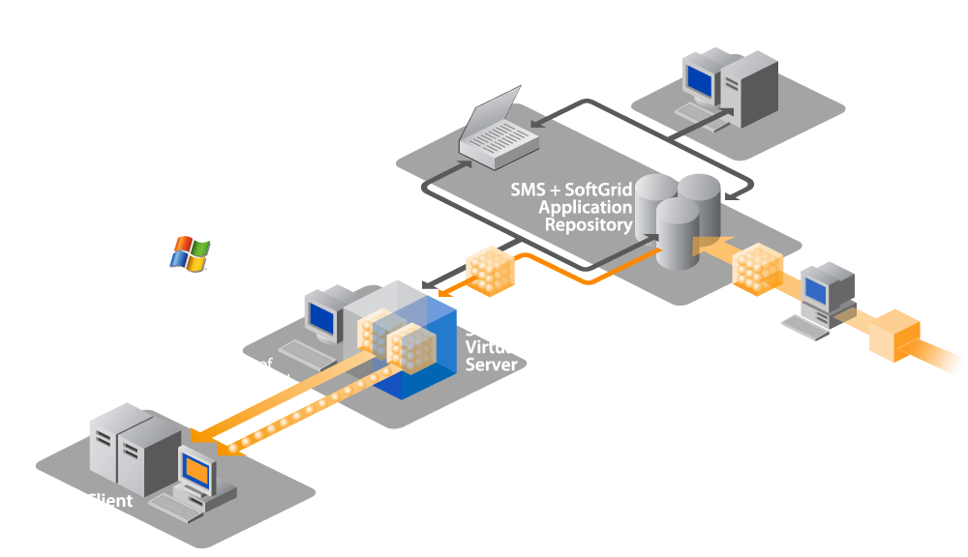
SoftGrid And Microsoft
Management Products
SoftGrid for Desktops and TS share infrastructure
Flexible application deployment:
  Pre-cached to clients with traditional updates
  Pre-cached with dynamic updates
  Pure dynamic delivery
Integrated reports and metering
Enterprise scale

Slide 28
SoftGrid And
SoftGrid For TS
demo
Alex Balcanquall
Product Manager
Terminal Services

Slide 29
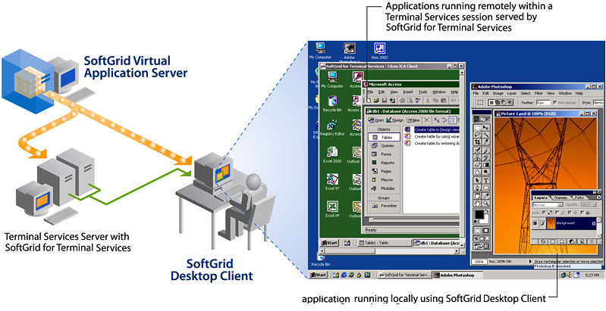
Myth: TS And SoftGrid Can't Be Used Together
Reality: Microsoft now offers a total
application delivery solution, all managed
with a single infrastructure
Decision Points
Application on:
Desktop, TS
or both?
Do I manage
my application with SoftGrid

Slide 30
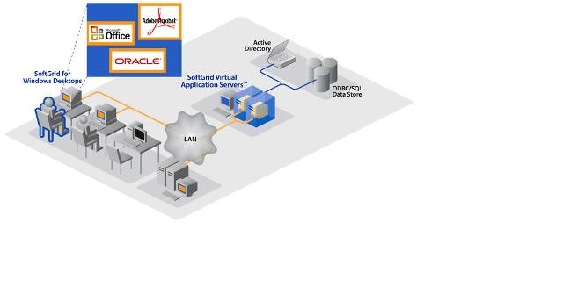
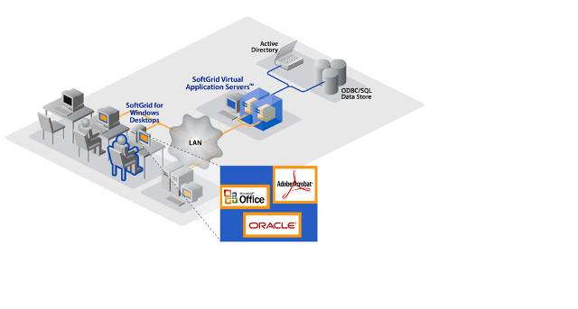
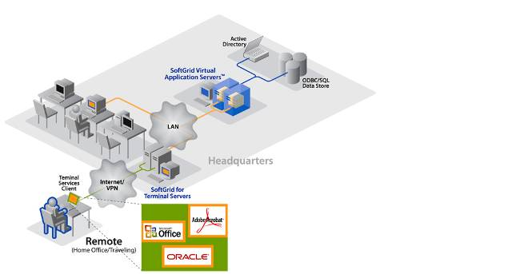
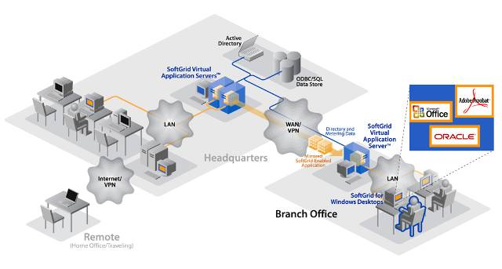
Putting It All Together
Applications become dynamic
Any user can access any computer on
the network to get their applications
Machines become generic instead of user-specific
Useful for office hoteling, business continuity, computer labs and
branch servers
Case Study
Northeastern University uses SoftGrid to provide access to any application from any computer on campus

Slide 31
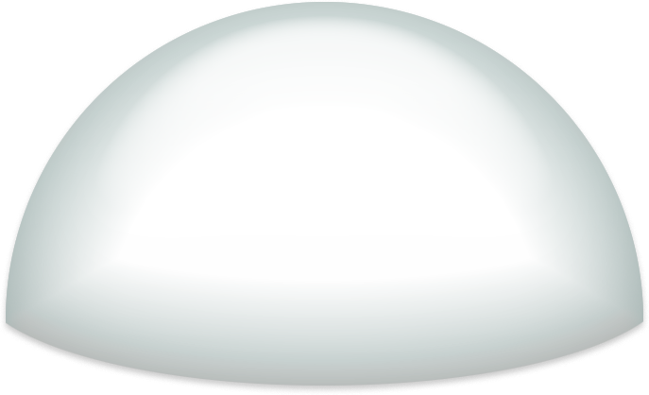






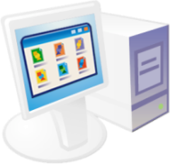
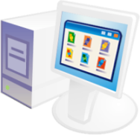
















Microsoft Virtualization Solutions
Management
Presentation
Virtualization
Application
Virtualization
Desktop
Virtualization
Server
Virtualization

Slide 32
Call To Action
Try Presentation Virtualization for yourself:
  Longhorn TS Webcast:
    http://msevents.microsoft.com/CUI/WebCastEventDetails.aspx?culture=en-US&EventID=1032297519&CountryCode=US
  TS Techet Virtual Lab:
    http://msevents.microsoft.com/CUI/WebCastEventDetails.aspx?EventID=1032310513&EventCategory=3&culture=en-US&CountryCode=US
Dive Deeper on Application Virtualization
  SoftGrid (MDOP) Webcast:
    http://msevents.microsoft.com/CUI/WebCastEventDetails.aspx?EventID=1032322633&EventCategory=5&culture=en-US&CountryCode=US
  SoftGrid for TS WebCast:
    http://msevents.microsoft.com/CUI/WebCastEventDetails.aspx?EventID=1032327814&EventCategory=5&culture=en-US&CountryCode=US

Slide 33
Virtualization Resources
Related Sessions:
  SVR-T340: Windows Server Terminal Services Easy Print
SC Virtual Machine Manager
  E-mail:
  Web: http://www.microsoft.com/scvmm
SoftGrid
  E-mail:
  Web: http://www.microsoft.com/softgrid
Terminal Services
  Blog: http://blogs.msdn.com/ts/
  Newsgroup: http://forums.microsoft.com/technet/showforum.aspx?forumid=580
  Web: www.microsoft.com/terminalserver
Virtual Server 2005
  Web: http://www.microsoft.com/virtualserver
scvmm @ microsoft.com
softinfo @ microsoft.com

Slide 34

© 2007 Microsoft Corporation. All rights reserved. Microsoft, Windows, Windows Vista and other product names are or may be registered trademarks and/or trademarks in the U.S. and/or other countries.
The information herein is for informational purposes only and represents the current view of Microsoft Corporation as of the date of this presentation. Because Microsoft must respond to changing market conditions, it should not be interpreted to be a commitment on the part of Microsoft, and Microsoft cannot guarantee the accuracy of any information provided after the date of this presentation.
MICROSOFT MAKES NO WARRANTIES, EXPRESS, IMPLIED OR STATUTORY, AS TO THE INFORMATION IN THIS PRESENTATION.

