Slide 1
NPIV SAN Integration And Microsoft Virtualization
Therron Powell
Principal Program Manager
Microsoft Corporation
Therron.Powell @ Microsoft.com

Slide 2
Key Takeaways Understand that
Platform and SAN virtualization technologies are complementary
Consolidation and VM agility can challenge SAN best practices, NPIV empowers solution for multiple domains
NPIV does not require a new device driver model
Windows Virtualization utilizes the existing WDM
I/O infrastructure and storage stack
‘In-Box’ key enterprise storage and management APIs
SAN Infrastructures provide virtualization synergy when NPIV is used
Dynamic instrumentation helps mitigate contending attributes like performance against agility

Slide 3
Agenda
Survey says
Machine and SAN Virtualization Synergy
Windows Virtualization Architectures
Emulex NPIV Discussion
Switch Complement
Future I/O models
Virtual Machine Manager
Call to Action

Slide 4
Infoworld 2006 Virtualization Survey
Reducing infrastructure costs 43%
Ease of application deployments 18%
Improving server utilization rates 15%
Consolidating physical floor space 12%
Reduce server and application provisioning times 10%
Nearly half of the respondents also claimed that disaster recovery benefits were also a huge factor in moving to a virtualized solution www.infoworld.com

Slide 5
SAN Best Practices
Zoning and Masking management controls
Direct and limit Target affiliations
Manage Scalability
Isolation / security controls
NP:1
Acctg
HA
S
S
NP:4, TD
SAN
NP:2
Patient
DB
S
S
HB
NP:5, TE
NP:3
S
Web
Site
S
HC
NP:6, TF

Slide 6
Server Consolidation
Reduce hardware overhead
Migrate to newer and more capable hardware
Save SAN infrastructure costs
VM Agility is powerful
May require re-programming of SAN
Acctg
S
S
NP:4, TD
HA
SAN
HB
Patient
DB
HC
S
S
NP:5, TE
VMM
S
Web
Site
NP:3
S
NP:6, TF

Slide 7
N-Port ID Virtualization (NPIV)
More dynamic assignment of multiple virtual N-Ports to a single physical port
Can more easily migrate virtual hosts
Might not need SAN re-programming
Acctg
S
S
NP:4, TD
HA
SAN
HB
Patient
DB
HC
S
S
NP:5, TE
VMM
S
Web
Site
NP:3
S
VNP:1 VNP:2
NP:6, TF

Slide 8
Hosted VMM Benefits
Use existing driver and IO stack infrastructure!
Miniport and class inheritance models
Unparalleled driver implementations
Innumerable partner solutions
Multiple different bus infrastructures (SCSI, FC, IDE, SATA, USB, 1394…)
Boot, security & data integrity services
3rd party value added such as volume managers, load balancers, routers, firewall, RAS/failover, virus scanners, backup…
Helps orchestrate complementary offerings from across a rich ecosystem
App
App
App
OS
OS
VM
VM
VMM
DD
OS
DD
Hardware

Slide 9
Virtual Server 2005 Architecture
Host OS
Guest OS
Provided by:
Virtual Server WebApp
Virtual Server Service
IIS
Microsoft, ISV or home-
grown Applications
Microsoft
Virtual Server
Device Emulation
Ring 3: User Mode
Applications
Ring 1: Guest Kernel Mode
OEM / IHV
User Mode
VM Additions
Kernel Mode
Windows (NT4, 2000, 2003)
Windows Server 2003 or Windows XP
Ring 0: Kernel Mode
Kernel
VMM Kernel
DD
VMM Kernel
“Designed for Windows” Server Hardware

Slide 10
Windows Storage Stack
Well known Layered services Model
File System, Volume / Partition Management, Class Drivers, Port Drivers, Miniport to HW or Virtual
Industry value added extensions
Isolate Error Propagation
Has eliminated need for Full-Port Drivers
Very Mature Disk Class Layer
Virtually no Changes between W2K3 / LHS
Very Flexible Storport Driver Interfaces
Supports SCSI, FC, SAS, SATA RAID and Virtual Devices
Full Power Management in Stack, including Fast Resume
Expansion of Existing Management Services
WMI Interfaces at all layers, T11 API at Miniport

Slide 11
Virtual Server 2005 Architecture
Host OS
Guest OS
Provided by:
Virtual Server WebApp
Virtual Server Service
IIS
Guest Applications
Microsoft
Device Emulation
Sits high in IO stack
Maximize compatibility and co-existence with layered IO services
Does not require modification of Client
Virtual Server
Device Emulation
Ring 3: User Mode
Applications
Ring 1: Guest Kernel Mode
OEM / IHV
User Mode
VM Additions
Kernel Mode
Windows (NT4, 2000, 2003)
Windows Server 2003 or Windows XP
Ring 0: Kernel Mode
Kernel
VMM Kernel
DD
VMM Kernel
“Designed for Windows” Server Hardware

Slide 12
Windows Virtualization Architecture
Parent Partition
Child Partitions
Provided by:
Virtualization Stack
Applications
Windows
VM Worker Processes
WMI Provider
Windows Virtualization
VM Service
ISV
LUN
User Mode
LUN
IHV / OEM
Virtualization Service Clients (VSCs)
Windows Kernel
Server Core
Virtualization Service Providers (VSPs)
Windows Kernel
IHV Drivers
VMBus
Enlightenments
Kernel Mode
Windows hypervisor
“Designed for Windows” Server Hardware

Slide 13
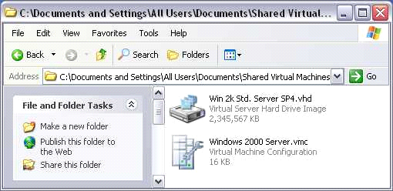
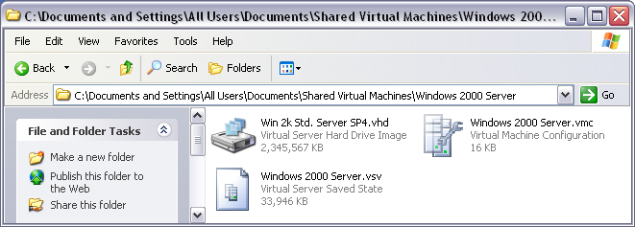
Virtual Machine File Structure
Virtual machine (VM) configuration (.vmc)
VHD (.vhd)
Virtual machine saved state (.vsv)

Slide 14
Virtual Hard Disk (VHD)
Boot image and backing store for Virtual Machine system Image
Dynamically expanding VHDs
Fixed-size VHDs
Differencing VHDs
Undo disks
File to Host mapping
Space management
“Loopback Mounting”

Slide 15
Storage VSP/VSC Design
Parent Partition
Child Partitions
VM Worker Process
Applications
User Mode
Windows File System
Image Parser
Windows File System
Volume
Volume
Provided by:
Partition
Partition
Windows
Virtual Storage
Provider (VSP)
Windows Virtualization
Disk
Disk
Fast Path Filter (VSC)
IHV / ISV
StorPort
iSCSIprt
OEM
StorPort
Miniport
Virtual Storage
Miniport (VSC)
VMBus
Kernel Mode
Hardware
Windows hypervisor

Slide 16
Workload External Targets
Applications may load from VHD and store data inside the VHD, and/or may access external storage resources as data stores
Applications can use pass-through from the Guest to external storage
IIS
SQL
VM
VM
VM
VHD
VHD
VHD
SAN
Web
Site
Patient
DB

Slide 17
WWN And HBA Server Demand
More than 2 HBAs per server is atypical on non-virtualized servers. Some prefer two dual-ported HBAs. Each HBA only 1 login
Each HBA contains a single WWPN with a single login, with Virtualization the needs compound
With newer multi-core/socket and large memory systems, the number of VMs on a physical server will approach triple digits (100+)
SAN ports and domains are limited too
NPIV enables more virtual ports and SAN scaling

Slide 18
Windows Virtualization Windows Server Longhorn
NPIV is a powerful adjunct for many of the Top Virtualization Use Cases
Server Consolidation
Application Compatibility and Re-Hosting
Business Continuity
Dynamic Data Center
Rapid Provisioning of New Solutions
Development and Test
Logical Partitioning

Slide 19
Emulex
partner
Mark Karnowski
VP Engineering
Emulex

Slide 20
NPIV Timeline
1998
Emulex and IBM first to develop SAN connectivity for virtualized mainframe servers.
2001
Emulex, IBM & McDATA initiate NPIV Standard.
2003
The NPIV standard is adopted by ANSI T11.
Emulex demonstrates initial NPIV support for Microsoft Virtual Server.
Emulex introduces VMPilot, the first NPIV management application for use with Microsoft Virtual Server.
2006

Slide 21
NPIV
Adopted by ANSI T11 FC-FS in 2003
Covers Fibre Channel Switches, HBAs and other endpoints
Allows a physical port to acquire multiple SAN addresses
T.11 NPIV standard only defines wire protocol, not how to map applications
Server to server VM migration can challenge SAN Best Practices
Zoning and Array-based LUN Masking are used to isolate HBA/LUN connections
SAN-Based Virtualization environments cross IT boundaries
Requires coordination between the “Server Guy” and the “Storage Guy”

Slide 22
SAN Industry NPIV Support
HBAs have added driver support that allows creation of multiple vports.
Switch Vendors created newer firmware allowing multiple N_Ports (1 Real, Many virtualized) through same connection
Storage RAID Controllers view the virtualized N_Ports as real WWPNs
Microsoft has deployed Virtual Server and its APIs, along with storage-related APIs
Facilitates mapping NPIV to applications
Applications like VMPilot tie everything together

Slide 23
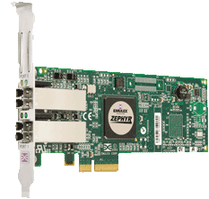
What Is VMPilot?
VMPilot
Creates Microsoft Virtual Server Virtual Machines in a Fibre Channel SAN Environment
Supports Emulex LightPulse 4Gb/s HBAs
Deploys N-Port ID Virtualization to enable SAN Best Practices
Utilizes key Microsoft APIs for a fully supported, future-proof implementation
Virtual Server APIs
HBA API
Virtual Disk Services

Slide 24
Design Guidelines
Support existing and future implementations of Virtual Server
Maintain current IT practices of separate server and storage management personnel
Interoperate with all available storage platforms
Include industry-standard interfaces wherever possible

Slide 25
High-Level Design
VMPIlot
VDS API
HBA API
Virtual Server API
Provided by:
VDS
Virtual Server
Storport Driver
Microsoft
Emulex
Emulex
Storport Miniport Driver
Bus Class Driver
Emulex Lightpulse LPe11002 Fibre Channel HBA

Slide 26
Solution Component Virtual Server APIs
Allow VM creation, deletion
Combined with NPIV, forms the building blocks for portable VMs
VMs can be created with an existing .vhd/.vmc fileset on any mapped drive
Facilitates migration
Support for Virtual Server through Windows Server Longhorn Server
Satisfies “Future proof” requirement

Slide 27
Solution Component: Virtual Disk Services (VDS)
Correlates file system mapping to SCSI addresses
Easily converted to Fibre Channel addresses for NPIV operations
Supports LUN Partitioning and Formatting
Allows bare LUNs to be created ahead of time
Can adjust Array-based LUN mapping for supported targets
Useful for future management requirements

Slide 28
Solution Component HBA API
Industry standard API for Fibre Channel HBAs
Stable implementation, broadly used
Readily available
Supported in-box since WS 2003 SP1
Broad functionality for management
Discovery
Host-to-Host communication
“Safe” SCSI pass-through (Management Commands only)

Slide 29
SAN-Connected VM Creation
Host 1
.vhd 1
Array
Fabric
Lun
1
.vmc 1
Host 2
Lun
2
Lun
3
Host 3
Zone A,B,C
WWN A
Mask
VM 1
VMPilot
WWN
Database
WWN B
Mask
Create Zone, and Mask Luns
Vport A
WWN C
Mask
Create Vport and VM

Slide 30
SAN-Connected VM Migration
VM 1
Host 1
Array
.vhd 1
Fabric
WWN A
Mask
Lun
1
Vport A
.vnc 1
Host 2
WWN B
Mask
Lun
2
Zone A,B,C
WWN C
Mask
Lun
3
Host 3
VMPilot
WWN
Database
Pause VM
Move Vport to Host 2
Move VM to Host 2

Slide 31
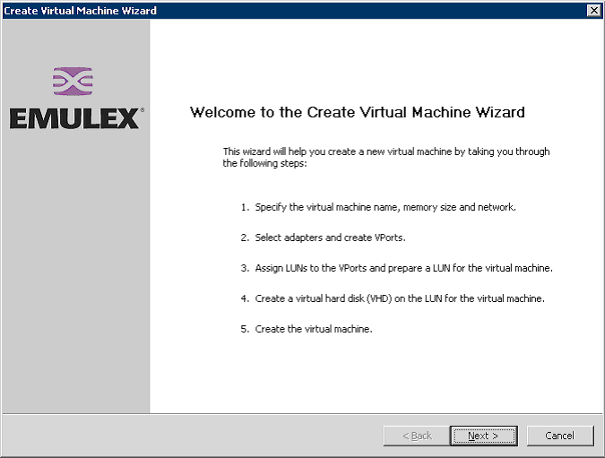
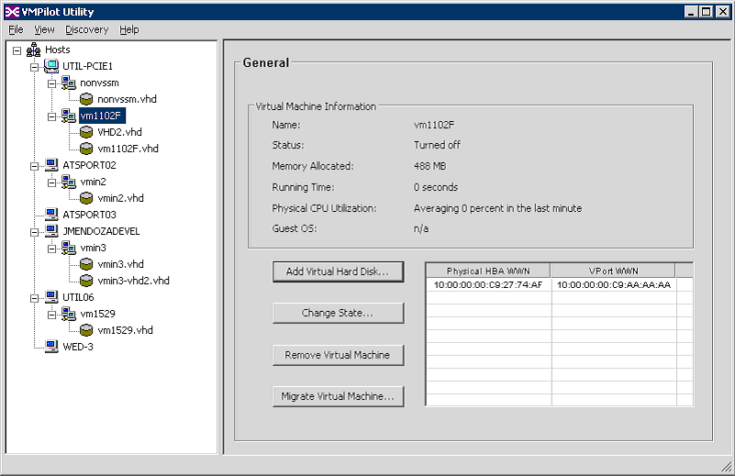
VMPilot Interface

Slide 32
Fabric Resource and NPIV
SAN Fabrics have limited switch domains, physical devices and ports
Fabric Port limit is 5280 ports
(including ISLs)
Physical port usage is limited to 3000 end devices
Maximum switch domains of 239
Virtualization technologies, both platform and storage, improve physical resource use

Slide 33
NPIV Enabled Switch Brocade Communications
NPIV – switches and HBAs must support NPIV
The NPIV enabled HBA asserts multiple WWPN logins through a single switch port
The NPIV enabled switch handles multiple logins on the same port and assigns Process IDs (PIDs) which are used to route the frames to targets
Allows more VMs on smaller fabrics with fewer ports

Slide 34
Blade Servers Embedded Switch Brocade Communications Access Gateway
Specifically addresses fabric challenges related to Bladed Server environments
# of domains, # of ports, vendor interoperability, etc.
Utilizes legacy or NPIV-enabled HBA modules
Provides flexibility by overcoming large numbers of blade servers utilizing Fabric Domain IDs by providing a pass-through mechanism for NPIV connectivity

Slide 35
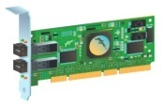
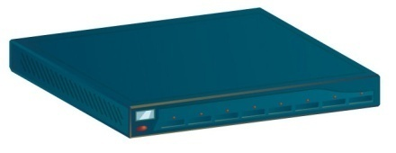
NPIV Use Case QLogic
1
Servers are configured in an active-passive cluster configuration with ISV DB application
2
Server A
Server B
5
A virtual HBA port is
created via NPIV and zoned (disks 1 & 2 are visible)
ISV Cluster Server
and Volume Manager
A fault forces the application along with the virtual HBA port to failover to the secondary server
ISV
Application
Heartbeat
ISV
Application
4
WWPN1
6
3
WWPN1
Access to disks 1 & 2 is maintained by migrating the original WWPN, VF ID, and zone parameters
The application is bound to the virtual HBA port (WWPN, VF ID, and zone), allowing disks 1 & 2 to be consumed only by the primary server
The virtual HBA port is
grouped into Virtual Fabric ID 1
for network isolation
VF ID1
VF ID1
VF ID 1
VF ID 1
QLogic QLA2462
(NPIV + VF enabled)
QLogic QLE2462
(NPIV + VF enabled)
VF ID 1
VF ID 1
Management Server
7
Communicates to QLogic HBA
Virtualization API
ISV Volume Manager
ISV CS Manager
NPIV (WWPN) management
Virtual Fabric assignment
NPIV + VF verification
Thus, storage administrators do not have to reconfigure their SAN settings (zoning, LUN masking)
VF ID 1
Cisco MDS 9216
(NPIV + VF enabled)
Disk 1
Disk 2
Storage (JBODs)

Slide 36
HBA NPIV Configuration QLogic
Simplified mgmt, persistent zones and LUN masking
Additional security through WWPN/storage bindings
Available port level statistics for each virtual port
Hot replacement of HBAs
Virtual Fabrics (VFs) with Cisco
Extends the VSAN ID tag to the FC HBA allowing each VM to participate in its own isolated Virtual Fabric
X86 Architecture
Service VM
VM1
VM2
VM3
Driver
App
App
App1
App2
App1
App2
App1
App2
I/O Stack
OS
OS
OS
HBA Driver
Driver
Driver
Driver
Virtualization Layer (Hypervisor)
HBA Function 0 (F0)
WWPN 1
N_Port ID 1
WWPN 2
N_Port ID 2
WWPN 3
N_Port ID 3
WWPN 4
N_Port ID 4
Logical HBA Ports
NPIV
D1
D2
D3
D4

Slide 37
Virtual HBA Approaches
Single PCI function
Single Function Driver
Virtual Ports abstracted by IHV function driver
LUNs surfaced to Windows Storage Stack en masse
Virtual Miniport driver
Multi-Function device
PCIe base or IOV
Prepares for direct guest Device Assignment
VT-d, IOMMU DMA remapping

Slide 38
PCI IO Virtualization - SR
PCIe Single-Root IOV
VI
SI
SI
A Single Root Complex
Hypervisor
PCIe RC
Device provides addressable virtual instances, assignable over it’s port to virtual machines
PCIe Port
PCIe SR-IOV
Capable Device
Single-Root IOV (SR-IOV) - A PCIe hierarchy with one or more components that support the SR-IOV Capability.
Each Virtual Function is individually addressable
Virtual N-Ports could align well for granular management controls for SAN resources

Slide 39
PCI IO Virtualization - MR
PCIe Single-Root IOV
PCIe Multi-Root IOV
VI
VI
VI
SI
SI
SI
SI
SI
SI
Hypervisor
Multiple Root Complexes
Hypervisor
Hypervisor
PCIe RC
Blade
PCIe RC
PCIe RC
Blade
PCIe Port
PCIe Fabric
PCIe SR-IOV
Capable Device
PCIe MRA Device
PCIe Device
PCIe SR-IOV
MRA Device
Multi-Root IOV (MR-IOV) - A PCIe Topology containing one or more PCIe Virtual Hierarchies.
Virtual Hierarchy (VH) - A portion of an MR Topology assigned to a PCIe hierarchy, where each VH has its own PCI Memory, IO, and Configuration Space.
NPIV can aid sharing and granular control for SAN resources within a blade chassis

Slide 40
Performance vs Agility?
Software IO Virtualization
Emulation, Enlightenment, Device Assignment
Windows Virtualization dynamic IO allocation
Hardware IO Virtualization
Multi-Function, Single-Root, Multi-Root
Brings more to VM direct Device Assignment
VM driver is device specific challenging motility
Orchestration of Dynamic Systems is powerful to having both

Slide 41
Orchestrating Virtual Machines System Center Virtual Machine Manager
SCVMM, a new System Center product that allows you to manage your virtualized environment
Manage Virtual Server – V1
Manage Windows Server Virtualization – R2
Feature set includes centralized
Host Platform Configuration
Virtual Machine Creation
Server Consolidation Tools
Image Library Management
Virtual Machine Placement and Deployment
Monitoring and Reporting
Rapid Recovery

Slide 42
Virtual Machine Manager At-A-Glance
Context
Sensitive
Actions
Host
Groups
VM
Views
Live
Thumbnail
Centralized
Library

Slide 43
Virtual Machine Manager Architecture
Client
Web Client
Scripting Client
Administrator Console
Self Service Web Portal
Windows PowerShell
Windows PowerShell
Windows PowerShell
Windows Communication Foundation
Windows Remote Management (WS-MAN)
Library
BITS
Host
BITS
P2V Source
SCVMM Agent
SCVMM Agent
SCVMM Agent

Slide 44
Key SAN Impacting Scenarios
Consolidation of Virtual Infrastructure
SAN Correlation
Rapid Provisioning of Virtual Machines
LUN Provisioning
Rapid Recovery from Server Loss
SAN synergy shines
Migration of Virtual Machines
SAN Correlation

Slide 45
SCVMM Storage Integration
Out the box integration with VDS for Fibre Channel and iSCSI-based migrations
Reprogram Masks for non-NPIV-capable HBAs
Working with partners to create an NPIV solution
N-Port ID Virtualization (NPIV) is an ANSI/INCITS T11 standard
Allows a physical port to acquire multiple SAN addresses
Can be assigned to Virtual Machines to provide unique SAN identities
Enables SAN best practices: each virtual machine is independently Zoned, and LUNs are mapped and masked using dedicated World Wide Port Names (WWPNs)
Partners include
Emulex QLogic Brocade

Slide 46
Summary
Remember – All of this happens without changes to current Windows storage stack
Complement for Platform, Device, BUS and SAN virtualization technologies
SAN Best Practices retained - Zoning, masking, virtual fabrics
Values to virtualized scenarios
Extend value through coherency with SAN infrastructure and utilization of SAN services
Ensure SLAs through granular resource control and monitoring
Improved SAN scalability (fewer physical ports used) and lower demand on ‘director class’ switches
Balance Agility vs Performance contention
Value of NPIV to Windows Servers even with no virtualization
Workload agility – move to faster servers as warranted
Dynamic platform configuration and resource allocation
HBA replacement and failover
Security for transient workloads…

Slide 47
Call To Action
Review related WinHEC sessions
Download the latest Virtual Server 2005 SP1
Join the SCVMM Beta
Ensure that your devices and drivers work on 64-bit enabled Windows operating systems for virtualization and end user flexibility
Watch for Windows Virtualization beta
Monitor IO virtualization standard evolutions
Intel – VT-d, AMD – IOMMU
PCI IO Virtualization
Instrument for dynamic orchestration

Slide 48
Additional Resources
Web Resources
Specs: http://www. T10.org
Intel VT-x, VT-i and VT-d specifications
Available at http://www.intel.com/technology/computing/vptech/
Main Page http://www.amd.com
IOMMU Developer Center http://devcenter.amd.com
PCI-SIG for PCI IOV http://www.pcisig.com
Brocade Access Gateway www.brocade.com/accessgateway
Whitepapers
"Virtual Server - SAN Connectivity: The emergence of N-Port ID Virtualization" - http://www.emulex.com/white/hba/wp-nport.pdf
"Emulex Enables the Virtualized Data Center: Key Building Blocks for Data Center Virtualization: - http://www.emulex.com/white/hba/wp_DataCenterVirtualizationr.pdf
"Optimizing SAN Connectivity for Microsoft Virtual Server with VMPilot.“ http://www.emulex.com/white/hba/vmpilot.pdf
QLogic's Continuous Innovation and Leadership Enables End-to-End Virtualization QLogic Enables End-to-End Virtualization

Slide 49
Additional Resources
Related Sessions
SVR-T335 Virtualization in Windows Server
SYS-T312 Intel's Vision for Virtualization and Benchmarking
SYS-T314 Virtualization Technology Directions
SYS-T313 Next-Generation AMD Virtualization Technology
SVR-T338 Application and Presentation Virtualization
SYS-T311 PCI I/O Virtualization Standards: Implementation
SYS-P319 PCI IOV Usage Models and Implementations
SVR-P337 VHD: Breaking New Ground with Virtualization
SVR-T336 Live Migration of Virtual Machines
therron.powell@microsoft.com

Slide 50
© 2007 Microsoft Corporation. All rights reserved. Microsoft, Windows, Windows Vista and other product names are or may be registered trademarks and/or trademarks in the U.S. and/or other countries.
The information herein is for informational purposes only and represents the current view of Microsoft Corporation as of the date of this presentation. Because Microsoft must respond to changing market conditions, it should not be interpreted to be a commitment on the part of Microsoft, and Microsoft cannot guarantee the accuracy of any information provided after the date of this presentation. MICROSOFT MAKES NO WARRANTIES, EXPRESS, IMPLIED OR STATUTORY, AS TO THE INFORMATION IN THIS PRESENTATION.

