Slide 1
Delivering Windows Vista IR Receiver Solutions
Henry Villadiego
Supervisor, Applications Software
Computing Platform Products
SMSC

Slide 2
Introduction
Follow up to last year’s session: A Case Study on Designing and Implementing IR and Remote Solutions for Windows Vista Media Center Systems
Hardware design and required interfaces
  LPC
Advantages of integrating consumer IR onto motherboards
  Cost
  Wake support
  Preserves USB Port

Slide 3
CIR Transceiver Solution
SMSC SIO1049
  1st CIR Class Port driver (OSR/MSFT)
  Supports Main IR Receive
  Supports Learn IR, Priority Receive
  Supports IR output: up to four (4) Emitter Jacks (Blaster ports)
Signed driver available from Microsoft OEM Online (MOO)

Slide 4
CIR Receive Only Solution
KBC1122P
SIO1039
  Supports Main IR Receive
  Completed CIR Test utility certification
Signed driver available from SMSC

Slide 5
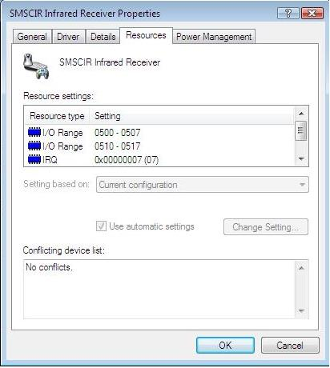
SMSC Support Collateral
BIOS Porting Guide
  Hardware Identifier
  Hardware Resources
  Wake Requirements
Reference Schematic
  Receiver subsystems tested with CIR Test Utility

Slide 6
Call To Action
Obtain signed CIR Port drivers
Verify layout and design using the Microsoft CIR Test Utility
Stop by the SMSC Booth and see the first solutions delivered to the market

