Slide 1
Main Memory Technology Direction
Kevin Kilbuck
Senior Segment Marketing Manager
Computing and Servers
Micron Technology, Inc.

Slide 2
Agenda
DRAM Technology Trends
Computing Customer Requirements
Introduction to DDR3

Slide 3
DRAM Technology Trends

Slide 4


Main Memory Data Rate Trends
NGM Diff
NGM SE
DDR
DDR2
SDRAM
DDR3
DRAM bandwidth requirements typically double every 3 years

Slide 5
Unit Interval (Bit-time) Trends
SDRAM
DDR
DDR2
DDR3
625ps
NGM SE
313ps
NGM Diff
156ps
30-40% of UI will be budgeted for RX circuits (jitter+S/H+static)

Slide 6
Die Size Impact
Triple Metal

Slide 7
Idd Impact
1.6Gpbs
2.5Gpbs
1.33Gpbs
400Mpbs
800Mpbs
X16
X32

Slide 8
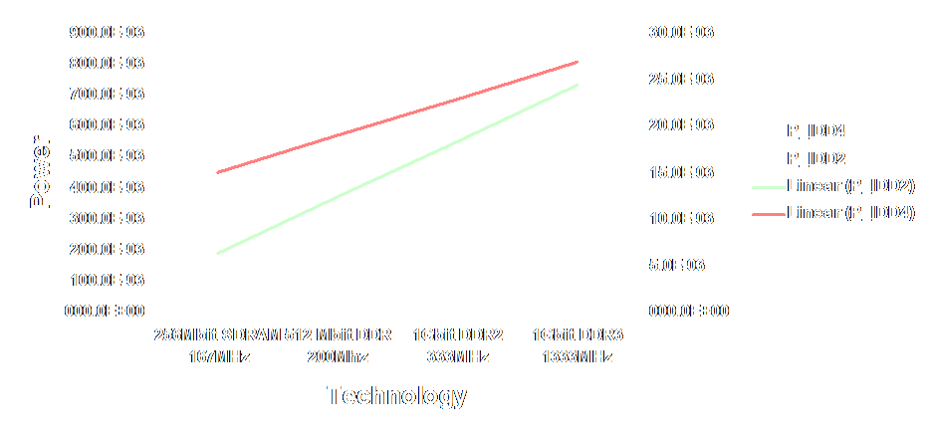
Power Dissipation Trends
X16 devices at nominal Vdd

Slide 9
Voltage Scaling
7
Historical
6
Enthusiast
5
4
3
2
1
0
1990
1995
2000
2005
2010

Slide 10
Historical DRAM Price-Per-Bit Decline ~35%/year
DRAM Market Price-per-bit Decline
(Normalized- Millicent/bit)
1979
1980
Price per Bit (Millicents)
1981
1984
1982
1983
1988
1985
1989
1986
1987
1990
1993
1995
1991
1992
1994
1996
1997
1998
2000
Historical
price-per-bit decline has
averaged 35.5%
(1978 - 2002)
1999
2003
2001
2004F
2006F
2002
2005F
2008F
2007F
1
100
10,000
1,000,000
100,000,000
Cumulative Bit Volume (10¹²)

Slide 11
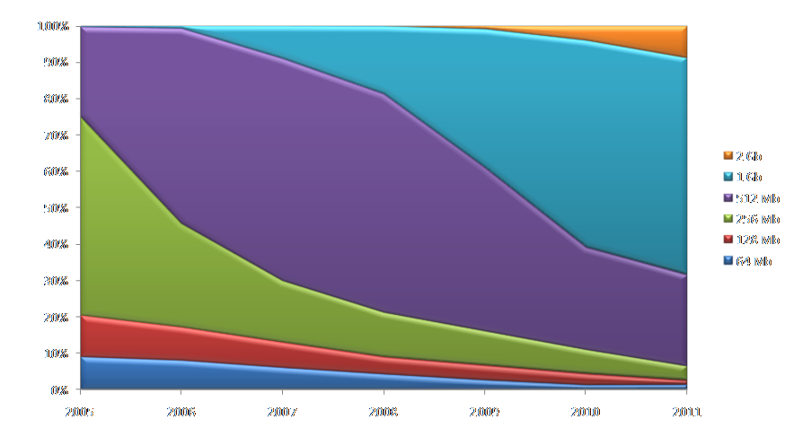
Industry Analyst DRAM
Density forecast
Source: IDC, Isuppli, Gartner, Micron Q107

Slide 12
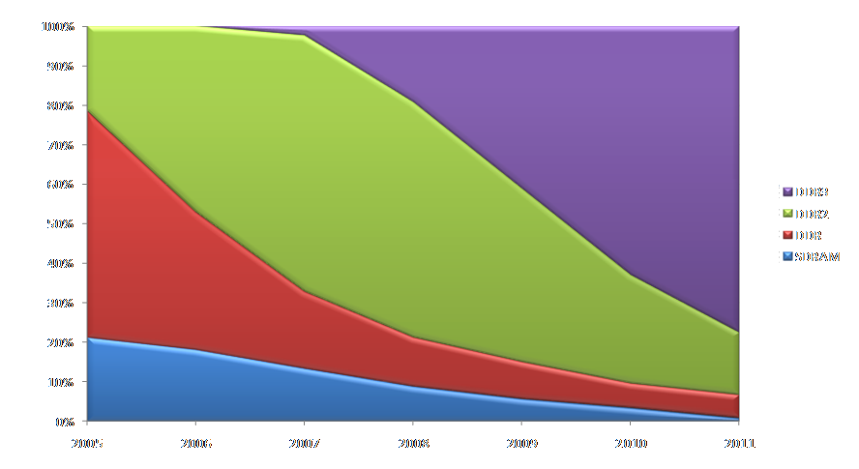
Industry Analyst DRAM
Interface forecast
DDR3 becomes mainstream in 2009
Source: IDC, iSuppli Q107

Slide 13
Computing Customer Requirements

Slide 14
You Can’t Have It All
Quality
Cost
Power
DRAM Design & Process Constraints
Density
Bandwidth
Latency
Pick two (maybe three if you’re really lucky!)

Slide 15
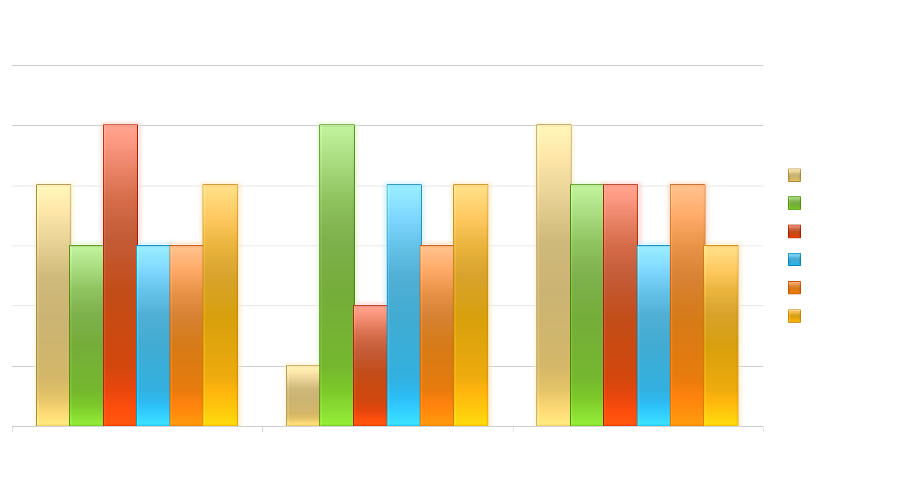
What Computing
Customers Care About

Slide 16
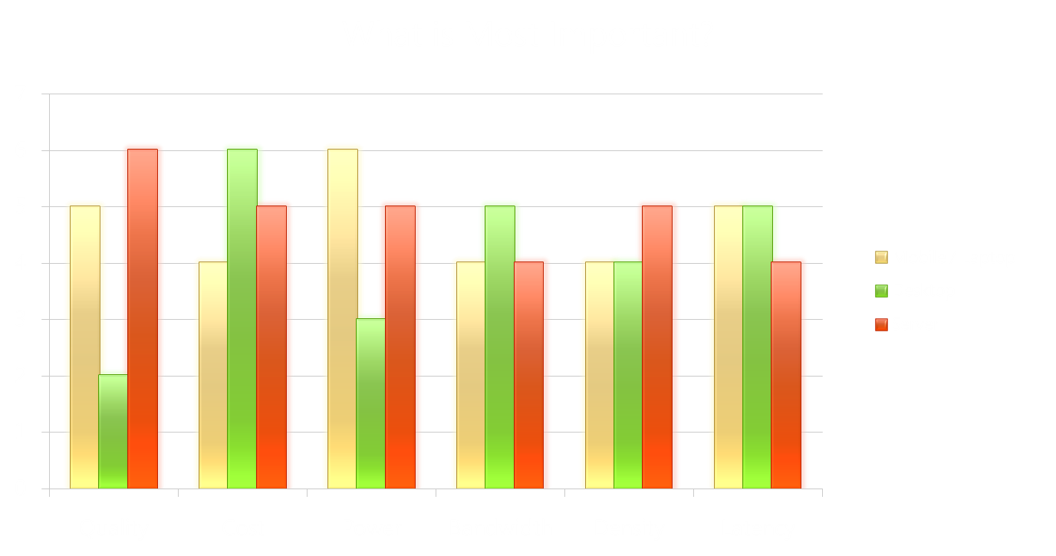
What Computing
Customers Care About

Slide 17
Windows Vista System Requirements
 | Minimum supported | Minimum recommended by SKU
 |  | Home basic | All other SKUs
CPU | An 800MHz x86 or x64 processor³ |  | A 1GHz x86 or x64 processor³
System memory | 512MB |  | 1GB
GPU | SVGA (800x600) | DX9 Capable | Aero Capable
Graphics memory |  | 32MB | 128MB ^{1, 2}
HDD | 20GB |  | 40GB
HDD free space | 15GB
Optical drive | CD-ROM⁴ | DVD-ROM⁴
Networking |  | Internet Access Capable
Audio |  | Audio Output Capability

Slide 18
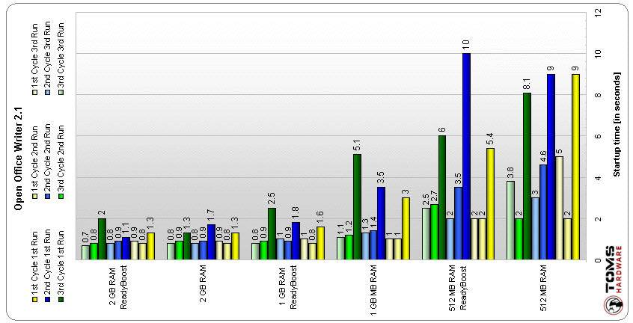
Density Matters
“Give Windows Vista as much memory as you can, and it will thank you by serving you quicker.”
  Tom’s Hardware, Windows Vista's SuperFetch and ReadyBoost Analyzed, January 31, 2007,
  http://www.tomshardware.com/2007/01/31/windows-vista-superfetch-and-readyboostanalyzed/index.html

Slide 19

Windows Vista RTM Test Results
Memory utilization is minimized with more system memory installed
SuperFetch exhausts DRAM memory before using NAND memory
  2GB appears to be optimal DRAM density for Windows Vista
Lower number means your system has more resources available for additional tasks
Multiple programs running
  Two Web browsers, Windows Media Player, Adobe Photoshop with 445MB file open, and Trend Virus Protection
System Specifications
Inspiron 6000 Intel 915GM/PM Windows Vista RC2
Intel Pentium M 1.7Ghz ATI Mobility Radeon X300 80GB Fujitsu ATA

Slide 20
Windows Vista ReadyBoost C&P Lab Results
With 2x CT3264AA667 512MB of DRAM installed:
Ready Boost disabled Ready Boost enabled
1:20.04 38.23 sec
1:09.48 33.23 sec
1:15.56 29.81 sec
1:06.06 44.46 sec
With 2x CT6464AA667 1024MB of DRAM installed:
Ready Boost disabled Ready Boost enabled
8.39 sec 7.43 sec
8.18 sec 7.29 sec
8.56 sec 6.50 sec
7.81 sec 7.51 sec

Slide 21
Windows Vista ReadyBoost C&P Lab Results
With 2x CT12864AA667 2048MB of DRAM installed:
Ready Boost disabled Ready Boost enabled
6.73 sec 5.57 sec
5.93 sec 5.14 sec
With 4x CT12864AA667 4096MB of DRAM installed:
Ready Boost disabled Ready Boost enabled
8.01 sec 7.08 sec
5.48 sec 6.29 sec
2GB DRAM achieves the peak performance gain for DRAM density in Windows Vista systems using Ready Boost

Slide 22
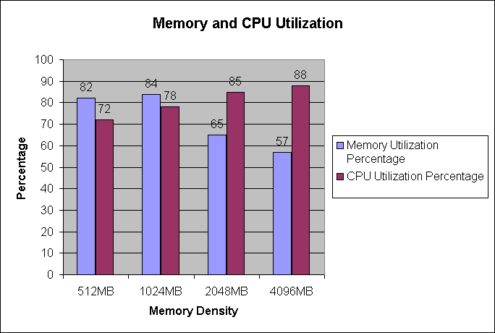
DRAM Density Increases CPU Efficiency
As memory density increases, memory utilization decreases
As memory density increases, processor utilization goes up
More memory drastically increases the efficiency of your processor
System Specifications Motherboard: Evga NF68 Chipset: nVidia 680i SLI Processor: Intel Pentium 4 2.8GHZ Video: ATI Radeon X1900XTX PCIE 512MB Hard Drive:WD 80GB OS: Windows Vista Ultimate DRAM: Crucial DDR2 6400 Real World Test Processes running to generate utilization: Nero Recode, ADOBE WITH 445 MEG FILE OPEN, 2 WEBSITES OPEN

Slide 23

Density Matters
video
1

Slide 24


Dual Die Stacking Technology
Typical monolithic FBGA packages utilize BOC (Board-On-Chip) technology
Typical dual die FBGA packages utilize COB (Chip-On-Board) technology
Supports DDR3 data rates
1.2mm thick

Slide 25
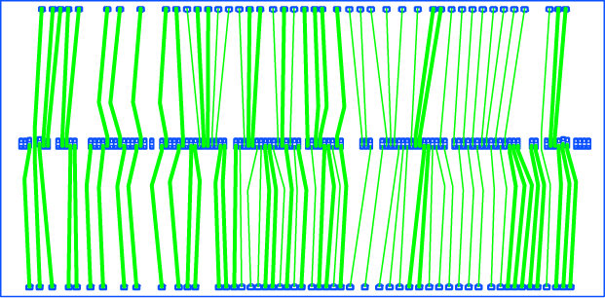

Dual Die Package Construction
Maximum Thickness = 1.35mm
Top view of a typical RDL layer
RDL = Re-distribution layer; center wire bond pads are re-distributed to perimeter of die through a metal layer to facilitate stacking
Wire Bonds
Die
Die
Substrate

Slide 26
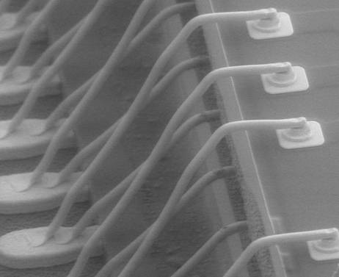
Dual Die Photo
Two die complete with wire bond prior to encapsulation

Slide 27
Power Consumption
4X density increase with little to no power increase
512Mb-based 1GB and 2GB RDIMMs
Converting from 512Mb to 1Gb-based reduces power by over 50%
Power estimates reflect a maximum DRAM utilization of 67% with a BL=4 and register/PLL power of 1.5W

Slide 28
Estimated WC Power
Using (1Gb) datasheet values
DDR3-1333 is slightly higher than DDR2-800 and about 2.2W more than DDR2-667
DDR3 (DR x4)
DDR2 (DR x4)
DDR3-1067 is about equal to DDR-667
DDR2-400
DDR2-533
DDR2-667
DDR2-800
Reflects a sustained channel bandwidth of 65% maximum DRAM, 2x READs to WRITEs distributed evenly through all ranks, closed page, single slot populated, PLL/Register package included

Slide 29
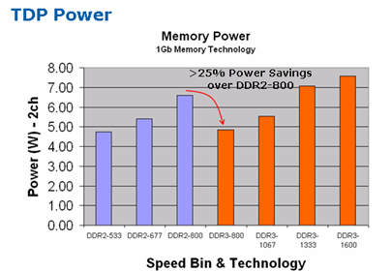
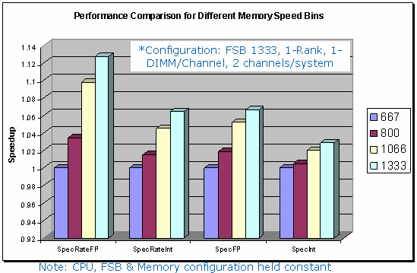
DDR3 Energy Efficient Performance
For Client
More energy efficient architecture
  ~25% better TDP power over DDR2
  Fewer thermal throttling conditions
  ~15% platform power reduction in
  sleep mode
  Added platform margin for Energy Star
Source: Intel Labs, Q1, 2007
Increased Performance
  ~10% perf gain DDR3-1333 versus DDR2-800 (SPECrateFP)
  Expect more gains from overclocking
  Increased memory compliment increased CPU performance and provide better system performance
Source: Intel Labs, Q1, 2007
Performance tests and ratings are measured using specific computer systems and/or components and reflect the approximate performance of Intel products as measured by those tests. Any difference in system hardware or software design or configuration may affect actual performance. Buyers should consult other sources of information to evaluate the performance of systems or components they are considering purchasing. For more information on performance tests and on the performance of Intel products, visit Intel Performance Benchmark Limitations.

Slide 30
Introduction To DDR3

Slide 31
DDR2 To DDR3 Comparison
Standard features
Features/Options | DDR2 | DDR3 | Comments
Pin-out/Package | 60-ball; x4, x8 84-ball; x16 FBGA only | 78-ball; x4, x8 96-ball; x16 FBGA only | Independent pin-out for x4/x8 and x16 (simplifies module design)
Voltage | 1.8V 1.8V I/O | 1.5V 1.5V I/O | Reduces memory system power demand
Densities | 256Mb-4Gb | 512Mb–8Gb | High‐density components enable large capacity memory subsystems
Internal Banks | 4 (256,512Mb) 8 (1Gb,2Gb,4Gb) | 8 (512Mb, 1Gb, 2Gb, 4Gb, 8Gb) | Larger density per monolithic package, 8-banks is standard
Prefetch (MIN READ burst) | 4-bits (2 clocks) | 8-bits (4 clocks) | Reduced core speed dependency for better yield
^{t}CK – DLL enabled | 125MHz to 400MHz | 300MHz to 800MHz | Support higher data rates

Slide 32
DDR2 To DDR3 Comparison Standard features
Features/Options | DDR2 | DDR3 | Comments
Burst length | BL4, BL8 | BC4, BL8 | BC4 provides relief from some “BL8” requirements
Burst type | Fixed, via LMR | (1) Fixed, via MRS (2) OTF, “on-the-fly” | OTF allows switching between BC4 and BL8 without MRS command
Speed (data pin) | 400, 533, 667, 800 Mb/s | 800, 1066, 1333, 1600 Mb/s | Migration to higher‐speed I/O
Additive Latency {AL} (Posted CAS) | AL options (0,1,2,3,4) | AL options 0, CL-1, CL-2 | Mainly used in server applications to improve command bus efficiency
READ Latency | AL + CL CL = 3,4,5,6 | AL + CL CL = 5,6,7,8,9,10, | 800(-25E) 5-5-5 1333(-15F) 8-8-8 800(-25) 6-6-6 1333(-15E) 9-9-9 1066(-187E) 7-7-7 1600(-125E) 9-9-9 1066(-187) 8-8-8 1600(-125) 10-10-10
WRITE Latency | RL - 1 | AL + CWL CWL = 5,6,7,8 | Reduces Latency combinations, one latency per ^{t}CK range

Slide 33
DDR2 To DDR3 Comparison
Standard features
Features/Options | DDR2 | DDR3 | Comments
Data Strobes | Single-ended or Differential | Differential Only | Reduce data strobe crosstalk
Data Bus Termination Rtt | on­die (ODT) opt. on MB | on­die (ODT) opt. on MB | Optimized for higher data rates
Rtt Values | 50, 75, 150 ohm | 120, 60, 40, 30, 20 ohm | Support higher data rates
Rtt Allowed | Read, Writes, standby | Writes, standby | DDR3 does not allow during Reads
Dynamic ODT | none | 120, 60 ohm | Support 2-slots; Writes only
DQ Driver Impedance | 18 ohm | 34 ohm | Optimized for 2-slot and pt-to-pt systems
Driver / ODT Calibration | none | External Resistor | Improves accuracy over voltage and temperature

Slide 34
DDR2 To DDR3 Comparison
Standard features
Features/Options | DDR2 | DDR3 | Comments
MPR {Multi-Purpose Register} | none | Four registers – 2 Defined, 2 RFU | Provides specialty readouts
Write Leveling | none | DQS captures CK, DQ drives out CK’s state | De-skews fly-by layout used by modules
RESET# | none | Dedicated input | Disable outputs, Resets DRAM
Modules | 240­pin UDIMM, RDIMM, FBDIMM; 200­pin SODIMM | 240­pin UDIMM; RDIMM and FBDIMM TBD; 204­pin SODIMM | Similar dimensions as DDR2

Slide 35
DDR2 To DDR3 Comparison
Optional features
Features/Options | DDR2 | DDR3 | Comments
ASR (Automatic Self Refresh) | none | Optional | Automatically adjust refresh rate during Self Refresh mode
^{t}CK – DLL disabled | Undefined (optional) | 128KHz to 125MHz (optional) | Provides some guidance for DLL disabled mode, if supported
ODTS, via MPR (On Die Temp Sensor) | none | 2 readout points (3 states – 1X, 2X, >2X refresh rate), Optional | ODTS to trip at Refresh points, with 2C grace margin. 85C, 95C

Slide 36
DDR3 Performance Timeline
DDR3 data rate and latency timeline
Fastest speed grade driven by high-end desktop
Mainstream will not pay for speed
Notebook and server segments tend to follow mainstream desktop
15ns latencies not expected to be required for 1333 and above
2007
2008
2009
Speed
Latency
tAA (ns)
Speed
Latency
tAA (ns)
Speed
Latency
tAA (ns)
1067
CL7
13.125
1333
CL8
12
1600
CL10
12.5
CL8
15
CL9
13.5
1333
CL8
12
800
CL5
12.5
1067
CL7
13.125
CL9
13.5
CL6
15
800
CL5
12.5
1067
CL7
13.125

