Slide 1
Common Device Driver Installation Errors
Mitsuru Saito
Program Manager
Microsoft Corporation

Slide 2
Key Takeaways
Understand Windows Error Reporting (WER) process for device driver installation failures
Understand the common device driver installation errors
Understand the root cause of the common driver installation errors

Slide 3
Agenda
Windows Error Reporting (WER) background
Common device driver installation errors
Call to action

Slide 4
Windows Error Reporting (WER)
Background

Slide 5
WER For Driver Installation Errors
Collects the driver installation errors
User Opt-in (Default: don’t send)
Windows Vista and later
Error Types
  Driver Import Errors
  Driver Install Errors
  Driver Not Found
  Driver Problem Code

Slide 6
WER For Driver Installation Errors
WER sends diagnostic information
  Error Code (e.g., 80070002)
  INF name
  Error section in the INF file
Additional Information
  INF file
  The list of files in the driver package
  Setupapi.dev.log
  Mini dump (only for timeout error)

Slide 7
WER Walkthrough
Introduction when WER report is sent
Typical driver installation flow
  User plugs in a new device
  System searches drivers for the device
  The driver is imported to driver store
  The driver is installed to driver folder
  The driver is loaded

Slide 8
WER Walkthrough
WER
Windows Vista System
Driver Store
Driver Folder

Slide 9

WER Walkthrough
User plugs in a new device
WER
Windows Vista System
Driver Store
Driver Folder

Slide 10
WER Walkthrough
System Searches for driver match
WER
Windows Vista System
Driver Store
Driver Folder

Slide 11
WER Walkthrough (Failed Case)
If NO driver matches…
WER
Windows Vista System
Driver Store
Driver Folder

Slide 12
WER Walkthrough (Failed Case)
The system sends Driver Not Found to WER
WER
Windows Vista System
Driver Store
Driver Folder
Driver Not Found
Error

Slide 13
WER Walkthrough
If the driver for the device is on the CD…
WER
Windows Vista System
Driver Store
Driver Folder

Slide 14
WER Walkthrough
Driver Store starts validation for the driver
WER
Windows Vista System
Driver Store
Driver Folder

Slide 15
WER Walkthrough (Failed Case)
If the driver validation fails…
WER
Windows Vista System
Driver Store
Driver Folder

Slide 16
WER Walkthrough (Failed Case)
Driver Store sends Driver Import Error to WER
WER
Windows Vista System
Driver Store
Driver Folder
Driver Import
Error

Slide 17
WER Walkthrough
If the driver validation passes, the driver is imported
WER
Windows Vista System
Driver Store
Driver Folder

Slide 18
WER Walkthrough
The system tries to install the driver package
WER
Windows Vista System
Driver Store
Driver Folder

Slide 19
WER Walkthrough (Failed Case)
If an error happens during this phase…
WER
Windows Vista System
Driver Store
Driver Folder

Slide 20
WER Walkthrough (Failed Case)
The system sends Driver Install Error to WER
WER
Windows Vista System
Driver Store
Driver Folder
Driver Install
Error

Slide 21
WER Walkthrough
If the driver is installed successfully…
WER
Windows Vista System
Driver Store
Driver Folder

Slide 22
WER Walkthrough
The system loads the driver
WER
Windows Vista System
Driver Store
Driver Folder

Slide 23
WER Walkthrough (Failed Case)
If the driver has a problem…
WER
Windows Vista System
Driver Store
Driver Folder

Slide 24
WER Walkthrough (Failed Case)
The system sends Driver Problem Code to WER
WER
Windows Vista System
Driver Store
Driver Folder
Driver Problem Code Error

Slide 25
Problem Reports and Solutions
WER Center on your Windows Vista PC
WER central point in Control Panel
All required information is collected
Good starting point to debug driver installation errors
Useful for developers and support engineers!

Slide 26
PRS Walkthrough
Introduction of how to check the WER
Check the errors and start debugging
  Open Control Panel
  Open Problem Reports and Solutions
  Check the report of each error
  Check the driver package of each error

Slide 27
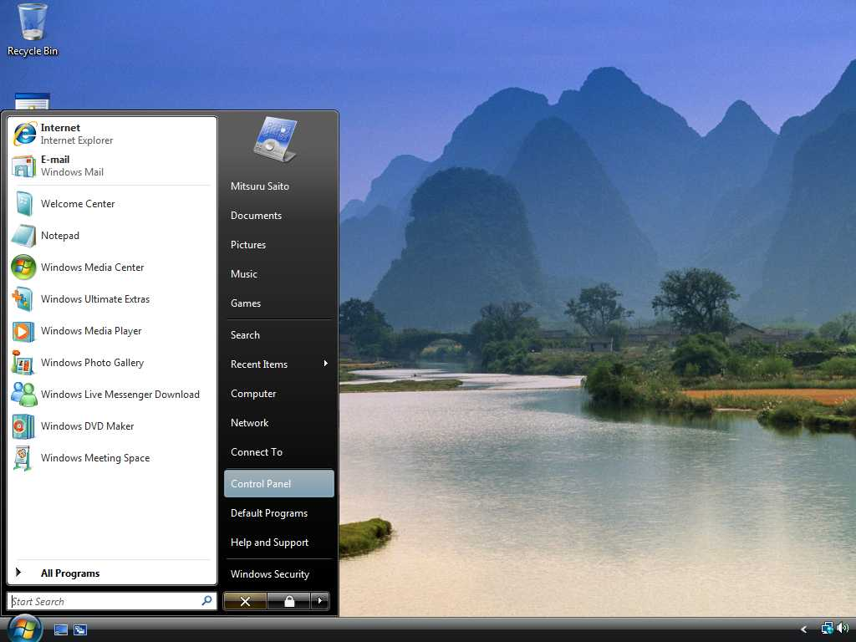

Slide 28
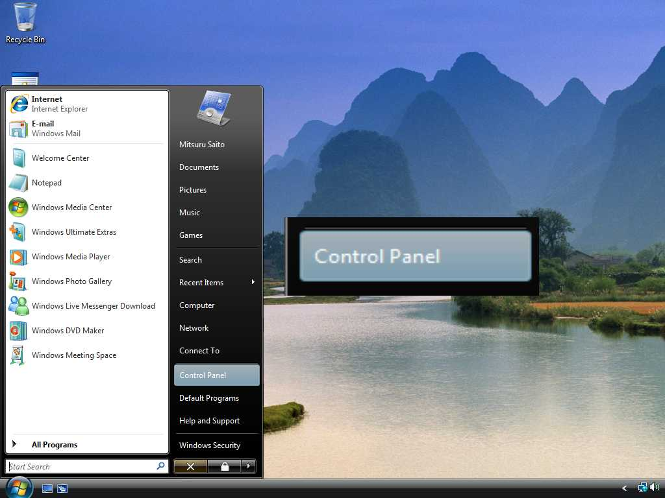

Slide 29
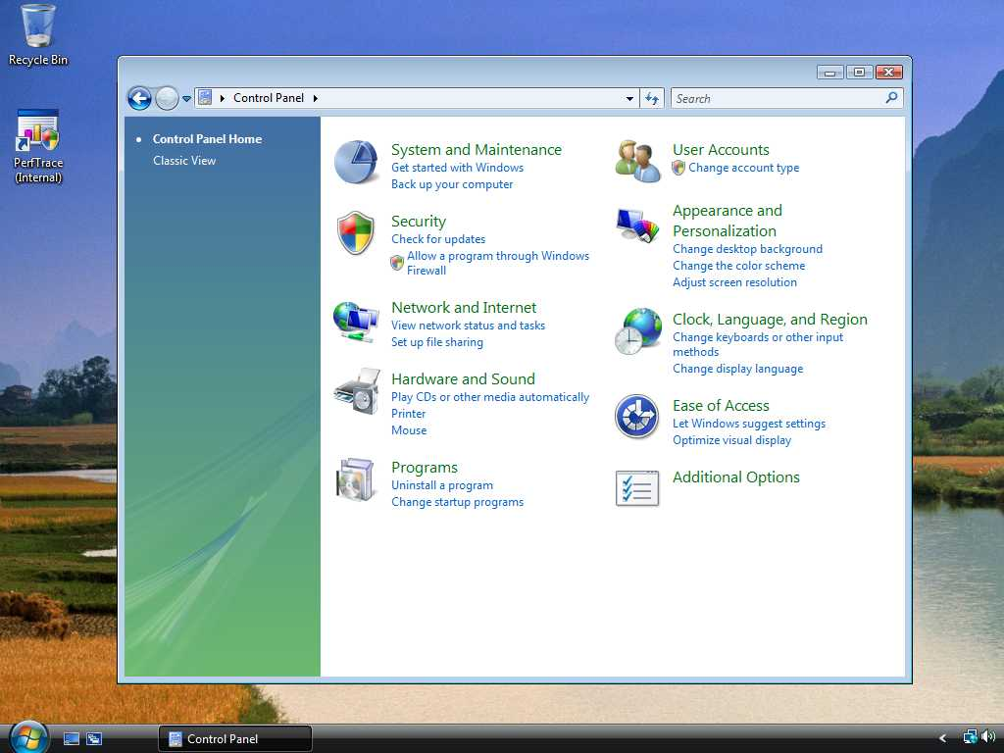

Slide 30
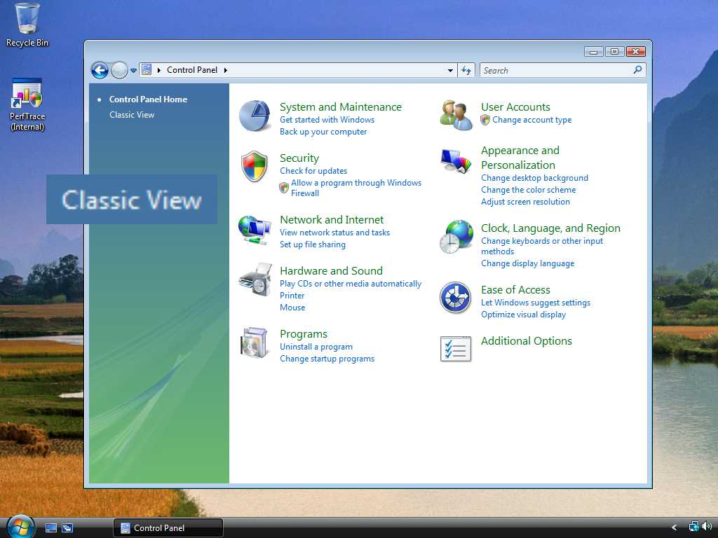

Slide 31
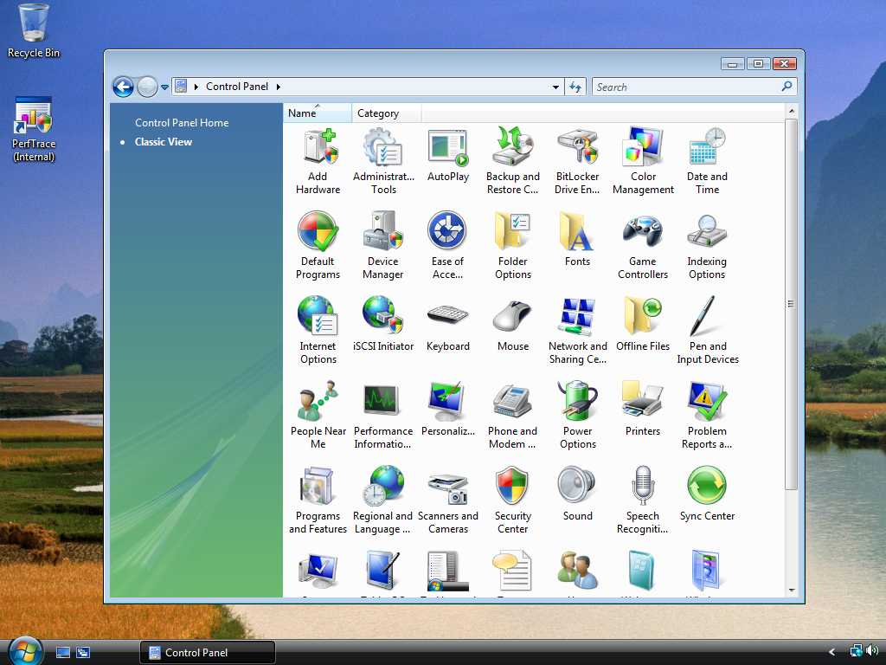

Slide 32
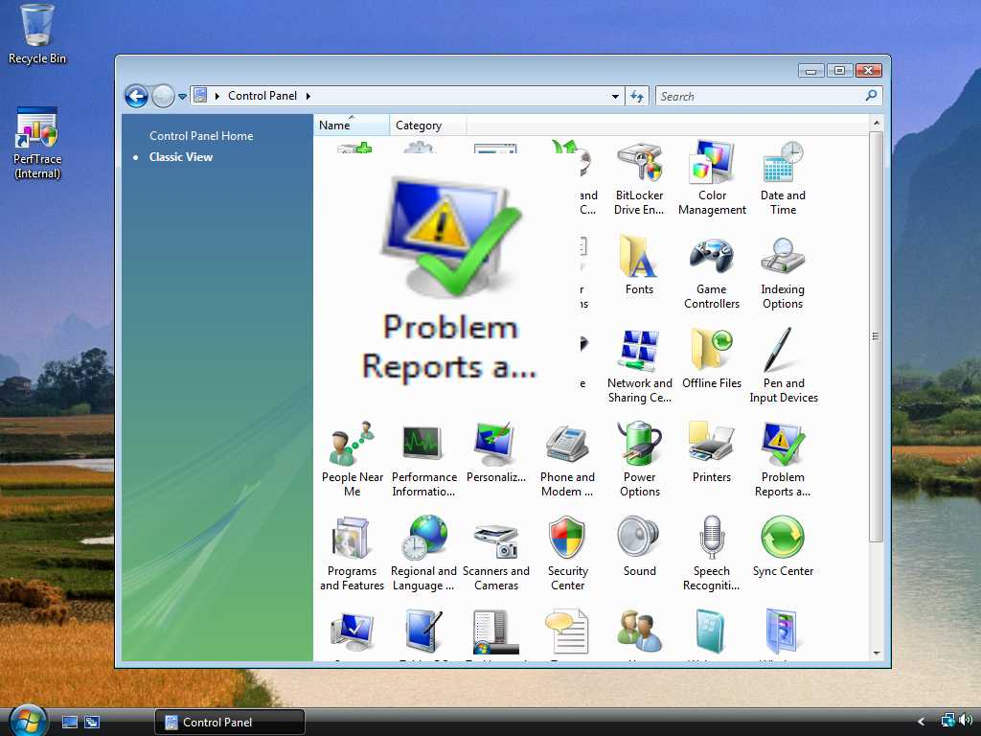

Slide 33
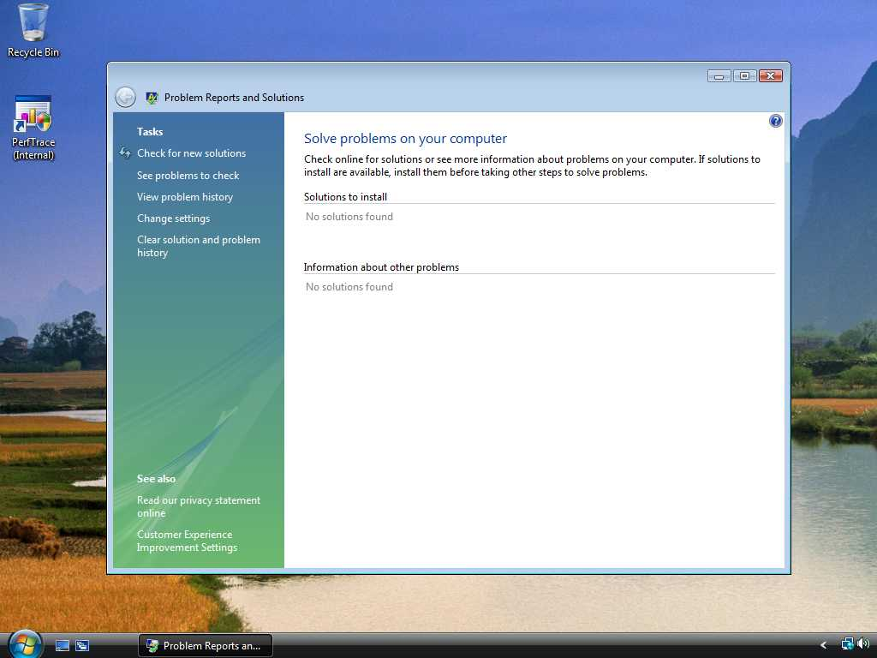

Slide 34
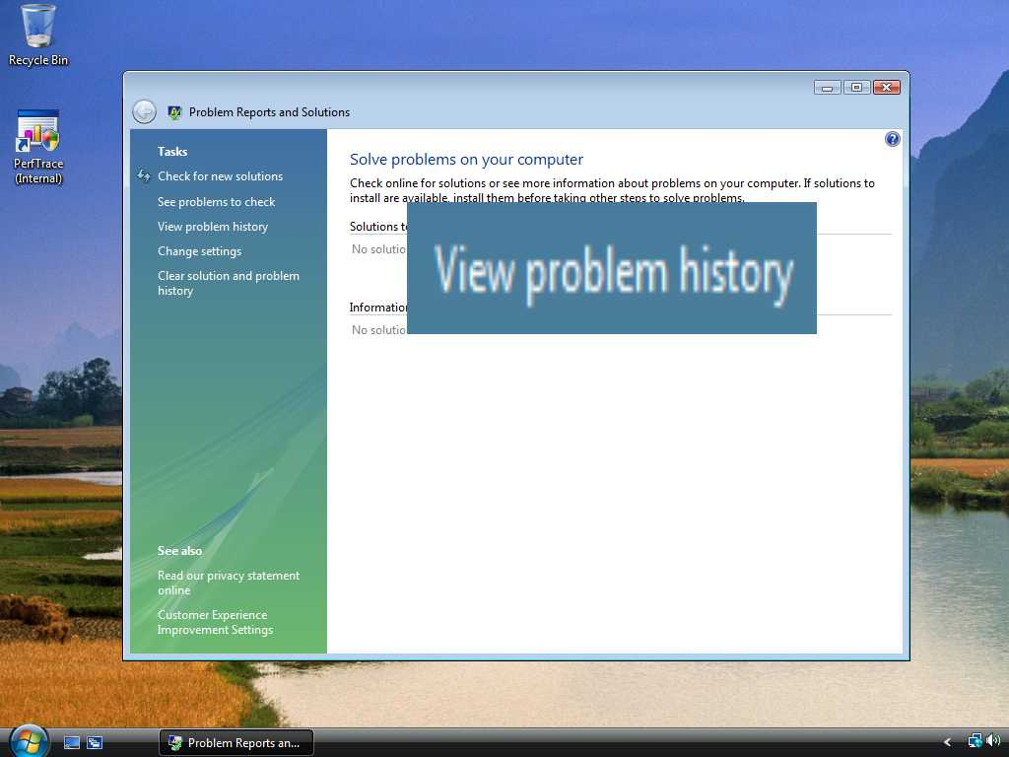

Slide 35
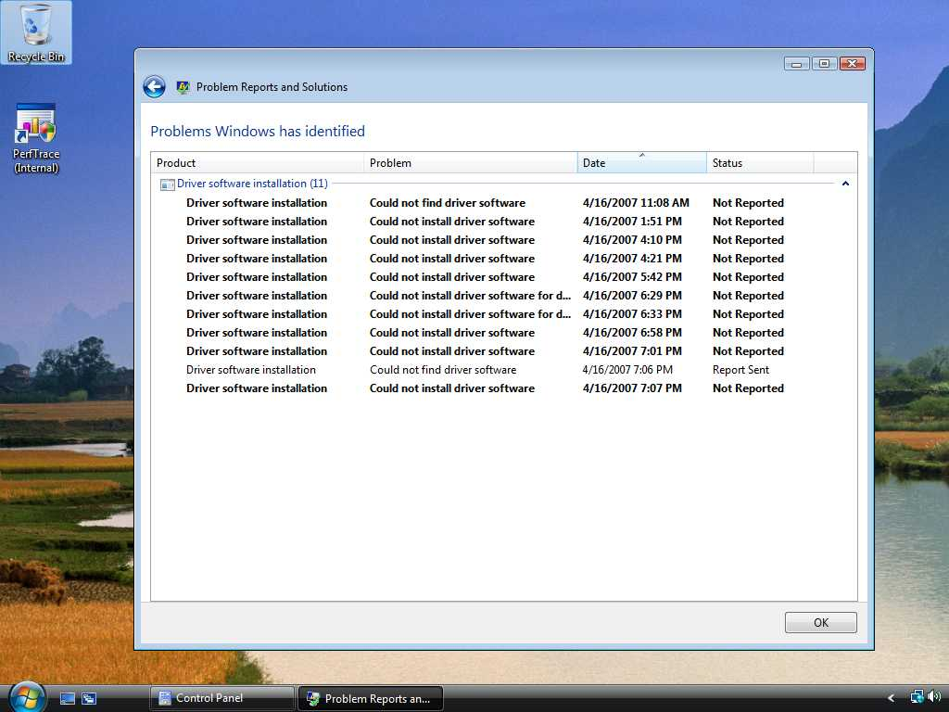

Slide 36
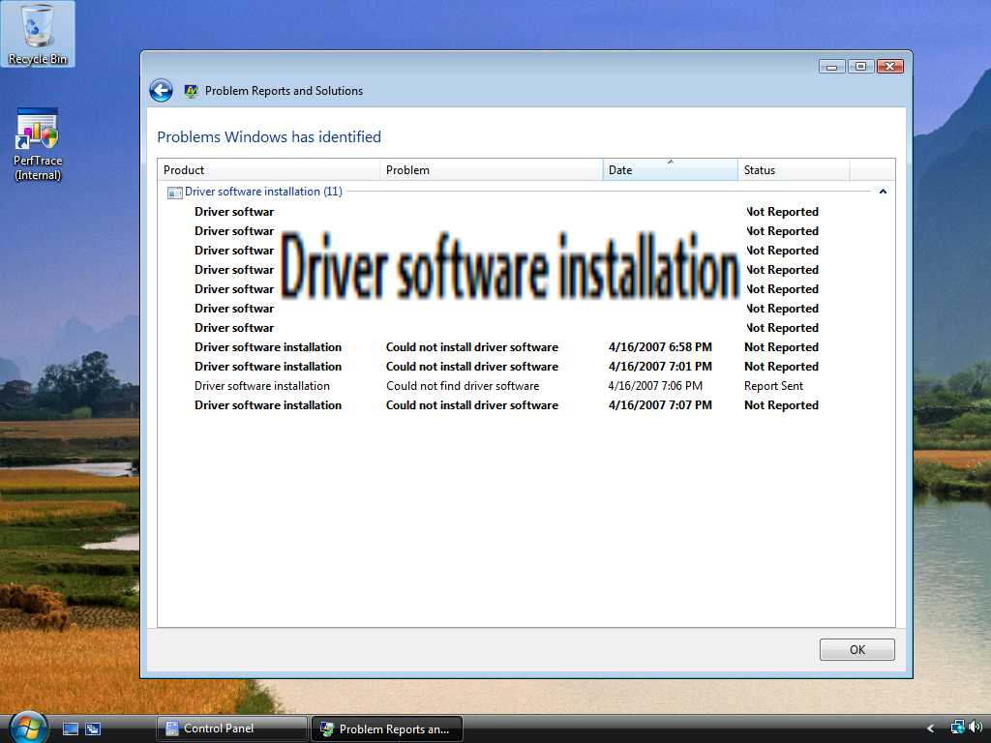

Slide 37
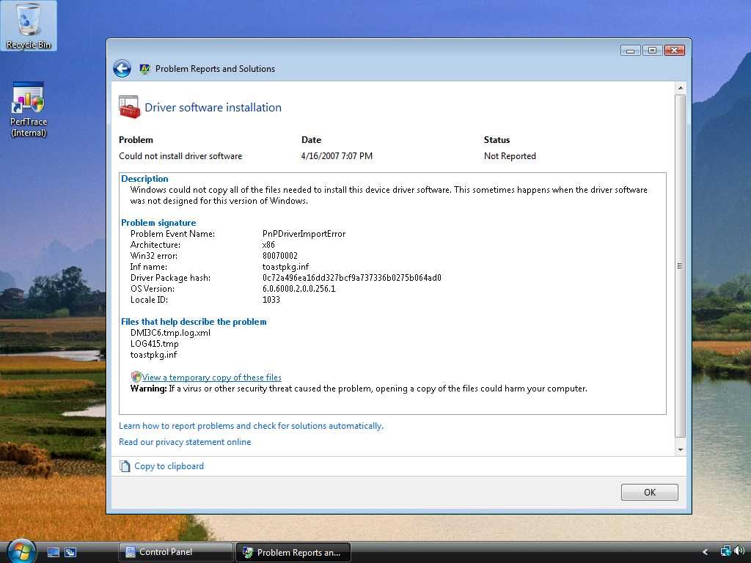

Slide 38
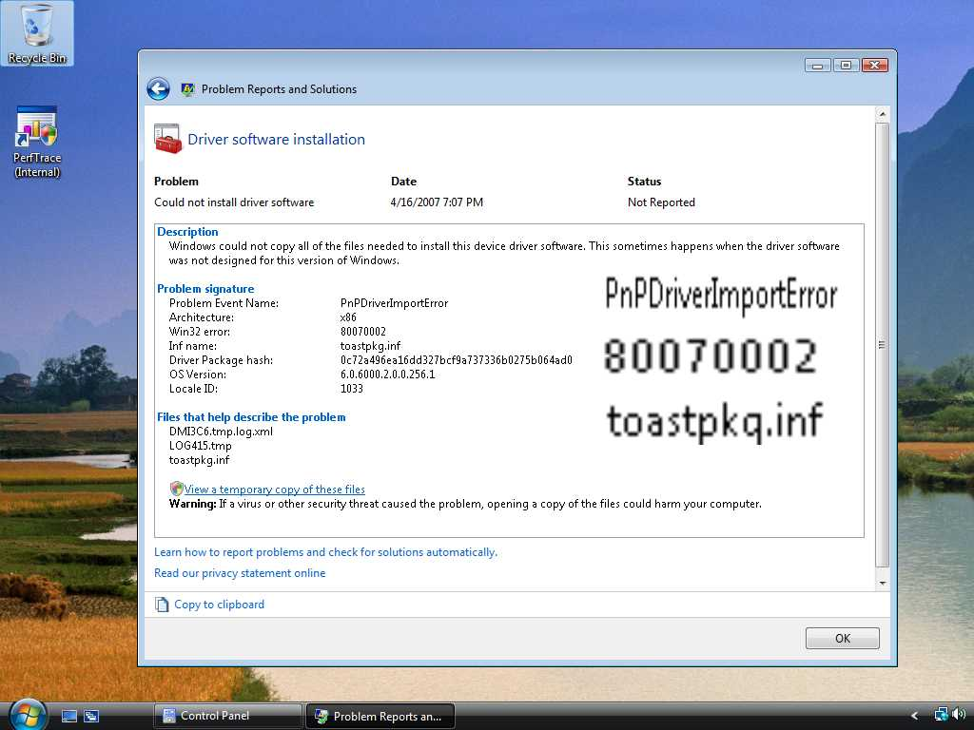

Slide 39
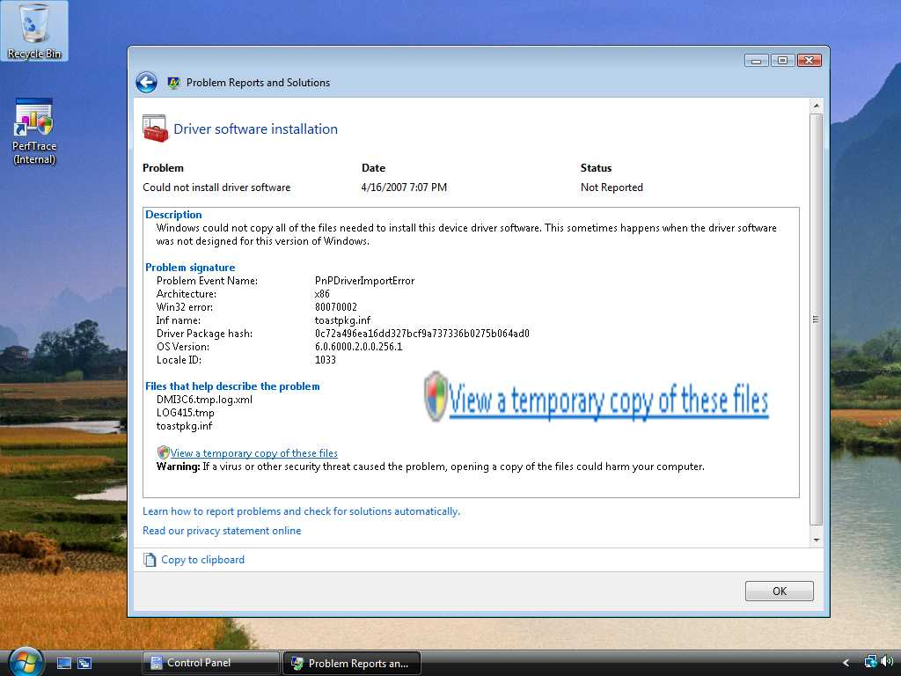

Slide 40
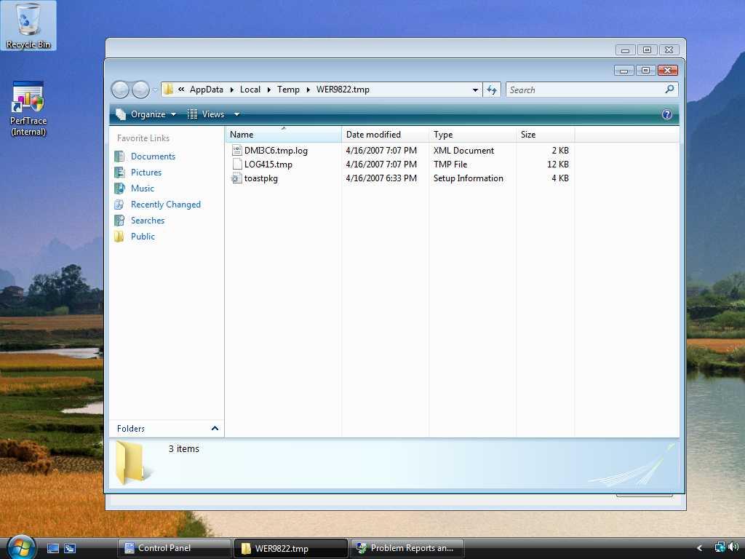

Slide 41
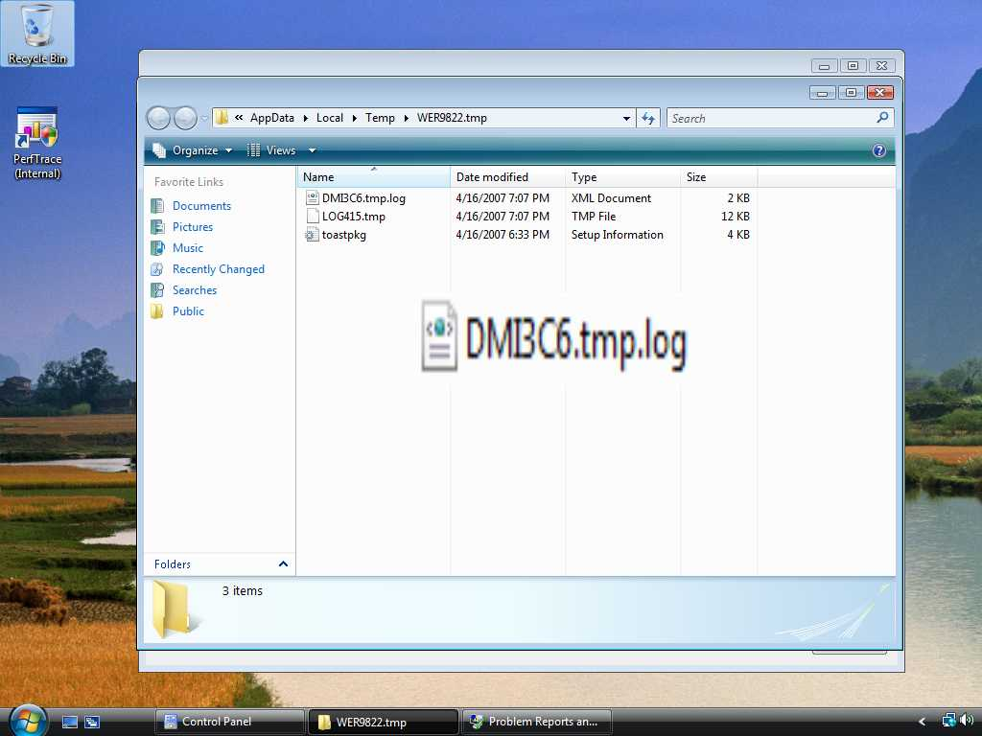

Slide 42
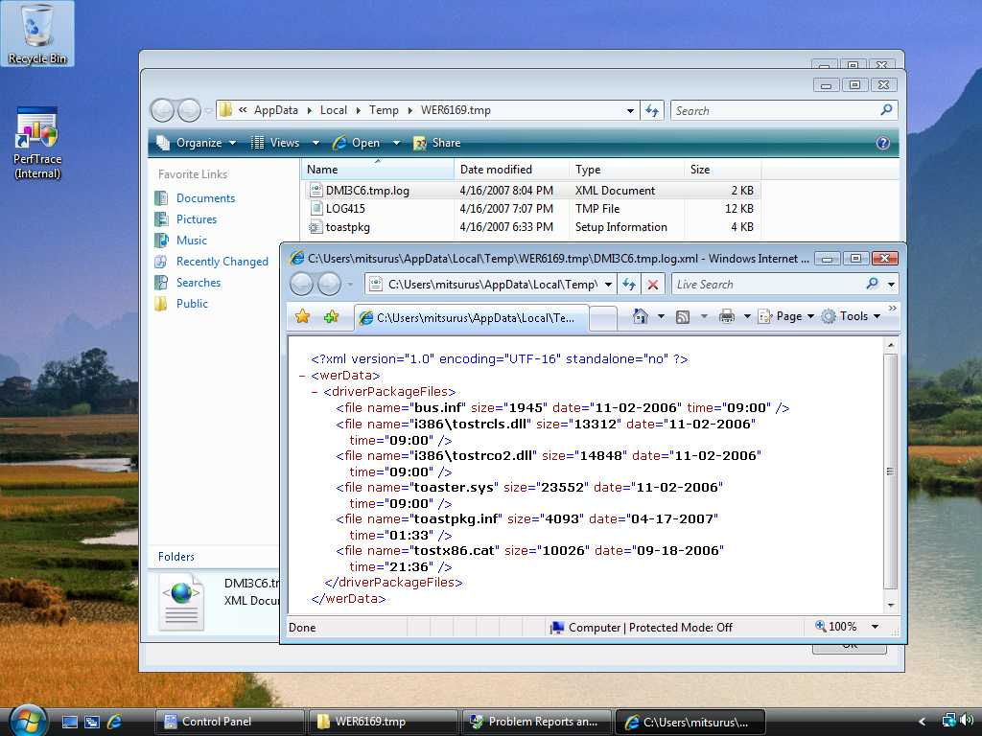

Slide 44
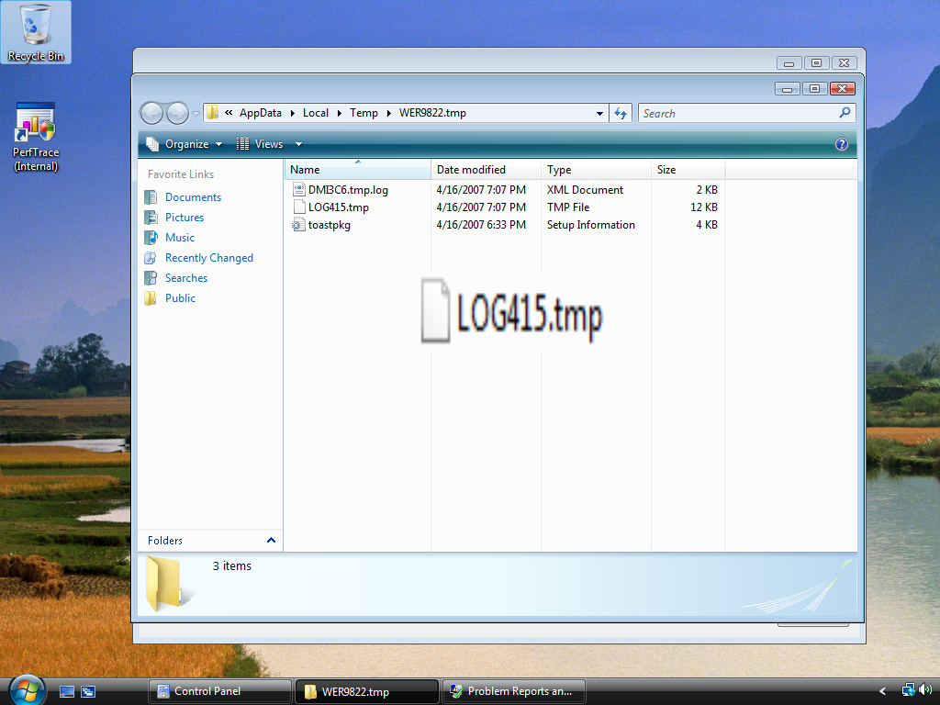

Slide 45
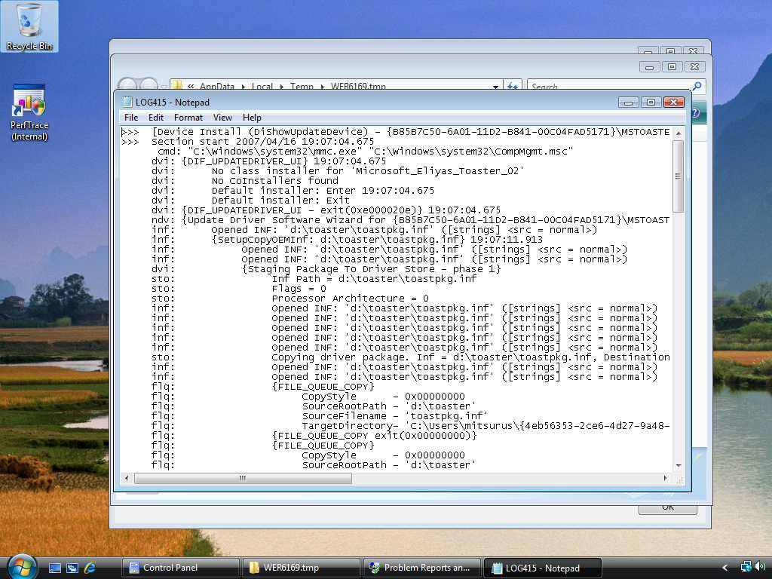

Slide 47


Slide 48
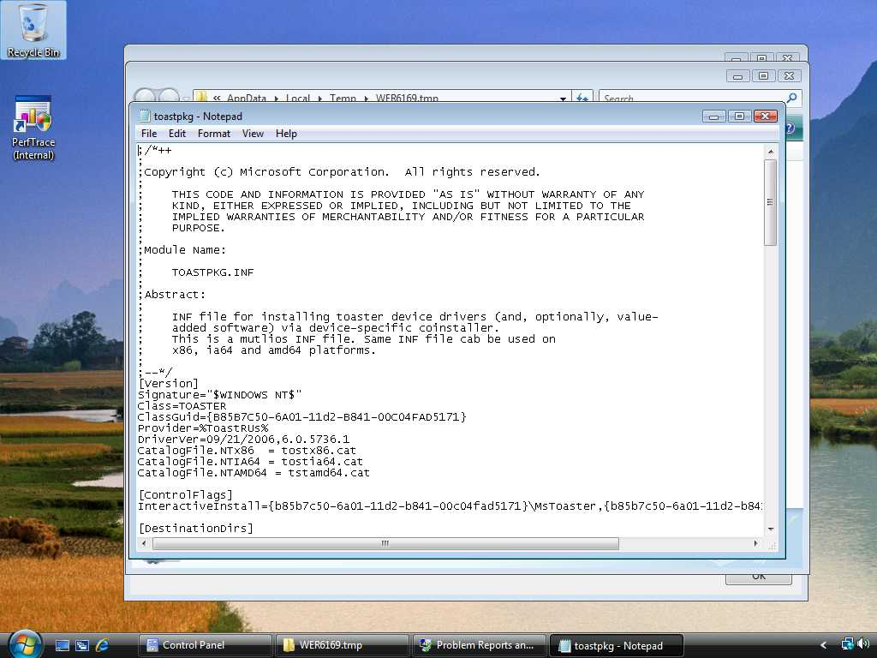

Slide 49
Common Device Driver Installation Errors
Collected through WER mechanism
November 2006 – March 2007
Windows Vista RTM build

Slide 50
Driver Installation Errors
Time Out Error 4,982,849 Hits
File Not Found 2,950,808 Hits
No Associated Service 1,278,169 Hits
Bad Service Install Section 528,541 Hits
Requires Interactive Window Station 445,318 Hits
Path Not Found 431,845 Hits

Slide 51
#1: Time Out Error
4,982,849 hits

Slide 52
Time Out Error
Code: 000005B4
Name: ERROR_TIMEOUT
Issues
  Various root error causes
    Co-installer hangs
      Showing Interactive UI
    Busy system
    Waiting for the device restart
Solution
  It depends on the problem

Slide 53
#2: File Not Found
2,950,808 Hits

Slide 54
File Not Found
Code: 00000002 or 80070002
Name: ERROR_FILE_NOT_FOUND
Issue
  The co-installer or the INF file references missing files
Solution
  Ensure that all files that are referenced in the INF file or in the co-installer are present in the driver package

Slide 55
File Not Found
Example 1
Some files are missing

Slide 56
File Not Found (Ex. 1)
There is a driver package
Driver Package

Slide 57
File Not Found (Ex.1)
The driver package has three files
Driver Package
Foo.inf
Foo.sys
Bar.sys

Slide 58
File Not Found (Ex.1)
The INF file has a “Copy File” section
Driver Package
[DDINSTALL.NT]
CopyFiles=WINXP_CPYFILE
[WINXP_CPYFILE]
Foo.sys
Bar.sys
Non-Exist.sys
Foo.sys
Bar.sys

Slide 59
File Not Found (Ex.1)
The copy file section refer to SYS files
Driver Package
[DDINSTALL.NT]
CopyFiles=WINXP_CPYFILE
[WINXP_CPYFILE]
Foo.sys
Bar.sys
Non-Exist.sys
Foo.sys
Bar.sys

Slide 60
File Not Found (Ex.1)
Issue: Cannot refer to Non-Exist.sys
Driver Package
[DDINSTALL.NT]
CopyFiles=WINXP_CPYFILE
[WINXP_CPYFILE]
Foo.sys
Bar.sys
Non-Exist.sys
Foo.sys
Bar.sys
Non-Exist.sys

Slide 61
File Not Found (Ex.1)
Typical Error Log
!!! flq: Error 2: The system cannot find the file specified.
flq: {SPFILENOTIFY_ENDQUEUE}
flq: {SPFILENOTIFY_ENDQUEUE - returned 0x00000000}
flq: {_commit_file_queue exit(0x00000002)}
!!! sto: Failed to copy the Driver Package to
C:\Users\Administrator\GUID Error = 80070002
!!! sto: Failed to copy driver package from source into temporary client location.
Error = 80070002,
SrcInf = X:\OEM Drivers\FooDriver\Foo.inf,
DestPath = C:\Users\Administrator\GUID

Slide 62
File Not Found (Ex.1)
Solution: All files should be in driver package
Driver Package
[DDINSTALL.NT]
CopyFiles=WINXP_CPYFILE
[WINXP_CPYFILE]
Foo.sys
Bar.sys
Exist.sys
Foo.sys
Bar.sys
Exist.sys

Slide 63
File Not Found
Example 2
SetupCopyOEMINF() in Co-Installer

Slide 64
File Not Found (Ex. 2)
There is a driver package
Driver Package

Slide 65
File Not Found (Ex.2)
The driver package has 4 files
Driver Package
Foo.inf
Foo.sys
Foo.dll
Bar.inf

Slide 66
File Not Found (Ex.2)
The INF file has a co-installer section
Driver Package
[DDInstall.CoInstallers]
CopyFiles = COINST_CPYFILES
[COINST_CPYFILES]
Foo.dll
Foo.sys
Foo.dll
Bar.inf

Slide 67
File Not Found (Ex.2)
The co-installer section registers Foo.dll
Driver Package
[DDInstall.CoInstallers]
CopyFiles = COINST_CPYFILES
[COINST_CPYFILES]
Foo.dll
Foo.sys
Foo.dll
Bar.inf

Slide 68
File Not Found (Ex.2)
The co-installer has SetupCopyOEMINF
Driver Package
[DDInstall.CoInstallers]
CopyFiles = COINST_CPYFILES
[COINST_CPYFILES]
Foo.dll
Foo.sys
DIF_INSTALLDEVICE:
SetupCopyOEMInf
(“Bar.inf”,,,);
Bar.inf

Slide 69
File Not Found (Ex.2)
Foo.dll tries to copy Bar.inf
Driver Package
[DDInstall.CoInstallers]
CopyFiles = COINST_CPYFILES
[COINST_CPYFILES]
Foo.dll
Foo.sys
DIF_INSTALLDEVICE:
SetupCopyOEMInf
(“Bar.inf”,,,);
Bar.inf

Slide 70
File Not Found (Ex.2)
Issue: SetupCopyOEMINF can't find the INF
Driver Package
[DDInstall.CoInstallers]
CopyFiles = COINST_CPYFILES
[COINST_CPYFILES]
Foo.dll
Foo.sys
DIF_INSTALLDEVICE:
SetupCopyOEMInf
(“Bar.inf”,,,);
Bar.inf

Slide 71
File Not Found (Ex.2)
Typical Error Log
dvi:CoInstaller 1: Enter (Post Processing)
inf:Opened PNF: ‘C:\Windows\INF\Foo.inf'
inf:{SetupCopyOEMInf: Z:\bar.inf}
inf:{SetupCopyOEMInf exit (0x00000002)}
!!! dvi: CoInstaller 1: failed(0x00000002)!
!!! Dvi:Error 2: The system cannot find the file specified.
dvi:{DIF_INSTALLDEVICE - exit(0x00000002)}
!!! ndv: Error(00000002) installing device!
ndv: Device install status=0x00000002

Slide 72
File Not Found (Ex.2)
Solution: Use CopyINF directive to copy the INF!
Driver Package
[DDInstall]
CopyINF = Bar.inf
Foo.sys
Foo.dll
Bar.inf

Slide 73
File Not Found
Example 3
References inbox driver directly

Slide 74
File Not Found (Ex.3)
There is a driver pkg and an inbox file
Driver Package
Driver Store
USBSER.sys

Slide 75
File Not Found (Ex.3)
The driver package has an INF file
Driver Package
Driver Store
Foo.inf
USBSER.sys

Slide 76
File Not Found (Ex.3)
The INF file has a "Copy File" section
Driver Package
Driver Store
[DDINSTALL.NT]
CopyFiles=VISTA_CPYFILE
[VISTA_CPYFILE]
usbser.sys
USBSER.sys

Slide 77
File Not Found (Ex.3)
The "Copy File" section refers to inbox file
Driver Package
Driver Store
[DDINSTALL.NT]
CopyFiles=VISTA_CPYFILE
[VISTA_CPYFILE]
usbser.sys
USBSER.sys

Slide 78
File Not Found (Ex.3)
Issue: Cannot find the sys file
Driver Package
Driver Store
[DDINSTALL.NT]
CopyFiles=VISTA_CPYFILE
[VISTA_CPYFILE]
usbser.sys
USBSER.sys

Slide 79
File Not Found (Ex.3)
Typical Error Log
flq:SourcePath - [C:\Windows\System32\DriverStore\FileRepository\foo.inf_3906eed6]
flq:SourceFile - [usbser.sys]
!!! Flq:SPFILENOTIFY_NEEDMEDIA: returned FILEOP_ABORT.
flq:{_COMMIT_FILE_QUEUE exit(0x00000002)}
ndv:Device install status=0x00000002
ndv:Performing device install final cleanup...
! Ndv:Queueing up error report since device installation failed...
ndv:{Core Device Install - exit(0x00000002)}

Slide 80
File Not Found (Ex.3)
Solution: Use Include/Needs directive!
Driver Store
Driver Package
Foo.inf
MDMCPQ.inf
USBSER.sys

Slide 81
File Not Found (Ex.3)
Solution: Use Include/Needs directive!
Driver Store
Driver Package
[DDINSTALL.NT]
Include=MDMCPQ.inf
Needs=
FakeModemCopyFileSection
MDMCPQ.inf
USBSER.sys

Slide 82
File Not Found (Ex.3)
Solution: Use Include/Needs directive!
Driver Store
Driver Package
[DDINSTALL.NT]
Include=MDMCPQ.inf
Needs=
FakeModemCopyFileSection
[FakeModemCopyFileSection]
usbser.sys,,,0x20
USBSER.sys

Slide 83
File Not Found (Ex.3)
Solution: Use Include/Needs directive!
Driver Store
Driver Package
[DDINSTALL.NT]
Include=MDMCPQ.inf
Needs=
FakeModemCopyFileSection
[FakeModemCopyFileSection]
usbser.sys,,,0x20
USBSER.sys

Slide 84
#3: No Associated Service
1,278,169 hits

Slide 85
No Associated Service
Code
  E0000219
Name
  SPAPI_E_NO_ASSOCIATED_SERVICE
Issue
  AddService directive was not processed.
Solution
  Ensure that all description of the AddService directive in the Services section is correct

Slide 86
No Associated Service Example
References non-existent section

Slide 87
No Associated Service
There is a driver pkg and an Inbox INF file
Driver Package
Driver Store
Bar.inf

Slide 88
No Associated Service
The driver package has an INF file
Driver Package
Driver Store
Foo.inf
Bar.inf

Slide 89
No Associated Service
The INF file uses Include/Needs directive
Driver Package
Driver Store
[DDINSTALL.NT]
Include=Bar.inf
Needs=
Non_Exist_Sect
Bar.inf

Slide 90
No Associated Service
Needs directive refers to non-existent section
Driver Package
Driver Store
[DDINSTALL.NT]
Include=Bar.inf
Needs=
Non_Exist_Sect
[Exist_Sect]
Usbser.sys
[Non_Exist_Sect}

Slide 91
No Associated Service
Solution: Refers to existent section!
Driver Package
Driver Store
The referred section doesn’t exist
[DDINSTALL.NT]
Include=Bar.inf
Needs=Non-Exist_Sect
[Exist_Sect]
Usbser.sys
[Non_Exist_Sect}

Slide 92
No Associated Service
Typical Error Log
!!! dvi: Error: No INF AddService directives contained the flag SPSVCINST_ASSOCSERVICE
!!! Dvi: Error while installing services.
!!! Dvi: Error 0xe0000219: The installation failed because a function driver was not specified for this device instance.
!!! Dvi: Cleaning up failed installation
dvi: {Install DEVICE exit (0xe0000219)}
!!! dvi: Cleaning up failed installation (e0000219)
!!! dvi: Error 0xe0000219: The installation failed because a function driver was not specified for this device instance.
dvi: {DIF_INSTALLDEVICE - exit(0xe0000219)}

Slide 93
No Associated Service
Solution: Refer to existent section!
Driver Package
Driver Store
[DDINSTALL.NT]
Include=Bar.inf
Needs=Exist_Sect
[Exist_Sect]
Usbser.sys

Slide 94
#4: Bad Service Install Section
528,541 hits

Slide 95
Bad Service Install Section
Code: E0000217
Name: SPAPI_E_BAD_SERVICE_INSTALLSECT
Issue
  An AddService directive in a service installation section is invalid.
  The drivers on CopyFile section are not copied correctly

Slide 96
Bad Service Install Section
Solution
  Ensure that all description of the AddService directive in the Services section is correct
  Ensure that the binary file that is described in the AddService directive is present on the system

Slide 97
Bad Service Install Section
Example
Some files are NOT copied correctly

Slide 98
Bad Service Install Section
There is a driver package
Driver Package

Slide 99
Bad Service Install Section
The driver package has two files
Driver Package
Foo.inf
Foo.sys

Slide 100
Bad Service Install Section
The INF file has CopyFile Sect and Service Sect
Driver Package
[DDINSTALL.NT]
CopyFiles=VISTA_CPYFILE
[VISTA_CPYFILE]
[DDINSTALL.NT.Services]
AddService=Foo,,,,,
Foo.sys

Slide 101
Bad Service Install Section
The copy file section refers to no file
Driver Package
No Files
[DDINSTALL.NT]
CopyFiles=VISTA_CPYFILE
[VISTA_CPYFILE]
[DDINSTALL.NT.Services]
AddService=Foo,,,,,
Foo.sys

Slide 102
Bad Service Install Section
Foo.sys is not copied correctly
Driver Package
[DDINSTALL.NT]
CopyFiles=VISTA_CPYFILE
[VISTA_CPYFILE]
[DDINSTALL.NT.Services]
AddService=Foo,,,,,
Foo.sys

Slide 103
Bad Service Install Section
Issue: The service section doesn't work
Driver Package
[DDINSTALL.NT]
CopyFiles=VISTA_CPYFILE
[VISTA_CPYFILE]
[DDINSTALL.NT.Services]
AddService=Foo,,,,,
Foo.sys

Slide 104
Bad Service Install Section
Typical Error Log
inf: {Install Inf Section [DDInstall.NT.Services]}
inf: AddService=WinXP,2,DriverService (Foo.inf line 47)
inf: ServiceBinary=C:\Windows\system32\drivers\Foo.sys
(Foo.inf line 53)
!!! Dvi:Add Service: Binary
'C:\Windows\system32\drivers\Foo.sys'
for service ‘Foo' is not present
!!! inf: {Install Inf Section [DDInstall.NT.Services]
exit(0xe0000217)}
!!! Dvi: Error while installing services.
!!! Dvi: Error 0xe0000217: A service installation section in this INF is invalid.
dvi: {Install DEVICE exit (0xe0000217)}
!!! dvi: Error 0xe0000217: A service installation section in this INF is invalid.

Slide 105
Bad Service Install Section
Solution: List files in the "Copy File" section
Driver Package
[DDINSTALL.NT]
CopyFiles=VISTA_CPYFILE
[VISTA_CPYFILE]
Foo.sys
[DDINSTALL.NT.Services]
AddService=Foo,,,,,
Foo.sys

Slide 106
#5: Interactive Window Station
445,318 Hits

Slide 107
Interactive Window Station
Error Code: 000005B3
Name: ERROR_REQUIRES_INTERACTIVE_WINDOWSTATION
Issue
  The driver installation requires an interactive window
This might be intentional error

Slide 108
Interactive Window Station
Solution
  Solve the root cause problem that requires an interactive window
  Ensure that the co‑installer uses a finish-install action or a finish-install page to show UI

Slide 109
Interactive Window Station
Example
Showing UI during driver installation

Slide 110
Interactive Window Station
There is a driver package
Driver Package

Slide 111
Interactive Window Station
The driver package has an INF file
Driver Package
Foo.inf

Slide 112
Interactive Window Station
There is InteractiveInstall directive
Driver Package
[ControlFlags]
InteractiveInstall = USB\VID_0000&PID_1111, USB\VID_0000&PID_2222

Slide 113
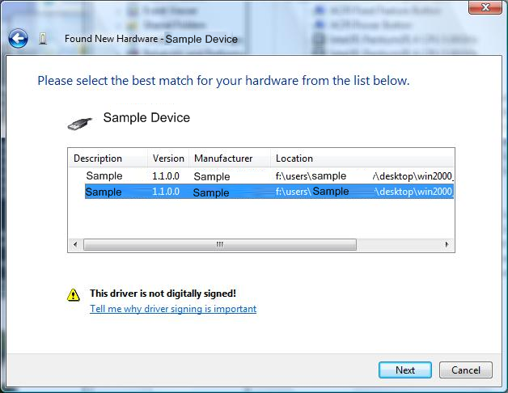
Interactive Window Station
InteractiveInstall directive tries to show UI
Driver Package
[ControlFlags]
InteractiveInstall = USB\VID_0000&PID_1111, USB\VID_0000&PID_2222

Slide 114
Interactive Window Station
Issue: This fails on Windows Vista
Driver Package
[ControlFlags]
InteractiveInstall = USB\VID_0000&PID_1111, USB\VID_0000&PID_2222

Slide 115
Interactive Window Station
Solution: Use Finish Install Action
Driver Package
Driver Package
Foo.dll
Foo.inf

Slide 116
Interactive Window Station
Solution: Use Finish Install Action
Driver Package
Foo.dll
Foo.inf
[DDInstall.CoInstallers]
CopyFiles = COINST_CPYFILES
[COINST_CPYFILES]
Foo.dll

Slide 117
Interactive Window Station
Solution: Use Finish Install Action
Driver Package
switch(InstallFunction) {
case DIF_NEWDEVICEWIZARD_FINISHINSTALL:
OpenUI()
Foo.inf
[DDInstall.CoInstallers]
CopyFiles = COINST_CPYFILES
[COINST_CPYFILES]
Foo.dll

Slide 118
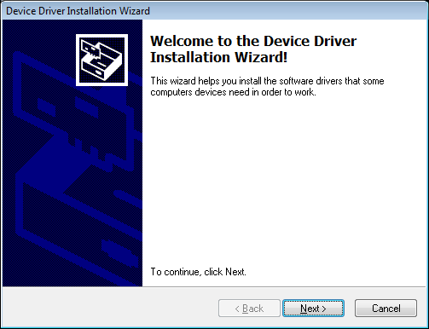
Interactive Window Station
Solution: Use Finish Install Action
Driver Package
switch(InstallFunction) {
case DIF_NEWDEVICEWIZARD_FINISHINSTALL:
OpenUI()

Slide 119
Call To Action
Use ‘Problem Reports and Solutions’ to debug driver installation errors
Check your driver package if it is installed correctly on Windows Vista
Verify and fix your driver installation errors with today’s information

Slide 120
Additional Resources
Web Resources
  Driver Installation Web Site: http://www.microsoft.com/whdc/driver/install/default.mspx
  Driver Package Compatibility for Windows Vista: http://www.microsoft.com/whdc/driver/install/drvpkgerrors.mspx
  Debugging Device Installation in Windows Vista: http://www.microsoft.com/whdc/driver/install/diagnose.mspx
  How to use or to reference the Usbser.sys: http://support.microsoft.com/kb/837637
  Device Finish-Install Actions in Windows Vista: http://www.microsoft.com/whdc/driver/install/Finish_Install.mspx
Related Sessions
  DVR-T393 Building Deployable Device Driver Packages
  DVR-T394 Extending Device Installation With Coinstallers
  DVR-T395 Deploying Device Drivers in Windows Vista
  DVR-T502 Debugging Device Installation On Windows Vista

Slide 121

© 2007 Microsoft Corporation. All rights reserved. Microsoft, Windows, Windows Vista and other product names are or may be registered trademarks and/or trademarks in the U.S. and/or other countries.
The information herein is for informational purposes only and represents the current view of Microsoft Corporation as of the date of this presentation. Because Microsoft must respond to changing market conditions, it should not be interpreted to be a commitment on the part of Microsoft, and Microsoft cannot guarantee the accuracy of any information provided after the date of this presentation.
MICROSOFT MAKES NO WARRANTIES, EXPRESS, IMPLIED OR STATUTORY, AS TO THE INFORMATION IN THIS PRESENTATION.

Slide 122
Appendix

Slide 123
#6: Path Not Found
431,845 hits

Slide 124
Path Not Found
Code: 80070003
Name: ERROR_PATH_NOT_FOUND
Issue
  The INF file specifies an invalid file path
Solution
  Ensure that references specify existing paths and are stated in the correct format.
[SourceDisksFiles]
Winxp.dll = 1, Correct Path (such as WinVista\i386)

Slide 125
Path Not Found
Example 1
Wrong path is referenced

Slide 126
Path Not Found (Ex.1)
There is a driver CD
Windows Driver CD

Slide 127

Path Not Found (Ex.1)
The CD has a file and a folder with two files
Windows Driver CD
[Windows Vista]
Foo.inf
Foo.sys
Bar.sys

Slide 128
Path Not Found (Ex.1)
The INF file's sections
Windows Driver CD
[Windows Vista]
[SourceDisksNames]
1=“Windows Driver CD”,,,
[SourceDisksFiles]
Foo.sys = 1, WindowsXP
Bar.sys = 1, WindowsXP
Foo.sys
Bar.sys

Slide 129
Path Not Found (Ex.1)
Issue: The sect refers to non-existent folder
Windows Driver CD
[Windows Vista]
[SourceDisksNames]
1=“Windows Driver CD”,,,
[SourceDisksFiles]
Foo.sys = 1, WindowsXP
Bar.sys = 1, WindowsXP
Foo.sys
Bar.sys
[Windows XP]

Slide 130
Path Not Found (Ex.1)
Issue: The section cannot refer to the folder
Windows Driver CD
[Windows Vista]
[SourceDisksNames]
1=“Windows Driver CD”,,,
[SourceDisksFiles]
Foo.sys = 1, WindowsXP
Bar.sys = 1, WindowsXP
Foo.sys
Bar.sys
[Windows XP]

Slide 131
Path Not Found (Ex.1)
Typical Error Log
!!! sto:CMI failed to import assembly into the File
Repository.
Error = 80070003,
Identity=
x86_Foo.inf_GUID_DRIVERVER_neutral_ID
!!! Sto:CMI failed to import driver package.
Error = 80070003,
Inf = Z:\Foo.inf
!!! sto: Server side import process failed to add package to the driver store.
Error = 80070003,
Inf Path = Z:\Foo.inf

Slide 132
Path Not Found (Ex.1)
Solution: Write the path correctly!
Windows Driver CD
[WindowsVista]
[SourceDisksNames]
1=“Windows Driver CD”,,,
[SourceDisksFiles]
Foo.sys = 1, WindowsVista
Bar.sys = 1, WindowsVista
Foo.sys
Bar.sys

Slide 133
Path Not Found (Ex.2)
There is a driver CD
Windows Driver CD

Slide 134
Path Not Found (Ex.2)
The CD has a file and a folder with two files
Windows Driver CD
[Windows Vista]
Foo.inf
Foo.sys
Bar.sys

Slide 135
Path Not Found (Ex.2)
The INF File sections
Windows Driver CD
[Windows Vista]
[SourceDisksNames]
1=“Windows Driver CD”,,,
[SourceDisksFiles]
WindowsVista\Foo.sys = 1
WindowsVista\Bar.sys = 1
Foo.sys
Bar.sys

Slide 136
Path Not Found (Ex.2)
The SourceDisksFiles sect has path on left side
Windows Driver CD
[Windows Vista]
[SourceDisksNames]
1=“Windows Driver CD”,,,
[SourceDisksFiles]
WindowsVista\Foo.sys = 1
WindowsVista\Bar.sys = 1
Foo.sys
Bar.sys

Slide 137

Path Not Found (Ex.2)
Issue: This INF doesn't work
Windows Driver CD
[Windows Vista]
[SourceDisksNames]
1=“Windows Driver CD”,,,
[SourceDisksFiles]
WindowsVista\Foo.sys = 1
WindowsVista\Bar.sys = 1
Foo.sys
Bar.sys

Slide 138
Path Not Found (Ex.2)
Typical Error Log
!!! sto:CMI failed to import assembly into the File
Repository.
Error = 80070003,
Identity=
x86_Foo.inf_GUID_DRIVERVER_neutral_ID
!!! Sto:CMI failed to import driver package.
Error = 80070003,
Inf = Z:\Foo.inf
!!! sto: Server side import process failed to add package to the driver store.
Error = 80070003,
Inf Path = Z:\Foo.inf

Slide 139
Path Not Found (Ex.2)
Solution: Write the path correctly!
Windows Driver CD
[Windows Vista]
[SourceDisksNames]
1=“Windows Driver CD”,,,
[SourceDisksFiles]
Foo.sys = 1, WindowsVista
Bar.sys = 1, WindowsVista
Foo.sys
Bar.sys

