Slide 1
Home Media Transports
Dr. Anton Monk
CTO
Multimedia over Coax Alliance

Slide 2
Agenda
Introduction to Multi-room DVR
Home Networking Requirements
MoCA as Industry Standard
MoCA Field Trial Data
MoCA Features

Slide 3
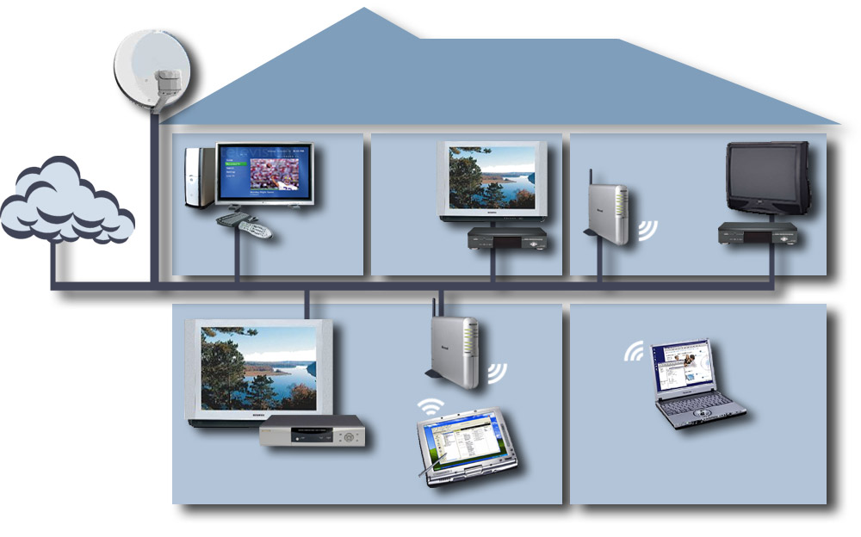
Multi-Room DVR – The “Killer App”
DBS
Office/Den
Master Bedroom
Kids Bedroom
802.11 Bridge
Cable, Telco
Media Center PC
Client STB
Client STB
Coax
Coax
Broadband Multimedia
802.11 Wireless AP
WebPad
Home Server - DVR
Family Room
Kitchen

Slide 4
Home Networking Requirements (1 Of 3)
Reliable and ubiquitous
Works where your TV and STB works
Clean, dedicated, shielded medium with open frequency band
Simple to install
No new wires (or splitters)
Retail or non-truck roll solution
High performance: >95% solution
With reasonable remediation for remaining <5%
Net Throughput > 100 Mbps
Packet Error Rate < 1e – 5
Delay < 10 msec; Jitter < 1 msec

Slide 5
Home Networking Requirements (2 Of 3)
Delivers “no excuses” HDTV and DVD quality
Supports and coexists with:
Cable, DBS, Terrestrial
Telco, CE, PC
Supports content protection, key protocols, high data rates
Consistent with DLNA, DTCP-IP, CableHome, UPnP

Slide 6
Home Networking Requirements (3 Of 3)
Meets all key market requirements
Enables cost-effective multi-room DVR
Including HDTV
Satisfies any-room access to all home media:
Video, audio, voice
Data, gaming, control
Saves installation and deployment costs
Future-proof support of >1 Gbps home network

Slide 7
Industry Standard (1 Of 3)
Open, industry-driven alliance, promoting:
Networking of digital video and entertainment
Through existing coaxial cable in the home
Only alliance with board-of-directors representation from:
Telco, Cable, DBS, and Retail
Field tested and deployed…
43 members and counting…

Slide 8
Industry Standard (2 Of 3)
Field tests of 250 homes
>110 Mbps net throughput
…in 97 percent of all outlets
Completed 4 certification waves with 17 certified products
MoCA MAC/PHY 1.0 approved
Distributed to members in January 2006
Deployed in well over 200,000 homes
In U.S., to date

Slide 9
Industry Standard (3 Of 3)
Promoter Members Associate and Affiliate Members

Slide 10
MoCA Field Trial Data Rate Results (1 Of 2)
250 homes, 15 cities, 120 zip codes, 5K+ person-hours
>110Mbps net/usable > 97% of outlets without remediation
Performance: Percent of Paths versus Bit Rate
100
90
80
70
100 Mbps
60
% Paths
50
40
30
20
10
0
0
50
100
Mbps
150
200
250
PHY Rate
Throughtput (MAC) Rate

Slide 11
MoCA Field Trial Data Rate Results (2 Of 2)
Packet Error Rate less than 10-6
Latency less than 5ms
Net usable (MAC) data rates:
With no changes to home coax system:
97% of all paths in all homes achieved ≥ 110 Mbps
With simple remediation to installed coax cable system:
100% of homes achieved ≥ 95 Mbps on every path in the home
Validated in mass deployment by Verizon FiOS service

Slide 12
MoCA Features (1 Of 2)
Physical Layer
Automatically pre-equalizes modulation to path frequency response
Each path independently and continuously optimized
Up to 270 Mbps PHY
PER < 10-6 (no retransmissions, low latency)

Slide 13
MoCA Features (2 Of 2)
MAC Layer
Fully scheduled protocol (no collisions)
Automatically selected and mobile network coordinator
Support for admission control and parameterized QoS
Privacy
>100Mbps net (UDP) throughput

Slide 14
MoCA Frequency Coexistence (1 Of 2)
Coax and splitters support reliable communications above 860 MHz
Coexistence with existing services (next slide)
MoCA is the only solution which…
…meets the strict requirements of a multimedia home network
…including coexistence with all service providers’ frequency plans

Slide 15
MoCA Frequency Coexistence (2 Of 2)
Coexistence with existing services
CATV Cable Modem upstream (5 to 42 MHz)
UHV/VHF video and Cable Modem downstream to 806/860 MHz
DBS services from 950 to 2150 MHz
1
5-42
Upstream
CM
54-806/860
Off-Air/CATV
MoCA
MoCA
…
MoCA
5-42
Upstream
CM
54-806/860
Off-Air/CATV
MoCA
950-2150
Satellite L-Band
2

Slide 16
Summary (1 Of 2)
Home usage model
Room-to-room, peer-to-peer, full mesh connectivity
>100 Mbps net throughput
No-excuses, glitch-free video
Consumer- or Service-provider enabled
Medium for whole home reliable, maintainable coverage
Connections collocated with TVs and other video devices
Coexists with existing services and devices
Medium used “as is” – no new cables, splitter replacements

Slide 17
Summary (2 Of 2)
Real world validation
>110Mbps in 97% of all connections
Reasonable remediation for other connections
Mass deployment by Verizon FiOS service
Deployment expected by other operators 2H07
MoCA meets all requirements for home networking digital entertainment without compromise

Slide 18
Additional Resources
Web Resources
MoCA Alliance: http://mocalliance.org
Whitepapers: http://www.mocalliance.org/en/industry/ whitepapers.asp
Contact
anton.monk@mocalliance.org

