Slide 1
Real Time Collaboration With Microsoft UC Platform
Warren Barkley
Microsoft Unified Communications

Slide 2
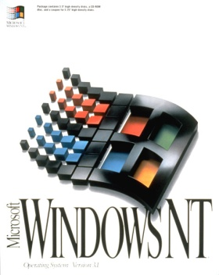
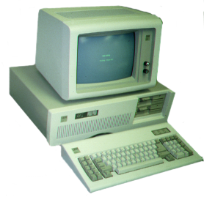
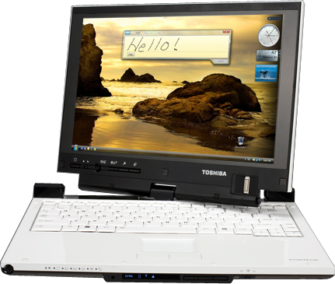
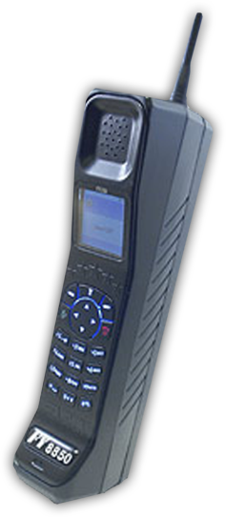
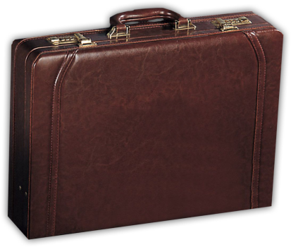
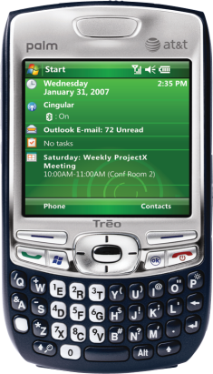
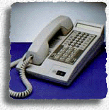
Historical Perspective
1992
2007

Slide 3
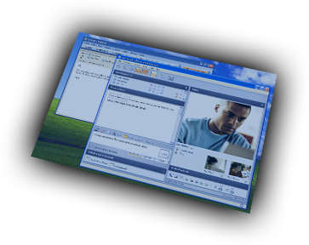
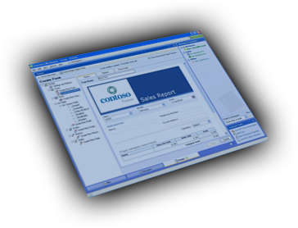
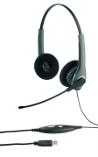
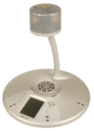
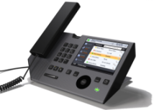
Opportunity Software Brings
More Innovation
More Productivity
Software-Powered VoIP
Basic VoIP
Cost Reduction
$
More Choice
Greater Cost Reduction

Slide 4
Today’s Business Environment What customers tell us
Too much time wasted playing phone tag
Communications tools don’t work together
Users want to be able to work from anywhere
Employee
Big investments in existing PBX systems
Deliver more than just cost savings
Make decisions that ensure flexibility
IT Decision Makers
Consumer software everywhere
Multiple directories across many systems
There are already many different admin tools
IT Professional
Notes:
5/29/2007 1:16 PM
© 2004 Microsoft Corporation. All rights reserved.
This presentation is for informational purposes only. Microsoft makes no warranties, express or implied, in this summary.
4

Slide 5
Today’s Business Environment Drivers for Unified Communications
Communicate From Inside Applications
Integrated Communications Tools
Anywhere Access
Streamlined Communications
Integration with Existing Telephony Systems
Software-powered VoIP
Rich Development Platform
Software-powered VoIP Foundation
Enterprise-grade Security and Compliance
Centralized Provisioning
Common Management Tools
Operational Control
Notes:
5/29/2007 1:16 PM
© 2004 Microsoft Corporation. All rights reserved.
This presentation is for informational purposes only. Microsoft makes no warranties, express or implied, in this summary.
5

Slide 6
UC Qualification Program For Devices
Greater Choice and Innovation
Innovative devices to support UC value prop
End-points tightly integrated into software experience (i.e., presence info on device)
Higher levels of functionality and quality
“Just Works” Experience
Improved Economics
Standards Based Extensions
Devices interoperate with UC software (i.e., USB telephony HID, extensions to telephony HID)
Uses inbox class drivers for audio/video
Focus on innovation – not creating new drivers
Breaks down vertical silos of proprietary hardware phones, devices, and servers)

Slide 7
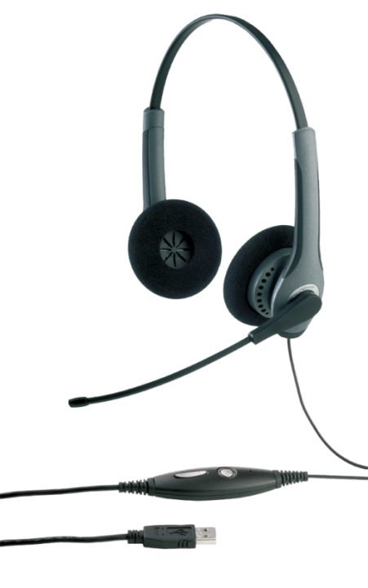
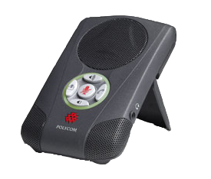
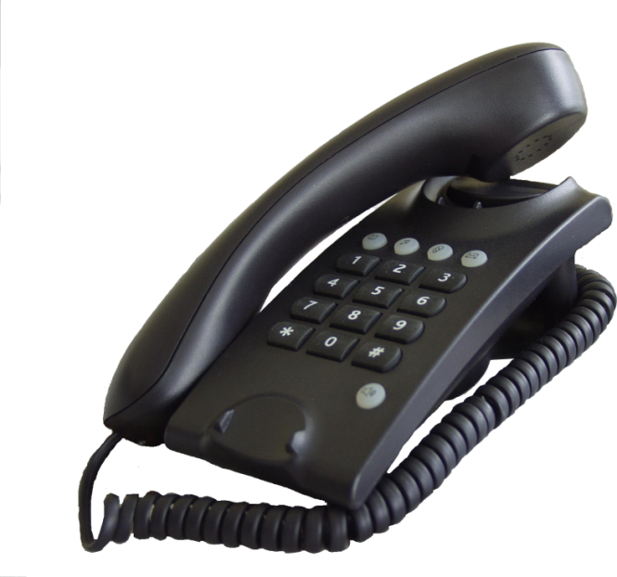
Unified Communications Devices HID based interop example
Answer incoming call
Press HOOKSWITCH on Jabra
Press TALK on Polycom
Lift Vitelix handset off cradle
Disconnect call in progress
Press HOOKSWITCH on Jabra
Press END on Polycom
Put Vitelix handset on cradle

Slide 8
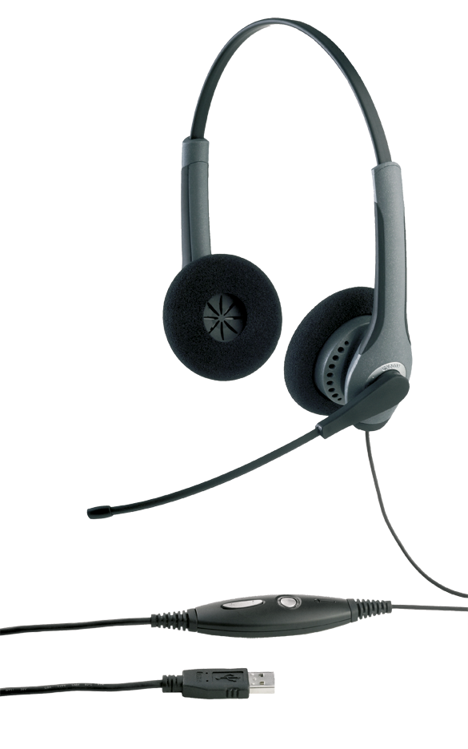
Unified Communications Devices Acoustic adjustments example
Volume level adjustment
Press volume +/- on Jabra
Mute/unmute a call
Press mute button on Polycom

Slide 9
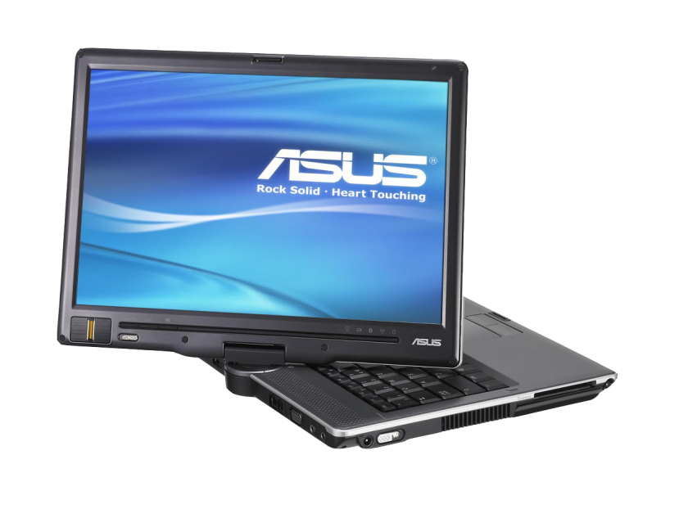
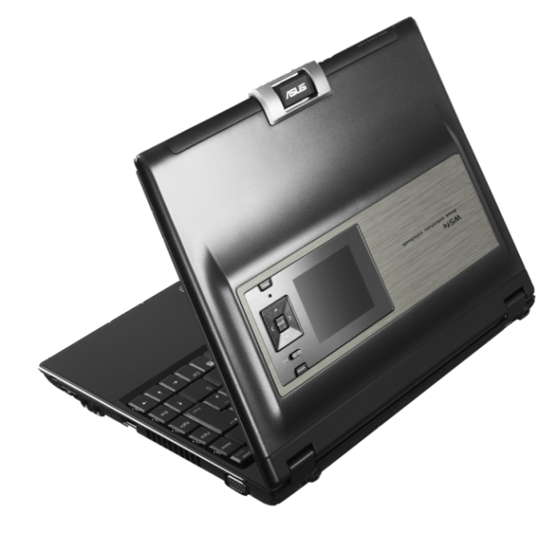
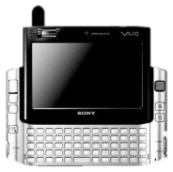
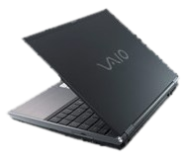
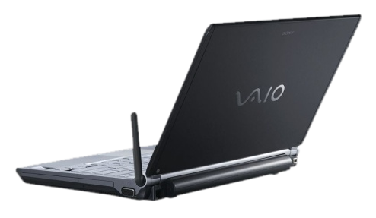
Unified Communications Devices Laptops evolve as personal communicators

Slide 10
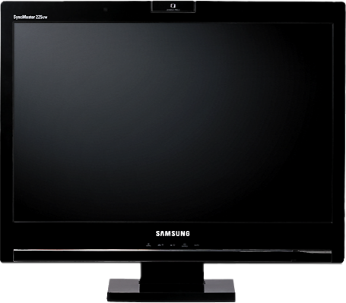
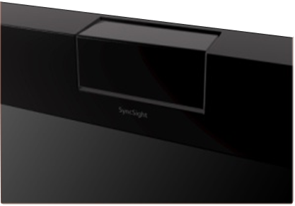
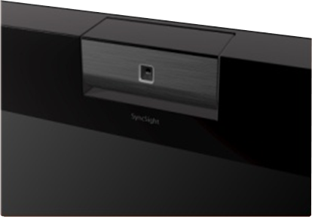
Unified Communications Devices Desktops evolve as UC solutions
Closed
Open

Slide 11
Samsung
partner
Mr. Chang Ik Choi
Senior Manager
Samsung

Slide 12
Samsung UC Monitor Center of communication

Slide 13
Samsung UC Monitor
Into your happy communication @ Samsung UC Monitor
Live Communication
Easy Communication
Video Communication
2.0M Pixel Webcam
2 Array Omni Microphones
Hidden Stereo Speaker
Support others devices
Support USB Head Set and Conventional Head Set
Just connect & enjoy
No need any special driver
Support the USB Video Class
Support others devices
Support USB Head Set and Conventional Head Set
Clean cables
Support an USB cable (Camera Video and Audio, Hub)
Added the USB 2 Down stream
Certified UC Communication
Guaranteed the compatibility and reliability

Slide 14
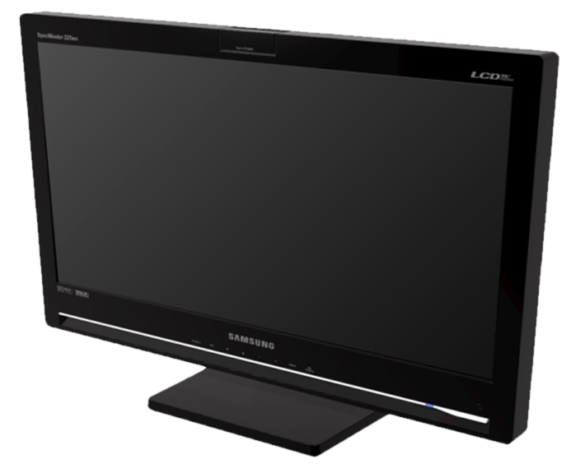
UC Monitor
Speaker phone, web-cam, integrated into widescreen monitor
Plug and play with Windows Vista and Windows XP
No additional drivers required
No additional setup required

Slide 15
UC Devices Demo
demo
Nilesh Londhe and Regis Crinon
Microsoft Unified Communications

Slide 16
The Road To Higher Quality
Audio
Video
Super Wide Band
HD
UC in 2007
Wideband
VGA
Narrowband
CIF

Slide 18
Next Steps
Develop audio/video peripheral devices that work with Microsoft UC software
UC Devices Specification
Available for download after signing NDA+TDA via Microsoft specserver
E-mail spec request to ucqdev @ microsoft.com
Download Office Communicator Server 2007 Public Beta (www.microsoft.com/uc)

Slide 20
© 2007 Microsoft Corporation. All rights reserved. Microsoft, Windows, Windows Vista and other product names are or may be registered trademarks and/or trademarks in the U.S. and/or other countries.
The information herein is for informational purposes only and represents the current view of Microsoft Corporation as of the date of this presentation. Because Microsoft must respond to changing market conditions, it should not be interpreted to be a commitment on the part of Microsoft, and Microsoft cannot guarantee the accuracy of any information provided after the date of this presentation. MICROSOFT MAKES NO WARRANTIES, EXPRESS, IMPLIED OR STATUTORY, AS TO THE INFORMATION IN THIS PRESENTATION.

