Slide 1
PlaysForSure Network Media Devices And Windows Vista
Craig Murphy
Program Manager
Microsoft Corporation

Slide 2
Key Takeaways
Be a leader in advancing 64-bit computing
Adopt best practices and new tools
Let’s partner on new hardware directions
Understand Windows Media Player Sharing technologies
Understand relationship with PlaysForSure for Network Devices
Create Windows Vista-friendly multimedia experiences

Slide 3
Agenda
Media Sharing on Windows
PlaysForSure Network Devices
Windows Media Player Sharing architecture and formats
Metadata and device compatibility settings
Digital Living Network Alliance (DLNA) and Windows support

Slide 4
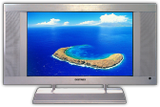
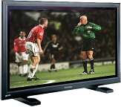
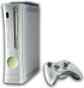
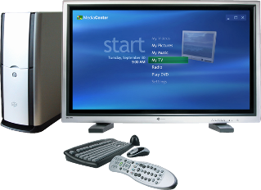
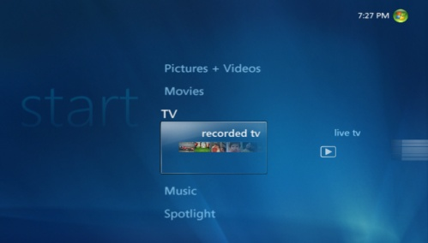
PC Uniquely Suited To Distribute Content Around The Home
content
devices
Photos
Videos
TV
Music
PlaysForSure devices
Smartphones
Portable Media Players
Media Center Extenders
Xbox 360

Slide 5
Media Sharing On Windows Guiding principles
“It just works”
Simple, intuitive and easy to use
Seamless Content Flow
Platform for media devices
Quality
Consumer Electronics-grade multimedia experiences
Device Reach
Extend content throughout the home media ecosystem

Slide 6
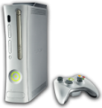
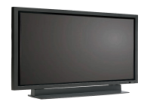
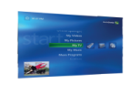
Media Sharing On Windows Connecting network devices
PlaysForSure Network Devices
CON-T418 PlaysForSure Network Devices and Windows Vista
Media Center Extenders
CON-T411 Media Center Extender Technology: Overview
CON-T412 Media Center Extender Device Design

Slide 7
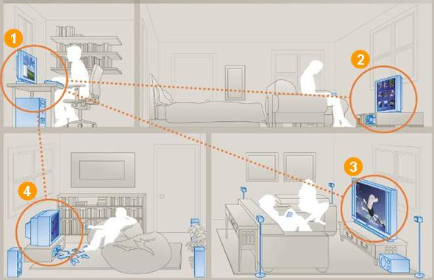
Media Sharing On Windows Whole home entertainment
Windows Vista PC with Media Sharing enabled
PlaysForSure media player streams music and movies
Xbox 360 streams music, pictures and video
PlaysForSure Digital TV streams photos, videos and music

Slide 8
Windows Media Player 11 Media sharing feature
Available on Windows Vista/Windows XP
Integration of Windows Media Connect
Access to Windows Media Player (WMP) library
Music, photos and videos
Clear, Windows Media DRM, URGE, etc.,
Album art, enhanced metadata, more…
Single media management point

Slide 9
WMP Sharing Baseline technologies
WMA, MP3 PCM, WAV
WMV, AVI MPEG-1/2
JPEG, PNG
YUV
Codecs
Windows Media DRM
for Network Devices
Windows Media Player
Metadata Store
Content Services
UPnP AV 1.0
UPnP 1.0
RTSP/RTCP
Control, Discovery and Eventing
HTTP 1.0/1.1, RTP
A/V Transport
TCP
UDP
Network Protocols
IP

Slide 10
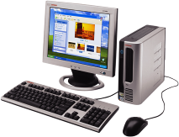
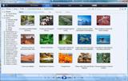
PlaysForSure Network devices
Enables content flow from a Windows PC to a network device
Windows Media DRM-protected content is downloaded and stored on PC
Protected content is streamed from PC to network device

Slide 11
PlaysForSure Network devices
Requirements ensure base-level of Windows media sharing interoperability
Uses certified WMA/WMV decoders
Supports Windows Media DRM for Network Devices (Cardea)
Implements UPnP/DLNA technologies
Required for Media Center Extender

Slide 12
PlaysForSure Network devices
2.x Requirements Categories
DLNA compliance
Network connectivity and discovery
Authorization and registration
Content playback
Requirements verified by Test Kit
PlaysForSure links at end of presentation

Slide 13
PlaysForSure And Windows Vista Certified for Windows Vista logo
PlaysForSure is the platform for Network Devices to get the Certified for Windows Vista logo
Network devices passing PlaysForSure 2.x can use the Certified for Windows Vista logo
Microsoft Marketing efforts are focused on the Certified for Windows Vista logo

Slide 14
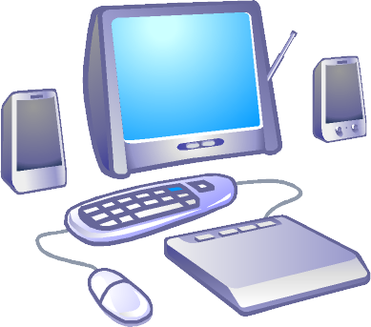
WMP Sharing Architecture
WMP Network Sharing Service
per user
WMP database
provider
Metadata
UPnP discovery
Browse/Search
WMP Sharing (UPnP MediaServer:1)
ContentDirectory:1
X_MS_MediaReceiverRegistrar:1
Content request and delivery
Media Delivery Engine (HTTP, RTSP/RTP)
c:\foo.wma

Slide 15
Supported Formats
Audio: WMA, MP3, WAV, PCM
Pictures: JPEG, PNG, RAW*
Video: WMV, MPEG1/2, AVI
Playlists: WPL, M3U
WMP Sharing format support is extensible
Requires codec and metadata handler
Additional information in whitepaper
* Windows Vista Only

Slide 16
Metadata Container hierarchy
Root (0)
Music (1)
Video (2)
Pictures (3)
Playlists (12)
All Music (4)
All Video (8)
All Video(B)
All Playlists (13)
Genre (5)
Genre (9)
Date Taken (C)
Folders (17)
Artist (6)
Actor (A)
Albums (D)
Album (7)
Series(E)
Keyword (D2)
Playlists (F)
Playlists (10)
Playlists (11)
Folders (14)
Folders (15)
Folders (16)
Contrib.Artists (100)
Rating (200)
Rating (300)
Album Artist (107)
1+ stars (301)
2+ stars (302)
(star ratings)
Composer (108)
3+ stars (303)
4+ stars (304)
Rating (101)
5+ stars (305)
Unrated(306)
(star ratings)

Slide 17
Metadata Searching
WMP Sharing supports Search action
Variety of searchable attributes
Specific operators for some metadata
Only “simple” searches allowed
Search can be disabled by device

Slide 18
Metadata Sorting
Containers and content items can be sorted based on metadata
Not all metadata attributes sortable
“Top level” containers not sortable

Slide 19
Metadata Filtering
Filtering containers
WMP Sharing supports upnp:searchClass
searchClass tag provided for each UPnP object under a container
Filtering content
GetProtocolInfo action
Use res@protocolInfo
Inspect file extension in URL

Slide 20
Metadata String Lengths
Maximum string lengths used by WMP Sharing are either
256 Unicode characters
1024 Unicode characters
After conversion of Unicode to UTF-8, number of bytes may be higher
Set buffer sizes accordingly

Slide 21
Microsoft Metadata Extensions General
Microsoft namespace-specific media content properties
Difficult to express with existing UPnP/DLNA attributes
Contained with <desc> element
Attributes searchable, sortable and filterable unless otherwise noted

Slide 22
Microsoft Metadata Extensions Microsoft attributes
Artist
Album artist
Performer (a.k.a. contributing artist)
Conductor
Author
Composer
Writer

Slide 23
Microsoft Metadata Extensions Microsoft attributes
Ratings
UserRating
UserEffectiveRating
UserRatingInStars
UserEffectiveRatingInStars
Service Provider
Source URL
Year

Slide 24
Codec Identification
“res@microsoft:codec” attribute
Represents codec used for the associated media file
Expressed as a GUID
Links to media type GUIDs and descriptions at end of presentation

Slide 25
Compatibility Flags
Used to define per-device behavior
Two types of compatibility flags values
User – set by a user or an application
Device – provided via device-description using “microsoft:X_DeviceCaps” attribute
User type has highest priority in defining device behavior
Stored in the registry HKLM\Software\Microsoft\Windows Media Player NSS\ 3.0\Devices\<DeviceMACAddress>\

Slide 26
Compatibility Flags Flag behaviors
Exclude URLs for
HTTP/RTSP
Protected or non-transcoded WMA Lossless content
Exclude DLNA tags or PCM parameters
Return no search capabilities
Disable device notifications
“Fake” playlist count

Slide 27
Retrieving Thumbnail Images
Available for music, pictures and video
Device must be validated by WMDRM service to get album art for music
Retrieval method #1: AlbumArt URI
root item URL + “?albumart=true”
Faster, but JPEG only
Retrieval method #2: Parameterized URL
root item URL + “?formatID=z,width=x,height=y”
Slower, but more flexible

Slide 28
WMP Sharing Windows operating system support
Windows XP Service Pack 2
Windows Vista Home Basic
Limited network QoS support
Windows Vista Home Premium/Ultimate
Home Basic features, plus
Advanced network QoS support
Windows Vista Business/Enterprise
Group Policy may block sharing

Slide 29
WMP Sharing Differentiating features on Windows Vista
Support for RTSP/RTP streaming
Unique device Model Number
4 → WMP Sharing on Windows Vista
3 → WMP Sharing on Windows XP
Media Sharing “bootstrapped” on network type selection
Port exceptions “pre-plumbed” in Windows Firewall

Slide 30
WMP Sharing And DLNA
DLNA 1.0 compliance is required for PlaysForSure 2.x network devices
WMP Sharing device description includes <dlna:X_DLNADOC> element
WMP Sharing includes DLNA tags and resource elements for media exposed to other devices
DLNA Guidelines for DLNA Digital Media Server (DMS) device not fully supported

Slide 31
Call To Action
Keep making devices that are fun and useable!
Comply with PlaysForSure 2.x Requirements for Network Devices
Get certified as a PlaysForSure device
Refer to the “Building a Device” whitepaper
Use Compatibility Flags, Microsoft metadata extensions, and Search capabilities
Link to whitepaper at end of presentation

Slide 32
Additional Resources
Web Resources
“Building a Network Device Compatible with Windows Media Player 11”: http://go.microsoft.com/fwlink/?LinkId=87957
UPnP MediaServer and MediaRenderer-related specifications: http://www.upnp.org/standardizeddcps/mediaserver.asp
Windows Media Player 11 – Media Sharing feature: http://www.microsoft.com/windows/windowsmedia/devices/athome/ default.aspx
GUID values for Windows Media-supported media types: http://msdn2.microsoft.com/en-us/library/Aa390521.aspx
Descriptions of Windows Media-supported media types: http://msdn2.microsoft.com/en-us/library/Aa390528.aspx
PlaysForSure 2.x Resources and Test Kits: http://www.playsforsure.com/product/specifications/default.aspx
Technical Overview of Windows Media DRM 10 for Devices http://go.microsoft.com/fwlink/?LinkId=28570

Slide 33
Additional Resources
Related Sessions
CON-T411: Media Center Extender Technology: Overview
CON-T412: Media Center Extender Device Design
CON-T419: PlaysForSure Portable Devices and Windows Vista
CON-H421: Certification Tests for Portable Devices: Workshop
Questions?
pfsinfo @ microsoft.com

Slide 34
© 2007 Microsoft Corporation. All rights reserved. Microsoft, Windows, Windows Vista and other product names are or may be registered trademarks and/or trademarks in the U.S. and/or other countries.
The information herein is for informational purposes only and represents the current view of Microsoft Corporation as of the date of this presentation. Because Microsoft must respond to changing market conditions, it should not be interpreted to be a commitment on the part of Microsoft, and Microsoft cannot guarantee the accuracy of any information provided after the date of this presentation. MICROSOFT MAKES NO WARRANTIES, EXPRESS, IMPLIED OR STATUTORY, AS TO THE INFORMATION IN THIS PRESENTATION.

