Slide 1
Web Services On Devices Rally Overview
Rob Williams
Program Manager
Microsoft Corporation

Slide 2
Key Takeaways
Be a leader in advancing 64-bit computing
Adopt best practices and new tools
Let’s partner on new hardware directions
Learn about Web Services
See great examples of Web Services that are shipping today

Slide 3
Agenda
Windows Rally
Web Services Overview
Device Examples

Slide 4
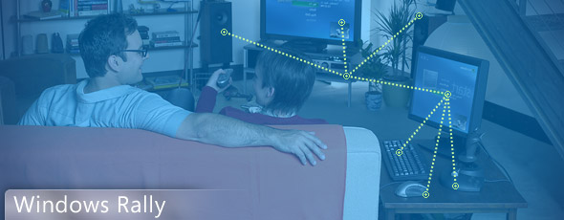
Windows Rally
Effortless to configure and maintain
Reliable and simple to manage
More secure and provide rich digital experiences

Slide 5
Device Challenges
How do I make my devices easier to install and use?
How can I offer new services and advanced scenarios to my customers?
How can I make it easier for IT pros to manage my devices?
How do I make it easy for developers to extend the functionality of my device?
How can I make devices with strong security easily and quickly?

Slide 6
Rally And Web Services
Windows Rally
How do I make my devices easier to install and use?
Windows Rally
How can I offer new services and advanced scenarios to my customers?
Windows Rally
How can I make it easier for IT pros to manage my devices?
Windows Rally
How do I make it easy for developers to extend the functionality of my device?
Windows Rally
How can I make devices with strong security easily and quickly?

Slide 7
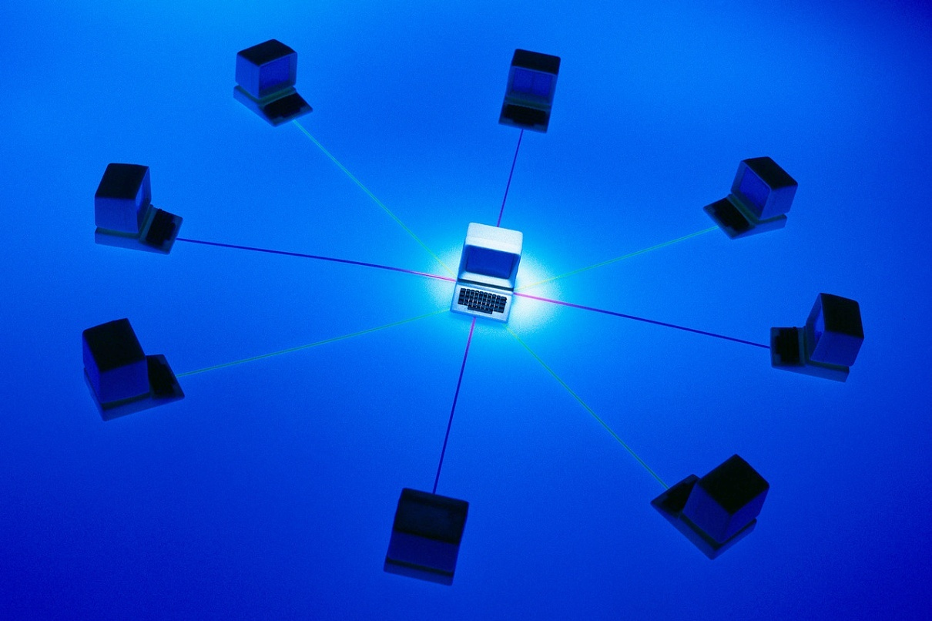
What Is Web Services
Interoperable Machine to Machine interaction over a network
Software talking to Software

Slide 8
Interoperability On The Internet

Slide 9
Interoperability For Browsers
User
HTML
HTTP
TCP
IP

Slide 10
Interoperability For Machines
Service and Client
WS-*
SOAP
HTTP
UDP
TCP
IP

Slide 11
Who Is Web Services?
WS-SEC. CONV.
SOAP / WSDL
WS-SECURITY
MTOM
WS-TRUST
Service Orientation
Support for Enterprise Scenarios
Support for Consumer Scenarios
Interoperable
Messaging
Security
Microsoft Corporation | ü | ü
Oracle | ü | ü
IBM | ü | A
BEA Systems, Inc. | ü | A
Sun Microsystems, Inc. | ü | ü
Google | ü
Amazon.com | ü
eBay, Inc | ü
Apache | ü | ü
White Mesa Software | ü | ü
gSOAP | ü | ü
Ricoh | ü | 
Epson Corporation | ü | 
HP | ü | 
Xerox | ü | 
Intel Corporation | ü | 
Canon Inc. | ü | 
Microsoft Corporation | ü | ü | ü
Oracle | ü |  | 
IBM | ü |  | ü
BEA Systems, Inc. | ü | A | 
RSA Security Inc. | ü |  | 
Systinet Corporation | ü |  | 
Apache | ü |  | 
Layer7 Technologies | ü | A | ü
Computer Associates International, Inc. | ü | A | A
Sun Microsystems, Inc. | ü
SAP AG | ü
Tibco Software, Inc. | ü
IONA Technologies | ü
WebMethods, Inc. | ü
Nokia | ü
Cape Clear | ü
gSOAP | ü
Netegrity |  | A | A
Verisign, Inc. |  | A | A
WS-RM
WS-Policy
WS-AT
MEX
Assurances
Metadata
Microsoft Corporation | ü | ü
Oracle | 
IBM | ü | ü
BEA Systems, Inc. | ü | A
Sun Microsystems, Inc. | ü
Cape Clear | ü
Systinet Corporation | ü
Blue Titan Software, Inc | ü
IONA Technologies |  | ü
Arjuna Technologies |  | ü
Choreology Ltd |  | ü
Apache | ü | ü
Microsoft Corporation | ü | ü
Oracle |  | 
IBM |  | 
BEA Systems, Inc. | A | ü
SAP AG | A | 
Sun Microsystems, Inc. | ü | ü
Verisign Inc. |  | A
Sonic Software |  | A
Computer Associates International, Inc. | A
WebMethods, Inc. | A
gSOAP |  | ü
ü | Released product
 | Public interop
A | Co-Author only
© 2005 Microsoft Corporation. All rights reserved. The information contained in this document represents the current view at the time of publication and is subject to change.

Slide 12
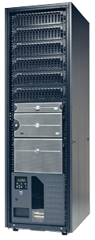
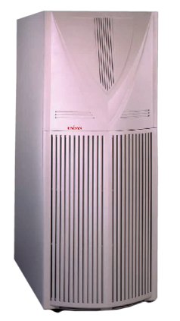
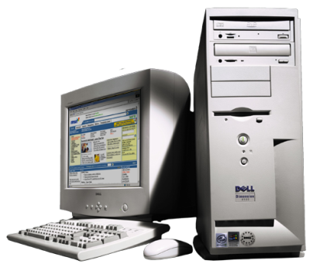
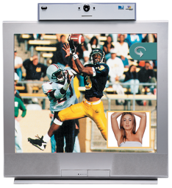
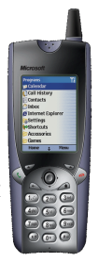
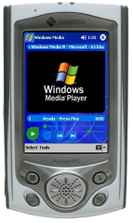
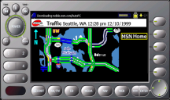
Web Services Scales
“Scales Away” spans organizations and geographies
“Scales Out”
by adding machines
“Scales Up” on large systems
“Scales In” on a machine
“Scales Down”
to devices

Slide 13
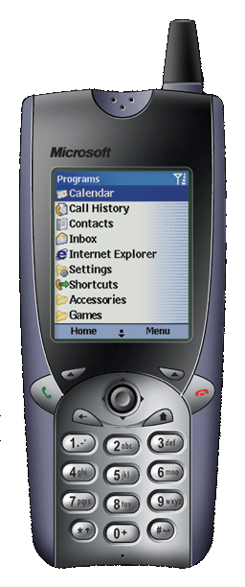
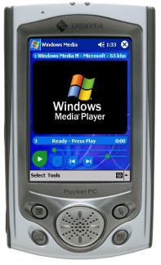
The Devices Profile For Web Services Scaling WS to limited resource devices
“Scales Down” to devices

Slide 14
Devices Profile For Web Services (DPWS)
A lightweight subset of WS specifications

Slide 15
The Imperative To Connect
Meetings
Documents
Life
Music
Presentations
Entertainment

Slide 16
Meetings Near Me
demo
Using Web Services to find people and meetings for collaboration

Slide 17
The Imperative To Connect
Meetings
Documents
Life
Music
Presentations
Entertainment

Slide 18
Network Projector
demo
Network Projectors are using Web Services to change the meeting room

Slide 19
The Imperative To Connect
Meetings
Documents
Life
Music
Presentations
Entertainment

Slide 20
Secure Enterprise Scan
demo
Web Services drives documents to the desktop

Slide 21
Secure Print
demo
Ensuring confidentiality of critical documents

Slide 22
The Imperative To Connect
Meetings
Documents
Life
Music
Presentations
Entertainment

Slide 23
Home And AV Control
demo
Simplifying Entertainment and Life

Slide 24
Implementations From Microsoft
WSDAPI in Windows Vista
Clients for Printers, Scanners, Projectors, PCs, People
Your Device Client or Service!
Windows Communication Foundation
Your Internet Service!
Windows Embedded CE 6.0
Projector Device Service
Full WSDAPI Support (2H07)
.NET Micro Framework (2H07)

Slide 25
Implementations From Industry
Printers
Scanners
MFPs
Projectors
Home Automation
Building Control
Medical
Routers / Firewalls
RFID
Factory Automation
Point Of Sale
Energy Management
Commercial Embedded Stacks
Open Source Stacks

Slide 26
Call To Action
Learn about and Adopt Windows Rally
Use Web Services for Discovery and Control of your Network Device
Join the Rally Summits to learn more about Network Connected Devices

Slide 27
Additional Resources
Web Resources
Rally: http://www.microsoft.com/Rally
Related Sessions
Wednesday
CON-T475 Web Services on Devices: Rally Implementation 3:15pm
Thursday
CON-V479 Web Services on Devices – Lab 8:30am

Slide 28
© 2007 Microsoft Corporation. All rights reserved. Microsoft, Windows, Windows Vista and other product names are or may be registered trademarks and/or trademarks in the U.S. and/or other countries.
The information herein is for informational purposes only and represents the current view of Microsoft Corporation as of the date of this presentation. Because Microsoft must respond to changing market conditions, it should not be interpreted to be a commitment on the part of Microsoft, and Microsoft cannot guarantee the accuracy of any information provided after the date of this presentation. MICROSOFT MAKES NO WARRANTIES, EXPRESS, IMPLIED OR STATUTORY, AS TO THE INFORMATION IN THIS PRESENTATION.

