Slide 1
Windows Rally Overview And Implementations
Jim Barber
Sr. Program Manager
Windows Rally

Slide 2
WinHEC Goals
Be a leader in advancing 64-bit computing
Adopt best practices and new tools
Let’s partner on new hardware directions

Slide 3
Key Takeaways
Understand the value proposition of the Rally program and its associated technologies
Understand the relationship between the Rally program and the Windows Vista logo program
Provide demonstrations of real world devices using Rally technologies
Facilitate adopting Rally technologies across product lines
Cast the vision for the connected Microsoft Home; Relying upon Windows Vista logo certified devices powered by Windows Rally technologies

Slide 4
Acronyms
LLTD: Link Layer Topology Discovery
WCN: Windows Connect Now
WPS: WiFi Protected Setup
PnP-X: Plug and Play Extensions
DPWS: Devices Profile for Web Services

Slide 5
Agenda
Why Windows Rally?
What is Windows Rally?
Windows Rally and the Windows Vista Logo
Windows Rally Team Update
Windows Rally in Action!

Slide 6



Slide 7



Slide 8




Slide 9

Vision without action is a daydream. Action without vision is a nightmare.
- Japanese Proverb

Slide 10






Windows Rally Tenets
Effortless
Device setup becomes intuitive and consistent
Connectivity problems become easier to solve
Secure
Simple device configuration onto secure networks
Secure access and control
Reliable
Connectivity across wired and wireless transports
QoS for stream prioritization
Seamless access to data where ever you are

Slide 11


Device Life Cycle
Installation
Configuration
Performance
Diagnostics

Slide 12
Legacy
Apply Power
Insert CD
Web server/Application Interaction
Wireless Configuration
Troubleshoot
Why do I need to insert a CD?
Where is my CD?

Slide 13
Legacy
Apply Power
Insert CD
Web server/Application Interaction
Wireless Configuration
Troubleshoot
Why do I open a web browser to use my device?
How do I use this application?

Slide 14
Legacy
Apply Power
Insert CD
Web server/Application Interaction
Wireless Configuration
Troubleshoot
What is a wireless security key?
What are my existing wireless settings?

Slide 15
Legacy
Apply Power
Insert CD
Web server/Application Interaction
Wireless Configuration
Troubleshoot
How do I open a CMD prompt?
What does PING mean?
What do I do if PING fails?

Slide 16
Windows Vista
Apply Power
Wireless Setup
Install Device
Troubleshoot

Slide 17
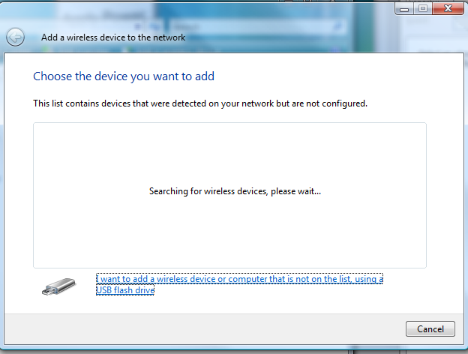
Windows Vista

Slide 18
Windows Vista
Apply Power
Wireless Setup
Install Device
Troubleshoot

Slide 19
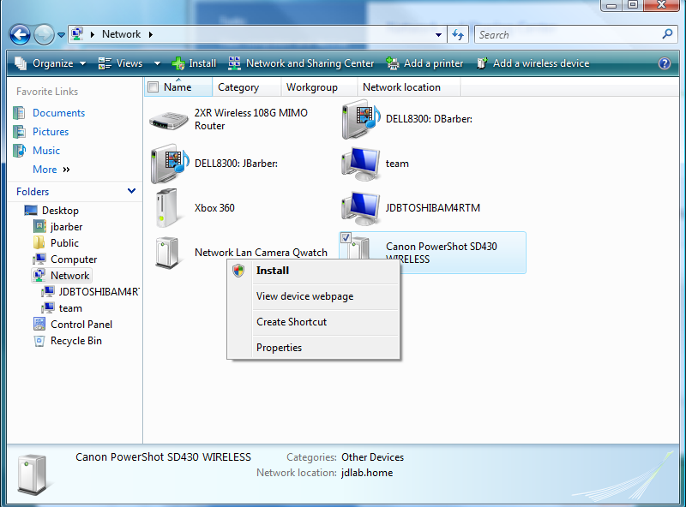
Windows Vista

Slide 20
Windows Vista
Apply Power
Wireless Setup
Install Device
Troubleshoot

Slide 21
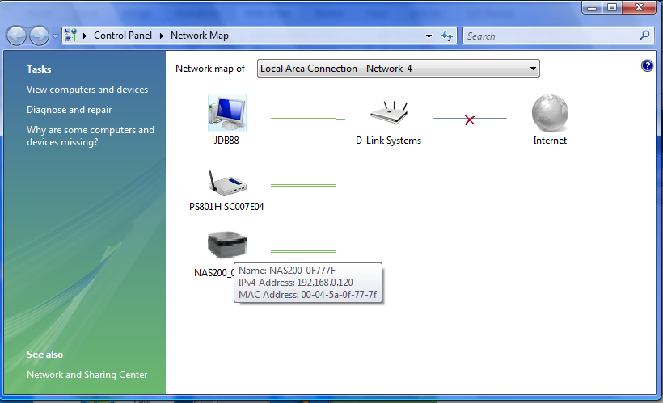
Windows Vista

Slide 22
Device Life Cycle
Install
WCN
WCN
Perform
LLTD QoS
LLTD
PnP-X
PnP-X
Web Services
Web Services
PnP-X
Web Services
Configure
Diagnose

Slide 23



Slide 24
Rally: PnP-X
Rally: LLTD
Rally: WPS (WCN)
Rally: WS-D/DPWS

Slide 25
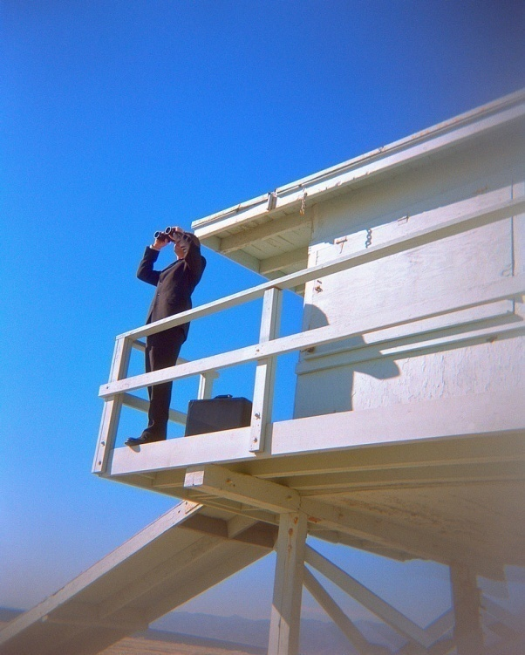
New Device Classes
Electronic Picture Frames
Network Attached Storage
iSCSI Storage
IP Streaming Video Cameras
Print Servers
VoIP Phones

Slide 26
General Rally Requirements
Device must implement LLTD protocol per specification
Device must implement PnP-X per specification
Basic- Device must support WCN (WCN-UFD is acceptable). Premium- Device must support WCN-NET per specification
If a WSDL is specified for the device class, it must be implemented

Slide 27


Slide 28
Call To Action
Get documentation (specs) and Rally Development Kit
New devices? Notify the Rally team so we can support your development
Bridge the ODM relationship
Attend Rally plugfests/summits
While you are here at WinHEC, attend the labs and sessions on the specific Rally technologies so that you can learn how to leverage them

Slide 29
Related Technical Sessions
CON-T417 Web Services on Devices: Rally Overview
CON-T475 Web Services on Devices: Rally Implementation
CON-T426 Router/AP (NID) Logo Program: Rally Implementation

Slide 30
Related Labs/Workshops
CON-H424 PNP-X for Network Connected Devices: Rally Workshop
CON-V511 PnP-X for Network-Connected Devices – Lab
CON-H422 Windows Connect Now and LLTD: Rally Workshop
CON-V479 Web Services on Devices - Lab

Slide 31
Web/E-mail Resources
Windows Rally Overview
  http://www.microsoft.com/rally
Windows Rally Technology Specifications
  http://www.microsoft.com/whdc/rally/rallyspecs.mspx
Windows Rally Dev Kit
  http://www.microsoft.com/whdc/rally/rallykit.mspx
Windows Rally E-mail
  Rally @ microsoft.com

Slide 32


Slide 33

© 2007 Microsoft Corporation. All rights reserved. Microsoft, Windows, Windows Vista and other product names are or may be registered trademarks and/or trademarks in the U.S. and/or other countries.
The information herein is for informational purposes only and represents the current view of Microsoft Corporation as of the date of this presentation. Because Microsoft must respond to changing market conditions, it should not be interpreted to be a commitment on the part of Microsoft, and Microsoft cannot guarantee the accuracy of any information provided after the date of this presentation.
MICROSOFT MAKES NO WARRANTIES, EXPRESS, IMPLIED OR STATUTORY, AS TO THE INFORMATION IN THIS PRESENTATION.

