Slide 1
Short-Range Wireless Device Connectivity
Zach Little
Kristina Hotz
Program Managers
Microsoft Corporation

Slide 2
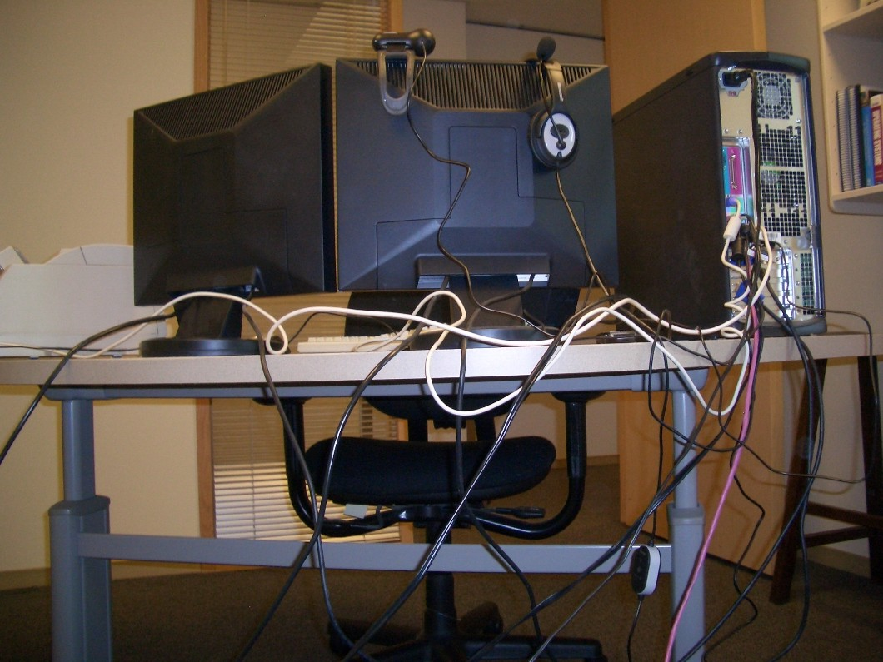
Look Familiar?

Slide 3
Key Takeaways
Lead in advancement of 64-bit computing
Adopt best practices and new tools
Partner on new hardware directions
Free the world from wires

Slide 4
Agenda
Bluetooth in Windows Vista
New Short-Range Wireless Device Connectivity Specifications
Bluetooth 2.1
Wireless USB
Wireless USB Certification Process

Slide 5
Bluetooth In Windows Vista New interfaces
Enabled Audio Profiles
Added SCO support for Headset (HSP)
Added L2CAP interfaces for Stereo Audio (A2DP)
Silicon vendors have audio profiles available today

Slide 6
Bluetooth In Windows Vista Available profiles
And More
DUN ● HCRP ● HID ● OPP ● PANU ● SDP ● Serial
A2DP ● A/V ● BIP ● BPP ● FAX ● FTP ● HS ● HF ● SYNC
● 3rd Parties ● Microsoft Partners
● Microsoft

Slide 7
Bluetooth In Windows Vista Channel avoidance
Bluetooth will not use noisy channels
2.4 GHz Spectrum

Slide 8
Bluetooth In Windows Vista Radio installation
Hardware ID and Compatible ID support
Use Microsoft OS Descriptor
Supply Compatible ID and SubCompatible ID
Windows Vista generates a Compat ID
Bluetooth INF will match on Compat ID
Vendor provided INF
Create INF that references Bth.inf
Upload INF to Windows Update

Slide 9
New Connectivity Scenarios
Improved Experiences in Bluetooth 2.1
New Scenarios Enabled by Wireless USB
Keep the same Wired ‘ease of use’
Remove the hassle of wires

Slide 10
New Connectivity Scenarios Bluetooth 2.1
Improved Pairing
Increased Quality
Better Battery Life

Slide 11
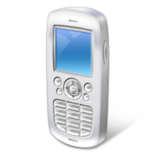
New Connectivity Scenarios Bluetooth 2.1 – Improved Pairing
Extended Inquiry Response
Secure Simple Pairing
Just Works
Passkey
Out of Band
Numeric Compare
123456
123
456

Slide 12
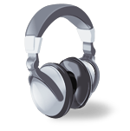
New Connectivity Scenarios Bluetooth 2.1 – Increased Reliability
Non-Flushable Packet Boundary Flag
ACL
F
N

Slide 13
New Connectivity Scenarios Bluetooth 2.1 – Better Battery Life
Sniff Subrating
Active
Sniff
Sniff Subrate

Slide 14
Wireless USB
Transition to Zach Little

Slide 15
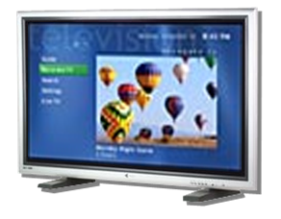
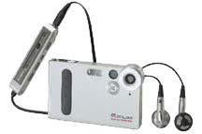
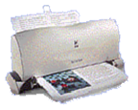
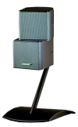
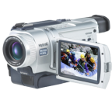
Wireless USB Overview
Up to 127 devices
USB Wire Replacement Technology
Hub-and-spoke connection relationship
Connection model is a wire replacement
Point-to-point connections
Between Certified Wireless USB host and peripheral
Certified Wireless USB Cluster
Certified Wireless USB Host with one or more peripherals (up to 127 addressable devices)
Support for legacy USB Host and Devices
Host scheduled data communications
Dual Role Devices

Slide 16
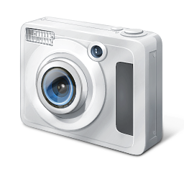
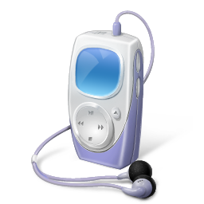
New Connectivity Scenarios Wireless USB enabled scenarios
Streaming of HD-quality video from a wireless storage device
Photo sync from camera wirelessly
Laptop docking stations
Partners demoing these in the expo hall
Opportunity for interaction between Smartphone/pocket PC and the PC
This is just the beginning

Slide 17
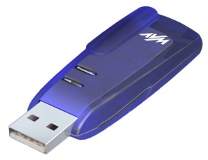
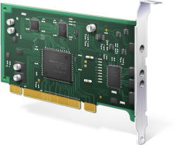
Wireless USB - Hosts
HWA (Host Wireless Adapter)
USB interface to the PC
Enabler for the market
Reference designs available from many companies today
USB dongle or Express card form factors generally
WHCI (Wireless Host Controller Interface)
PCI interface to the PC
Enables better performance
Required interface for non-removable devices for WLP certification
Potential for better power management

Slide 18
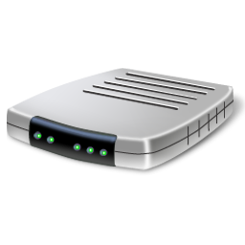
Wireless USB - Devices
DWA (Device Wireless Adapter)
Enables existing wired USB connections to be wireless
Many implementations are in a hub form factor
Could also be implemented within the device
Some performance limitations
Enables the market
Native Device
Best option for optimal performance
Integrated directly into device
Custom power management possible
Less hardware

Slide 19
Wireless USB Certification
USB-IF Wireless USB certification program now online
Helps communicate the brand promise to consumers
Sign that the industry is getting ready to ship products
Required for Microsoft WLP certification
The time is now!
Companies that have obtained Wireless USB Certification
NEC
Intel
Alereon

Slide 20
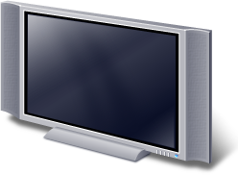
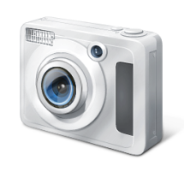
Long-Term Scenarios
Ultrawide-Band Enables Next-Gen Scenarios
Wireless Desktops
Wireless Monitors
Wireless Docking for Laptops
Bluetooth for HID Devices
UWB for Monitors, Storage devices
Video Streaming
Laptop/Camera to TV

Slide 21
Call To Action
OEMs
Adopt Microsoft stack for Bluetooth on Windows Vista
Prepare for Wireless USB and Bluetooth 2.1
Device vendors and IHVs
Begin using Compatible IDs for Bluetooth radio installation
Support Bluetooth 2.1
Support Wireless USB

Slide 22
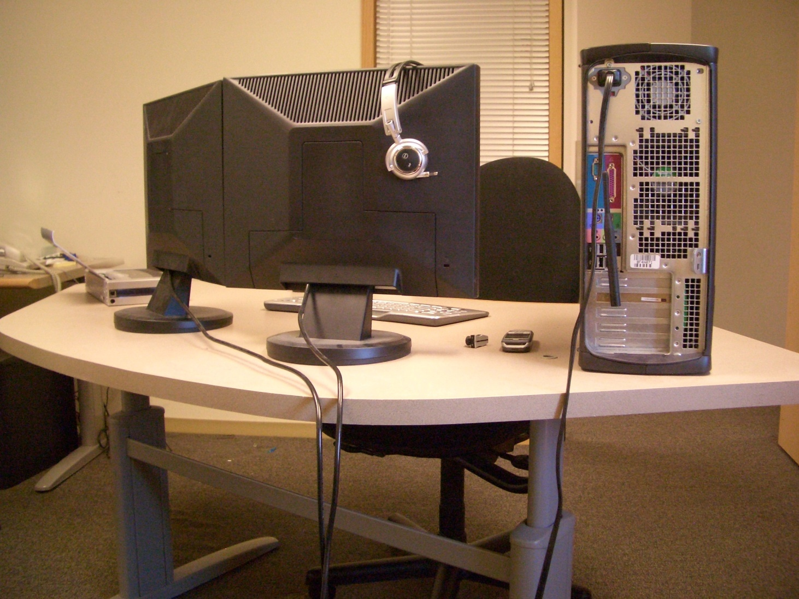
Look Familiar?

Slide 23
Questions?
CON-C430 – Windows Device Connectivity Chalk Talk

Slide 24
Additional Resources
Related Sessions
Windows Logo Program for Wireless USB: Best Practices (CON-T429)
Windows Device Connectivity (CON-C430)
Contact Information
Microsoft Bluetooth Stack:
Bluetooth Windows Vista Driver Kit:
Wireless USB:
UWB Feedback:
bthapi@microsoft.com
bthddi @ microsoft.com
wusbbeta@microsoft.com
uwbfb@microsoft.com

Slide 25
Additional Resources
Web Resources
Bluetooth Specification: http://www.bluetooth.org/
Wireless USB Specification: http://www.usb.org
Wireless USB PDK: http://www.usb.org/developers/estoreinfo/
Whitepapers: http://www.microsoft.com/whdc/
Windows Logo Program: http://www.microsoft.com/whdc/winlogo/default.mspx
WDK and Developer Tools: http://www.microsoft.com/whdc/DevTools/default.mspx
Partner Hardware and Software Information
www.broadcom.com/products/Bluetooth
www.csr.com

Slide 26
© 2007 Microsoft Corporation. All rights reserved. Microsoft, Windows, Windows Vista and other product names are or may be registered trademarks and/or trademarks in the U.S. and/or other countries.
The information herein is for informational purposes only and represents the current view of Microsoft Corporation as of the date of this presentation. Because Microsoft must respond to changing market conditions, it should not be interpreted to be a commitment on the part of Microsoft, and Microsoft cannot guarantee the accuracy of any information provided after the date of this presentation. MICROSOFT MAKES NO WARRANTIES, EXPRESS, IMPLIED OR STATUTORY, AS TO THE INFORMATION IN THIS PRESENTATION.

