Slide 1
Windows Audio Fidelity Tests And Your Board Design
Kymberly Schmidt
Applications Engineer
MultiMedia Business Unit
Maxim Integrated Products

Slide 2
WLP Device Requirements
Premium Mobile, v 3.09
Device Type | Requirement | Value | Frequency Range
Analog Line Output Jack | THD+N | < -65dB FS | [20Hz, 20KHz]
 | Dynamic Range with Signal Present | < 80dB FS A-weight | [20Hz, 20KHz]
 | Magnitude Response | < ±0.25dB ripple (0.5dB peak to peak delta), 1dB at upper band edge, 3dB at lower band edge | [20Hz, 20KHz]
 | Sampling Frequency Accuracy | 0.02% | `
 | Line Output Crosstalk | < -50dB | [20Hz, 15KHz]
 | Full Scale Output Voltage | > 0.707V_{RMS}
 | Noise Level During System Activity | < -80dB FS A-weight
 | Interchannel Phase Delay | 30º or 12.5us, whichever is greater | [20Hz, 20KHz]

Slide 3
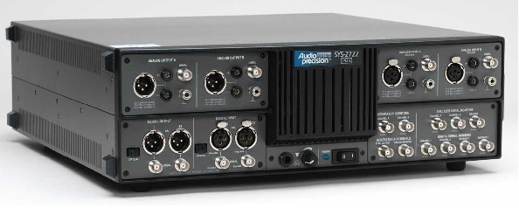
Device Test Manager (DTM)
DTM Controller
DTM Studio
Network
Audio Precision Host
System Under
Test
Audio Precision

Slide 4
Audio System Under Test

Slide 5
Total Harmonic Distortion Plus Noise (THD+N)

Slide 6
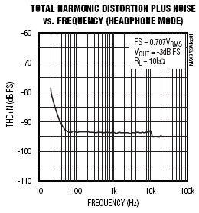
Total Harmonic Distortion Plus Noise (THD+N)
A measure of the total non-linearities in a system represented as a percentage of the output signal

Slide 7
Measuring THD+N

Slide 8
Troubleshooting THD+N Failures
Top three contributors
Active Components (CODEC, Amplifier)
Passive Components
(Capacitor, Ferrite Bead)
Layout (Grounding)

Slide 9
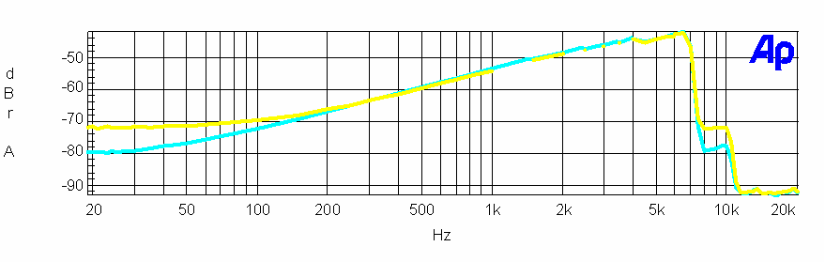
THD+N
Active components
Premium Mobile Limit for Line Output
An active component will typically fail at high frequencies if the device is not Windows Vista-compliant

Slide 10
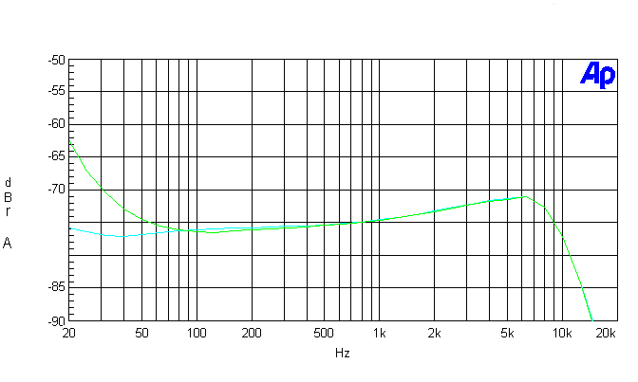
THD+N
Passive components
Premium Mobile Limit for Line Output
X5R 16V
X7R 16V
If improperly selected, the Input Coupling Capacitors (CIN) can result in an increase of THD+N at low frequencies

Slide 11
Input Coupling Capacitors
Piezoelectric effect of the input coupling capacitor, CIN, can contribute nonlinearities to the audio signal path (http://www.edn.com/article/CA6430345.html)
Replace CIN with X7R ceramic capacitors with high voltage ratings and measure THD+N performance again

Slide 12
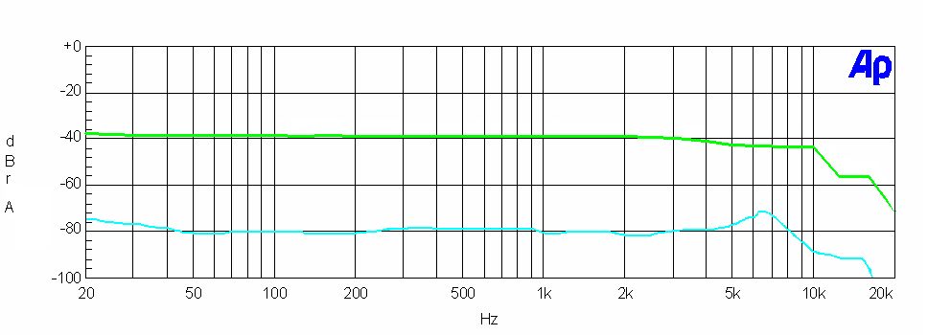
THD+N
Passive components
With ferrite bead
Premium Mobile Limit for Line Output
Ferrite beads used for EMI protection at the headphone jack can contribute non-linearities to the audio signal path

Slide 13

Ferrite Beads
THD+N is dominated by distortion
Replace the ferrite beads in your system with 0Ω resistors and measure THD+N performance again

Slide 14
Premium Mobile Windows Vista
Compliant ferrite beads
The following ferrite beads have been tested in-circuit for THD+N performance and have shown to be premium mobile Windows Vista-compliant
TDK………………………..MMZ1608Y601BTA
Murata….…………………..BLM18BD601SN1
Taiyo Yuden.……………….LFBK1608HM601

Slide 15
THD+N
Layout
NON-IDEAL
IDEAL
CODEC analog ground and audio amplifier ground may not be referenced to the same quiet ground plane
The difference between ground potentials resembles a noise source

Slide 16
THD+N
Layout
NON-IDEAL
IDEAL
Map out IC layout early in the design stage to optimize proximity of analog circuitry

Slide 17
Full Scale Output Voltage

Slide 18
Full Scale Output Voltage
The maximum output voltage level measured at the output jack

Slide 19
Troubleshooting Full Scale Output Voltage Failures
Top contributor
Attenuation in the signal path

Slide 20
Attenuation In Signal Path
Ensure the CODEC outputs a full scale signal
Ensure the audio amplifier has at least 0dB gain
Ensure any series resistors that may be in headphone output path are not severely attenuating the output voltage

Slide 21
Dynamic Range (DR) With Signal Present

Slide 22
Dynamic Range (DR) With Signal Present
The ratio of the full scale reference level to the weighted RMS noise floor in the presence of a signal
Typical output level is -60dB FS
Expressed in dB

Slide 23
Measuring Dynamic Range (DR) With Signal Present
STEP 1: NOMINAL OUTPUT
STEP 2: NOISE FLOOR WITH SIGNAL PRESENT

Slide 24
Troubleshooting Dynamic Range (DR) Failures
Top two contributors
Attenuated Output Level
Elevated Noise Floor

Slide 25
Dynamic Range
Output level
Does the system reproduce a full scale output voltage?

Slide 26
Dynamic Range
Noise
NON-IDEAL
IDEAL
CODEC analog ground and audio amplifier ground may not be referenced to the same quiet ground plane
The difference between ground potentials resembles a noise source

Slide 27
Dynamic Range
Noise
Noise may be Coupled into the Audio Amplifier Inputs
Gain structure may amplify noise
Output jack ground reference may contribute noise

Slide 28
Crosstalk

Slide 29
Crosstalk
Crosstalk measures the amount of signal coupled from one channel to another channel
IDEAL
NON-IDEAL

Slide 30
Measuring Crosstalk
LEFT TO RIGHT
RIGHT TO LEFT

Slide 31
Troubleshooting Crosstalk Failures
Top contributor
Layout (IC or PCB)
  Capacitive Coupling
  Shared, Resistive Ground Return

Slide 32
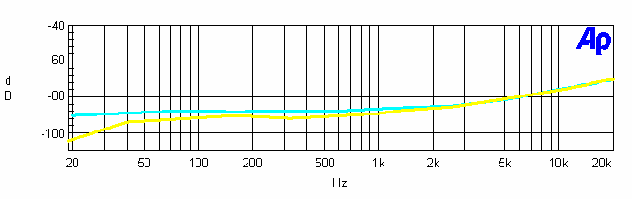
Crosstalk
Capacitive Coupling - causes
High impedance drive of CODEC
Poor separation between stereo amplifier input path

Slide 33
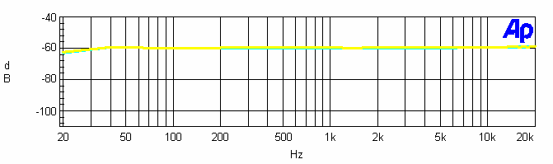
Crosstalk
Shared, resistive ground return

Slide 34
Magnitude Response

Slide 35
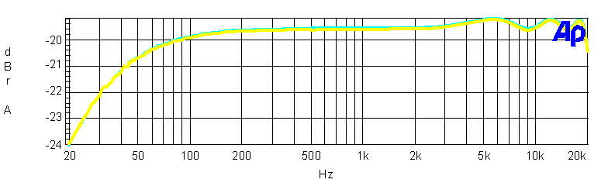
Magnitude Response
A measurement of the output level over a given frequency range referenced to the full scale output level

Slide 36
Measuring Magnitude Response
Sweep a constant-amplitude pure tone through the bandwidth of interest and measure the output level relative to the full scale output level

Slide 37
Troubleshooting Magnitude Response Failures
Top two contributors
System EQ
Passive Components
(Coupling Capacitors, Filtering)

Slide 38
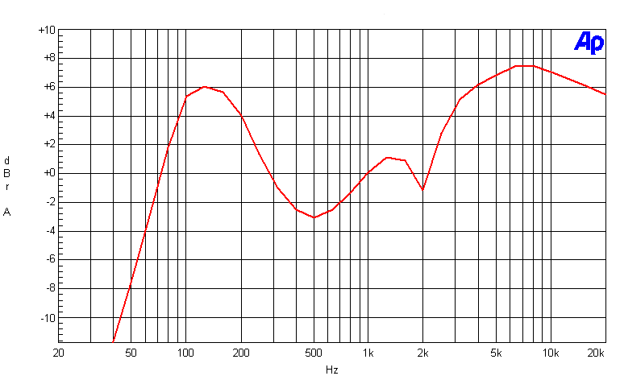
Magnitude Response
System EQ
EQ Circuitry may be boosting/suppressing selected frequencies
Disable EQ and repeat measurement

Slide 39
Magnitude Response
Filtering high frequencies
Passive components around the audio amplifier may be limiting the magnitude response

Slide 40
Magnitude Response
Filtering low frequencies (Case 1)
C Case Size
Select C_{OUT} such that C_{OUT} = 1/(2ΠR_{L}f_{C}), where f_{C} is 100Hz and R_{L} is 32Ω to ensure premium mobile compliance. Be sure to account for the tolerance of C_{OUT}

Slide 41
Magnitude Response
Filtering Low Frequencies (Case 2)
0805 Case Size
Select C_{IN} such that C_{IN} = 1/(2ΠR_{IN}f_{C}). Where f_{C} is < 20Hz to ensure premium mobile compliance into a 10kΩ load

Slide 42
Interchannel Phase Delay

Slide 43
Interchannel Phase Delay
The phase difference between stereo outputs
Reported in degrees or microseconds as a function of frequency

Slide 44
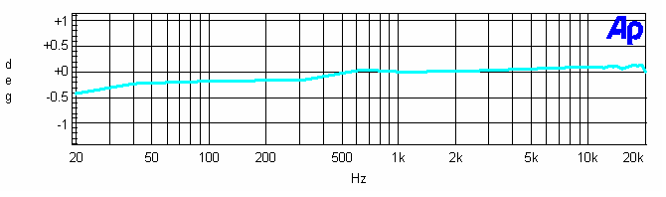
Measuring Interchannel
Phase Delay
Measure the phase difference of the audio outputs as the frequency is swept between 20Hz and 20kHz
Reported in degrees or microseconds as a function of frequency

Slide 45
Troubleshooting Interchannel Phase Delay Failures Top two contributors
Tolerance of Passives
Digital Domain

Slide 46
Windows Audio Fidelity
Debug Tool
Select the Audio Specification Your System is Failing:
THD+N
Crosstalk
Dynamic Range
Frequency Response
Click-and-Pop

Slide 47
Additional Resources
WLP Device Requirements: http://www.microsoft.com/whdc/winlogo/hwrequirements.mspx
AES-17 Specification: http://www.aes.org/publications/standards
Audio Precision: http://www.audioprecision.com
Choose Capacitor Types to Optimize PC
Sound Quality: http://www.edn.com/article/CA6430345.html
Vista Compliance Troubleshooting Tool: http://www.maxim-ic.com/fidelity-debug-tool

