Slide 1
HD Photo
Implementation Guidelines
Bill Crow
Principal Program Manager
Microsoft Corporation

Slide 2
Goals
Review the unique features and capabilities of the HD Photo still image file format
Identify specific best practices for using
HD Photo in a variety of scenarios
Discuss high dynamic range wide gamut image content and workflow
Empower you to implement HD Photo support in your devices and applications and take full advantage of it’s advanced capabilities to differentiate your products

Slide 3
Agenda
HD Photo overview
Pixel formats
Encoder parameters
High dynamic range workflow
Progressive image decoding
Metadata
Summary

Slide 4
Why Do We Need Another Format?
Deliver a single format for end-to-end digital photo acquisition, editing, archiving, sharing, and printing
Support fixed point and floating point pixel formats for high dynamic range, wide gamut workflows
Support pixel formats and image options for high quality photo printing
Provide significant improvements in image quality and performance

Slide 5
HD Photo Overview
A new format for end-to-end digital photography which offers higher image quality, greater preservation of data, and advanced features for today’s digital imaging applications
Better image fidelity: Preserving original image content, enabling higher quality exposure and color adjustments
State of the art compression: Up to twice the efficiency of JPEG with fewer damaging artifacts, and scalable to lossless, all in a high performance, low footprint algorithm
Powerful features: Decode only the information needed for any resolution or region, or manipulate the image as compressed data

Slide 6
HD Photo Versus JPEG
Support for a much wider range of pixel formats, including high dynamic range
Lossless and lossy compression modes
Option for higher quality lossy compression
Bit-exact algorithm guarantees identical decoded results with any app or device
Region and frequency progressive decoding
Twice the compression efficiency, enabling the same image quality at half the file size

Slide 7
Pixel Formats
Channel Organization
  RGB, Grayscale, CMYK, n-Channel
Numerical Encoding
  Unsigned Integer, Fixed Point, Floating Point
  Bit Depth – 8bpc, 16bpc, 32bpc, others
Alpha Channel
  RGB and CMYK
  Legacy support for pre-multiplied alpha
  Planar or interleaved

Slide 8
Pixel Formats
 | Gray | RGB | RGBA | PRGBA | CMYK | CMYKA | n-Channel
1bpc UINT | ✓
8bpc UINT | ✓ | ✓ | ✓ | ✓ | ✓ | ✓ | ✓
16bpc UINT | ✓ | ✓ | ✓ | ✓ | ✓ | ✓ | ✓
16bpc Fixed Point | ✓ | ✓ | ✓
32bpc Fixed Point | ✓ | ✓ | ✓
16bpc Half | ✓ | ✓ | ✓
32bpc Floating Pt. | ✓ | ✓ | ✓ | ✓
16bpc RGBE |  | ✓
5-5-5 UINT |  | ✓
5-6-5 UINT |  | ✓
10-10-10 UINT |  | ✓

Slide 9
Pixel Format Best Practices
8bpc RGB offers legacy compatibility with more extensive compression options; stick to sRGB profiles for maximum compatibility
16bpc fixed point provides scRGB HDR/WG image manipulation with high performance processing; it’s ideal for acquisition
32bpc floating point delivers scRGB with the maximum resolution and dynamic range; PC hardware floating point support makes this a great working space

Slide 10
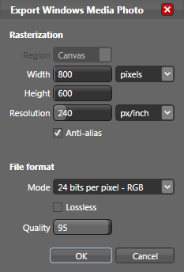
Basic Encoder Parameters
Quality
  0.0 (small) to 1.0 (best)
  File size depends on content
  Maps to specific advanced quality parameter settings based on image bit depth
Lossless
  Mathematically lossless
  Same as Quality = 1.0
  Overrides Quality setting
For Example
Microsoft Expression Design

Slide 11
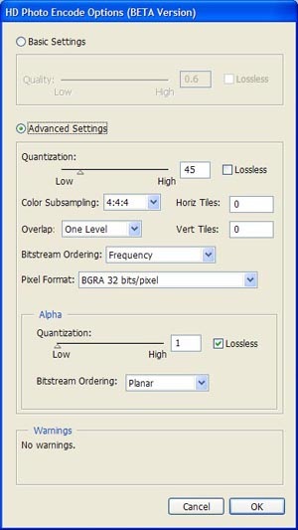
Advanced Encoder Parameters
Quality
  Quantization
  Chroma Sub-sampling
  Overlap Processing
Organization
  Tiling
  Frequency or Spatial Order
  Transformation
  Planar or Interleaved Alpha
For Example
Adobe® Photoshop®

Slide 12
Quantization
1 – 255; 1 = lossless; excellent granularity for controlling the amount of compression
32bpc is always lossy; roundoff with >24bpc
Quantization controls image quality;
file size is dependent on image content
Bit stream and decoder spec allows for future implementation of adaptive quantization encoders, adjusting Q per channel or macro-block

Slide 13

RGB Chroma Sub-Sampling
Allows reduction of chroma resolution to improve luminance compression quality
Three options
  4:4:4 – Full chroma resolution; best quality
  4:2:2 – ½ chroma resolution
  4:2:0 – ¼ chroma resolution; same as JPEG
4:4:4 recommended; let the codec decide how to quantize the content

Slide 14
Overlap Processing
No overlap
  Enables faster encode and decode
  Useful for low compression ratios only
One level overlap
  Best overall quality
  Normal encode and decode times
Two level overlap
  Only for very high compression ratios
  Minimal additional processing
Recommended

Slide 15
Tiling
Optional regular partitioning of the image into rectangular regions
Each tile can be independently decoded
Enables higher performance sub-region decoding
Separately decoded tiles may be stitched together seamlessly
Special option for high performance tile extraction

Slide 16
Frequency Versus Spatial Ordering
Spatial Order
  Ideal for low-cost serial
  encoders with minimal
  buffer requirements
Frequency Order
  Preferred for resolution
  progressive decoding
  from a serial stream
  Three sequential frequency bands plus flexbits

Slide 17


Encoder Transformation
Eight possible combinations of rotate/flip
Encoder sets a bit stream header flag that is processed during decode
Transformation is expensive
  Allows cost to be deferred to decode
  Can simplify the encoder implementation, but makes decoding more expensive
  Virtually disables progressive decode

Slide 18
Alpha Channel
Interleaved
  Adds another channel to the main image
  Uses all the main image encoder parameters
  Always encoded/decoded with main image
Planar
  Stored as a separate bitmap
  Has its own quantization settings
    Ideal for high quality composite with lossy image
  Could be skipped on decode

Slide 19
Encoder Best Practices
Unless there are known data limitations, 4:4:4 sub-sampling is always recommended
In many cases, high quality lossy modes are a great alternative to lossless compression
Frequency ordering is preferred to optimize different decoding modes
Applications should always try to expose advanced options to give users full control
Tiling is only needed when region
decode is a requirement

Slide 20
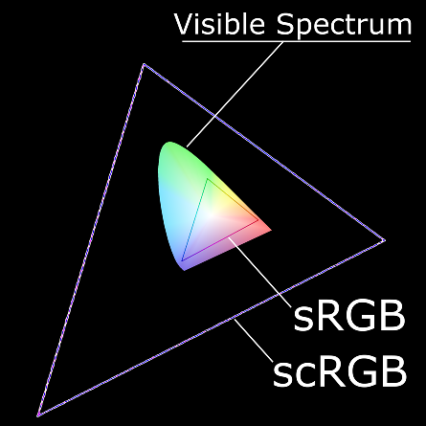
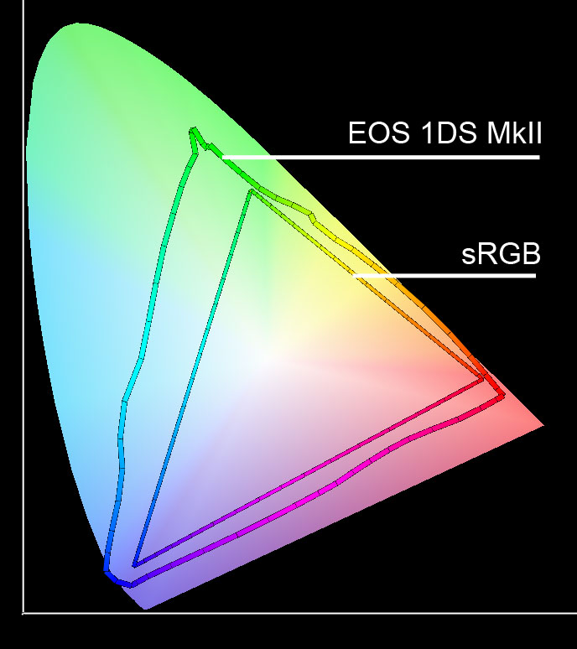
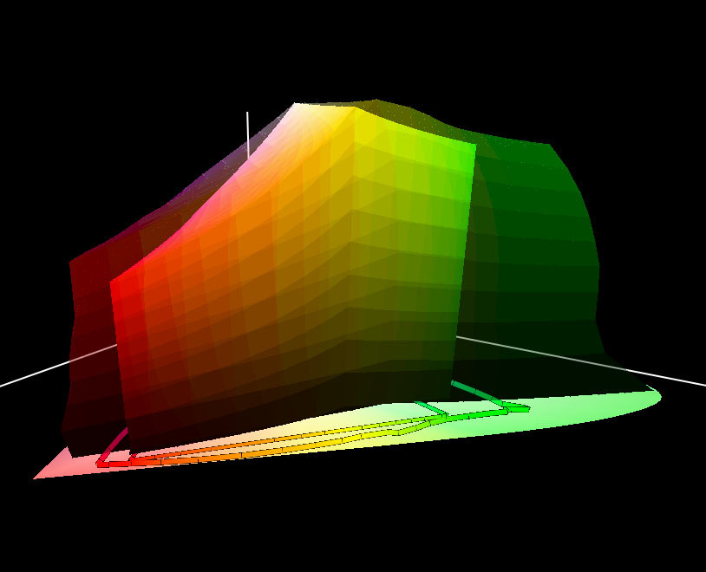
Preserving All The Content
Today’s unsigned integer formats discard useful information
12+ bpc
linear RGB
16/32bpc fixed/float
linear scRGB
8+ bpc non-
Linear RGB
Intermediate
Storage, Editing and
Management
Camera
Source
Devices
Display
Destination
Devices
8bpc non-linear RGB
Intermediate Storage,
Editing and Management
Scanner
Source
Devices
Printer
Destination
Devices
12-16+ bpc
linear RGB
8+ bpc non-
Linear CMYK
scRGB uses fixed or floating point values to
define colors beyond the visible spectrum
Notes:
20

Slide 21

Original Unprocessed Image
Red, green, and blue channels
Represents min and max sensor values
Based on device settings and color space
Notes:
5/29/2007
21

Slide 22
Initial Image Processing
White balance is set using offsets, scaling and curves
Some adjusted color values exceed the device’s numerical limits and will be lost
Notes:
5/29/2007
22

Slide 23

Adjust Appearance For The Target Color Space
White and black points are set
Defines the total visible range
Maps to the gamut limits of the target space
Notes:
5/29/2007
23

Slide 24
Setting The Target Color Space Using Unsigned Integers
Data that exceeds the black or white points is out of gamut
Unsigned integers can only represent data in the gamut
Notes:
5/29/2007
24

Slide 25
Setting The Target Color Space Using Unsigned Integers
Any reference to
the source color space is lost
Only data within the gamut of the target color space is kept
Any data outside this visible range is discarded
Notes:
5/29/2007
25

Slide 26
Using Fixed Or Float And scRGB
Black and white points are still set as desired
The visible range remains the same
Image values outside of the visible range are not discarded
Notes:
5/29/2007
26

Slide 27
High Dynamic Range Wide Gamut
Unsigned integer image encoding only captures the visible range
scRGB retains the same color primaries and white point of sRGB, but with linear gamma
scRGB uses fixed or floating point to encode image content beyond the visible range
Provides the best combination of features
  A ready-view image in a standard color space
  Retains maximum original content to
  enable high quality image adjustments

Slide 28
HDR/WG Best Practices
scRGB is the preferred image work space
  16bpc fixed point for high performance
  32bpc float for the highest precision and widest exposure and color range
Perform color profile conversions from source color context and to rendering color context using fixed or float scRGB
scRGB enables correct image processing with linear gamma

Slide 29
Progressive Decoding
Multiple encoder options for different modes of progressive image decoding
  Tiling for region decoding
  Frequency order for
  resolution decoding
  Flexbits for progressive
  quality decoding
Compressed domain ops
for high performance
down-sample and/or crop
Spatial order

Slide 30





Compressed Domain Regions
Tiled Source Image
Region of interest
Arbitrary Region
Specific Tile
Additional tiles needed
for overlap processing
Tile Extraction Mode
Post processing required to
stitch tiles seamlessly

Slide 31
Decoder Best Practices
Frequency progressive decoding provides an optimized viewing experience with faster initial display times
Tiled images allow fast region decode
Compressed domain operations enable powerful client/server imaging solutions
Tile extraction mode is extremely efficient, but may require additional post processing to compensate for tile edge errors

Slide 32
Metadata
HD Photo bitmap definition IFD Tags
TIFF-compatible descriptive IFD Tags
Legacy EXIF for camera info metadata
EXIF compatible GPS metadata
XMP preferred for all descriptive metadata
Padding for fast metadata updates

Slide 33
HD Photo Bitmap Definition
PixelFormat
  GUID for each specific pixel format
  Defines channel organization, bit depth, and numeric encoding
  Replaces multiple non-deterministic tags used in TIFF and other formats
Width, Height
Transformation
  Allows transform without touching bit stream
  Merges with bit stream transform flag

Slide 34
Additional Descriptive Metadata
TIFF-compatible IFD Tags
  Spec identifies acceptable tags
  Supported for legacy compatibility only
EXIF metadata for camera information
  Stored as single IFD tag
  Legacy compatibility with existing formats
EXIF GPS metadata
  Stored as single IFD tag
  Legacy compatibility for location info

Slide 35
XMP Metadata
Full compatibility with Adobe XMP Spec
XML stored as text in single IFD tag
Self describing and extensible
Preferred choice for all descriptive info
Fully supported in Windows Vista
XMP metadata handler in WIC and .NET 3.0
Supports industry standard schemas
  Dublin Core, EXIF, IPTC, TIFF

Slide 36
Metadata Padding
Extra space written to metadata to allow future in-place metadata edits without
re-writing the entire file
By default, WIC codec inserts 2K of padding in three separate locations
  Padding tag in main image IFD table
  Padding tag in EXIF table (if EXIF present)
  Blank padding in XMP (if XMP present)

Slide 37
Metadata Best Practices
All descriptive metadata should be stored using XMP and standard schemas
When editing an image, other descriptive metadata should migrate to XMP
Retaining original camera information in EXIF improves legacy compatibility
Take advantage of metadata padding for fast metadata updates and additions
Strip excess metadata and padding
when size/speed is the priority

Slide 38
Summary
HD Photo enables new imaging solutions
  High dynamic range image manipulation
  Enhanced quality with excellent compression
  Progressive decoding
  Compressed domain operations
The new standard for digital photography
  Can be easily added to existing applications
  Advanced features enable new capabilities
  The ideal format for devices and the net

Slide 39
Call To Action
Support HD Photo in devices and apps
  If it currently uses JPEG, add HD Photo
Take advantage of scRGB and high dynamic range wide gamut imaging
  Preserve content by converting color spaces through scRGB, including RAW image acquisition and printing
  Extend image editing to use HDR
Use compressed domain operations and progressive decode for new features

Slide 40
Additional Resources
Free Device Porting Kit 1.0
  http://www.microsoft.com/windows/windowsmedia/wmphoto
  Compressed bit stream technical specification
  Reference ANSI-C codec source code and sample applications
  Support for both little-endian and big-endian architectures
Free Windows Imaging Component (WIC) HD Photo codec
  Standard component in Windows Vista
  Available for Windows XP in .NET Framework 3.0 and WIC Redists
  Developer’s information for WIC:
  http://windowssdk.msdn.microsoft.com/en-us/library/ms735422.aspx
Free Plug-in for Adobe® Photoshop® (Windows and OS/X)
Technical questions:
HD Photo blog: http://blogs.msdn.com/billcrow
hdphoto @ microsoft.com

Slide 41

© 2007 Microsoft Corporation. All rights reserved. Microsoft, Windows, Windows Vista and other product names are or may be registered trademarks and/or trademarks in the U.S. and/or other countries.
The information herein is for informational purposes only and represents the current view of Microsoft Corporation as of the date of this presentation. Because Microsoft must respond to changing market conditions, it should not be interpreted to be a commitment on the part of Microsoft, and Microsoft cannot guarantee the accuracy of any information provided after the date of this presentation.
MICROSOFT MAKES NO WARRANTIES, EXPRESS, IMPLIED OR STATUTORY, AS TO THE INFORMATION IN THIS PRESENTATION.

