Slide 1
XPSDrv Best practices using Print Verifier
Manski Fransazov
Test Development Lead
Microsoft Corporation
Ashwin Needamangala
Test Development Lead
Microsoft Corporation

Slide 2
Agenda
Introduction to Print Verifier
Using Print Verifier
Setup and Configuration
Usage Recommendations
Demonstration
Advanced Features
Print Verifier Fault Detection
Future Directions
Call to Action

Slide 3
App/Driver Quality Challenges
Print problems difficult to troubleshoot
No print subsystem resource tracking
Leaking print resources
Using print resources in unsafe manner
No print-specific tools allowing extended runtime checks
Contracts between XPS filter and the Operating System (OS)
Contracts between GDI driver and the OS
Contracts between applications and the OS

Slide 4
Introduction To Print Verifier
Designed to address many of the challenges
Runtime verification tool
Implemented as a DLL, injected early in each process
Designed to catch violators in the act
Flags errors via debugger breaks
Supports both XPSDrv and GDI drivers
Works per process
Hooks the interfaces between 3rd party code and OS code
Ships as part of Application Verifier
Available on microsoft.com
Well documented

Slide 5
High Level Architecture
Applications
Provided by:
Microsoft
Print Verifier (PrintAPI layer)
ISV
Spooler APIs
IHV
OEM
Core Print Driver (unidrv, pscript, XPSDrv)
Print Verifier (PrintDriver layer)
Plug-in/XPSDrv Filter
Notes:
5/29/2007 12:42 PM
© 2006 Microsoft Corporation. All rights reserved. Microsoft, Windows, Windows Vista and other product names are or may be registered trademarks and/or trademarks in the U.S. and/or other countries.
The information herein is for informational purposes only and represents the current view of Microsoft Corporation as of the date of this presentation. Because Microsoft must respond to changing market conditions, it should not be interpreted to be a commitment on the part of Microsoft, and Microsoft cannot guarantee the accuracy of any information provided after the date of this presentation. MICROSOFT MAKES NO WARRANTIES, EXPRESS, IMPLIED OR STATUTORY, AS TO THE INFORMATION IN THIS PRESENTATION.
5

Slide 6
Print Verifier Philosophy
100% certainty when issuing a stop
When in doubt, don’t stop in the debugger
Print Verifier design is suitable for Windows Logo tests
Under consideration for a future Windows Logo requirement

Slide 7
Using Print Verifier
Typical Workflow
Install and enable Print Verifier for a process (say PrintFilterPipelineSvc.exe)
Restart the process and start testing
App/driver violates an invariant at runtime
Say, over-releases an XPS filter interface pointer, or uses invalid print ticket, etc
Print Verifier immediately issues a debugger break (“verifier stop”)
Look up the documentation for the stop code and identify the bug

Slide 8
Setup And Configuration
Part of Application Verifier MSI package
Easy, scriptable, and configurable install
Once installed, can be enabled for each desired process
For all verified processes the presence of a debugger is required
Known limitations
System processes (csrss, lsass) not supported
Application and Print Verifiers designed to verify native applications, not .NET applications
It works, but provides limited value

Slide 9
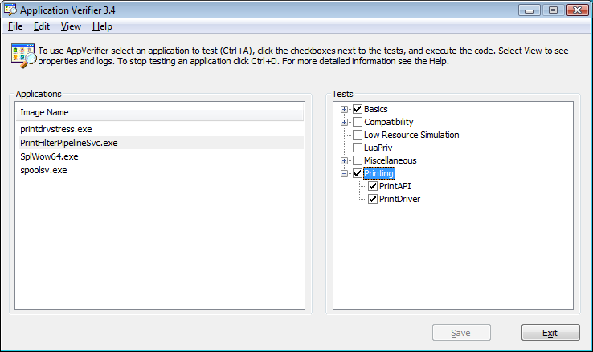
Setup And Configuration

Slide 10
Recommended Settings
If you are a driver developer or tester
Enable Basics, Print Driver, and Print API layers for
Spoolsv.exe (core print spooler service)
PrintFilterPipelineSvc.exe (filter pipeline process)
Splwow64.exe (thunk process for WoW64 printing)
All test .EXEs you have

Slide 11
Recommended Settings
If you are an ISV developer or tester
Enable Basics and Print API layers for
Your ISV application
All test .EXEs you have

Slide 12
PrintVerifier Demo
demo
Notes:
5/29/2007 12:42 PM
© 2006 Microsoft Corporation. All rights reserved. Microsoft, Windows, Windows Vista and other product names are or may be registered trademarks and/or trademarks in the U.S. and/or other countries.
The information herein is for informational purposes only and represents the current view of Microsoft Corporation as of the date of this presentation. Because Microsoft must respond to changing market conditions, it should not be interpreted to be a commitment on the part of Microsoft, and Microsoft cannot guarantee the accuracy of any information provided after the date of this presentation. MICROSOFT MAKES NO WARRANTIES, EXPRESS, IMPLIED OR STATUTORY, AS TO THE INFORMATION IN THIS PRESENTATION.
12

Slide 13
Additional Features
Individual layers under “Printing” can be disabled
Individual stops can be downgraded or disabled
Print Ticket verification (PTConform) can be turned off
All of the above available from both App Verifier UI as well as command line

Slide 14
Additional Features
Fault injection
Available in both PrintAPI and PrintDriver layers
FaultRate property controls rate of fault injection
Logging
Log is generated when a stop occurs during the verification of an application or driver
Command line support to export logs to XML
AppVerifier UI has a link to Log Viewer

Slide 15
Print Verifier Fault Detection
Print resource tracking
Printer handles, printer change notification handles, PRINTER_NOTIFY_INFO, spool file handles, HPTPROVIDER handles
Will issue a stop if the verified code is
Leaking any of the above print resources
Using already closed handles
Using unknown/un-initialized handles
Using handles in a thread-unsafe manner

Slide 16
Print Verifier Fault Detection
Invalid PrintTicket or PrintCapabilities objects crossing interface boundaries
Application passing bad PrintTicket
Driver/filter returning bad PrintTicket
Incorrect interface reference counting
XPS filters, plug-ins
XPS filter making illegal call to the pipeline
Example: Two IPrintWriteStream::Close calls

Slide 17
Print Verifier Fault Detection
XPS filter changing/removing common property from the property bag
XPS filter calling pipeline interface out of order
Drivers/Filters causing structured exceptions
Access violations
Integer divide-by-zero
Invalid OS handle usage
Changing the security context in plug-in
Bad DEVMODE buffer passed
Illegal API call made in DllMain

Slide 18
Future Improvements
Considering support for
XPS conformance at runtime
Asynchronous notifications
Rendering and UI COM interfaces
Stricter return value/GetLastError checks
Non-driver components
Print processors, port monitors, language monitors, etc
Monolithic driver verification

Slide 19
Call To Action
Get familiar with Application Verifier and Print Verifier
Try out Print Verifier against your XPSDrv filters and GDI mini-drivers
Integrate Print Verifier in your development and test environments
Visit the Print Verifier blog
Post questions to Print Verifier newsgroup
Feature requests more than welcome!

Slide 20
Related Sessions
Chalk Talk: Print Verifier and XPSDrv Driver Development
Chalk Talk: XPS Document Optimization and Best Practices
Technical Session: Performance Optimization for XPS Documents
XPSDrv Lab: How to Develop and Test Print Drivers and Filters

Slide 21
Additional Resources
Blog: http://blogs.msdn.com/PrintVerifier
Newsgroup: Microsoft.public.win32.programmer.tools on www.msdn.com
Email:
Download AppVerifier: http://www.microsoft.com/downloads/details.aspx?FamilyID=bd02c19c-1250-433c-8c1b-2619bd93b3a2&DisplayLang=en
AppVerifier: http://msdn2.microsoft.com/en-us/library/aa480483.aspx
WHDC for Print Devices: http://www.microsoft.com/whdc/device/print/default.mspx
XPS: http://www.microsoft.com/xps
xpsinfo@microsoft.com
prninfo@microsoft.com

Slide 22
© 2007 Microsoft Corporation. All rights reserved. Microsoft, Windows, Windows Vista and other product names are or may be registered trademarks and/or trademarks in the U.S. and/or other countries.
The information herein is for informational purposes only and represents the current view of Microsoft Corporation as of the date of this presentation. Because Microsoft must respond to changing market conditions, it should not be interpreted to be a commitment on the part of Microsoft, and Microsoft cannot guarantee the accuracy of any information provided after the date of this presentation. MICROSOFT MAKES NO WARRANTIES, EXPRESS, IMPLIED OR STATUTORY, AS TO THE INFORMATION IN THIS PRESENTATION.

