Slide 1
Audio Device Driver Implementation Guidelines
Mitchell Rundle
Software Design Engineer
Cheng-mean Liu
Software Design Engineer
Microsoft Corporation

Slide 2
Agenda
Windows Vista Audio Endpoints
New KS Properties
New Control Panel Applet
Windows Vista Audio System Effects

Slide 3
Endpoints
Mitchell Rundle
Software Design Engineer
Microsoft Corporation

Slide 4
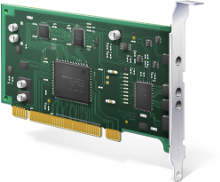
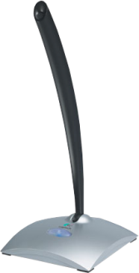
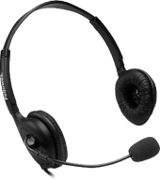
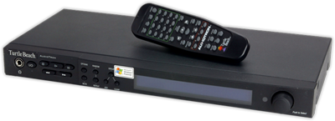
Paradigm Shift To Endpoints
Motivation
  Correlate the device concept with what the user interacts with
  Simplify access to MUXed capture devices
The Windows XP audio device is a
device in the PNP tree
The Windows Vista audio device is a
device with which the user physically interacts
  MMDeviceAPI calls these Endpoints
  In Vista UI, the PNP object is now called the Controller
  With most USB devices, the Endpoint is the Controller

Slide 5
Endpoints
Endpoints are enumerated and used directly through new Vista APIs
  MMDevice API
  WASAPI (IAudioClient)
Endpoints are enumerated and used indirectly through the more familiar APIs
  Wave, DirectSound, DShow, etc.
Endpoints have an globally unique ID that persists across reboots
  More reliable than saving a waveOut ID or a friendly name
  Methods exist to get from MMDevice ID to wave or DirectSound ID

Slide 6
Endpoints
Endpoints have a PropertyStore that persists
across boots
  Save device-related metadata in the Endpoint PropertyStore
MUXes (and DEMUXes) are managed automatically
  Activating IAudioClient (explicitly or implicitly via higher APIs) “flips the mux” if necessary

Slide 7
AudioEndpointBuilder
Service that monitors KSCATEGORY_AUDIO Device Interface arrivals and removals
Makes Endpoints for all unconnected bridge pins with specific categories …
  Bridge Pin is one with Communication = KSPIN_COMMUNICATION_NONE
  Unconnected means KSPhysicalConnection = NULL and doesn’t already have an Endpoint
Sets default properties
  Name, Icon, FormFactor, Other internal properties
Finds paths through the controller topology to host pins that support PCM, AC3 or WMV
  Host Pin is one with Communication = KSPIN_COMMUNICATION_SINK (or _BOTH)

Slide 8
AudioEndpointBuilder
5. Migrates properties groups from the device interface registry keys to the Endpoint PropertyStore
  Described in more detail earlier
6. Sets the endpoint state
  Active if a path is found in step (4)
  Unplugged if device supports Jack Detection and
  says it’s unplugged
  Not present if no path found in step (4) and Jack Detection
  not supported
7. Makes the endpoint the default
(if specified by the INF)

Slide 9

Endpoint Building Sequence
KS Filter arrives in the form of a KSCATEGORY_AUDIO device interface notification
AudioEndpointBuilder examines the topology
… finds an unconnected KSNODETYPE_SPEAKER bridge pin
… creates a new Speaker Endpoint
… Sets default properties
… Migrates properties set by the INF
… finds a path to a host pin that supports PCM
… sets the endpoint state to Active
… if PKEY_AudioDevice_SetupPreferred is set, makes the endpoint the default

Slide 10
Render Categories
Bridge Pin Category | Endpoint Form Factor | Icon
KSNODETYPE_SPEAKER KSNODETYPE_DESKTOP_SPEAKER | Speakers
KSNODETYPE_HEADPHONES | Headphones
KSNODETYPE_LINE_CONNECTOR | LineLevel
KSNODETYPE_SPDIF_INTERFACE | SPDIF
KSNODETYPE_DIGITAL_AUDIO_INTERFACE | UnknownDigitalPassthrough
KSNODETYPE_HDMI_INTERFACE | HDMI
KSNODETYPE_HEADSET KSNODETYPE_HEADSET_SPEAKERS | Headset
KSNODETYPE_HANDSET | Handset
KSNODETYPE_ANALOG_CONNECTOR KSCATEGORY_AUDIO KSNODETYPE_PHONE_LINE KSNODETYPE_CD_PLAYER | UnknownFormFactor

Slide 11
Capture Categories
Bridge Pin Category | Endpoint Form Factor | Icon
KSNODETYPE_MICROPHONE KSNODETYPE_DESKTOP_MICROPHONE KSNODETYPE_OMNI_DIRECTIONAL_MICROPHONE | Microphone
KSNODETYPE_MICROPHONE_ARRAY | Microphone
KSNODETYPE_LINE_CONNECTOR | LineLevel
KSNODETYPE_SPDIF_INTERFACE | SPDIF
KSNODETYPE_DIGITAL_AUDIO_INTERFACE | UnknownDigitalPassthrough
KSNODETYPE_HDMI_INTERFACE | HDMI
KSNODETYPE_HEADSET KSNODETYPE_HEADSET_SPEAKERS | Headset
KSNODETYPE_HANDSET | Handset
KSNODETYPE_ANALOG_CONNECTOR KSCATEGORY_AUDIO KSNODETYPE_PHONE_LINE KSNODETYPE_CD_PLAYER | UnknownFormFactor

Slide 12
Issues
Naming
  Endpoint name comes from bridge pin friendly name
  Speaker Endpoint name is hardcoded to “Speakers”
Suboptimal topologies
  Hidden endpoints
  Splitters
PCM Speaker
AC-3
PCM Speaker
AC-3/PCM SPDIF
Problematic
Recommended
PCM Speaker
SPDIF
PCM Speaker
SPDIF
DEMUX
Problematic
Recommended

Slide 13
Issues
The Endpoint Format
  The audio engine in shared mode runs at a specific format
  Can be set from the INF at install time, but…
  … thereafter under user control only.
  Lots of discussion/partial workarounds posted on WDMAUDIODEV
The Default Device
  Can be set from the INF at install time, but…
  … thereafter under user control only.

Slide 14
The Default Endpoint
Used by most apps
  IMMDeviceEnumerator::GetDefaultAudioDevice
  waveOutOpen(WAVE_MAPPER,…)
  DirectSoundCreate(NULL,…)
  PlaySound
  etc…
SetupPreferredDevice INF entry still works
  Applies to all Endpoints created for that device interface
  Cannot be applied to handsets
PKEY_AudioDevice_SetupPreferred property is
more precise
  Can be applied to endpoints by category
  Cannot be applied to handsets

Slide 15
When No Default Device Is Set…
MMDeviceAPI chooses for you based on the Form Factor
A tie in ranking produces a random (but consistent) result
  Alphabetical by Endpoint ID
The system chooses a default only when asked
  Result not persisted
  If the system chooses the default, it can change if a higher-ranking
  endpoint appears
Render Rank | Capture Rank
Speakers Line-out SPDIF | Microphone Line-in SPDIF

Slide 16
The Endpoint PropertyStore
See IPropertyStore in platform SDK propsys.h
Actually two stores
  The regular PropertyStore
    Accessibly via IMMDevice::OpenPropertyStore
    Admin privileges required for Writes
  The SysFX PropertyStore
    No public method for opening the SysFX PropertyStore
    It’s given to SysFx UI and SysFX APO
    SysFX UI has R/W access, SysFX APO has RO access
Open-ended, VARTYPE’d repository for most any property you want
Currently persisted in the registry
  Locked down
  May move elsewhere in the future

Slide 17
Writing To PropertyStore Via Inf
Problem
  Endpoint objects don’t exist until after the controller is installed
Solution
  Create a property group using
  AddReg directives
  Property groups are migrated to the
  Endpoint PropertyStore by the AudioEndpointBuilder service

Slide 18
Writing To PropertyStore Via Inf
[MyDevice.AddReg]
HKR,"EP\\0", %PKEY_AudioEndpoint_Association%,,%KSNODETYPE_SPEAKER%
HKR,"EP\\0", %PKEY_AudioEngine_OEMFormat%, %REG_BINARY%, 41,00,8C,70,28,00,00,00,FE,FF,02,00,80,BB,00,00,00,EE,02,00,04,00,10,00,16,00,10,00,03,00,00,00,01,00,00,00,00,00,10,00,80,00,00,AA,00,38,9B,71
Association property is the key
  Potential problems if multiple bridge pins have the same category
Groups are migrated in order (0, 1, 2, …) until failure
  Implies that groups must be sequential. Gaps cause exit.
Use “FX” instead of “EP” to write to the System FX PropertyStore

Slide 19
Expressing Format Capabilities
The system wants to know “Do you support Format X?”.
  IKsFormatSupport::IsFormatSupported is the usermode API
IsFormatSupported tries each of the following until it gets an answer
  Asks via KSPROPERTY_PIN_PROPOSEDATAFORMAT
  Infers via KSPROPERTY_PIN_DATAINTERSECTION
  Infers via KSPROPERTY_PIN_DATARANGES
Datarange and Data Intersection results are ambiguous due to limitations of the KSDATARANGE_AUDIO structure
  No MinimumChannels field
  No ChannelMask field
  No ValidBitsPerSample field
KSPROPERTY_PIN_PROPOSEDATAFORMAT is better

Slide 20
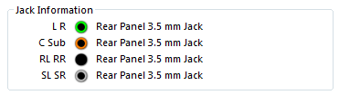
New KS Properties
KSPROPERTY_JACK
  Designed for HD Audio, but any driver can use it
  A filter property indexed by the bridge pin id (KSP_PIN)
  Makes for a nice user experience in the “Sounds”
  control panel
KSPROPERTY_AUDIO_MIC_ARRAY_GEOMETRY
    A filter property indexed by the bridge pin id (KSP_PIN)
    Used by Windows Vista mic array DSP
See whitepaper

Slide 21
New Audio Control Panel
A total rewrite of mmsys.cpl from Windows XP
Endpoint-centric
A place to
  See audio devices and monitor activity
  See IHV branding
  Choose the default device
  View and modify metadata
  Set device controls (volume, mute, etc.)
  Set the device format
  Control SPDIF format capabilities

Slide 22
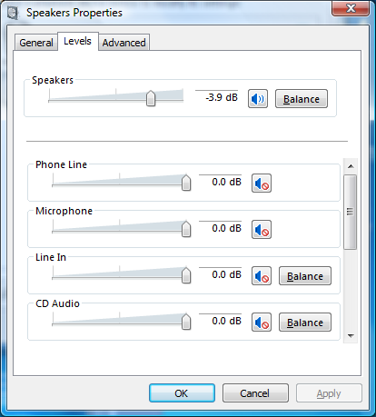
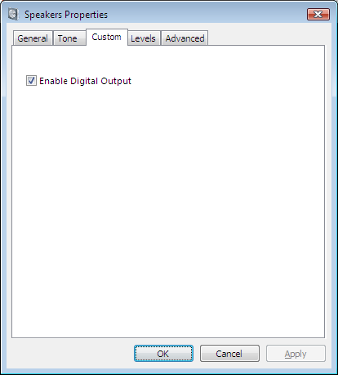
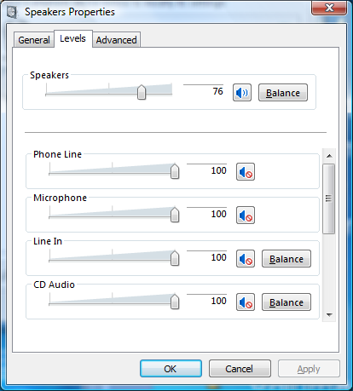
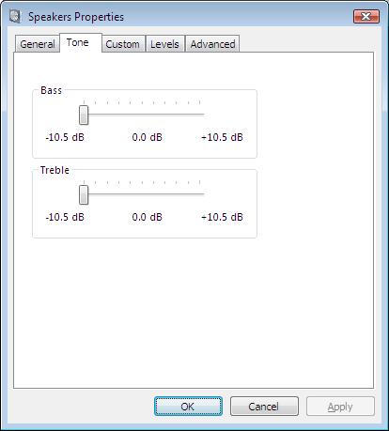
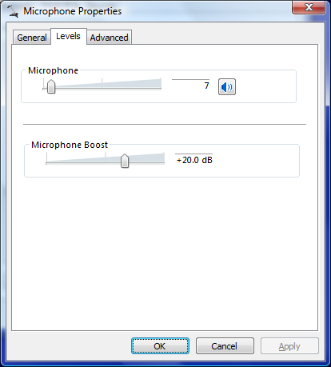


Hardware Controls
“Levels Tab” shows Volume and Mute
  Volume can be shown in dB or
  “normalized scalar”
  Volume with < 10 steps is always shown in
  dB-mode
    Useful for variable microphone boost
“Tone” Page shows Treble and Bass
  Always in dB
“Custom” Page shows
  AGC
  “Device Specific” controls
    Supports LONG, ULONG and BOOL controls
    Free checkboxes without adding “fake” AGC nodes
    see WDK MSVAD sample

Slide 23
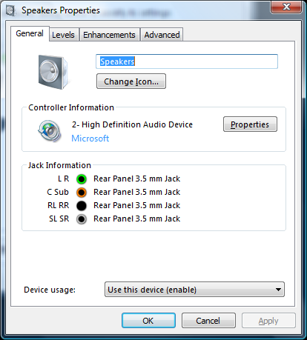
Branding The CPL
Endpoint Icons
  Use PKEY_DeviceClass_IconPath
Controller Branding
  XP AddReg INF directives still work
DeviceBrandingIcon,,,,"%1%\HDAudio.sys,-203"
DeviceVendorWebSite,,,,"http://www.microsoft.com"

Slide 24
Customizing The CPL
Standard PropertyPages
  Create a COM component that supports IShellPropSheetExt
  Cast IShellPropSheetExt::Initialize LPARAM to AudioExtensionParams*
  Register using “EP\\n” property group in the INF
    HKR,"EP\\0", %PKEY_AudioEndpoint_Association%,,%KSNODETYPE_SPEAKER%
    HKR,"EP\\0", %PKEY_AudioEndpoint_ControlPanelPageProvider%,,%CPLEXT_CLSID%
SysFX-specific PropertyPages
  Create a COM component that supports IShellPropSheetExt
  Cast IShellPropSheetExt::Initialize LPARAM to AudioFXExtensionParams*
  Register using “FX\\n” property group in the INF
    HKR,"FX\\0",%PKEY_SYSFX_Association%,,%KSNODETYPE_SPEAKER%
    HKR,"FX\\0",%PKEY_FX_UserInterfaceClsid %,,%SYSFX_UI_CLSID%

Slide 25
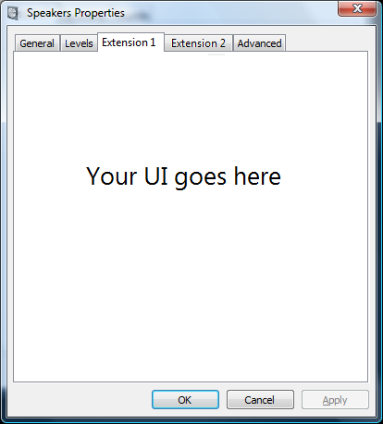
Customizing The CPL
Standard PropertyPages
  Create a COM component that supports IPropertyPageExt
  Cast IPropertyPageExt::Initialize LPARAM to AudioExtensionParams*
  Register using “EP\\n” property group in the INF
    HKR,"EP\\0", %PKEY_AudioEndpoint_Association%,,%KSNODETYPE_SPEAKER%
    HKR,"EP\\0", %PKEY_AudioEndpoint_ControlPanelPageProvider%,,%CPLEXT_CLSID%
SysFX-specific PropertyPages
  Create a COM component that supports IPropertyPageExt
  Cast IPropertyPageExt::Initialize LPARAM to AudioFXExtensionParams*
  Register using “FX\\n” property group in the INF
    HKR,"FX\\0",%PKEY_SYSFX_Association%,,%KSNODETYPE_SPEAKER%
    HKR,"FX\\0",%PKEY_FX_UserInterfaceClsid %,,%SYSFX_UI_CLSID%

Slide 26
Windows Vista Audio System Effects
Cheng-mean Liu
Software Design Engineer
Microsoft Corporation

Slide 27
Subsession Outline
Brief introduction to Windows Vista
audio architecture
System effects
  Inbox systems effects
  Custom system effects
How to implement custom system effects
  Installation
  Required interfaces and run time behavior
  Samples

Slide 28
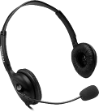
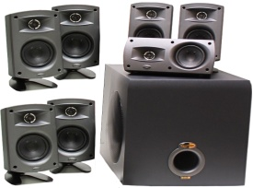
Vista Audio Architecture
App
App
App
App
App
App
Audio Engine
Audio Engine
Audio Engine
User Mode
Kernel Mode
Logical render device
Logical render device
Logical capture device
Audio driver (WaveRT miniport driver)
Audio Codec

Slide 29
WaveRT Driver
App
Control
Information
Audio
Data
Audio Engine
Shared Memory
User Mode
Kernel Mode
WaveRT Miniport Driver
Audio Codec

Slide 30
Audio Engine Pipeline
App
App
App
APO
APO
APO
Vol APO
Vol APO
APO
Stream pipe
Stream pipe
Stream pipe
APO (LFX)
APO (LFX)
APO (LFX)
Mixer APO
Mixer APO
Mixer APO
APO
Audio Engine
Vol APO
Device pipe
APO
APO (GFX)
Audio Driver
Logical render device

Slide 31
APO
Audio Processing Object
Basic building block of Audio Engine’s processing pipe
Implemented as In-process COM objects
Host digital signal processing audio effect operations
Run in user-mode

Slide 32
System Effect
Is also called sAPO
Allows IHVs to perform audio
processing by plugging in APOs into
audio engine pipeline
Types of systems effects
  LFX is per stream effect
  GFX is per audio endpoint effect
Install with audio driver package

Slide 33
System Effect
A complete system effect package includes
  sAPOs
  SysFX UI
  INF
  Audio Driver
Audio driver
sAPO
sAPO
SysFX UI
sAPO
INF

Slide 34
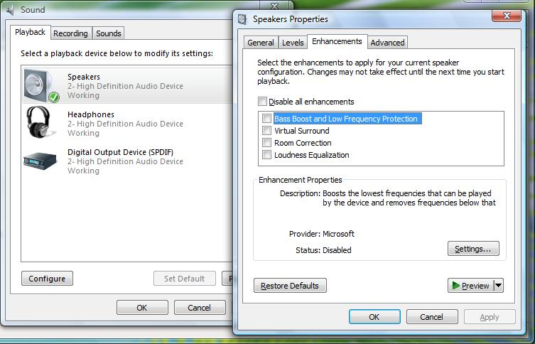
Inbox System Effects
sAPO
Loudness Equalization
Bass Management
Speaker Fill
Virtualized Surround Sound over Headphones
Low Frequency Protection
Virtual Surround
Speaker Phantoming
Bass Boost
  Room Correction (GFX)
HD Audio/USB Class Driver
HDAudio.inf WDMA_USB.inf

Slide 35
Custom sAPO Options
Reuse all Windows Vista inbox sAPOs
MS sAPO
IHV Audio driver
MS sAPO
MS
SysFX UI
MS sAPO
IHV INF
Provided by:
Microsoft
3rd Party

Slide 36
Custom sAPO Options
Reuse some or all of inbox sAPO. Custom sAPOs that support some of the required functionality and delegate any missing functionality to the Microsoft sAPOs
IHV sAPO
IHV Audio driver
MS sAPO
MS
SysFX UI
IHV INF
IHV sAPO
MS sAPO
Provided by:
Microsoft
3rd Party

Slide 37
Custom sAPO Options
Implement a complete set of custom sAPOs
IHV sAPO
IHV Audio driver
IHV sAPO
IHV
SysFX UI
IHV sAPO
IHV INF
Provided by:
Microsoft
3rd Party

Slide 38
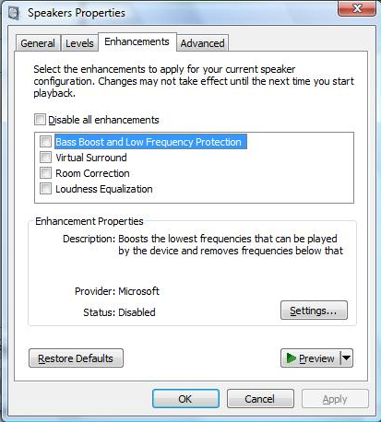
System Effects Installation
INF
COM Registration
RegisterDlls=Fx.RegisterDlls
[FX.RegisterDlls]
WMALFXGFXDSP.dll,
SysFxUI.dll
Registry
APO COM
Objects Database
Device Interface Registration
HKCR\
AudioEngine\
AudioProcessingObjects
[HDInst.Interfaces]
AddInterface=…HDInst.Ep0_Topo
[HDInst.Ep0_Topo]
AddReg = SysFx.Endpoint0.AddReg
[HDInst.Interfaces]
AddInterface=…HDInst.Ep1_Topo
[HDInst.Ep0_Topo]
AddReg = SysFx.Endpoint0.AddReg
[HDInst.Interfaces]
AddInterface=…HDInst.Ep2_Topo
[HDInst.Ep2_Topo]
AddReg = SysFx.Endpoint0.AddReg
Registry
FXProperty
Audio Engine
GFX / LFX declaration
[SysFx.Endpoint0.AddReg]
HKR,"FX\\0",Friendly name
HKR,"FX\\0",LFX GUID
HKR,"FX\\0", GFX GUID
HKR,"FX\\0", SysFX GUID
HKR,"FX\\0", NodeType
HKLM\SOFTWARE
\Microsoft\Windows\
CurrentVersion\
MMDevices\Audio\
Render\..\FXProperties
[SysFx. Endpoint1.AddReg]
HKR,"FX\\1",Friendly name
HKR,"FX\\1",LFX GUID
HKR,"FX\\1", GFX GUID
HKR,"FX\\1", SysFX GUID
HKR,"FX\\1", NodeType
sAPO
[SysFx. Endpoint2.AddReg]
HKR,"FX\\0",Friendly name
HKR,"FX\\0",LFX GUID
HKR,"FX\\0", GFX GUID
HKR,"FX\\0", SysFX GUID
HKR,"FX\\0", NodeType

Slide 39
Required sAPO Interfaces
s
sAPO
IAudioProcessingObject
Reset()
GetLatency()
GetRegistrationProperties()
Initialize()
IsInputFormatSupported()
IsOutputFormatSupported()
GetInputChannelCount()
IAudioProcessingObjectRT
APOProcess()
CalcInputFrames();
CalcOutputFrames()
IAudioSystemEffects
IAudioProcessingObjectConfiguration
LockForProcess()
UnlockForProcess()

Slide 40
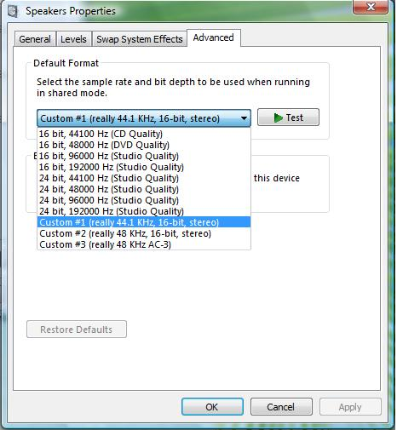
Optional sAPO Interface
sAPO that support some form of encoding or want to drive the device at an atypical format can support this interface
Called by MMSYS.CPL
IAudioSystemEffectsCustomFormats
GetFormatCount()
GetFormat()
GetFormatRepresentation(…)

Slide 41
Run-Time Behavior Of sAPO
Audio Engine will attempt to include a successfully registered sAPO into its processing pipe line
APO
Vol
sAPO (LFX)
Mixer
APO
sAPO (GFX)
APO
Device
APO
Vol
sAPO (LFX)
Mixer

Slide 42
Run-Time Behavior Of sAPO
Audio Engine
Step 1
s
sAPO->Initialize()
Step 2
sAPO-> IsInputFormatSupported()
sAPO-> IsOutputFormatSupported()
Step 3
sAPO-> LockForProcess()
Step 4
sAPO-> APOProcess()
All DSP work done here
Step 5
sAPO-> UnlockForProcess()
Step 6
~sAPO() called when streaming is done
Step 2 might repeat until format negation is done

Slide 43
Basic Design Considerations
Support IEEE 32-bit float input and output. The audio engine’s native sAPOs all operate on a float32 data path
Do not use nonlinear processing
  It can interfere with other processing algorithms that the system’s application audio graph provides, such as AEC
Processing should be non-blocking

Slide 44
Basic Design Considerations
An sAPO can modify only the audio
data that is passed to it through its APOProcess routine
An sAPO must have precisely one input and one output connection
No GFX on capture endpoint
Only one LFX and one GFX can be applied on each endpoint type
Audio Engine decide the position where the sAPO will be inserted

Slide 45
Basic Design Considerations
An sAPO is recommended be real-time compatible for lower latency
  All code and data in the sAPO process path are
  non-pageable
  All methods that are members of real-time interfaces are non-blocking
  AERT memory APIs exported by AUDIOENG.LIB
    AERT_Allocate(size_t size, void **pMemory);
    AERT_Free(void *pMemory);
    See WinDDK\inc\baseaudioprocessingobject.h for documentaton

Slide 46
System Effects Samples
HDAudio.INF and WDMA_USB.INF
WDK AudioEngineBaseApo.idl contains detailed information on required interfaces
WinDDK\<build#>\src\audio\sysfx, a complete sAPO sample
    Includes LFX and GFX APOs
    Sample INF, install sAPO on HD Audio driver
    SysFX UI

Slide 47
System Effects Samples
“Reusing Windows Vista Audio System Effects” (Vista_SysFX.doc)
  Includes samples Swap, Compress, Spkrfill
  All 3 samples preserve the Windows SysFx APO's functionality by hosting it inside the replacement APO

Slide 48
Call To Action
Ensure your drivers report Vista friendly device topologies
Make use of the system effect infrastructure for audio IHV
value-add processing
Continue to report anomalies and problems to us
Provide feedback on desired future OS audio infrastructure functionality

Slide 49
Resources
Audio Device Technologies for Windows
  http://www.microsoft.com/whdc/device/audio/default.mspx
  A Wave Port Driver for Real-Time Audio Streaming
  Reusing Windows Vista Audio System Effects
  Custom Audio Effects in Windows Vista
  And much more…
Q&A Chalk Talk directly following the
conclusion here
  CLN-C466 Audio Device Support: Best Practices
Related WinHEC 2007 Chalk Talk
  CLN-C353 Audio Device Compatibility Design Tool Demo

Slide 50


FACT:
6,900+ devices have been submitted to the Logo Program as April 1

Slide 51

© 2007 Microsoft Corporation. All rights reserved. Microsoft, Windows, Windows Vista and other product names are or may be registered trademarks and/or trademarks in the U.S. and/or other countries.
The information herein is for informational purposes only and represents the current view of Microsoft Corporation as of the date of this presentation. Because Microsoft must respond to changing market conditions, it should not be interpreted to be a commitment on the part of Microsoft, and Microsoft cannot guarantee the accuracy of any information provided after the date of this presentation.
MICROSOFT MAKES NO WARRANTIES, EXPRESS, IMPLIED OR STATUTORY, AS TO THE INFORMATION IN THIS PRESENTATION.

