Slide 1
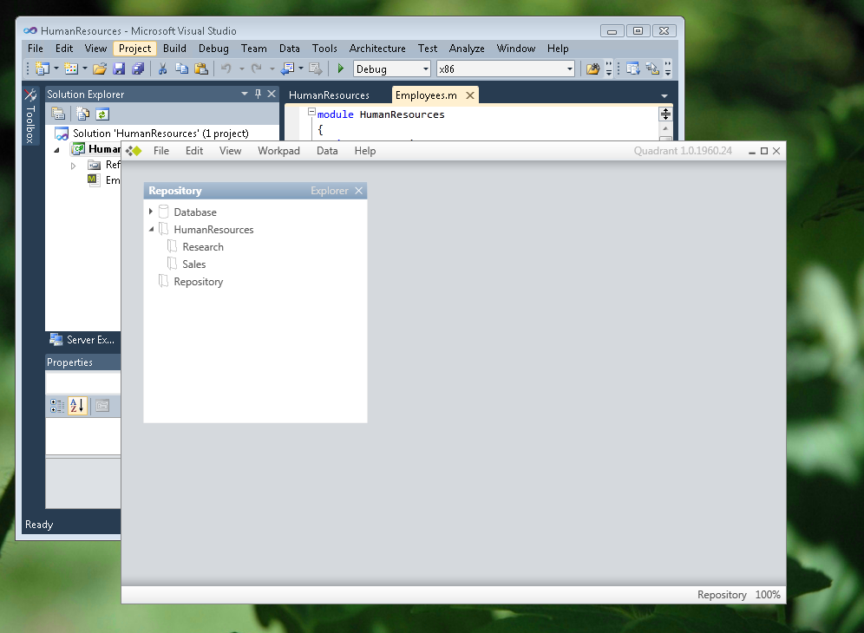
 | 300 | SQL Server Modeling Services | Folders and Security Jason Roth Senior Programming Writer Microsoft SQL Server Modeling CTP (November 2009)

Slide 2
Resources
Getting Started with the SQL Server Modeling CTP (SetupApplication Tutorial):
http://msdn.microsoft.com/en-us/library/dd857488(VS.85).aspx
How to: Create and Use Modeling Services Folders:
http://msdn.microsoft.com/en-us/library/dd129548(VS.85).aspx
How to: Grant Users Access to SQL Server Modeling Services:
http://msdn.microsoft.com/en-us/library/dd129576(VS.85).aspx
Data Developer Center:
http://msdn.microsoft.com/en-us/data/ee461169.aspx
For questions, comments, feedback:
http://social.msdn.microsoft.com/Forums/en-US/oslo/threads/

